Slide 1
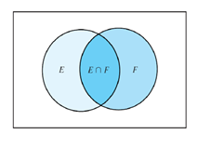


Recap of L10
Page <number>
Page <number>
Probability starts with a process (test, experiment) whose outcome is uncertain
Sample space: the set of all possible outcomes
  Might not be unique
Consider the probability of an event E
  At the beginning, we have some assessment: P(E)
  Then we get a new piece of information:
    “Event F occurred”
  Afterwards, we talk about the probability of E given F

Slide 2
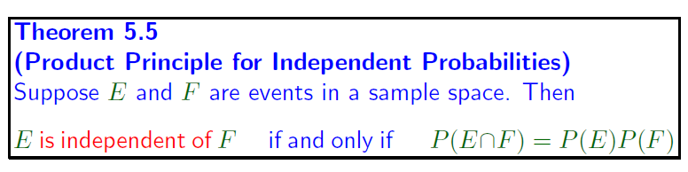

Recap of L10
Page <number>
If P(E|F) = P(E)
  The information that “Event F occurred” does not change the probability of E
  So, E is independent of F

Slide 3


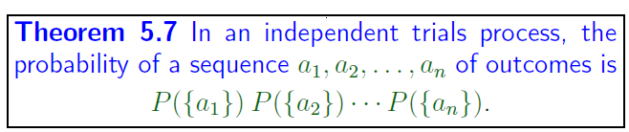
Recap of L10
Page <number>
Outcome at stage i independent of outcomes at earlier stages

