Slide 1

Page <number>
Page <number>
Recap of L14
Objective:
  When does have an inverse?
  How to compute the inverse?
  Need: Greatest common dividers (GCDs)
Greatest Common Divisors (GCDs)
  Definitions
  Euclid’s Division Theorem
  The GCD Algorithm
Multiplicative Inverses
  Definition and Properties
  Link to GCD
  The extended GCD algorithm.
  Computing inverses

Slide 2
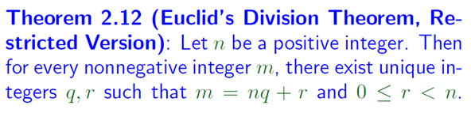
Page <number>
Page <number>
Recap of L14
Proved:
Proof technique
  Proof by contradiction
  Proof by smallest counter example

Slide 3
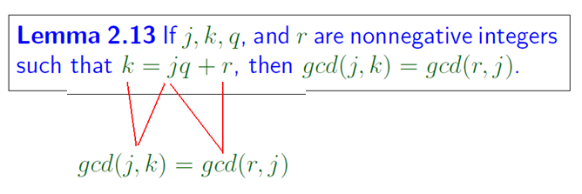
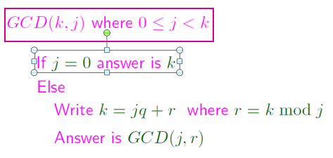
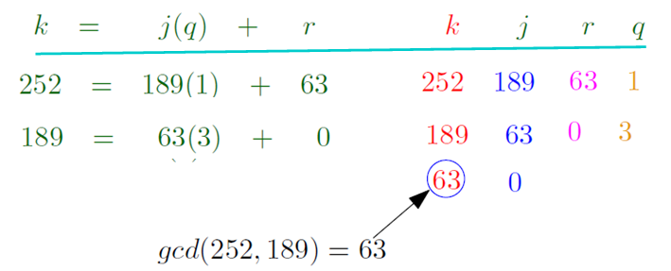
Recap of L14
Page <number>
Page <number>

Slide 4


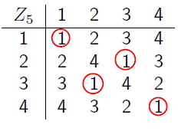
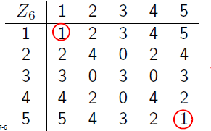
Recap of L14
Page <number>
Can determine by scanning multiplication table
But very time-consuming when n is large.

Slide 5
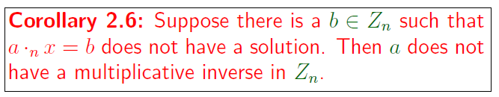
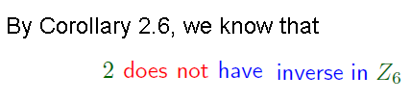
Recap of L14
Page <number>
* Lemma 2 . 5
a has inverse => a ·_{n} x = b
in z_{n} has unique solution
for ANY b

Slide 6




Recap of L14
Page <number>

Slide 7
Page <number>
Extended GCD Algo
﹡ Input : a , n > 0 , integers
﹡ Output :
- gcd (a , n)
- x , y s . t .
ax + ny = gcd ( a , n )
gcd(a, n)=1
  a have inverse in Zn, it is x mod n
gcd(a, n) \= 1
  a does not have inverse in Zn.

Slide 8

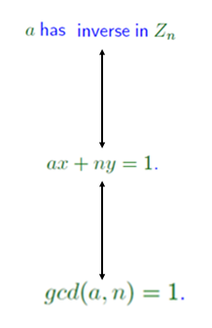


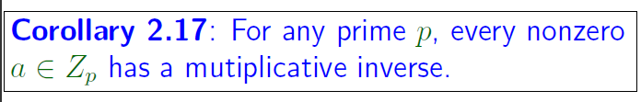
Recap of L14
Page <number>
Theorem 2.14
Lemma 2.11

