Slide 1



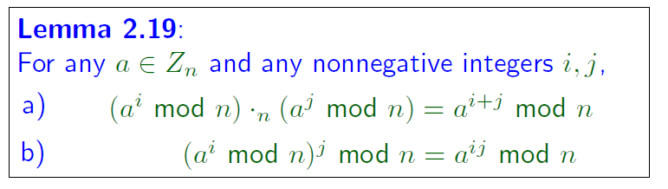
Page <number>
Page <number>
Recap of L15

Slide 2
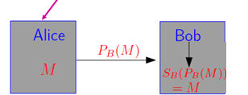
Page <number>
RSA Algorithm
Builds a one-way function using
  Exponentiation mod n
  Prime numbers
  gcd
  Multiplicative inverse
Questions to answer
  How to generate the public key: PB ?
  How to generate the secrete key: PS ?
  How to encrypt plaintext M using PB ?
  How to decrypt ciphertext PB(M) using PS ?

Slide 3
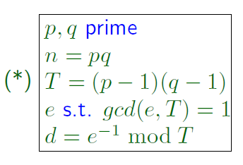


RSA Algorithm
Page <number>

Slide 4
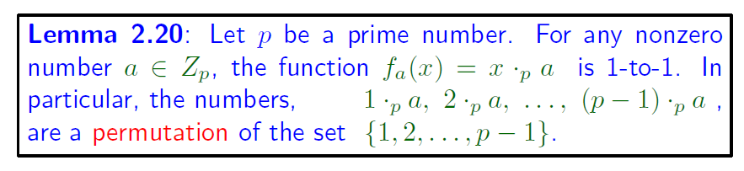
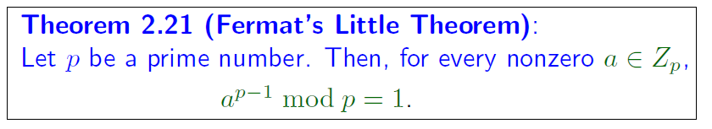

Fermat’s Little Theorem
Page <number>

Slide 5
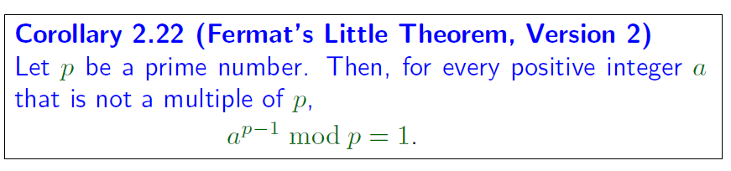
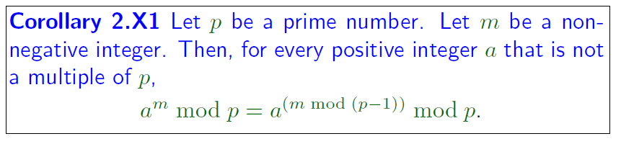

Recap of L15
Page <number>

Slide 6
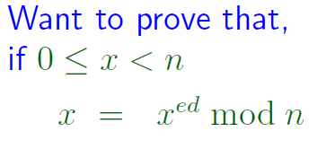
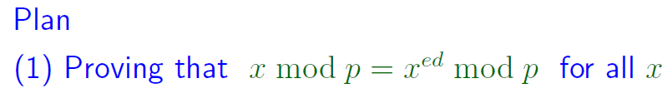

Page <number>
Page <number>
RSA Decipherability

Slide 7





Page <number>
Page <number>
Exponentiation mod n efficiently
* Key operation of RSA: a^{e} mod n

Slide 8








Chinese Reminder Theorem
Page <number>

