Slide 1
Page <number>
Page <number>
Recap of L16

Slide 2




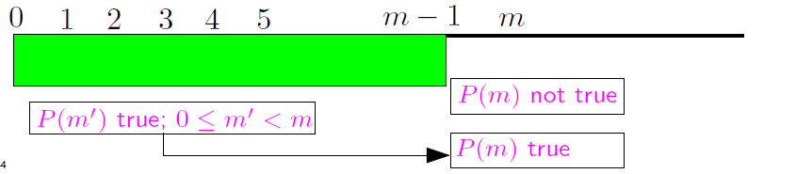
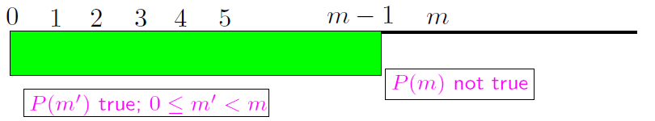
Page <number>
Proof by Smallest Counter Example

Slide 3



A General Principle
Page <number>
What we did:
  Given: (a) p(0) is True; (b) If n>0 , then p(n-1) => p(n)
  Conclusion: p(n) is True for all
How we did it: Proof by Smallest Counter Example

Slide 4
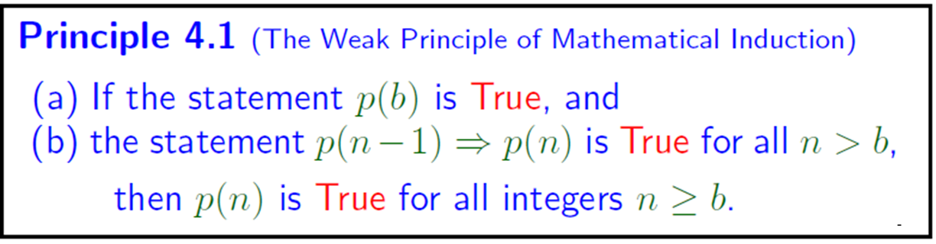
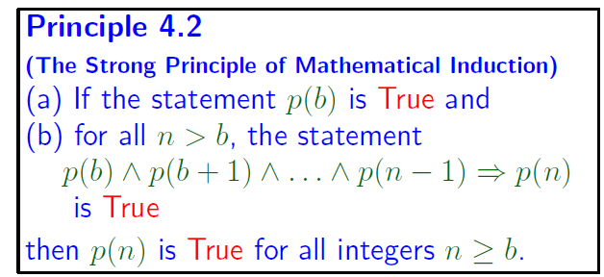
Page <number>
By s.c., we have actually proved:
It is also possible to prove the following using proof by s.c.

Slide 5



Summary
Page <number>

