Slide 1
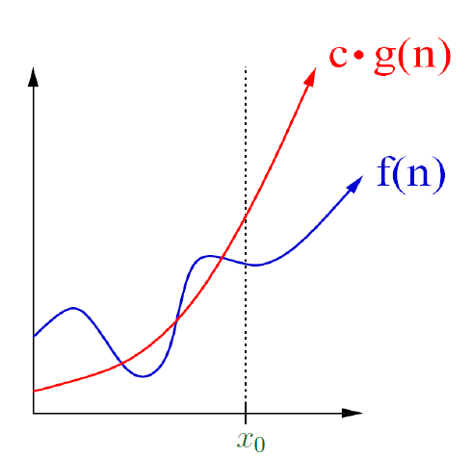


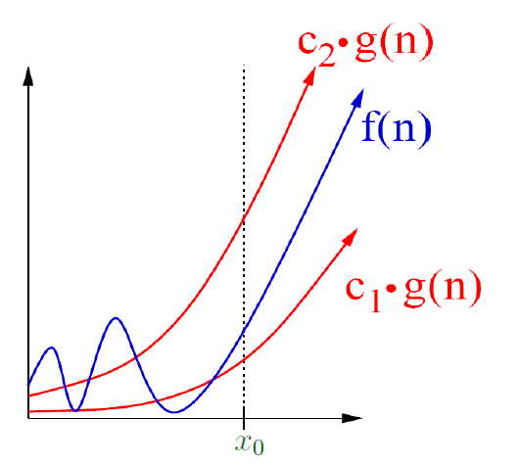
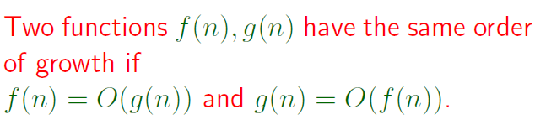
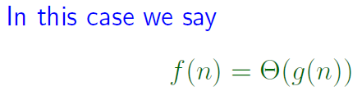
Recap of L18
Page <number>

Slide 2
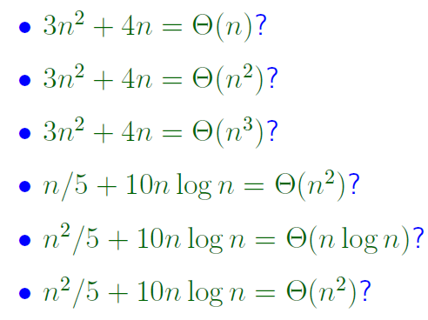






Examples
Page <number>

Slide 3


Page <number>
Page <number>
Recap of L18
Prob
1
n
1
n
Subs
1
n/2
n/2+1
n
1
n/2

Slide 4



D&C Example: Merge Sort
Page <number>
7 2 4 3 1 8 6 5
Divide
7 2 4 3
1 8 6 5
Conquer
2 3 4 7
1 5 6 8
Merge
1
2
3 4 5 6
7 8

Slide 5
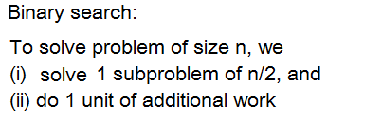

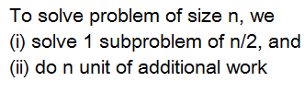

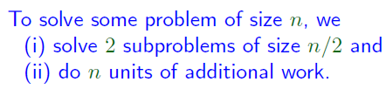





Page <number>
D&C Scenarios and Recurrences

Slide 6



Recap of L18
Page <number>

Slide 7







Page <number>
Page <number>
Running time in terms of Big-O

Slide 8
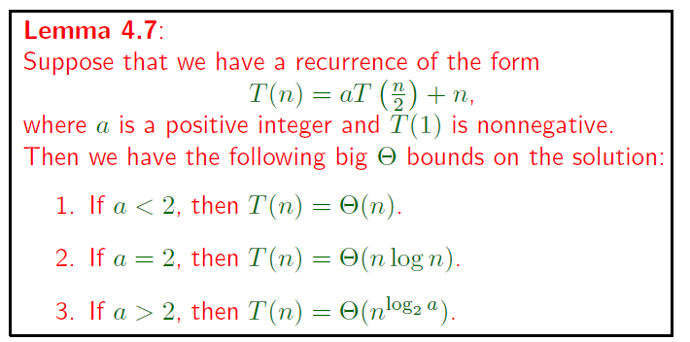
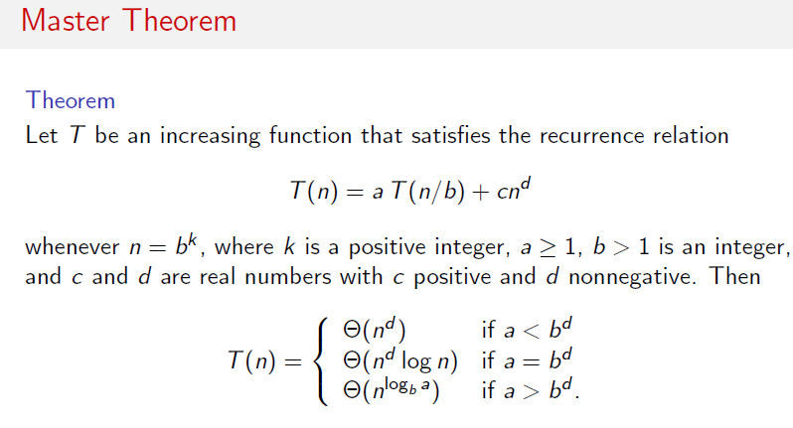
Three Asymptotic Behaviors
Page <number>

