Slide 1
Traveling with a Pez Dispenser
(Or, Routing Issues in MPLS)
Anupam Gupta
Amit Kumar FOCS 2001
Rajeev Rastogi
Iris Reinbacher COMP670P 15.03.2007
Notes:
Good afternoon, thanks for coming.
In this embedding class I will talk about a paper of Gupta, Kumar, and Rastogi called “Traveling with a Pez Dispenser. Despite the title, the paper is about network routing in the Multi Protocol Layer Switching Scheme.

Slide 2
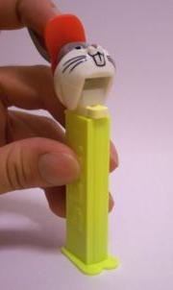

Pez Dispenser?
Notes:
For everybody here who has no clue what a PEZ dispenser is or looks like: This is the very thing. You feed it with a stack of candy and get it out one by one moving its head. Of course, Bugs Bunny is more of a reminiscence of my childhood, nowadays we go to the stars…

Slide 3
Outline
Motivation, Overview of Results
Non-uniform Routing
  on a line
  on a tree
Covering graphs by trees
  Tree cover
  Bounds for tree covers
  Tree covers for planar graphs
Summary
Notes:
Okay, lets get serious. The outline of the talk is as follows:
I’ll start with motivation and an overview of the results of the paper.
Then I will explain non uniform routing schemes on a line and on a tree, before talking about covering graphs by trees.
I will finish with a summary of the results.

Slide 4
Outline
Motivation, Overview of Results
Non-uniform Routing
  on a line
  on a tree
Covering graphs by trees
  Tree cover
  Bounds for tree covers
  Tree covers for planar graphs
Summary

Slide 5
Motivation: Network Routing
packet from source to destination
Conventional Routing:
each router examines header locally and independently
Multi Protocol Label Switching:
first router assigns stack of labels
following routers examine top of stack only
Main questions: stack depth s, label size L

Slide 6

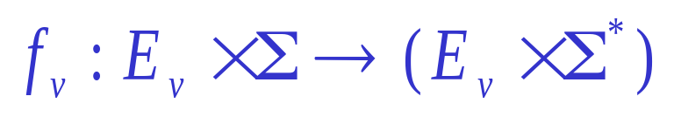
The Model
each packet contains stack S of labels
labels are of set : {1,2,3,…,L}
network: graph G = (V,E)
each node v ←→ router
each router runs (L, s) protocol
protocol at v:

Slide 7
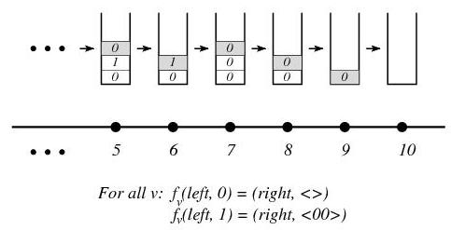
Example: Uniform Line Routing

Slide 8
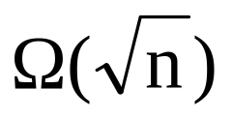
Overview of Results
  line (L, Ln^{1/L}) uniform
  line (L, log_{L}n) non-uniform
  tree (deg + k, kn^{1/k} log n)
  tree (deg + k, log²n/log k)
  planar graph (L|T|,s) with stretch D
  with |T| ... size of tree cover, e.g.
    , D =1 ... uniform grid
    O(r(n) log n), D = 3 ... r(n) isometric separators

Slide 9
Outline
Motivation, Overview of Results
Non-uniform Routing
  on a line
  on a tree
Covering graphs by trees
  Tree cover
  Bounds for tree covers
  Tree covers for planar graphs
Summary

Slide 10
Non-uniform Routing on a line
Packet moves from left to right
Directed path P_{n} with n vertices v = {0,1,... n-1}
Labels L = {0,1}
P_{n} itself has labels = 0
Additional directed edges with labels = 1
Full graph has properties:
  Low diameter (path(u,v) <= 3 log n)
  Nesting (no two edges cross each other)

Slide 11
Lemma
The nesting property ensures:
Let u < u' < v' < v be four nodes on P_{n}
If the shortest path P from u to v contains v', then the shortest path from u' to v contains v'

Slide 12
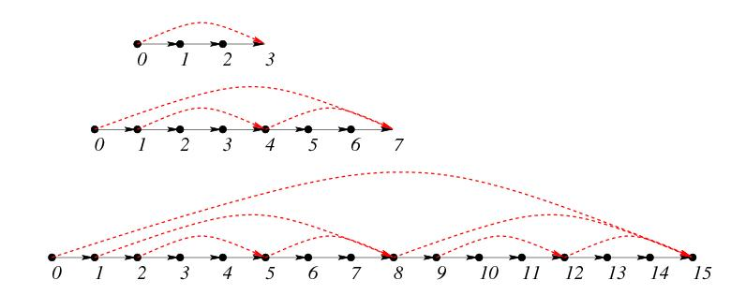
The protocol on a line
Packet goes from u to v
Stack defines 01 shortest path between u and v
Invariant: path is shortest for all u < u' < v

Slide 13
Maintaining the invariant
Packet is at vertex u'
Edges e₀ = (u',u'') and e₁ = (u',u'''), with e₀ on the shortest path P to v
If top label = 0, pop, send packet along e₀
If top label = 1, pop, push labels encoding shortest path from u'' to u''', send packet along e₀

Slide 14
Final protocol
For each router until stack is empty do
If label = 0, pop
Else (label = 1)
  If router – out degree = 1, pop
  Else (out degree = 2)
  push 11 on stack
Theorem:
There is a non-uniform protocol for routing on a the n-vertex path which uses L labels and stack depth at most O(log_{L}n).

Slide 15
Outline
Motivation, Overview of Results
Non-uniform Routing
  on a line
  on a tree
Covering graphs by trees
  Tree cover
  Bounds for tree covers
  Tree covers for planar graphs
Summary

Slide 16
Non-uniform routing on a tree
Extend line protocol to trees
Decompose tree into edge-disjoint paths
(Caterpillar decomposition)
Unique path P between u and v
P intersects at most 2 log n other paths

Slide 17
Non-uniform routing on a tree
Theorem follows directly:
Given a tree T with maximum degree deg, there is a (deg + k, log_{k}n K) non-uniform routing protocol for T.
k = log n, K… Caterpillar dimension of T
We will show a better protocol:
There exists a (deg + log log n, log n) non-uniform routing protocol for trees.

Slide 18
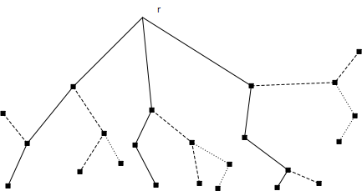
Caterpillar Decomposition
Decomposition into edge disjoint paths
Construction in linear time (DFS)
Caterpillar dimension: number of levels

Slide 19
Routing from u to v in tree
2 directions:
''upwards'': using the line protocol from u to the least common ancestor of u and v
2 labels, stack depth O(log n)
''downwards'' from root of (subtree of) T
2 log k + deg labels, stack depth <= 6ck

Slide 20
Outline of protocol on a tree
Preliminaries:
There is caterpillar decomposition such that:
If P₁,..,P_{t} are all paths from root r, then for any vertex v in P_{i}, any connected component not containing a node of P_{i} has at most n/2 nodes
Fix a path P_{i} containing r

Slide 21
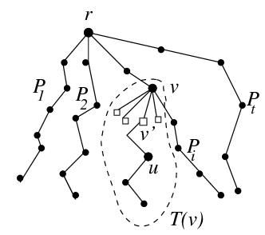
Outline of protocol on a tree
Preliminaries
v in P_{i}, V'... set of children(v) not on P_{i}
T(v)...subtree rooted at v
Index of node v: t(v) = log|T(v)|
I(j)... set of nodes in P_{i} – r with index j
|I(j)| <= 2^{k-j+1}

Slide 22
Outline of protocol on a tree
Form log k supergroups of union of some I(j):
p = 1,..,log k
I'(p) = U(I(k-2^{p+1}+2),..,I(k-2^{p}+1))
Divide labels into log k sets L₁,...,L_{k} containing 2 labels each
Labels in L_{p} route from r only to nodes in I'(p) (otherwise: send forward only)
Result: stack depth c(2^{p+1}+1) with 2 log k labels

Slide 23
Outline of protocol on a tree
root r sends packet to u in T(v):
Suppose v in I(j) in I'(p)
Top of stack routes from r to v
Next symbol on stack chooses correct child v'
Rest of stack routes from v' to u
T' rooted at v', j' = log|T'|
j' <= k-2^{p}+1, j' <= k-1
Stack depth needed:
6cj <= 6ck = 6 c log n

Slide 24
Outline
Motivation, Overview of Results
Non-uniform Routing
  on a line
  on a tree
Covering graphs by trees
  Tree cover
  Bounds for tree covers
  Tree covers for planar graphs
Summary

Slide 25
Covering graphs by trees
Extending the line/tree scheme to arbitrary graphs involves dealing with:
Shortest path P between u,v is not unique
P_{i} intersect non-trivially
''path decomposition'' not trivial
Solution: Tree cover

Slide 26
Definition
Given a graph G = (V,E), a tree cover (with stretch D) of G is a family F of subtrees {T₁,T₂,...,T_{k}} of G such that for every pair of vertices u,v there is a tree T_{i} such that
d_{Ti}(u,v) <= D d_{G}(u,v).

Slide 27
Simple Theorem
Let there be an (L,s) protocol for routing on trees. Let F be a tree cover of G with stretch D. Then there is an (L |F|,s) protocol for G.
This protocol has stretch D, i.e., given any pair of vertices u,v in G, this protocol routes from u to v on a path which has length at most D times the shortest path between u and v.

Slide 28
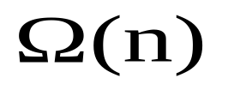
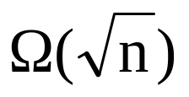
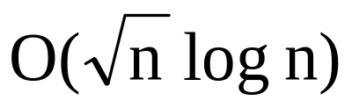
Bounds for tree covers
general
unit weighted grid , O(log n)
O(r(n)) separator O(r(n) log n)
treewidth k O(k log n)
planar graphs

Slide 29
Tree cover for r(n) separator graphs
Given a graph G = (V,E), a k-part isometric separator is a family S of k subtrees
S₁ = (V₁,E₁),..., S_{k} = (V_{k},E_{k}), such that
S = U V_{i} is a 1/3-2/3 separator of G
For each i and each pair of vertices u,v in S_{i}, d_{Si}(u,v) = d_{G}(u,v)
Theorem
For any graph G = (V,E) with r(n)-part isometric separators, there exists a tree cover with stretch 3 having O(r(n) log n) trees

Slide 30
Tree cover for r(n) separator graphs
General idea:
Contract the vertices of each S_{i}
Construct shortest path tree T_{i} in resulting graph
Expand S_{i}
T_{i} contains S_{i} and the union of shortest paths from every other vertex in V-V_{i} to S_{i}
This gives O(r(n)) trees
Recurse to get O(r(n) log_{3/2} n) trees overall

Slide 31
Tree cover for planar graphs
Planar graphs have 2-part isometric separators:
Theorem
Given an (L, s) routing scheme for trees, there is an (L log n, s) routing scheme for planar graphs with stretch at most 3.

Slide 32
Outline
Motivation, Overview of Results
Non-uniform Routing
  on a line
  on a tree
Covering graphs by trees
  Tree cover
  Bounds for tree covers
  Tree covers for planar graphs
Summary

Slide 33
Summary of Routing Results
  line (L, Ln^{1/L}) uniform
  line (L, log_{L}n) non-uniform
  tree (deg + k, kn^{1/k} log n)
  tree (deg + k, log²n/log k)
  planar graph (L|T|,s) with stretch D
  with |T| ... size of tree cover

Slide 34
Bounds for tree covers
general
unit weighted grid , O(log n)
O(r(n)) separator O(r(n) log n)
treewidth k O(k log n)
planar graphs

