Slide 1
Lower Bounds on the Distortion of Embedding Finite Metric Spaces in Graphs
Y. Rabinovich
R. Raz DCG 19 (1998)
Iris Reinbacher COMP 670P 26.04.2007
Notes:
Good afternoon everybody!
In this embeddings class I will talk about a paper that is almost ancient – from Discrete and Computational Geometry 1998. it is from Rabinovich and Raz and has the title “Lower Bounds on the Distortion of Embedding Finite Metric Spaces in Graphs“.

Slide 2
Main Question
Given: Finite metric space X of size n and a graph G.
Question: How well can X be embedded into the graph G?
Notes:
The main question addressed in the paper is as follows:
Given a finite metric space of size n and a graph G, how well can the metric space be embedded into the graph?

Slide 3
Main Lemma
The metric space induced by an unweighted graph H of girth g can only be embedded in a graph G of smaller Euler characteristic with distortion at least g/4 – 3/2.
Special case:
|V(G)| = |V(H)| and |E(G)| < |E(H)| → g/3 - 1
Notes:
The paper answers as follows:
A graph H of girth g can be embedded in a graph G of smaller Euler characteristic with a distortion of atleast g/4 – 3/2.
A special case of this lemma is when H and G have the same number of vertices, but G has strictly less edges than H. Then we get a bound of g/3 -1

Slide 4
Outline
Basic Definitions
Special case of Main Lemma
Proof of Special Case (sketch)
General Main Lemma
Approximating Cycles
t-spanner theorem
Applications of t-spanner theorem
Notes:
Today, I am planning to do the following:
I will first give some basic definitions that we will need to understand the special case of the main lemma, in particular its proof. Then I will mention the general main lemma.
If there is enough time I would like to tell you how we can use the lemma to approximate cycles by trees.
And then I would like to tell you about the t-spanner theorem and its applications.

Slide 5

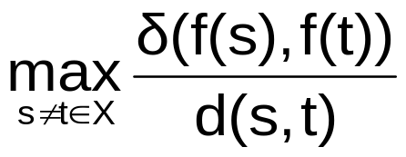
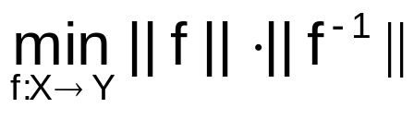

Overview of Definitions
(X,d), (Y, ) … finite metric spaces with |X| = |Y| = n
f: X→ Y … bijective map
Lipschitz norm of f ||f||_{LIP} =
Lipschitz distortion between X,Y
Euler characteristic of graph G
Notes:
For the proof of the lemma, we will need the following definitions:
We have two metric spaces with size n and and injective map f from one to the other.
The Lipschitz norm (or simply norm) of f is defined as the maximum of the distance of the images of s and t in Y over the distance of s and t in X for all s and t from X.
The Lipschitz distortion between the metric spaces is the minimum of the norm of f times the norm of the inverse map
And finally, the Euler characteristic of a graph is defined as the number of its edges minus the number of its vertices plus one.

Slide 6
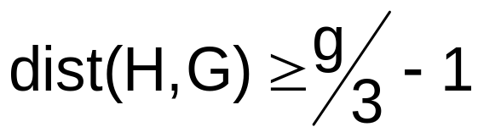
Main Lemma – Special Case
Let H be a simple, unweighted, connected graph of size n and girth g.
Let G be an arbitrary (weighted) graph with the same number of vertices, but strictly less edges than H.
Then it holds:
Notes:
The Special case of the main lemma, which we will show later, is as follows:
Given are H, a simple, unweighted, connected graph of size n and girth g;
and G and arbitrary, possibly weighted graph with the same number of vertices, but strictly less edges than H.
Then, the distortion between H and G is at least g/3 -1.

Slide 7
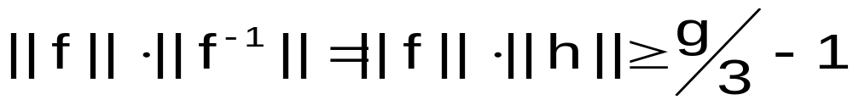
Special Case – Idea of Proof
Special case: |V(G)| = |V(H)| = n
we show:
there is a mapping f: V(H) → V(G) such that
We assume: G simple
Notes:
The idea of the proof is simple:
We need to show that there is a bijective mapping f from the nodes of H to the nodes of G such that the norm of f times the norm of the inverse f is at least g/3 -1. In the following, we will denote with h the inverse of f.
We assume that G is simple and that G and H have the same number of edges.
The proof contains of seven steps…

Slide 8
Special Case – Sketch of Proof
Replace discrete graphs H and G with continuous graphs:
  edge with weight w → interval of length w
  H’, G’ … “continuous” H,G
  distances between vertices are preserved
  distance between any x,y in H’ or G’ equals the length of shortest path “geodetic” x - y
Notes:
In the first step, we replace the discrete graphs H and G with continuous graphs.
We do this by simple replacing each edge with weight w by an interval of length w
We denote the continuous graphs by H’ and G’. We observe that the distances between vertices are preserved (when we assign the distances in the graphs by the weight of the edge). Furthermore, the distance between any pair of nodes x and y in H’ or G’ is equal to the length of the shortest path beween x and y. We call this a geodetic, and it need not be unique!

Slide 9
Special Case – Sketch of Proof
Extend f and h to continuous maps
f’: H’→ G’ and h’: G’→ H’ such that
||f|| = ||f’|| and ||h|| = || h’||
  for each edge e = (u,v) in H mark a geodetic path P_{(u,v)} from f(u) to f(v) in G’
  let x in H’ be a point in edge (a,b)
  let alpha = dist(a,x) / dist(a,b) in H’
  f’(x) is defined as y on P(a,b) such that in G’ dist(f(a),y) / dist(f(a),f(b)) = alpha
Notes:
In the second step, we extend f and h to continuous maps such that the norms of the maps remain the same.
We do this in the following way: For each edge in H we mark a geodetic path in G’ from the images of the vertices u to v.
in H’, x is a point in the edge a, b.
we define alpha to be the distance from a to x over the distance from a to b in H’
then we can define f’(x) to be the point y on the geodetic from a to b such that in G’ the distance between the image of a and y over the distance of the images of a and b equals alpha.
We can define h’ in the same way.
We note that f’ and h’ need not be bijective any longer, and that h’(f’(x)) need not be the identity on H’.

Slide 10
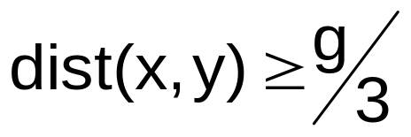
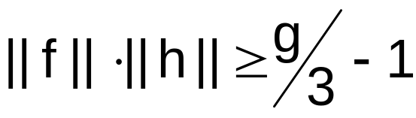
Special Case – Sketch of Proof
Claim I
If there exist x and y in H’ such that
  f’(x) = f’(y)
then it holds that
The lemma is true under these conditions
Notes:
In the third step, we have to prove the following claim (which we will not do):
If there exist x and y in H’ such that the images of x and y under f’ are the same, and the distance of x and y is larger than g/3, then it holds that the norm of f times the norm of h is at least g/3 -1.
Hence, the lemma is true under these conditions.

Slide 11
Special Case – Sketch of Proof
If no such points exist:
  Define T(x) = h’(f’(x)) … continuous
  show that T is homotopic to identity
  (leads to contradiction)
Notes:
That means, if there are no such points,
then we define T(x) as the convolution of h’ and f’, to be continuous.
and we show that T is homotopic to identity. This will lead to a contradiction.

Slide 12
Special Case – Sketch of Proof
Claim II:
For any x in H’, the distance between
x and T(x) is smaller than g/2.
Notes:
We can prove in a fifth step (although we won’t do it)
that for any x in H’, the distance between x and T(x) is smaller than g/2.

Slide 13
Special Case – Sketch of Proof
Establish homotopy between T and Id(H’)
  P(x) is unique geodetic path in H’ between x and T(x)
  Define M[t,x] = (1- t) x +t T(x); t in [0,1]
  y in P(x) is unique such that
  dist(x,y)/dist(x,T(x)) = t
  M[t,x] is continuous
  Hence, M[t,x] is wanted homotopy
Notes:
In step number six, we establish a homotopy between T and the Identity function on H’.
We have that P(x) is the unique geodetic path in H’ between x and T(x). This is because the distance between them is smaller than the girth/2, so there is only a half-circle between them.
We define M to be (1-t)x = t T with t between 0 and 1. We have a unique y on the path P(x) such that the distance between x and y over the distance between x and T(x) equals t.
M is continuous, and hence, M is the homotopy that we wanted

Slide 14


Special Case – Sketch of Proof
Use definitions and facts from algebraic topology to arrive at:
  T = h’(f’(x)) is homotopic to identity
  the first homology group H₁(H’) is embeddable in H₁(G’)
  On the other hand:
  cannot be embedded in
  → contradiction!
Notes:
In the seventh and final step – and it has a lot of handwaving here... we use definitions and facts from algebraic topology to finally arrive at the following:
We know from the last step that T is homotopic to identity
We can show that the first homology group of H’ is embeddable in the first homology group of G’
On the other hand, we know that the Euler characteristic of H’ is larger than the Euler characteristic of G’, hence, there is no embedding of Z (x(H’) into Z(x(G’))
and that is our contradiction! And we are done with this proof.

Slide 15

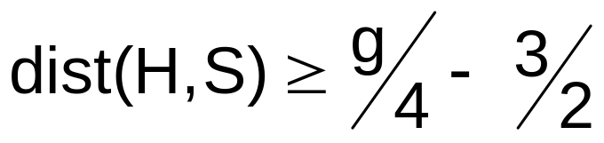
Main Lemma – General Case
Let H be a simple, unweighted, connected graph of size n and girth g
Let G be a finite weighted graph of size at least n such that
Then, for any subset S of G with n vertices and the induced metric, it holds that
Notes:
The general case of the main lemma is as follows:
Let H be a simple, unweighted, connected graph of size n and girth g; and let G be a finite weighted graph of size at least n such that the Euler characteristic of G is smaller than that of H.
Then, for any subset S of G with n vertices and the induced metric, the distance between H and S is at least g/4 – 3/2.

Slide 16
General Case – Idea of Proof
general scheme like in the special case:
  find a mapping on the vertices…
Difference: How to find a suitable h’
Sketch of Proof:
RTNP!
Notes:
For the general case, the proof mainly follows the scheme of the special case. The difference lies in how to find a suitable h’.
For a sketch of the proof, I suggest you simply read the nice paper!

Slide 17
Outline
Basic Definitions
Special case of Main Lemma
Proof of Special Case (sketch)
General Main Lemma
Approximating Cycles
t-spanner theorem
Applications of t-spanner theorem
Notes:
In the last part of the talk I will go into more applicable details, like how to approximate cycles, the t-spanner theorem and its applications.

Slide 18
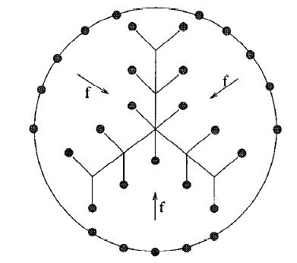

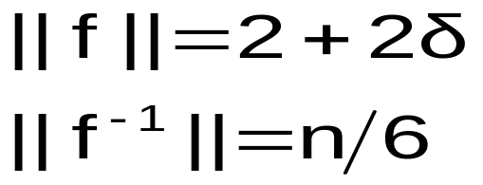
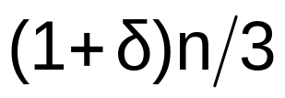
Approximating Cycles
Lemma states:
conjecture: constant can be improved to 1/3
Example: embed C_{n} in tree T_{n}
outer edges: weight 1
inner edges: weight
distortion:
Notes:
The lemma states that there is a distortion between two graphs with the same number of vertices of at least g/4 -3/2. The paper conjectures that the constant factor can be improved to 1/3.
As an example for that, we try to embed the cycle with n vertices into the tree with n vertices. We do this by “contracting” the cycle, and giving a weight one to the outer edges and a weight 2 delta to the inner edges. The map f has a norm of 2 + 2delta, and the inverse map has a norm on n/6. Alltogether, we get a distortion of (1+delta)n/3.

Slide 19
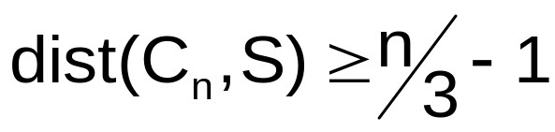
Approximating Cycles
In fact, it can be shown that:
Lemma: Let S be an n-point finite metric space defined by a subset of vertices of some tree. Then
Notes:
In fact, when approximating cycles, this lemma can be shown that
if S is an n-point finite metric space defined by a subset of vertices of some tree, then the distortion between the cycle with n vertices and S is at least n/3 – 1.

Slide 20

Definition
The approximation pattern AH(i) of a graph H is the minimum possible distortion in an embedding of H in a graph G with Euler characteristic
Notes:
Finally, because it fits nicely into this embeddings talk, we’ll get to the t-spanner theorem. We will start with the definition of approximation pattern.
It is the minimum possible distortion in an embedding of H in a graph G with Euler characteristic smaller than i.

Slide 21
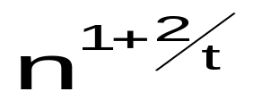
t-spanner theorem
Let H be a (weighted) graph with n vertices.
Then, for all integers t, H has a t-spanner with
edges at most.
This bound is tight
Any metric space of cardinality n can be
t-approximated by such a graph.
Notes:
The t-spanner theorem states that if H is a weighted graph with n vertices, then H has a t-spanner with at most n(1+2/t) edges.
In fact, this bound is tight. Furthermore, any metric space of cardinality n can be t-approximated by such a graph.

Slide 22
t-spanner theorem
t-spanner theorem gives upper bound on the envelope of the approximation pattern of all graphs of size n.
That means that
any graph of size n can do at least as well
for any i there is a graph of size n which cannot do much better
Question: Find bounds on the approximation pattern of a fixed graph H
Notes:
How does the t-spanner theorem connect to the approximation pattern? Well, it gives us an upper bound on the envelope of the approximation pattern of all graphs of size n.
What does that mean?
Well, any graph of size n can do at least as well. and for any I there is a graph of size n which cannot do much better.
The question is now to find bounds on the approximation pattern of a fixed graph H

Slide 23
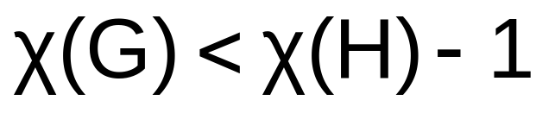

H… simple unweighted graph (no tree)
Omit one edge in a shortest cycle
(g(H) -1)- spanner of H with |E(H)|-1 edges
Notes:
If the Euler characteristic of H is one smaller than the Euler characteristic of G
We assume that H is a simple unweighted graph, but no tree.
Then we find a shortest cycle and omit one edge of it. We get a g(H)-1 spanner of H with |E(H)|-1 edges and the approximation pattern is Theta of the girth(H)

Slide 24
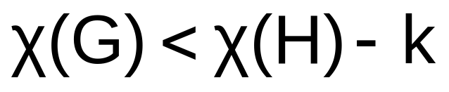
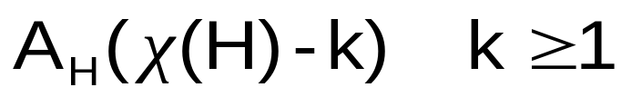
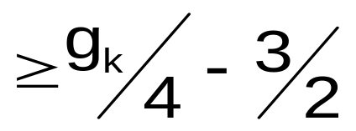
Same idea applies to
for small k:
g_{k} … length of k-th shortest simple cycle in H
Omit k (properly chosen) edges from H to get a (g_{k}-1) spanner of H
→ distortion
Notes:
In fact, we can do the same for graphs whose Euler characteristics differ by a small number of k:
We choose the kth shortest simple cycle of H and omit k edges from H to get a gk-1 spanner of H. The distortion matches our main lemma: gk/4 – 3/2.
That’s it for today, thank you!

