Slide 1
TAG
Presenters: Ken, Anshul, Rorschach, Adam and Taiga
Unit code: ITD103

Slide 2
Summary
App
Target user
Functionality
Analysis in competitors
Feedback and Demo

Slide 3
App
Adam

Slide 4
Problems
Peoples who interested in different cultures but lack of timing to find.
Oversea Students want to connect with peoples who have the same culture because they feel socially isolated or do not fit the new cultural environment. That generate social issues like homesick.(Sanzagiri,2014).
There is no easy and good way of connecting people with different cultures, activities and interesting services that those cultures can have. (Sorensen,2017)
.

Slide 5
Solution
Create an application which makes it easier for people who are interested in different cultures to find related services or activities that are related to that culture.

Slide 6
Target user
Anshul

Slide 7
Target
The local cities who want to discover the things of specifying country in limited time.
Food hurter who just want the great and famous specify country restaurant.
A housewife who want the search the Ingredients in the special market.

Slide 8
Why do they like our app?
Our targets are all interested in cultural related services and activities, therefore our app is specifying into cultural related searching.

Slide 9
Functionality
Rorschack

Slide 10
Functionality
Tag Search System
Encourage user to give rating and comment
Hosting services or activities(Culture tag)
Administrator account
Clear Interface(Large Buttons & Law of UI design)
P.s. No advertisment!!

Slide 11
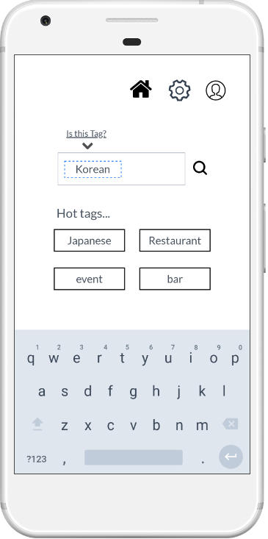
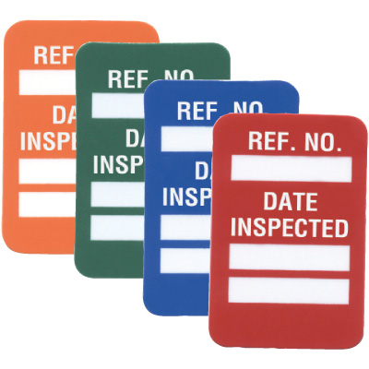
Seton Microtag® Equipment Identification Tagging System

Slide 12
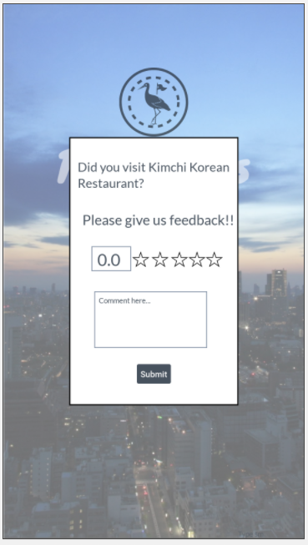
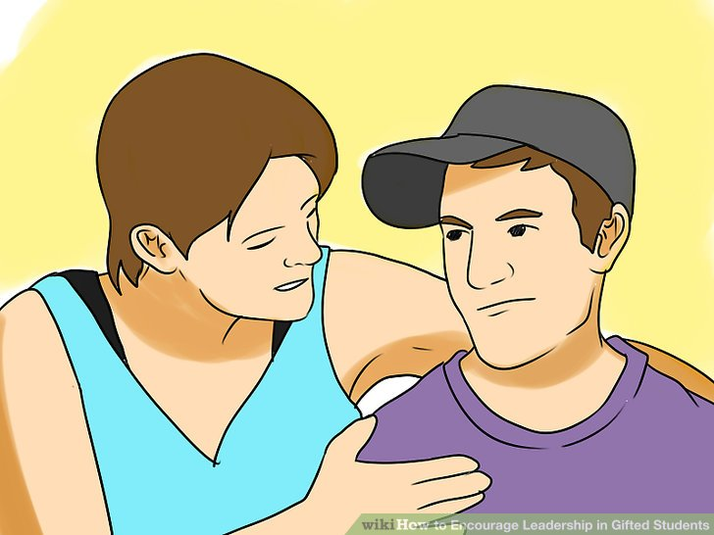
How to Encourage Leadership in Gifted Students: 13 Steps wikiHow Image titled Encourage Leadership in Gifted Students Step 3

Slide 13
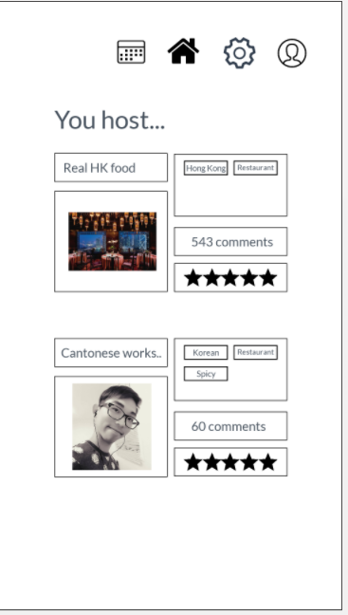
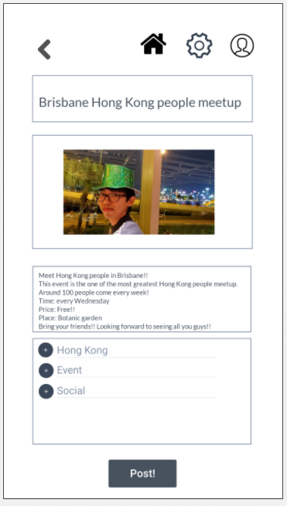

Slide 14
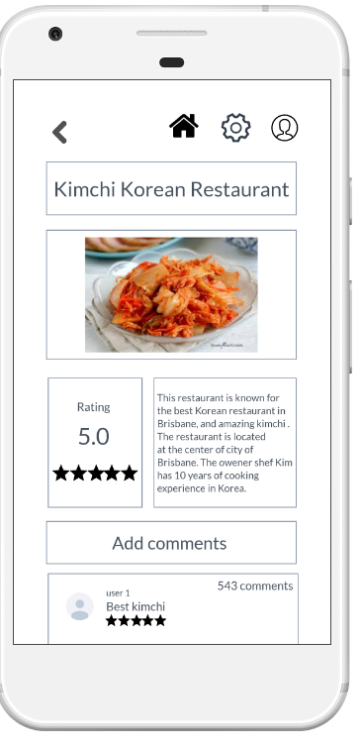

Configuration, fix, maintenance, modify, repair, tool, wrench icon ... Iconfinder configuration, fix, maintenance, modify, repair, tool, wrench icon

Slide 15


Slide 16
Analysis in Competitors
Ken

Slide 17

Competitors
Our user need…
Recommendation
User Reviews
Good Range
Accurate Search
User friendly
Company Cost
Function fit

Slide 18
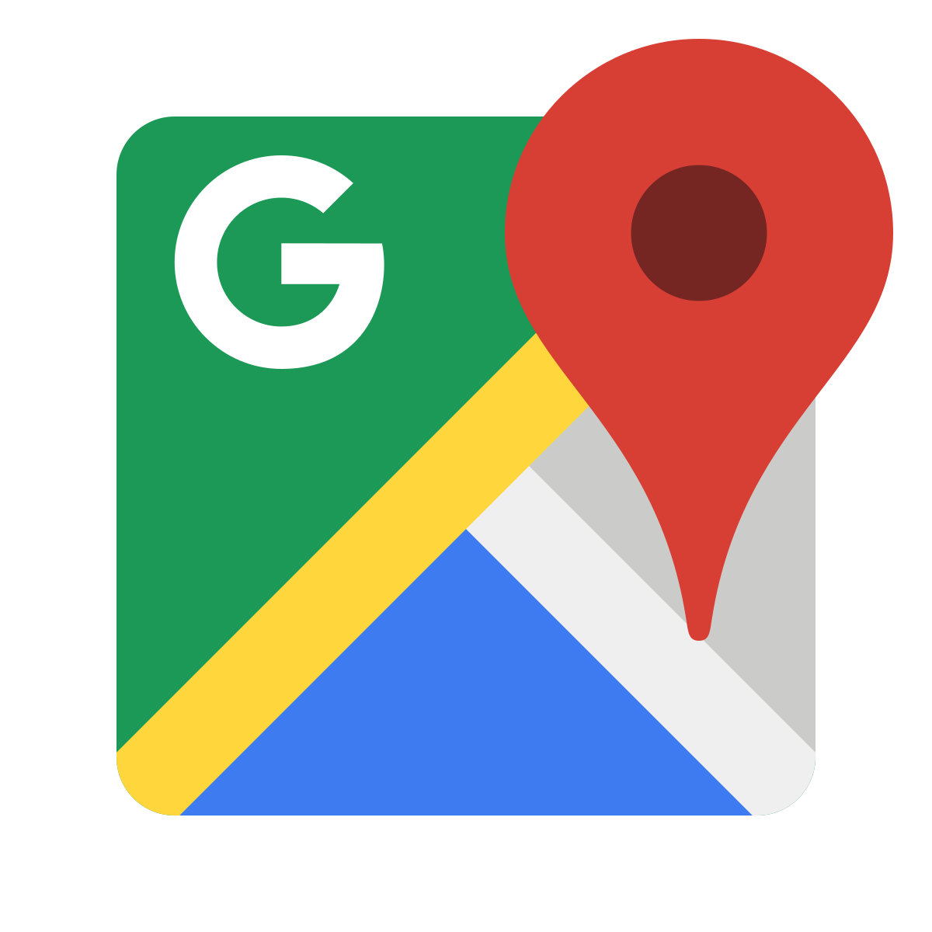


Name | Advantage | Disadvantage
Google maps | Showing location of restaurant of shops Good rating and commenting system from users | Does not show events or workshop (services) Hard to search accurately
Meetup | Original events by Meetup users Accurate search | Limited range of information
Facebook | Great range of information from restaurant (physical products) to services Accurate Information | Too much Functionality Not accurate searching Not user friendly

Slide 19
Gap
Range of information
Great range of information.
Function fit
Specifies into culture related services and activities.
Good rating and commenting system.
Accurate search
Fast and accurate searching system.
User reviews
Simple and specific functionality.

Slide 20
Demo and Feedback
Taiga

Slide 21

Feedbacks of functionality
About Functionality
The way of encouraging users to provide comments
The way of uploading new information
Finding name of services and activities
Better way of finding user location

Slide 22

Feedback of UI design
Needs to be simple and clear
The way of encouraging user to give comments.
Make font and logo bigger
Consistent in color

Slide 23
Demo with User Scenarios
https://marvelapp.com/15h48b66

Slide 24
References
Facebook. (n.d.). Facebook. Retrieved from https://www.facebook.com/
Google. (n.d.). Google maps. Retrieved from https://www.google.com/maps
Meetup. (n.d.). Meetup. Retrieved from https://www.meetup.com/
Sanzagiri, N. (2014). How I beat homesickness, by an international student. Retrieved from https://www.theguardian.com/education/mortarboard/2014/jun/11/homesickness-international-student-university
Sorensen, B. (2017). What are the Causes of Homesickness? Retrieved from https://www.livestrong.com/article/264461-what-are-the-causes-of-homesickness/

