Slide 1

HKMA K S LO COLLEGE
Gemini Notebook Workshop
(Intermediate Level)
Beyond “Generate”
01 Make outputs fit your lesson.
02 Use your sources as evidence.
03 Keep the teacher in control.
HKMA K S Lo College Tech in Ed Task Force
13 Oct 2026
01

Slide 2
What makes
Gemini Notebook different?
01
Works with the sources you provide.
02
Shows citations you can check.
03
Turns sources into different formats.
HKMA K S Lo College Tech in Ed Task Force
13 Oct 2026
02

Slide 3
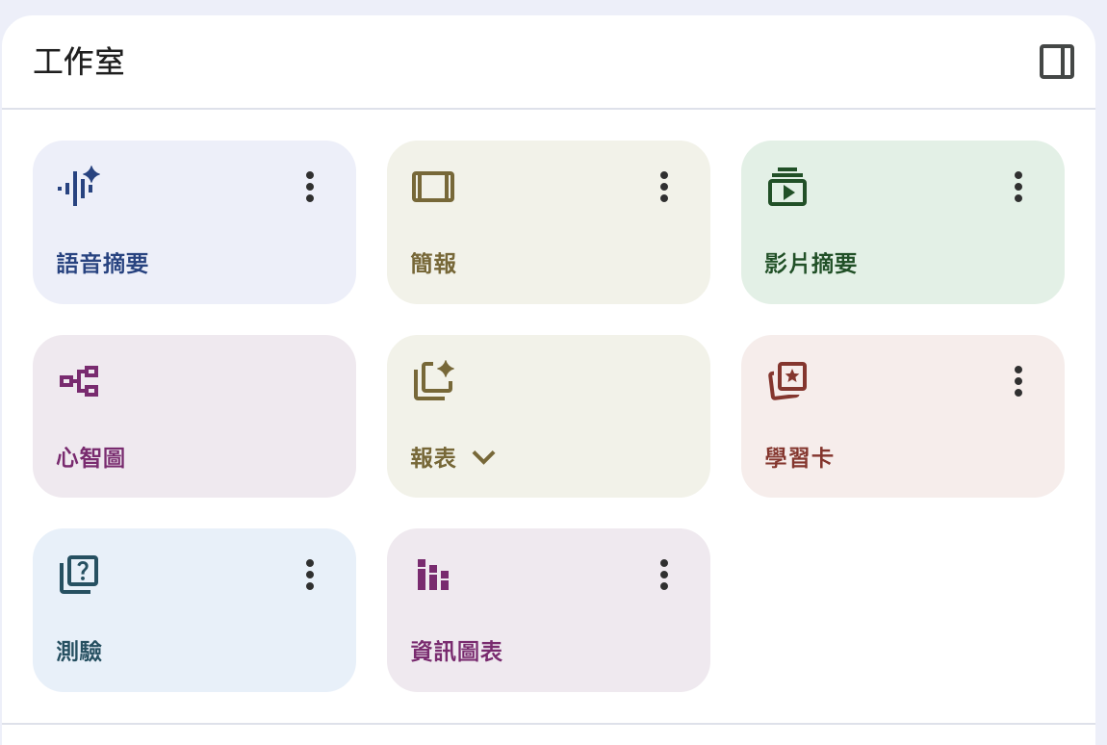
Eight Studio tools in our version
Read
Reports, Mind Maps
See / hear
Slides, Infographics, Audio, Video
Check understanding
Flashcards, Quizzes
HKMA K S Lo College Tech in Ed Task Force
13 Oct 2026
03

Slide 4

Use our school route
kslo.tech/nb-teachers
01 Open kslo.tech/nb-teachers.
02 Use the school’s link—not a retail tutorial link.
03 Sign in with your school apps email account.
HKMA K S Lo College Tech in Ed Task Force
13 Oct 2026
04

Slide 5
Enterprise is a different service—
not just “paid retail”.
01 School-managed access and sharing.
02 Google Cloud data protections.
03 Features can differ by version and region.
Personal / retail ≠ Workspace / Education ≠ Cloud Enterprise
HKMA K S Lo College Tech in Ed Task Force
13 Oct 2026
05

Slide 6
Safer does not mean
“upload anything”.
Use approved, non-sensitive sources.
Check sharing and citations.
Review before teaching or grading.
Cloud terms: no model training or fine-tuning without customer permission or instruction.
School policy, privacy duties and teacher judgement still apply.
HKMA K S Lo College Tech in Ed Task Force
13 Oct 2026
06

Slide 7
Why do versions
feel different?
Features and rollouts can differ.
Some new features reach the retail version first.
The Enterprise version may receive these features later.
Unofficial explanation:
Features may undergo additional stability testing before Enterprise release.
HKMA K S Lo College Tech in Ed Task Force
13 Oct 2026
07

Slide 8
Create a new notebook.
Add the workshop documents.
01
Create a new notebook.
Chinese version
DigitalEducationBlueprint(Chinese).pdf
02
Name it:
Digital Education Blueprint
English version
03
Upload both PDFs.
Wait until the sources are ready.
DigitalEducationBlueprint(English).pdf
HKMA K S Lo College Tech in Ed Task Force
13 Oct 2026
08

Slide 9
Better instructions.
Better answers.
01 Select only relevant sources.
02 Set a short teacher instruction in Chat settings.
03 State audience, task, format—and ask for evidence.
04 Check, then refine.
For whom? Do what? In what format? With what limits?
HKMA K S Lo College Tech in Ed Task Force
13 Oct 2026
09

Slide 10
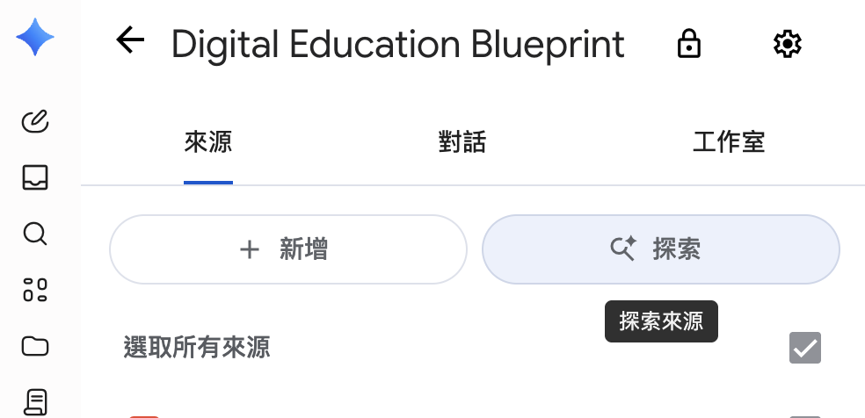
Try Explore.
Find more relevant sources.
01
In your Blueprint notebook:
Sources (來源) → Explore (探索).
02
Search for guidance related to the Blueprint. Be specific.
03
Review the results; add 1–2 relevant, trustworthy sources.
HKMA K S Lo College Tech in Ed Task Force
13 Oct 2026
10

Slide 11
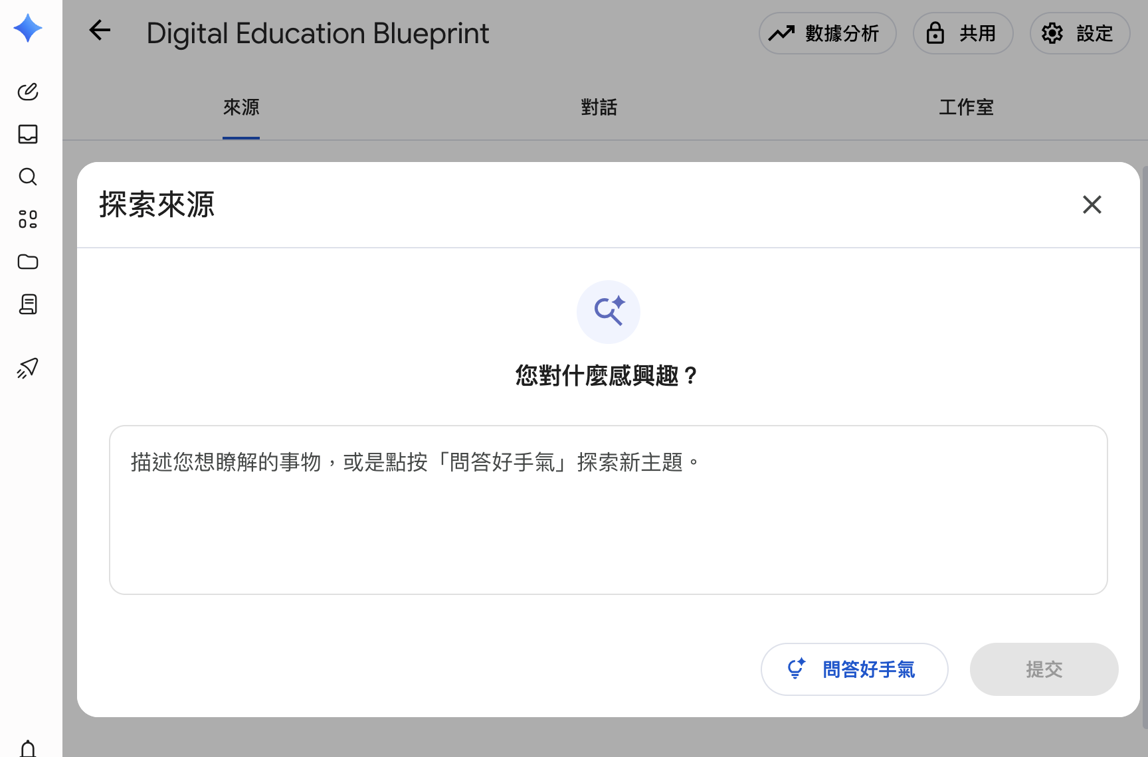
Explore sources
What specific sources are required?
Too broad
Government documents on digital education
More specific
Hong Kong government documents on digital education
HKMA K S Lo College Tech in Ed Task Force
13 Oct 2026
11

Slide 12
Tell chat how
to organise the answer.
Point form: how many? · Table: column count + names · Steps: numbering
Vague: “Summarise this in a table.”
Clear: Use a four-column table: Key point; Document statement;
Teacher implication; Citation. Keep cells brief.
Key point | Document statement | Teacher implication | Citation
HKMA K S Lo College Tech in Ed Task Force
13 Oct 2026
12

Slide 13
Hands-on: generate,
customise, compare.
01
02
03
Generate A
Customise B
Compare A & B
Without customisation.
Keep it as Version A.
Open ⋮ → Customise / 自訂.
Specify audience and focus.
Generate Version B.
More relevant? Clearer?
More useful for teaching?
Keep the Studio tool, selected sources and output language the same.
HKMA K S Lo College Tech in Ed Task Force
13 Oct 2026
13

Slide 14
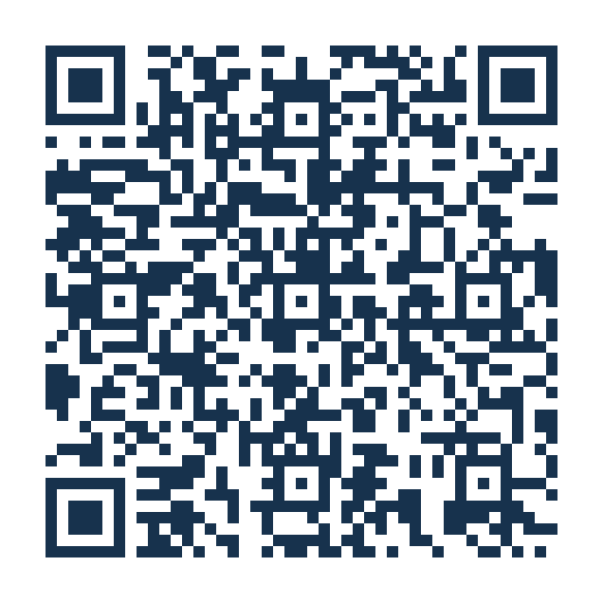
Post your Studio output
on Padlet.
Upload the output or screenshot.
Briefly describe its purpose and what changed.
Open workshop Padlet →
HKMA K S Lo College Tech in Ed Task Force
13 Oct 2026
14

Slide 15
Example
Check S6 English reading materials.
Situation
Before planning S6 revision, an English teacher wants to know whether the school’s reading-comprehension notes address the skills identified in the selected official guidance.
Sources to add to Notebook
English Language Curriculum and Assessment Guide (Secondary 4 - 6)
English Language Assessment Framework for HKDSE
The related reading notes
HKMA K S Lo College Tech in Ed Task Force
13 Oct 2026
15

Slide 16
Example / English prompt
Compare ‘S6 Reading Revision — teacher notes’ with the selected HKDSE English Language Curriculum and Assessment Guide and assessment framework. Focus on reading comprehension and supporting answers with text evidence.
Use a four-column table: Official objective; Evidence in our notes; Coverage (clear / partial / not found); Suggested improvement. Cite both the guidance and our notes. End with three revision-teaching priorities.
Keep curriculum objectives separate from exam rules. Flag anything not stated in the sources. ‘Not found’ refers only to the selected notes.
Write in English.
HKMA K S Lo College Tech in Ed Task Force
13 Oct 2026
16

Slide 17
Example / 繁體中文提示詞
請把「S6 Reading Revision — teacher notes」與所選HKDSE英文科《課程及評估指引》及評核大綱比較，集中於閱讀理解及以文本證據支持答案。
用四欄表格：官方目標；教材證據；涵蓋程度（清楚／部分／未找到）；改進建議。引用官方資料及筆記，最後列出三項溫習教學重點。
區分課程目標與考試規則。資料未有說明的內容，請指出。「未找到」只指所選筆記。
請以繁體中文回答。
HKMA K S Lo College Tech in Ed Task Force
13 Oct 2026
17

Slide 18
Ten useful prompts for teachers.
01
Check materials against HKDSE requirements
06
Turn fictional errors into feedback and reteaching
02
Turn an HKEAA briefing into revision-teaching notes
07
Audit a teaching or assessment draft before use
03
Plan an HKDSE lesson with an exit ticket
08
Turn a long EDB document into a staff briefing
04
Support different levels—keep the same learning goal
09
Extract actions, dates and unanswered questions
05
Draft HKDSE-style practice and a separate answer key
10
Compare official documents: updates or contradictions?
HKMA K S Lo College Tech in Ed Task Force
13 Oct 2026
18

Slide 19
Q&A.
What will you try
next week?
One teaching task.
One improvement to your instructions.
One Studio function that you will put to work.
HKMA K S Lo College Tech in Ed Task Force
13 Oct 2026
19

