Slide 1


AI Teaching Assistant
Building an AI Teaching Assistant from scratch – right from first principles
Hari Krishna Malladi
Solutions architect, Cognida.ai

Slide 2
From Zero to Production
We will build an agentic AI Teaching Assistant that can:
  Chat with students on any topic
  Explain complex concepts clearly
  Generate quizzes and assignments
  Assesses student answers
  Help with programming

Slide 3
Why an AI TA
  Personalized attention
  Availability
  Scalability
  Consistency
  Data-driven

Slide 4
Evolution of this session
  Single prompt to an LLM
  Prompt + a conversation history
  Add a single tool call
  Add multiple tools with the decision making to invoke them
  Single agent system
  Multiple agents with an orchestrator agent
  Package it all with a UI

Slide 5
Tech stack
  Backend:
    Python
    FastAPI for API server
    Azure OpenAI for LLMs
  Frontend
    React + TypeScript
    Tailwind CSS

Slide 6
Step 1 – Basic Prompt
  Three basic steps:
    Create client
    Create messages array
    Call API and get response
Parameter | Purpose | Example
Model | Which model? | gpt-4.1
Messages | Conversation history | List of messages
Temperature | Creativity | 0 to 1 (least to most)
Max_tokens | Response length | 500, 1000, 2000

Slide 7
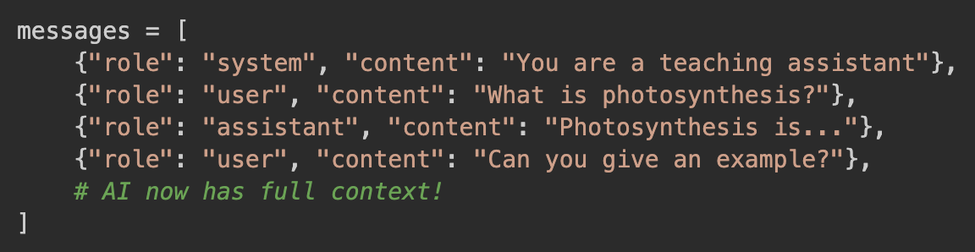
Step 2 – Conversation History
  Three basic concepts:
    Message list: The entire conversation history
    Context: The story so far
    Roles: system/user/assistant

Slide 8
Step 3 – Streaming
  Time to first token (TTFT) : The time elapsed between the end of the user typing and the first token output from the model.
  Considerations while streaming:
    Send the stream out as it arrives – can sometimes be jittery
    Cache a window and stream the window once full – TTFT higher
    Cache entire message before responding – No stream
  When should you use what?

Slide 9
Step 4 – Tool Calls
  LLM might not have full knowledge of everything
  Invoke a tool for answering specific questions or doing specific tasks
  AI decides which tool to invoke
  Three considerations for tools:
    Tool description – better description, better chances of accurate match
    Tool properties – describe properties better for better matches
    Mandatory properties – Fill them before tool invocation
  What to do when you’ve multiple narrowly spaced tools?
    Reserve booking, confirm booking, book appointment

Slide 10
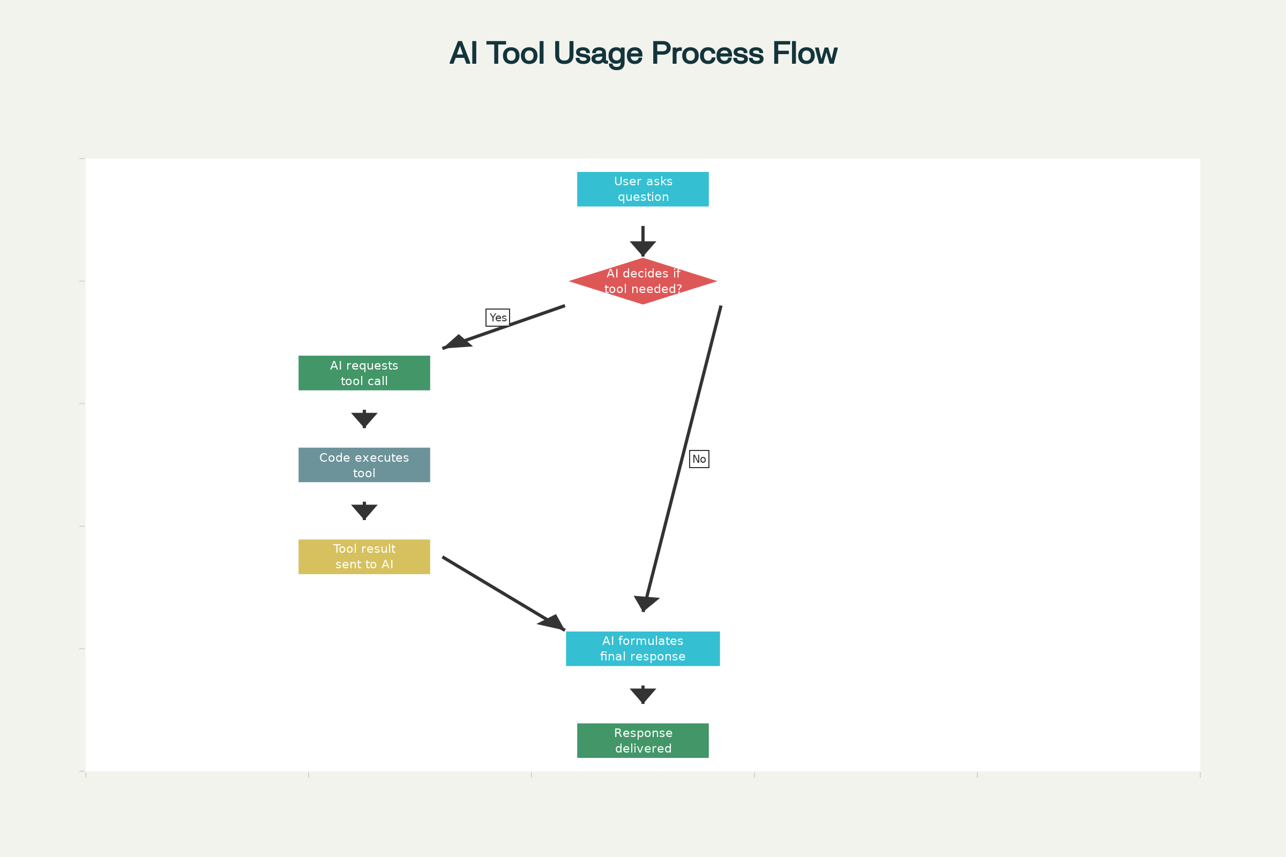
Step 4 –Tool Calls

Slide 11
Step 5 – Multiple Tool Calls
  AI decides which tool to invoke
  Tools demonstrated:
    Generate quiz
    Explain concept
    Assess answer
  What to do when you’ve multiple narrowly spaced tools?
    Reserve booking, confirm booking, book appointment

Slide 12
Step 5 – Multiple Tool Calls
  AI decides which tool to invoke
  Tools demonstrated:
    Generate quiz
    Explain concept
    Assess answer
  What to do when you’ve multiple narrowly spaced tools?
    Reserve booking, confirm booking, book appointment

Slide 13
Step 6 –Agents
Feature | Agent | Prompt + LLM
Autonomy | Acts independently | Just responds to prompts
Tool use | Can invoke tools, APIs | Just text output
Goal seeking | Pursue objective, plan multiple steps | One-shot
Memory + Feedback | State management, memory, history | Stateless
Interactivity | Interacts with environment and adapts | Purely reactive
Example | AI assistant booking flight + sending email | LLM summarizing an email

Slide 14
Step 7 –Multi-Agent system
  AI decides which tool to invoke
  Tools demonstrated:
    Generate quiz
    Explain concept
    Assess answer
  What to do when you’ve multiple narrowly spaced tools?
    Reserve booking, confirm booking, book appointment

Slide 15
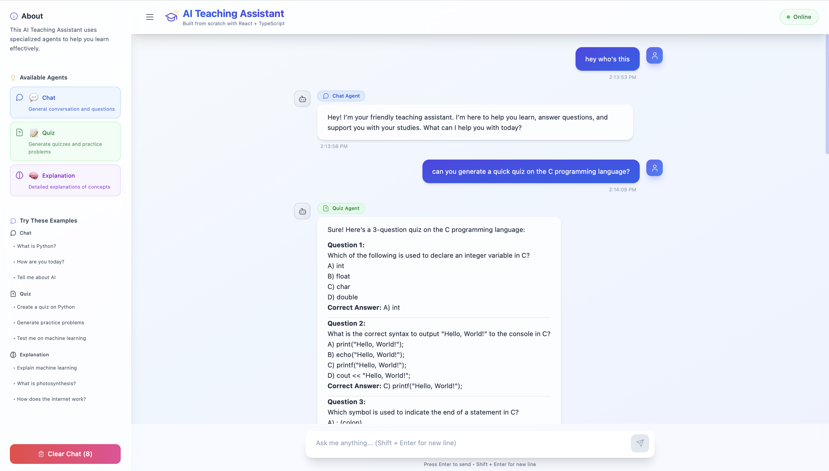

Slide 16
Decision to take
  Should you build the AI Teaching Assistant using tools alone, keeping all tools under a single flow?
  OR
  Should you build it using agents, one agent per flow?

Slide 17
Questions?

