Slide 1
Cascading Style Sheets
Created by: Hemant Mangla

Slide 2
Cascading Style Sheets
CSS is used to control the style of a web document in a simple and easy way.
Using CSS, we can control the color, font-size, font-family and many other things of a text.
We can also set the size of images, paragraph, their background color and many more other things using CSS.
In simple words, CSS make an HTML page attractive and user friendly.

Slide 3
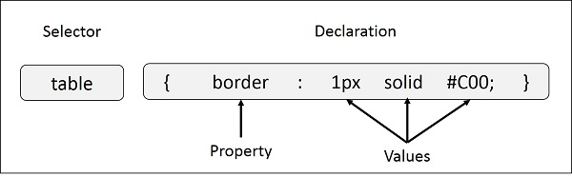
Cascading Style Sheets (Contd.)
A CSS comprises of style rules that are interpreted by the browser and then applied to the corresponding elements in your document. A style rule is made of three parts
Selectors: HTML tag, class, or id on which property will be applied.
Property: Property is like HTML attribute which modifies the selector.
Value: The value that will be assigned to that property.

Slide 4
CSS Selectors
We can define CSS selector in various different ways
Type Selector
Select on basis of the type of HTML tag.
Universal Selector
Matches the name of any element type.
h1 {
color: #36CFFF;
}
* {
color: #36CFFF;
}

Slide 5
CSS Selectors
Descendant Selector
Select a particular element if it’s lies inside a particular element.
Class Selector
Select on the basis of the class name.
ul em {
color: #36CFFF;
}
.class_name {
color: #36CFFF;
}

Slide 6
CSS Selectors
ID Selector
Select on the basis of the Id of the element.
Child Selector
Select a particular element if it is the direct child of other particular element.
#black {
color: #36CFFF;
}
body > p {
color: #36CFFF;
}

Slide 7
CSS Selectors
Attribute Selector
Select an element of the particular attribute.
Grouping Selector
Select more than a element in a group.
Input[type=“text”] {
color: #36CFFF;
}
h1, h2, h3 {
color: #36CFFF;
}

Slide 8
CSS Selectors
Along with that we can select the elements using CSS pseudo classes
E::before : generated content before an E element's content
E::after : generated content after an E element's content
E:root : an E element, root of the document
E:nth-child(n) : an E element, the n-th child of its parent
E:nth-last-child(n) : an E element, the n-th child of its parent from last
E:last-child : an E element, last child of its parent
E:only-child : an E element, only child of its parent
E:link, E:visited etc.

Slide 9
CSS Rule Overriding
Any inline style sheet takes highest priority. So, it will override any rule defined in <style>...</style> tags or rules defined in any external style sheet file.
Any rule defined in <style>...</style> tags will override rules defined in any external style sheet file.
Any rule defined in external style sheet file takes lowest priority, and rules defined in this file will be applied only when above two rules are not applicable.

Slide 10
CSS Measurement Units
CSS supports many measurement units like
% – percentage relative to another value
ex – unit is equivalent to height of the font’s lowercase letter x
em – em unit is equivalent to size of give font
vh, vw – 1% of viewport height and width respectively
px – measurement in screen pixel
pt – measurement in points. 1 point is equal to 1/72nd of an inch.
in, mm, cm – measurement in inch, millimeter and centimeter resp.

Slide 11
CSS Color Codes
In CSS, we can specify the color value in various format like
Hex Code : #RRGGBB
Short Code : #RGB (shorter version of #RRGGBB)
RGB% : rgb(rrr%, ggg%, bbb%)
RGB Absolute : rgb(rrr, ggg, bbb)
keyword : aqua, black, red etc.

Slide 12
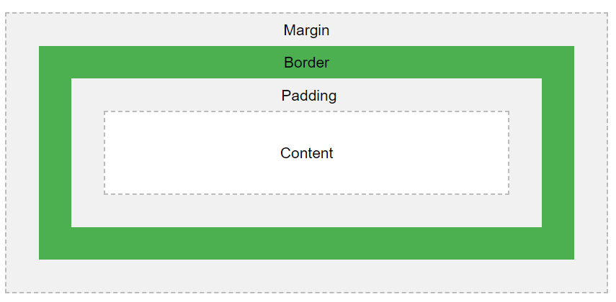
CSS Box Model
The CSS box model is essentially a box that wraps around every HTML element.
It consists of: margins, borders, padding, and the actual content.
Content - The content of the box, where text and images appear
Padding - Clears an area around the content. The padding is transparent
Border - A border that goes around the padding and content
Margin - Clears an area outside the border. The margin is transparent

Slide 13
CSS Properties
CSS provide various properties to an element which are
Background
background-color
background-image
background-repeat
background-position
background-attachment
background

Slide 14
CSS Properties
Fonts
font-family
font-style
font-variant
font-weight
font-size
Font

Slide 15
CSS Properties
Text properties
color
direction
letter-spacing
word-spacing
text-indent
text-align
text-decoration
text-transform
white-space

Slide 16
CSS Properties
Image properties
border
width
height
-moz-opacity
Link properties
:link
:visited
:hover
:active

Slide 17
CSS Properties
Table properties
border-collapse
border-spacing
caption-side
empty-cells
table-layout
Border properties
border-color
border-style
border-width

Slide 18
CSS Properties
Margin and Padding
margin-left, margin-right, margin-bottom, margin-top
padding-left, padding-right, padding-bottom, padding-top
List Properties
list-style-type
list-style-position
list-style-image
list-style
marker-offset

Slide 19
CSS Properties
Outlines properties
outline-width
outline-style
outline-color
outline
Cursors properties
cursor: auto, crosshair, pointer, move, e-resize, ne-resize, nw-resize, n-resize, se-resize, sw-resize, s-resize, w-resize, text, wait, help, <url>

Slide 20
CSS Properties
Dimension properties
height
width
line-height
max-height, min-height
max-width, min-width
Scrollbar properties
overflow: visible, hidden, scroll, auto

Slide 21
CSS Positioning
CSS help us to position our HTML element. We can put any HTML element at whatever location we like.
Following is the main and mostly used type of the CSS positioning
Relative Positioning
Set position of the HTML elements relative to where it normally appears.
Absolute Positioning
Set position relative to it’s nearest positioned ancestor. Remove element from flow of the document.
Fixed Positioning
Fixed the position of an element, regardless of scrolling. Position will be relative to browser’s window and it also removed element from the normal flow of the document.

Slide 22
CSS Positioning Attributes
CSS positioning is done by using the following attributes
position - Specify types of positioning (e.g. relative, fixed etc.)
left, right, top, bottom - Set left, right, top and bottom position of the element respectively.
E.g.

Slide 23
CSS Display Property
CSS display property specifies if/how an element is displayed.
There is many different display values in CSS. Few of them are
Inline
Inline-block
Block
None

Slide 24
CSS Floating elements
The float property specifies how an element should float.
This is used for positioning and layout on web pages.
The float property can have the one of the following values:
left - The element floats to the left of its container
right- The element floats to the right of its container
none - The element does not float (will be displayed just where it occurs in the text). This is default
inherit - The element inherits the float value of its parent

Slide 25
CSS Layers
We can create layers of various divisions using CSS.
This can be done by using CSS z-index property.
The z-index property is used along with the position property to create an effect of layers.
You can specify which element should come on top and which element should come at bottom.

Slide 26
CSS Layers Example (code)

Slide 27
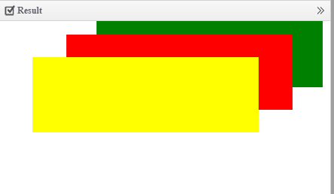
CSS Layers Example (Result)

Slide 28
Introduction of CSS3 tags
CSS3 is the upgraded version of CSS2
This can be used to display the web page differently which can change depending on your screen size
Changes to the design of a document can be applied quickly and easily

Slide 29
New things in CSS3
Media Queries
Namespaces
Selectors level 3
Color
Rounded Corners
2D/3D Transformations
Multi Background and many more.

Slide 30
Media Queries
@media at rules, used to target styles at specific media, such as screen or print.
But this can be pushed to an even greater level of sophistication, enabling you to specify different design choices depending on screen size.
A page can then be optimized and laid out completely differently for mobile phones, tablets, and varying browser window sizes.

Slide 31
Media Queries (Contd.)
Using media queries, we can make our page
Browser-size specific
Orientation specific
Device specific
Or Others like device’s resolution, aspect ratio etc.

Slide 32
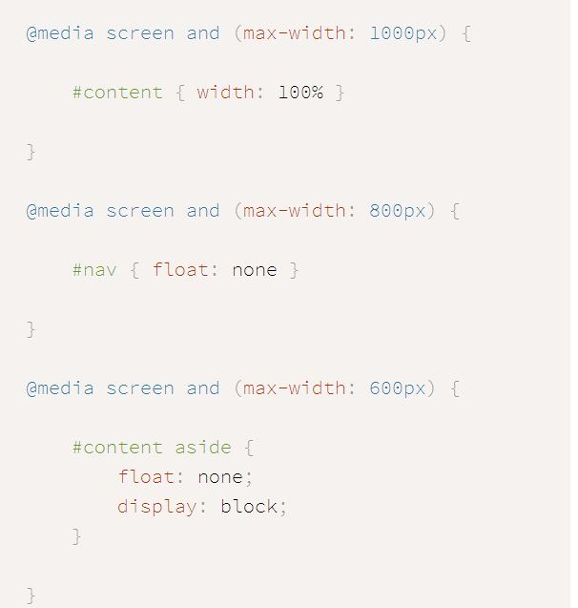
Browser-size specific

Slide 33
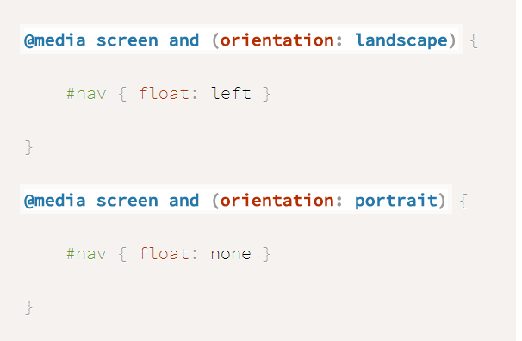
Orientation Specific

Slide 34
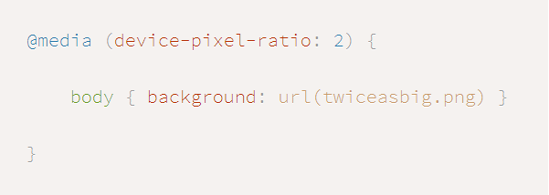
Device specific
CSS pixel need not be the same as a physical pixel
While a screen may physically be 720 pixels wide, a browser may actually apply CSS assuming that it is 480 pixels wide.
E.g.

Slide 35
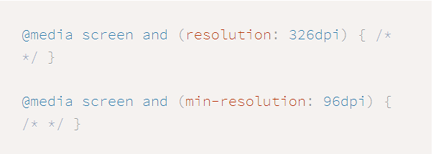

Others
Depending on device resolution
Depending on aspect ration

