Slide 1
JavaScript
By Hemant Mangla

Slide 2
Introduction to JavaScript
JavaScript was initially created to “make webpages alive”, but now it is used in many other environments as well.
JavaScript can execute not only in the browser, but also on the server, or actually on any device where there exists a special program called the JavaScript engine.
At this moment, JavaScript has a unique position as the most widely-adopted browser language with full integration with HTML/CSS.
The modern JavaScript is a “safe” programming language. It does not provide low-level access to memory or CPU.
It is supported by all major browsers and enabled by default.

Slide 3
What can in-browser JS do?
Add new HTML to the page, change the existing content, modify styles.
React to user actions, run on mouse clicks, pointer movements, key presses.
Send requests over the network to remote servers, download and upload files (so-called AJAX and COMET technologies).
Get and set cookies, ask questions to the visitor, show messages.
Remember the data on the client-side (“local storage”).

Slide 4
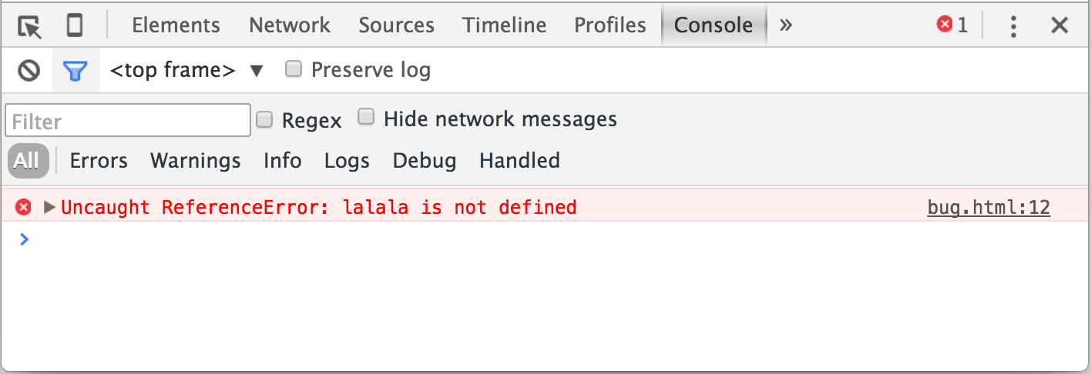
Developer Console
Code is prone to errors. We all are absolutely going to make errors. To see errors and get a lot of other useful information about scripts, browsers have embedded “developer tools”.
Developer tools allow us to see errors, run commands, examine variables and much more. They can be opened with F12 for most of the browsers under windows.

Slide 5
JavaScript Fundamental
Before going JS fundamental, let’s see how to attach a script to a webpage.
We can use a <script> tag to add JavaScript code to the page.
The type and language attributes are not required.
To attach a external script we use
<script src="path/to/script.js"></script>
For server-side environments, you can just execute it with a command like “node my_script.js” for NodeJS.

Slide 6
JS Operators
Function and precedence of JS operators are not much different than other language e.g. C/C++, python etc. So, I will only discuss the things that are not common with other language.
If we add two operands using ‘+’, if one of the operand is string then other one is converted to string too.
e.g. 1 + ‘2’ gives ‘12, ‘2’ + 1 + 1 gives ‘211’ and 1 + 2 + ‘2’ gives ‘32’ (here 1 + 2 added first then the result is added into ‘2’)
If ‘+’ operand is applied to single value, it try to convert the value into number regardless of its previous type.
e.g. +21 gives 21 (no effect on numbers),
+”21” also gives 21 (convert string into number)
+”string” gives NaN (since can’t convert it into a number)

Slide 7
JS Comparison
In JS, ‘==‘ converts the operands first into number then compare them. So, it will give true for ‘1’ and 1, similarly for false and “0”.
To compare two values in JS strictly, we use ‘===‘ operator. It will compare without type conversion. So, ‘1’ === 1 gives false.
If we compare two different types then they will first converted into numbers then comparison is done (with the exclusion of a strict equality check).
Values null and undefined equal ‘==‘ each other and do not equal any other value.

Slide 8
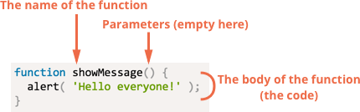
JS Functions
Functions are the main “building blocks” of the program. They allow the code to be called many times without repetition.
To create a function we can use a function declaration.
It’s look like this

Slide 9
JS Function (contd.)
Values passed to a function as parameters are copied to its local variables.
A function may access outer variables. But it works only from inside out. The code outside of the function doesn’t see its local variables.
A function can return a value. If it doesn’t, then its result is undefined.
To make the code clean and easy to understand, it’s recommended to use mainly local variables and parameters in the function, not outer variables.

Slide 10
JS Function (contd.)
The syntax that we used before is called a Function Declaration.
There is another syntax for creating a function that is called a Function Expression.
let sayHi = function() {
alert(“hello world”);
};
There’s one more very simple and concise syntax for creating functions, that’s often better than Function Expressions. It’s called Arrow Functions, because it looks like this:
let func = (arg1, arg2, …) => expression; Or
let func = () => { body };

Slide 11
JS Function (contd.)
Function Declarations are processed before the code block is executed. They are visible everywhere in the block.
Function Expressions are created when the execution flow reaches them.
In most cases when we need to declare a function, a Function Declaration is preferable, because it is visible prior to the declaration itself.
That gives us more flexibility in code organization, and is usually more readable.

Slide 12
Interaction with visitors
As we use a browser as the demo environment. So we should know at least a few user-interface functions. Some of the browser functions alert, prompt, and confirm.
alert: This shows a message and pauses the script execution until the user presses “OK”.
prompt: It shows a modal window with a text message, an input field for the visitor and buttons OK/CANCEL. It accepts two argument title and default.
title: Text to shows to the visitors.
default: An optional second parameter, the initial value for the input field.
confirm: It shows a model window with a question and two buttons: OK and CANCEL. Returns true if OK is pressed and false otherwise.

Slide 13
JS variables
We can declare variables to store data. That can be done using var or let or const.
let: It is a modern variable declaration. Variables defined using let keyword have scope only in the block that are defined. We can’t use a let variable before it’s declaration.
var: It is an old-school fashioned variable declaration. Normally, we don’t use it. It has two scope local and global. Local scope if value is inside a function else global. We can use a variable defined using var before it’s declaration.
const: It is like let but the value of the variable is constant i.e. can’t be changed.

Slide 14
JS Data Types
There are 7 basic data types in JS.
number: for number of any kind: integer or floating point.
string: for strings. A string may have one or more characters, there’s no separate single-character type
boolean: for true/false.
null: for unknown values – a standalone type that has a single value null.
undefined: for unassigned values – a standalone type that has a single value undefined.
objects: for more complex data structures.

Slide 15
Debugging
As code is prone to errors, so we need debugging for finding and fixing errors in the code.
All modern browsers and most other environments support “debugging” – a special UI in developer tools that makes finding and fixing errors much easier.
The developer tools of browser includes Source pane, Console, Elements pane.
In the next slides, I will be using chrome’s developer tools for debugging.

Slide 16
Sources Pane
We can turn ON developer tools of chrome using F12.
There is a tab named Source, click on it to select the Sources pane.

