Slide 1
HTML PROGRAMMING NOTES
Created by: Hemant Mangla

Slide 2
Topics to be covered (acc. to Training sheet)
Overview of HTML
Basic HTML Tags and Attributes
Tables and Forms
Frames (Nested Frames)
Cross Browser Compatibility
Overview of DOM
Html 5(New Things)
Assignments

Slide 3
Overview of HTML
HTML stands for HyperText Markup Language and is the most widely used language to write web pages.
As it is a markup language, so we use HTML to simply markup the document means tell a Web browser how to structure it to display.
Originally, HTML was developed with the intent of defining the structure of documents like headings, paragraphs, lists, and so forth to facilitate the sharing of scientific information between researchers.

Slide 4
Basic HTML Document

Slide 5
Basic HTML Tags and Attributes
HTML Tags:
HTML use various tags to structure the web pages or format the content. Every HTML tag has a corresponding closing tag except few tags.
Above HTML code has following tags:
<!DOCTYPE …>, <html>, <head>, <title>, <body>, <h1>, <p>.

Slide 6
Basic HTML Tags
<!DOCTYPE …>
This tag is used to define the document type and HTML version.
e.g. if the HTML version is HTML5 then we write
<!DOCTYPE html>
<html>
This tag enclose the complete html document.
<head>
This tag represents HTML header and contains the meta data of the document like title, encoding used etc.

Slide 7
Basic HTML Tags (Contd.)
<body>
This tag defines the document body. All the content that will be displayed on browser comes under this. It may contain tags like <p>, <h1>, <a> etc.
<title>
This tag is used inside the <body> tag to define the title of the document.
<h1>, <h2>, …., and <h6>
These are the heading tags where <h1> defines the most important heading and <h6> defines the least important heading.

Slide 8
Basic HTML Tags (Contd.)
<br />
This tag is used for line break in the HTML document. It’s a self closing tag.
<pre>
This tag is used to preserve the formatting of the text.
<hr />
This tag is used to insert a horizontal line inside the document.
<button>
HTML buttons are defined by the <button> tag.

Slide 9
Basic HTML Tags (Contd.)
<p>
This tag is used to define the paragraph of the document.
<a>
HTML links are defined by the <a> tag. Link destination is set by the src attribute.
e.g. <a src=“https://www.facebook.com”>Facebook</a>
<img>
This tag is used to define the HTML images. It’s a self closing tag i.e. it doesn’t require a closing tag.
Source file and alternative text is provide by the src and alt attribute respectively.
e.g. <img src=“image.jpg” alt=“Image” />

Slide 10
Basic HTML Tags (Contd.)
<ol>
Ordered list in document are created by the <ol> tag in HTML documents. This tag has
<li> tag inside it which is used to define the list items.
e.g. <ol>
<li>First item</>
<li>Second item</>
</ol>
<ul>
Just like ordered list, unordered list are defined by the <ul> tag in HTML.

Slide 11
HTML Elements
A HTML Element is defined by the starting tag. If the element contains the content then it’s end with the closing tag.
All the content of the element is inserted in b/w the start and end tag.
e.g. <p>This is the paragraph</p>
This is the paragraph element where <p> is the tag. Tag and element is the two different things in HTML.

Slide 12
HTML Attributes
Attributes provide the additional information about HTML attributes.
All HTML elements can have attributes.
Attributes are always specified in the start tag.
Attributes usually comes in name/value pair e.g. name=“value”.

Slide 13
HTML Attributes (Contd.)
Some basic HTML attributes are
href
Use to specify the link address for the <a> tag.
src
Use to specify the source file address for the <img> tag.
style
Use to specify the styling of the element like it’s background color, color, alignment etc.

Slide 14
HTML Attributes (Contd.)
title
The value of the title attribute will be displayed as a tooltip when you mouse over the paragraph.
width
Use to specify the width of the element.
height
Use to specify the height of the element.
There many other HTML attributes like id, class, disabled etc.

Slide 15
HTML Tables
HTML tables are created using the <table> tag.
Table rows are created using <tr> tag.
Table heading are specified by the <th> tag.
Table cells is created by using <td> tag. The elements under <td> is left aligned by default.
The <caption> tag is used to specify the title or explanation of the table.
In HTML tables, we can also use <thead>, <tbody>, and <tfoot> tag to create separate table header, to indicate main body and to create separate table footer respectively.

Slide 16
HTML Tables Attributes
Like all other elements HTML Tables also have some attributes
cellpadding: Specify the distance b/w cell borders and the content.
cellspacing: Specify the spaces b/w the table cells.
colspan: Used to merge two or more columns.
rowspan: Used to merge two or more rows.
bgcolor: Used to set the background color of the table.
There is also some other attributes like width, height, id etc.

Slide 17
HTML Tables Example

Slide 18
HTML Forms
HTML forms are required when you want to collect some data from the visitor like name, email-id, address etc.
A form will take input and post it to a back-end application like CGI, PHP script etc.
HTML <form> tag is used to create an HTML form.
An HTML form can contain various format of the input like test fields, text-area fields, radio buttons, checkboxes, dropdown menu etc.

Slide 19
HTML Forms Attributes
HTML <form> tag has some main attributes which is frequently used
action: Backend script ready to process your passed data.
method: Method to be used to upload data. Most common are Get and Post.
target: Specify the target window or frame where the result of the script will be displayed
enctype: How the browser encodes the data before it sends it to the server.

Slide 20
HTML Form Controls
HTML form controls is used to control the input type. We can set the type of input using “type” attribute of <input> tag.
Text Input Controls <input type=“text” />
Checkboxes Controls <input type=“checkbox” />
Radio Box Controls <input type=“radio” />
Select boxes <select> and <option> tag
Hidden Control <input type=“hidden” />
Submit and Reset Button <input type=“submit” />

Slide 21
HTML Frames
HTML frames are used to divide your browser window into multiple sections where each section can load a separate HTML document. There are few drawbacks with using frames,
Smaller devices can’t cope because their screen is not too big to be divided up.
Different display of page on different computer due to their different screen resolution.
The browser back button might not work as user hopes.
There are still browser who do not support frame technology.

Slide 22
Cross Browser Compatibility
Cross Browser Compatibility means does a webpage works on different web browser or different versions of a web browser.
A lack of cross-browser compatibility doesn’t mean that something looks different; it means that it doesn’t work.
So, it’s best to make a webpage so that they look consistent across a range of browsers. This is often known as cross-browser (or multi-browser) coding.
Here is some useful tips for cross browser coding.

Slide 23
Cross Browser Coding Tips
Write simple code. The more complex code is, the more there is to go wrong.
Many browser has some different default values of things like padding, margin etc. So, it’s best to use CSS reset rule to reset the things.
Try to test your code in as many browser as possible.
Use conditional comments to fix IE issues. By this, you can serve up additional HTML.
Provide fallbacks in case if some of the features like flash movies doesn’t support by visitor’s browser.

Slide 24
Overview of DOM
When a web page is loaded, the browser creates a Document Object Model of the page.
With the HTML DOM, JavaScript can access and change all the elements of an HTML document.
With the object model, JavaScript gets all the power it needs to create dynamic HTML like change elements, attributes, CSS style etc.
In other words: The HTML DOM is a standard for how to get, change, add, or delete HTML elements.

Slide 25

The HTML DOM Tree of Objects

Slide 26
New Things in HTML5
HTML5 introduce many new elements and attributes but it also removed some elements from HTML4 in HTML5. The new elements introduced in HTML5 are
New semantic elements like <header>, <footer>, <article>, and <section>.
New attributes for form elements like number, date, time, calendar, and range.
New graphic elements: <svg> and <canvas>.
New multimedia elements <audio> and <videos>.

Slide 27
HTML5 Browser Support
HTML5 supports all modern browser.
In addition, all browsers, old and new, automatically handle unrecognized elements as inline elements.
Because of this, you can "teach" older browsers to handle "unknown" HTML elements. You can do this by setting the CSS display property of these elements to block.
header, section, footer, aside, nav, main, article, figure { display: block; }

Slide 28
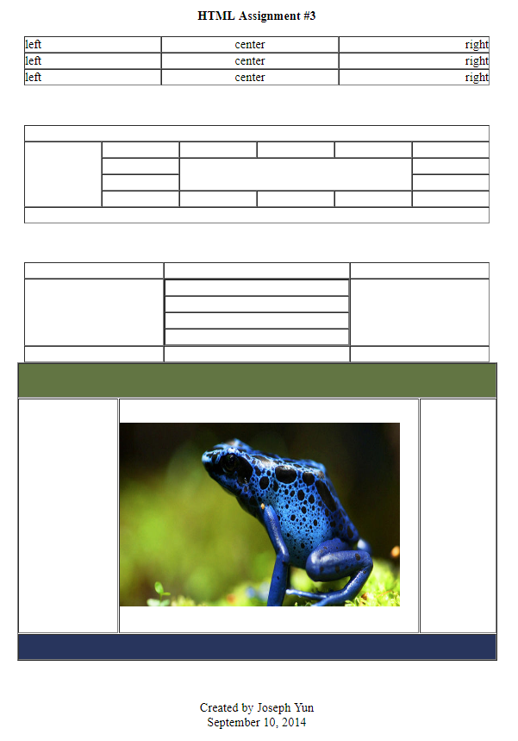
Assignments
Assignment reference page
(Click on the image to see it
as a webpage.)

Slide 29
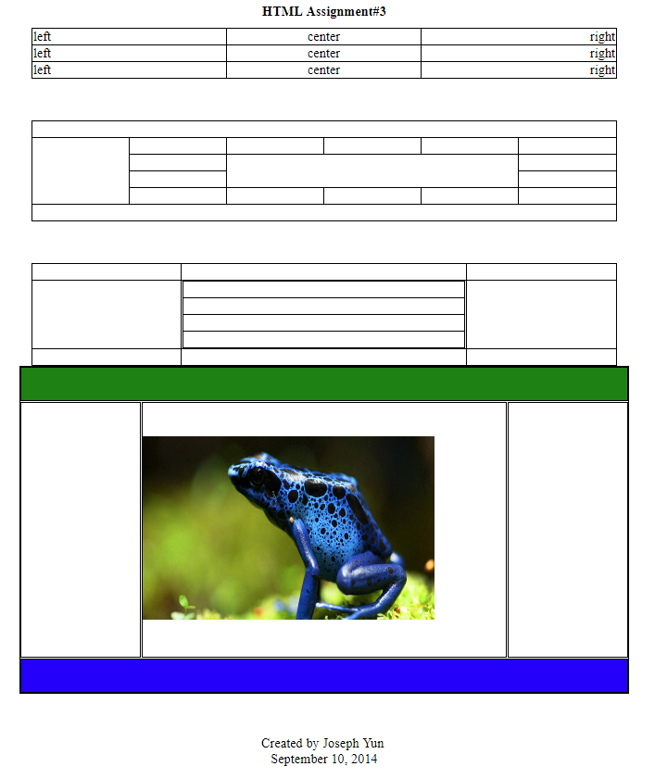
Assignments (Contd.)
Page created by me
(Click on the image to see it
as a webpage.)

Slide 30
THANK YOU

