Slide 1
LENDING CLUB CASE STUDY SUBMISSION
Name: Navin Ahmed and Hanif Khan

Slide 2
Business Objective
Consumer Finance Company wants to identify risky loan applicants sothat company can make a decision for loan-approval based on the applicant’s profile or can reduce the loan and cut down the amount of credit loss.
The company wants to understand the driving factors (or driver variables) behind loan default, i.e. the variables which are strong indicators of default. The company can utilize this knowledge for its portfolio and risk assessment.

Slide 3
Goals of Analysis
1. Target attributes of consumer:
Identify the target attributes of consumer which influence the tendency of default.
2. Target attributes of loan:
Identify the target attributes of loan which influence the tendency of default.
3. Result:
Identify the pattern of attributes which influence the tendency of default.

Slide 4
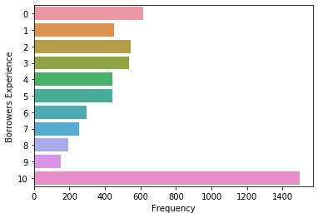
1. Target attributes of consumer
Borrower’s Experience Analysis:
According to the graph, Borrower’s experience influence the tendency of default.
Highest defaulter-rate is 27.59% for 10+ years of experience of borrower.

Slide 5
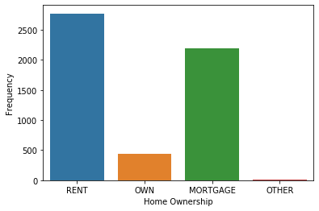
1. Target attributes of consumer
Home-ownership Analysis:
According to the graph, home ownership of borrower influence the tendency of default.
Highest defaulter-rate is 51.18% for Rent type of home ownership and 40.49% for Mortgage type of home ownership.

Slide 6
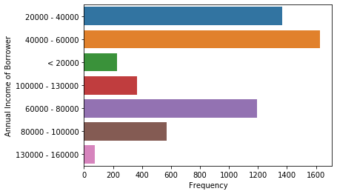
1. Target attributes of consumer
Annual Income Analysis:
According to the graph, annual income of borrower influence the tendency of default.
Highest defaulter-rate is 30.07% for 40000 to 60000 range of annual income and 25.25% for 20000 to 40000 range of annual income of borrower.

Slide 7
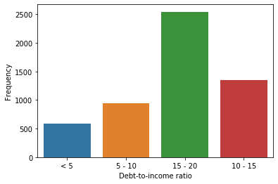
1. Target attributes of consumer
Debt to Income Analysis:
According to the graph, debt to income ratio of borrower influence the tendency of default.
Highest defaulter-rate is 46.95% for 15 to 20 range of debt to income ratio.

Slide 8
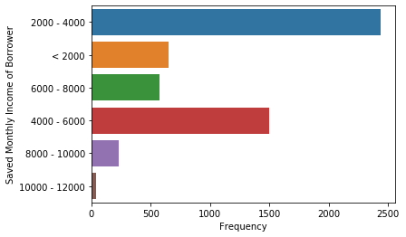
1. Target attributes of consumer
Saved Income Analysis:
According to the graph, saved income of borrower influence the tendency of default.
Highest defaulter-rate is 44.94% for 2000 to 4000 range of saved income(monthly income borrower save after deducting all the debts).

Slide 9
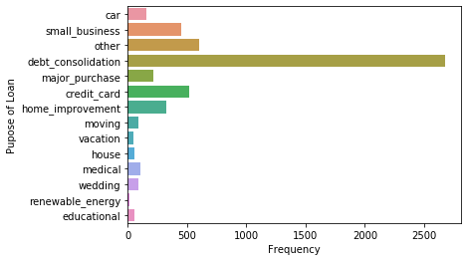
2. Target attributes of loan
Loan-purpose Analysis:
According to the graph, purpose of loan influence the tendency of default.
Highest defaulter-rate is 49.41% for debt consolidation type of Loan-purpose.

Slide 10
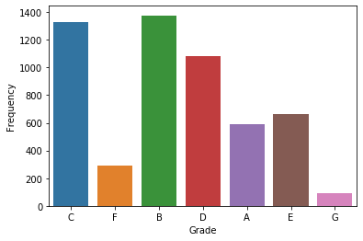
2. Target attributes of loan
Grade Analysis:
According to the graph, grade variable influence the tendency of default.
Highest defaulter-rate is 25.4% for Grade B and 24.46% for Grade C.

Slide 11
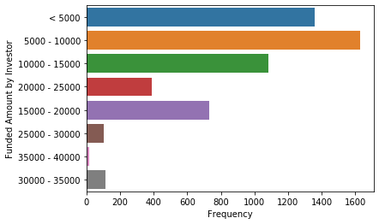
2. Target attributes of loan
Funded Amount Analysis:
According to the graph, Funded amount by investor variable influence the tendency of default.
Highest defaulter-rate is 30.05% for 5000 to 10000 range of funded amount by investor and 25.05% for lessthan 5000 range of funded amount by investor.

Slide 12
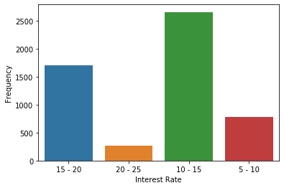
2. Target attributes of loan
Interest Rate Analysis:
According to the graph, Interest Rate variable influence the tendency of default.
Highest defaulter-rate is 49.13% for 10 to 15 range of Interest Rate.

Slide 13
Indicators of default
Following variables are indicators of default:
Existing variables:
home_ownership: Home ownership
purpose: Purpose of Loan
grade: Grade
Derived variables:
annual_inc: Annual Income Categories
funded_amnt_inv_cat: Investor's Funded Amount Categories
dti_cat : Debt-to-income ratio Categories
emp_experience: Borrower’s Experience
save_income_cat: Categories of monthly income saved by borrower after deduction of all the debts
int_rate_cat: Interest Rate Categories

Slide 14
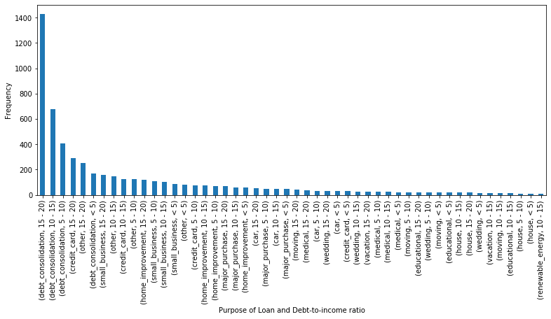
Results 1
According to graph, borrowers who’s
debt to income ratio is between 15-20
and purpose is debt consolidation
have high chance of being defaulter.

Slide 15
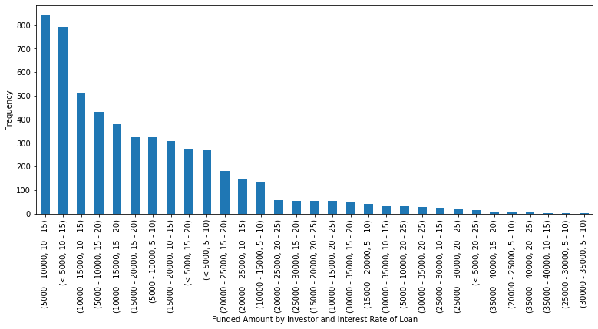
Results 2
According to graph, borrowers who’s
investor’s funded amount is less than 10000
and interest rate is 10 to 15
have high chance of being defaulter.

Slide 16
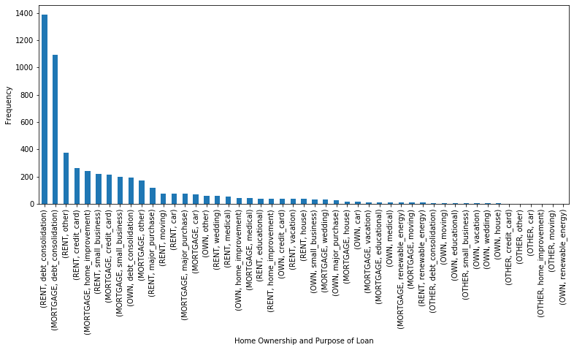
Results 3
According to graph, applicants who’s
home ownership is Mortgage
and purpose is debt consolidation
have high chance of being defaulter.

Slide 17
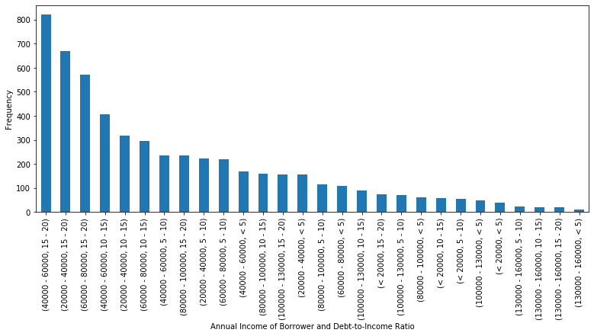
Results 4
According to graph, applicants who’s
annual income is 40000 to 60000
and debt to income ratio is 15-20
have high chance of being defaulter.

Slide 18
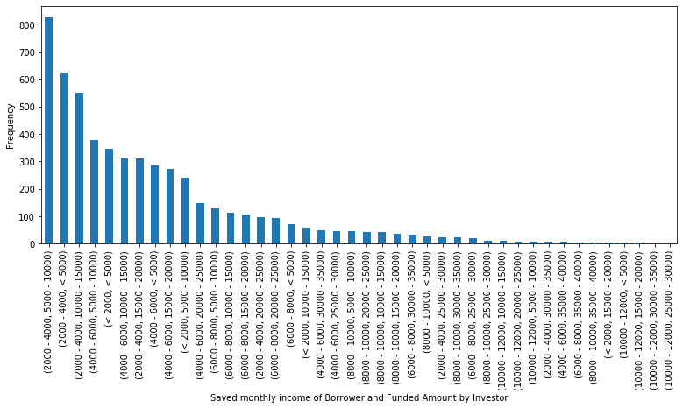
Results 5
According to above plot applicants who’s
saved monthly Income is 2000 to 4000
and investor's funded amount is 5000 to 10000
have high chance of being defaulter.

Slide 19
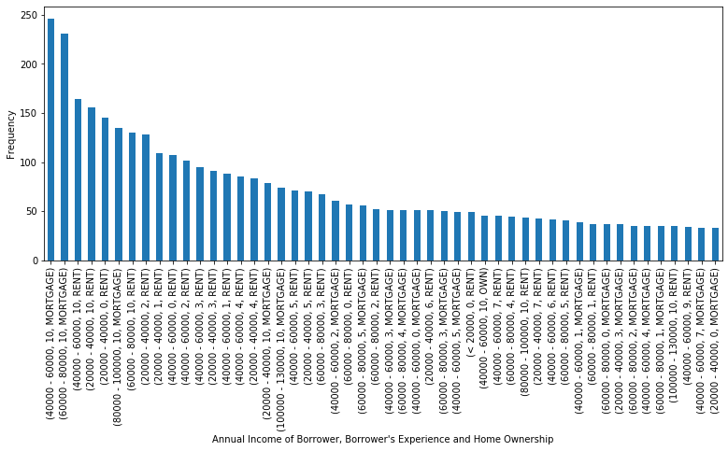
Results 6
According to graph, applicants who’s
annual income is 40000 to 80000,
years of experience is 10+
and home ownership is Mortgage
have high chance of being defaulter.

Slide 20
Recommendations
As per our analysis, following points recommended to Consumer Finance Company which can reduce the chances of funding a likely defaulter:
Company should not fund to borrowers who’ debt-to-income ratio is between 15-20 and purpose is debt consolidation
Company should not fund to borrowers who’s investor’s funded amount is less than 10000 and interest rate is 10 to 15
Company should not fund to borrowers who's home ownership is Rent or Mortgage and purpose is debt consolidation
Company should not fund to borrowers who’s annual income is 40000 to 60000 and debt-to-income ratio is 15-20
Company should not fund to borrowers who’s saved-monthly-income is 2000 to 4000 and investor's funded amount is 5000 to 10000.
Company should not fund to borrowers who’s annual income is 40000 to 80000, years of experience is 10+ and home ownership is Mortgage

