Slide 1
INVESTMENT ASSIGNMENT SUBMISSION
Name: Hanif Khan

Slide 2
<Abstract>
Analysis to identify best sectors, countries and suitable investment type for making the investment.
Spark Funds is an assent management company and they want to invest 5 to 15 million USD per round of investment in English-speaking countries where English is one of the official language in that country. Spark Funds wants to choose one of four investment types(venture, seed, angel, private equity) for each potential investment they will make.

Slide 3
<Problem solving methodology>
Identify Problem
Gather Data
Analyze Data
Compute Date
Select Solution

Slide 4
<Analysis>
Investment Type Analysis:
- Determined average of funding amount for each investment type "seed", "angel", "venture“ and "private_equity“
- Determined the investment type who's average funding amount is between 5 to 15 million USD

Slide 5
<Analysis>
Country Analysis:
Determined the sum of funding amount for each country for venture funding type
By sorting the funding amount, we found top nine countries with highest funding
By using following Wikipedia link and top nine countries of highest funding, we determined top three English countries with highest funding.

Slide 6
<Analysis>
Sector Analysis:
- By using mapping data and master data frame, we determined primary sectors and main sectors.
- Determined total number of investments (count)
- Determined total amount of investment (USD)
- Determined top sector (based on count of investments)
- Determined second-best sector (based on count of investments)
- Determined third-best sector (based on count of investments)
- Determined number of investments in the top sector
- Determined number of investments in the second-best sector
- Determined number of investments in the third-best sector

Slide 7
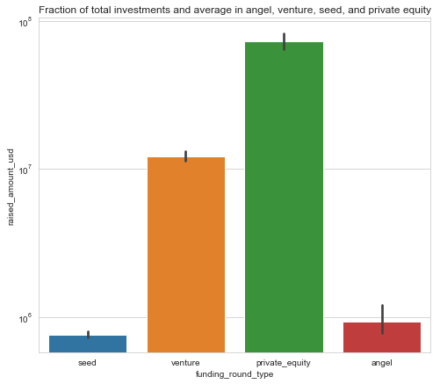
<Results>
Plot 1

Slide 8
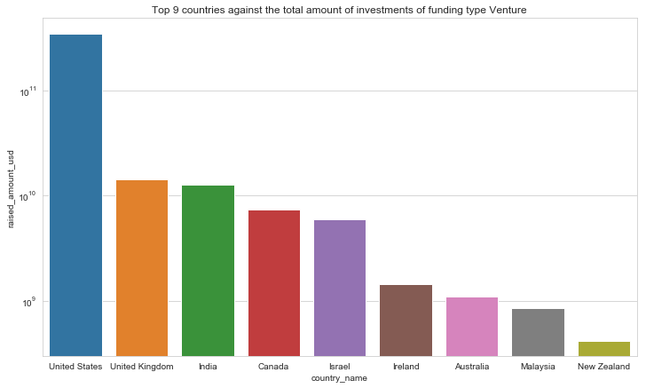
<Results>
Plot 2

Slide 9
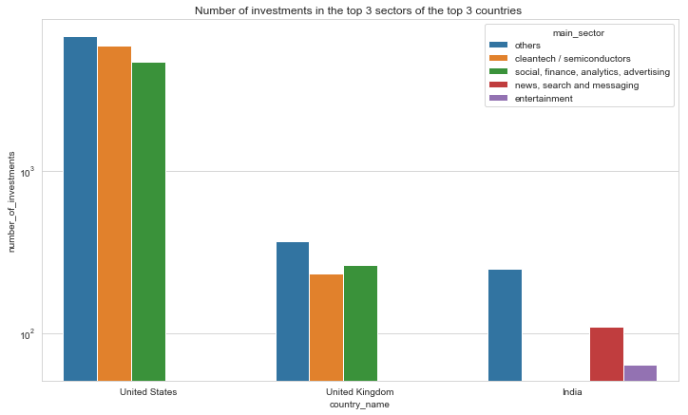
<Results>
Plot 3

Slide 10
<Conclusions>
Based on the analysis of the sectors
- United States is having highest number of Investments count, highest amount of total investment
- Others sector is having highest number of investment.
We would recommend Spark Funds to invest in Others sector and country United States.

