Slide 1
HKN Review Session
Midterm 1 CS/ECE 374 Spring 2021
By Teja Gupta
Inspired by Mahir Morshed and Nathan Bleir

Slide 2
Overview
Different variations of Strings and Induction
Regular Languages/Expressions
DFAs/NFAs
Closure Properties
Fooling Sets

Slide 3
Regular Languages
One of the following (where A and B are both regular languages):
∅
w (a string)
A*
A ∪ B
AB
A ∩ B
A - B
A ^{R}

Slide 4
DFAs
Deterministic Finite Automatas (DFA’s) Formal Definition Includes:
Accepts a language L iff it accepts all strings in L and rejects all strings not in L
Σ The finite alphabet which is used to construct strings in the language
Q The set of states in the DFA [visually represented by circles]
s [∈ Q] The single start state [visually represented by source-less arrow to state]
A [⊆ Q] The set of accepting states in
δ The transitions between states depending on your next input [visually represented by arrows between states]

Slide 5
NFAs
Formal definition same as DFA, only now with ε-transitions as well
Look at set of states instead of single state
String needs one accept state to be accepted
Accepts a language L iff it accepts all strings in L and rejects all strings not in L
Recall: DFA ⇒ NFA ⇒ Regex ⇒ DFA
○ Nice way to prove regular languages
Regex to NFA: Thompson’s Algorithm

Slide 6
NFA Cont.
A DFA accepts the same language as an NFA if every possible set of states in an NFA is itself a state in the DFA
An NFA with Q states has an equivalent DFA with at most 2^{Q} states
A DFA can accept any language that an NFA can!
NFAs are a nice way to prove a function of a language is regular.

Slide 7
Fooling Sets
A fooling set F is a set of strings that are all distinguishable with respect to a given language.
Suppose you take a pair of strings x,y from F. There is some w such that xw ∈ L and yw ∉ L.
This means no pair x,y ∈ F reaches the same state in a DFA. The DFA must have at least |F| states.
What if F is infinite? This means it is impossible to build a DFA that accepts L. L is not regular.

Slide 8
Context-Free Grammars
Σ The set of terminal symbols [usually all lowercase]
Γ The set of non-terminal symbols [usually all capitals]
R The set of production rules [usually of form → {}]
S ∈ R The single start state
Closed under: union, kleene star, concatenation
Not closed under complementation and intersection
More inclusive than regular languages

Slide 9
Advice
Something is better than nothing
Go easiest to hardest
Reread questions
Do as many practice problems as you can
THIS CLASS IS CURVED!!!
Cheating won’t help

Slide 10
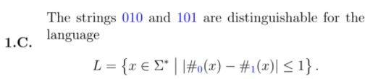

Slide 11
True

Slide 12


Slide 13
False

Slide 14


Slide 15
True

Slide 17
False

Slide 18
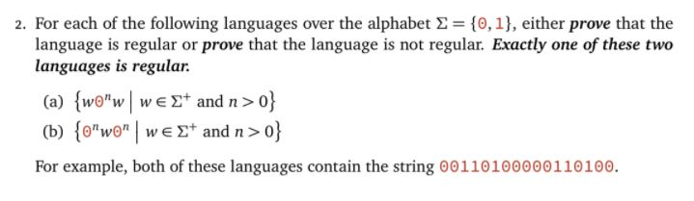
Midterm 1 Fall 2016 version B

Slide 19
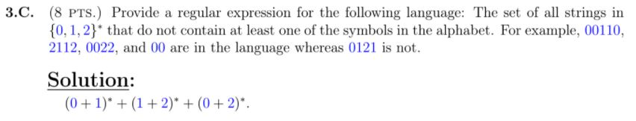

Slide 21
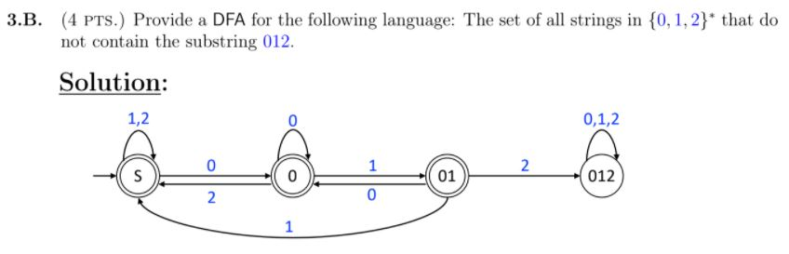
Midterm 1 Spring 2019

Slide 23
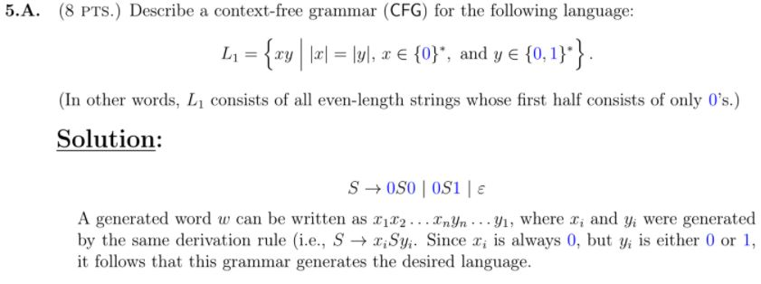

Slide 25
