Slide 1
HKN ECE 342 Review Session 1
Anthony Li
Keshav Harisrikanth

Slide 2
KVL/KCL
Sum of all voltages in a loop is 0
Sum of current entering a node equals sum of current exiting a node

Slide 3

Incremental/Small Signal Model
Can be numerically derived from Taylor Series approximation (up to first-order term)
Taylor Series: $y = f(x0) + f’(x0)(x − x0) + \frac{f’’(x0)(x−x0)2}{2} + …$

Slide 4
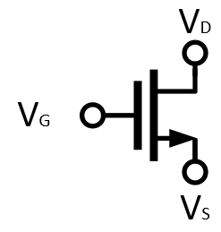
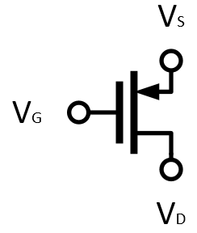
MOSFET’s
NMOS
PMOS

Slide 5
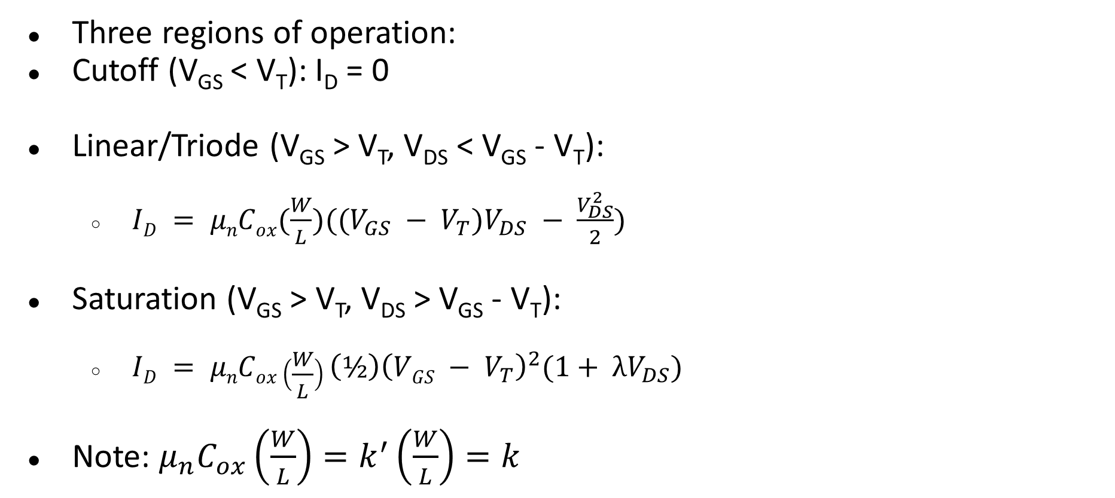
MOSFET Operating Point
Three regions of operation:
Cutoff (V_{GS} < V_{T}): I_{D} = 0
Linear/Triode (V_{GS} > V_{T}, V_{DS} < V_{GS} - V_{T}):
$ID = μnCox(\frac{W}{L})((V_{GS} − V_{T})V_{DS} − \frac{V_{DS}^{2}}{2})$
Saturation (V_{GS} > V_{T}, V_{DS} > V_{GS} - V_{T}):
$ID = μnCox\left(\frac{W}{L}\right){\left(½\right)\left(VGS − V_{T}\right)}^{2}(1+ λV_{DS})$
Note: $μ_{n}C_{ox}\left(\frac{W}{L}\right)=k^{′}\left(\frac{W}{L}\right)=k$

Slide 6
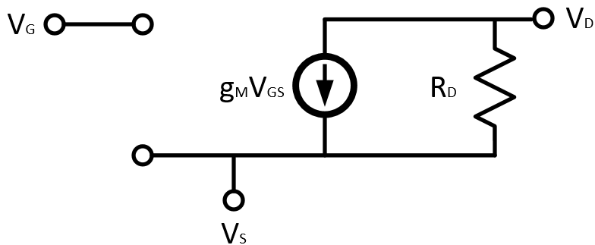

MOSFET Incremental Model
Transconductance: $g_{m}=\frac{2I_{D}}{V_{OV}}$

Slide 7
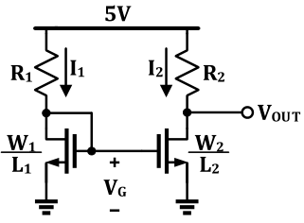

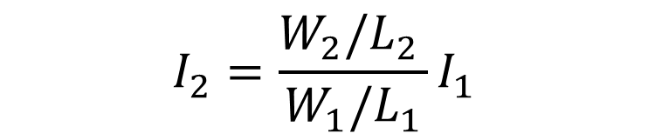
Current Mirrors
Transistors sharing the same $V_{OV}$ “mirror” current – just a ratio of transistor sizing.
$$I_{2}=\frac{W_{2}/L_{2 }}{W_{1}/L_{1}}I_{1}$$
Notes:
Minghao

Slide 8
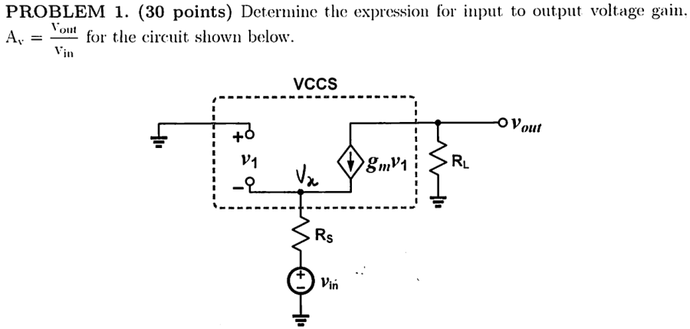
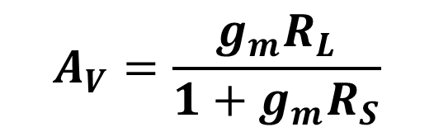
Problem 1 – Sp16 Midterm 1
$$A_{V}=\frac{g_{m}R_{L}}{1+g_{m}R_{S}}$$
Notes:
Milan

Slide 9
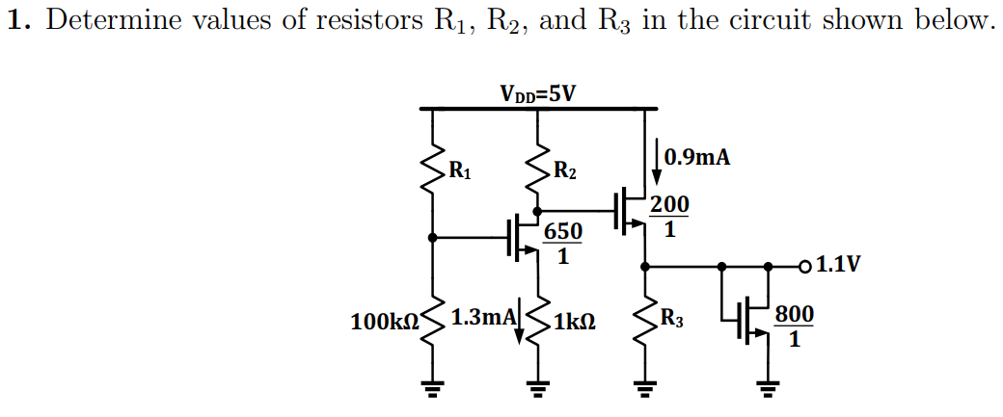
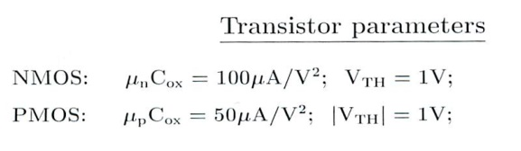

Problem 2
$$R_{1}=100 kΩ$$
$$R_{2}=2 kΩ$$
$$R_{3}=2.2 kΩ$$
Notes:
Minghao

Slide 10
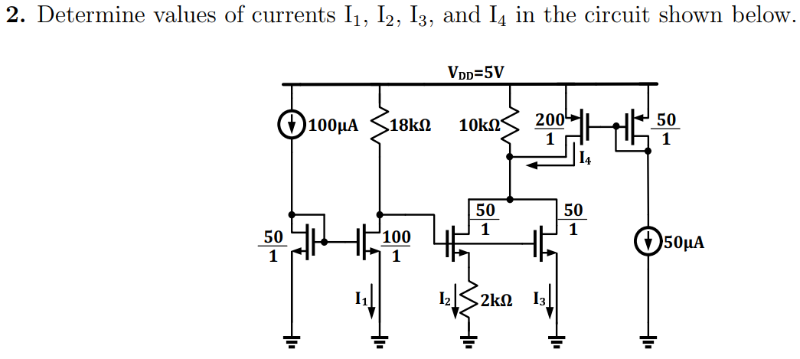

Problem 3
$$I_{1}=200 μA$$
$$I_{2}=100 μA$$
$$I_{3}=400 μA$$
$$I_{4}=200 μA$$
Notes:
Minghao

Slide 11
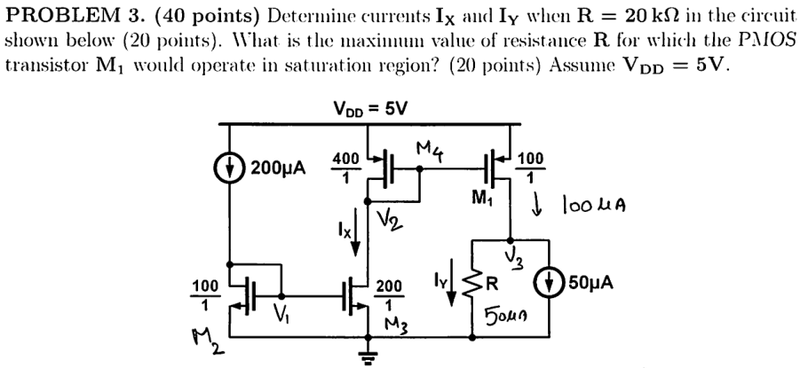

Problem 4 – Sp16 Midterm 1
$$I_{X}=400 μA$$
$$I_{Y}=50 μA$$
$$R_{max}=96 kΩ$$
Notes:
Milan

Slide 12
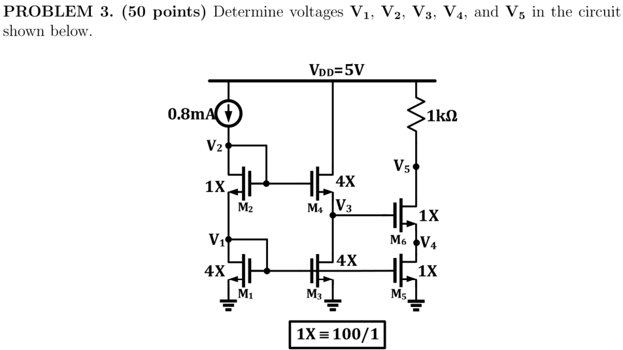

Problem 5 – Fa16 Midterm 1
$$V_{1}=1.2 V$$
$$V_{2}=2.6 V$$
$$V_{3}=1.4 V$$
$$V_{4}=0.2 V$$
$$V_{5}=4.8 V$$
Notes:
Anthony

Slide 13
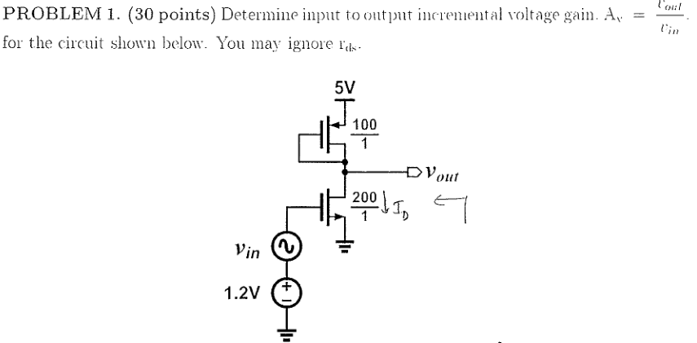
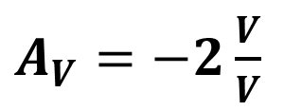
Problem 6 – Sp16 Midterm 2
$A_{V}=−2\frac{V}{V}$
Notes:
Anthony

Slide 14
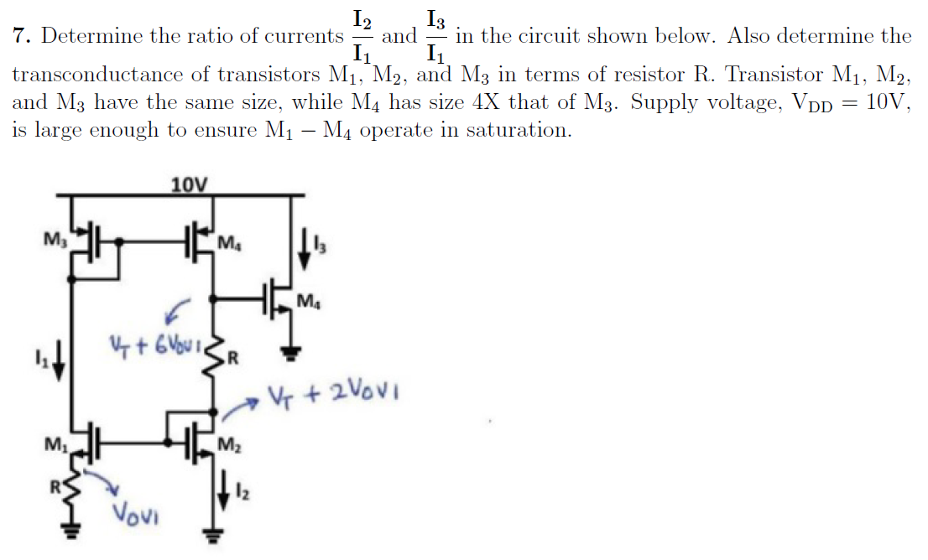
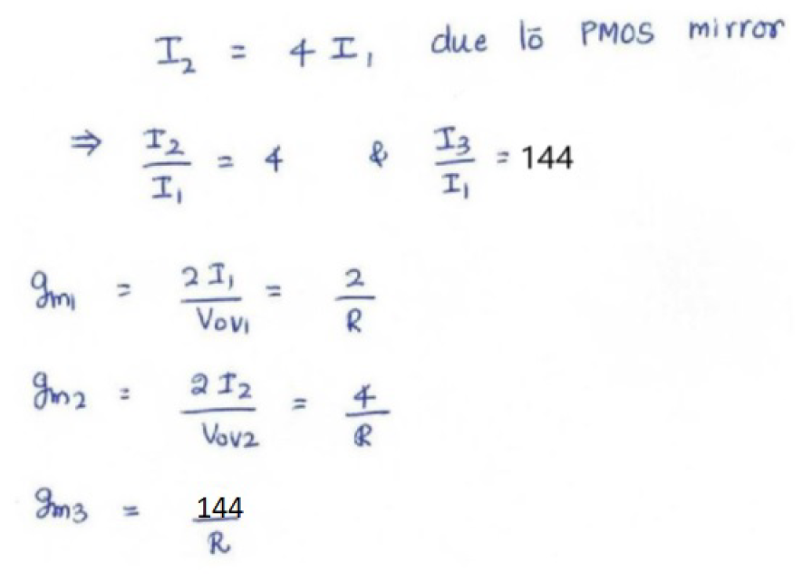
Problem 7 – HW 3

