Slide 1
ECE 120 Midterm 2
HKN Review Session

Slide 2
Overview of Review
CMOS logic, Boolean expressions, Boolean Algebra
K-maps, SOP, POS
2-level networks
Adders, ALUs, and Bit Slice Design
Multiplexers, Decoders
Flip-Flops and Latches (S-R & D)
FSM Design, Moore Machines
Practice Exams! (The not so secret sauce in success)

Slide 3
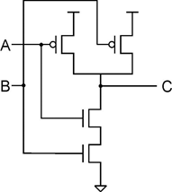
CMOS logic
Metal Oxide Semiconductor Field Effect Transistors (MOSFET)
N-type: pull-down, voltage applied (1) means it conducts, voltage absent (0) means it is off
P-type: pull-up, voltage applied (1) means it is off, voltage absent (0) means it is on
Complementary layout
Prevents floating / short-circuited outputs
Requires p-type on top (connected to V_{dd}), requires that the top is the dual of the bottom
NAND Gate

Slide 4
Boolean Expressions and Algebra
 | * indicates AND | + indicates OR
identity | 1 * A = A | 0 + A = A
null | 0 * A = 0 | 1 + A = 1
idempotence | A * A = A | A + A = A
complementarity | A * A’ = 0 | A + A’ = 1
DEMORGAN | (A + B)’ = A’B’ | (AB)’ = A’ + B’
involution | (x’)’ = x
Distribution | (A + B)C = AC + BC | AB + C = (A + C)(B + C)
Consensus | (A + B)(A’ + C)(B + C) = (A + B)(A’ + C) | AB + A’C + BC = AB + A’C

Slide 5
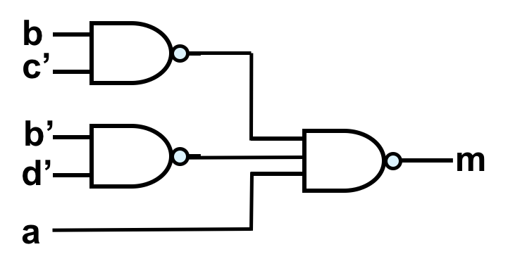
Duality Principle, Ex. Demorgan’s Law
Duality: swap 1’s and 0’s, swap AND’s and OR’s, maintain precedence using parentheses
Complement: find dual, complement each variable
m(a,b,c,d) = a’ + bc’ + b’d’
Dual: n(a,b,c,d) = a’(b+c’)(b’+d’)
m’(a,b,c,d) = (a’ + bc’ + b’d’)’
m’(a,b,c,d) = a(bc’)’(b’d’)’

Slide 6
Logical Equivalence
2 ways to prove that two boolean functions are equivalent
Use truth tables: if they have the same output over all input combinations then they are logically equivalent
Use boolean algebra properties to show equality.
Let’s prove deMorgan’s law:
(A + B)’: So, we can see in this truth table that (A+B)’ is logically equivalent to A’B’. QED.
A | B | (A+B)’ | A’B’
0 | 0 | 1 | 1
0 | 1 | 0 | 0
1 | 0 | 0 | 0
1 | 1 | 0 | 0

Slide 7
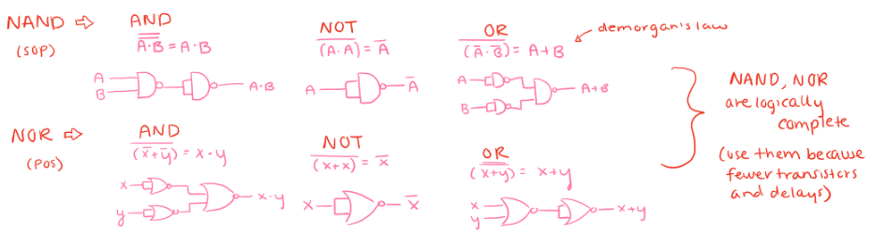
Logical Completeness
A set of gates is said to be logically complete if it can implement any boolean expression with exclusively those set of gates.
For example, NAND and NOR are individually logically complete as well as AND, OR, and NOT together.
How?
What about NOT? Is NOT logically complete?

Slide 8
K(arnaugh)-maps
A way to represent the outputs of a logical design with respect to its inputs
Should arrange inputs along row and columns in gray code order.
00 01 11 10
Should be able to form whether asked to from a circuit, problem statement, or a design goal.
Can accommodate up to 4 inputs, more requires more than a 2d representation.
Simple example for a 3-input AND, f(A,B,C):
A, BC-> | 00 | 01 | 11 | 10
0 | 0 | 0 | 0 | 0
1 | 0 | 0 | 1 | 0

Slide 9
SOP, POS
SOP- Sum of Products
A group of products (ANDs) which are being summed (OR’d).
Example: f(A,B) = AB’+A’B (XOR)
AB’ and A’B are the products, which are summed.
POS- Product of Sums
A group of sums (ORs) which are being multiplied (AND’d).
Example: f(A,B) = (A+B)(A’+B’) (Still XOR)
(A+B) and (A’+B’) are the sums, which are AND’d.

Slide 10
Minimal vs. Canonical
A | B | C | F
0 | 0 | 0 | 0
0 | 0 | 1 | 0
0 | 1 | 0 | 0
0 | 1 | 1 | 1
1 | 0 | 0 | 1
1 | 0 | 1 | 1
1 | 1 | 0 | 1
1 | 1 | 1 | 1
Minimal - Listing terms as efficiently as possible (no redundancy)
Can find through the bubbling method on kmaps.
Example: f(A,B,C) = A+BC
Canonical - Listing every term of the function with every input.
Can find through writing out a truth table.
Canonical SOP: A listing of every set that makes the function return true (OR’d)
Example for above f: f(A,B,C) = ABC+ABC’+AB’C+AB’C’+A’BC
Canonical POS: A listing of every set that makes the function return false
Example for above: f(A,B,C) = (A+B+C)(A+B+C’)(A+B’+C)

Slide 11
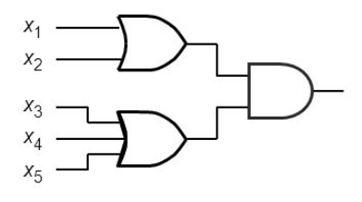
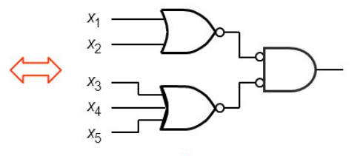
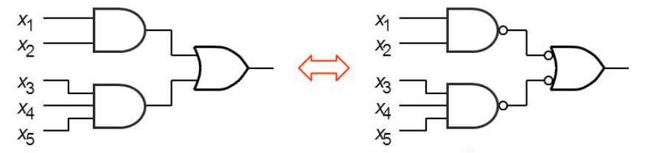
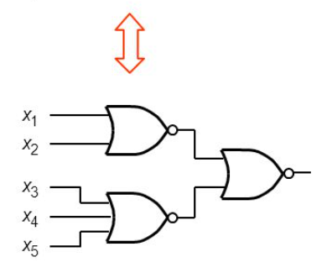
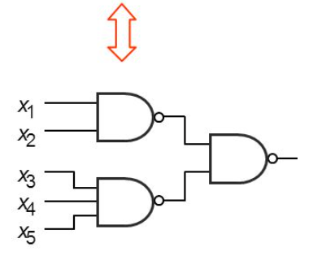
Converting SOP/POS to 2-level NAND or NOR
Any 2 level POS or SOP circuit can be converted quickly to a NOR-NOR or NAND-NAND implementation.
POS
SOP
Change the final AND gate to a NOR with NOT’d Inputs
Change the final OR gate to a NAND with NOT’d Inputs

Slide 12
Optimized Boolean Expressions
When trying to find the Boolean expression for the outputs of a function
consider both the POS and SOP forms
Check which of these minimizes the total number of gates
Prime implicants
The largest grouping of 1’s not fully contained by another grouping of 1’s (with power of 2 dimensions, ie. 2,4,8)
Uniqueness
Look for other prime implicants of equal size that are not currently being used in your minimal expression
If you can write another function with the same number of terms, then it is not unique
Don’t Cares
Symbol: X, used if the output can be a 0 or a 1
Can be included in any kmap circling
Important for making simplified SOP/POS (allows larger implicants)

Slide 13
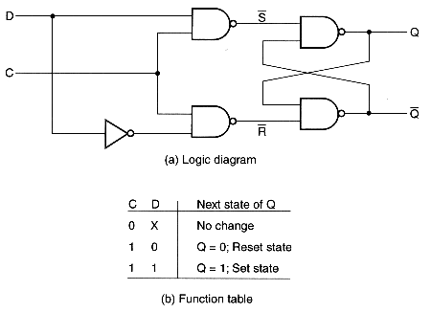
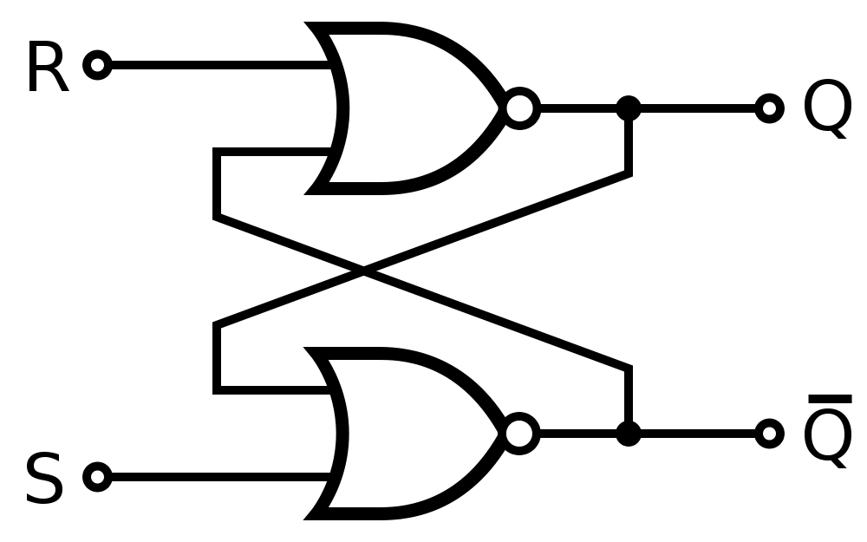
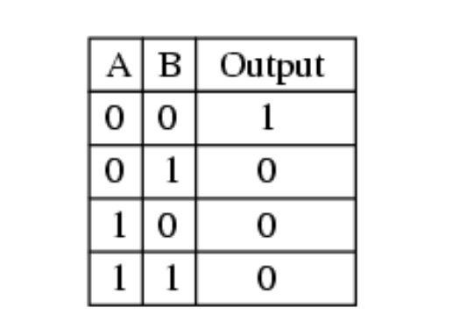
Latches (S-R & D)
This SR latch above is active High for S (set) and R (reset)
functionality. This SR latch is made from 8 transistors C is the enable bit for this D - Latch
This D - latch is made from 18 transistors
R | S | Q⁺
0 | 0 | Q
0 | 1 | 1
1 | 0 | 0
1 | 1 | Invalid
Nor Truth Table

Slide 14
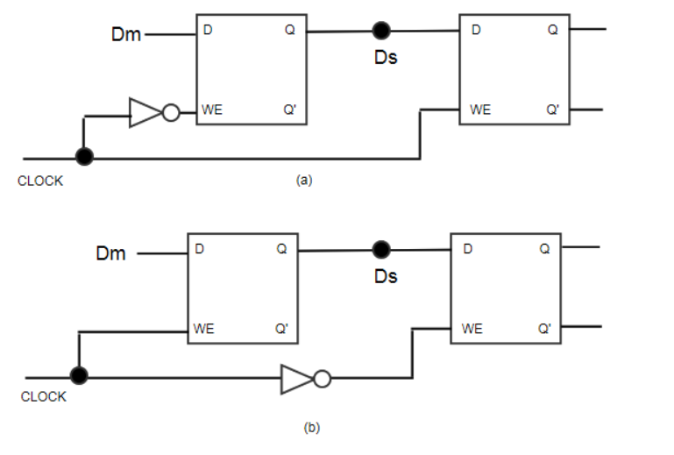
How to build Flip-Flops from latches
Rising edge triggered flip flop on top, Falling edge triggered flip flop on the bottom.
Looking at the top picture we have a rising edge triggered flip flop. How?
When the clock is 0, master latch is write enabled, slave latch is write disabled. This way once the edge rises, the master latch becomes write disabled storing/holding the value of the input Dm from right before the rising edge. The WE of the slave (second) latch goes high allowing the value stored in the master to be written to and stored into the slave latch.

Slide 15
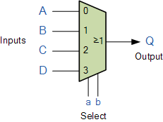
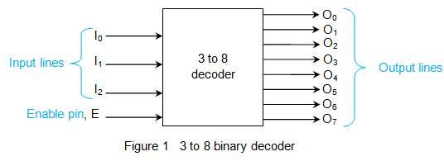
Multiplexers and Decoders
Multiplexers:
n select bits
2^{n} input options
1 output
Decoders:
1 enable bit
n select bits
(input lines specify which output to raise)
2^{n} possible outputs (one high at a time)

Slide 16
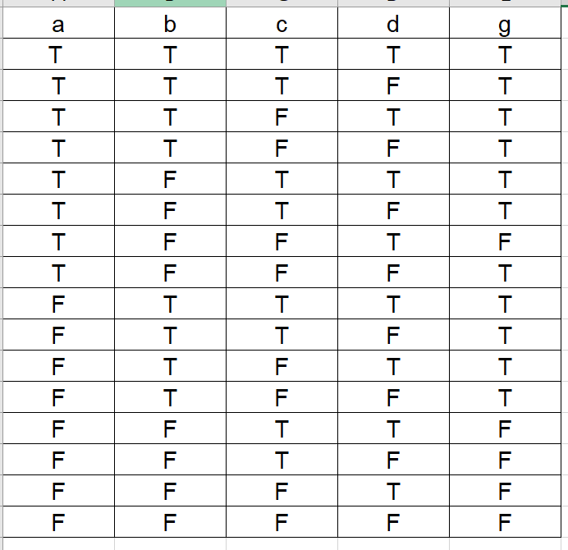
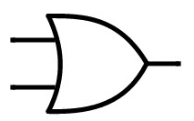
Multiplexers and Decoders
Implement g(a,b,c,d)=ab+a’b+ab’c+ab’c’d’ using a 4:1 MUX and no more than one extra gate.
A/B/0
B/1
C
~D
A/B/1
A B

Slide 17
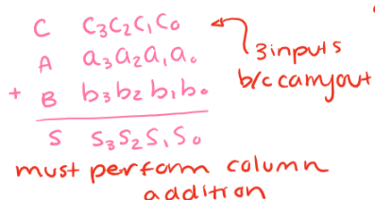
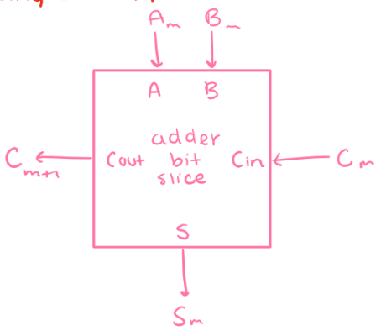
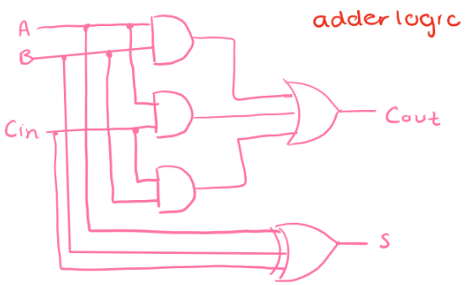
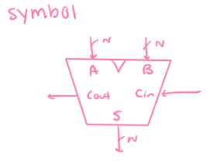
Adders and Bit Slice Design
Bit Slice Adder Circuit: broken down into repeated operations on individual bits, this design extends to any # of bits bc slices pass information between them

Slide 18
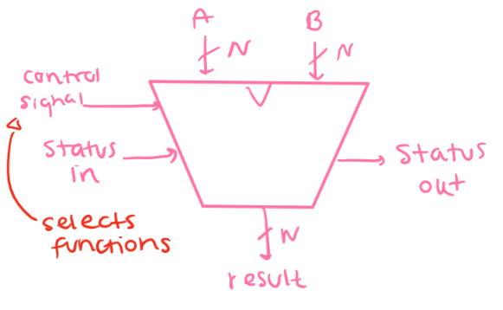
ALUs
Combinational logic circuit that performs arithmetic & logic operations on integers

Slide 19
Practice Questions

Slide 20
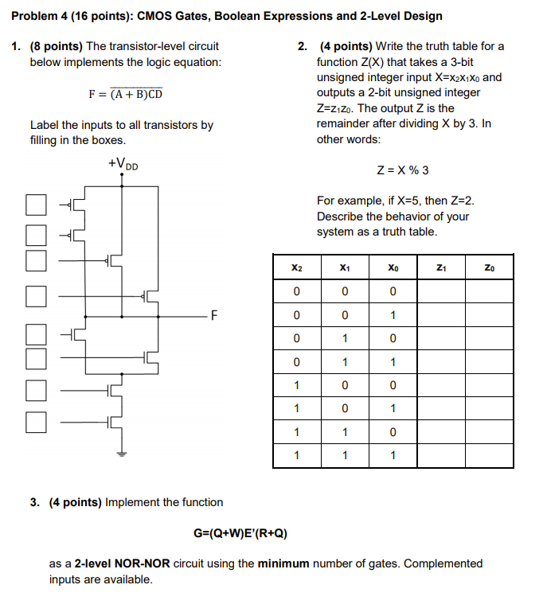
Problem 4, Spring 2017

Slide 21
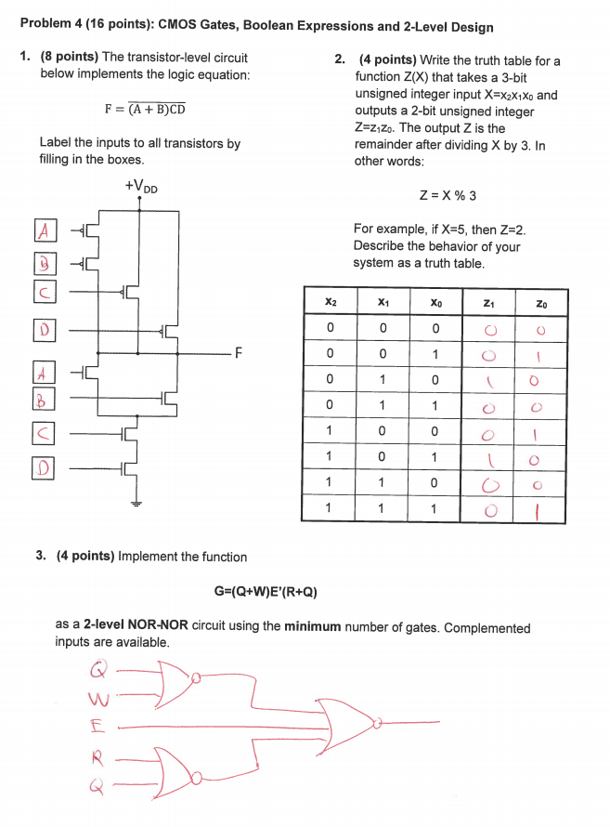
Problem 4, Spring 2017

Slide 22
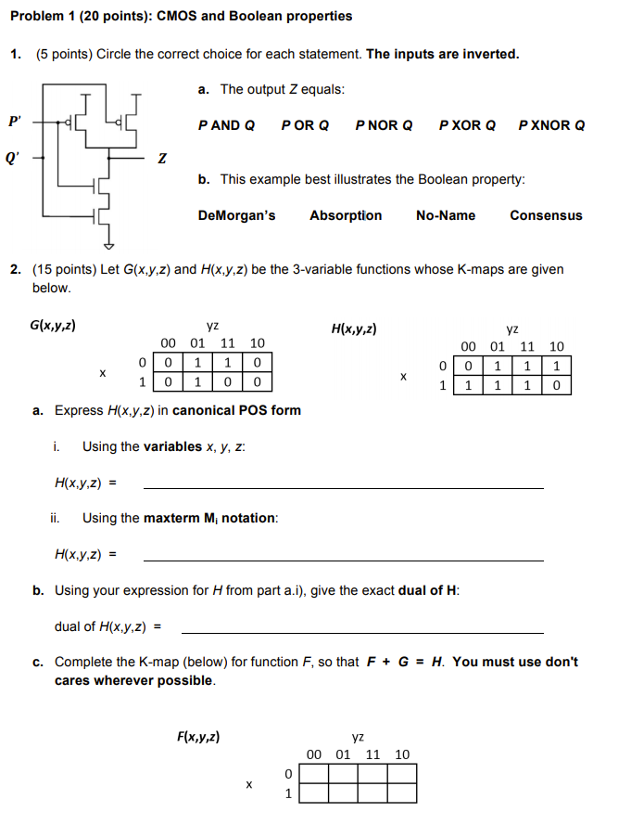
Problem 1, Spring 2016

Slide 23
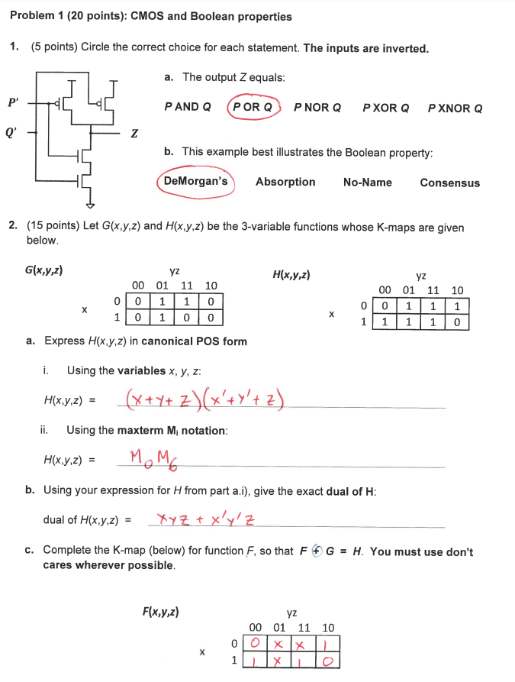
Problem 1, Spring 2016

Slide 24
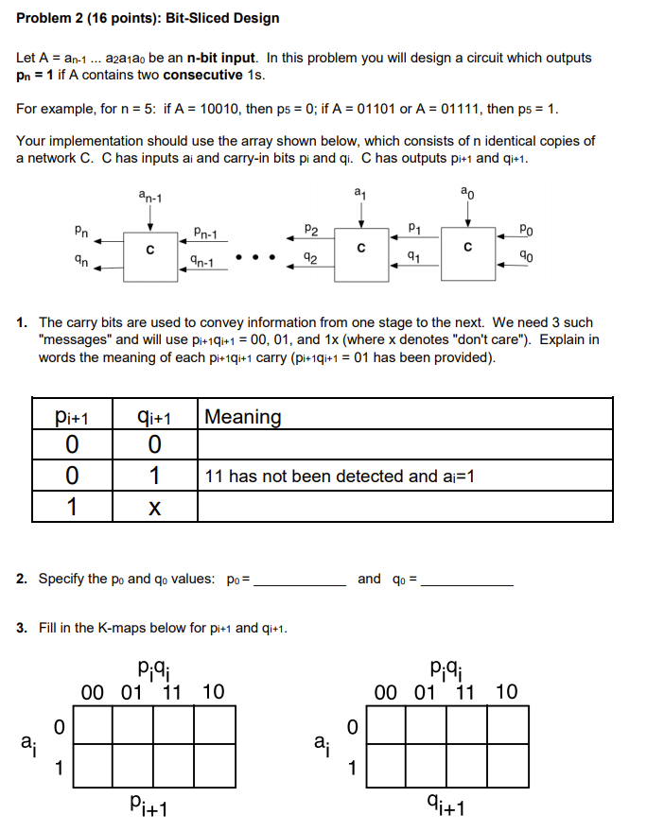
Problem 2, Spring 2017

Slide 25
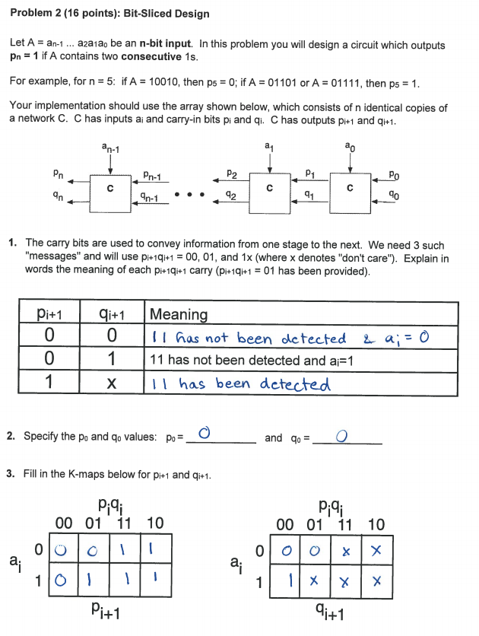
Problem 2, Spring 2017

Slide 26
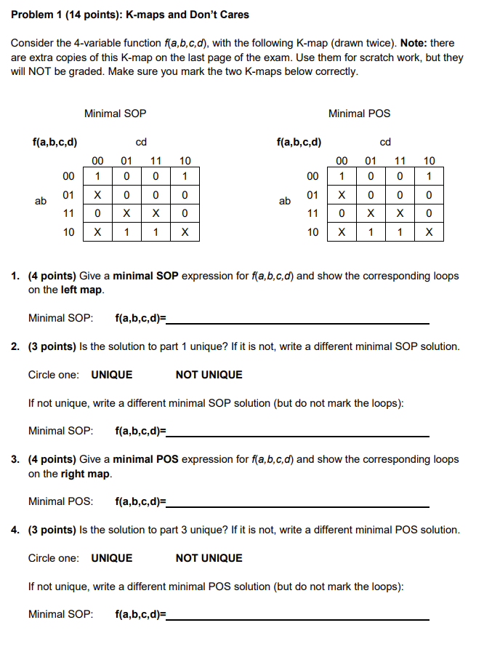
Problem 1, Fall 2016

Slide 27
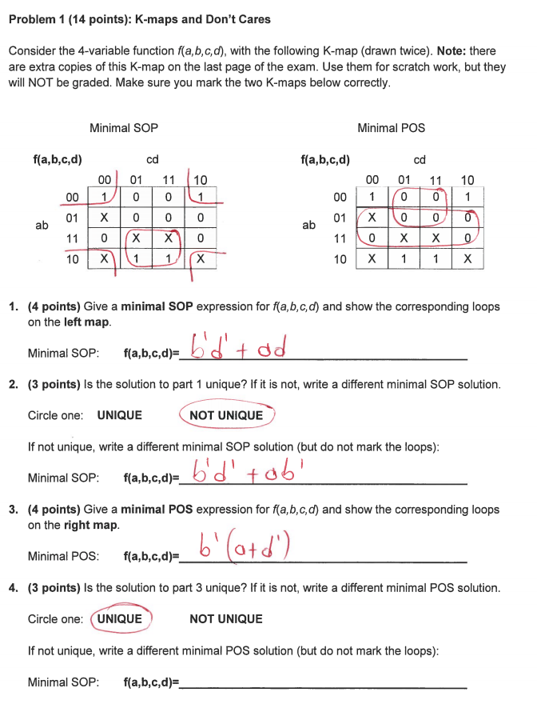
Problem 1, Fall 2016

Slide 28
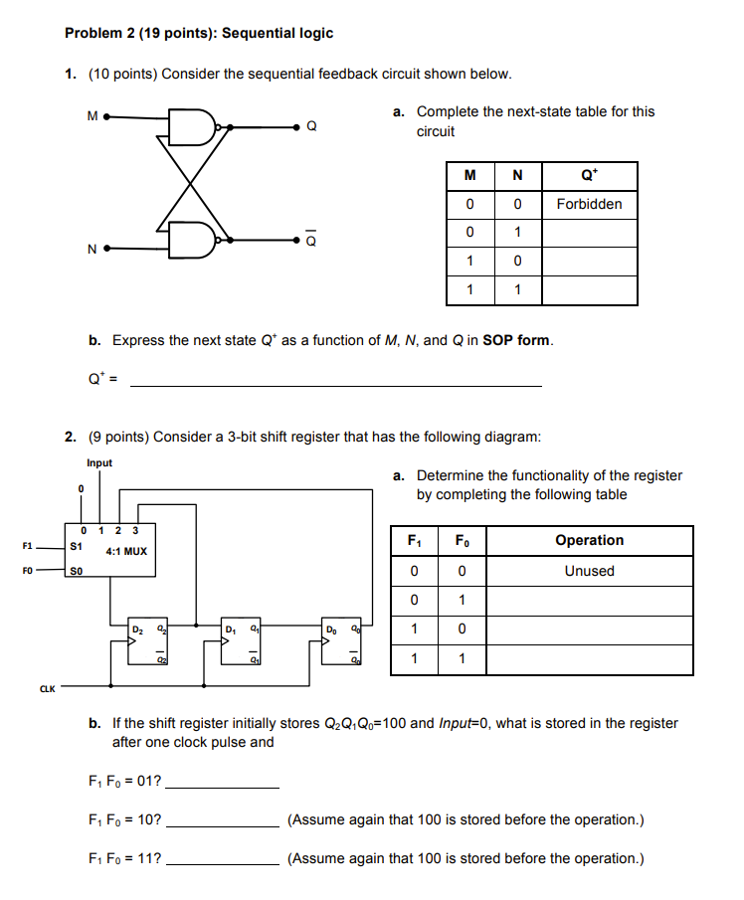
Problem 2, Spring 2016

Slide 29
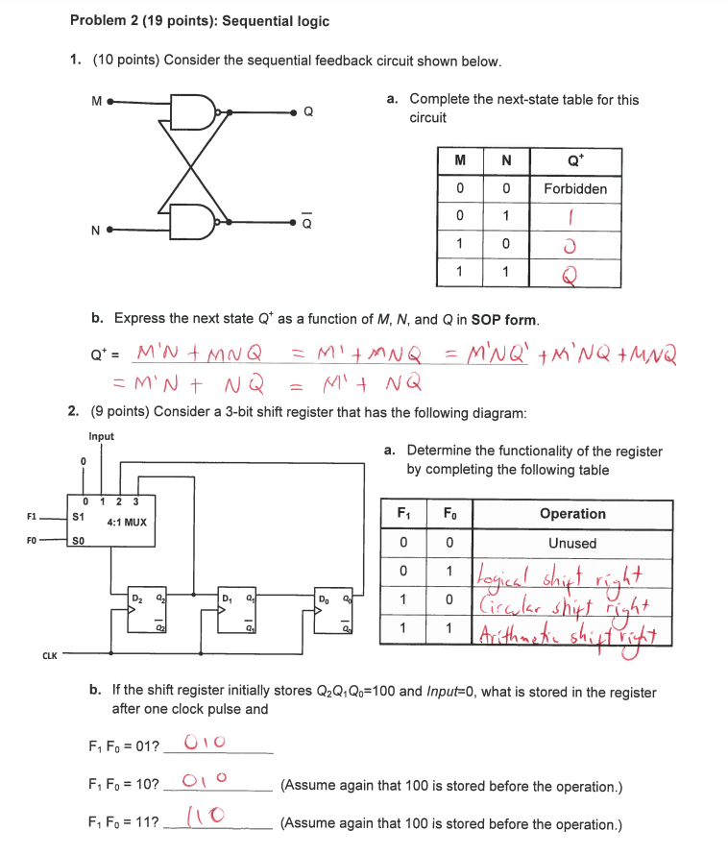
Problem 2, Spring 2016

Slide 30
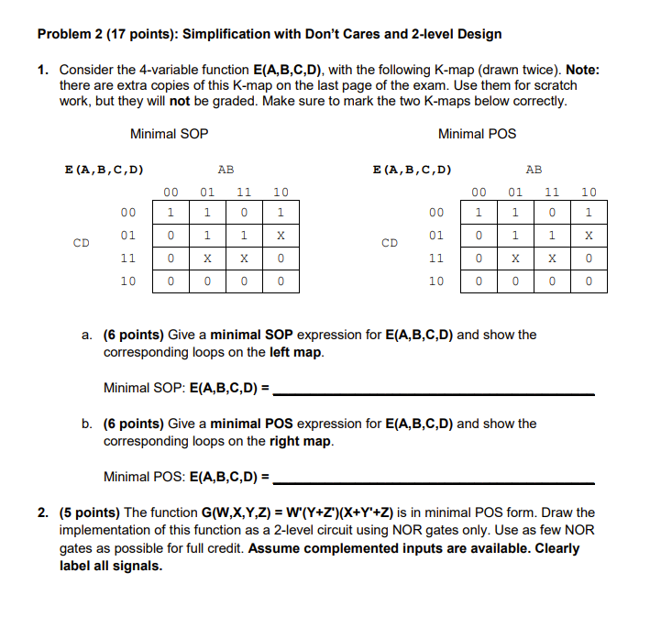
Problem 2, Fall 2017

Slide 31
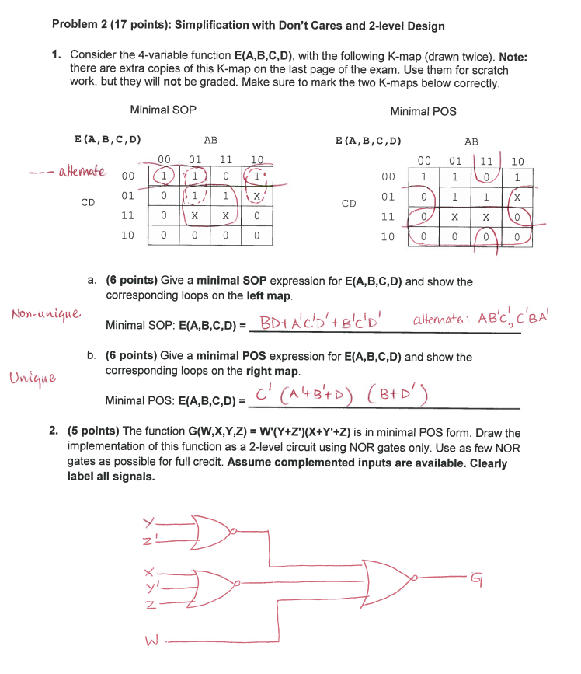
Problem 2, Fall 2017

Slide 32
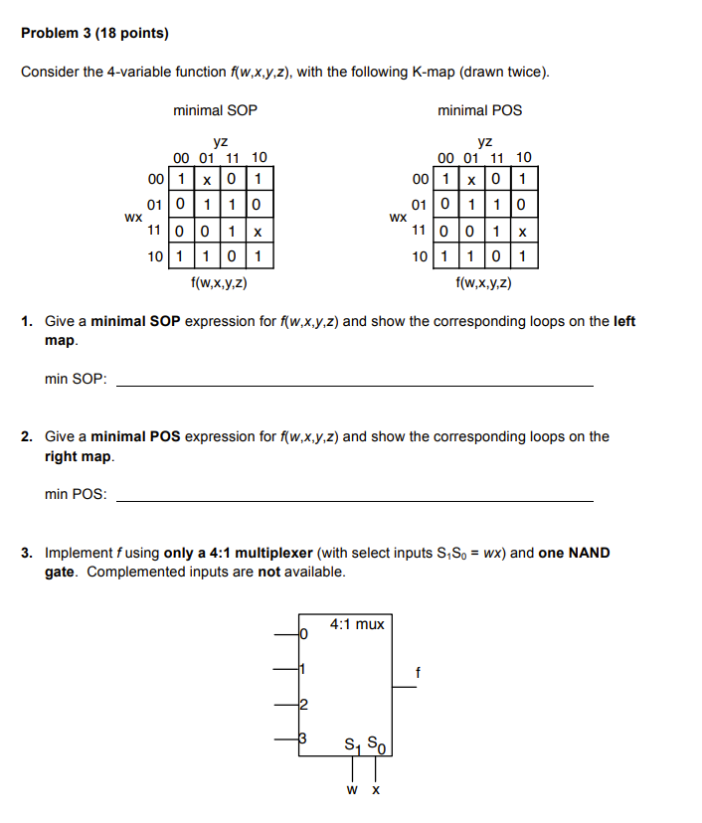
Problem 3, Spring 2016

Slide 33
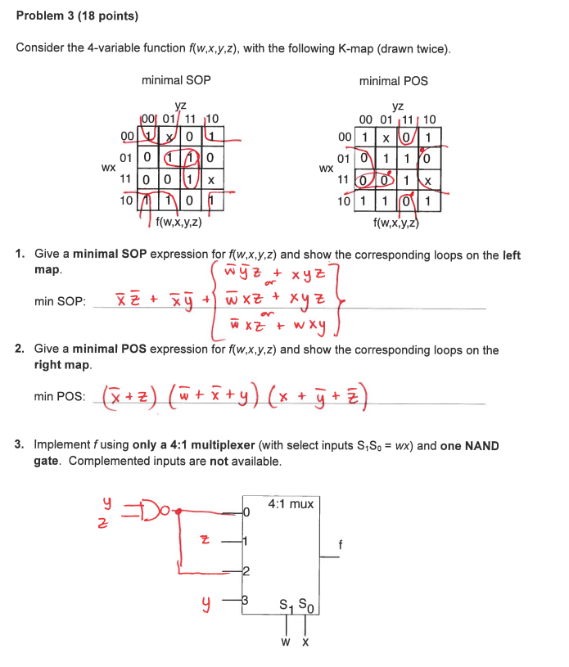
Problem 3, Spring 2016

Slide 34
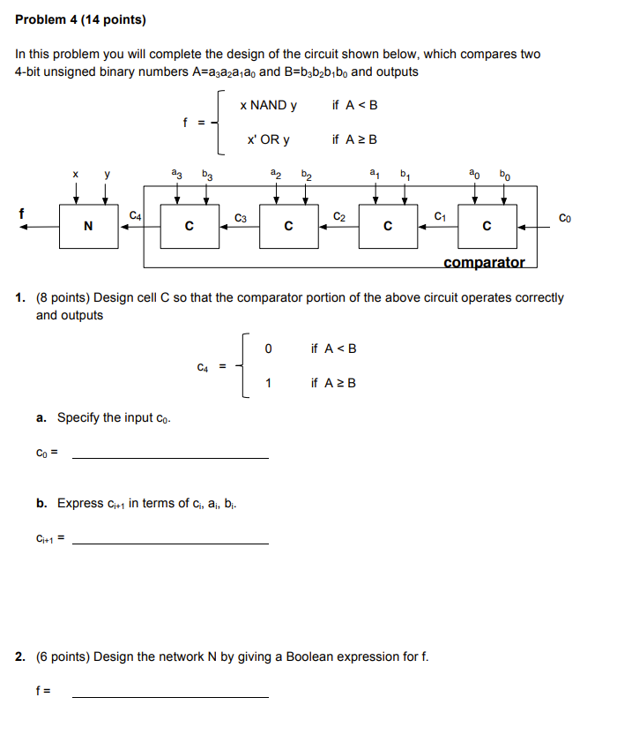
Problem 4, Spring 2016

Slide 35
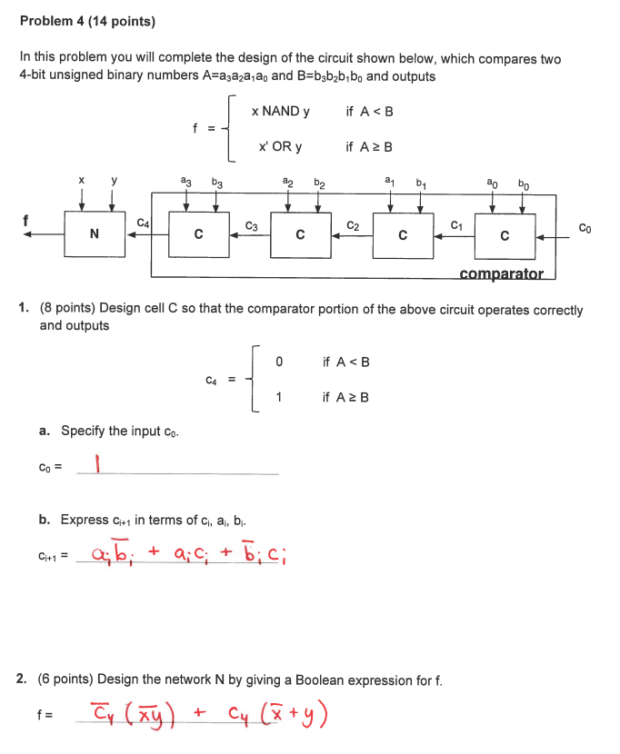
Problem 4, Spring 2016

Slide 36
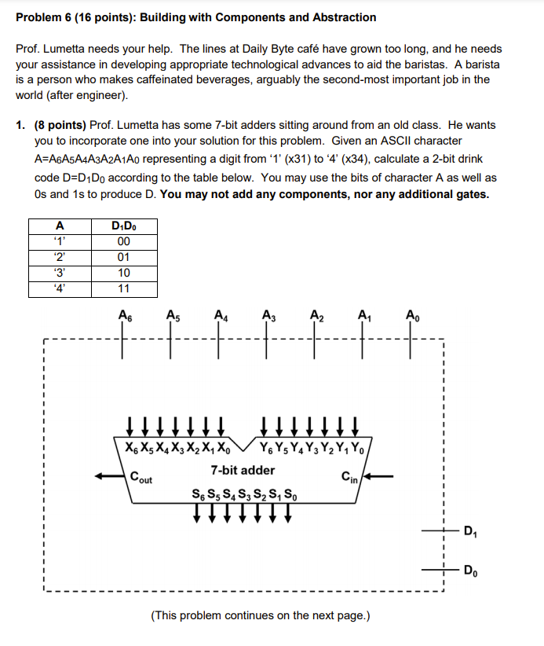
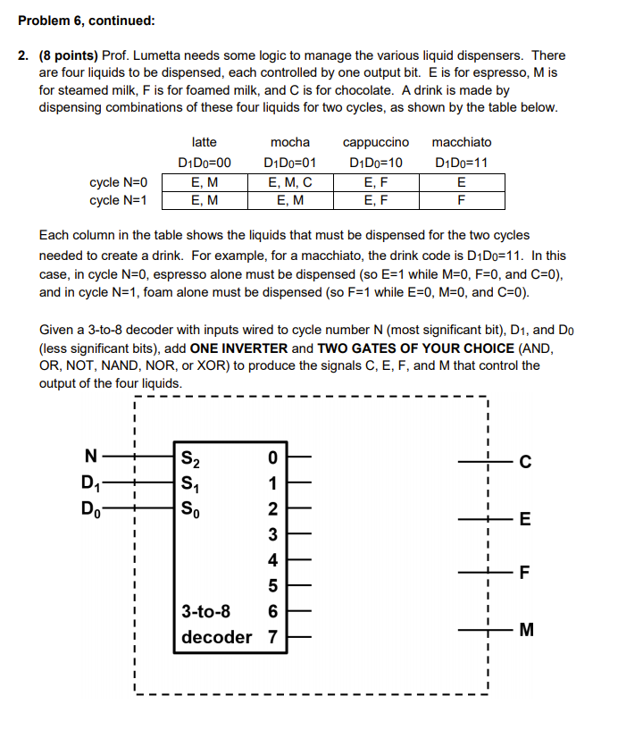

Slide 37
