Slide 1
ECE 220 Midterm 2
HKN Review Session
Presented by: Prannav Gupta, Michelle Zhang, Edric Lin, Panav Munshi
Slides will be posted on hkn.illinois.edu/service

Slide 2
HKN: Who are we?
Review sessions for most required ECE and PHYS courses
Tutoring available for a variety of classes (including 220!)
Lots of other events like Resume Reviews, Tech Electives fair, etc
https://hkn.illinois.edu/service
List of previous review session slides
Names of tutors you can email

Slide 3
Topics (Lectures 7-17)
Basic C - data types, operators, scope, storage, functions, I/O
Run-time Stack
Pointers & Arrays
C -> LC-3
Recursion & Backtracking
Sorting
Structs, Typedef, & Union
File I/O
Notes:
Liz:
-Runtime stack
-C->LC3
Ritesh:
-Basic C
Anna:
-Pointers and arrays
- Sorting
Daksh:
-Recursion
-Structs/typedef/union
-File I/O

Slide 4

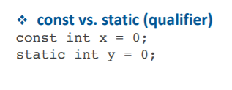
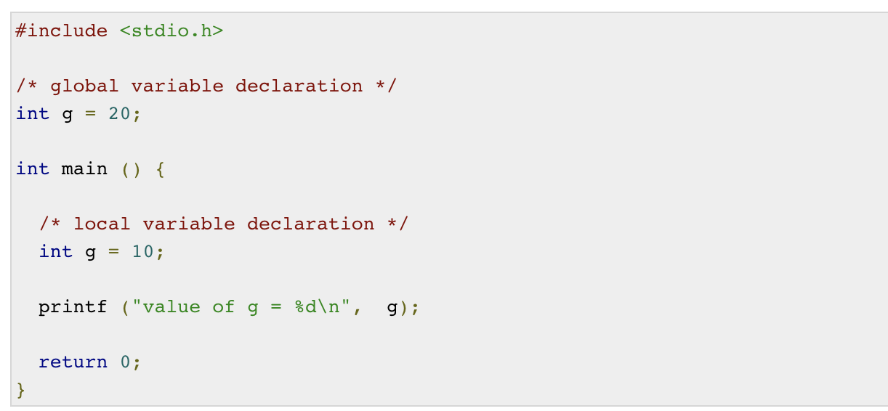
Basics of C
Scope: local vs global
Storage class: static vs automatic
Pre vs post decrement
Conditional and iterative constructs
Nested loops

Slide 5
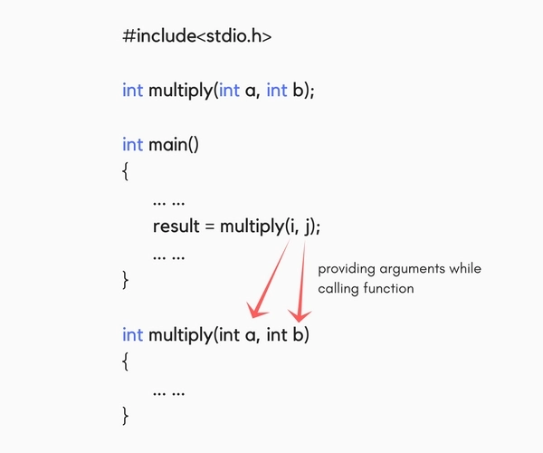
Functions in C
Function prototype
Function call
Function definition
Why use functions?
Provides abstraction
Reusable
Hides low-level details

Slide 6
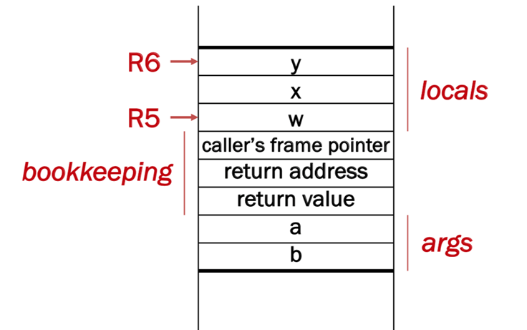
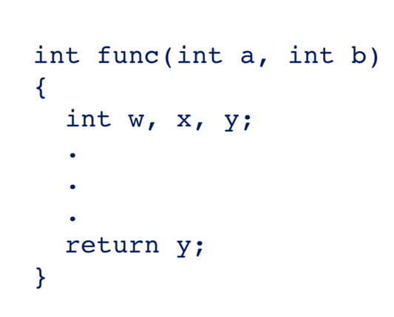
Run Time Stack
R5 – Frame Pointer
It points to the beginning of a region of activation record that stores local variables for the current function.
R6 – Stack Pointer
It points to the top most occupied location on the stack.
R7 - Return Address
It stores the address
Arguments are pushed to the stack RIGHT TO LEFT
Local variables are pushed to the stack in the order declared

Slide 7
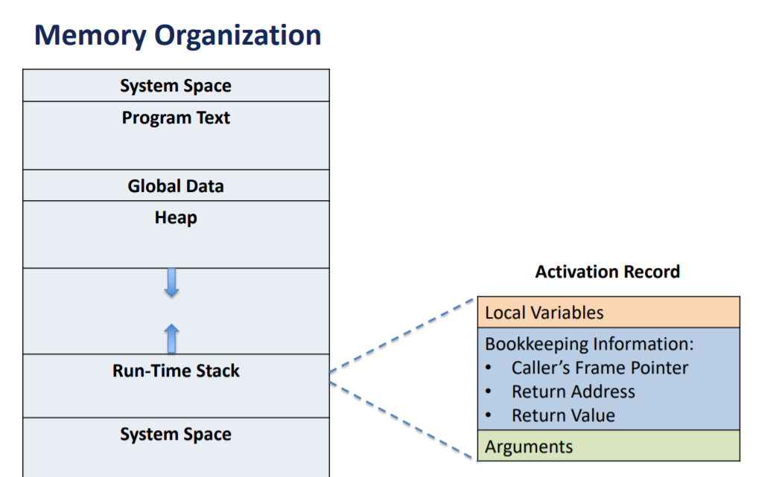

Slide 8
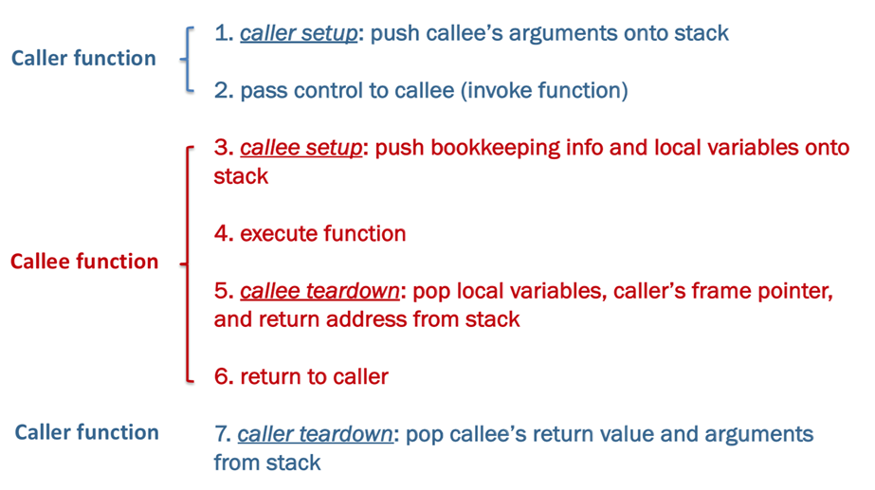

Slide 9
Callee Setup
ADD R6, R6, #-3 ;Allocate space for linkage
STR R5, R6, #0 ;Save old value of R5
ADD R5, R6, #-1 ;Set R5 to new frame base
STR R7, R5, #2 ;Save return address

Slide 10
Callee Teardown
ADD R6, R5, #3 ;Have R6 point to return space (3 below R5)
STR R0, R6, #0 ;Push return value into return spot (If R0 has value)
LDR R5, R6, #-2 ;Push old stack frame back into R5
LDR R7, R6, #-1 ;Load old return address back into R7

Slide 11
Pointers
Address of a variable in memory, can be used to access of variables
Value is an LC3 address (x3000, xCAFE) or NULL
Declaration: type *ptr; (type* ptr;)
Dereference Operator: *
Returns the data that the pointer points to
Address Of Operator: &
Returns the address in memory of the object applied on
Shorthand Dereference & access operator: ->
pointer->member is equivalent to *(pointer).member
Good for use with struct pointers

Slide 12
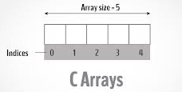
Arrays
A list of values stored sequentially in contiguous memory
Random access by inde, pointer to several blocks of memory
Declaration: type array[size] = {...}; (type array[size];)
int a[#], a is a pointer to the FIRST element
arr[x] operator is same as *(arr + x)
Basically gets you to starting address of object at x
When passed to function, only pointer to first element is passed
Arrays cannot be passed by value
Can access any element by pointer due to sequential nature

Slide 13
Multi-Dimensional Arrays
Declaration: type array[row][col]= {{...}, {...}};
Stored in memory as a 1D array
Row-major order: index = (row * (# of columns)) + column
Ex. int array[2][3] = {{a, b, c}, {d, e, f}};
array[0][2] = array[(0 * 3) + 2];
a | b | c
d | e | f

Slide 14
Pointer-Array Duality
char word[10];
char *cptr;
cptr = word;
 | Pointer | Array
cptr | word | &word[0]
cptr + n | word + n | &word[n]
*cptr | *word | word[0]
*(cptr + n) | *(word + n) | word[n]

Slide 15
Searches
Linear Search: iterates from the start of the array till the item is found.
Binary Search: (Requires a sorted array in ascending order)
Find the middle and check if it is the item
If search item < center item: search the 2nd half
If search item > center item: search the 1st half
Repeat 1 and 2 until item found

Slide 16
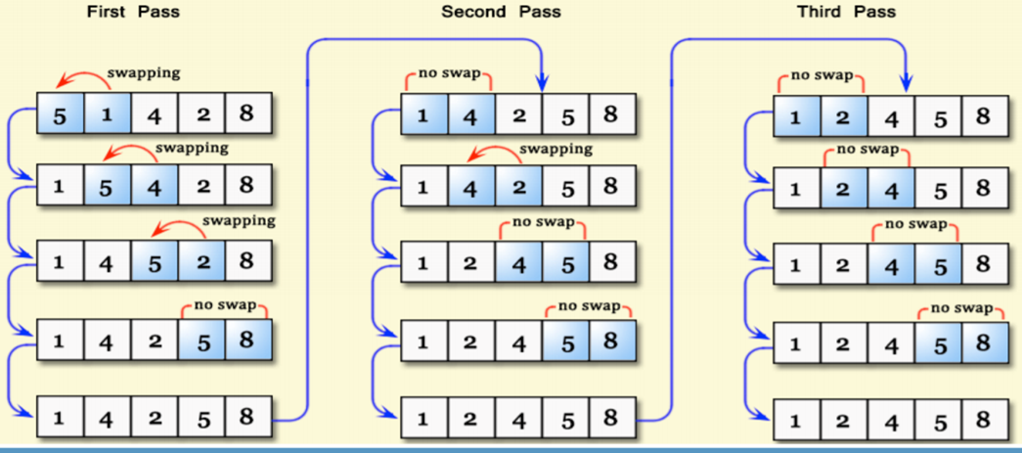
Sorting
Bubblesort: Most basic (and slow) algorithm
(Check EVERY element for EVERY spot)
Compare items next to each other and swap if necessary
Repeat until entire array is sorted

Slide 17
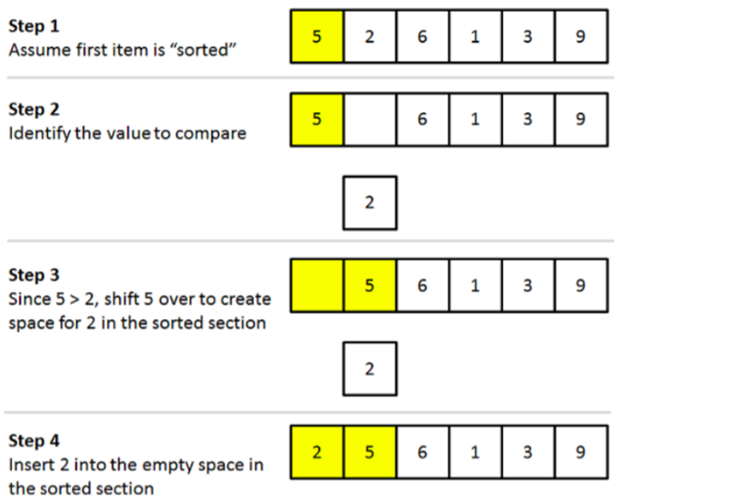
Insertion Sort
Remove item from array, insert it at the proper location in the sorted part by shifting other items.
Repeat this process until the end of the array is reached.

Slide 18
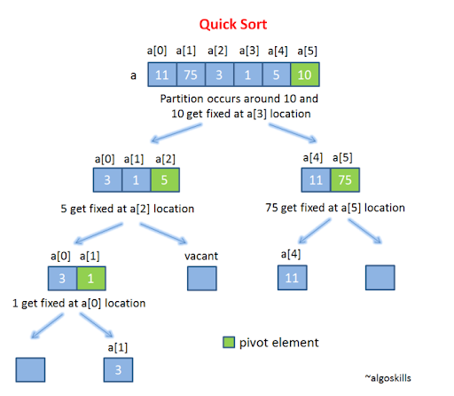
Quick Sort
A.K.A Divide-and-Conquer
Pick a pivot and partition array into 2 subarrays.
Continue to sort subarrays using this method.

Slide 19
Recursion and Backtracking
Whenever a function calls itself
Builds a runtime stack frame every call
Always include a base case
Recursive case should make problem smaller

Slide 20
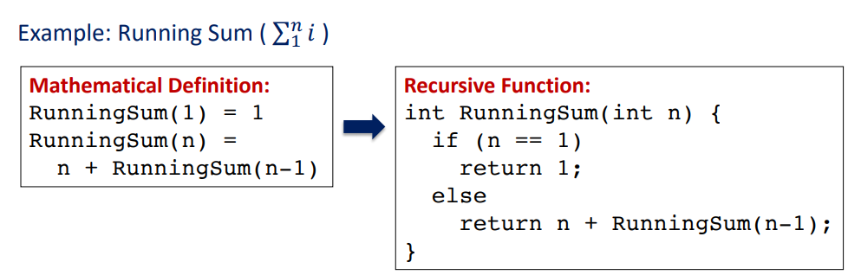
Recursion Example: Running Sum

Slide 21
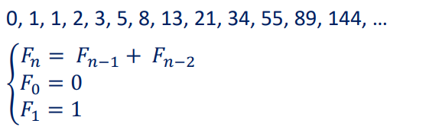
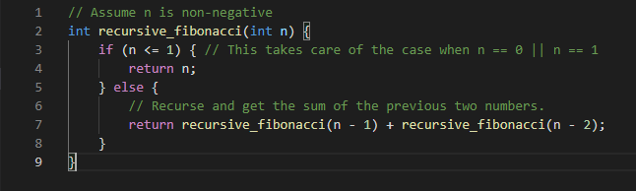
Recursion Example: Fibonacci Series
Mathematical Definition Vs. C implementation

Slide 22
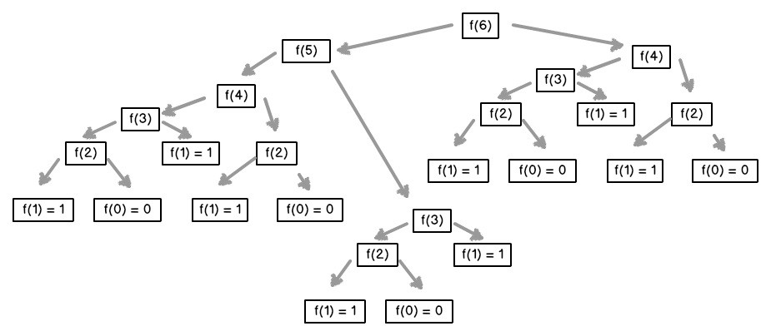
Recursion Example: Recursion w/ Lookup Table
Image Source: Recursive Fibonnaci Method Explained | by Bennie van der Merwe | Launch School | Medium

Slide 23
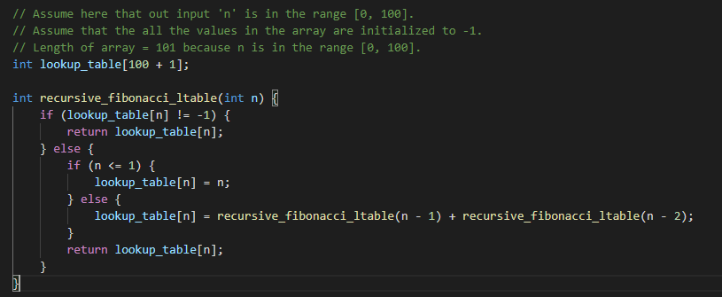
Recursion Example: Fibonacci w/ Lookup Table (contd.)

Slide 24
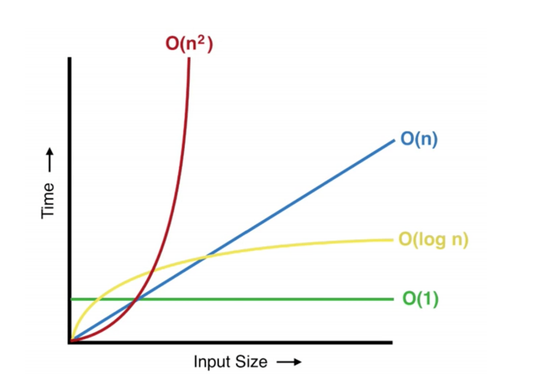
Big-O: Sneak Peak

Slide 25
Big-O: Sneak Peak
Nested loop (One outer and one inner loop)
Single Loop
Binary Search
Array Access

Slide 26
File I/O
int fscanf(FILE* stream, consta char* format, ...)
success-> returns the number of items read; 0, if pattern doesn’t match
failure-> returns EOF
int fgetc(FILE* stream)
success-> returns the next character
failure-> returns EOF and sets end-of-file indicator
int fputc(int ch, FILE* stream)
success-> write the character to file and returns the character written
failure-> returns EOF and sets end-of-file indicator
char* fgets(char* string, int, num, FILE* stream)
success-> returns a pointer to string
failure-> returns NULL
int fputs(const char* string, FILE* stream)
success-> writes string to file and returns a positive value
failure-> returns EOF and sets the end-of-file indicator
FILE* fopen(char* filename, char* mode)
//mode: “r”, “w”, “a”, ...
success-> returns a pointer to FILE
failure-> returns NULL
int fclose(FILE* stream)
success-> returns 0
failure-> returns EOF
int fprintf(FILE* stream, const char* format, ...)
success-> returns the number of characters written failure-> returns a negative number

Slide 27
Structs: aggregate data type; multiple types of variables
Example:
struct StudentStruct {
char Name[100];
int UIN;
float GPA;
};
To access a member of a struct, use the “.” operator:
struct StudentStruct my_struct;
my_struct.UIN = 123456789;
To access a member of a struct pointer, use the “->” operator:
struct StudentStruct *my_struct;
my_struct->UIN = 123456789;

Slide 28
Typedef
//Example 2:
struct StudentStruct {
...
}
typedef struct StudentStruct Student;
//Example 1:
typedef struct StudentStruct {
...
} Student;
// Both allow you to use ‘Student’ as an alias to ‘struct StudentStruct’

Slide 29
Unions: One member “in use” at a time
union Data {
int i;
float f;
char str[20];
} data;

Slide 30
Coding Practice

Slide 31
Write a program to print a string in reverse using a pointer
Concepts used: arrays, pointers, loops
Notes:
#include <stdio.h>
int
main ()
{
char string[50];
char reverse[50];
char *stringptr = string;
char *reverseptr = reverse;
printf("Please insert string \n");
scanf("%s", stringptr);
int i = -1;
while (*stringptr)
{
stringptr++;
i++;
}
while (i >= 0)
{
stringptr--;
*reverseptr = *stringptr;
reverseptr++;
i--;
}
*reverseptr = '\0';
printf("Reverse string is:");
printf("%s \n", reverse);
return 0;
}

Slide 32
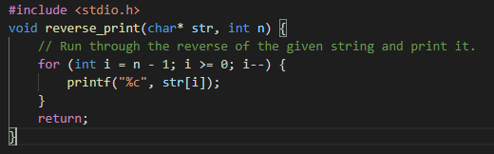
Write a program to print a string in reverse using a pointer
Concepts used: arrays, pointers, loops
Notes:
#include <stdio.h>
int
main ()
{
char string[50];
char reverse[50];
char *stringptr = string;
char *reverseptr = reverse;
printf("Please insert string \n");
scanf("%s", stringptr);
int i = -1;
while (*stringptr)
{
stringptr++;
i++;
}
while (i >= 0)
{
stringptr--;
*reverseptr = *stringptr;
reverseptr++;
i--;
}
*reverseptr = '\0';
printf("Reverse string is:");
printf("%s \n", reverse);
return 0;
}

Slide 33
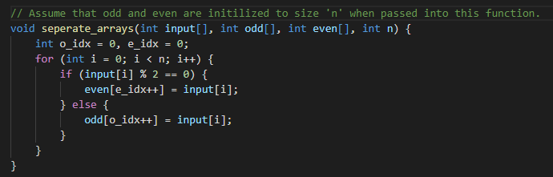
Write a program to separate odd and even integers in separate arrays
One possible implementation:
Notes:
#include <stdio.h>
int
main ()
{
int even[10];
int odd[10];
int numbers[10];
int n;
int i = 0;
int j = 0, k = 0;
printf("Please enter the number of elements \n");
scanf("%d", &n);
for(i = 0; i < n; i++)
{
printf("element - %d : ", i);
scanf("%d", &numbers[i]);
}
for(i = 0; i < n; i++)
{
if(numbers[i] % 2 == 0)
{
even[j] = numbers[i];
j++;
}
else
{
odd[k] = numbers[i];
k++;
}
}
printf("\n Even Elements: \n");
for(i = 0; i < j; i++)
{
printf("%d ", even[i]);
}
printf("\n Odd Elements: \n");
for(i = 0; i < k; i++)
{
printf("%d ", odd[i]);
}
return 0;
}

Slide 34
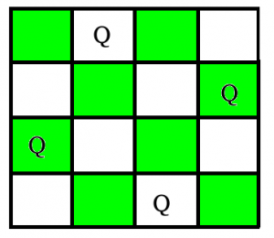
Write a Program to solve nQueens problem
Concepts used: arrays, recursion, backtracking
Notes:
#include <stdio.h>
#define N 3
int check(int board[N][N], int row, int col){
//1. check if any otehr queen is in the same row as me
for(int i=0; i<col; i++){
if(board[row][i]){return 0;}
}
//check the diagonals.
//1. upper diagonals(on the left side (top left to bottom right)
int i = row;
int j = col;
while(i>=0 && j>=0){
if(board[i][j]){return 0;}
i--; j--;
}
//2. lower diagoals (top right to bottom left)
i = row;
j = col;
while(i<N && j>=0){
if(board[i][j]){return 0;}
i++; j--;
}
return 1;
}
int NQueens(int board[N][N], int current_column){
if(current_column >= N){return 1;}
for(int i=0; i<N; i++){
int queen_placed = check(board, i, current_column);
if(queen_placed){
board[i][current_column] = 1;
if(NQueens(board, current_column+1)){return 1;}
board[i][current_column] = 0;
}
}
//queen cannot be placed anywhere
return 0;
}
int main()
{
int board[N][N];
for(int i=0; i<N; i++){
for(int j=0; j<N; j++){
board[i][j] = 0;
}
}
int can_be_placed = NQueens(board, 0);
if(can_be_placed){
for(int i=0; i<N; i++){
for(int j=0; j<N; j++){
printf("%d ", board[i][j]);
}
printf("\n");
}
} else {
printf("Queens cannot be placed");
}
return 0;
}

Slide 35
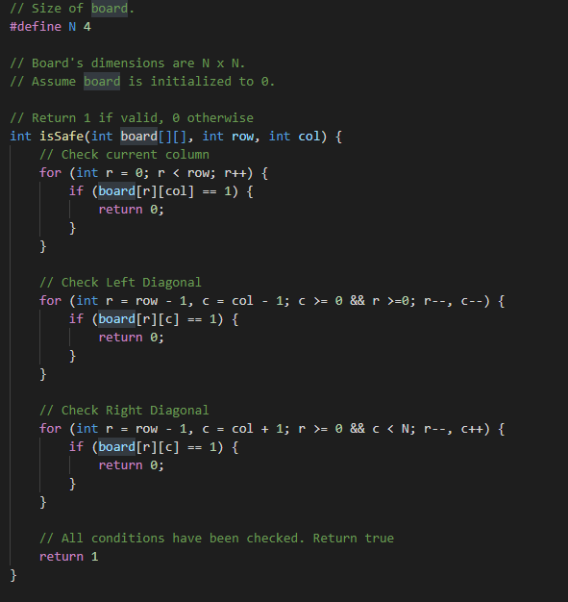
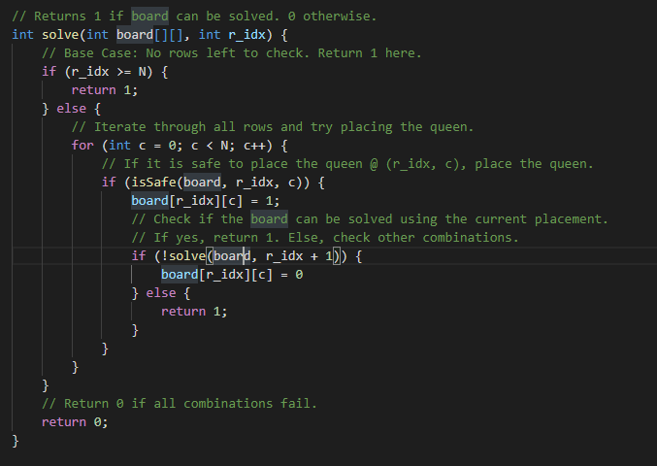
Write a Program to solve nQueens problem
Notes:
#include <stdio.h>
#define N 3
int check(int board[N][N], int row, int col){
//1. check if any otehr queen is in the same row as me
for(int i=0; i<col; i++){
if(board[row][i]){return 0;}
}
//check the diagonals.
//1. upper diagonals(on the left side (top left to bottom right)
int i = row;
int j = col;
while(i>=0 && j>=0){
if(board[i][j]){return 0;}
i--; j--;
}
//2. lower diagoals (top right to bottom left)
i = row;
j = col;
while(i<N && j>=0){
if(board[i][j]){return 0;}
i++; j--;
}
return 1;
}
int NQueens(int board[N][N], int current_column){
if(current_column >= N){return 1;}
for(int i=0; i<N; i++){
int queen_placed = check(board, i, current_column);
if(queen_placed){
board[i][current_column] = 1;
if(NQueens(board, current_column+1)){return 1;}
board[i][current_column] = 0;
}
}
//queen cannot be placed anywhere
return 0;
}
int main()
{
int board[N][N];
for(int i=0; i<N; i++){
for(int j=0; j<N; j++){
board[i][j] = 0;
}
}
int can_be_placed = NQueens(board, 0);
if(can_be_placed){
for(int i=0; i<N; i++){
for(int j=0; j<N; j++){
printf("%d ", board[i][j]);
}
printf("\n");
}
} else {
printf("Queens cannot be placed");
}
return 0;
}

Slide 36
Merge two arrays and sort the result in ascending order using insertion sort
Concepts used: arrays, sorting algorithm
Notes:
Skeleton:
#include <stdio.h>
#include <stdio.h>
void main()
{
// Declare variables
//Ask the user for the number of elements in the first array
printf("Input the number of elements to be stored in the first array :");
scanf(__, __);
// Ask user for each element one at a time
printf("Input ___ elements in the array :\n",___);
// Ask the user for the number of elements in the second array
printf("Input the number of elements to be stored in the second array :");
scanf(__, __);
// Ask user for each element one at a time
printf("Input __ elements in the array :\n",__);
/* size of merged array is size of first array and size of second array */
/*-----------------merge arrays------------------------------------*/
/*----------------- sort the array in ascending order using Insertion sort---------------------------*/
/*--------------- Prints the merged array ------------------------------------*/
printf("\nThe merged array in ascending order is :\n");
for(i=0; i< __ ; i++)
{
printf("__",__);
}
printf("\n\n");
}
Solution:
#include <stdio.h>
#include <stdio.h>
void main()
{
// Declare variables
int arr1[100], arr2[100], arr3[200];
int s1, s2, s3;
int i, j, k;
//Ask the user for the number of elements in the first array
printf("Input the number of elements to be stored in the first array :");
scanf("%d",&s1);
// Ask user for each element one at a time
printf("Input %d elements in the array :\n",s1);
for(i=0;i<s1;i++)
{
printf("array[%d] : ",i);
scanf("%d",&arr1[i]);
}
// Ask the user for the number of elements in the second array
printf("Input the number of elements to be stored in the second array :");
scanf("%d",&s2);
// Ask user for each element one at a time
printf("Input %d elements in the array :\n",s2);
for(i=0;i<s2;i++)
{
printf("array[%d] : ",i);
scanf("%d",&arr2[i]);
}
/* size of merged array is size of first array and size of second array */
s3 = s1 + s2;
/*----------------- insert in the third array------------------------------------*/
for(i=0;i<s3; i++)
{
if(i < s1){
arr3[i] = arr1[i];
}
else{
arr3[i] = arr2[i - s1];
}
}
/*----------------- sort the array in ascending order using Insertion sort---------------------------*/
int temp, empty;
for(i = 1; i < s3; i++){
temp = arr3[i];
empty = i;
for(j = i-1; j > -1; j--){
if(temp < arr3[j]){
arr3[j+1] = arr3[j];
empty = j;
}
}
arr3[empty] = temp;
}
// /*----------------- sort the array in ascending order ---------------------------*/
// for(i=0;i<s3; i++)
// {
// for(k=0;k<s3-1;k++)
// {
// if(arr3[k]<=arr3[k+1])
// {
// j=arr3[k+1];
// arr3[k+1]=arr3[k];
// arr3[k]=j;
// }
// }
// }
/*--------------- Prints the merged array ------------------------------------*/
printf("\nThe merged array in ascending order is :\n");
for(i=0; i<s3; i++)
{
printf("%d ", arr3[i]);
}
printf("\n\n");
}

Slide 37
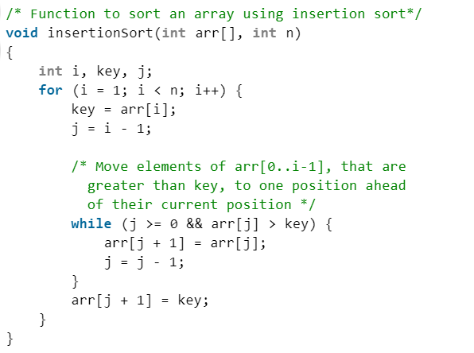
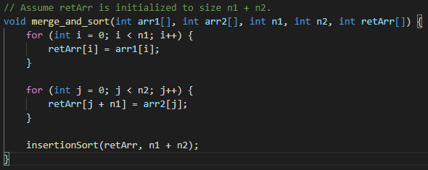
Merge two arrays and sort the result in ascending order using insertion sort
Code from GeeksForGeeks
Notes:
Skeleton:
#include <stdio.h>
#include <stdio.h>
void main()
{
// Declare variables
//Ask the user for the number of elements in the first array
printf("Input the number of elements to be stored in the first array :");
scanf(__, __);
// Ask user for each element one at a time
printf("Input ___ elements in the array :\n",___);
// Ask the user for the number of elements in the second array
printf("Input the number of elements to be stored in the second array :");
scanf(__, __);
// Ask user for each element one at a time
printf("Input __ elements in the array :\n",__);
/* size of merged array is size of first array and size of second array */
/*-----------------merge arrays------------------------------------*/
/*----------------- sort the array in ascending order using Insertion sort---------------------------*/
/*--------------- Prints the merged array ------------------------------------*/
printf("\nThe merged array in ascending order is :\n");
for(i=0; i< __ ; i++)
{
printf("__",__);
}
printf("\n\n");
}
Solution:
#include <stdio.h>
#include <stdio.h>
void main()
{
// Declare variables
int arr1[100], arr2[100], arr3[200];
int s1, s2, s3;
int i, j, k;
//Ask the user for the number of elements in the first array
printf("Input the number of elements to be stored in the first array :");
scanf("%d",&s1);
// Ask user for each element one at a time
printf("Input %d elements in the array :\n",s1);
for(i=0;i<s1;i++)
{
printf("array[%d] : ",i);
scanf("%d",&arr1[i]);
}
// Ask the user for the number of elements in the second array
printf("Input the number of elements to be stored in the second array :");
scanf("%d",&s2);
// Ask user for each element one at a time
printf("Input %d elements in the array :\n",s2);
for(i=0;i<s2;i++)
{
printf("array[%d] : ",i);
scanf("%d",&arr2[i]);
}
/* size of merged array is size of first array and size of second array */
s3 = s1 + s2;
/*----------------- insert in the third array------------------------------------*/
for(i=0;i<s3; i++)
{
if(i < s1){
arr3[i] = arr1[i];
}
else{
arr3[i] = arr2[i - s1];
}
}
/*----------------- sort the array in ascending order using Insertion sort---------------------------*/
int temp, empty;
for(i = 1; i < s3; i++){
temp = arr3[i];
empty = i;
for(j = i-1; j > -1; j--){
if(temp < arr3[j]){
arr3[j+1] = arr3[j];
empty = j;
}
}
arr3[empty] = temp;
}
// /*----------------- sort the array in ascending order ---------------------------*/
// for(i=0;i<s3; i++)
// {
// for(k=0;k<s3-1;k++)
// {
// if(arr3[k]<=arr3[k+1])
// {
// j=arr3[k+1];
// arr3[k+1]=arr3[k];
// arr3[k]=j;
// }
// }
// }
/*--------------- Prints the merged array ------------------------------------*/
printf("\nThe merged array in ascending order is :\n");
for(i=0; i<s3; i++)
{
printf("%d ", arr3[i]);
}
printf("\n\n");
}

Slide 38
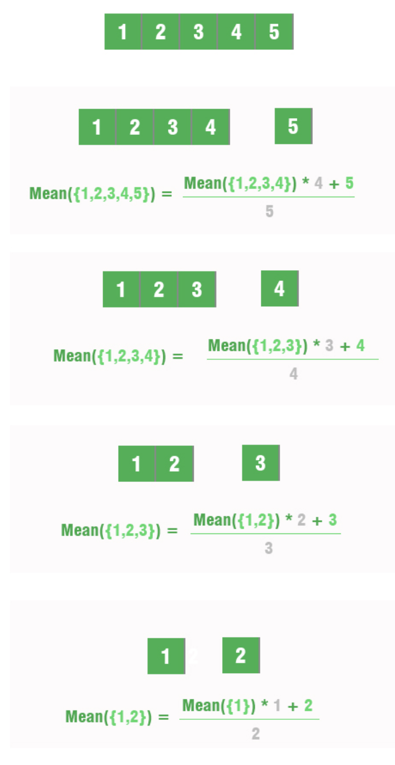
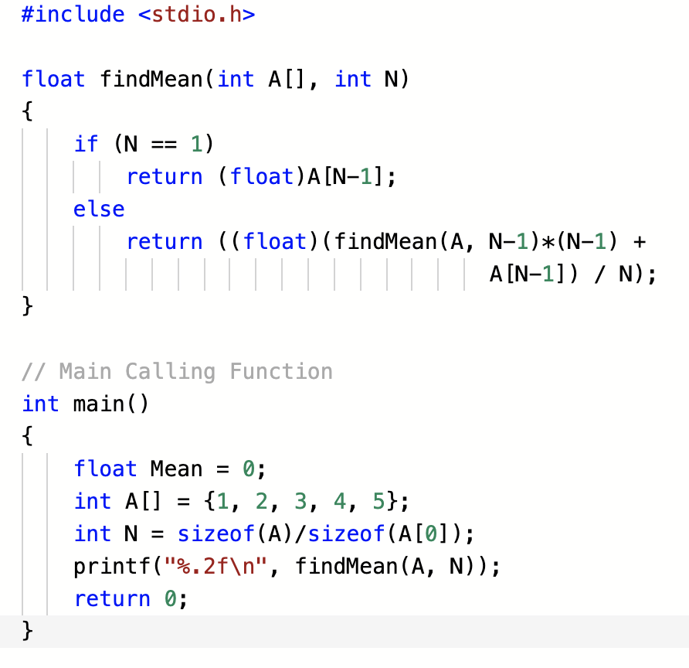
Find the mean of a given array of integers recursively
Concepts used: arrays, recursion

Slide 39
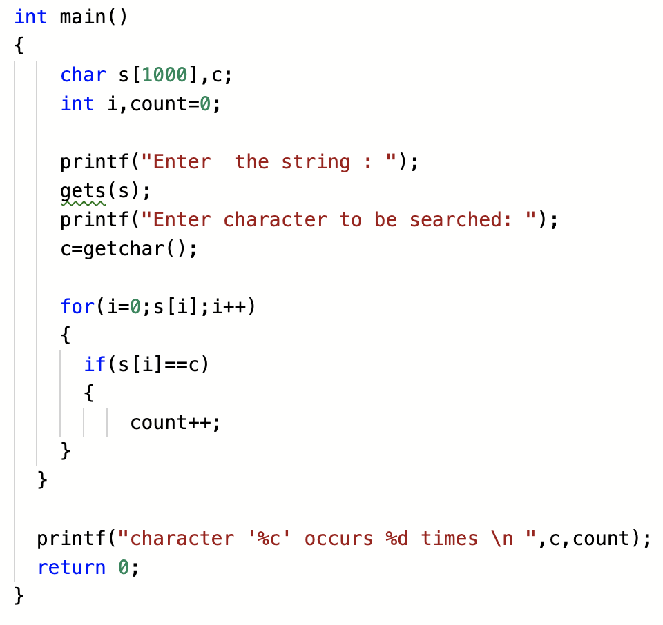
Count number of occurrences of a character in a string
Concepts used: arrays, data types, loops

Slide 40
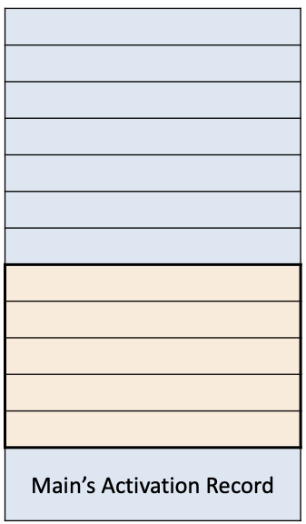
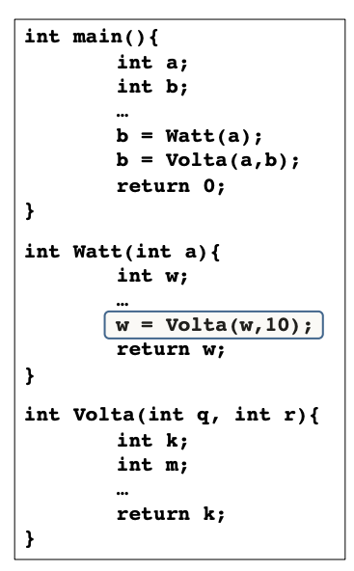
RTS Example

