Slide 1
Physics 214 HKN Final Exam Review Session
Steven Kolaczkowski
Shuen Wu
Slides by Steven Kolaczkowski

Slide 2

Wavefunctions and Eigenstates
Wavefunctions, $ψ(x,t)$, are how we describe the probabilistic nature of quantum particles. By themselves, wavefunctions do not have an intuitive meaning however its magnitude squared is the probability of finding a particle in that state.
$P\left(Δx\right)=\int_{−\frac{Δx}{2}}^{\frac{Δx}{2}}{Ψ^{∗}\left(x\right)Ψ\left(x\right)dx}$ iff $\int_{−∞}^{+∞}{Ψ^{∗}\left(x\right)Ψ\left(x\right)dx}=1$
Momentum of a particle is described by its wavenumber, $k=\frac{p}{ℏ} \left[=\right]m^{−1}$
In later classes, $k$, will be a vector
When we say a wavefunction is an eigenstate of some quantity, we mean that quantity is definite.
Ex. $ψ\left(x\right)=Ae^{ikx}$ is a momentum eigenstate with momentum $p=ℏk$
$Ψ\left(x,t\right)=Ae^{i\left(kx−ωt\right)}$ is an eigenstate of both momentum and energy

Slide 3

Superposition, Normalization, and Orthogonality
Superposition: If we have two valid wavefunctions, linear combinations of these wavefunctions are also valid.
If a wavefunction is a superposition of a quantity (momentum, energy, polarization, etc.) it is not an eigenstate of that quantity
Normalization:
$∫{\left|Ψ\left(x,t\right)\right|}^{2}dx=∫{\left|ψ\left(x\right)\right|}^{2}dx=∫ψ^{∗}\left(x\right)ψ\left(x\right)dx=1$
Does this change with superposition?
Orthogonality Principle:
$∫{(aψ}_{n})\left(bψ_{m}\right)dx=\left\{\begin{aligned}0 if n≠m \\ ab if n=m\end{aligned}\right.$

Slide 4
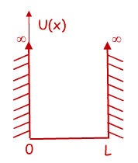

Time Independent Schrödinger Equation (TISE) and the Infinite Potential Well
$$−\frac{ℏ^{2}}{2m}\frac{d^{2}ψ\left(x\right)}{dx^{2}}+U\left(x\right)ψ(x)=Eψ(x)$$
Free Particle solution: if $U\left(x\right)=0$, then our original harmonic wave solutions works and we can say $ψ\left(x\right)=\operatorname{Acos}\left(kx\right)+Bsin(kx)$
You can verify that this will get us $\frac{k^{2}ℏ^{2}}{2m}ψ\left(x\right)=Eψ(x)$
Infinite Square Well: We need a function that is zero at x=0 and x=L
From our options above, $ψ\left(x\right)=\sqrt{\frac{2}{L}}\sin\left(k_{n}x\right)$ works if $k_{n}=\frac{nπ}{L}=\frac{2π}{λ_{n}}$
$λ_{n}=\frac{2L}{n}$ and $E_{n}=\frac{n^{2}π^{2}ℏ^{2}}{2mL^{2}}=\frac{n^{2}h^{2}}{8mL^{2}}$
$n$ is the state of the system and $n=1, 2, 3, …$

Slide 5
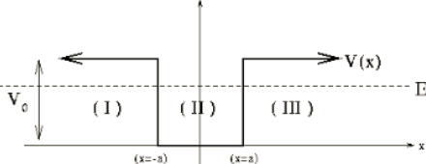
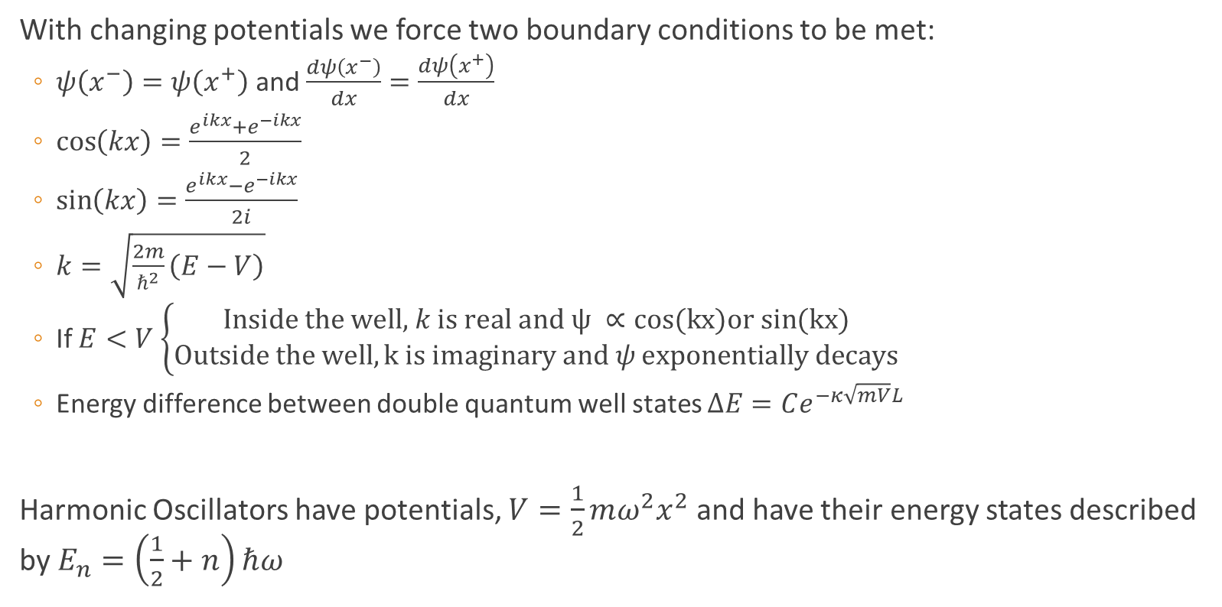
Finite Potential Wells, Boundary Conditions, and Harmonic Oscillators
With changing potentials we force two boundary conditions to be met:
$ψ\left(x^{−}\right)=ψ\left(x^{+}\right)$ and $\frac{dψ\left(x^{−}\right)}{dx}=\frac{dψ\left(x^{+}\right)}{dx}$
$\cos\left(kx\right)=\frac{e^{ikx}+e^{−ikx}}{2}$
$\sin\left(kx\right)=\frac{e^{ikx}−e^{−ikx}}{2i}$
$k=\sqrt{\frac{2m}{ℏ^{2}}\left(E−V\right)}$
If $E<V$ $\left\{\begin{aligned}\text{Inside} \text{the} \text{well}\text{, }k \text{is} \text{real} \text{and} ψ ∝cos(kx)or sin(kx) \\ Outside the well, k is imaginary and ψ exponentially decays\end{aligned}\right.$
Energy difference between double quantum well states $ΔE=Ce^{−κ\sqrt{mV}L}$
Harmonic Oscillators have potentials, $V=\frac{1}{2}mω^{2}x^{2}$ and have their energy states described by $E_{n}=\left(\frac{1}{2}+n\right)ℏω$

Slide 6


Time Dependent Schrödinger Equation (TDSE): dotting your $i$’s and crossing your $h$’s
TISE: $−\frac{ℏ^{2}}{2m}\frac{d^{2}ψ\left(x\right)}{dx^{2}}+U\left(x\right)ψ\left(x\right)=Eψ\left(x\right)$
Now we are going to look at time dependent wave functions $Ψ\left(x,t\right)=ψ_{n}\left(x\right)e^{−iω_{n}t}$
TDSE: $−\frac{ℏ^{2}}{2m}\frac{d^{2}Ψ\left(x,t\right)}{dx^{2}}+U\left(x\right)Ψ\left(x,t\right)=iℏ\frac{dΨ\left(x,t\right)}{dt}$
Superposition principle: TDSE can also be solved by:
$$Ψ\left(x,t\right)=aψ_{0}\left(x\right)e^{−iω_{0}t}+bψ_{1}\left(x\right)e^{−iω_{1}t}+ …$$
Notice that this is not a solution to TISE
Superpositions oscillate with a beat frequency $ω_{beat}=ω_{i}−ω_{j}$
Does $∫{\left|Ψ\left(x,t\right)\right|}^{2}dx$ vary with time?

Slide 7
Electrons in Materials
Pauli Exclusion Principle: For this class, all it means is you can have a max of 2 electrons per energy level.
Bandgap: The separation between energy levels in a material. There are no available states for particles to fill in the gap.
Metals have no bandgap
Insulators have large bandgaps
Semiconductors have small bandgaps
What constitutes large and small? There isn’t exactly a clear boundry

Slide 8
Past Exam Questions

Slide 9

Spring 2018 Practice, Spring 2010

Slide 10
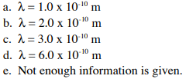
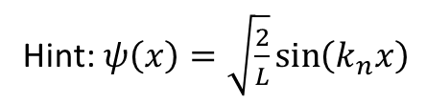
Spring 2018 Practice, Spring 2010
Hint:$ψ\left(x\right)=\sqrt{\frac{2}{L}}\sin\left(k_{n}x\right)$

Slide 11

Spring 2018 Practice, Spring 2009

Slide 12


Spring 2018 Practice, Spring 2009

Slide 13
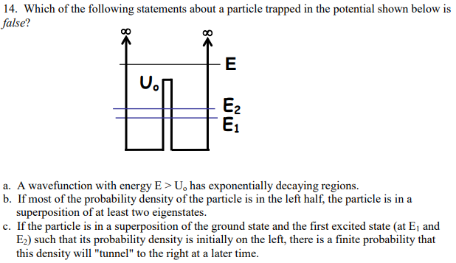
Spring 2009

Slide 14


Spring 2018 Practice

Slide 15

Spring 2018 Practice

Slide 16

Spring 2018 Practice

Slide 17
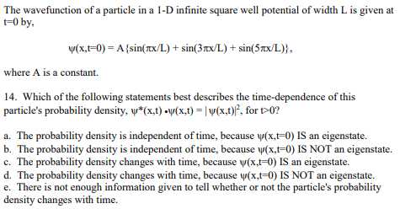
Fall 2001

Slide 18

Spring 2010

Slide 19
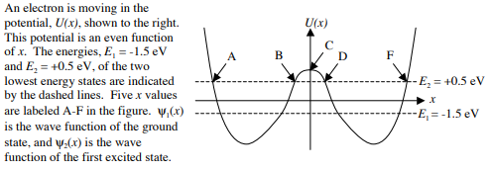

Spring 2010

Slide 20

Spring 2010

