Slide 1
ECE 120 Midterm 1
HKN Review Session

Slide 2
Overview
Representations of Bits
Boolean Logic & Bitmasks
Programming in C
Practice Problems

Slide 3
Representations of Bits
Representations map sequences of bits into meaningful information
There must be no ambiguity for any bit pattern
Many possible representations, but some are better than others
Without knowing the representation, bits are meaningless
Notes:
Ryan

Slide 4
Unsigned Representation
Sequentially maps base 2 numbers to base 10 numbers
Range: 0 to 2^{k}-1 for k bits
Overflow Conditions: Most Significant Bit (MSB) has a carry out
Extending: Pad the left with zeros

Slide 5
Sign-Magnitude Representation
MSB is the sign bit, followed by the magnitude
MSB is 1 for negative numbers, or 0 for positive numbers
Range: -2^{k-1} - 1 to 2^{k-1} - 1 for k bits
Modern computers don’t use this anymore …
Two possible ways to represent zero (0 or 1 followed by a zero magnitude) – wastes bits
Requires separate logic to perform arithmetic

Slide 6
Two’s Complement Representation
Range: -2^{k-1} to 2^{k-1} - 1 for k bits
Overflow Conditions: Adding two numbers with the same MSB yields a result with a different MSB
Extending: Pad the left with value of the MSB
Uses the same logic as the unsigned representation does for arithmetic
Negative when the MSB is 1

Slide 7
Two’s Complement Representation (cont.)
Decimal to 2’s Comp.
Positive Numbers:
Treat as an unsigned number and convert to binary
Negative Numbers:
Convert the magnitude as an unsigned number
Negate and add one
2’s Comp. to Decimal
MSB is 0 (Positive):
Treat as an unsigned binary number and convert to decimal
MSB is 1 (Negative):
Negate and add one to obtain the magnitude
Convert the magnitude as an unsigned number
Add a negative sign to the magnitude
Fun Fact: First negating a number then adding one produces the same result as first subtracting one then negating!

Slide 8
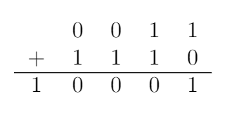
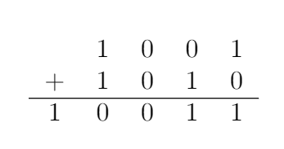
Unsigned & Two’s Complement Arithmetic
Unsigned Addition:
Two’s Complement Addition:
Even though there is a carry out, there is no overflow here (3 + -2 = 1)
Result
Result
Overflow when there is a carry out
There is only overflow when the MSB’s of the addends is different from the MSB of the sum
Result
Overflow!

Slide 9
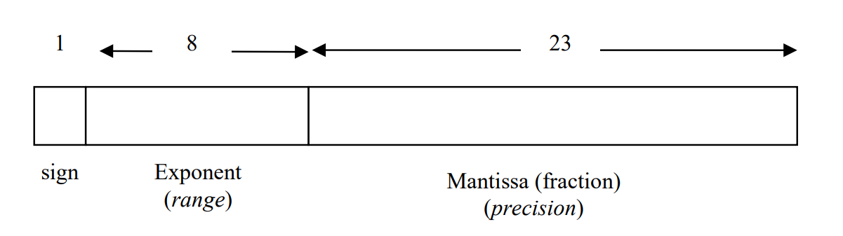
IEEE 754 Floating Point Representation
Approximates decimals and very large or small numbers
Conversion: (-1)^{sign} × 1.mantissa × 2^{(exponent - 127)}
Special Meanings
Exponent is 255: +/- infinity (depending on sign bit) when mantissa is 0, otherwise NaN (not a number) when mantissa is non-zero
Exponent is 0: Denormalized number (leading 1 before mantissa is replaced with a 0)
Notes:
Panav

Slide 10
IEEE 754 Floating Point to Decimal Conversion
Convert: 1 1000 0101 1110 0011 0000 0000 0000 000
(-1)¹ × 1.11100011000000000000000 × 2⁽¹³³ ⁻ ¹²⁷⁾
-1 × 1111000.11000000000000000
-1 × (2⁷ + 2⁶ + 2⁵ + 2⁴ + 2⁻¹ + 2⁻²)
-120.75
Sign
Exponent
Mantissa

Slide 11
Decimal to IEEE 754 Floating Point Conversion
Convert: 3481.375
3481₁₀ = 110110011001₂.
0.375 × 2 = 0.75 (< 1, so the bit at 2⁻¹ is 0)
(0.75 - 0) × 2 = 1.5 (≥ 1, so the bit at 2⁻² is 1)
(1.5 - 1) × 2 = 1 (≥ 1, so the bit at 2⁻³ is 1)
1 - 1 = 0 (Done!)
Keep going until you get a remainder of zero or you run out of bits …
Exponent is 2¹¹ 11 + 127 = 138
138₁₀ = 1000 1010₂

Slide 12
Decimal to IEEE 754 Floating Point Conversion
Convert: 3481.375
Putting it together …
0 10001010 10110011001 011000000000
From 3481₁₀ with the left-most 1 removed (since there is an implicit 1)
From our repeated division, right-padded with zeroes since we reached a zero remainder.
Sign
Exponent
Mantissa

Slide 13
Hexadecimal Representation
Each hexadecimal character is four bits
Remember to prefix your hexadecimal answers with “x”
Having the hexadecimal to binary chart on your cheat sheet (or memorizing it) can save time and prevent mistakes on the exam
Hex: | x0 | x1 | x2 | x3 | x4 | x5 | x6 | x7
Binary: | 0000 | 0001 | 0010 | 0011 | 0100 | 0101 | 0110 | 0111
Hex: | x8 | x9 | xA | xB | xC | xD | xE | xF
Binary: | 1000 | 1001 | 1010 | 1011 | 1100 | 1101 | 1110 | 1111

Slide 14
ASCII Representation
American Standard Code for Information Interchange
Each ASCII character is 7 bits, but usually stored in a byte (leading bit is zero)
You will be given an ASCII chart on the exam if needed – no need to memorize anything
Common mistake: numbers in ASCII are not the same as in hex or decimal (e.g. “3” in ASCII is NOT x03 in hex)!

Slide 15




Boolean Logic
Operation | Expression | Symbol | Truth Table
AND | AB
OR | A + B
XOR | A ⊕ B
NOT | A’
A | B | AB
0 | 0 | 0
0 | 1 | 0
1 | 0 | 0
1 | 1 | 1
A | B | A + B
0 | 0 | 0
0 | 1 | 1
1 | 0 | 1
1 | 1 | 1
A | B | A ⊕ B
0 | 0 | 0
0 | 1 | 1
1 | 0 | 1
1 | 1 | 0
A | A’
0 | 1
1 | 0

Slide 16












Bitmasks
Quickly isolate or modify only certain bits in a group
Isolating a group of bits
Set bit to 0
Set bits to 1
Flip bits
Data:
Operation:
AND
AND
OR
XOR
Bitmask:
Result:

Slide 17
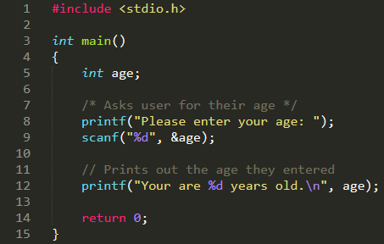
C: Program Structure
A function named main which executes when the program starts
Declaration of variable(s) used by the function
Statements within the function that execute in sequential order
Comments can be made with either /* Comment */ or // Comment Line
Returns 0 to exit out of the function and terminate the program
Notes:
Nathan

Slide 18
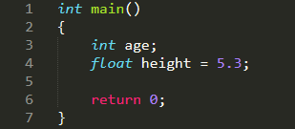
C: Variables
Variables are used to store data within a program.
When declaring variables, the programmer must specify the data type
Variable’s name
The variable age is declared, but uninitialized. It must first be initialized before being used.
Variable’s data type
The variable height is initialized with a value of 5.3

Slide 19
C: Primitive Data Types
Name | Size in Memory* | Meaning
char | 8 bits | Two’s complement number between -128 and 127, used for ASCII
unsigned char | 8 bits | Unsigned number between 0 and 255
int | 32 bits | Two’s complement number between -2³¹ and 2³¹ - 1
unsigned int | 32 bits | Unsigned number between 0 and 2³² - 1
float | 32 bits | IEEE 754 single-precision floating point number
double | 64 bits | IEEE 754 double-precision floating point number
* The sizes of data types on different machines or architectures may vary, but you should always use these values in this class.

Slide 20
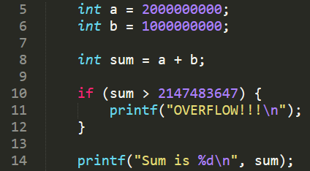

C: Variable Overflow
What happens to a number when it overflows?
A computer is only given k bits to store a number
Any extra bits will be discarded
Can you spot the bug in this code?
Hint: can sum ever be greater than 2,147,483,647?
Program Output:

Slide 21
C: Input & Output
Use printf(format string, var1, var2, …) to print out text
Use scanf(format specifiers, &var1, &var2, …) to read user input
You can only pass format specifiers (e.g. “%d”) into scanf. If you want to print a prompt (e.g. “Enter a number:”), use printf first
Remember to include the ampersand “&” in front of variable names
Will return the number of successful conversions

Slide 22
C: Input & Output Format Specifiers
Format Specifier | Used In | Used For
%d | printf & scanf | signed integer
%f | printf & scanf | float
%c | printf & scanf | char
%u or %lu | printf & scanf | unsigned integer
%% | only printf | prints out a “%” (no argument needed)
Escape Sequence | Used For
\n | Prints new line
\t | Prints a tab
\” | Prints a double quote
\\ | Prints a single backslash

Slide 23
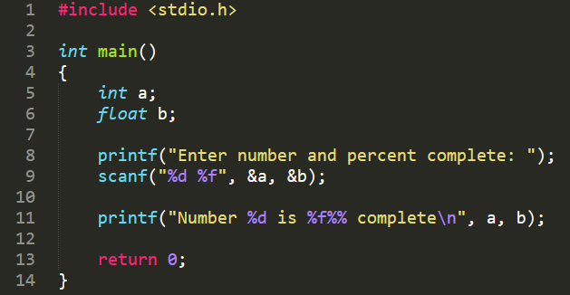
C: Input & Output Format Specifier Examples
Program Output:

Slide 24
C: Operators
Arithmetic: *, /, %, +, -, ++, --
Know the order of operations: *, /, %, +, then -
Assignment: =
Variable must be on the left side of the assignment operator (e.g. x = 5)
Relational: ==, !=, >, >=, <, <=
Logical: && (and), || (or), ! (not)
Bitwise: & (and), | (or), ^ (xor), ~ (not), << (shift left), >> (shift right)
Will manipulate the raw bits

Slide 25

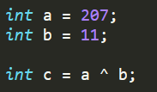

C: Bitwise Operator Examples
a = 24₁₀ = 0000 0000 0001 1000₂
b = 0000 0000 0110 0000₂ = 96₁₀
c = 0000 0000 0000 0110₂ = 6₁₀
a = 207₁₀ = 0000 0000 1100 1111₂
b = 11₁₀ = 0000 0000 0000 1011₂
c = 0000 0000 1100 0100₂ = 196₁₀
a = 2₁₀ = 0000 0000 0000 0010₂
b = 1111 1111 1111 1101₂ = -3₁₀
Note: The upper 16 bits in this example were not written for simplicity, an integer should be 32 bits.

Slide 26
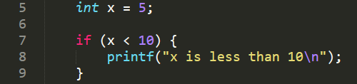
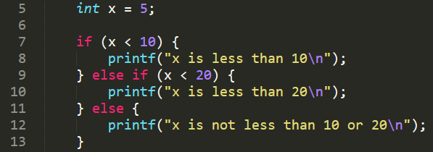

C: Conditional Constructs
If Statements
If-ElseIf-Else Statements
Output for both programs:

Slide 27
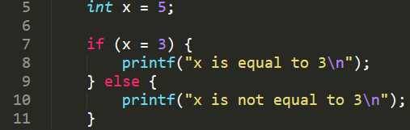
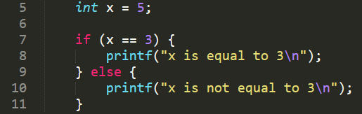
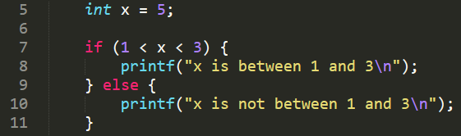
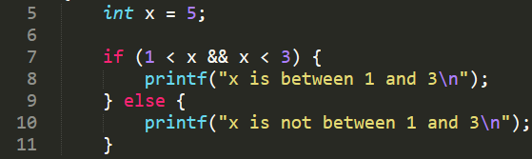
C: Conditional Constructs Common Pitfalls
Assignment instead of comparison
Chaining relational operators
Correct Way:
Program Output:
Correct Way:
Program Output:

Slide 28
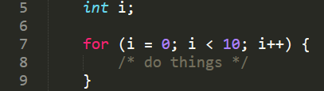
C: Iterative Constructs
For Loop
Initialization: runs once at the very beginning of the loop
Condition: checked before each iteration of the loop body
Update: run after each iteration of the loop body

Slide 29
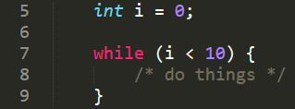
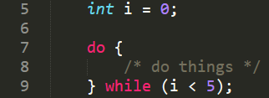
C: Iterative Constructs
While Loop: checks condition before looping
Do-While Loop: runs once before checking condition

Slide 30
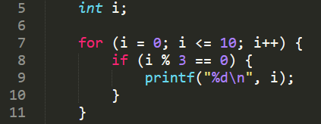

C: Iterative Construct Example
Program Output:

Slide 31
Questions?

Slide 32
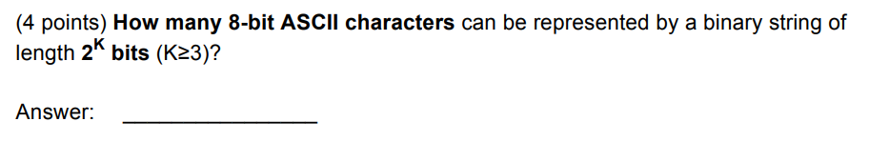
Practice Problems: Spring 2016 Problem 3
Notes:
Anna

Slide 33
Practice Problems: Spring 2016 Problem 3
2^{K - 3}

Slide 34
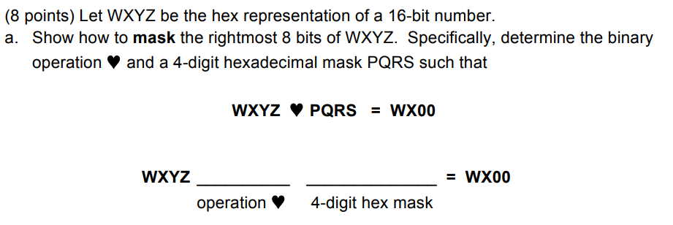
Practice Problems: Spring 2016 Problem 4
Notes:
Panav

Slide 35
Practice Problems: Spring 2016 Problem 4
AND
xFF00

Slide 36
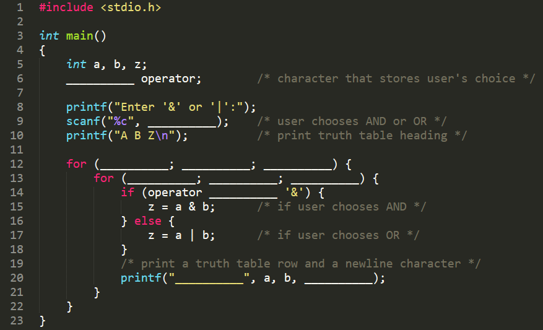
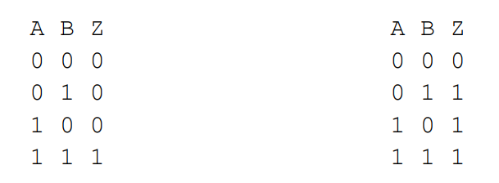
Practice Problems: Spring 2016 Problem 6
Complete the program that prints one of the truth tables shown below, depending on the user enters the character ‘&’ or ‘|’, respectively:
Notes:
Nathan

Slide 37
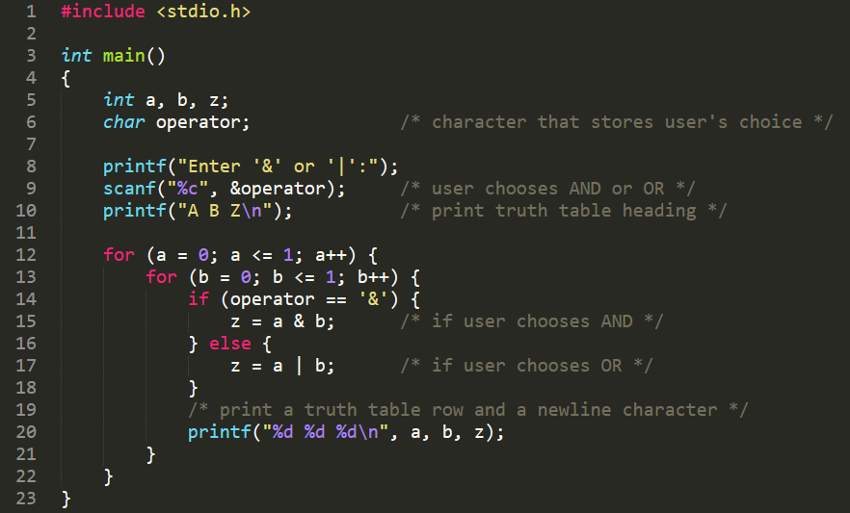
Practice Problems: Spring 2016 Problem 6
Complete the program that prints one of the truth tables shown below, depending on the user enters the character ‘&’ or ‘|’, respectively:

Slide 38
Practice Problems
Let X = X₆X₅X₄X₃X₂X₁X₀ be 7 bits representing a letter in ASCII (a-z or A-Z)
Find a Y = Y₆Y₅Y₄Y₃Y₂Y₁Y₀ and a logical operation ★ such that the result of X ★ Y will change the ASCII character’s case (e.g. ‘A’ ★ Y = ‘a’ and ‘a’ ★ Y = ‘A’).
Y = ____________________
★ = AND / OR / NOT / NAND / NOR / XOR (pick one)
You can reference an ASCII table for this problem.
Notes:
Ryan

Slide 39
Practice Problems
Let X = X₆X₅X₄X₃X₂X₁X₀ be 7 bits representing a letter in ASCII (a-z or A-Z)
Find a Y = Y₆Y₅Y₄Y₃Y₂Y₁Y₀ and a logical operation ★ such that the result of X ★ Y will change the ASCII character’s case (e.g. ‘A’ ★ Y = ‘a’ and ‘a’ ★ Y = ‘A’).
Y = ____________________
★ = AND / OR / NOT / NAND / NOR / XOR (pick one)
You can reference an ASCII table for this problem.
010 0000

Slide 40
Practice Problems
Convert IEEE 754 Floating Point to decimal:
1 1000 1001 0101 0011 1001 1000 0000 000
Notes:
Panav

Slide 41
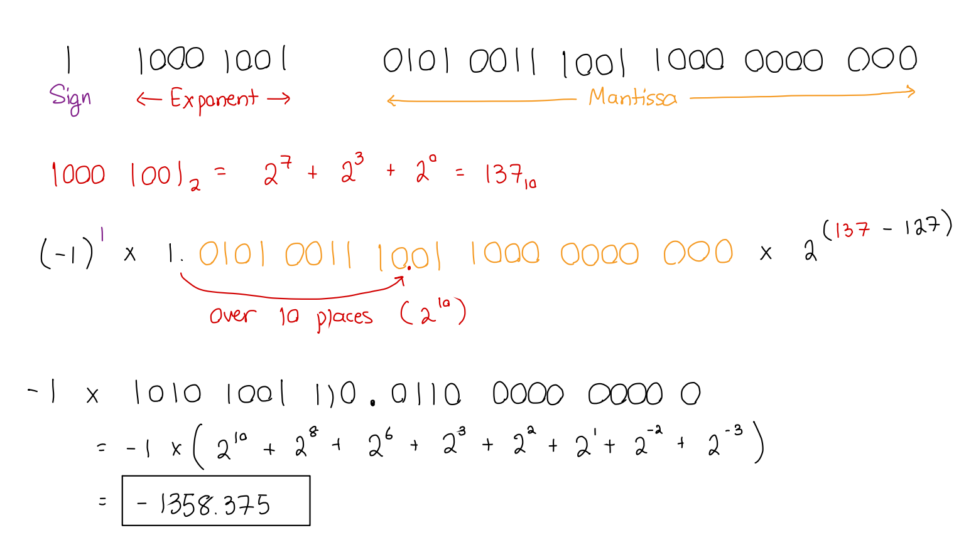
Practice Problems
Convert IEEE 754 Floating Point to decimal:
1 1000 1001 0101 0011 1001 1000 0000 000

Slide 42
Practice Problems
Let P = xBE and Q = xEF
Find P + Q in unsigned representation. Indicate whether there is any overflow.
Find P + Q and P - Q in two’s complement representation. For each solution, indicate whether there is any overflow.
Notes:
Anna

Slide 43
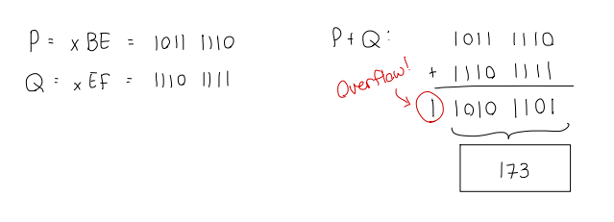
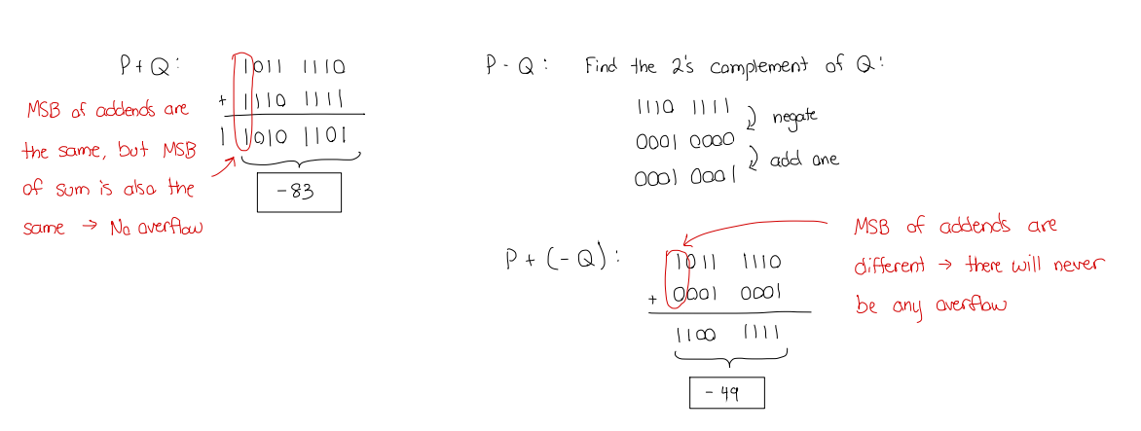
Practice Problems
Let P = xBE and Q = xEF
Find P + Q in unsigned representation. Indicate whether there is any overflow.
Find P + Q and P - Q in two’s complement representation. For each solution, indicate whether there is any overflow.

Slide 44
