Slide 1
Physics 213 Final Exam HKN Review Session
Steven Kolaczkowski
Alex Littlefield

Slide 2
First Law of Life
Check your units

Slide 3

First Law of Thermodynamics
Check Your Units
$dU=dQ+dW_{on}=dQ−PdV$
If volume is constant: $dU=dQ$

Slide 4

Entropy, Temperature, and the Second Law of Thermodynamics
CHECK YOUR UNITS
$S≡k_{B}ln⁡(Ω)$ where $Ω$ is the number of microstates
$Ω_{total}=Ω_{1}∗Ω_{2}∴S_{total}=S_{1}+S_{2}$
$dS=\frac{1}{T}dU+\frac{P}{T}dV−\frac{μ}{T}dN$
For an Isolated system $ΔS≥0$ or $ΔS_{Universe}≥0$
If $ΔS=0$the process is reversible
Temperature: $\frac{1}{T}≡{\left(\frac{dS}{dU}\right)}_{V,N}$

Slide 5
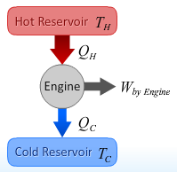

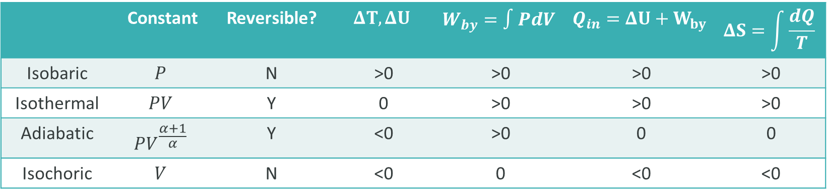
Engines
Hot and Cold Reservoirs: Constant $T$ and $PΔV=0$
$Q_{H}=W_{by}+Q_{C}$ $dS=\frac{dU}{T}$
Engine Efficiency: $ε≡\frac{W_{by engine}}{Q_{H}}=1−\frac{Q_{C}}{Q_{H}}≤1−\frac{T_{C}}{T_{H}}=ε_{Carnot}$
$ε≤ε_{Carnot}$ When $ΔS_{Total}>0$. Processes that are adiabatic or isothermal are reversible
Follow table is for EXPANSION ONLY!!!
Reverse signs for Compression
 | Constant | Reversible? | $$ΔT, ΔU$$ | $$W_{by}=∫PdV$$ | $$Q_{in}=ΔU+W_{by}$$ | $$ΔS=\int{\frac{dQ}{T}}$$
Isobaric | $$P$$ | N | >0 | >0 | >0 | >0
Isothermal | $$PV$$ | Y | 0 | >0 | >0 | >0
Adiabatic | $$PV^{\frac{α+1}{α}}$$ | Y | <0 | >0 | 0 | 0
Isochoric | $$V$$ | N | <0 | 0 | <0 | <0

Slide 6

Free Energy and Chemical Potential
Helmholtz Free Energy: $F_{system}=U_{system}−T_{env}S_{system} \left[=\right] Joules$
The maximum work that can be obtained from a system as it comes to equilibrium is just the negative change in Helmholtz Free Energy ${\left(W_{Max}=F_{i}−F_{equilibrium}\right)}_{V,T}$
Helmholtz Free Energy is minimized at equilibrium
Chemical Potential: $μ={\left(\frac{∂F}{∂N}\right)}_{V,T}$
Particle exchange will occur between two states until they have the same chemical potential
This is the equilibrium condition
Ideal Gas: $μ=u+k_{B}Tln\left(\frac{n}{n_{Q}}\right)$ where $n_{Q}$ is the quantum density or the density of available states
Ideal Solution (Low concentrations): $\frac{N_{solute}}{N_{solvent}}=e^{−\frac{Δ}{k_{B}T}}$
Simplified Semiconductor: $\frac{N_{conduction}}{N}=e^{−\frac{Δ}{2k_{B}T}}$ where $Δ$ is the bandgap energy

Slide 7

Gibbs Free Energy and the Fundamental Thermodynamic Relation
Gibbs Free Energy: ${\left(dG=dU+PdV−TdS=μdN\right)}_{P,T}$
Helmholtz Free Energy is the work that you put into a system to create it at constant T and V
Gibbs Free Energy is the work that you put into a system to create it at constant T and P
At Equilibrium and fixed Temperature and Pressure: $G_{total}=μ_{G}N_{G}+μ_{S}N_{S}$
Fundamental Equilibrium Relation: $dS=\left(\frac{1}{T}\right)dU+\left(\frac{P}{T}\right)dV−\left(\frac{μ}{T}\right)dN$
Rest in Peace Vapor Pressure. That topic sucked to teach at review sessions

Slide 8
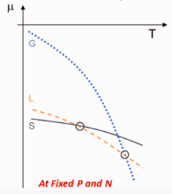
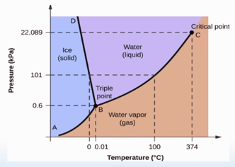
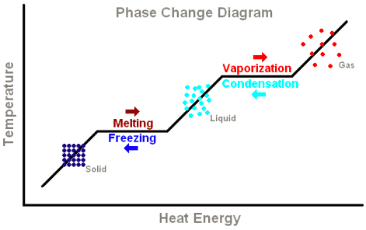

Phase Changes
Enthalpy (H): $H=U+PV$
Latent Heat: $L_{vaporization}=H_{gas}−H_{liquid}$

Slide 9

Thermal Radiation
Any material above absolute zero will radiate thermal energy
Radiation Current $(J)$: The amount of power radiated by an object per unit area
$J=e\left(λ\right)σ_{SB}T^{4}$
Emissivity or Absorbance $\left(e\left(λ\right)\right)$: $0≤e\left(λ\right)≤1$ Represents the materials ability to absorb light.

Slide 10
Exam Advice
When doing problems, PLEASE PLEASE PLEASE CHECK YOUR UNITS!!!
You will be shocked how many questions you can solve just matching units
Know when and how to use your equation sheet
Don’t panic, just keep on moving
Make sure you are in the right mindset going into the exam
Spend your time showing what you know
DON’T CHEAT

Slide 11
Past Exam Questions

Slide 12

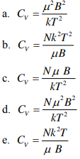

Spring 2013

Slide 13

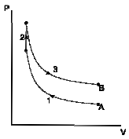


Spring 2014

Slide 14


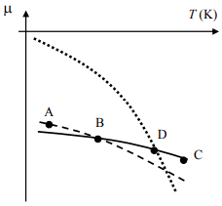



Spring 2014

Slide 15


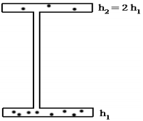


Spring 2013

Slide 16
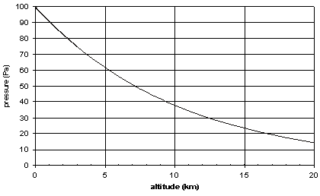


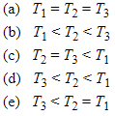

Sample Final

Slide 17
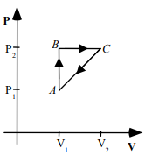


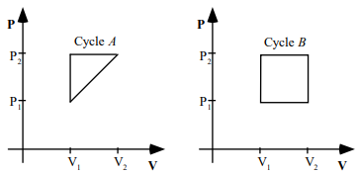


Fall 2007

Slide 18




Spring 2013

Slide 19



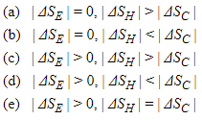
Fall 2007 and Sample Final

Slide 20
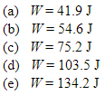

Sample Final

Slide 21
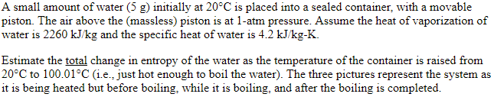
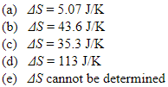
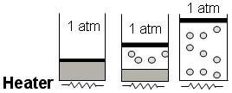

Sample Final

