Slide 1
HKN ECE 313 Exam 1 Review Session
Kanad Sarkar
Anit Kapoor

Slide 2
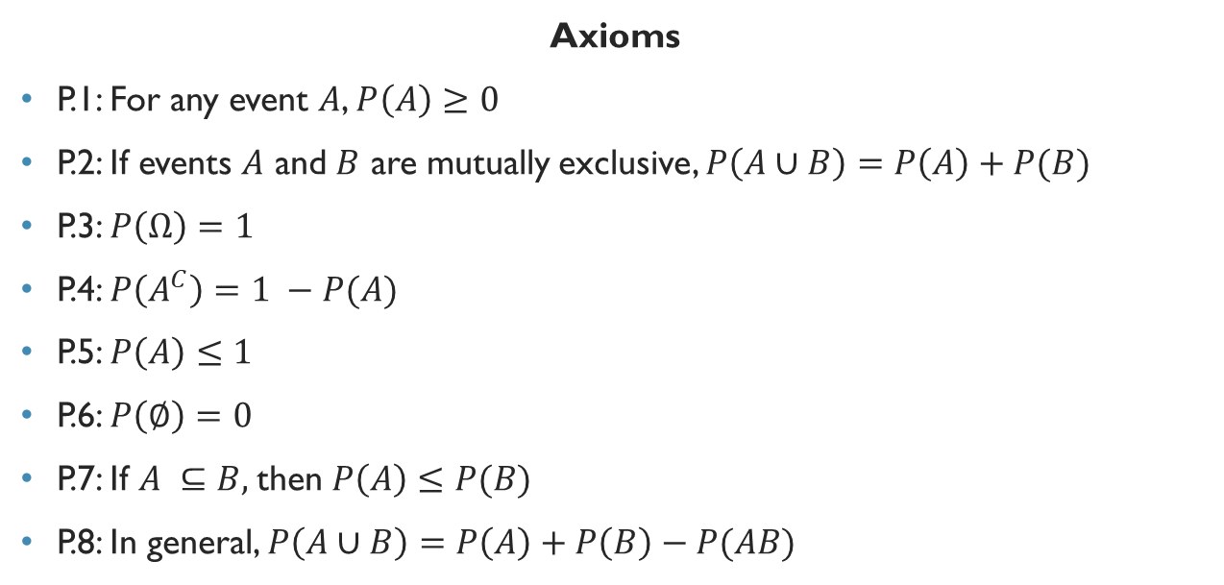
Axioms and Properties of Probability
Axioms
P.1: For any event $A$, $P\left(A\right)≥0$
P.2: If events $A$ and $B$ are mutually exclusive, $P\left(A∪B\right)=P\left(A\right)+P(B)$
P.3: $P\left(Ω\right)=1$
P.4: $P\left(A^{C}\right)=1 −P(A)$
P.5: $P\left(A\right)≤1$
P.6: $P\left(∅\right)=0$
P.7: If $A ⊆B,$then $P\left(A\right)≤P(B)$
P.8: In general, $P\left(A∪B\right)=P\left(A\right)+P\left(B\right)−P(AB)$

Slide 3
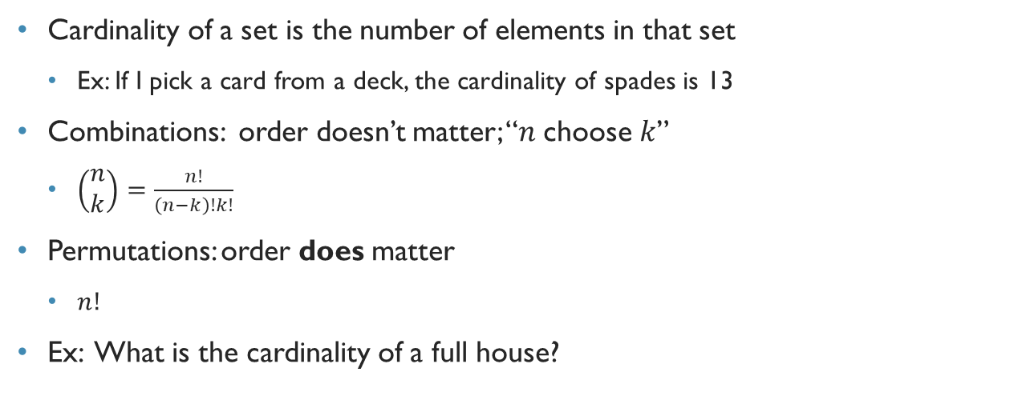
Cardinality of Sets
Cardinality of a set is the number of elements in that set
Ex: If I pick a card from a deck, the cardinality of spades is 13
Combinations: order doesn’t matter; “$n$choose$k$”
$\left(\begin{matrix}n \\ k\end{matrix}\right)=\frac{n!}{\left(n−k\right)!k!}$
Permutations: order does matter
$n!$
Ex: What is the cardinality of a full house?

Slide 4
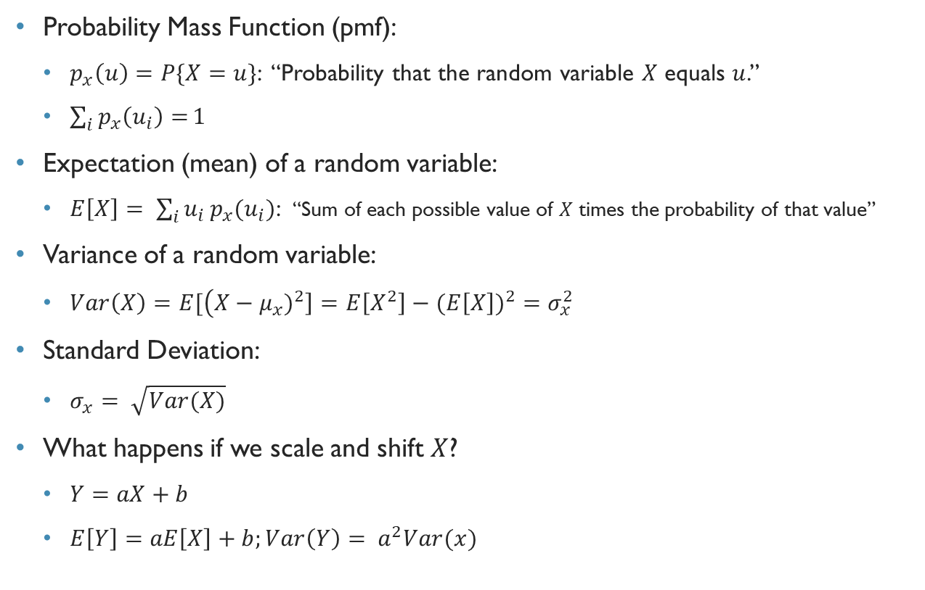
Random Variables
Probability Mass Function (pmf):
$p_{x}\left(u\right)=P\{X=u\}$: “Probability that the random variable $X$ equals $u$.”
$\sum_{i}{p_{x}\left(u_{i}\right)=}1$
Expectation (mean) of a random variable:
$E\left[X\right]= \sum_{i}{u_{i}}p_{x}(u_{i})$: “Sum of each possible value of $X$ times the probability of that value”
Variance of a random variable:
$Var\left(X\right)=E[\left(X−μ_{x})^{2}\right]=E\left[X^{2}\right]−(E\left[X\right])^{2}=σ_{x}^{2}$
Standard Deviation:
$σ_{x}= \sqrt{Var(X)}$
What happens if we scale and shift $X$?
$Y=aX+b$
$E\left[Y\right]=aE\left[X\right]+b;Var\left(Y\right)= a^{2}Var(x)$

Slide 5
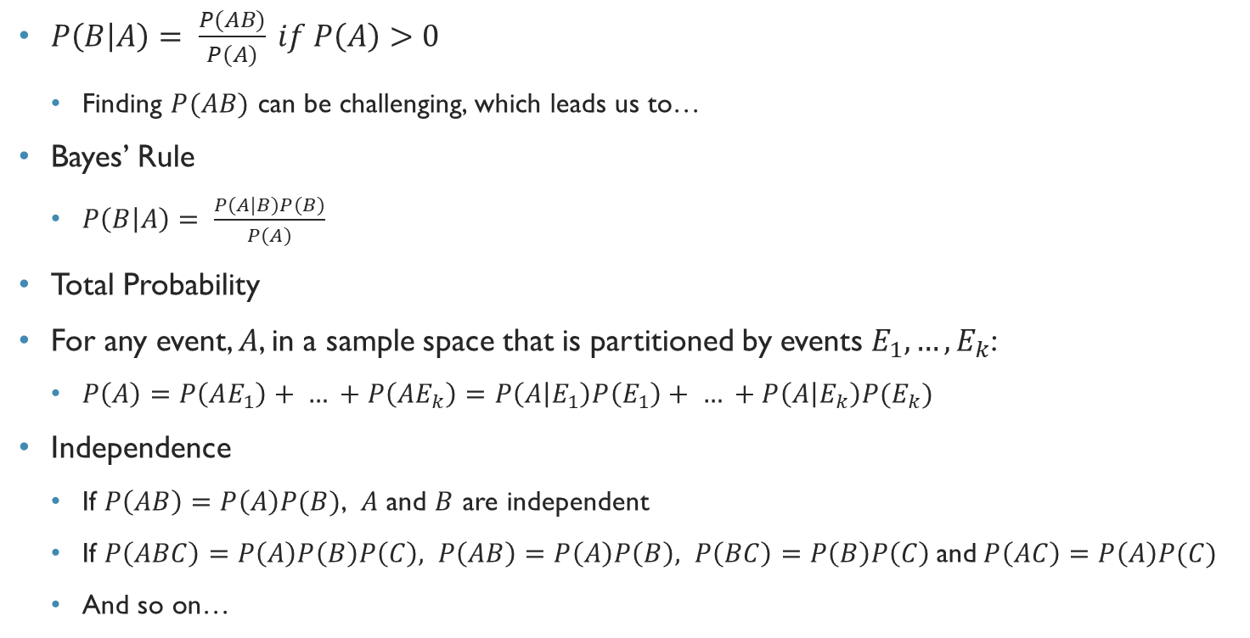
Conditional Probability, Independence, Total Probability, Bayes’ Rule
$P\left(B | A\right)= \frac{P(AB)}{P(A)} if P\left(A\right)>0$
Finding $P(AB)$ can be challenging, which leads us to…
Bayes’ Rule
$P\left(B | A\right)= \frac{P(A|B)P(B)}{P(A)}$
Total Probability
For any event, $A$, in a sample space that is partitioned by events $E_{1},…,E_{k}$:
$P\left(A\right)=P\left(AE_{1}\right)+ … +P\left(AE_{k}\right)=P\left(A | E_{1}\right)P\left(E_{1}\right)+ … +P\left(A | E_{k}\right)P(E_{k})$
Independence
If $P\left(AB\right)=P\left(A\right)P(B)$, $A$ and $B$ are independent
If $P\left(ABC\right)=P\left(A\right)P\left(B\right)P\left(C\right), P\left(AB\right)=P\left(A\right)P\left(B\right), P\left(BC\right)=P\left(B\right)P\left(C\right)$and$P\left(AC\right)=P\left(A\right)P(C)$
And so on…

Slide 6
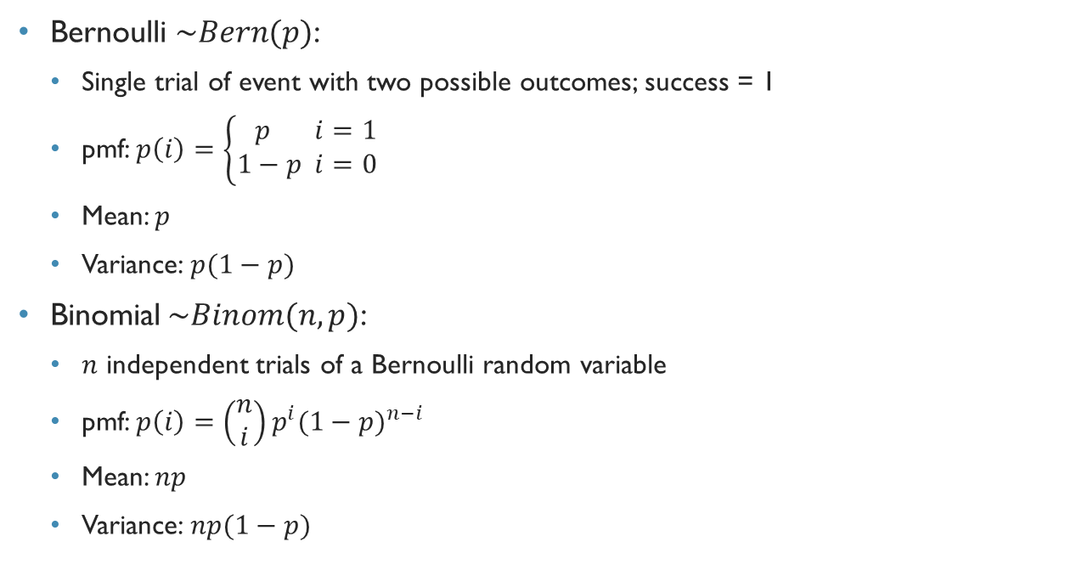
Bernoulli and binomial Distributions
Bernoulli $\sim Bern(p)$:
Single trial of event with two possible outcomes; success = 1
pmf: $p\left(i\right)=\left\{\begin{aligned}p i=1 \\ 1−p i=0 \end{aligned}\right.$
Mean: $p$
Variance: $p(1−p)$
Binomial$\sim Binom(n,p)$:
$n$ independent trials of a Bernoulli random variable
pmf: $p\left(i\right)=\left(\begin{matrix}n \\ i\end{matrix}\right)p^{i}(1−p)^{n−i}$
Mean: $np$
Variance: $np(1−p)$

Slide 7
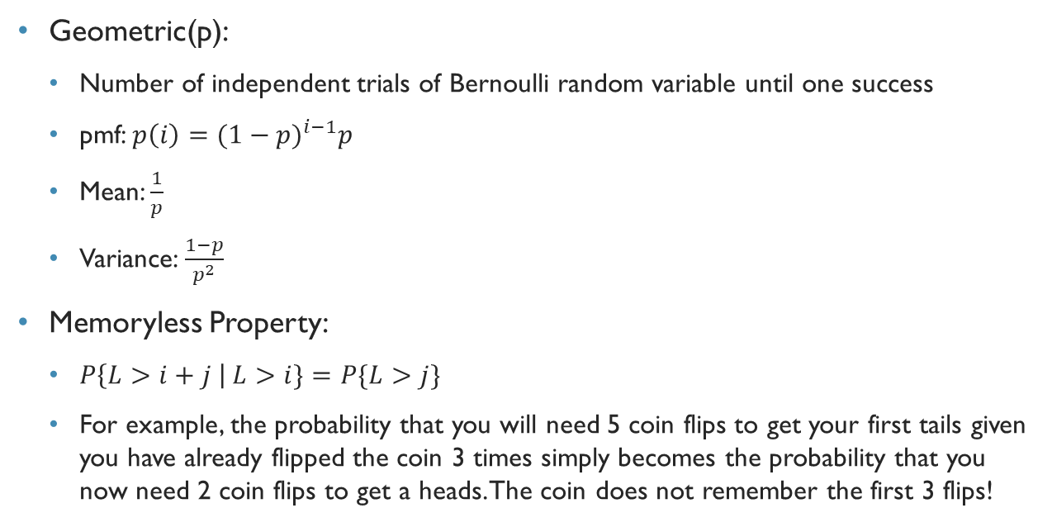
Geometric Distribution
Geometric(p):
Number of independent trials of Bernoulli random variable until one success
pmf: $p\left(i\right)=(1−p)^{i−1}p$
Mean: $\frac{1}{p}$
Variance: $\frac{1−p}{p^{2}}$
Memoryless Property:
$P\left\{L>i+j \right| L>i\}=P\{L>j\}$
For example, the probability that you will need 5 coin flips to get your first tails given you have already flipped the coin 3 times simply becomes the probability that you now need 2 coin flips to get a heads. The coin does not remember the first 3 flips!

Slide 8
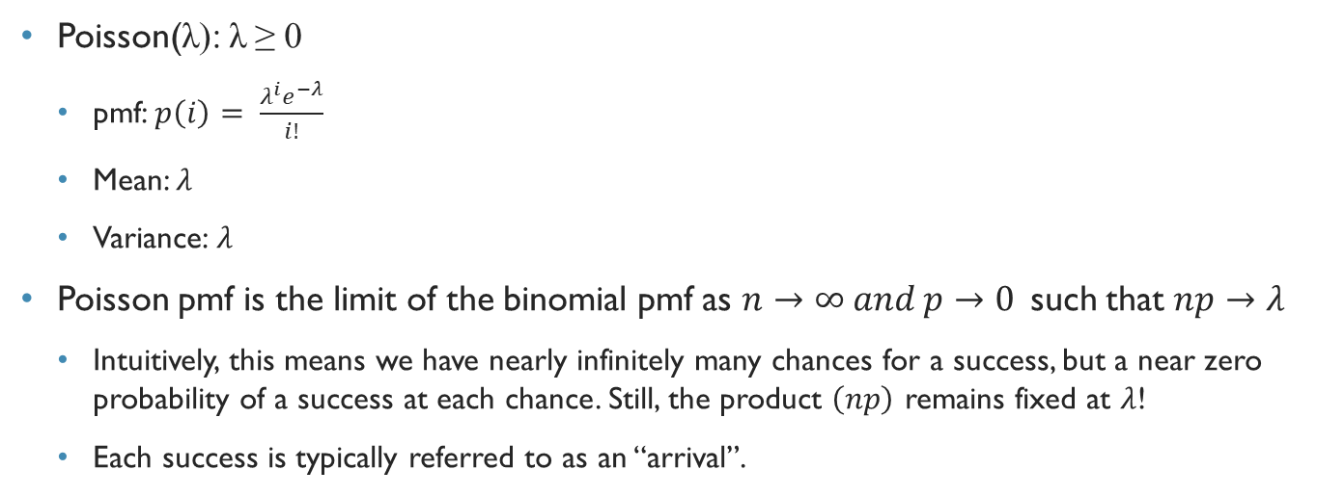
Poisson Distribution
Poisson(λ): λ ≥ 0
pmf: $p\left(i\right)= \frac{λ^{i}e^{−λ}}{i!}$
Mean: $λ$
Variance: $λ$
Poisson pmf is the limit of the binomial pmf as $n→∞ and p→0$such that $np→λ$
Intuitively, this means we have nearly infinitely many chances for a success, but a near zero probability of a success at each chance. Still, the product $\left(np\right)$ remains fixed at $λ$!
Each success is typically referred to as an “arrival”.

Slide 9
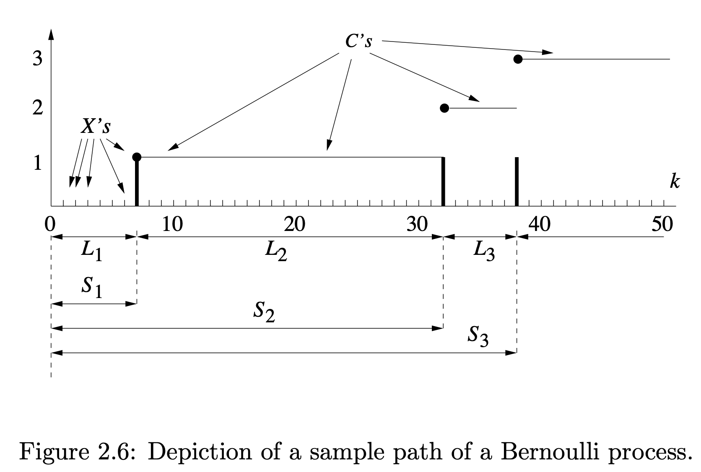
Bernoulli Counting Process

Slide 10
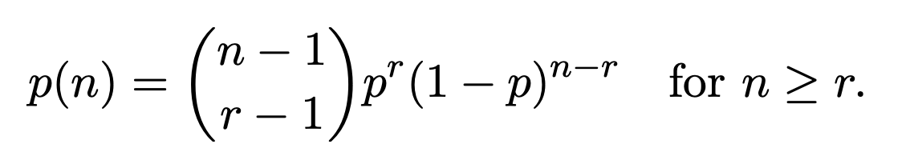
Negative Binomial
Mean:
Variance:

Slide 11
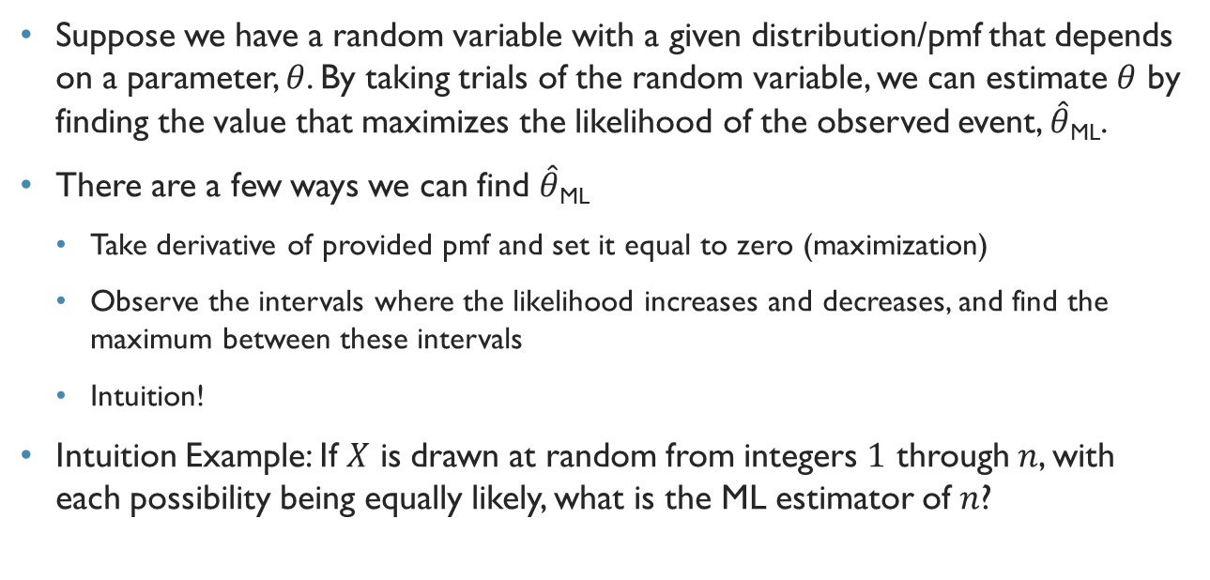
Maximum Likelihood Parameter Estimation
Suppose we have a random variable with a given distribution/pmf that depends on a parameter, $θ$. By taking trials of the random variable, we can estimate $θ$ by finding the value that maximizes the likelihood of the observed event, $\hat{θ}$_{ML}.
There are a few ways we can find $\hat{θ}$_{ML}
Take derivative of provided pmf and set it equal to zero (maximization)
Observe the intervals where the likelihood increases and decreases, and find the maximum between these intervals
Intuition!
Intuition Example: If $X$ is drawn at random from integers $1$ through $n$, with each possibility being equally likely, what is the ML estimator of $n$?

Slide 12
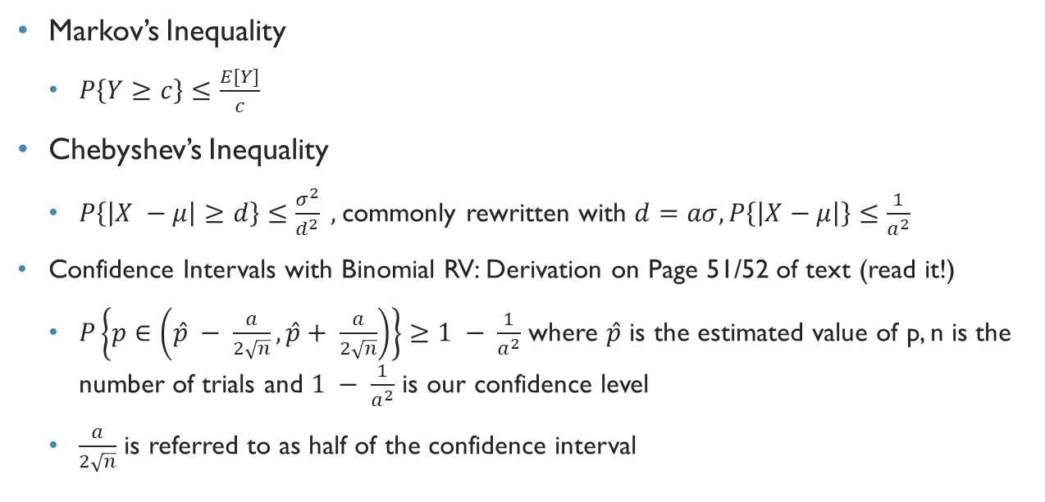
Markov and Chebyshev Inequalities
Markov’s Inequality
$P\left\{Y≥c\right\}≤\frac{E[Y]}{c}$
Chebyshev’s Inequality
$P\left\{\left|X −μ\right|≥d\right\}≤\frac{σ^{2}}{d^{2}} ,$commonly rewritten with $d=aσ, P\left\{\left|X−μ\right|\right\}≤\frac{1}{a^{2}}$
Confidence Intervals with Binomial RV: Derivation on Page 51/52 of text (read it!)
$P\left\{p∈\left(\hat{p} − \frac{a}{2\sqrt{n}}, \hat{p}+ \frac{a}{2\sqrt{n}}\right)\right\}≥1 − \frac{1}{a^{2}}$ where $\hat{p}$ is the estimated value of p, n is the number of trials and $1 − \frac{1}{a^{2}}$ is our confidence level
$\frac{a}{2\sqrt{n}}$ is referred to as half of the confidence interval

Slide 13
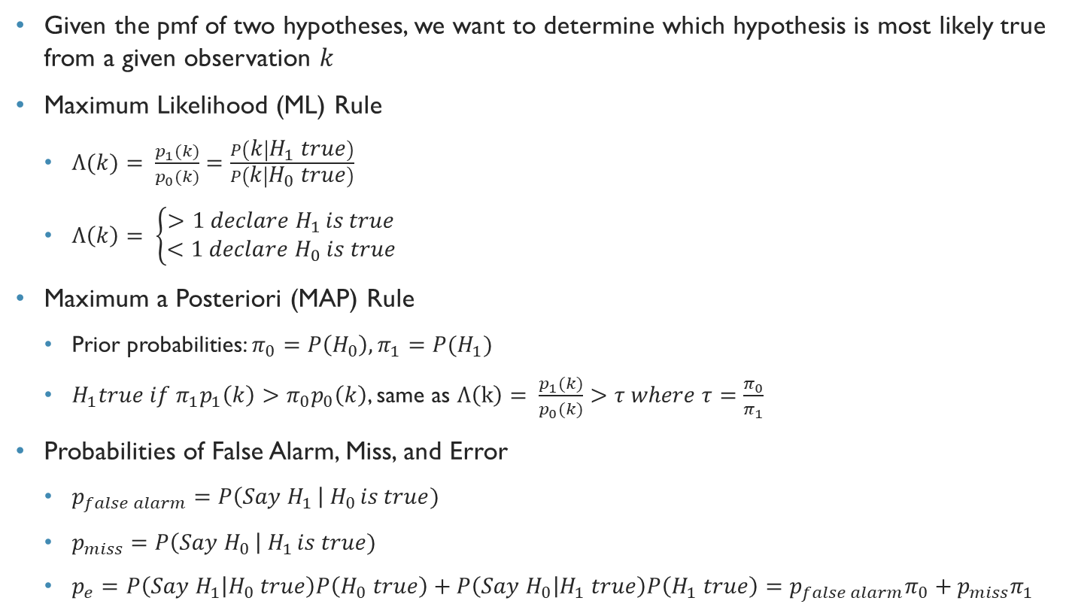
Hypothesis Testing
Given the pmf of two hypotheses, we want to determine which hypothesis is most likely true from a given observation $k$
Maximum Likelihood (ML) Rule
$Λ(k)= \frac{p_{1}(k)}{p_{0}(k)}=\frac{P\left(k | H_{1} true\right)}{P\left(k | H_{0} true\right)}$
$Λ\left(k\right)= \left\{\begin{aligned}>1 declare H_{1 }is true \\ <1 declare H_{0} is true\end{aligned}\right.$
Maximum a Posteriori (MAP) Rule
Prior probabilities: $π_{0}=P\left(H_{0}\right), π_{1}=P{(H}_{1})$
$H_{1}true if π_{1}p_{1}\left(k\right)>π_{0}p_{0}\left(k\right)$, same as $Λ\left(k\right)= \frac{p_{1}(k)}{p_{0}(k)}>τ where τ=\frac{π_{0}}{π_{1}}$
Probabilities of False Alarm, Miss, and Error
$p_{false alarm}=P\left(Say H_{1 }\right| H_{0 }is true)$
$p_{miss}=P\left(Say H_{0 }\right| H_{1 }is true)$
$p_{e}=P\left(Say H_{1} | H_{0} true\right)P\left(H_{0} true\right)+P\left(Say H_{0} | H_{1} true\right)P\left(H_{1} true\right)=p_{false alarm}π_{0}+p_{miss}π_{1}$

Slide 14
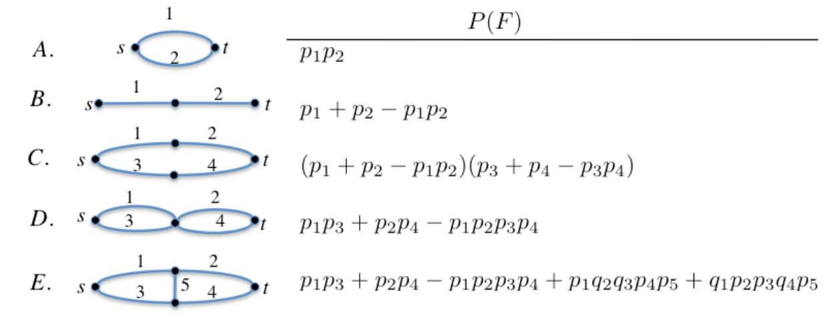
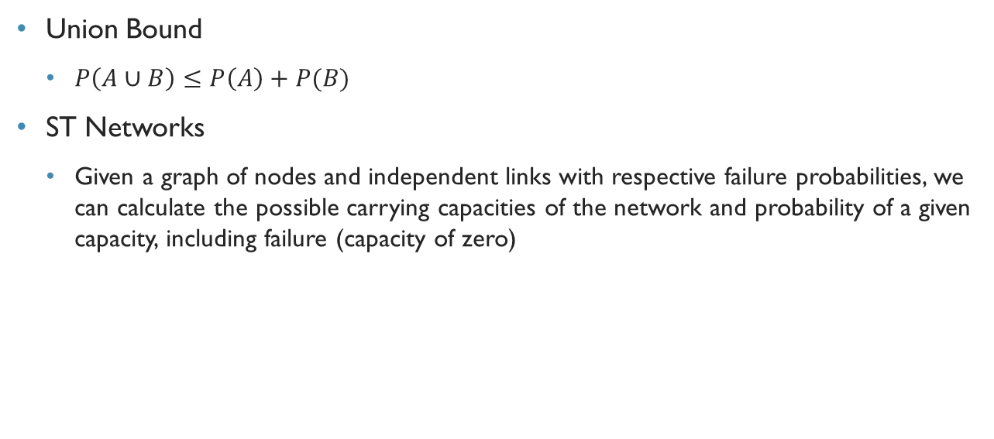
Union Bound and ST Networks
Union Bound
$P\left(A∪B\right)≤P\left(A\right)+P(B)$
ST Networks
Given a graph of nodes and independent links with respective failure probabilities, we can calculate the possible carrying capacities of the network and probability of a given capacity, including failure (capacity of zero)

Slide 15
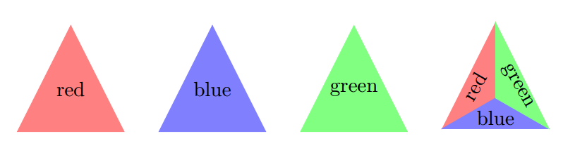
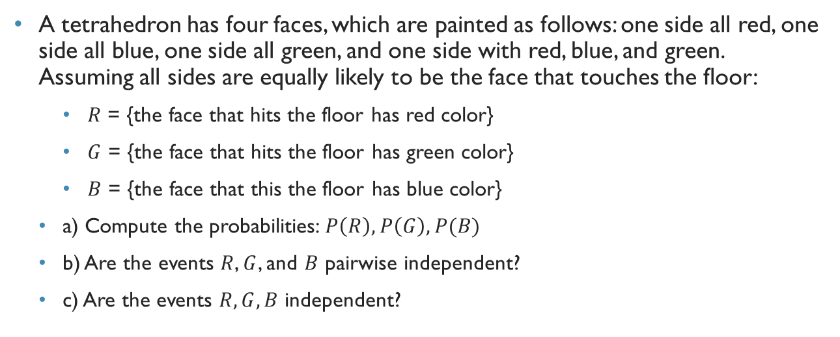
FA15 Exam 1 Q1
A tetrahedron has four faces, which are painted as follows: one side all red, one side all blue, one side all green, and one side with red, blue, and green. Assuming all sides are equally likely to be the face that touches the floor:
$R$ = {the face that hits the floor has red color}
$G$ = {the face that hits the floor has green color}
$B$ = {the face that this the floor has blue color}
a) Compute the probabilities: $P\left(R\right), P\left(G\right), P(B)$
b) Are the events $R$, $G$, and $B$ pairwise independent?
c) Are the events $R,G,B$ independent?

Slide 16
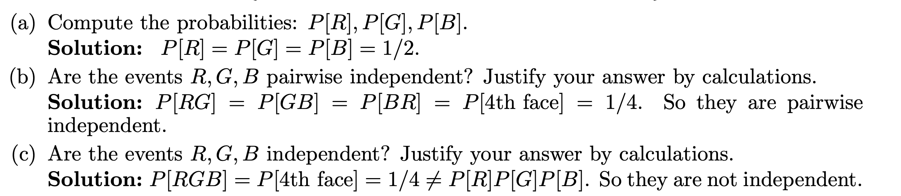

Slide 17
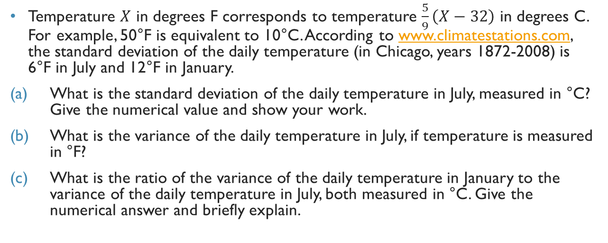
SP16 Exam 1 Q2
Temperature $X$ in degrees F corresponds to temperature $\frac{5}{9}\left(X−32\right)$ in degrees C. For example, 50°F is equivalent to 10°C. According to www.climatestations.com, the standard deviation of the daily temperature (in Chicago, years 1872-2008) is 6°F in July and 12°F in January.
What is the standard deviation of the daily temperature in July, measured in °C? Give the numerical value and show your work.
What is the variance of the daily temperature in July, if temperature is measured in °F?
What is the ratio of the variance of the daily temperature in January to the variance of the daily temperature in July, both measured in °C. Give the numerical answer and briefly explain.

Slide 18
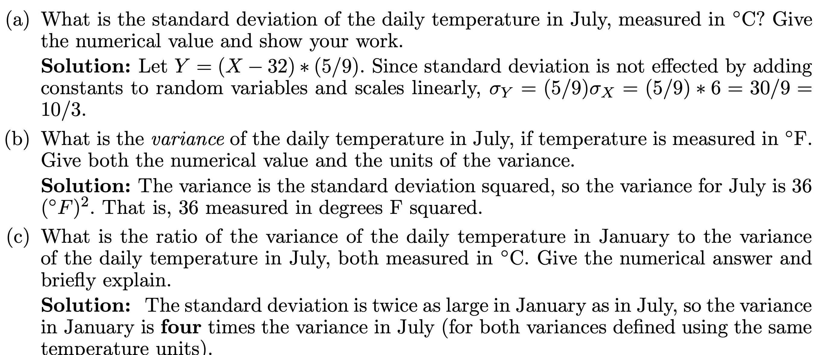

Slide 19
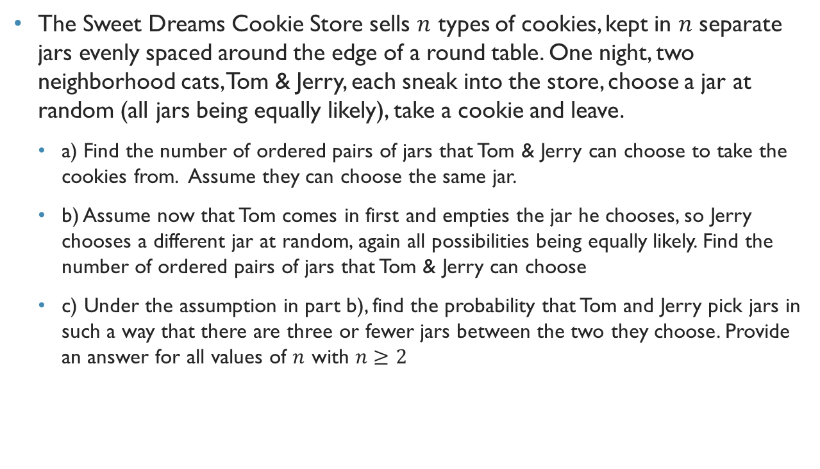
SP14 Exam 1 Q1
The Sweet Dreams Cookie Store sells $n$ types of cookies, kept in $n$ separate jars evenly spaced around the edge of a round table. One night, two neighborhood cats, Tom & Jerry, each sneak into the store, choose a jar at random (all jars being equally likely), take a cookie and leave.
a) Find the number of ordered pairs of jars that Tom & Jerry can choose to take the cookies from. Assume they can choose the same jar.
b) Assume now that Tom comes in first and empties the jar he chooses, so Jerry chooses a different jar at random, again all possibilities being equally likely. Find the number of ordered pairs of jars that Tom & Jerry can choose
c) Under the assumption in part b), find the probability that Tom and Jerry pick jars in such a way that there are three or fewer jars between the two they choose. Provide an answer for all values of $n$ with $n≥2$

Slide 20
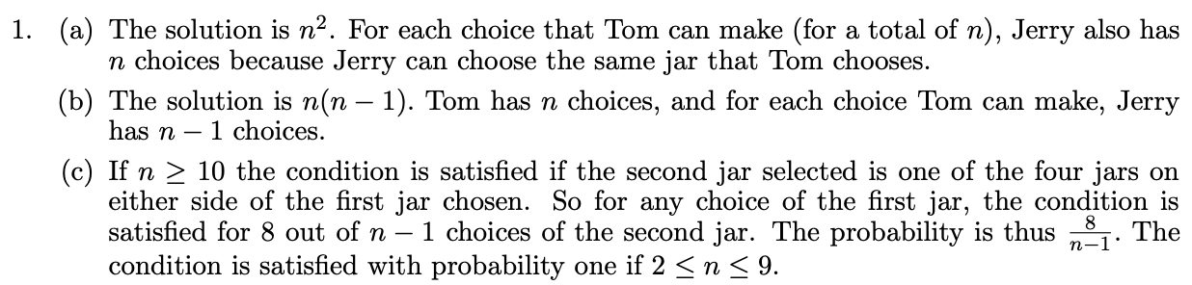

Slide 21
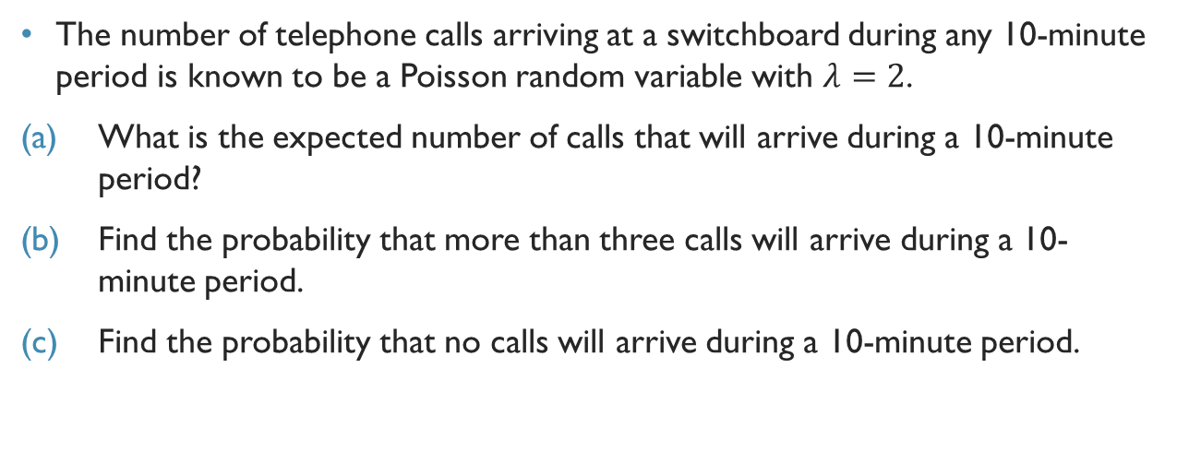
FA15 Exam 1 Q3
The number of telephone calls arriving at a switchboard during any 10-minute period is known to be a Poisson random variable with $λ=2$.
What is the expected number of calls that will arrive during a 10-minute period?
Find the probability that more than three calls will arrive during a 10-minute period.
Find the probability that no calls will arrive during a 10-minute period.

Slide 22
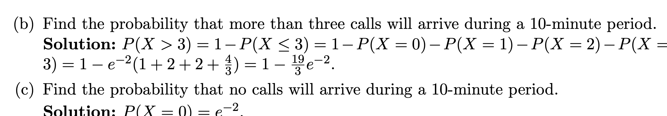
a) E[X] = λ = 2

Slide 23
Fa13 Exam 1 q7
Consider a regular 8x8 chessboard, which consists of 64 squares in 8 rows and 8 columns.
a) How many different rectangles, comprised entirely of chessboard squares, can be drawn on the chessboard? Hint: there are 9 horizontal and 9 vertical lines in the chessboard.
b) One of the rectangles you counted in part a) is chosen at random. What is the probability that it is square shaped?

Slide 24
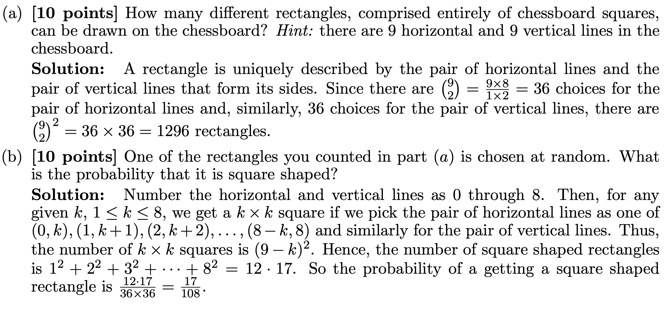

Slide 25
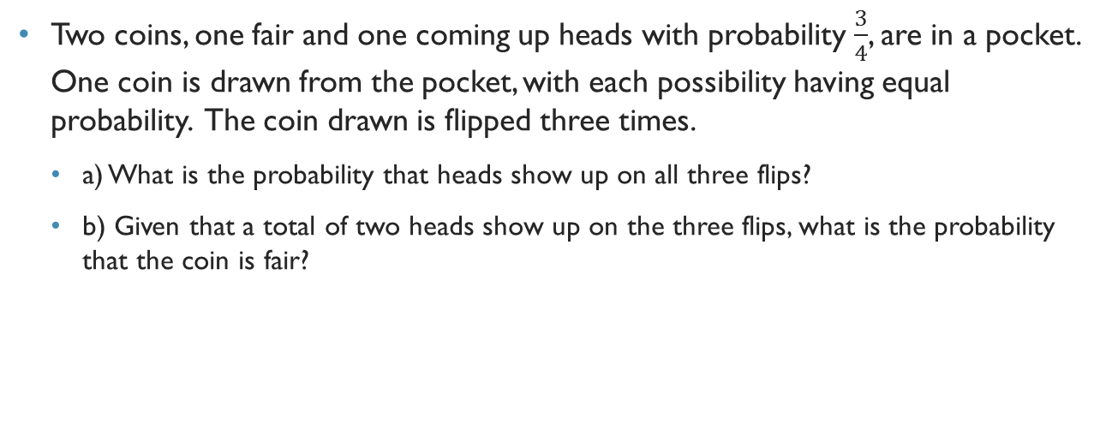
SP14 Exam 1 Q5
Two coins, one fair and one coming up heads with probability $\frac{3}{4}$, are in a pocket. One coin is drawn from the pocket, with each possibility having equal probability. The coin drawn is flipped three times.
a) What is the probability that heads show up on all three flips?
b) Given that a total of two heads show up on the three flips, what is the probability that the coin is fair?

Slide 26
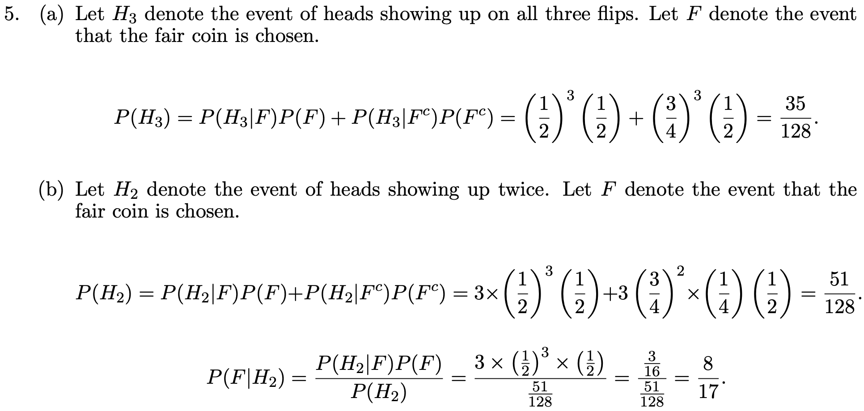

Slide 27
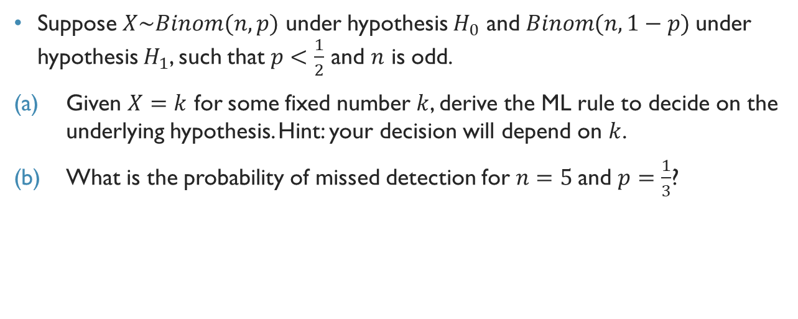
SP16 Exam 1 Q4
Suppose $X\sim Binom(n,p)$ under hypothesis $H_{0}$ and $Binom(n, 1−p)$under hypothesis $H_{1}$, such that $p<\frac{1}{2}$ and $n$ is odd.
Given $X=k$ for some fixed number $k$, derive the ML rule to decide on the underlying hypothesis. Hint: your decision will depend on $k$.
What is the probability of missed detection for $n=5$and $p=\frac{1}{3}$?

Slide 28
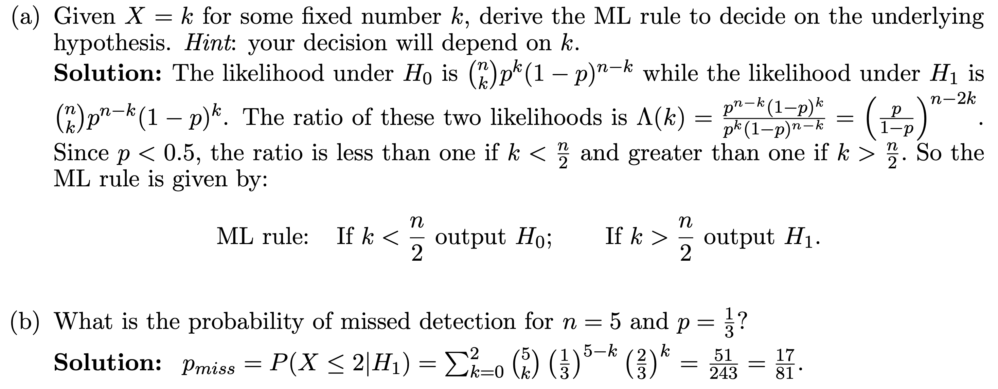

Slide 29
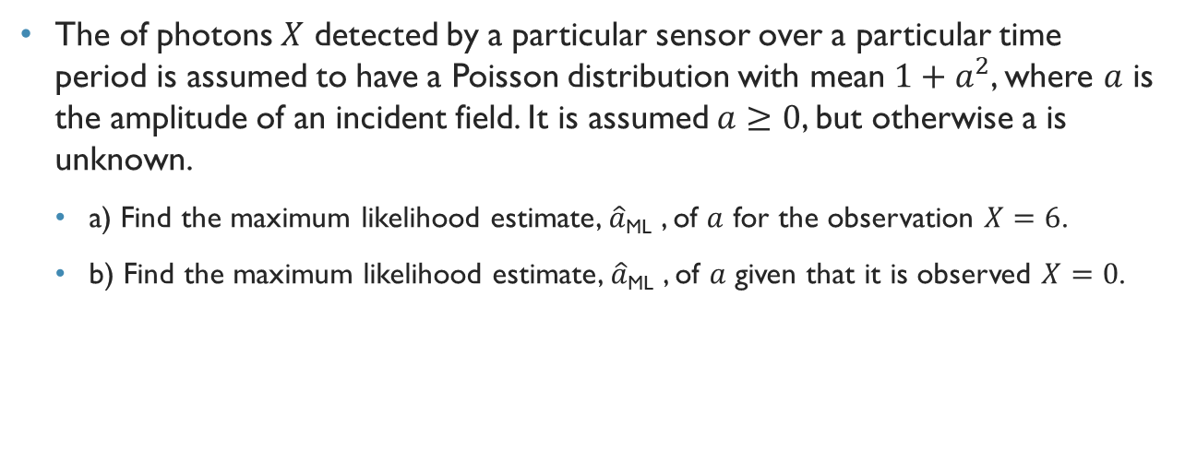
Fa12 exam 1 q4
The of photons $X$ detected by a particular sensor over a particular time period is assumed to have a Poisson distribution with mean $1+a^{2}$, where $a$ is the amplitude of an incident field. It is assumed $a≥0$, but otherwise a is unknown.
a) Find the maximum likelihood estimate, $\hat{a}$_{ML} , of $a$ for the observation $X=6$.
b) Find the maximum likelihood estimate, $\hat{a}$_{ML} , of $a$ given that it is observed $X=0$.

Slide 30
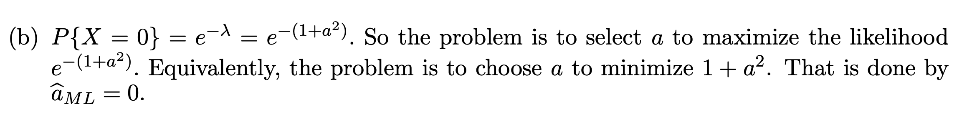

Slide 31
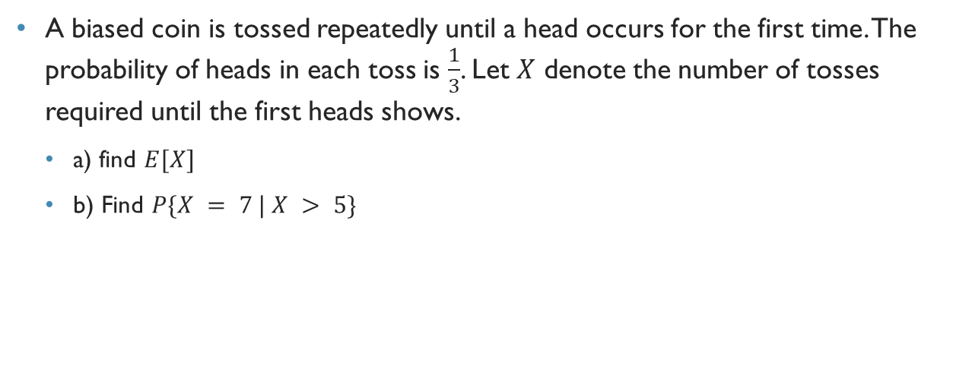
Fa13 exam 1 q4
A biased coin is tossed repeatedly until a head occurs for the first time. The probability of heads in each toss is $\frac{1}{3}$. Let $X$ denote the number of tosses required until the first heads shows.
a) find $E[X]$
b) Find $P\{X = 7 | X > 5\}$

Slide 32
