Slide 1
HKN ECE 110 Quiz 4 Review Session
Alan Liu, Rubhav Nayak, Daniel Ahn, Sanjana Pingali

Slide 2

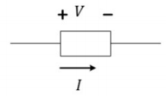
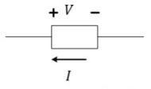

Standard VS Non-Standard Labeling
Standard Labeling: Current flows from + to –
$V=IR$ (only for resistors!)
$P=IV$
Non-standard Labeling: Current flows from – to +
$P=−IV$
Component absorbs power if $P>0$
Component dissipates power if $P<0$
Notes:
Eric

Slide 3
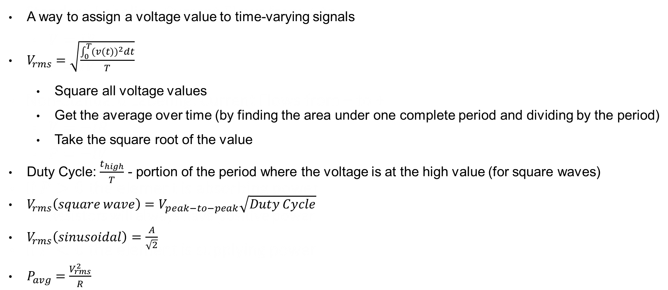
Root Mean Square
A way to assign a voltage value to time-varying signals
$V_{rms}=\sqrt{\frac{\int_{0}^{T}{{(v(t))}^{2}dt}}{T}}$
Square all voltage values
Get the average over time (by finding the area under one complete period and dividing by the period)
Take the square root of the value
Duty Cycle: $\frac{t_{high}}{T}$ - portion of the period where the voltage is at the high value (for square waves)
$V_{rms}\left(square wave\right)=V_{peak−to−peak}\sqrt{Duty Cycle}$
$V_{rms}\left(sinusoidal\right)=\frac{A}{\sqrt{2}}$
$P_{avg}=\frac{V_{rms}^{2}}{R}$
Notes:
Eric

Slide 4
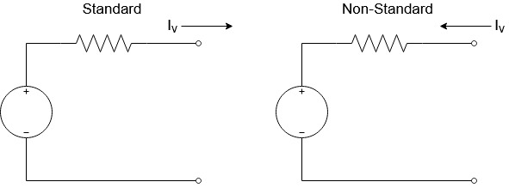
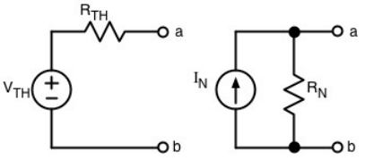
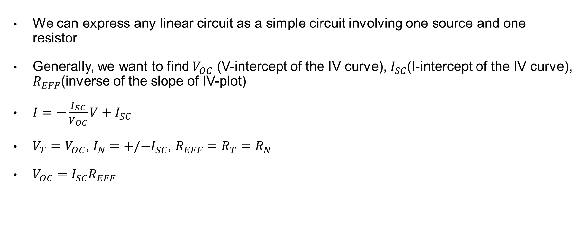
Thevenin, Norton, and IV Relationship
We can express any linear circuit as a simple circuit involving one source and one resistor
Generally, we want to find $V_{OC}$ (V-intercept of the IV curve), $I_{SC}$(I-intercept of the IV curve), $R_{EFF}$(inverse of the slope of IV-plot)
$I=−\frac{I_{SC}}{V_{OC}}V+I_{SC}$
$V_{T}=V_{OC}$, $I_{N}={+/−I}_{SC}$, $R_{EFF}=R_{T}=R_{N}$
$V_{OC}=I_{SC}R_{EFF}$
I
+
V
-

Slide 5
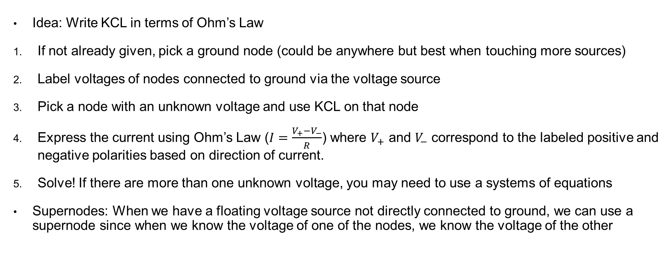
Node Voltage Method
Idea: Write KCL in terms of Ohm’s Law
If not already given, pick a ground node (could be anywhere but best when touching more sources)
Label voltages of nodes connected to ground via the voltage source
Pick a node with an unknown voltage and use KCL on that node
Express the current using Ohm’s Law ($I=\frac{V_{+}−V_{−}}{R}$) where $V_{+}$ and $V_{−}$ correspond to the labeled positive and negative polarities based on direction of current.
Solve! If there are more than one unknown voltage, you may need to use a systems of equations
Supernodes: When we have a floating voltage source not directly connected to ground, we can use a supernode since when we know the voltage of one of the nodes, we know the voltage of the other

Slide 6
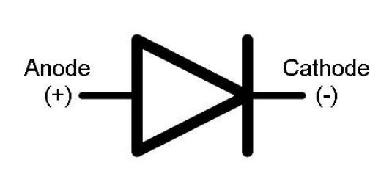
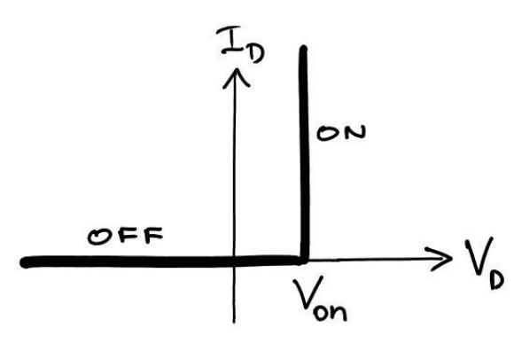
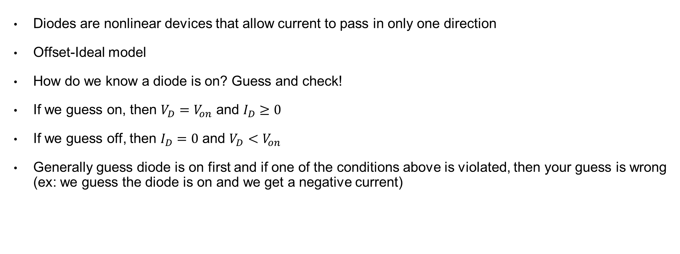
Diodes (not covered on quiz 2)
Diodes are nonlinear devices that allow current to pass in only one direction
Offset-Ideal model
How do we know a diode is on? Guess and check!
If we guess on, then $V_{D}=V_{on}$ and $I_{D}≥0$
If we guess off, then $I_{D}=0$ and $V_{D}<V_{on}$
Generally guess diode is on first and if one of the conditions above is violated, then your guess is wrong (ex: we guess the diode is on and we get a negative current)

Slide 7
Exam advice
If you are stuck on a question, skip it and come back
Show what you know!!
PrairieLearn practice exams are great but don’t memorize them
Take some time to relax before the exam

Slide 8
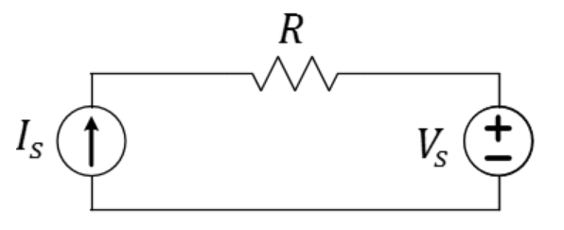

Let $I_{S}=50 mA$, $V_{S}=−0.4 V$, and $R=100 Ω$. Find the power for each element.

Slide 9
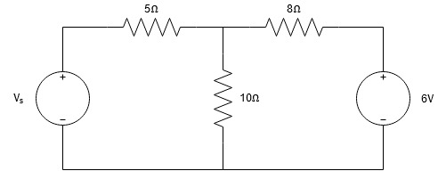

Find the max value of voltage source $V_{s}$ such that the 6V source neither absorbs nor dissipates power

Slide 10
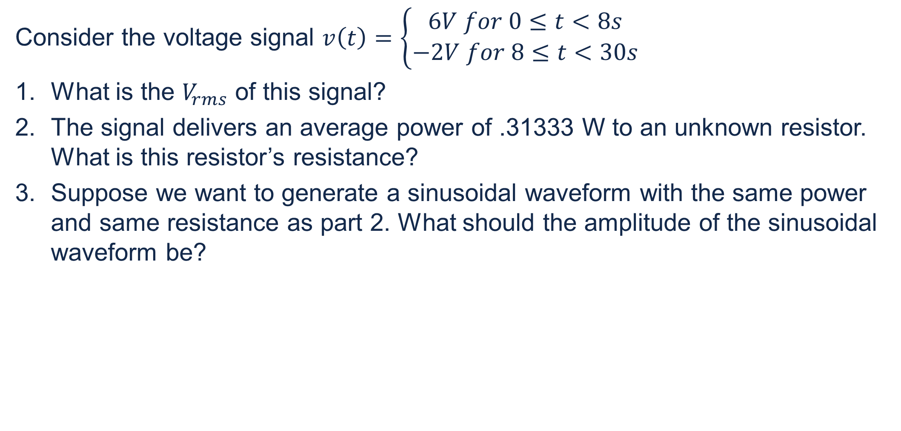
Consider the voltage signal $v\left(t\right)=\left\{\begin{aligned}6V for 0≤t<8s \\ −2V for 8≤t<30s\end{aligned}\right.$
What is the $V_{rms}$ of this signal?
The signal delivers an average power of .31333 W to an unknown resistor. What is this resistor’s resistance?
Suppose we want to generate a sinusoidal waveform with the same power and same resistance as part 2. What should the amplitude of the sinusoidal waveform be?

Slide 11
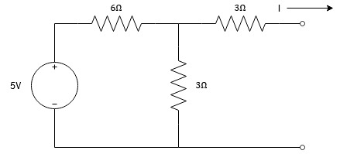

Find the Thevenin voltage $V_{T}$, Thevenin resistance $R_{T}$, and Norton current $I_{N}$, and the IV equation for this circuit.
+
V
-

Slide 12
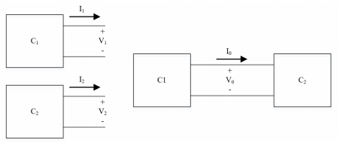

The two following subcircuits have the following values for Thevenin voltage and resistance. Find the operating point $I_{0}$ and $V_{0}$.
$$I_{1}={−\frac{1}{5}V}_{1}+1$$
$$I_{2}=−\frac{1}{2}V_{2}+2$$

Slide 13
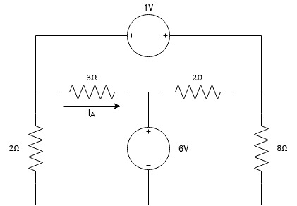

Find the value of $I_{A}$

