Slide 1
Physics 214 HKN Final Exam Review Session
Steven Kolaczkowski
Alex littlefield

Slide 2
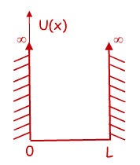

Time Independent Schrödinger Equation (TISE) and the Infinite Potential Well
$$−\frac{ℏ^{2}}{2m}\frac{d^{2}ψ\left(x\right)}{dx^{2}}+U\left(x\right)ψ(x)=Eψ(x)$$
Free Particle solution: if $U\left(x\right)=0$, then our original harmonic wave solutions works and we can say $ψ\left(x\right)=\operatorname{Acos}\left(kx\right)+Bsin(kx)$
You can verify that this will get us $\frac{k^{2}ℏ^{2}}{2m}ψ\left(x\right)=Eψ(x)$
Infinite Square Well: We need a function that is zero at x=0 and x=L
From our options above, $ψ\left(x\right)=\sqrt{\frac{2}{L}}\sin\left(k_{n}x\right)$ works if $k_{n}=\frac{nπ}{L}=\frac{2π}{λ_{n}}$
$λ_{n}=\frac{2L}{n}$ and $E_{n}=\frac{n^{2}π^{2}ℏ^{2}}{2mL^{2}}=\frac{n^{2}h^{2}}{8mL^{2}}$
$n$ is the state of the system and $n=1, 2, 3, …$

Slide 3
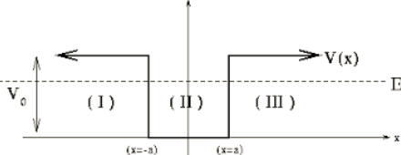

Finite Potential Wells and Boundary Conditions
Normalization: since ${\left|ψ\left(x\right)\right|}^{2}$ is a probability density, the sum of all probabilities must be one
$1=∫{\left|ψ\left(x\right)\right|}^{2} dx$
With changing potentials we force two boundary conditions to be met:
$ψ\left(x^{−}\right)=ψ\left(x^{+}\right)$ and $\frac{dψ\left(x^{−}\right)}{dx}=\frac{dψ\left(x^{+}\right)}{dx}$
$\cos\left(kx\right)=\frac{e^{ikx}+e^{−ikx}}{2}$
$\sin\left(kx\right)=\frac{e^{ikx}−e^{−ikx}}{2i}$
$k=\sqrt{\frac{2m}{ℏ^{2}}\left(E−V\right)}$

Slide 4

Reflections and Tunneling
How does k change when we pass from a classically allowed region to a classically forbidden one? What happens when we go back?
$k=\sqrt{\frac{2m}{ℏ^{2}}\left(E−V\right)}$
Transmission Probability: $T\sim Ge^{−2KL}$ where $G=16\frac{E}{U_{0}}(1−\frac{E}{U_{0}})$, $K=\sqrt{\frac{2m}{ℏ^{2}}\left(U_{0}−E\right)}$, and L is the thickness of the barrier

Slide 5


Time Dependent Schrödinger Equation (TDSE): dotting your $i$’s and crossing your $h$’s
TISE: $−\frac{ℏ^{2}}{2m}\frac{d^{2}ψ\left(x\right)}{dx^{2}}+U\left(x\right)ψ\left(x\right)=Eψ\left(x\right)$
Now we are going to look at time dependent wave functions $Ψ\left(x,t\right)=ψ_{n}\left(x\right)e^{−iω_{n}t}$
TDSE: $−\frac{ℏ^{2}}{2m}\frac{d^{2}Ψ\left(x,t\right)}{dx^{2}}+U\left(x\right)Ψ\left(x,t\right)=iℏ\frac{dΨ\left(x,t\right)}{dt}$
Superposition principle: TDSE can also be solved by:
$$Ψ\left(x,t\right)=aψ_{0}\left(x\right)e^{−iω_{0}t}+bψ_{1}\left(x\right)e^{−iω_{1}t}+ …$$
Notice that this is not a solution to TISE

Slide 6

Normalization and Orthogonality
Normalization:
$∫{\left|Ψ\left(x,t\right)\right|}^{2}dx=∫{\left|ψ\left(x\right)\right|}^{2}dx=∫ψ^{∗}\left(x\right)ψ\left(x\right)dx=1$
Does this change with superposition? Will it change over time?
Orthogonality Principle:
$∫{(aψ}_{n})\left(bψ_{m}\right)dx=\left\{\begin{aligned}0 if n≠m \\ ab if n=m\end{aligned}\right.$

Slide 7

Taking Quantum to Higher Dimensions
$−\frac{ℏ^{2}}{2m}∇^{2}Ψ\left(r,t\right)+U\left(r\right)Ψ\left(r,t\right)=iℏ\frac{dΨ\left(r,t\right)}{dt}$
Wavefunctions still need to be normalized in all space.
In this class we will only deal with rectangular potentials or spherical potentials with no $φ$ dependence $ψ\left(r,θ,φ\right)=R\left(r\right)Θ\left(θ\right)Φ\left(φ\right)=R\left(r\right)Θ(θ)$
Want to see $φ$ dependent potentials? Go to grad school!!!
Hydrogen Atom Energy: $E_{n}=−\frac{13.6eV}{n^{2}}$

Slide 8

Quantum Numbers
$n$ (Principal): $n≥1$ describes the size of the orbital
$l$(Angular or Orbital): $0≤l≤n−1$ describes the shape of the orbital
$L^{2}=l\left(l+1\right)ℏ^{2}=L_{x}^{2}+L_{y}^{2}+L_{z}^{2}$
$m$ (Magnetic): $−l≤m≤l$ describes the orientation of the orbital
$L_{z}=mℏ$
$$ψ_{n,l,m}\left(r,θ,φ\right)=R_{n,l}\left(r\right)Y_{l,m}(θ,φ)$$
$Y_{l,m}=P\left(θ\right)e^{imφ}$

Slide 9

Spin and Moments
$U=−μ ∙B=−μ_{z}B_{z}$
Stern-Gerlach: Electrons can only have two possible spin projections:
$s_{z}=\left(±\frac{1}{2}\right)ℏ=m_{s} ℏ$

Slide 10

Classes of Particles and Beyond Hydrogen (kinda)
Fermions: half integer spins
Can NEVER share all the same quantum numbers (Pauli Exclusion Principle)
Ex: electrons, quarks, protons, neutrons
Bosons: integer spins
Prefer to share all quantum numbers (This is the reason lasers work!)
Ex: photons $(γ)$, gluons, pions, $α$-particles
Want to learn more? Take Physics 470!!!
For single electrons in atoms: $E_{n}=−\frac{13.6eV}{n^{2}}Z^{2}$ where $Z$ is the number of protons

Slide 11
Exam Advice
Know when and how to use your equation sheet
Don’t panic, just keep on moving
Make sure you are in the right mindset going into the exam
Spend your time showing what you know
DON’T CHEAT

Slide 12
Past Exam Questions

Slide 13
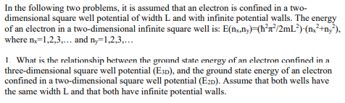



Fall 2001

Slide 14

Fall 2001

Slide 15




Fall 2001

Slide 16
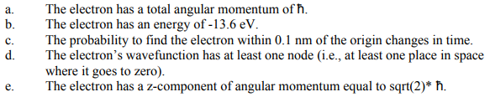
Spring 2018 Practice

Slide 17
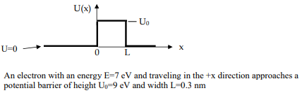


Fall 2001

Slide 18



Spring 2018 Practice

Slide 19
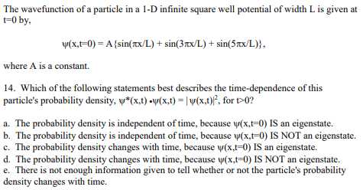
Fall 2001

Slide 20
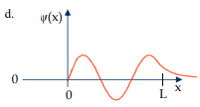
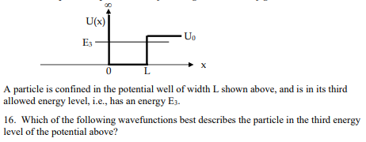
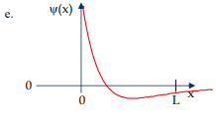
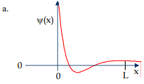
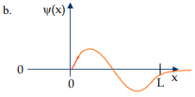
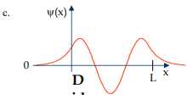
Fall 2001

Slide 21
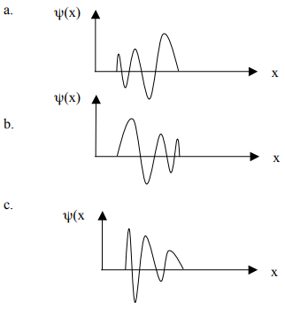
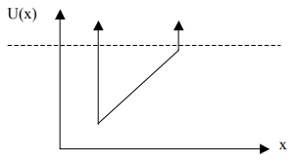

Spring 2018 Practice

Slide 22
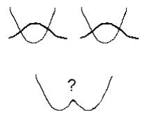
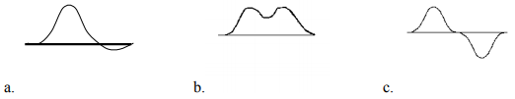

Spring 2018 Practice

Slide 23

Spring 2010

Slide 24

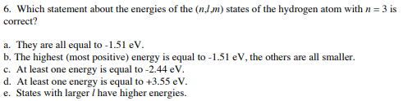
Spring 2010

Slide 25
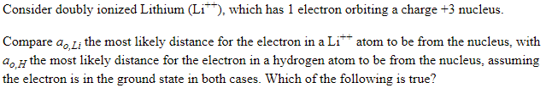

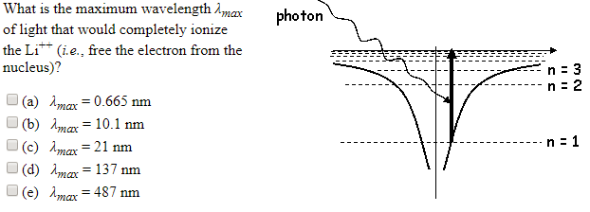
Spring 2010 26 & 27

Slide 26
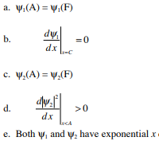
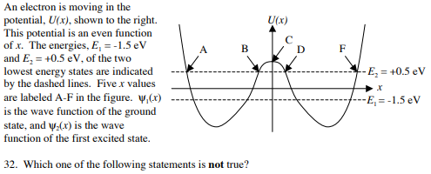


Spring 2010

Slide 27



Spring 2018 Practice

Slide 28

Spring 2009

Slide 29
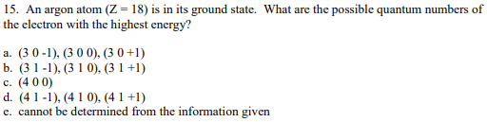
Spring 2009

Slide 30


Spring 2010

