Slide 1
HKN Phys 212 Exam 1 Review Session
Steven Kolaczkowski
Presentation by: Will Cai, Ege Gunal, Deniz Caglar, Aishee Mondal

Slide 2
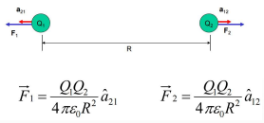

Coulomb’s law and electric field
$F=\frac{{kq}_{1}q_{2}}{r^{2}}\hat{r}$ where $k=\frac{1}{4πε_{0}}=9∗{10}^{9}\frac{Nm^{2}}{C^{2}}$
$$E≡\frac{F}{q}=\frac{kQ}{r^{2}}\hat{r}=∫k\frac{dq}{r^{2}}\hat{r}$$
Superposition: The force and electric field at any point is just the sum of all forces and fields $F_{total}=Σ_{i}F_{i}=Σ_{i}\frac{kq_{0}q_{i}}{r^{2}}\hat{r}$ and $E_{total}=Σ_{i}E_{i}=Σ_{i}\frac{kq_{i}}{r^{2}}\hat{r}$

Slide 3
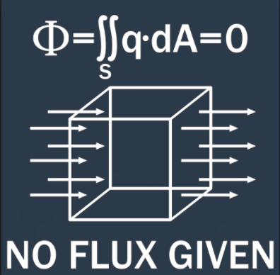

Electric flux and Gauss’ law: Always true, not always useful
Electric field lines point out of + charges and point into – charges
Electric flux is the number of field lines that pass through a certain area
$∫\int_{S}{E∙dA}=Φ_{S}=\frac{Q_{enc}}{ε_{0}}$
This is a universal law and is always true, however it is only very useful in situations when we have symmetry: spheres, infinite lines, and infinite sheets
Useful Equations: $A_{sphere}=4πr^{2}$ $A_{cylinder}=2πRL \left(+2πR^{2}\right)$
$V_{sphere}=\frac{4}{3}πr^{3} V_{cylinder}=πR^{2}L$

Slide 4

Conductors and energy
$E_{conductor}=0$ in equilibrium (for us, always)
The charges inside a perfect conductor will move to ensure that this is true
Energy of a System $ΔU=−W_{cons}=−∫F∙dr=−∫qE∙dl$

Slide 5

Electric Potential
For Potential (just like energy) what matters is the difference!
$ΔV_{a→b}≡\frac{ΔU_{a→b}}{q}=−∫E∙dl$ $E=−∇V=−(\frac{dV}{dx}\hat{x}+\frac{dV}{dy}\hat{y}+\frac{dV}{dz}\hat{z})$
Electric Field lines point from high potential to low potential!

Slide 6

Capacitance and stored energy
$C≡\frac{Q}{V}$ for a parallel plate capacitor (most common) $C=\frac{ε_{0}A}{d}$
This will always be a function of geometry only!
Energy Density: $u=\frac{1}{2}ε_{0}E^{2}$
Stored Energy of a Capacitor: $U=\frac{1}{2}QV=\frac{1}{2}CV^{2}=\frac{1}{2}\frac{Q^{2}}{C}$

Slide 7

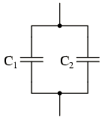

Capacitors in Circuits
Series Capacitors: $C_{total}=\frac{1}{\frac{1}{C_{1}}+\frac{1}{C_{2}}}=\frac{C_{1}C_{2}}{C_{1}+C_{2}}$
Q is the same for both capacitors
Parallel Capacitors : $C_{total}=C_{1}+C_{2}$
V is the same for both capacitors

Slide 8

Resistance, Ohm’s law, and resistors
Ohm’s Law: $J=σE$ this is usually represented as $V=IR$ in circuit analysis
Here J is the current density, $σ$ is the conductivity, I is the current, and R is the resistance
Resistance: a measure of an elements opposition to charge flow $R=\frac{L}{σA}=\frac{ρL}{A}$
Series resistance: $R_{total}=R_{1}+R_{2}$
Resistors in series share the same current ($I$)
Parallel resistance: $R_{total}=\frac{1}{\frac{1}{R_{1}}+\frac{1}{R_{2}}}=\frac{R_{1}R_{2}}{R_{1}+R_{2}}$
Resistors in parallel share the same voltage

Slide 9
Test Taking Strategies
Know when and how to use your equation sheet
Don’t panic, just keep on moving
Make sure you are in the right mindset going into the exam
Spend your time showing what you know
DON’T CHEAT

Slide 10
Past exam Questions

Slide 11
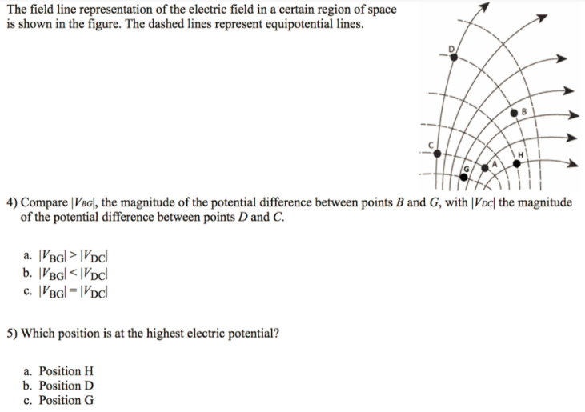
Spring 2017

Slide 12
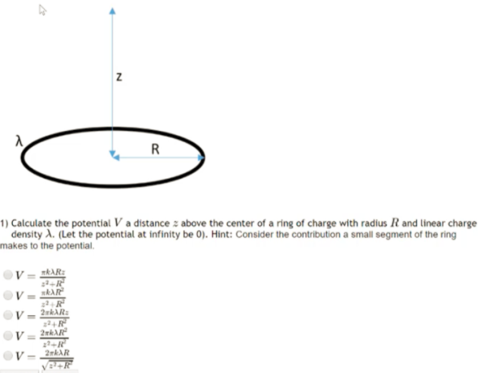
Fall 2017

Slide 13
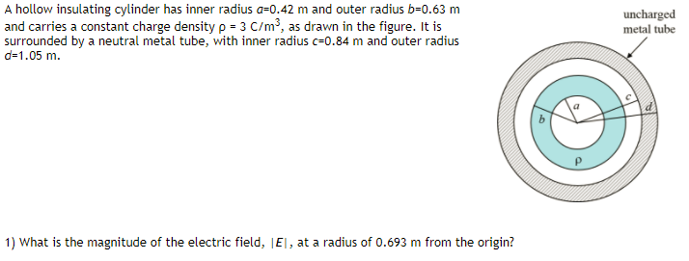
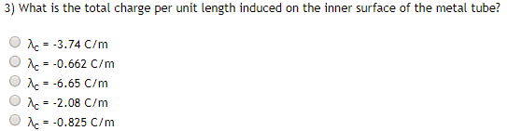



Fall 2015

Slide 14
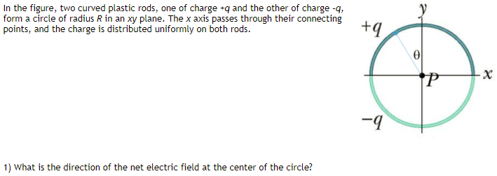

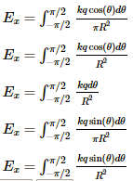
Fall 2015

Slide 15
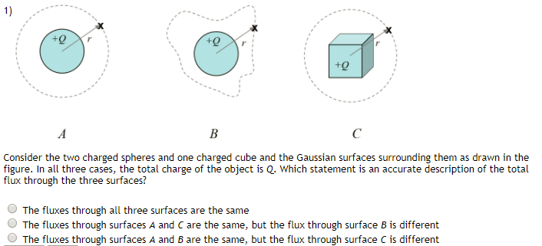
Fall 2015

Slide 16
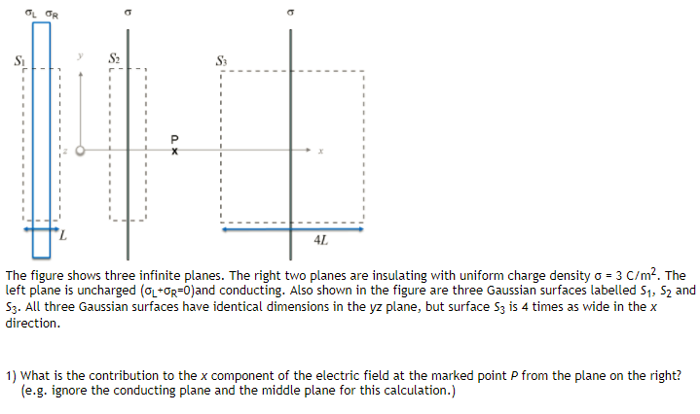



Fall 2015

Slide 17
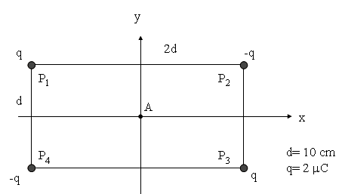


Fall 2009 Questions 1&2

Slide 18
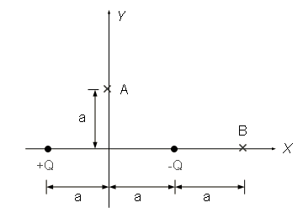
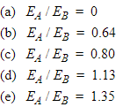
Fall 2009 Question 9

Slide 19
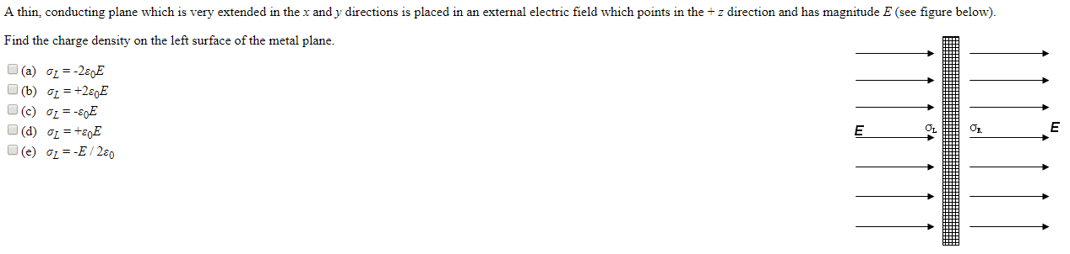
Spring 2009 Question 24

Slide 20
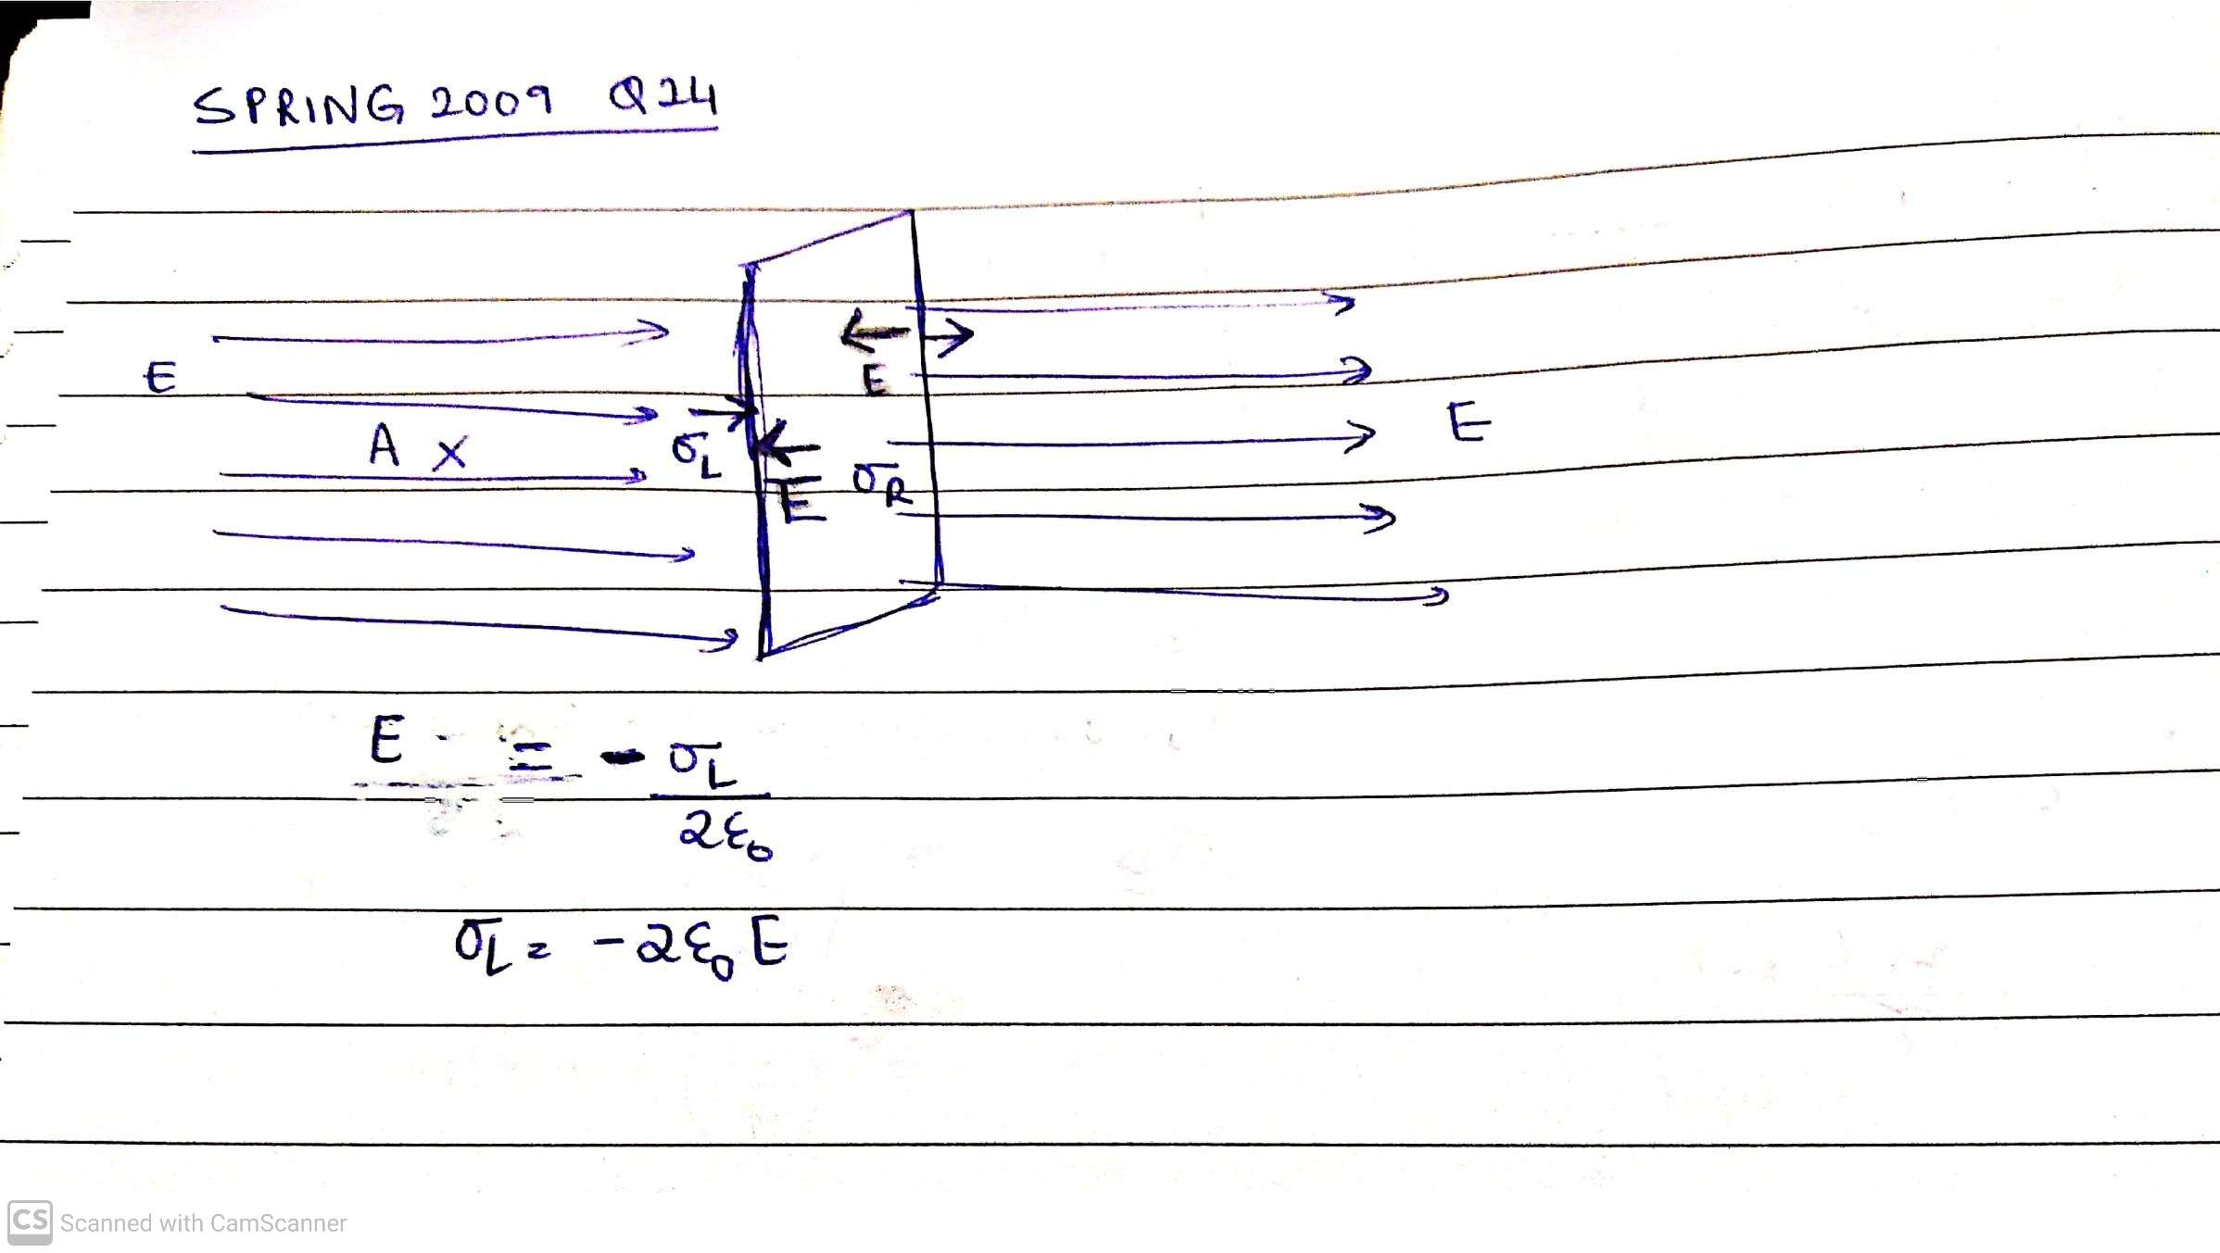

Slide 21
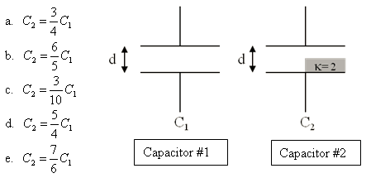
Spring 2010 Question 17

Slide 22
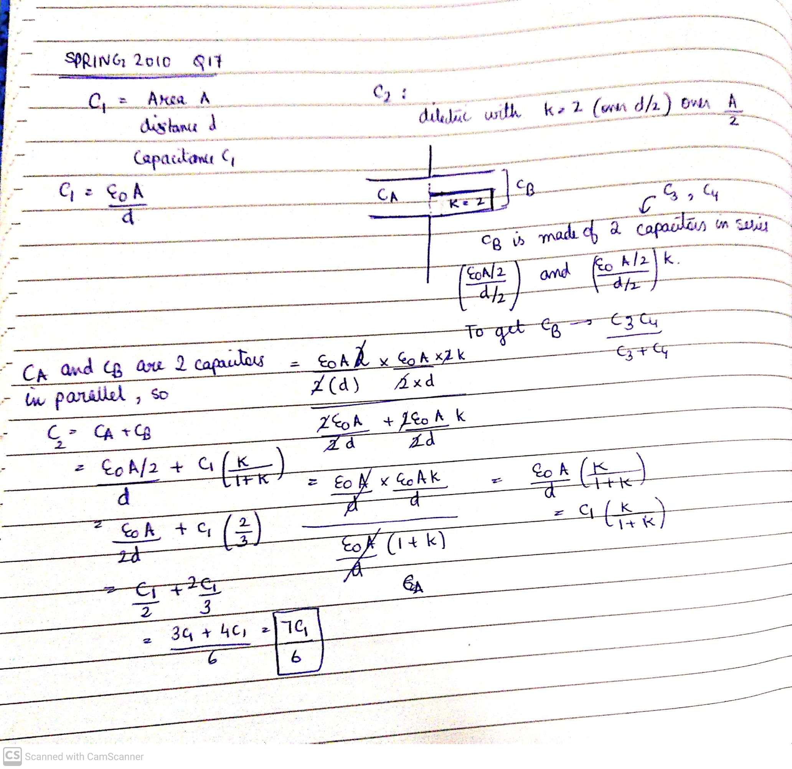

Slide 23
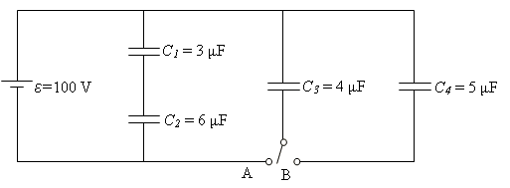
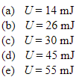


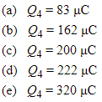
Fall 2009

Slide 24
