Slide 1
HKN ECE 110 Quiz 2 Review Session
ALAN LIU
CYRIL JAZRA
RALPH BALITA
SHUEN WU

Slide 2
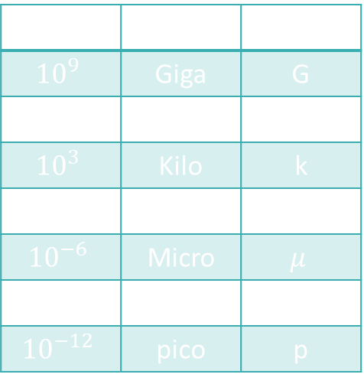

Important Quantities and Their Units
Charge (Q): Intrinsic property of matter, the driving property behind electrical energy and forces
Units: Coulombs [C]
Current (I): The amount of charge that flows in a given time
Units: $\frac{Coulmbs}{second}=Amps [A]$
Voltage $\left(V\right)$: Think of this as the pressure pushing electrons
Units: $\frac{Joules}{Coulomb}=Volts [V]$
Resistance: A material’s opposition to charge flow
Units: Ohms $[Ω]$
Power | Prefix | Symbol
$${10}^{9}$$ | Giga | G
$${10}^{6}$$ | Mega | M
$${10}^{3}$$ | Kilo | k
$${10}^{−3}$$ | Milli | m
$${10}^{−6}$$ | Micro | $$μ$$
$${10}^{−9}$$ | Nano | n
$${10}^{−12}$$ | pico | p
Notes:
Added “pico” because it is so often used in electronics (capacitors).

Slide 3

Energy, Power, and Their Many Forms
Energy: The ability of a substance to do work
Units: Joules [J]
Total Energy is always conserved
Power: The Rate at which Energy is absorbed or supplied
Units: $\frac{Joules}{second}=Watts \left[W\right]$
$$P=\frac{ΔE}{Δt}=IV$$
$$E=Pt=QV=IVt$$

Slide 4

Capacitors
Capacitance (C): The ability of a device to store charge
Units: $\frac{Coulombs}{Volt}=Farads [F]$
$C≡\frac{Q}{V}$
$E_{Capacitor}=\frac{1}{2}CV^{2}$
The factor of one half comes from the fact that the voltage changes from 0 to V in a capacitor instead of holding a constant V (as assumed in a battery).
Notes:
There was an error here. The efficiency of charging has nothing to do with ultimately how much energy a capacitor charged to V volts stores.

Slide 5

Ohm’s Law and Resistive Elements
Ohm’s Law is a way of relating the voltage across and the current through a resistive element.
Ohm’s law does NOT work for voltage sources or current sources
Ohm’s law does work for resistors, although it is still just an approximation/model.
If you want to learn about other linear components, take ECE 210
$V=IR$
Resistance of a cylindrical conductor of some homogeneous conductive material can by found by: $R=\frac{ρL}{A}$
Power Dissipated by an element can be found by: $P=IV=I^{2}R=\frac{V^{2}}{R}$
Notes:
Ohm’s “Law” isn’t a law at all…just an approximate model based on measurements. The device we call a “resistor” behaves more complexly at higher and higher frequencies as it will exhibit inductive and capacitive traits as well.

Slide 6



Series and Parallel Combinations
Series: It is impossible for current to flow through one element and not the other
Components in series always have the same Current
$R_{eq}=R_{1}+R_{2}+…$
Parallel: Two components share BOTH of their nodes
Components in parallel have the same Voltage
$R_{eq}=\frac{1}{\left(\frac{1}{R_{1}}+\frac{1}{R_{2}}+ …\right)}$
If we have two resistors: $R_{eq}=\frac{R_{1}R_{2}}{R_{1}+R_{2}}$
Notes:
Parallel – draw a loop with only those two elements and nothing else in between
Series – draw a loop and if one element is in the loop then the other must necessarily be in the loop

Slide 7
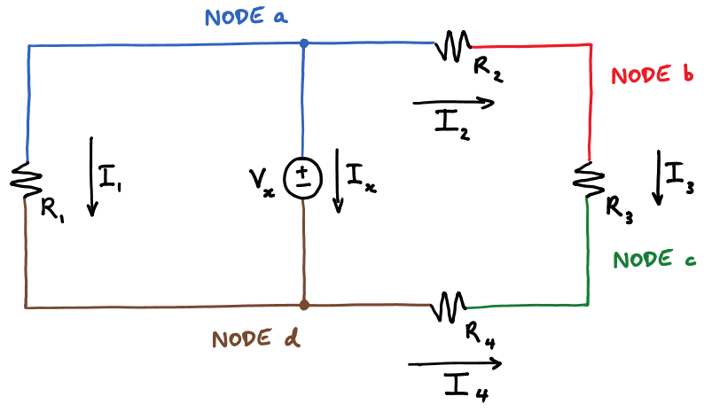

Nodes and Kirchhoff's Circuit Laws
Node: Any part of a circuit that is an equipotential (zero voltage difference)
Any connected “wires” with no element
in between
Kirchhoff’s Voltage Law
Conservation of Energy
Performed in a loop
$Σ V_{rises}=Σ V_{drops}$
Kirchhoff’s Current Law
Conservation of Charge
Performed on a node/supernode
Bubble Method
$Σ I_{in}=Σ I_{out}$
Notes:
If using this description of a node, make sure student’s understand that “wires” on a schematic do not necessarily correspond one-to-one with wires on a circuit board! The node is a concept while wires are an implementation.
KVL comes from conservation of energy because voltage is Joules/coulomb and the charges must be all accounted for in the same way all the energy is accounted for.
Node: a bubble that contains all the “wire” stuff at a single potential.
Supernode: a bubble with one or more devices inside of it and the “wire” stuff (nodes) immediately outside of those devices.

Slide 8
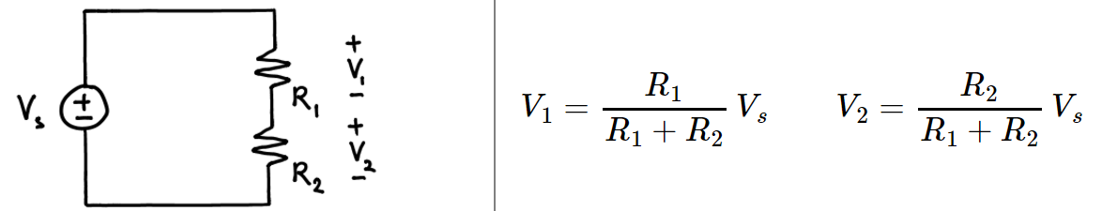
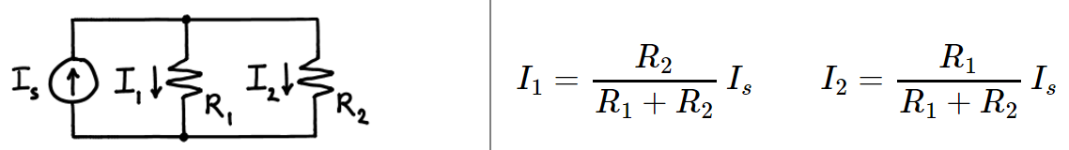
Voltage Divider and Current Divider
We use Voltage Divider Rule (VDR) in order to find the voltage across series resistors
We use Current Divider Rule (CDR) in order to find the current through parallel resistors
Notes:
Note that this works even if it isn’t a voltage source connected across two series resistors. It could be two serious resistors in a more-complicated circuit for which someone has just measured the total voltage across the series combination. Similarly for the current divider…

Slide 9
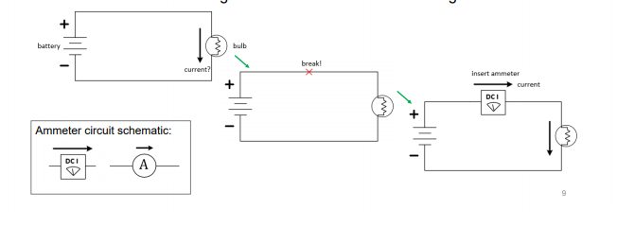
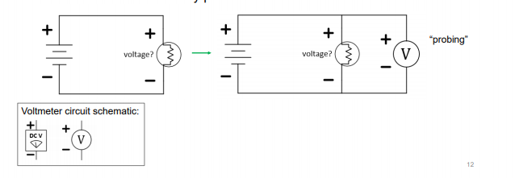
Ammeter and Voltmeters

Slide 10



Power and Labeling (Not covered, look at the first slide)
Standard vs. Non-Standard Labeling:
Standard: Current goes $+ →−$
$P=IV$
$V=IR$
If $P>0$, the element is absorbing power.
If $P<0$, the element is supplying power.
Non-Standard: Current goes $− →+$
$P=−IV$
$V=−IR$
If $P>0$, the element is absorbing power (unchanged from above!).
If $P<0$, the element is supplying power (unchanged from above!).
Standard-reference Power for resistors can be expressed three ways: $P=IV=I^{2}R=\frac{V^{2}}{R}$
Resistors will ALWAYS have $P>0$
Notes:
We haven’t covered standard and non-standard power yet (only through Lecture 8 for exam 1), so signed power will not be tested until Exam 2. Power questions for this semester’s exam 1 will just generally request the magnitude without the sign.
The original slide implies that P = I^2R in general because the sub-bullets discussed both P>0 and P<0.

Slide 11

Root-mean-square Voltage ($V_{rms}$) (Not covered)
Exact formula and what it means:
$$V_{rms}=\sqrt{\frac{\left(\int_{0}^{T}{v^{2}\left(t\right)dt}\right)}{T}}$$
Square your entire voltage signal, $v^{2}\left(t\right)$
Find the average value of this signal over 1 period, $\frac{\int_{0}^{T}{v^{2}\left(t\right)dt}}{T}$ (equivalently, area-under-one-period/T)
Square root this average, $\sqrt{\frac{\left(\int_{0}^{T}{v^{2}\left(t\right)dt}\right)}{T}}$
Useful formulas:
$V_{rms}\left(sinusoid\right)=\frac{Amplitude}{\sqrt{2}}$
$V_{rms}\left(0−to−A square wave\right)=A\sqrt{d.c.}=A\sqrt{\frac{t_{on}}{T}}$
$P_{avg}=\frac{V_{rms}^{2}}{R}$, for power dissipated by a resistor
Notes:
Save this for the review of Exam 2. We have only covered through Lecture 8 for Exam 1.
Removed ambiguity for square wave calculation (it matters if square wave has a DC offset!) and also changed notation to be consistent with class (t_on). %DC implies we insert it as a %...we insert it as a fraction from 0 to 1. Capital “DC” is direct current. That’s why we should use lower case with periods, “d.c.” for duty cycle.

Slide 12
Exam Advice
Check your units
Use the practice exams on PrairieLearn
Don’t spend too much time on questions you can’t answer
Spend time showing what you know
Study past exam

Slide 13
Example Problems

Slide 14

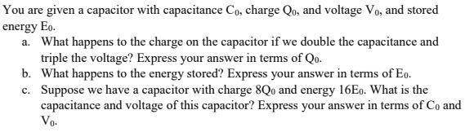

Slide 15


Slide 16
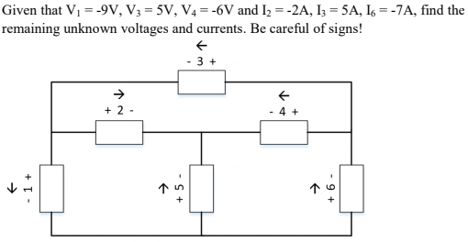
(Not covered) Also, find the power’s of the components. (Check that $Σ_{i}P_{i}=0)$

Slide 17
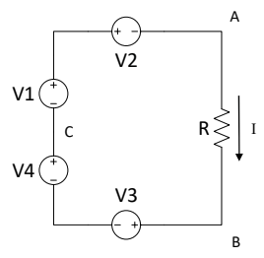
++
-
Notes:
Be sure to define what we mean by V_AB (+ at A, - at B for a voltmeter).

Slide 18
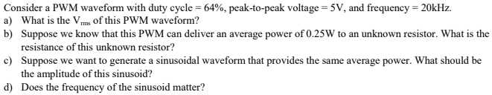
(Not covered)
Notes:
No, we have only covered through Lecture 8 for Exam 1.

Slide 19
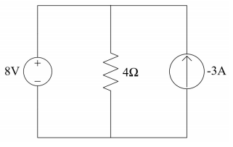

Find currents I_V and I_R
I_V
I_R
Notes:
Only through Lecture 8. Okay to do this if you want, but be careful…students don’t yet understand signed power. Change it to just find all the missing currents and voltages for exam 1, power for the resistor perhaps. They do/should know about pushing current uphill (that it will put energy into a circuit).

Slide 20
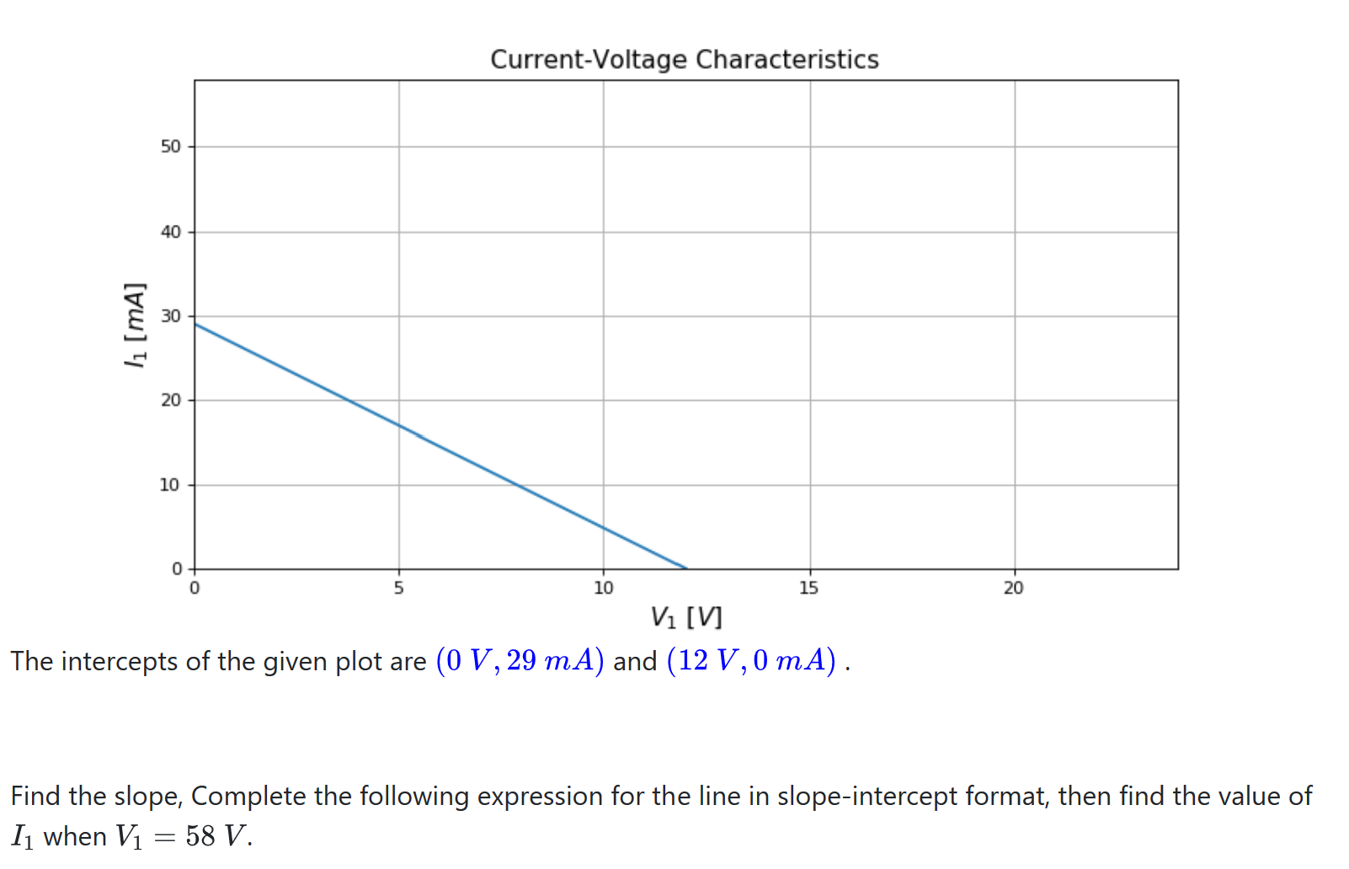
In this question:
Find the slope
Find the y-intercept
Find the value of I, given V = 58V
Notes:
m = -2.416666 Ohms-1
29 mA
-111.16 mA

Slide 21
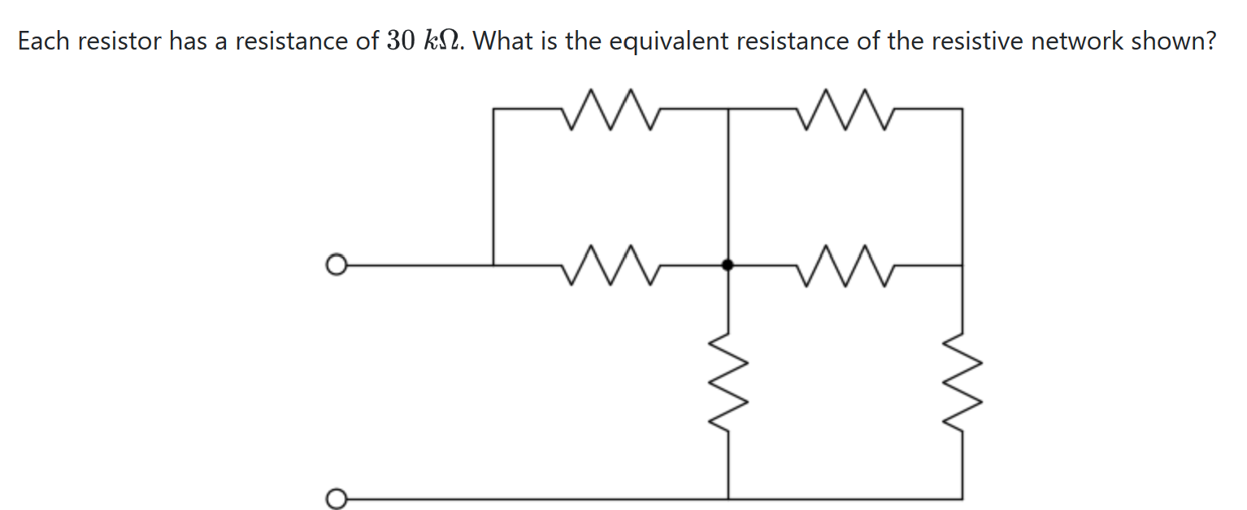
Notes:
Req = 33 kOhms

Slide 22
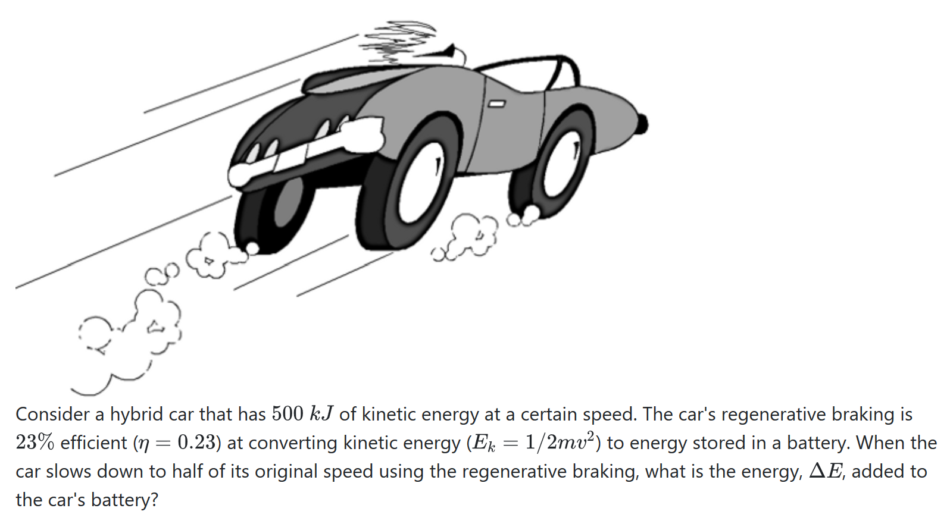
Notes:
E = 28.75 J

Slide 23






$$E_{0}=500 kJ$$
$$v_{0}=\sqrt{\frac{2∗500kJ}{m}}$$
Fast way: Realize that since E depends on v squared, when v halves, E is quartered
The change in E $= \frac{3}{4} E_{0}$
$$v_{1}= \sqrt{\frac{500kJ}{2m}}$$
Multiply result by efficiency.
$$E_{1}= \frac{1}{2}mv_{1}^{2}=\frac{500kJ}{4}$$
$$E_{0} −E_{1}=\frac{3}{4}(500kJ)$$
Energy added = $μ\left(E_{0} −E_{1} \right)=86.25kJ$

Slide 24
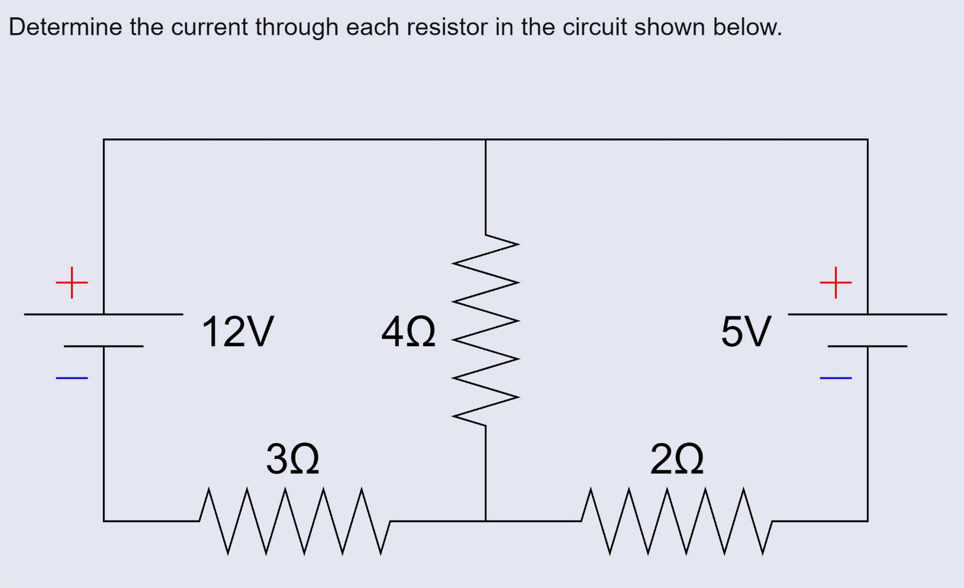
Practice: Kirchhoff’s Circuit Laws

Slide 25
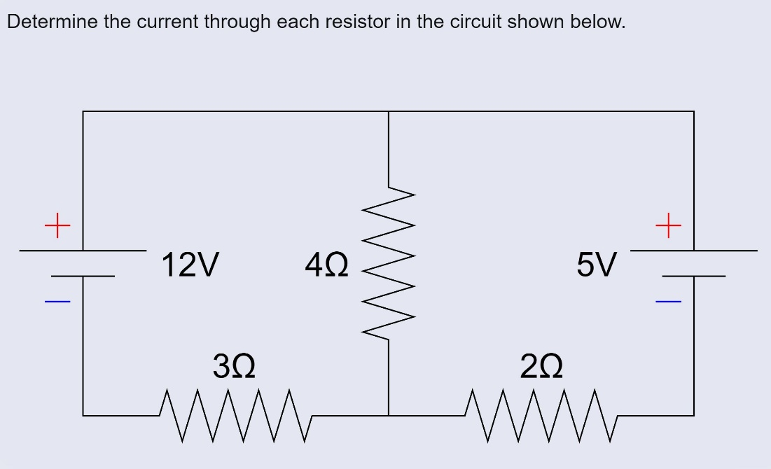
Practice: Kirchhoff’s Circuit Laws – Pointers
Label Currents and voltages
Remove Redundant Variables (KCL)
Construct Loop Equations (KVL)
Solve Equations, check direction
Bonus: Predicting number of loops

Slide 26





$$12−4I_{4}−3I_{3}=0$$
$$12−5−2I_{2}−3I_{3}=0$$
$$I_{3}=I_{4}+I_{2}$$
$$12−4\left(I_{3}−I_{2}\right)−3I_{3}=0$$
$$2I_{2}+3I_{3}=7$$
$$−4I_{2}+7I_{3}=12$$
$$2I_{2}+3I_{3}=7$$
$$I_{3}=2A$$
$$I_{2}=0.5A$$
$$I_{4}=1.5A$$

Slide 27






$$\frac{12−V}{4}+\frac{7−V}{2}=\frac{V}{3}$$
$$I_{4}= \frac{(12−6)}{4}=1.5A$$
$$3\left(12−V\right)+6\left(7−V\right)=4V$$
$$I_{2}=\frac{(7−6)}{2}=0.5A$$
$$78=13V_{1}$$
$V=6$volts
$$I_{3}=\frac{(6−0)}{3}=2A$$

Slide 28
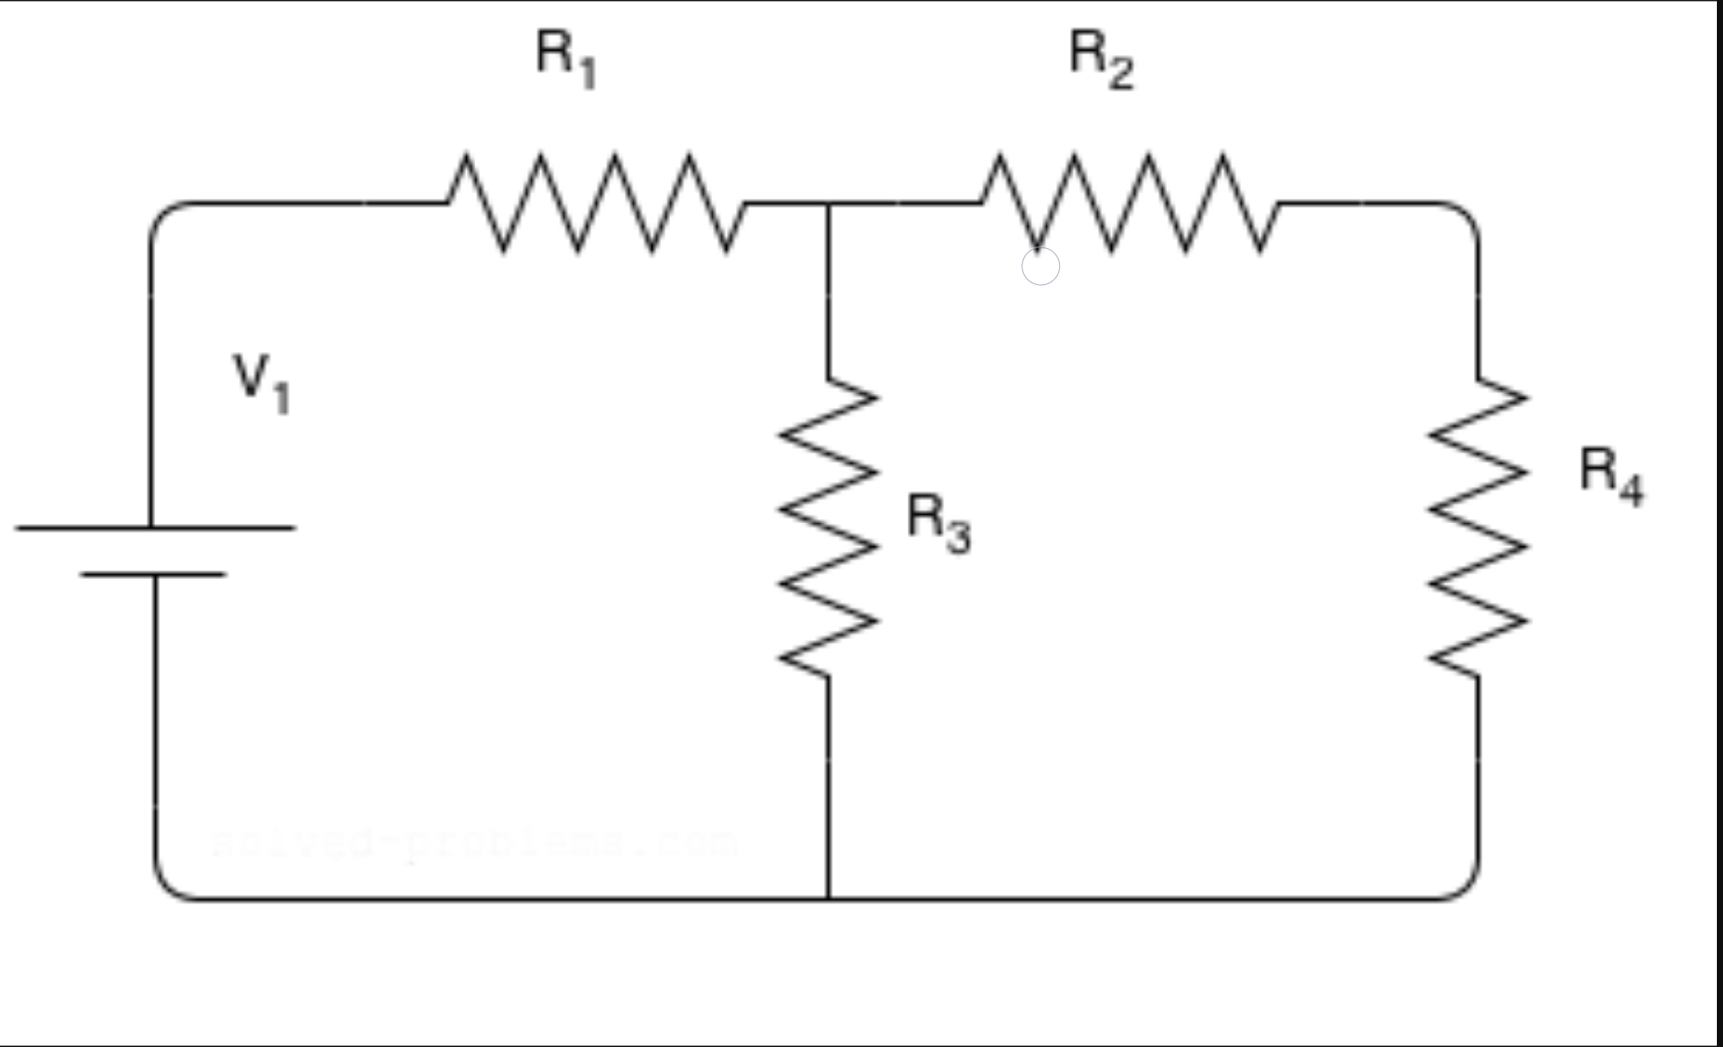
Practice: “Double Trouble” Voltage Divider
Find Vr2 & Vr4
V1 = 20 volts
R1 = 10 ohms
R2 = 5 ohms
R3 = 30 ohms
R4 = 10 ohms

Slide 29
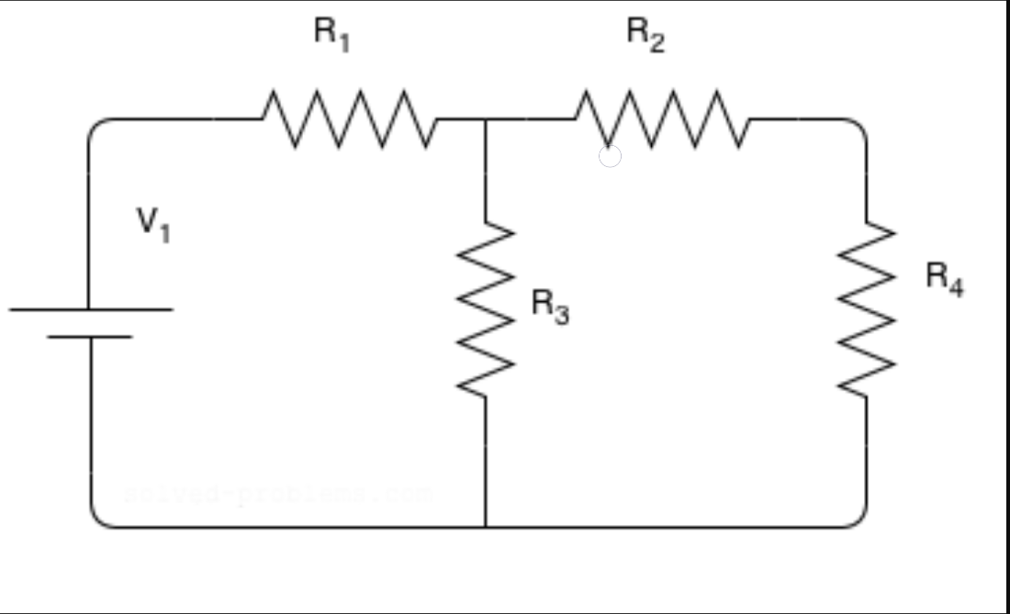
Practice: “Double Trouble” Voltage Divider - Pointers
Mark down required nodes
Begin Solving…….?
Stop Solving, can I simplify?
Manipulate circuit to suit your needs
Combine resistors to match your “type”

Slide 30





$$R_{eq}=\left(R_{2}+R_{4}\right)||\left( R_{3}\right)+R_{1}$$
$$R_{eq}=\frac{15∗30}{15+30}+10=20$$
$$I=\frac{20}{20}=1$$
$$V_{2}=V −IR_{1}=10$$
$$V_{R2}=10∗\frac{5}{10+5}=\frac{10}{3}volts$$
$$V_{R4}=10∗\frac{10}{10+5}=\frac{20}{3}volts$$

Slide 31
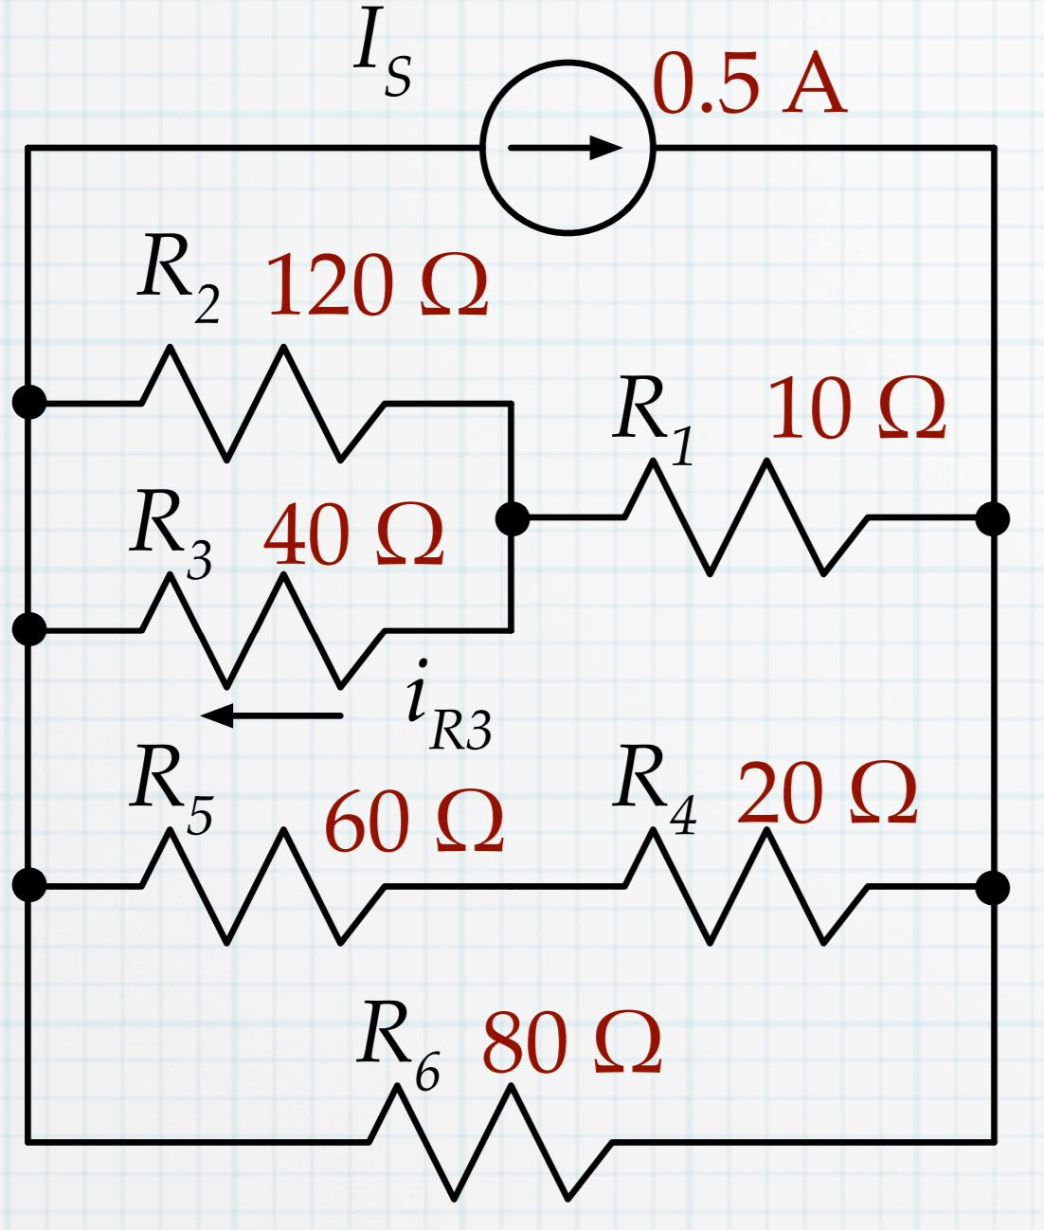
Practice: The Curious Case of Current Dividers (Find iR3)

Slide 32
Practice: The Curious Case of Current Dividers - Pointers
KISS – Keep it Simple, Stupid
Too tedious for KVL and KCL
Just like before, manipulate to suit your case
Big Hint – A current source and resistors in parallel

Slide 33




$$R_{1eq}=R_{1}+R_{2}||R_{3}=30+10=40$$
$$R_{2eq}=R_{4}+R_{5}=80$$
$$R_{eq}=R_{1eq}\left|\left|R_{2eq}\right|\right|R_{6}=\frac{1}{\frac{1}{40}+\frac{1}{80}+\frac{1}{80}}=20$$
$$i_{R3}=I_{S}\left(\frac{R_{eq}}{R_{1eq}}\right)\left(\frac{\frac{1}{40}}{\frac{1}{40}+\frac{1}{120}}\right)=\frac{3}{16}A$$

