Slide 1
ECE 329 Exam 3
HKN Review Session
Jason Pan
Michael Grawe

Slide 2
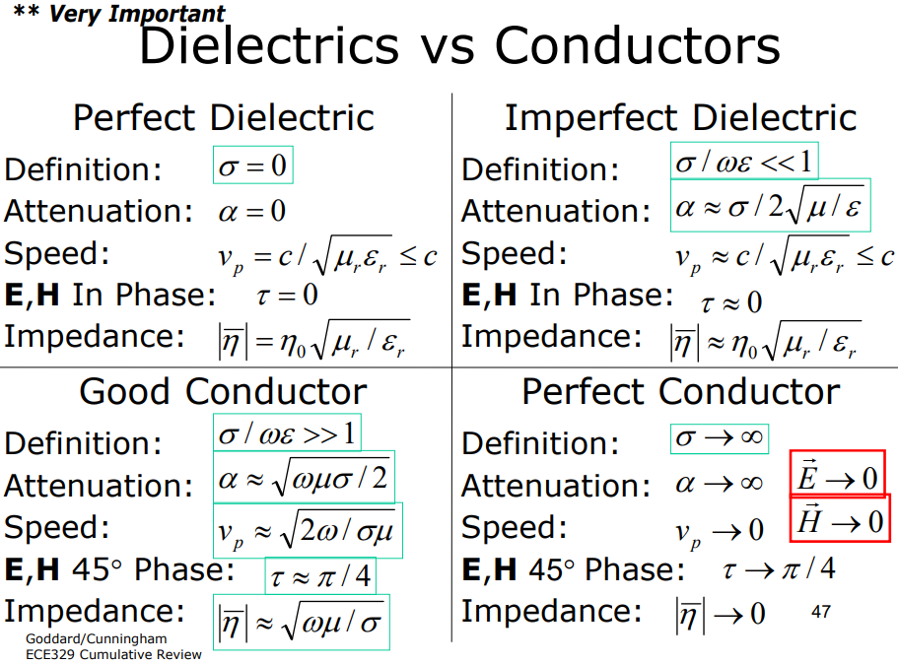

Slide 3
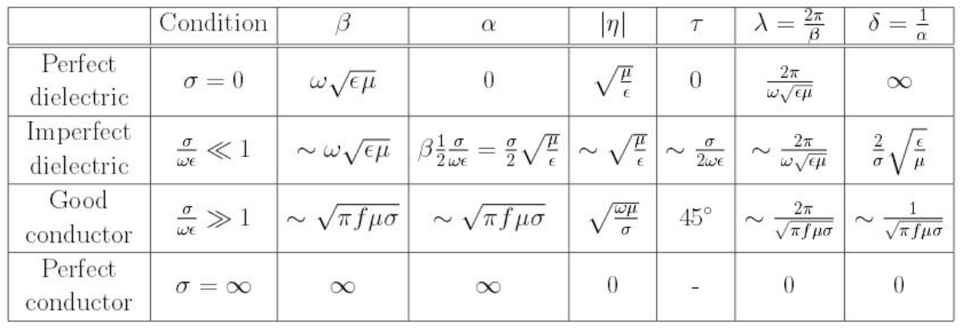

Slide 4
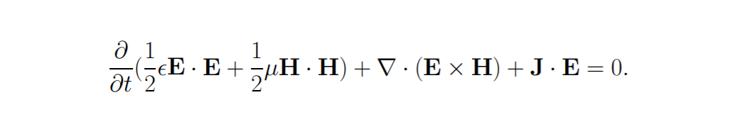
Poynting Theorem
Time rate of change of total electric and magnetic energy density
Energy Transport
Positive -> Energy Flowing out
Power absorbed (Joule Heating)
Negative -> Power supplied

Slide 5
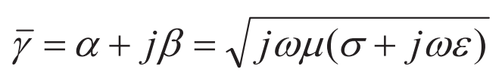
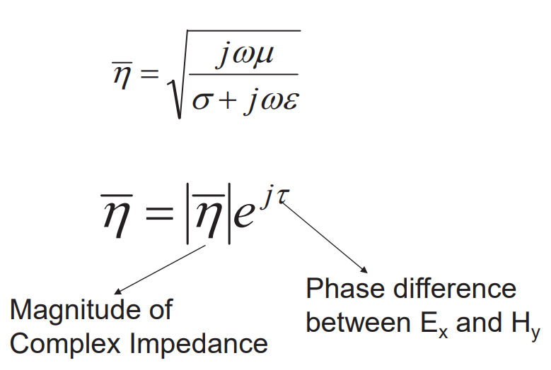
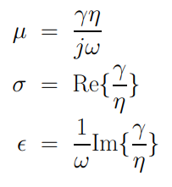
Wave Properties in Material Media
Propagation constant
Impedance
Notes:
\bar{\gamma}=\alpha+j \beta=\sqrt{j \omega \mu(\sigma+j \omega \varepsilon)}

Slide 6

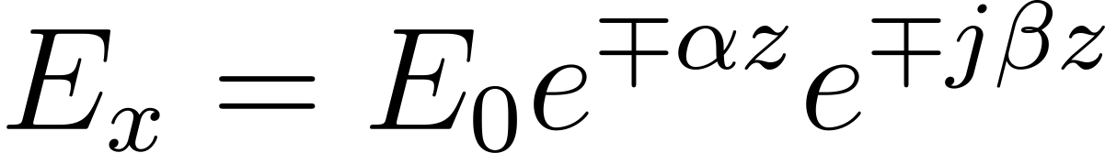



Wave Equations in Material Media
Propagation velocity in some media is frequency dependent
From the wave equation, we can get a general solution for a x-polarized wave
Penetration depth, or skin depth
Wavelength
$$H_{y}= {}_{−}^{+}{\frac{E_{0}}{\left|η\right|}e^{{}_{+}^{−}{γz}}e^{jτ}}$$
Notes:
v_{p}=\frac{\omega}{\beta}
E_{x}=E_{0} e^{\mp \alpha z} e^{\mp j \beta z}
\delta=\frac{1}{\alpha}
\lambda=\frac{2 \pi}{\beta}

Slide 7


Wave Polarization
Linear: In phase
Circular: 90 degrees out-of-phase with equal magnitude
Right-Handed
Left-Handed
Elliptical: Anything else
Propagating in +z:

Slide 8
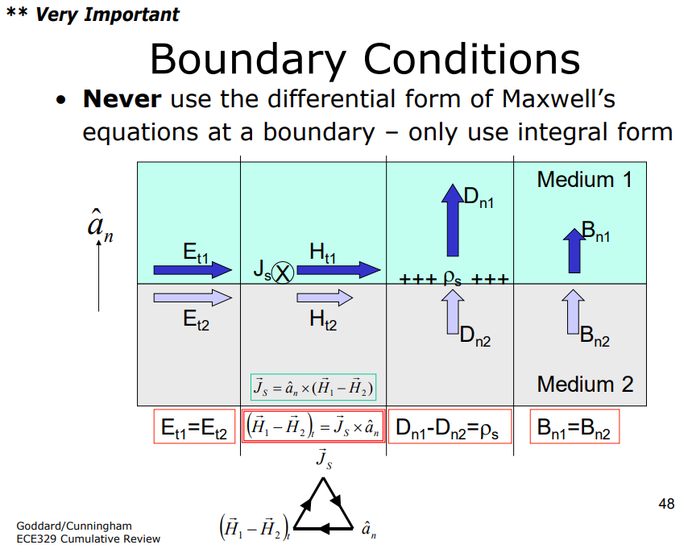

Slide 9
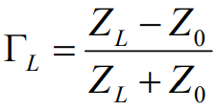

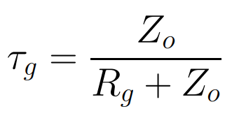
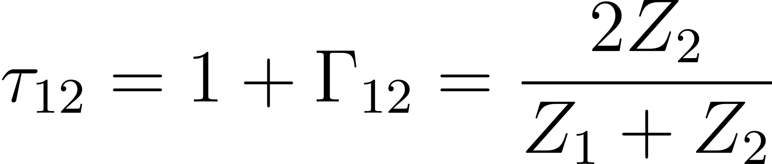
Reflection and Transmission
Perfect reflection at perfect conductor interface (Z_{L} = 0)
Partial reflection at perfect dielectric
Perfect transmission at impedance matched interface (Z₁=Z₂)
Reflection coefficient
Injection coefficient
Transmission coefficient
Note: Z is for transmission lines and η for material propagation
Notes:
\Gamma_{L}=\frac{Z_{L}-Z_{0}}{Z_{L}+Z_{0}}
\Gamma_{C}=-\Gamma
\tau_{g}=\frac{Z_{o}}{R_{g}+Z_{o}}
\tau_{12}=1+\Gamma_{12}=\frac{2Z_{2}}{Z_{1}+Z_{2}}

Slide 10

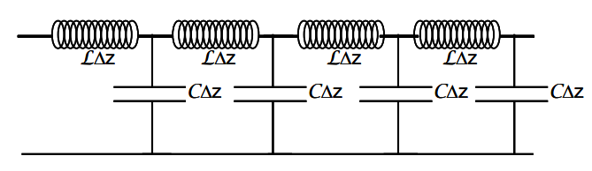
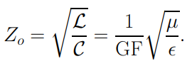
Transmission Lines (TL)
At steady state DC, TL acts like a wire
However, at microwave frequencies, lumped element model cannot be used
Creates propagating (or standing) TEM wave
To derive TL formulas, apply boundary conditions to get Telegrapher’s equations

Slide 11

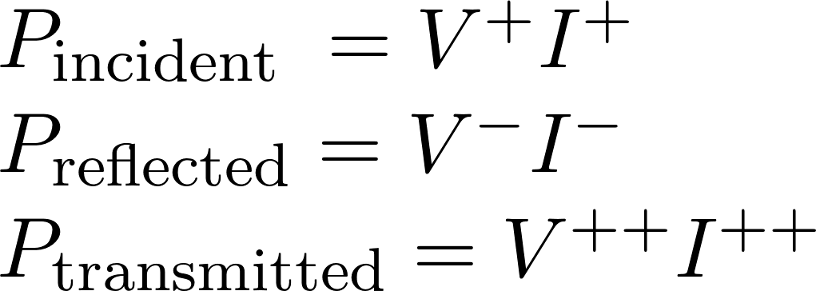

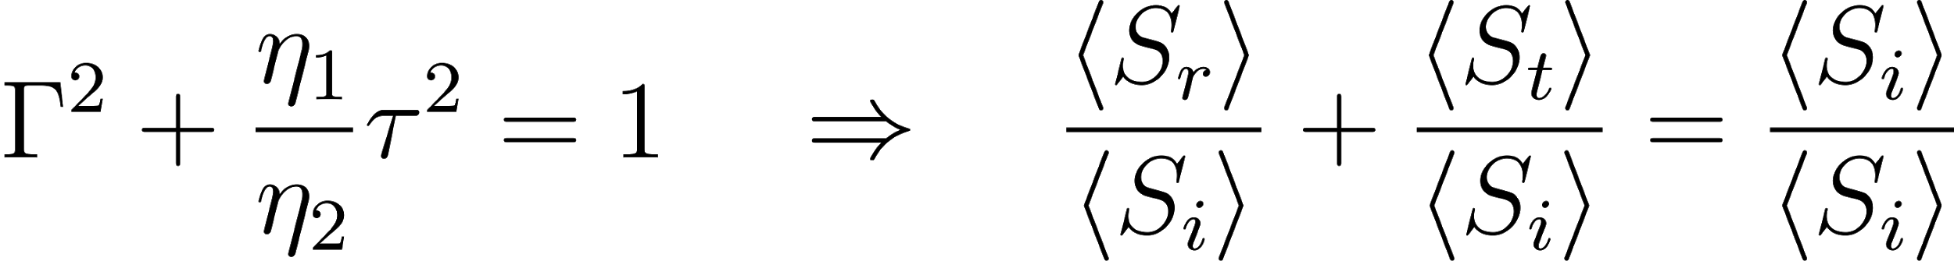
Transmission Lines
Lossless transmission lines absorb no power
All power is dissipated in resistive loads
Notes:
$\begin{array}{l}{P_{\text {incident }}=V^{+} I^{+}} \\ {P_{\text {reflected}}=V^{-} I^{-}} \\ {P_{\text {transmitted}}=V^{++} I^{++}}\end{array}$

Slide 12
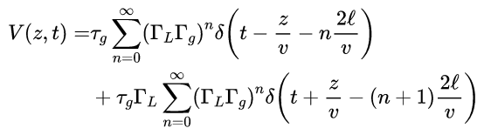
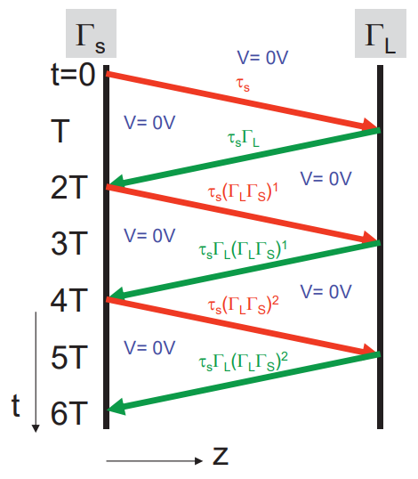
Bounce Diagram
Don’t memorize these formulas
Instead, understand bounce diagrams conceptually
Note the speed of propagation (material dependent!)
Determine the distance per time in convenient units
Multiply by the correct coefficient at any interface
Remember to negative reflection coefficient for current!
Remember, each term in I(z,t) has a 1/Z0 factor
Output function will be the same as input function
Notes:
\begin{aligned} V(z, t)=& \tau_{g} \sum_{n=0}^{\infty}\left(\Gamma_{L} \Gamma_{g}\right)^{n} \delta\left(t-\frac{z}{v}-n \frac{2 \ell}{v}\right) \\ &+\tau_{g} \Gamma_{L} \sum_{n=0}^{\infty}\left(\Gamma_{L} \Gamma_{g}\right)^{n} \delta\left(t+\frac{z}{v}-(n+1) \frac{2 \ell}{v}\right) \end{aligned}

Slide 13
Previous Exam Questions

Slide 14
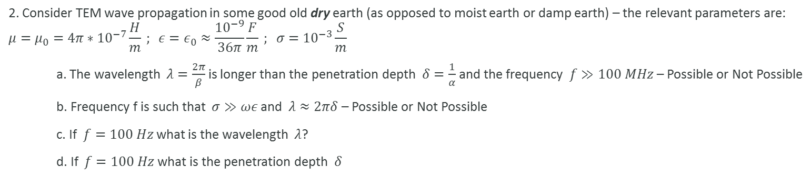
Summer 2016 #2

Slide 15
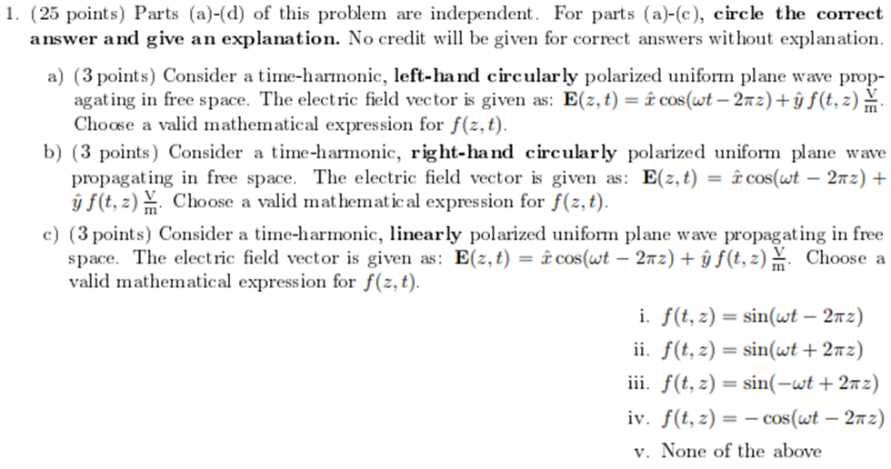
Spring 2016 #1

Slide 16
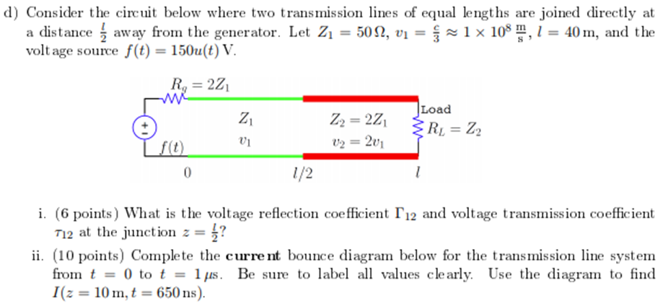
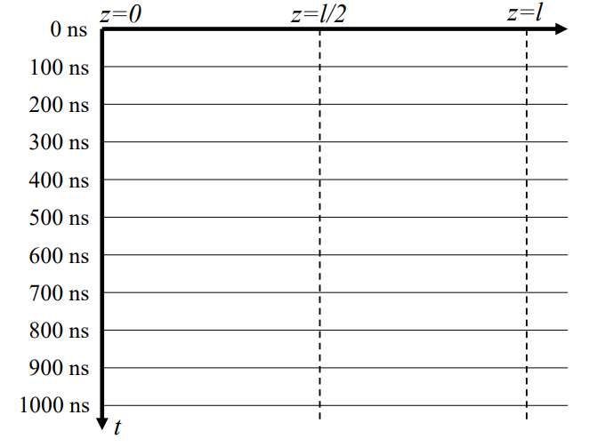
Spring 2016 #1

Slide 17
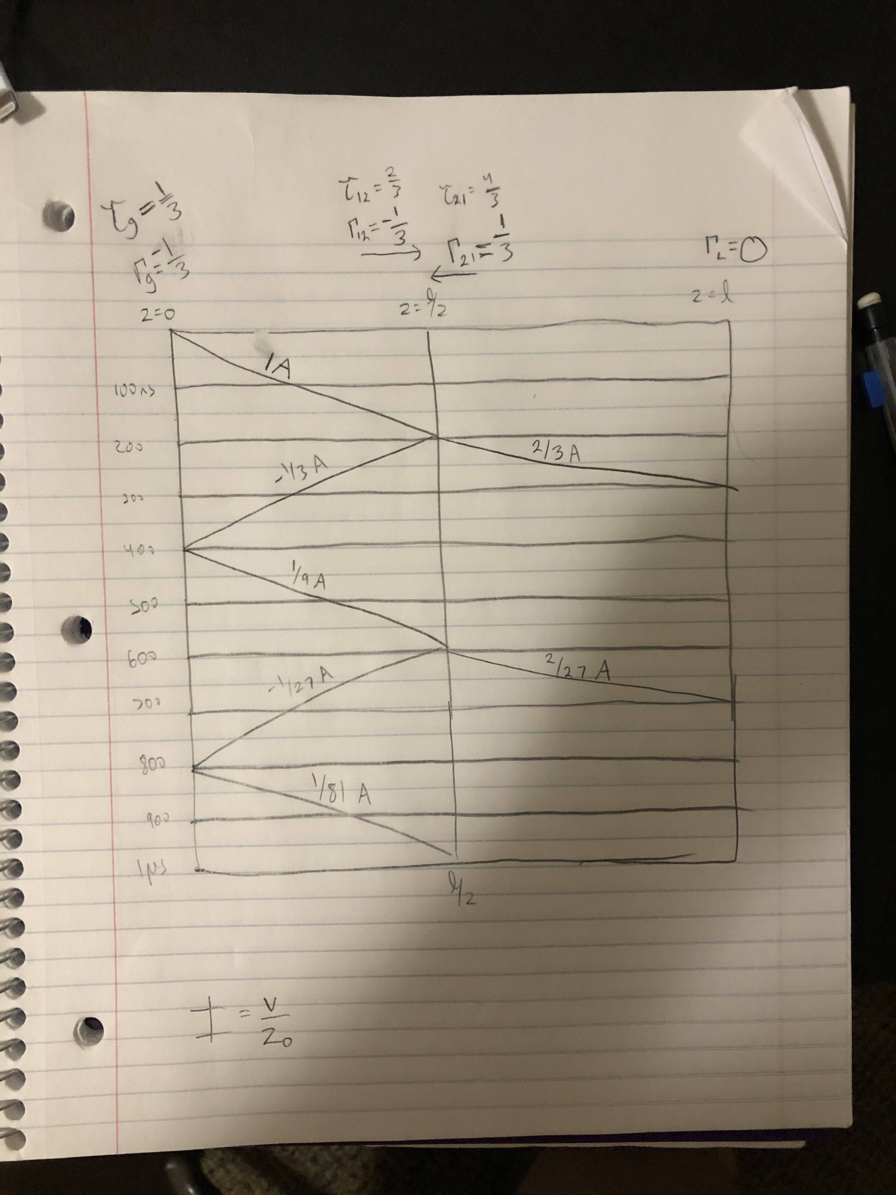

Slide 18
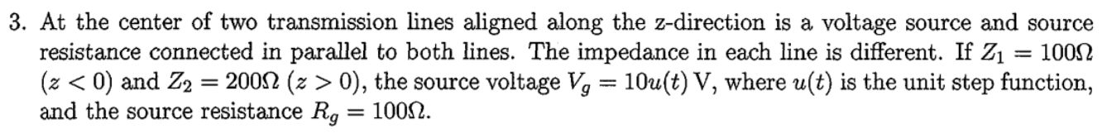
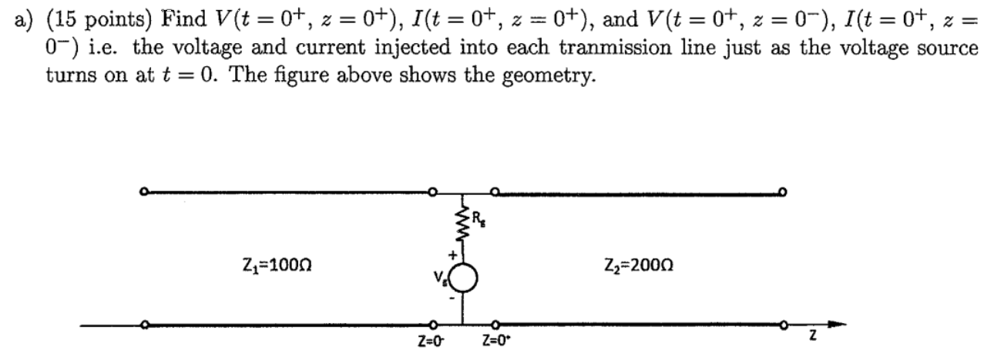
Summer 2016 #2

