Slide 1
ECE 120 Midterm 1
HKN Review Session
Time: 8:30-10:00 pm (Arrive at 8:15 pm)
Location: Your Room on Compass
What to bring: iCard, pens/pencils, Cheat sheet (Handwritten)

Slide 2
Overview of Review
Binary
IEEE floating point
Hex & ASCII
Operators
Bitmasks
C programming
Practice Exam

Slide 3
Binary Representation
Unsigned - k bits can represent [0, 2^k) values
Can only represent non-negative integers
Overflow Condition: If the most significant bit has a carry out
Zero Extended - pad the front with zeros when moving to larger data type
(10101) = (16+4+1) = 21
Signed Magnitude - (- 2^(k-1), 2^(k-1) ) values
First bit determines sign of number ( 1 = negative, 0 = positive)
(10101) = (-1) x (4+1) = -5
Notes:
3-5 - Kanad

Slide 4
Binary Representation - Part II
2’s Complement - k bits represents [ -2^(k-1), 2^(k-1) - 1]
Sign Extended - pad the front of the number with the sign bit when moving to larger data type
Overflow Condition: if adding numbers of the same sign yields a result of the opposite sign
If signed bit is 0, magnitude is same as if the number were treated as unsigned
If signed bit is 1, to determine the magnitude, bitwise NOT the bits, and add 1 before finding magnitude
2’s complement provides a greater range of values and cleaner binary arithmetic operations
ie. the same logic circuit used to add binary unsigned and 2’s complement numbers

Slide 5
iEEE 754 Floating Point Representation
Great for approximations & expressing very large/very small decimal values
1st bit is sign bit, 0 for positive and 1 for negative
2nd through 9th bit is exponent
Special Cases: When exponent is 0 or 255, then denormalized or NAN/inf forms respectively.
Denormalized format has normal sign, and magnitude: 0.mantissa * 2^(-126)
NAN/inf form is NAN when mantissa is non-zero, and infinity (inf) when mantissa is all zeros
10th through 32nd bit is 23 bit mantissa
Normal Form has magnitude of 1.mantissa * 2 ^ (exponent - 127)
(-1)^sign * 1.fraction * 2^(exponent - 127)

Slide 6
Hexadecimal & ASCII Representations
7-bit ASCII table will be provided if necessary
Although 7 bits, chars in C are 1 byte of memory and allocate 8 bits per character anyway
Hexadecimal is base 16 number system (0-9 & A-F)
All numbering systems that have a power of 2 base can have individual characters mapped to binary strings
A=1010 B=1011 C=1100 D=1101 E=1110 F=1111
converting 76 (01001100) to hex = 0x4C
0111010, 0110011, 0101001 converting to ASCII -
Notes:
Arvind 6-9

Slide 7
Hexadecimal & ASCII Representations
7-bit ASCII table will be provided if necessary
Although 7 bits, chars in C are 1 byte of memory and allocate 8 bits per character anyway
Hexadecimal is base 16 number system (0-9 & A-F)
All numbering systems that have a power of 2 base can have individual characters mapped to binary strings
A=1010 B=1011 C=1100 D=1101 E=1110 F=1111
converting 76 (01001100) to hex = 0x4C
0111010, 0110011, 0101001 converting to ASCII -
0x3A 0x33 0x29
:3)

Slide 8
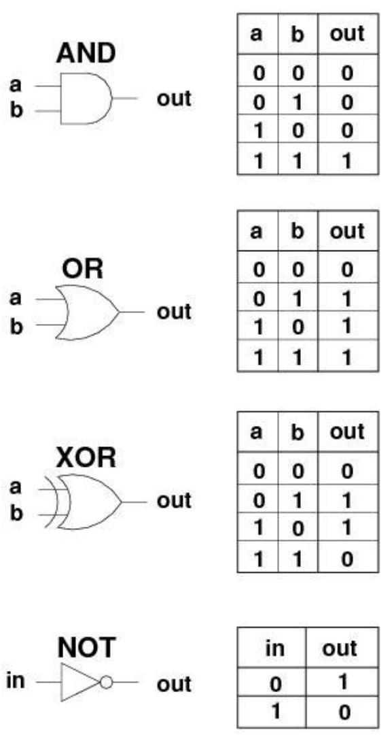
Operators
AND
Returns 1 if both inputs are 1
OR
Returns 1 if any of the inputs are 1
XOR
Returns 1 if either a or b is 1, not both
NOT
Returns opposite of input ( 0->1 , vice versa)

Slide 9
Bitmasks
Great for looking at only certain bits
A bitmask using AND as the bitwise operator will selectively mask bits to 0
A bitmask using OR as the bitwise operator will selectively mask bits to 1

Slide 10
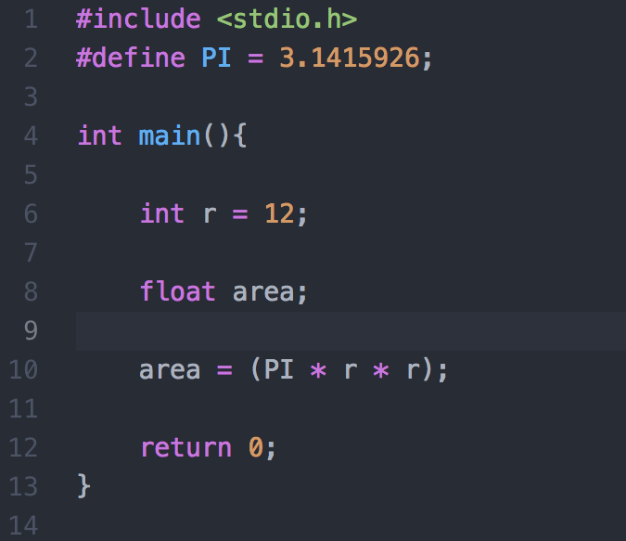
C programming
Variables
Double, Long (8 bytes)
Int, Float (4 bytes)
Int may be 2 bytes on some systems
Short (2 bytes)
Char (1 byte)

Slide 11
Format Specifiers and Escape Sequences
Format Specifiers: %c char single character %d (%i) int signed integer %e (%E) float or double exponential format %f float or double signed decimal %g (%G) float or double use %f or %e as required %o int unsigned octal value %p pointer address stored in pointer %s array of char sequence of characters %u int unsigned decimal %x (%X) int unsigned hex value | Escape Sequences: \n - new line character \b - backspace character \t - horizontal tab \’ - allows for storing and printing of ‘ ASCII value in string \\ - allows for storing and printing of \ ASCII value in string \” - allows for storing and printing of “ ASCII value in string \? - allows for storing and printing of ? ASCII value in string Ie. char x = ‘\’’; (those are 2 single quotes) will store the data byte associated with ‘ into x

Slide 12
Format Specifier Example
int integer = 5;
float decimal = 2.5;
printf(“This is an integer: %d\nThis is a float: %f\n”, integer, decimal);

Slide 13
Format Specifier Example
int integer = 5;
float decimal = 2.5;
printf(“This is an integer: %d\nThis is a float: %f\n”, integer, decimal);
Prints:
This is an integer: 5
This is a float: 2.50000

Slide 14
C - operators
Order of precedence
* , / , % , then + , - (Note, Modular Arithmetic (%) is not defined for floating point numbers)
Assignment operator
= (takes a variable on the left and a value/expression on the right side)
Sets the variable on the left equal to the expression on the right
IE, you can’t do 5 = x; as 5 is not a variable (you can’t assign a value to 5!)
Relational
==, !=, <, >, <=, >=
Returns 1 for true, 0 for false
Bitwise
&, |, ~, ^ (AND, OR, NOT, XOR)
Logical
!, &&, || (NOT, AND, OR)

Slide 15
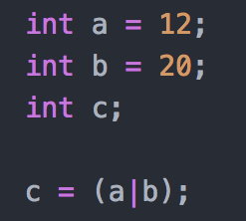
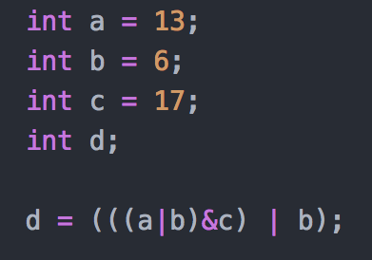
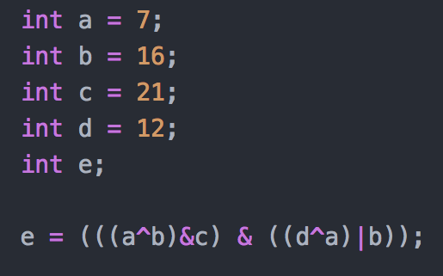
C operators - bitwise examples

Slide 16
C operators - bitwise examples
c = 28 d = 7 e = 17

Slide 17
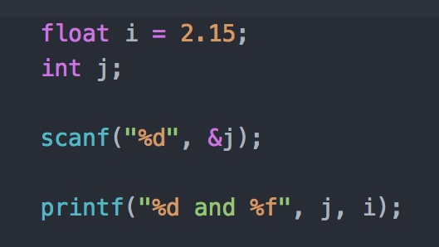
Basic Input / Output

Slide 18
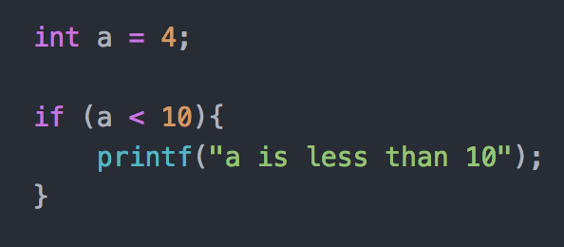
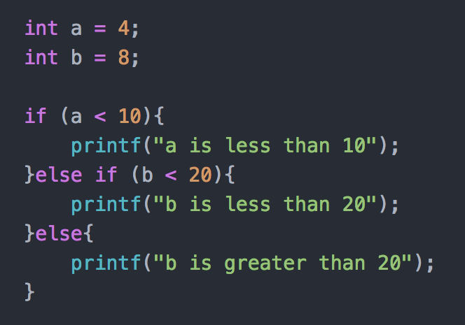
Conditional Constructs

Slide 19
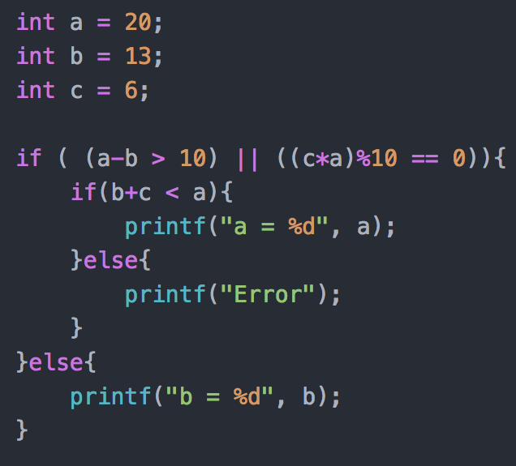
Conditional Constructs - Example

Slide 20
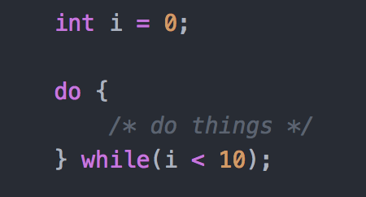
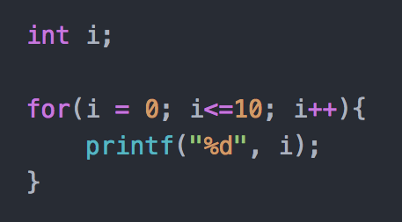
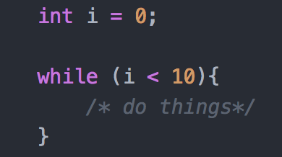
Iterative Constructs

Slide 21
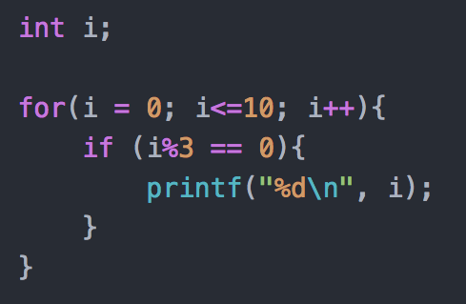
Iterative - Example

Slide 22
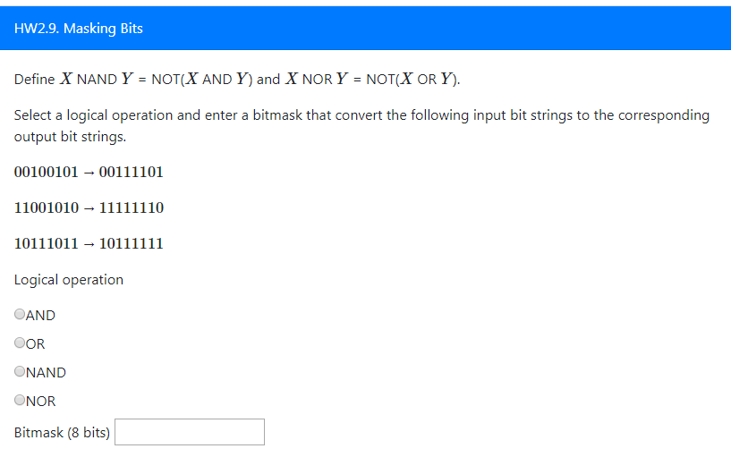
HW2.9

Slide 23
Past Exam Review
https://wiki.illinois.edu/wiki/display/ece120/Midterm+1
Fall 2016, Midterm 1
Solutions available

