Slide 1

ECE 210 Review Session
Midterm one

Slide 2
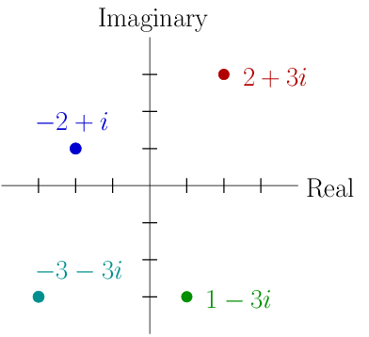
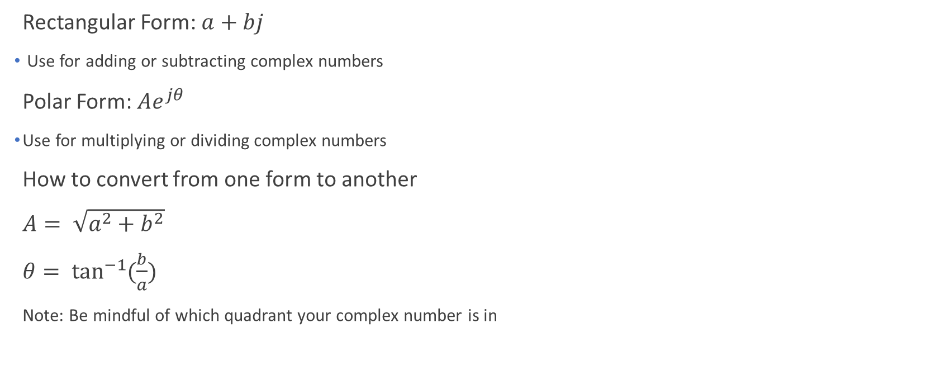
Complex Numbers
Rectangular Form: $a+bj$
Use for adding or subtracting complex numbers
Polar Form: ${Ae}^{jθ}$
Use for multiplying or dividing complex numbers
How to convert from one form to another
$A= \sqrt{a^{2}+b^{2}}$
$θ= \tan^{−1}{(\frac{b}{a})}$
Note: Be mindful of which quadrant your complex number is in

Slide 3
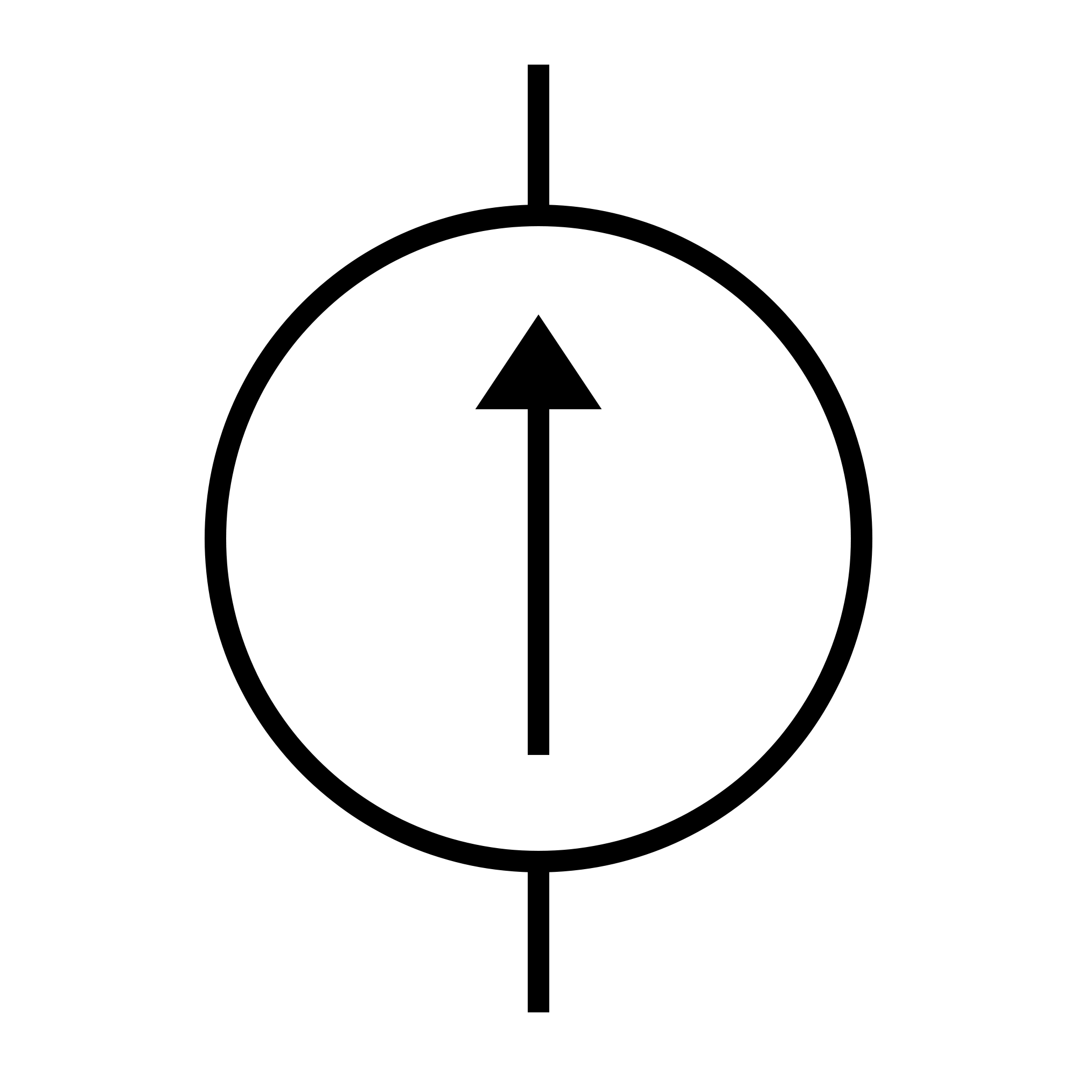

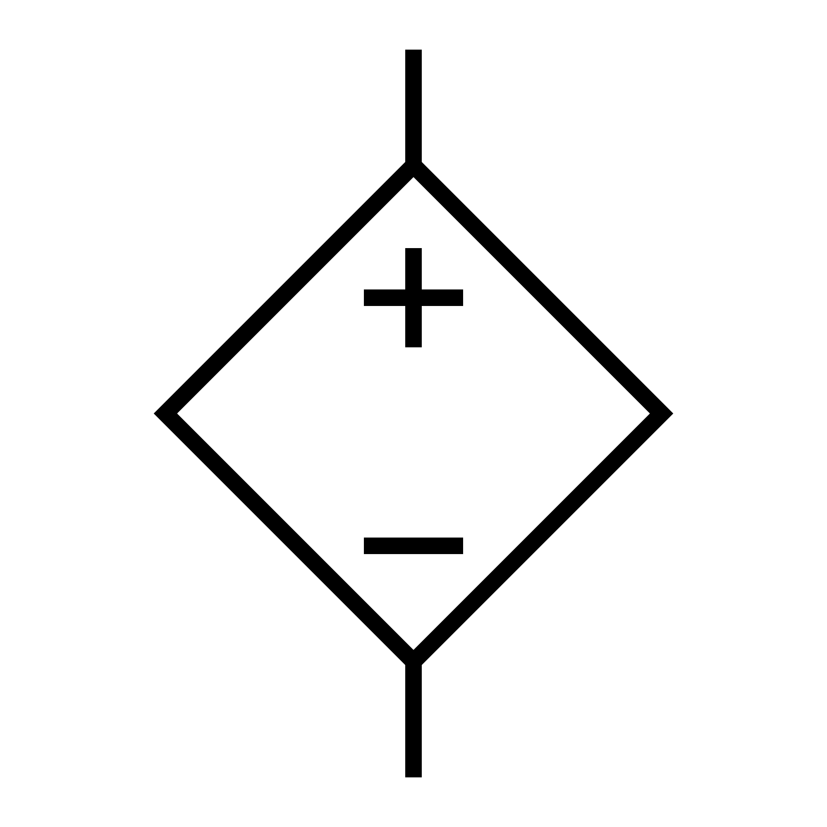
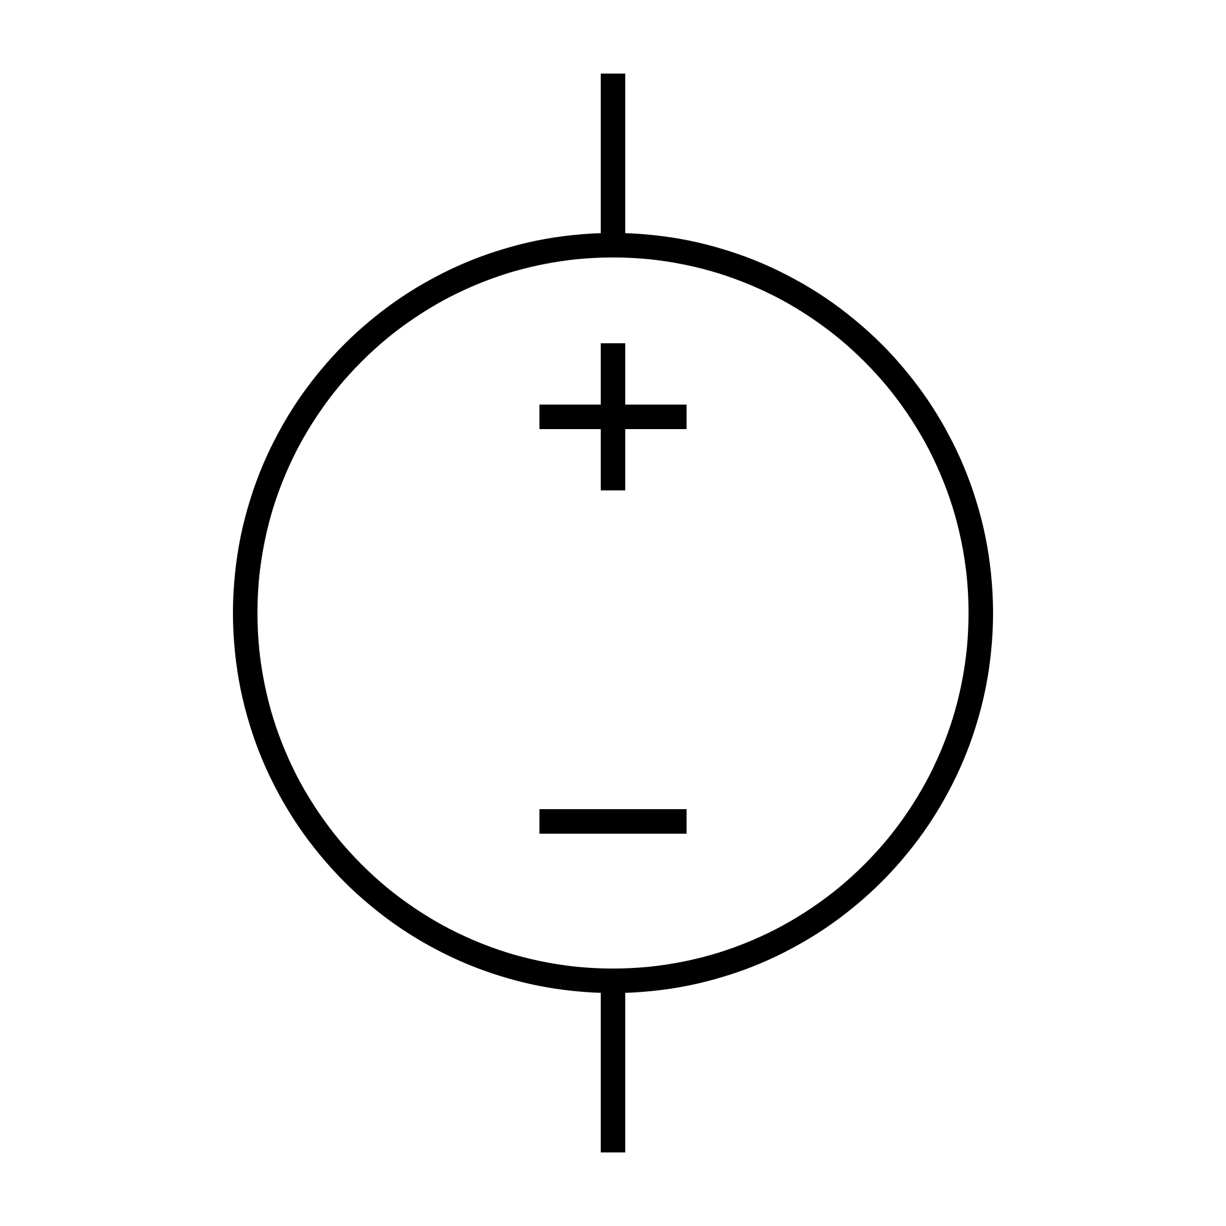




Independent and Dependent Sources
$$I=av_{x }or bi_{x}$$
$$I_{s}$$
Independent Current Source
Dependent Current Source
$$V=av_{x }or bi_{x}$$
$$V_{s}$$
Independent Voltage Source
Dependent Voltage Source

Slide 4
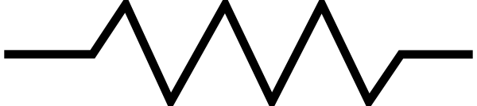
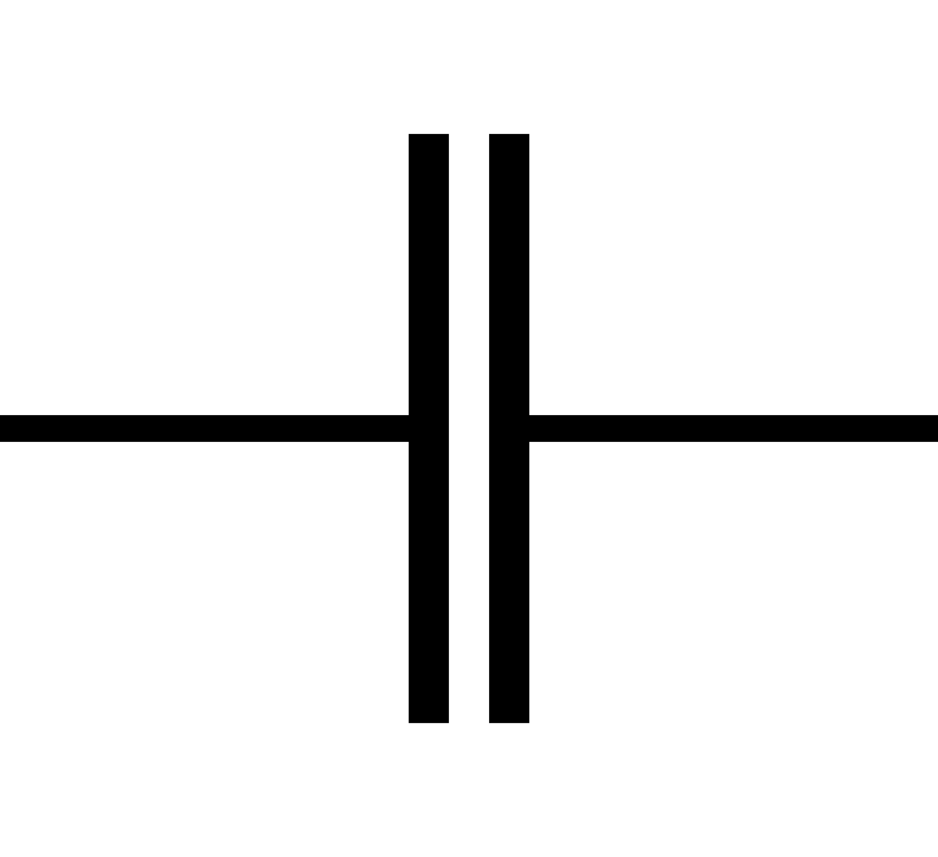
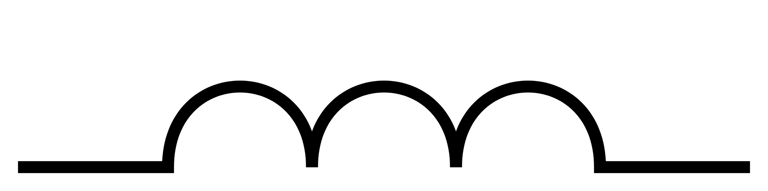



Resistors, Capacitors, and Inductors
Resistor
$$V=iR$$
$$i=C\frac{dv}{dt}$$
Capacitor
$$V=L\frac{di}{dt}$$
Inductor

Slide 5
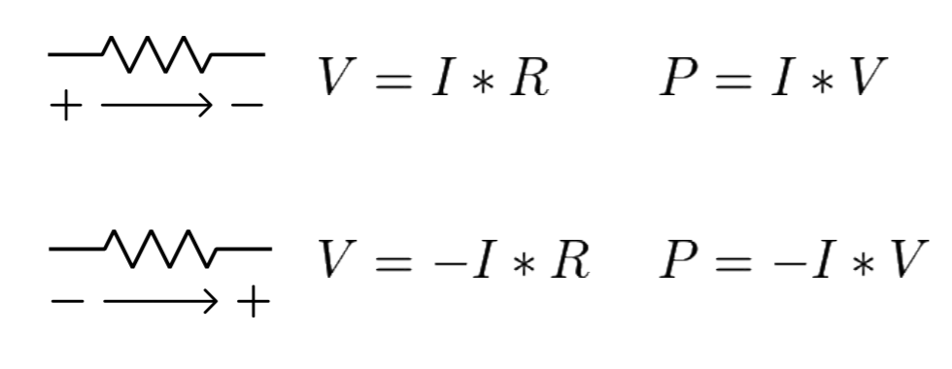

Power
Energy absorbed/gained in a unit time
$P=VI$
From the textbook: where v denotes the voltage drop across the element in the direction of the current i
When P > 0 Power is ABSORBED
When P < 0 Power is
INJECTED (SOURCE)

Slide 6
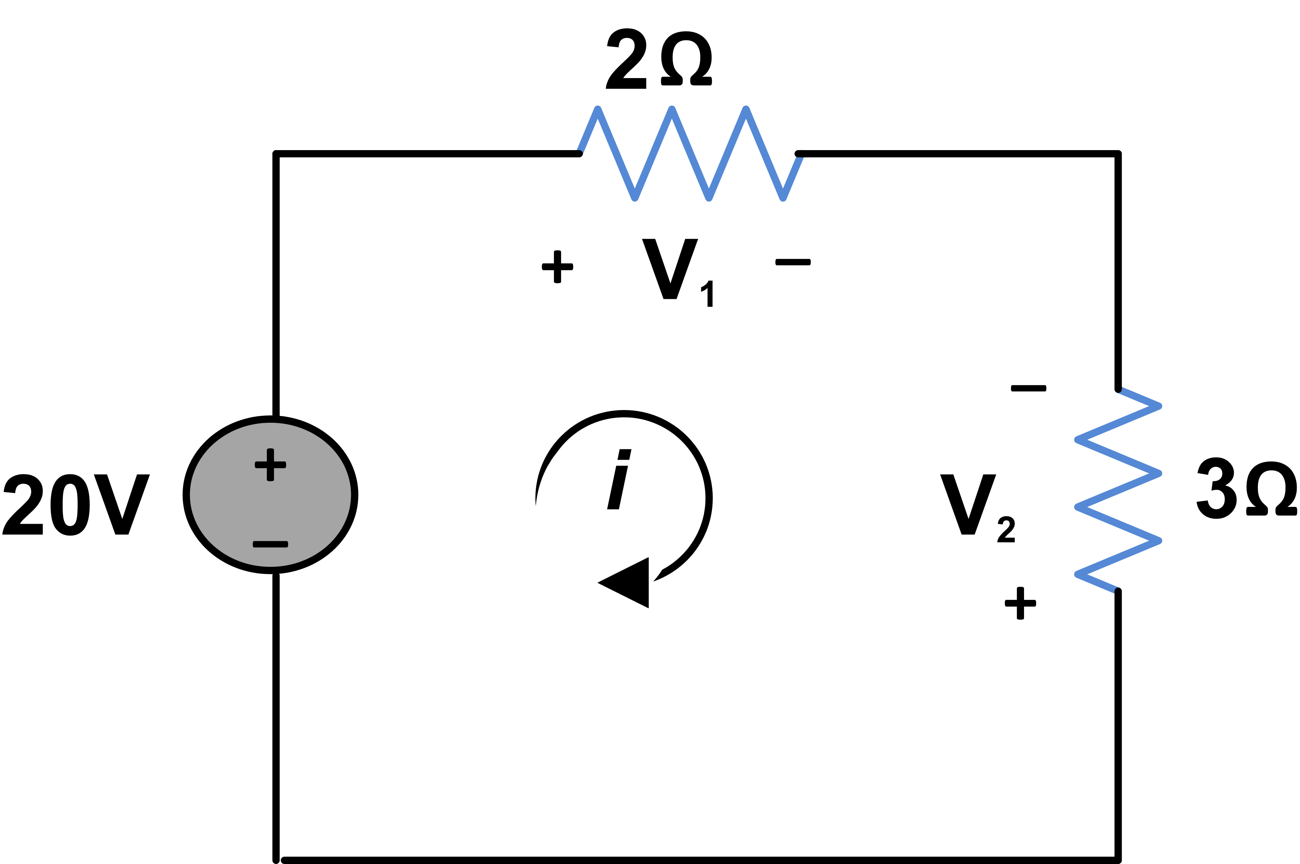


Kirchhoff's Voltage Law
Conservation of Energy
The sum of all voltage rises across a closed loop is equal to the sum of voltage drops
$\sum{V_{rise}=\sum{V_{drop}}}$
$$V_{1}=20+V_{2}$$

Slide 7
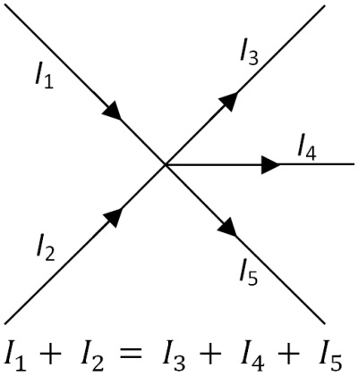
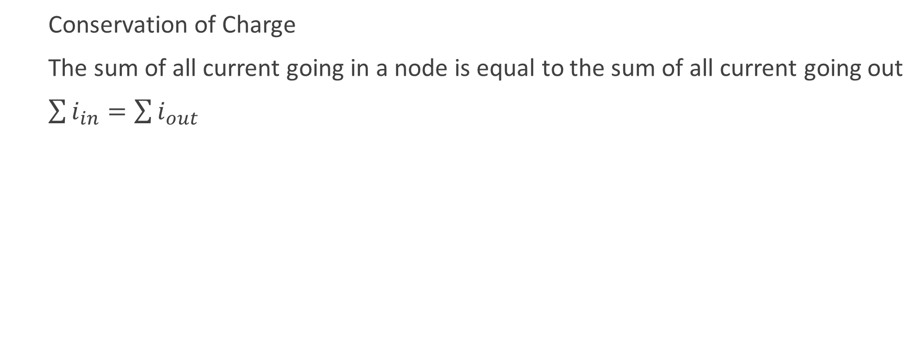
Kirchhoff’s Current Law
Conservation of Charge
The sum of all current going in a node is equal to the sum of all current going out
$\sum{i_{in}=\sum{i_{out}}}$

Slide 8
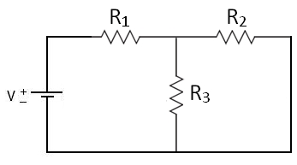
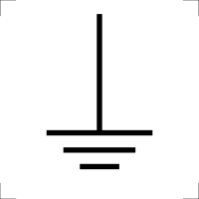










Node Voltage Method
Assign ground (reference) node
Assign names to unknown nodes
Set up KCL equations
$$i_{1}$$
$$i_{2}$$
$$V_{1}$$
$$V_{2}$$
$i_{1}=\frac{V−V_{1}}{R_{1}}$
$$i_{1}= i_{2}+i_{3}$$
$$i_{3}$$
$i_{2}=\frac{V_{1}−V_{2}}{R_{2}}$
$i_{3}=\frac{V_{1}}{R_{3}}$
Remember $i= \frac{V_{START}− V_{END}}{R}$

Slide 9




Loop Current Method
Assign loops in circuit
Assign signs for voltages along elements
Form KVL equations along loops
+
-
+
-
+
$$loop 1:V=i_{1}R_{1}+(i_{1}−i_{2})R_{3}$$
$$i_{1}$$
-
$$i_{2}$$
$$loop 2:i_{2}R_{2}=(i_{2}−i_{1})R_{3}$$

Slide 10
Superposition Principle
For a circuit with N independent sources, redraw the circuit N times
Suppress all sources but one
Find the node voltage or current of interest
Add up all the values for each source to get the result
Don’t suppress any dependent source
Short Circuit
Open Circuit

Slide 11
Thevenin and Norton Equivalents
Thevenin Voltage: Leave the output terminal open
Norton Current: Create a short between output terminals
Thevenin/Norton Resistance: Suppress all sources. Calculate the equivalent resistance “looking in” from the output terminals

Slide 12
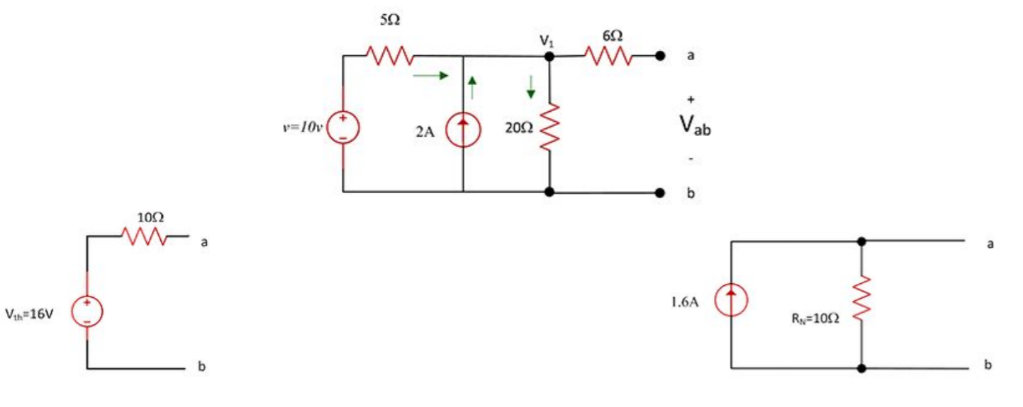

Slide 13
Dependent Sources (Test Signal)
Connect a 1A current source across the output terminals
Suppress all independent sources
Calculate the voltage across the current source
The value of the resistance is equal to the value of the voltage across the current source

Slide 14
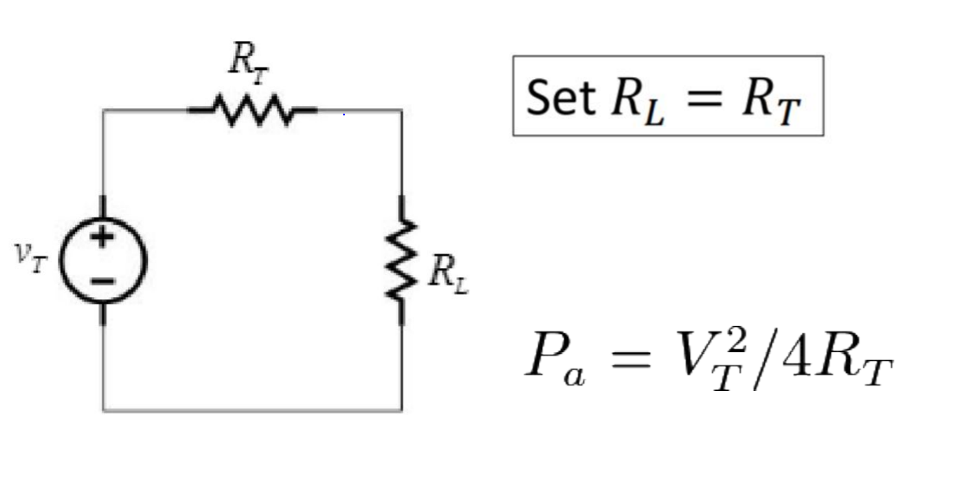
Available/Maximum Power

Slide 15
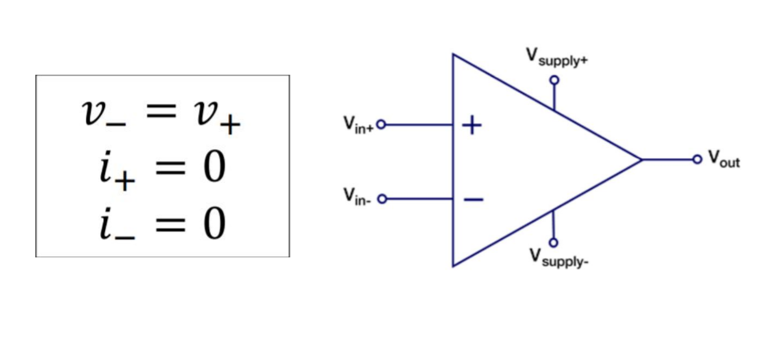
Op-Amp

Slide 16
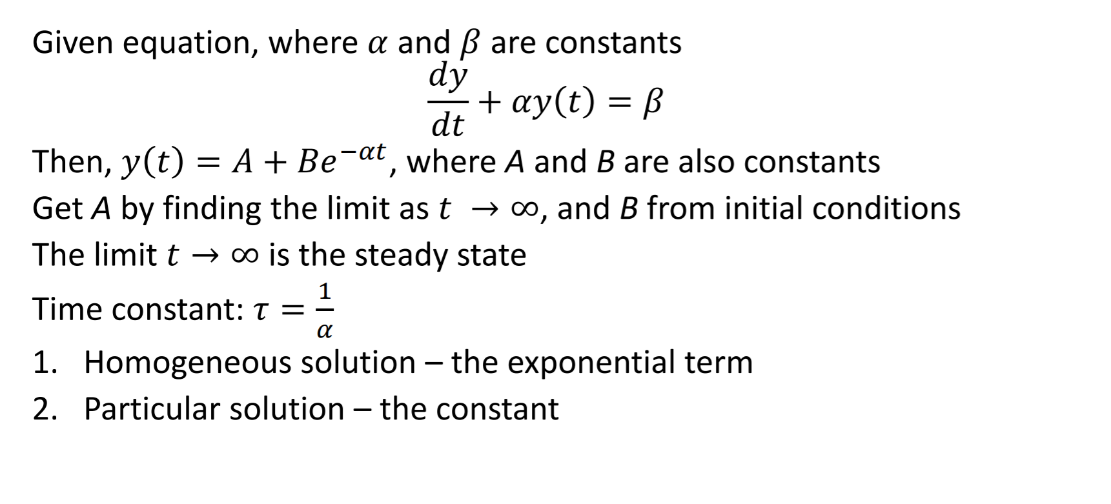
First Order Differential Equations

Slide 17
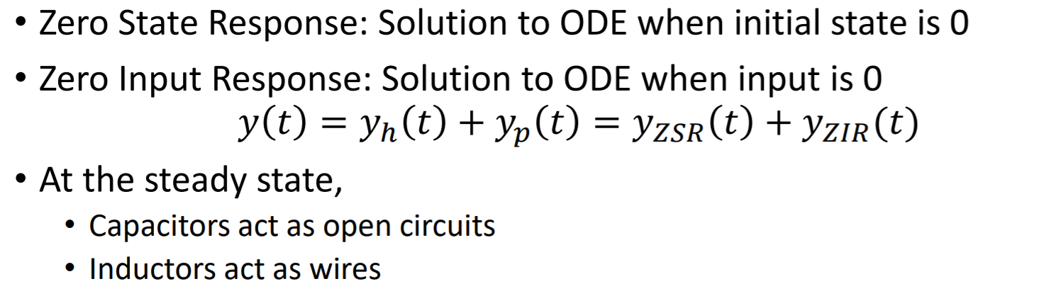
First Order Circuits

Slide 18
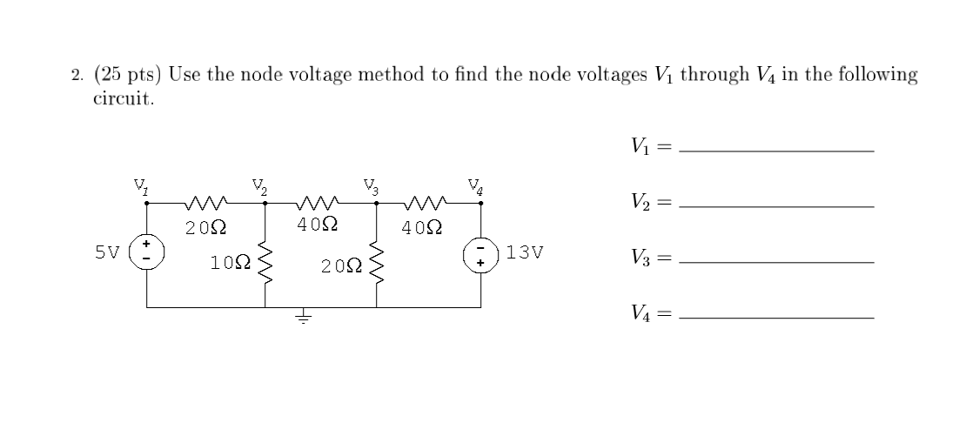
Spring 2016 Q2

Slide 19
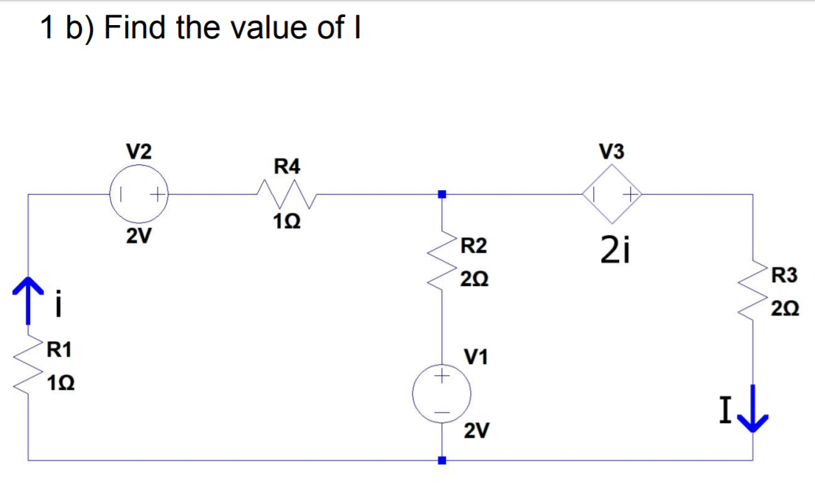
Fall 2016 Q1b

Slide 20
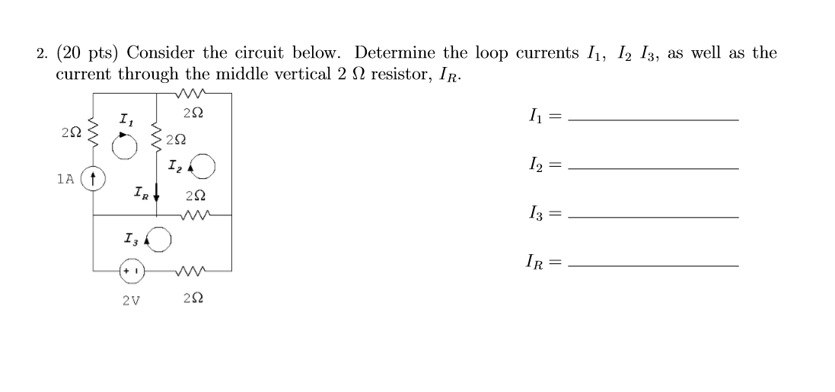
Spring 2018 Q2

Slide 21
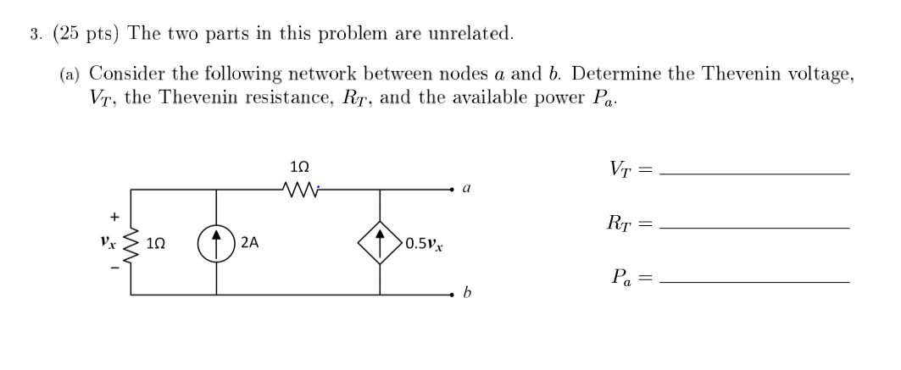
Fall 2014 Q3

Slide 22
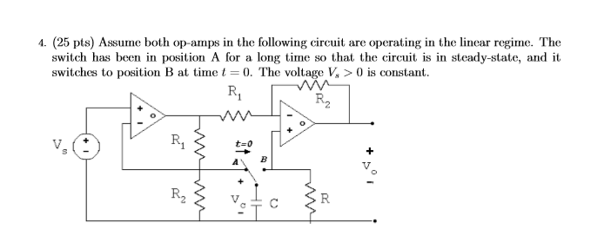
Fall 2017 Q4
$$1)For t<0, obtain V_{c}\left(t\right)and V_{o}(t)$$
$$2)For t>0, obtain V_{c}\left(t\right)and V_{o}(t)$$
$$3)For −1<t, sketch V_{c}\left(t\right) and V_{o}\left(t\right)and determine their discontinuities$$

Slide 23
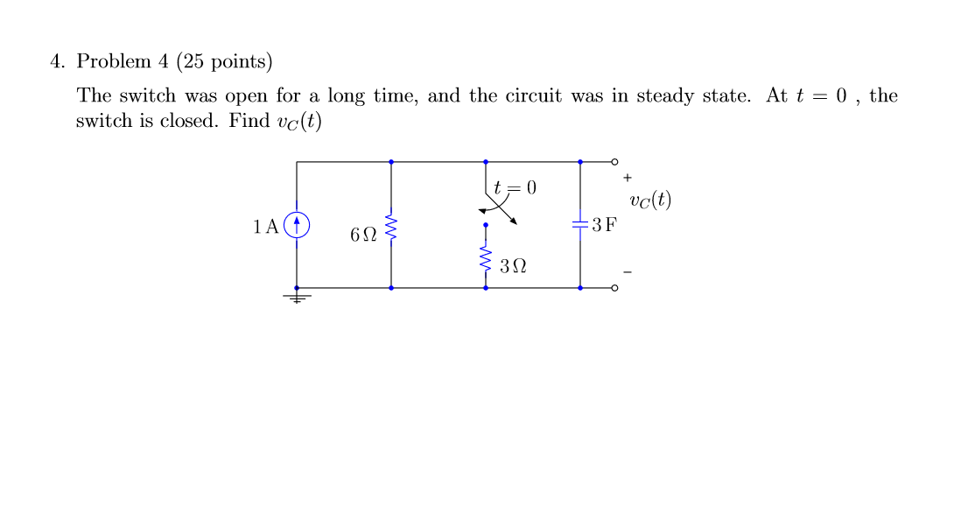
Fall 2010 Q4

Slide 24
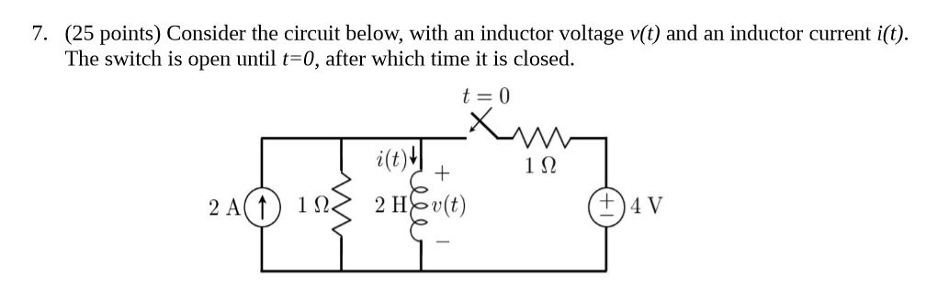


Fall 2013 Q7

