Slide 1
ECE 329 Exam 3 HKN Review Session
Steven Kolaczkowski
Soo Min Kimm

Slide 2
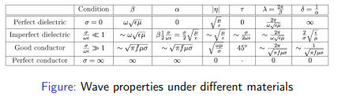

Slide 3
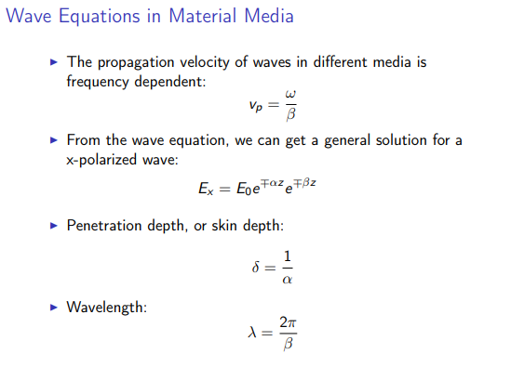

Slide 4
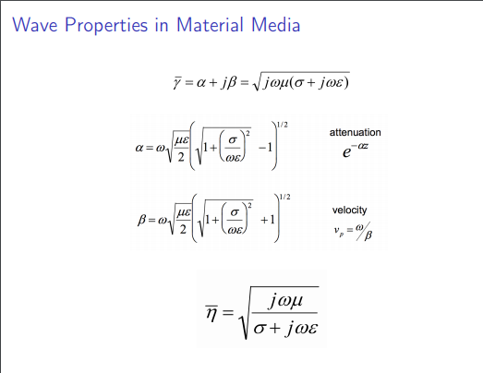

Slide 5
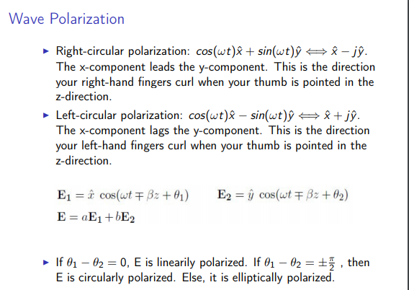

Slide 6
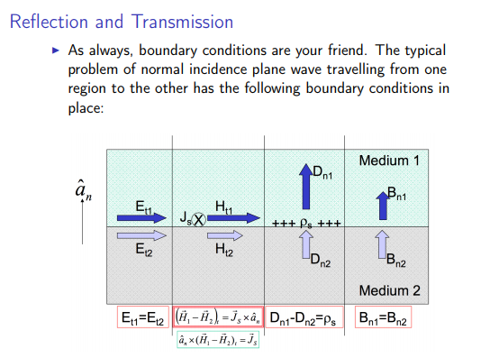

Slide 7
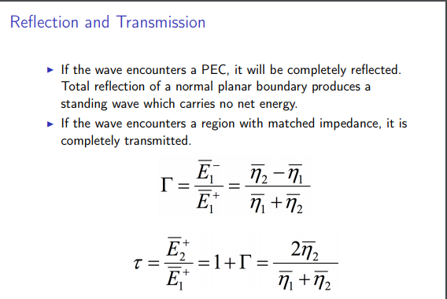

Slide 8
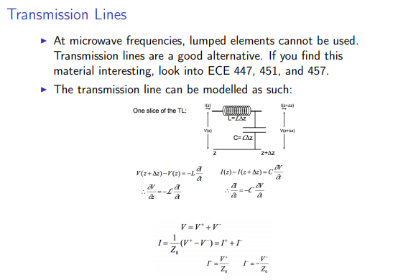

Slide 9
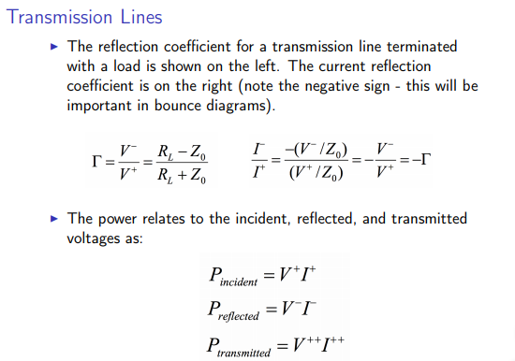

Slide 10
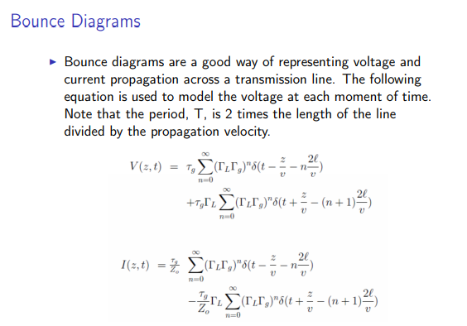

Slide 11
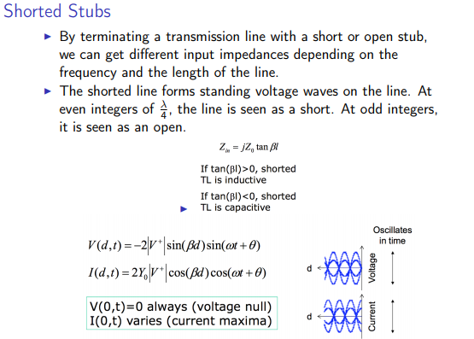

Slide 12
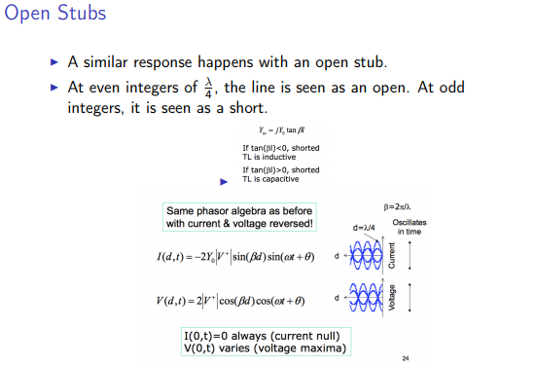

Slide 13
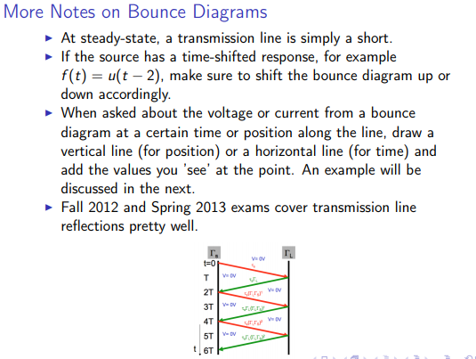

Slide 14
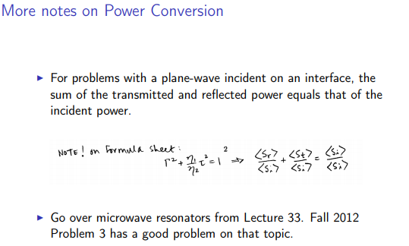

Slide 15
Previous Exam Questions

Slide 16

Summer 2016
2. Consider TEM wave propagation in some good old dry earth (as opposed to moist earth or damp earth) – the relevant parameters are:
$$μ=μ_{0}=4π∗{10}^{−7}\frac{H}{m} ; ε=ε_{0}≈\frac{{10}^{−9}}{36π}\frac{F}{m} ; σ={10}^{−3}\frac{S}{m}$$
a. The wavelength $λ=\frac{2π}{β}$ is longer than the penetration depth $δ=\frac{1}{α}$ and the frequency $f≫100 MHz$ – Possible or Not Possible
b. Frequency f is such that $σ≫ωε$ and $λ≈2πδ$ – Possible or Not Possible
c. If $f=100 Hz$ what is the wavelength $λ$?
d. If $f=100 Hz$ what is the penetration depth $δ$

Slide 17

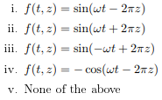
Spring 2016

Slide 18
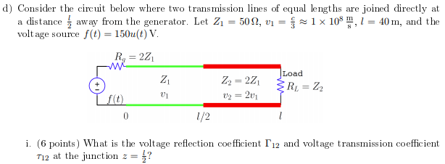
Spring 2016

Slide 19


Fall 2016

