Slide 1
HKN ECE 411 Midterm 1 Review Session
Keshav Harisrikanth, Srijan Chakraborty, Sean Ngo

Slide 2
Agenda
Architecture Concepts
Instruction Set Architecture (ISA)
Performance, Energy, Power
Memory Hierarchy
Caches
Virtual Memory (VM)
Pipelines and Hazards
MPs

Slide 3
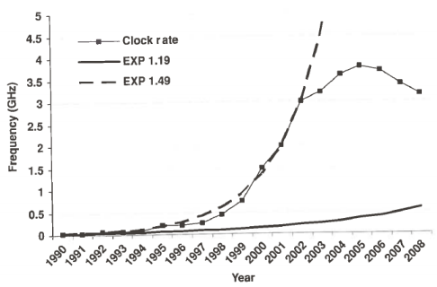
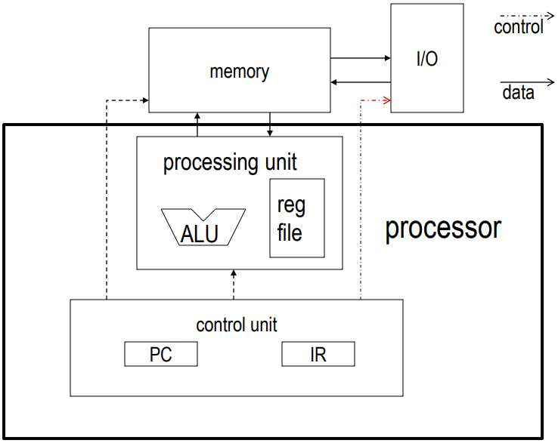
Architecture Concepts
Dennard Scaling
Same area, same power, smaller and faster transistors
von Neumann Architecture
RISC vs CISC (fixed vs. variable length)

Slide 4
Instruction Set Architecture
5 Basic types of ISA:
Accumulator
Stack
Mem-Mem
Reg-Mem
Load-Store
Tradeoffs?
Other design considerations:
Fixed vs variable instr. length, register count, number of opcodes

Slide 5
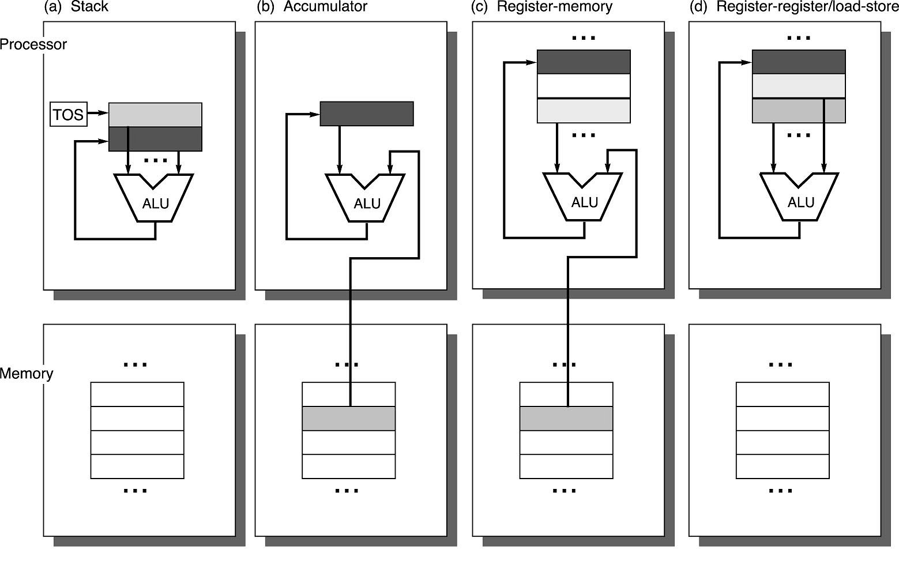
stack | accumulator | register (register-memory) | register (load-store)
push A push B add pop C | load A add B store C | load R1, A add R1, B store C, R1 | load R1,A load R2, B add R3, R1, R2 store C, R3
ISA (cont.)
Be able to:
Convert between any ISAs
Evaluate performance
HW and SW
Consider new ISAs
Larger ISA Categories
RISC vs. CISC
REG vs MEM

Slide 6
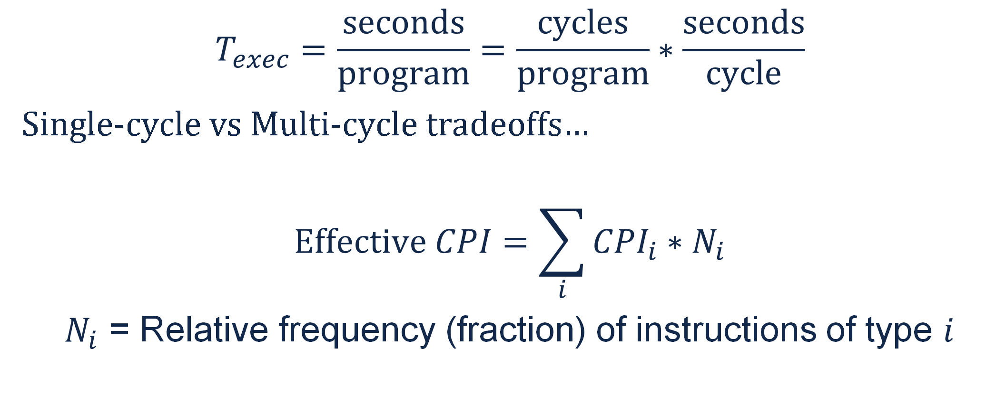
Performance
$$T_{exec}=\frac{seconds}{program}=\frac{cycles}{program}∗\frac{seconds}{cycle}$$
Single-cycle vs Multi-cycle tradeoffs…
$$Effective CPI=\sum_{i}{{CPI}_{i}∗N_{i}}$$
$N_{i}$ = Relative frequency (fraction) of instructions of type $i$

Slide 7
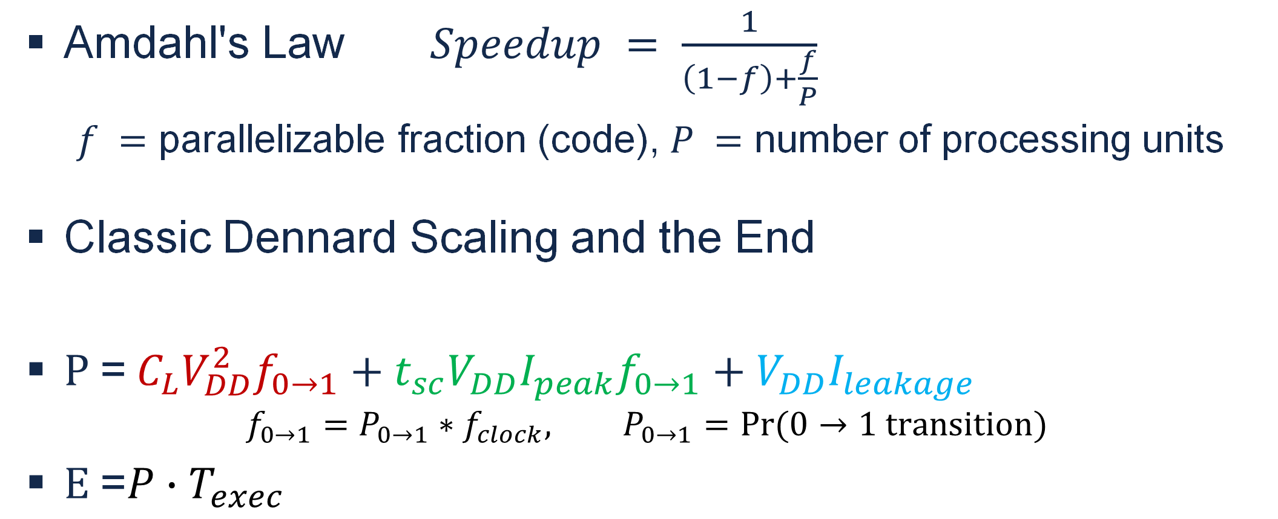
Energy & Power
Amdahl's Law $Speedup = \frac{1}{\left(1−f\right)+\frac{f}{P}}$
$f =$ parallelizable fraction (code), $P =$ number of processing units
Classic Dennard Scaling and the End
$\text{P}\text{ =} C_{L}V_{DD}^{2}f_{0→1}\text{ + }t_{sc}V_{DD}I_{peak}f_{0→1} \text{+ }V_{DD}I_{leakage}$
$$f_{0→1}=P_{0→1}∗f_{clock}, P_{0→1}=Pr⁡(0→1 transition)$$
$\text{E}\text{ =}P∙T_{exec}$

Slide 8
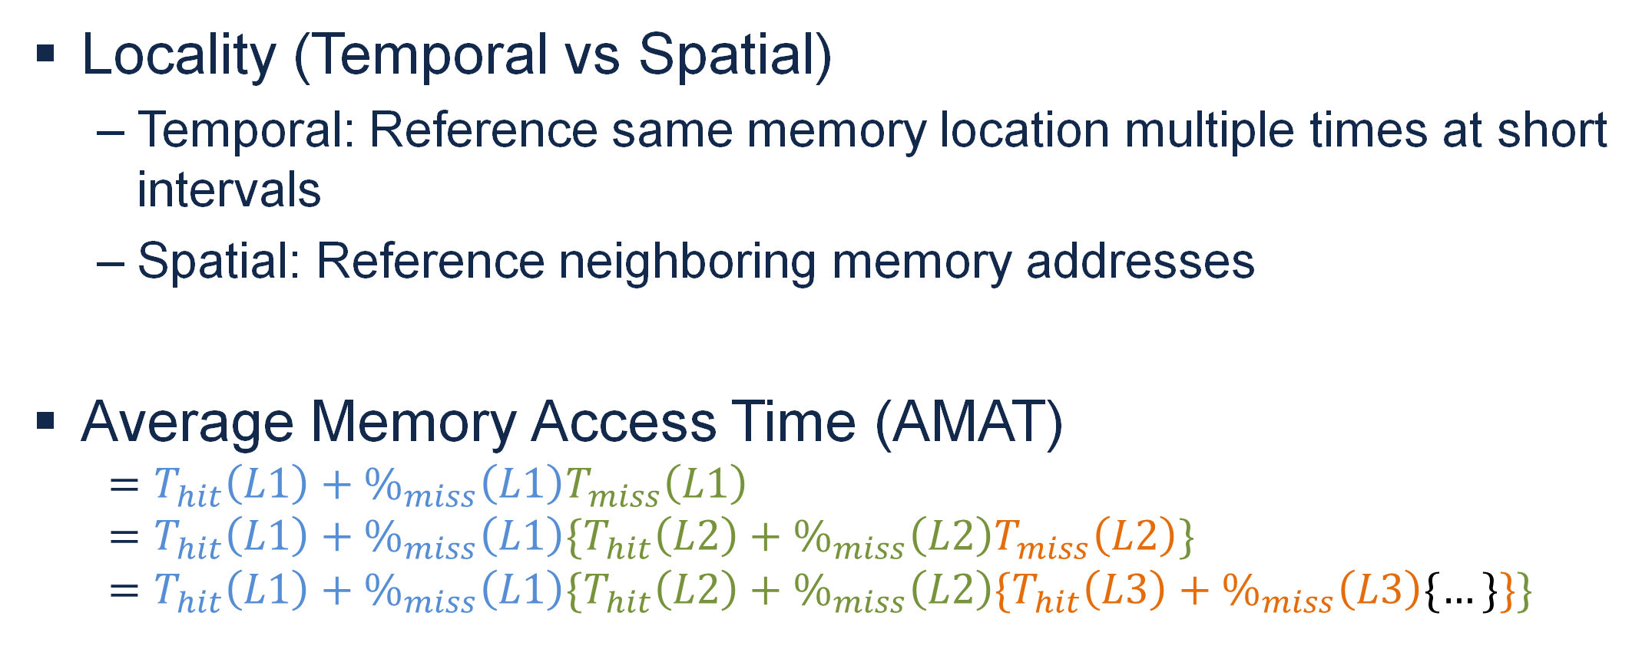
Memory Hierarchy
Locality (Temporal vs Spatial)
Temporal: Reference same memory location multiple times at short intervals
Spatial: Reference neighboring memory addresses
Average Memory Access Time (AMAT)
$$=T_{hit}\left(L1\right)+\%_{miss}\left(L1\right)T_{miss}\left(L1\right)=T_{hit}\left(L1\right)+\%_{miss}\left(L1\right){\{T}_{hit}\left(L2\right)+\%_{miss}\left(L2\right)T_{miss}\left(L2\right)\}=T_{hit}\left(L1\right)+\%_{miss}\left(L1\right){\{T}_{hit}\left(L2\right)+\%_{miss}\left(L2\right){\{T}_{hit}\left(L3\right)+\%_{miss}\left(L3\right)\{…\}\}\}$$

Slide 9
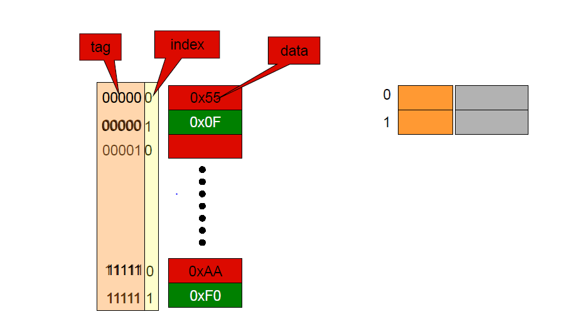
Caches
Types of Caches
Direct Mapped
Memory Value can be placed at a single corresponding location in cache
Fast Indexing mechanism

Slide 10
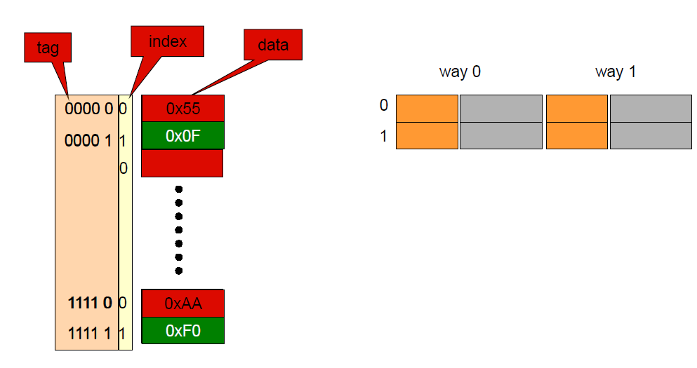
Caches
Types of Caches
Set Associative (Two way in image)
Memory Value can be placed into a set of locations in cache
More complex mechanism

Slide 11
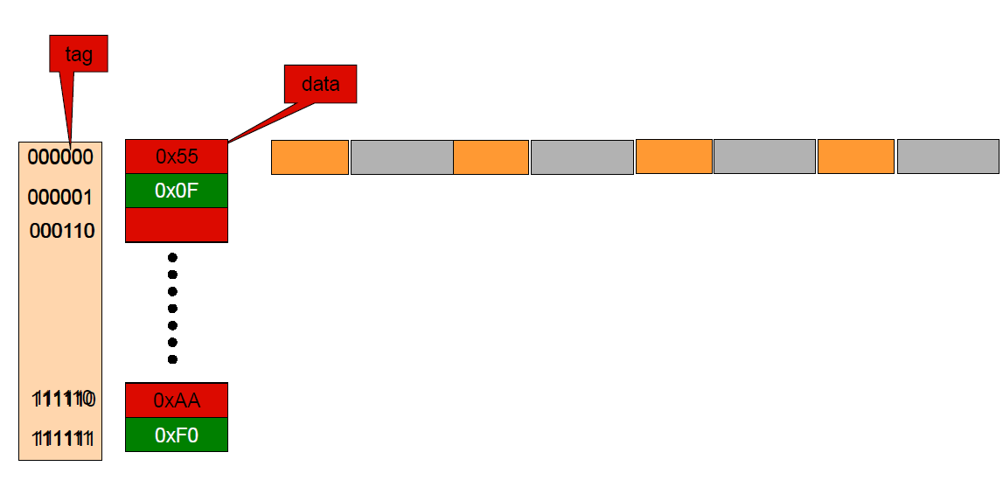
Caches
Types of Caches
Fully Associative
Memory Value can be placed into any location in cache
Very complex mechanism
required to search cache
such as CAM

Slide 12
Cache Characteristics
Three C’s
Compulsory Misses: Cold start misses (no valid data at start)
Capacity Misses: Cache is full, and needs to evict
Conflict Misses: Wrong tag at index, cache may not be full
Replacement Policies
Least Recently Used (LRU, pLRU)
Not Most Recently Used (Not-MRU)
Least Frequently Used (LFU)

Slide 13
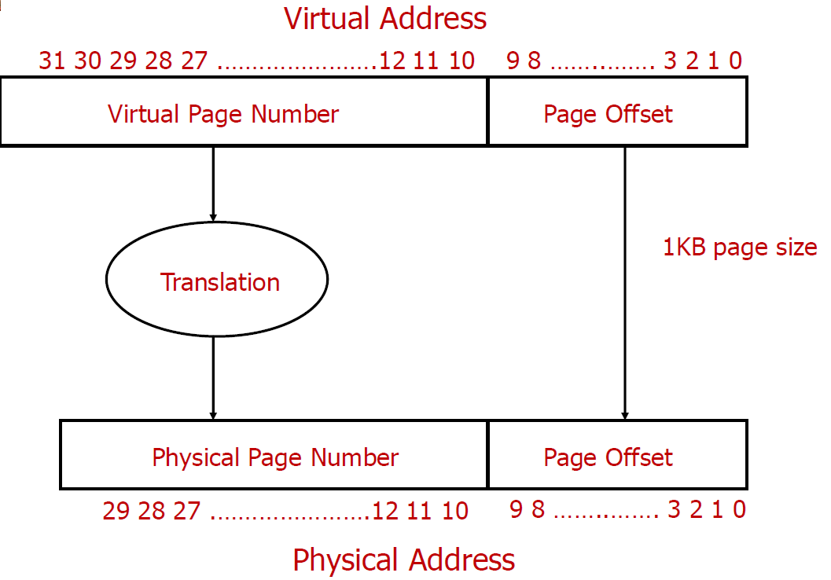
Virtual Memory
Num bits VPN ≥ PPN
More addressable space than physical memory
Homonym Problem:
1 Virtual Address maps to multiple Physical Addresses
Synonym Problem:
Multiple Virtual Addresses map to 1 Physical Address

Slide 14
Virtual Memory
Homonym Solution:
Flush TLB and caches on context switch
Synonym Solution:
Depends on cache size and page size
Num bits VPN ≥ PPN
More addressable space than physical memory
Homonym Problem:
1 Virtual Address maps to multiple Physical Addresses
Synonym Problem:
Multiple Virtual Addresses map to 1 Physical Address

Slide 15
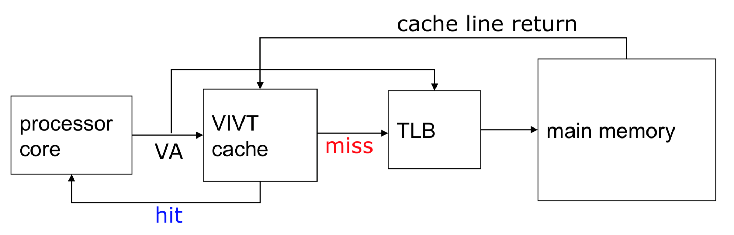
VIVT Cache
Virtually-Indexed, Virtually-Tagged (VIVT)
Very fast access time
Susceptible to homonym and synonym problem

Slide 16
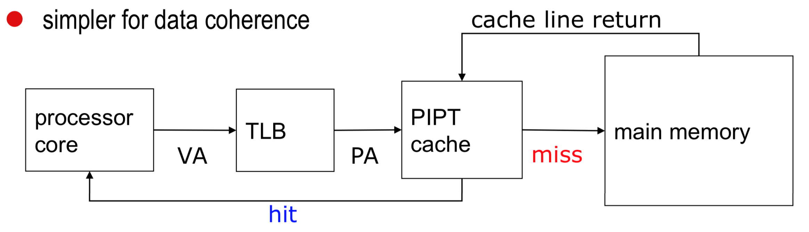
PIPT Cache
Physically-Indexed, Physically-Tagged (PIPT)
Slower access time
Not susceptible to homonym and synonym problem
Simpler coherence

Slide 17
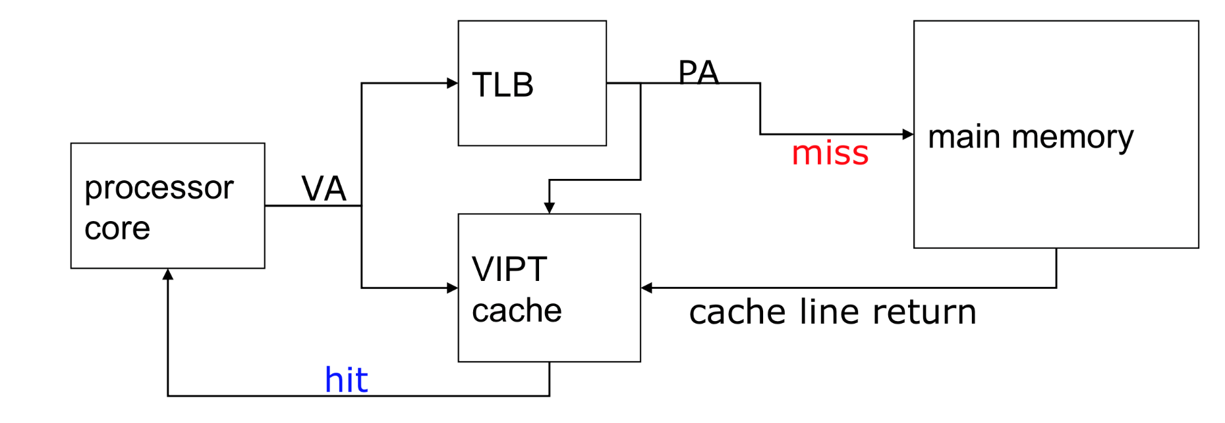
VIPT Cache
Virtually-Indexed, Physically-Tagged (VIPT)
Very fast access time (Parallelize TLB and Cache)
Not susceptible to homonym
Synonym problem remains under certain conditions

Slide 18
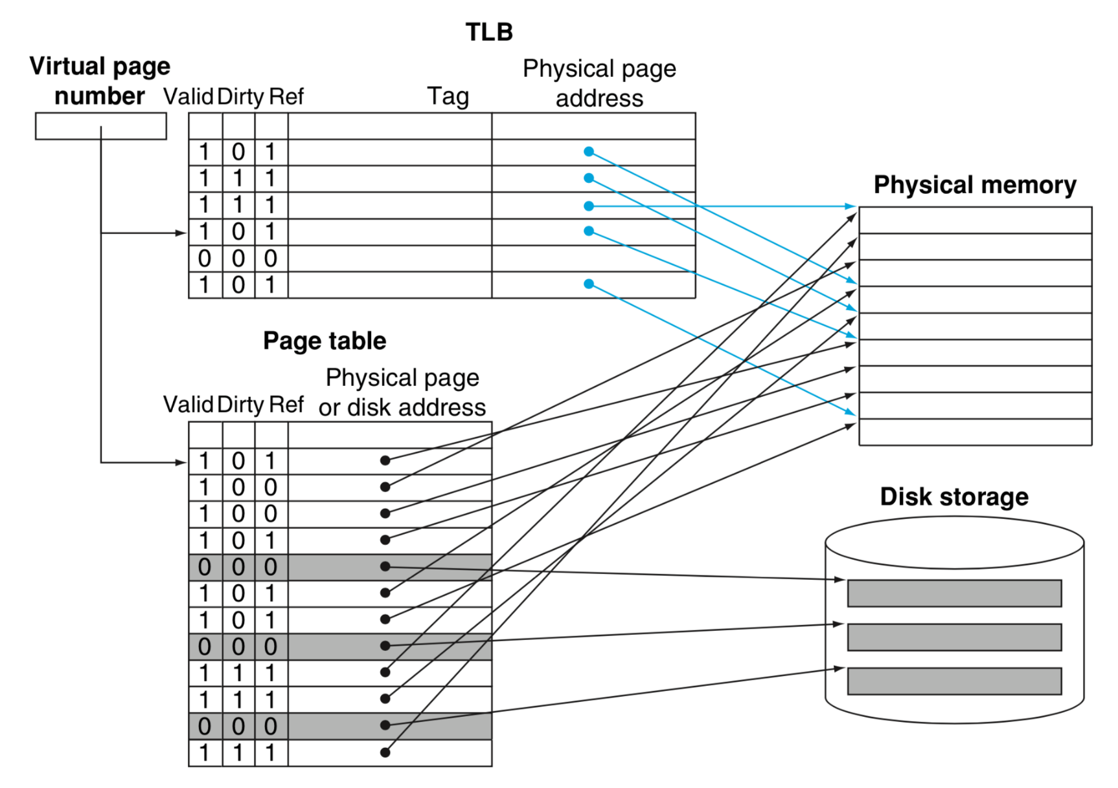
Address Translation
Page Table Walk
Be prepared for 391-esque page table/entry sizing.
Be able to break down address as used.
Flat vs n-Level
2 Level for x86

Slide 19
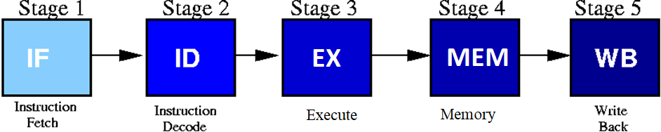
Pipelining
What can be pipelined?
Why does pipelining improve performance?
What extra considerations do pipelines add?
Hazards (and their various solutions)
The “Classic” 5 Stage RISC Pipeline:

Slide 20
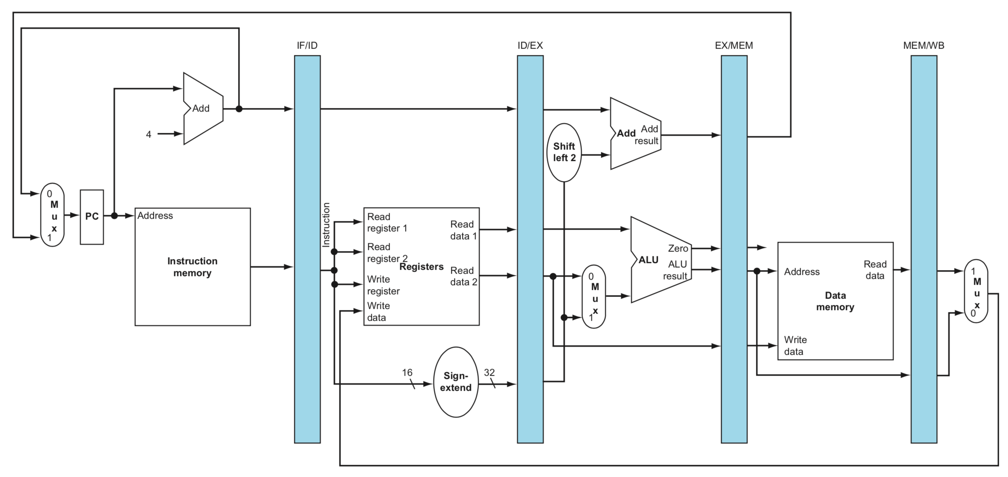
Hazards
Structural – Limitation
on functional units.
Data – Same data has different values at different stages.
Control – Control flow of the program is incorrect.
Branch prediction.

Slide 21
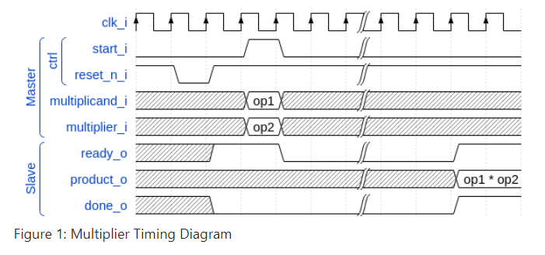
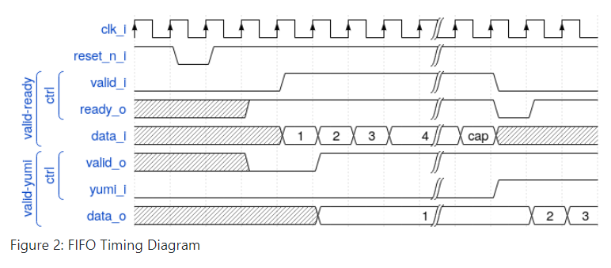
MPs: MP1
SystemVerilog Proficiency
Tasks, Functions
Procedural Statements
Be able to trace a waveform with SV.
Verification fundamentals
Stressing input stimuli
Error reporting

Slide 22
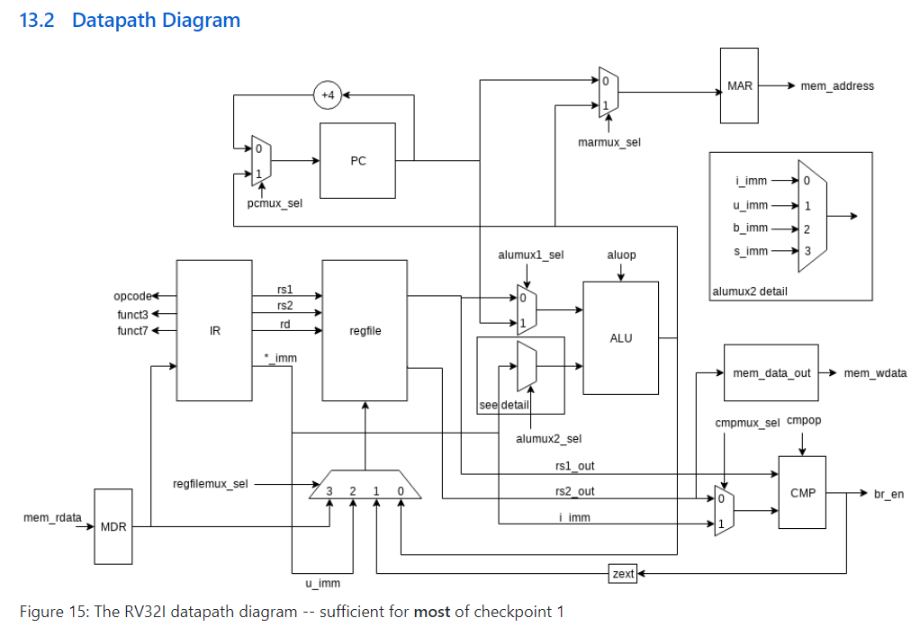
MPs: MP2
RISC-V
Memory structures
Alignment
Multicycle processors
For more, take ECE 385

Slide 23
Questions?

