Slide 1
ECE 120 Midterm 3
Keshav Harisrikanth
Joseph Ravichandran, Srijan Chakraborty, Kanad Sarkar

Slide 2
Topic Overview
Finite State Machine
Analysis, Design, Counter Design
Memory
Flip flops, RAM, Tri-state buffer
Addressability
How to construct from smaller blocks
LC3
Von Neumann Architecture
LC3 Architecture
ISA
Instruction Cycle

Slide 3
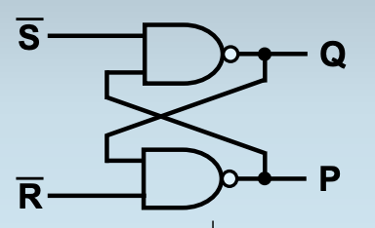
S'-R' Latch
If S = R, then Q and P can't store a bit.
When S' is 0 and R' is 1, stores 1 into Q.
When S' is 1 and R' is 0, stores 0 into Q.

Slide 4
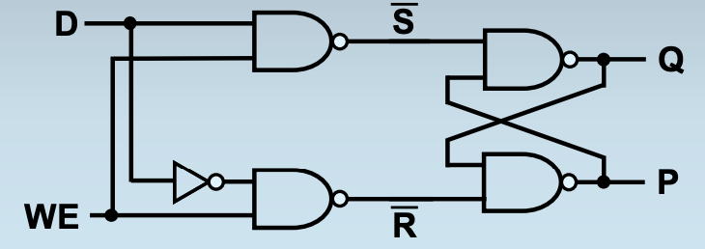
D latch
D stands for the DATA, WE stands for Write Enable
Stores the value of D when WE is high.

Slide 5
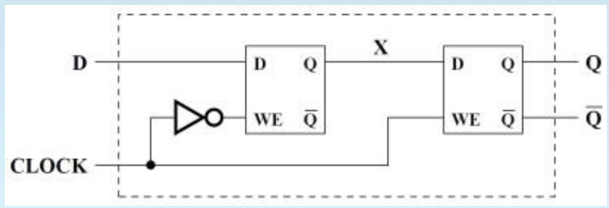
D Flip Flops
Made from two D latches
D latch behavior:
D flip flop stores the input bit D when clock goes low to high
C | D | R | S | Q+ | Definition
1 | 0 | 1 | 0 | 0 | Reset
1 | 1 | 0 | 1 | 1 | Set
0 | 0 | 0 | 0 | Q | No change
0 | 1 | 0 | 1 | 1 | No change

Slide 6
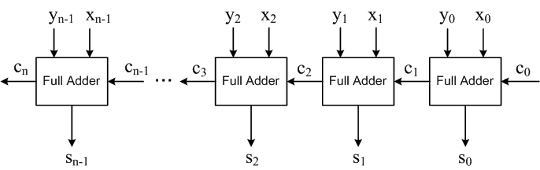
Bit Slice Design
Design 1 component for a single bit
Repeat it k times for a k-bit design
Example of bit slice design: Ripple Carry Adder

Slide 7
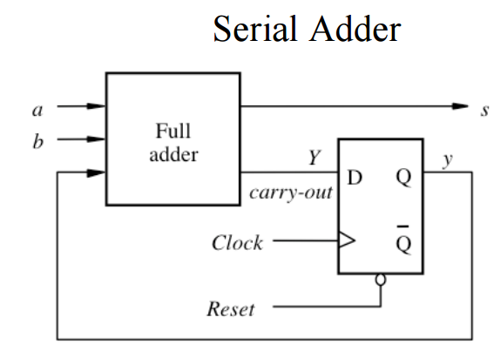
Serialized Design
Same as a bit slice design, except instead of many bit slices only use 1
Use flip-flops to store intermediate results
Compute each bit slice in sequence, over time

Slide 8
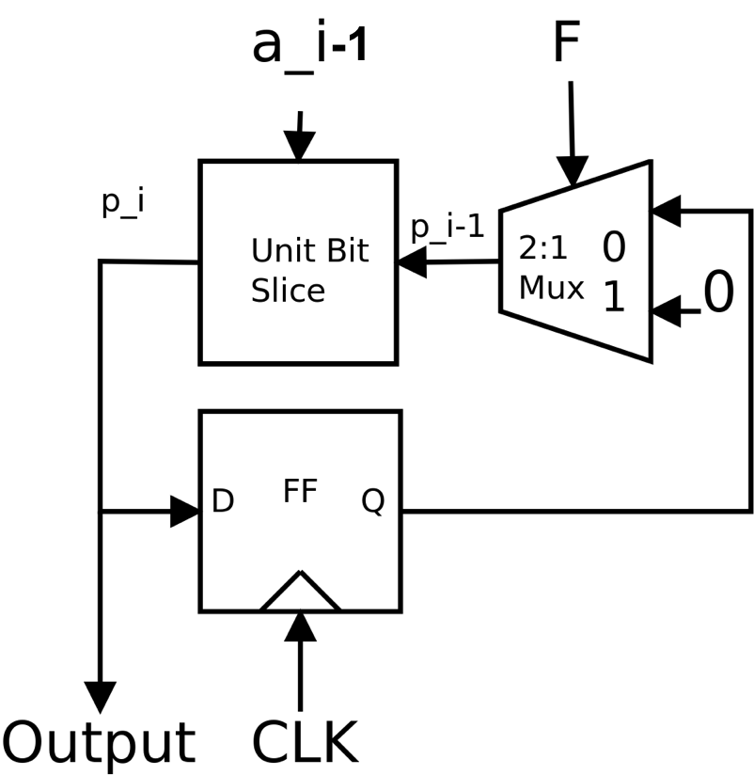
Serialized Design
The ‘F’ Signal is 1 when the first bit of data enters, 0 otherwise
Use the ‘F’ signal to initialize your registers to the correct value
In the full adder example, this means load the register with carry in of 0

Slide 9
Bit Slice VS Serial
Area
For large number of bits, serial uses less area
For smaller number of bits, bit slice uses less area
Speed
Bit slice is usually faster
Serial is usually slower

Slide 10
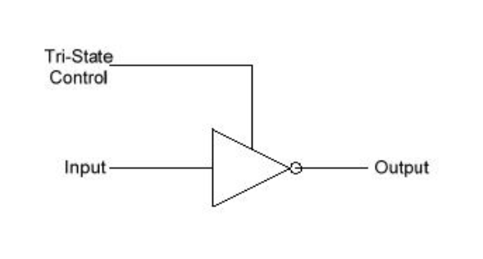
Tri-State Buffers
When enable is 1, they act as a wire
When enable is 0, they act as high impedance (disconnected)

Slide 11
Finite State Machine
3 Main Components of FSMs:
Next state logic
Current state
Output logic
How many bits are needed to represent N states in a standard FSM?

Slide 12
FSMs In Detail
2 types: Mealy and Moore
Moore: Outputs are a function of current state only
Mealy: Outputs are a function of current state and inputs
Mealy machines use less states
5 key elements:
Finite number of states
Finite number of inputs
Finite number of outputs
Explicit number of state transitions
Explicit definition of outputs as a function of state (and as function of inputs for Mealy machines)

Slide 13
FSM Design
List all inputs to your FSM
List all outputs from the FSM
Create a truth table for the FSM
State and inputs on the left
Next state and outputs on the right
Outputs should be the same for the same current state (unless Mealy machine)
Create a state diagram
K-maps, etc.

Slide 14
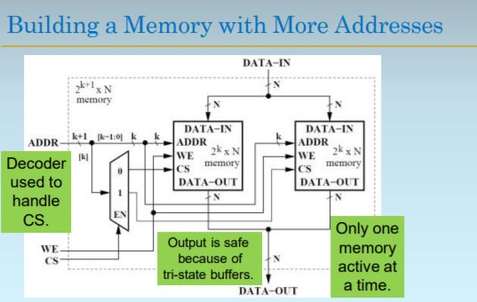

Slide 15
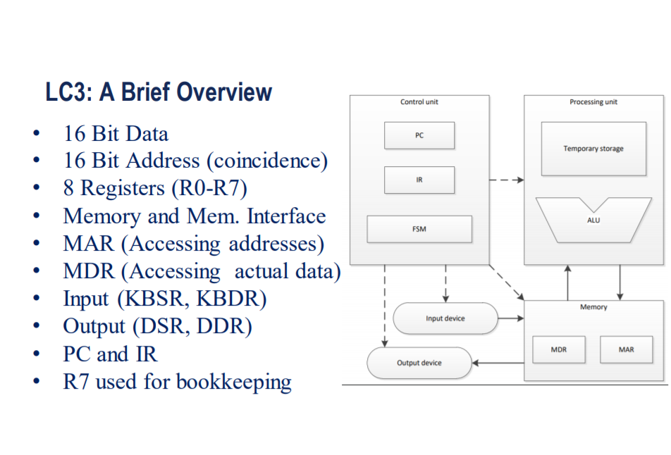

Slide 16
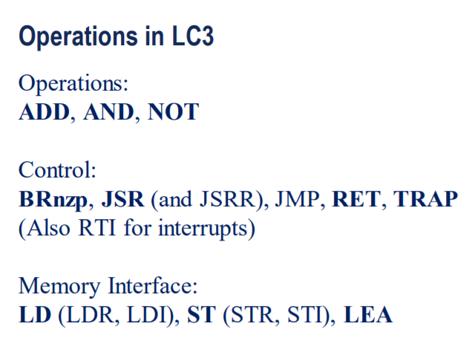
EVERY 16 BIT INSTRUCTION CORRESPONDS TO ONE OF THESE!
CHEAT SHEET IS YOUR SAVIOR HERE!
Side: Don't worry about JSR, JSRR, TRAP, or RTI yet, just know they exist

Slide 17
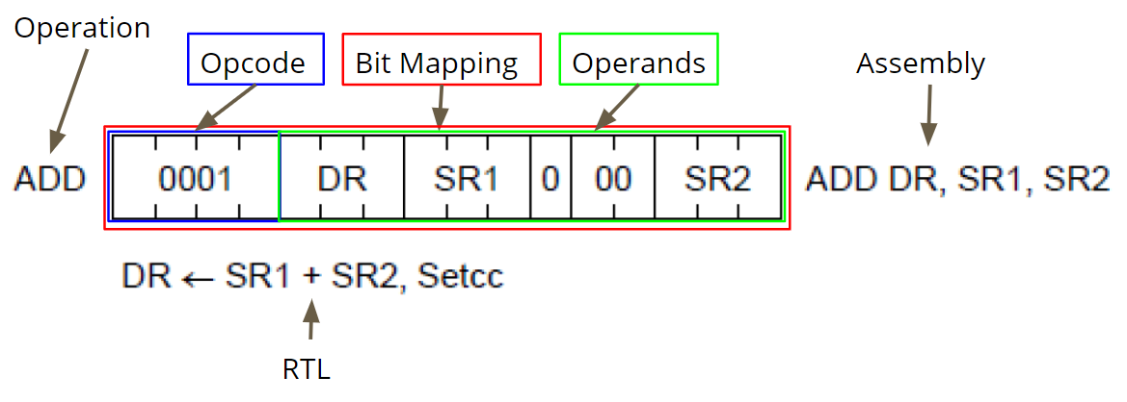
How to read your Cheat Sheet (for ISA)

Slide 18
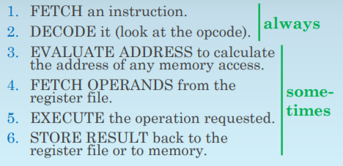
Instruction Cycle!

Slide 19
Details
FETCH
MAR ← PC
PC ← PC+1
MDR ← M[MAR]
IR ← MDR
Used to obtain the next instruction
IMPORTANT! PC is incremented to next spot BEFORE current instruction put in IR
DECODE
- Opcode (IR[15:12]) examined (first 4 bits)

Slide 20
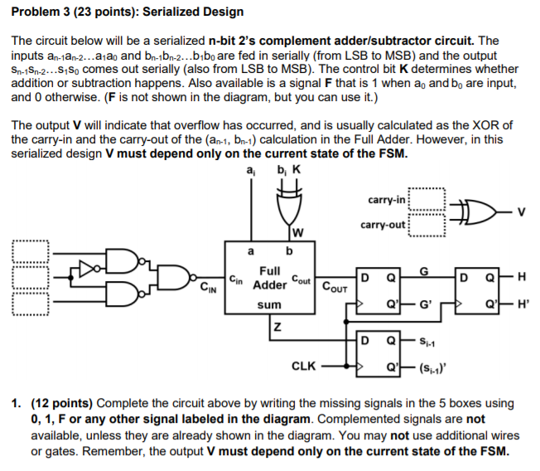

Slide 21
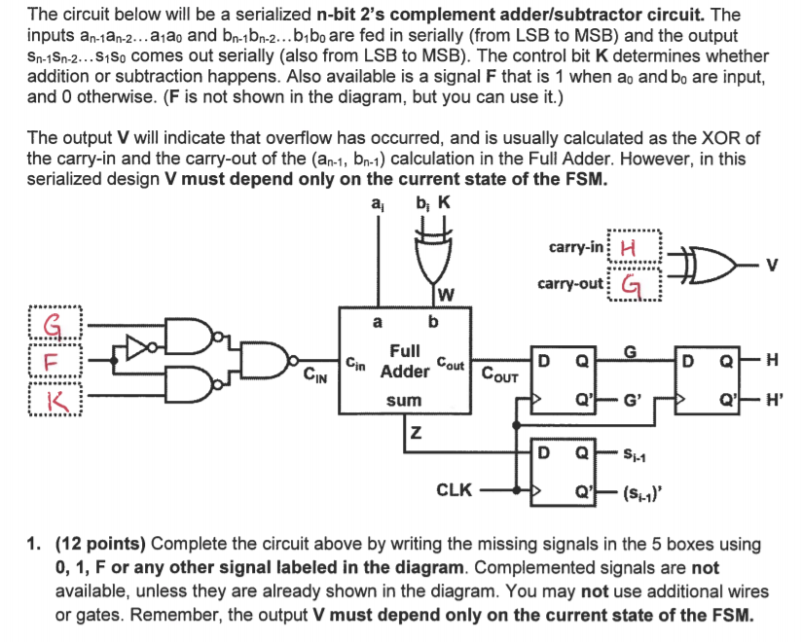

Slide 22
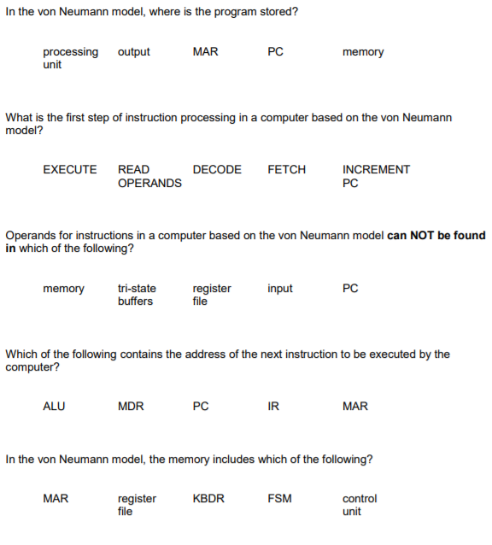


Slide 23
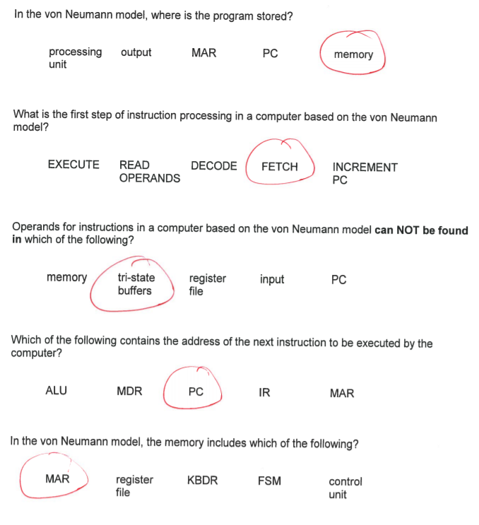

Slide 24
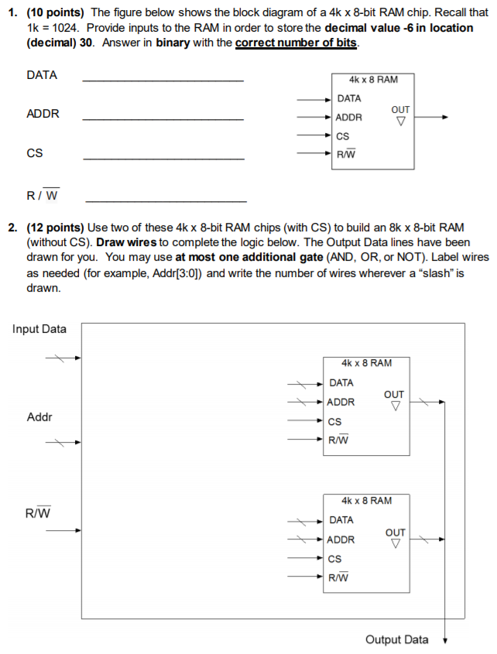
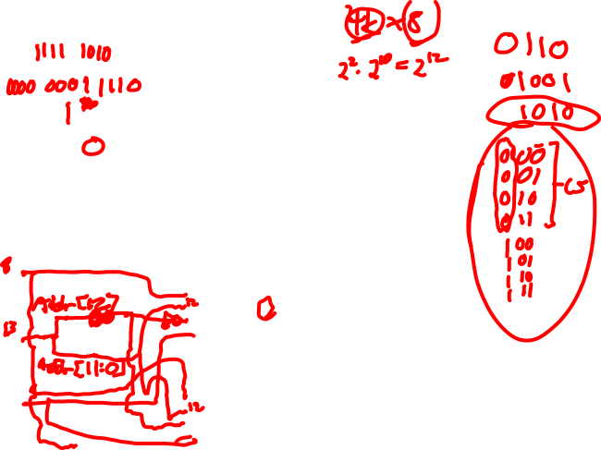

Slide 25
