Slide 1
HKN ECE 210 Exam 3 Review Session
Corey Snyder
Grant Greenberg

Slide 2
Topics
Fourier Transform
Signal Energy and Bandwidth
LTI System Response with Fourier Transform
Modulation, AM, Coherent Demodulation
Impulse Response and Convolution
Sampling and Analog Reconstruction
LTIC and BIBO Stability

Slide 3
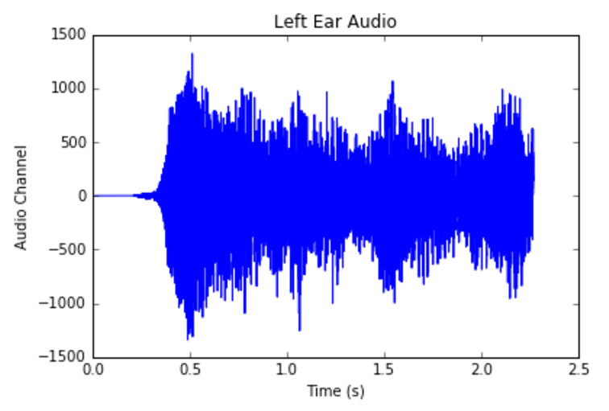
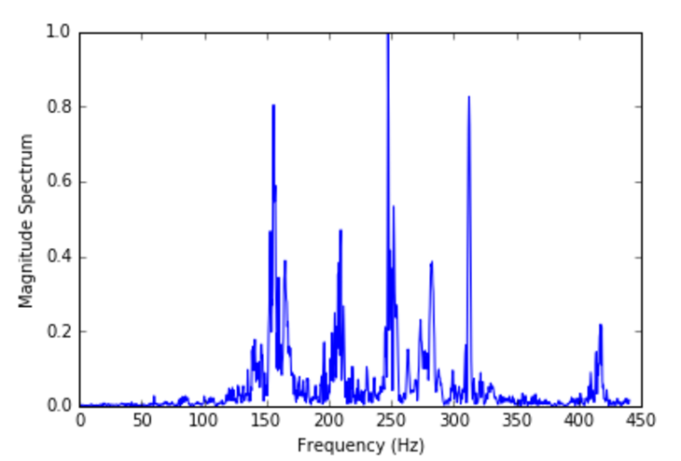

Fourier Transform
The Fourier Transform of a signal shows the frequency content of that signal
In other words, we can see how much energy is contained at each frequency for that signal
This is a big deal!
This is the biggest deal!
$F\left(ω\right)=\int_{−∞}^{∞}{f\left(t\right)e^{−jωt}dt}$
$f\left(t\right)=\frac{1}{2π}\int_{−∞}^{∞}{F\left(ω\right)e^{jωt}dω}$

Slide 4

Important Signals for Fourier Transform
$rect\left(\frac{t}{T}\right)=\left\{\begin{aligned}1, for \left|t\right|<\frac{T}{2} \\ 0, for \left|t\right|>\frac{T}{2}\end{aligned}\right\}$
$u\left(t\right)= \left\{\begin{aligned}0, for t<0 \\ 1, for t>0\end{aligned}\right\}$
$Δ\left(\frac{t}{T}\right)=\left\{\begin{aligned}1+\frac{2t}{T}, for\frac{−T}{2}<t<0 \\ 1 −\frac{2t}{T}, for 0<t<\frac{T}{2}\end{aligned}\right\}$
$sinc\left(t\right)=\left\{\begin{aligned}\frac{\sin\left(t\right)}{t}, for t≠0 \\ 1, for t=0\end{aligned}\right\}$

Slide 5
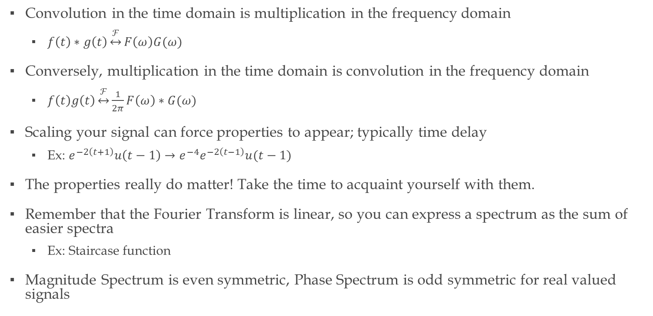
Fourier Transform Tips
Convolution in the time domain is multiplication in the frequency domain
$f\left(t\right)∗g\left(t\right)\underset{↔}{ℱ}F\left(ω\right)G(ω)$
Conversely, multiplication in the time domain is convolution in the frequency domain
$f\left(t\right)g\left(t\right)\underset{↔}{ℱ}\frac{1}{2π}F\left(ω\right)∗G(ω)$
Scaling your signal can force properties to appear; typically time delay
Ex: $e^{−2\left(t+1\right)}u\left(t−1\right)→e^{−4}e^{−2\left(t−1\right)}u(t−1)$
The properties really do matter! Take the time to acquaint yourself with them.
Remember that the Fourier Transform is linear, so you can express a spectrum as the sum of easier spectra
Ex: Staircase function
Magnitude Spectrum is even symmetric, Phase Spectrum is odd symmetric for real valued signals

Slide 6
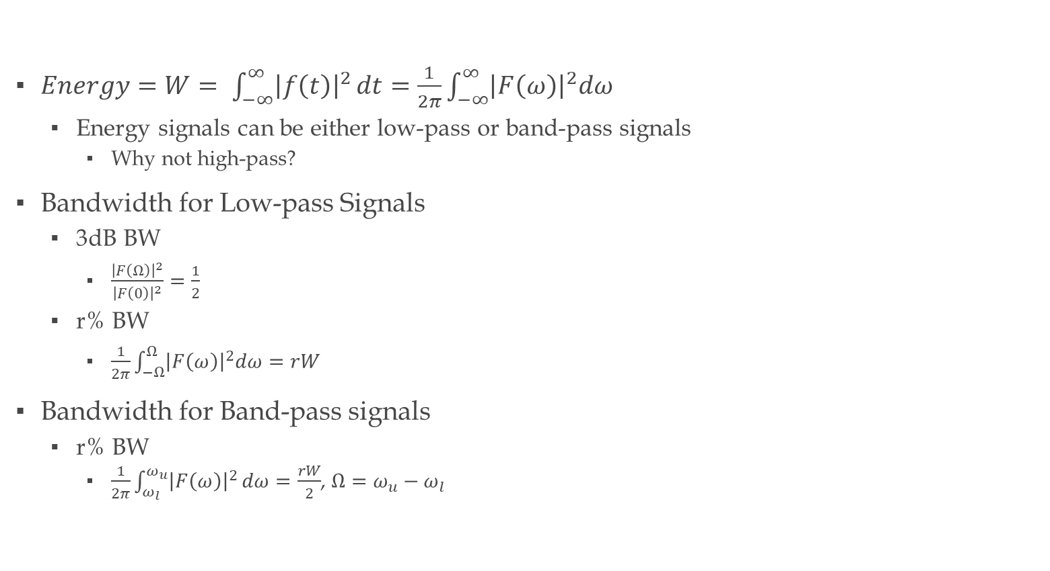
Signal Energy and Bandwidth
$Energy=W= \int_{−∞}^{∞}{{\left|f\left(t\right)\right|}^{2}}dt=\frac{1}{2π}\int_{−∞}^{∞}{{\left|F\left(ω\right)\right|}^{2}dω}$
Energy signals can be either low-pass or band-pass signals
Why not high-pass?
Bandwidth for Low-pass Signals
3dB BW
$\frac{{\left|F\left(Ω\right)\right|}^{2}}{{\left|F\left(0\right)\right|}^{2}}=\frac{1}{2}$
r% BW
$\frac{1}{2π}\int_{−Ω}^{Ω}{{\left|F\left(ω\right)\right|}^{2}dω=rW}$
Bandwidth for Band-pass signals
r% BW
$\frac{1}{2π}\int_{ω_{l}}^{ω_{u}}{{\left|F\left(ω\right)\right|}^{2}}dω=\frac{rW}{2}$, $Ω=ω_{u}−ω_{l}$

Slide 7

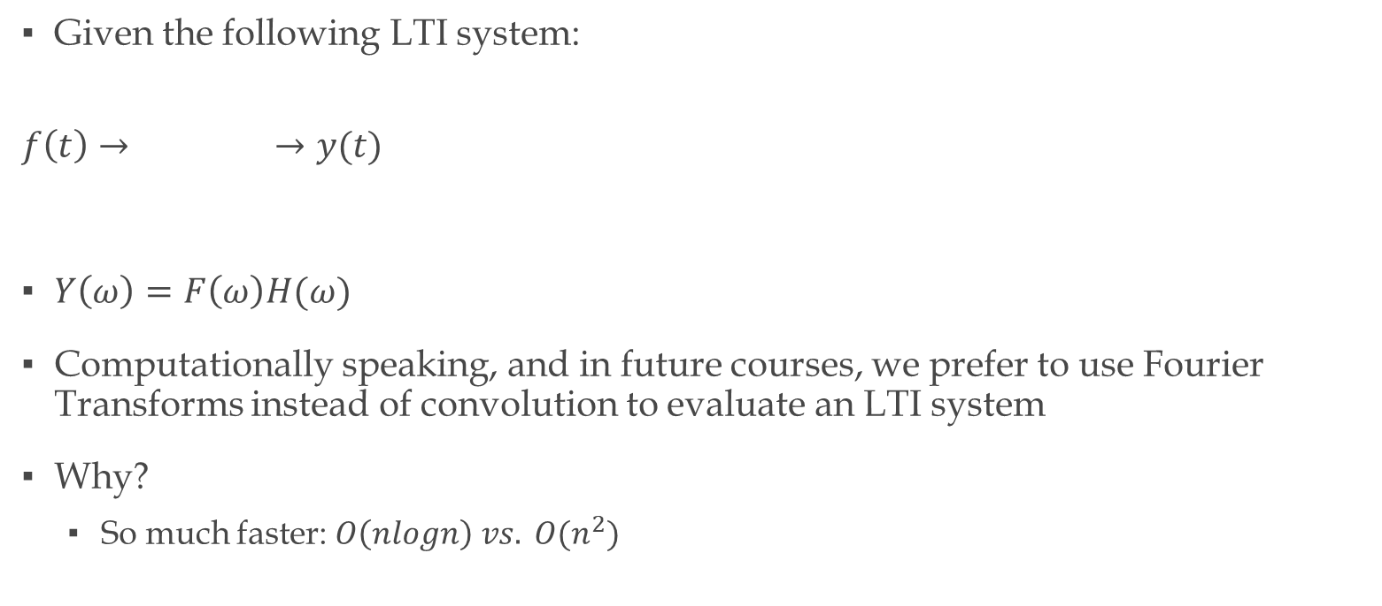
LTI System Response using Fourier Transform
Given the following LTI system:
$$f\left(t\right)→ →y(t)$$
$Y\left(ω\right)=F\left(ω\right)H(ω)$
Computationally speaking, and in future courses, we prefer to use Fourier Transforms instead of convolution to evaluate an LTI system
Why?
So much faster: $O\left(nlogn\right) vs. O(n^{2})$
$$H(ω)$$

Slide 8
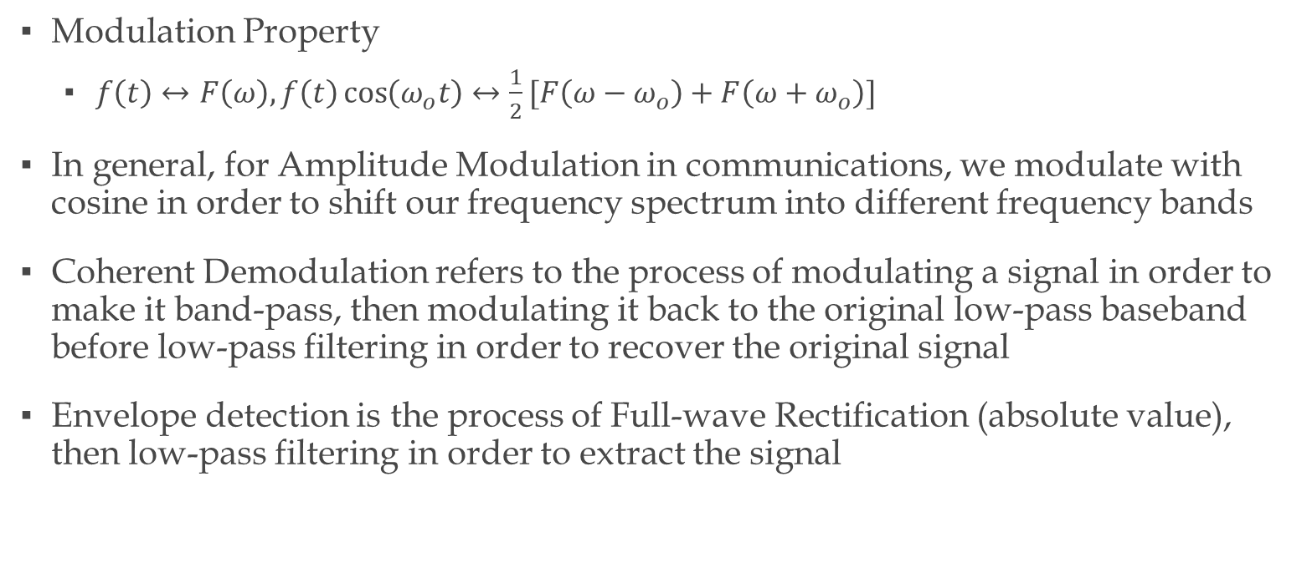
Modulation, AM Radio, Coherent Demodulation
Modulation Property
$f\left(t\right)↔F\left(ω\right), f\left(t\right)\cos\left(ω_{o}t\right)↔\frac{1}{2}[F\left(ω−ω_{o}\right)+F\left(ω+ω_{o}\right)]$
In general, for Amplitude Modulation in communications, we modulate with cosine in order to shift our frequency spectrum into different frequency bands
Coherent Demodulation refers to the process of modulating a signal in order to make it band-pass, then modulating it back to the original low-pass baseband before low-pass filtering in order to recover the original signal
Envelope detection is the process of Full-wave Rectification (absolute value), then low-pass filtering in order to extract the signal

Slide 9
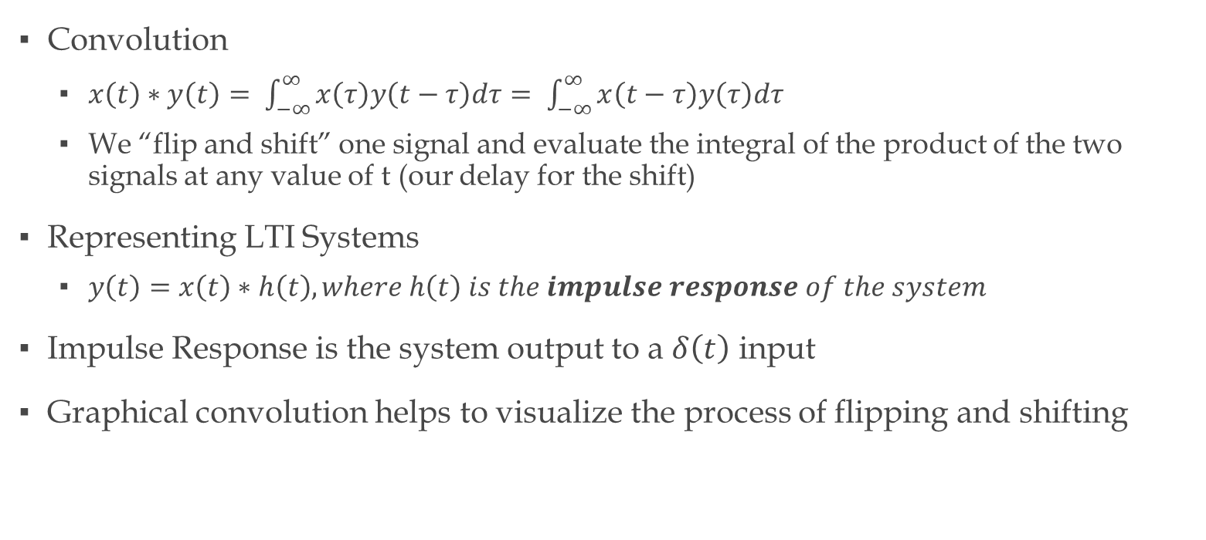
Impulse Response and Convolution
Convolution
$x\left(t\right)∗y\left(t\right)= \int_{−∞}^{∞}{x\left(τ\right)y\left(t−τ\right)dτ= \int_{−∞}^{∞}{x\left(t−τ\right)y\left(τ\right)dτ}}$
We “flip and shift” one signal and evaluate the integral of the product of the two signals at any value of t (our delay for the shift)
Representing LTI Systems
$y\left(t\right)=x\left(t\right)∗h\left(t\right), where h\left(t\right) is the impulse response of the system$
Impulse Response is the system output to a $δ\left(t\right)$ input
Graphical convolution helps to visualize the process of flipping and shifting

Slide 10
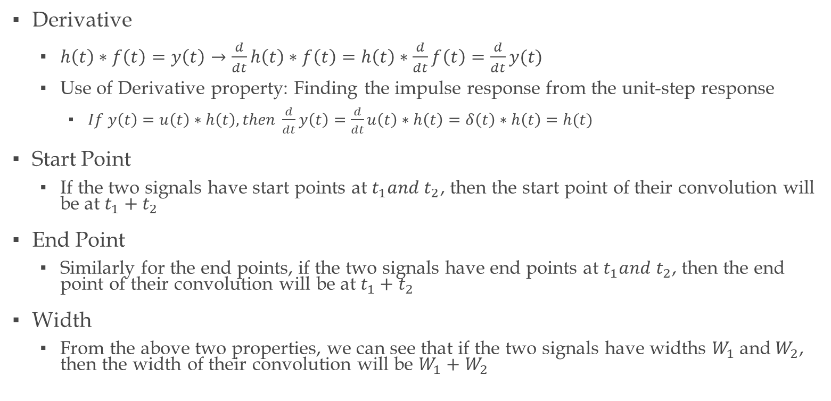
Helpful Properties for Convolution
Derivative
$h\left(t\right)∗f\left(t\right)=y\left(t\right)→\frac{d}{dt}h\left(t\right)∗f\left(t\right)=h\left(t\right)∗\frac{d}{dt}f\left(t\right)=\frac{d}{dt}y(t)$
Use of Derivative property: Finding the impulse response from the unit-step response
$If y\left(t\right)=u\left(t\right)∗h\left(t\right), then \frac{d}{dt}y\left(t\right)=\frac{d}{dt}u\left(t\right)∗h\left(t\right)=δ\left(t\right)∗h\left(t\right)=h(t)$
Start Point
If the two signals have start points at $t_{1}and t_{2}$, then the start point of their convolution will be at $t_{1}+t_{2}$
End Point
Similarly for the end points, if the two signals have end points at $t_{1}and t_{2}$, then the end point of their convolution will be at $t_{1}+t_{2}$
Width
From the above two properties, we can see that if the two signals have widths $W_{1}$and$W_{2}$, then the width of their convolution will be $W_{1}+W_{2}$

Slide 11
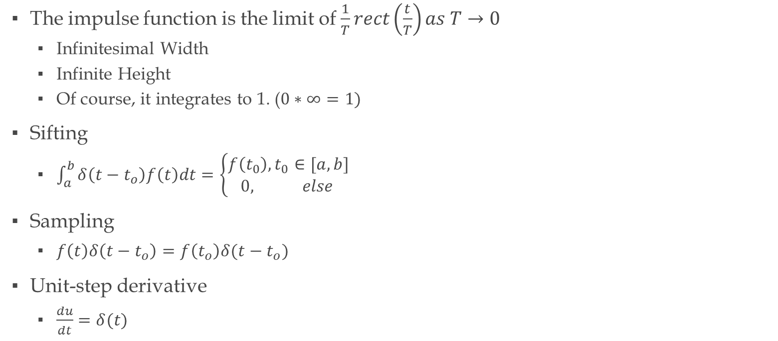

The Impulse Function $δ(t)$
The impulse function is the limit of $\frac{1}{T}rect\left(\frac{t}{T}\right)as T→0$
Infinitesimal Width
Infinite Height
Of course, it integrates to 1. ($0∗∞=1)$
Sifting
$\int_{a}^{b}{δ\left(t−t_{o}\right)f\left(t\right)dt=\left\{\begin{aligned}f\left(t_{0}\right), t_{0}∈[a,b] \\ 0, else \end{aligned}\right. }$
Sampling
$f\left(t\right)δ\left(t−t_{o}\right)=f\left(t_{o}\right)δ(t−t_{o})$
Unit-step derivative
$\frac{du}{dt}=δ(t)$

Slide 12
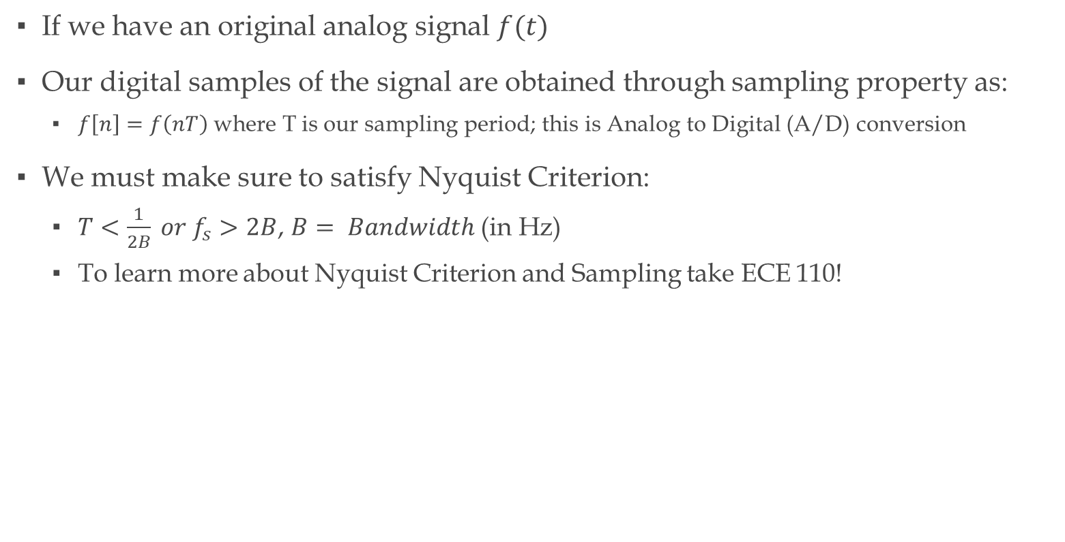
Sampling and Analog Reconstruction
If we have an original analog signal $f(t)$
Our digital samples of the signal are obtained through sampling property as:
$f\left[n\right]=f\left(nT\right)$where T is our sampling period; this is Analog to Digital (A/D) conversion
We must make sure to satisfy Nyquist Criterion:
$T<\frac{1}{2B} or f_{s}>2B$, $B= Bandwidth \text{(}\text{in} \text{Hz}\text{)}$
To learn more about Nyquist Criterion and Sampling take ECE 110!

Slide 13
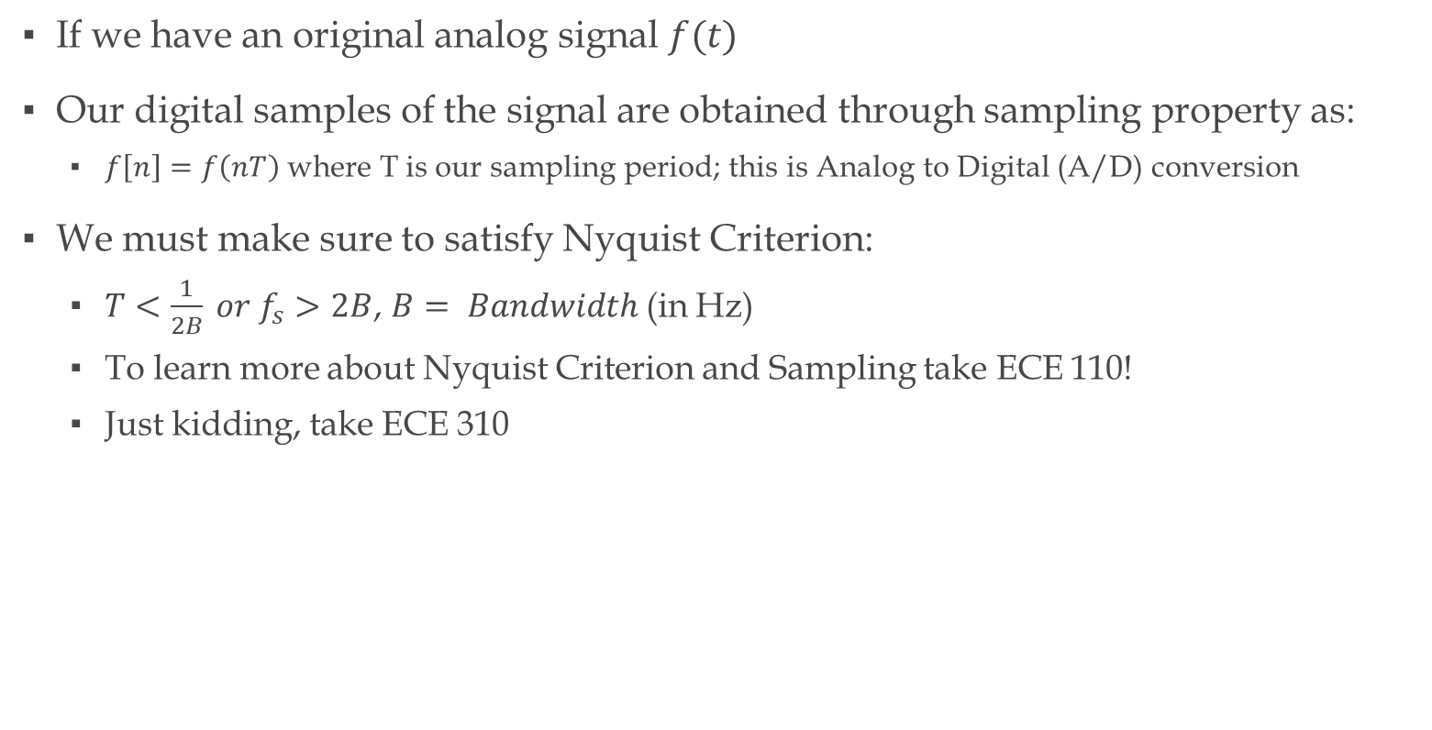
Sampling and Analog Reconstruction
If we have an original analog signal $f(t)$
Our digital samples of the signal are obtained through sampling property as:
$f\left[n\right]=f\left(nT\right)$where T is our sampling period; this is Analog to Digital (A/D) conversion
We must make sure to satisfy Nyquist Criterion:
$T<\frac{1}{2B} or f_{s}>2B$, $B= Bandwidth$(in Hz)
To learn more about Nyquist Criterion and Sampling take ECE 110!
Just kidding, take ECE 310

Slide 14

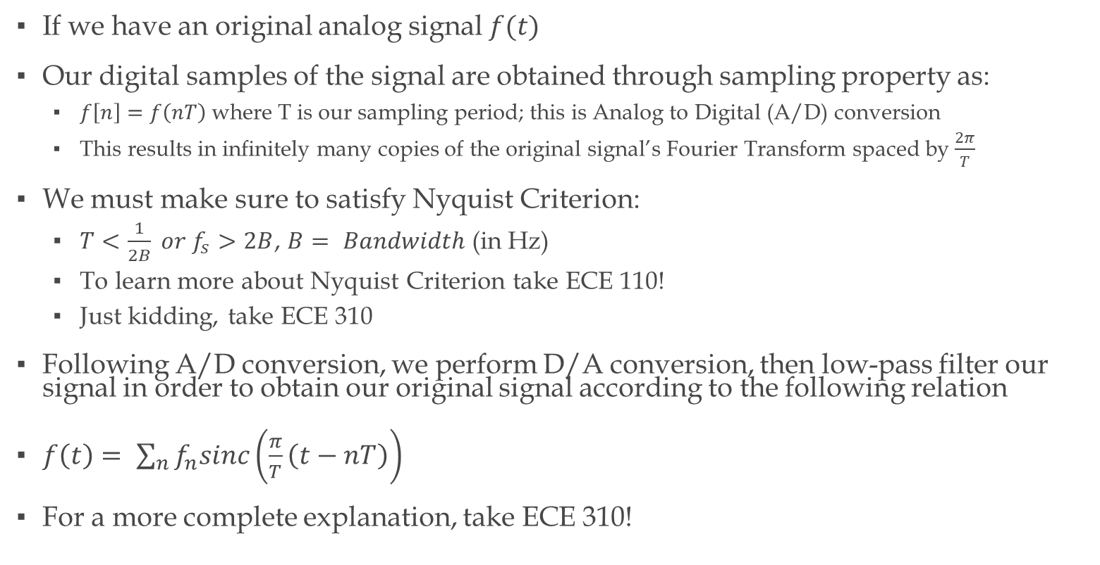
Sampling and Analog Reconstruction
If we have an original analog signal $f(t)$
Our digital samples of the signal are obtained through sampling property as:
$f\left[n\right]=f\left(nT\right)$where T is our sampling period; this is Analog to Digital (A/D) conversion
This results in infinitely many copies of the original signal’s Fourier Transform spaced by $\frac{2π}{T}$
We must make sure to satisfy Nyquist Criterion:
$T<\frac{1}{2B} or f_{s}>2B$, $B= Bandwidth$(in Hz)
To learn more about Nyquist Criterion take ECE 110!
Just kidding, take ECE 310
Following A/D conversion, we perform D/A conversion, then low-pass filter our signal in order to obtain our original signal according to the following relation
$f\left(t\right)= \sum_{n}{f_{n}sinc\left(\frac{π}{T}\left(t−nT\right)\right)}$
For a more complete explanation, take ECE 310!

Slide 15
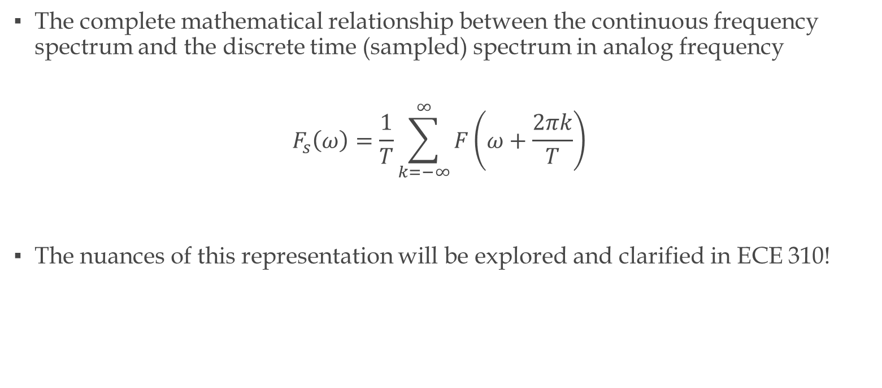
Sampling and Analog Reconstruction (cont’d)
The complete mathematical relationship between the continuous frequency spectrum and the discrete time (sampled) spectrum in analog frequency
$$F_{s}\left(ω\right)=\frac{1}{T}\sum_{k=−∞}^{∞}{F\left(ω+\frac{2πk}{T}\right)}$$
The nuances of this representation will be explored and clarified in ECE 310!

Slide 16
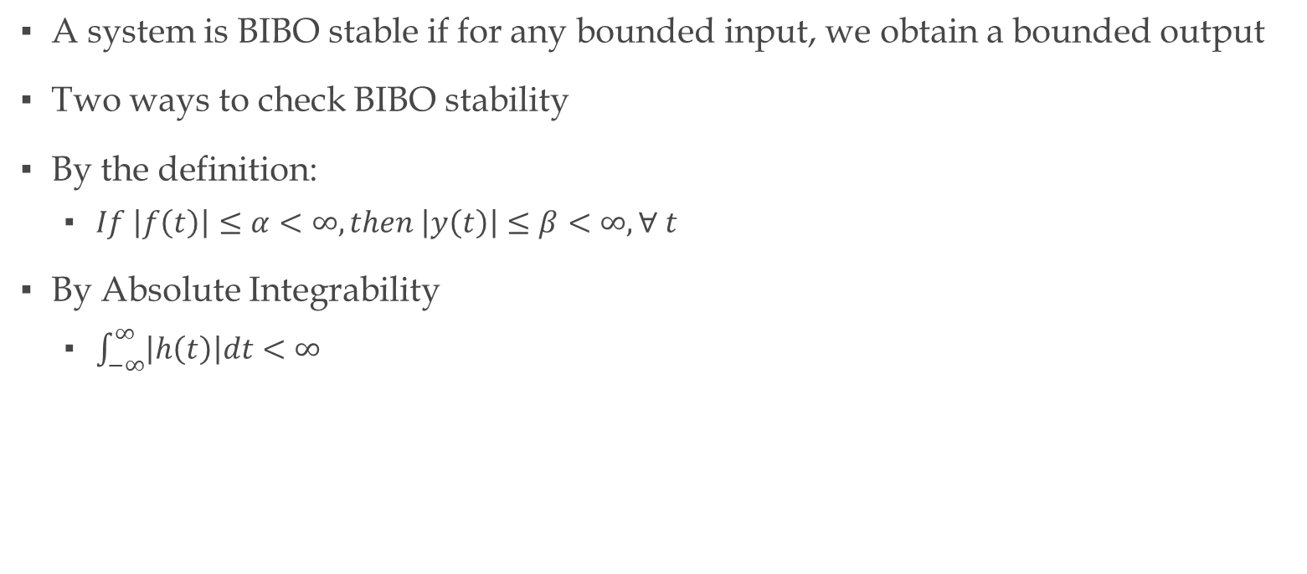
BIBO Stability
A system is BIBO stable if for any bounded input, we obtain a bounded output
Two ways to check BIBO stability
By the definition:
$If \left|f\left(t\right)\right|≤α<∞, then \left|y\left(t\right)\right|≤β<∞, ∀ t$
By Absolute Integrability
$\int_{−∞}^{∞}{\left|h\left(t\right)\right|dt<∞}$

Slide 17
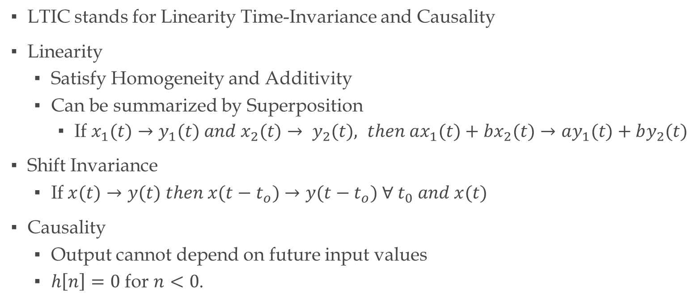
LTIC
LTIC stands for Linearity Time-Invariance and Causality
Linearity
Satisfy Homogeneity and Additivity
Can be summarized by Superposition
If $x_{1}(t)→y_{1}(t) and x_{2}(t)→ y_{2}(t), then ax_{1}(t)+bx_{2}(t)→ay_{1}(t)+by_{2}(t)$
Shift Invariance
If$x(t)→y(t) then x(t−t_{o})→y(t−t_{o}) ∀ t_{0} and x(t)$
Causality
Output cannot depend on future input values
$h\left[n\right]=0$ for $n<0$.

Slide 18
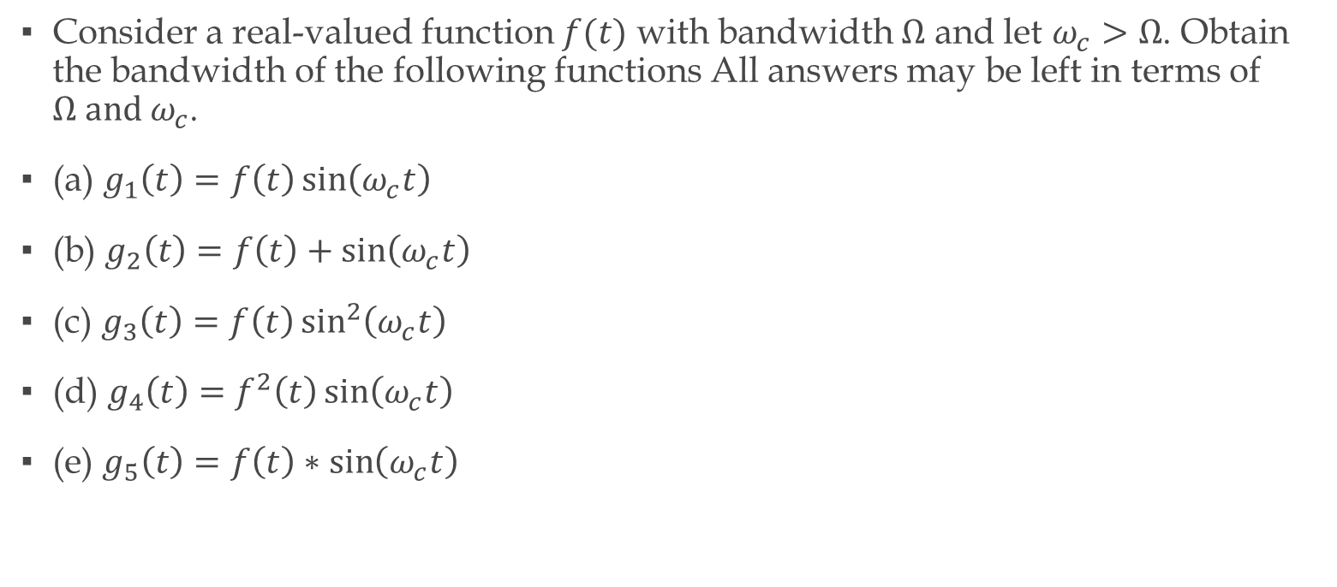
Problem 1 SP16
Consider a real-valued function $f(t)$ with bandwidth $Ω$ and let $ω_{c}>Ω$. Obtain the bandwidth of the following functions All answers may be left in terms of $Ω and ω_{c}$.
(a) $g_{1}\left(t\right)=f\left(t\right)\sin\left(ω_{c}t\right)$
(b) $g_{2}\left(t\right)=f\left(t\right)+\sin\left(ω_{c}t\right)$
(c) $g_{3}\left(t\right)=f\left(t\right)\sin^{2}\left(ω_{c}t\right)$
(d) $g_{4}\left(t\right)=f^{2}\left(t\right)\sin\left(ω_{c}t\right)$
(e) $g_{5}\left(t\right)=f\left(t\right)∗\sin\left(ω_{c}t\right)$

Slide 19
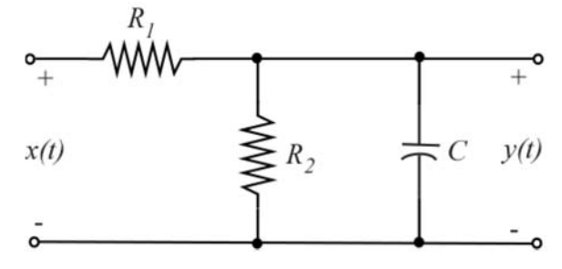

Problem 3 FA16
Given the circuit on the right:
Find the step response
Find the response to $x\left(t\right)=rect\left(\frac{t−1}{2}\right)$

Slide 20
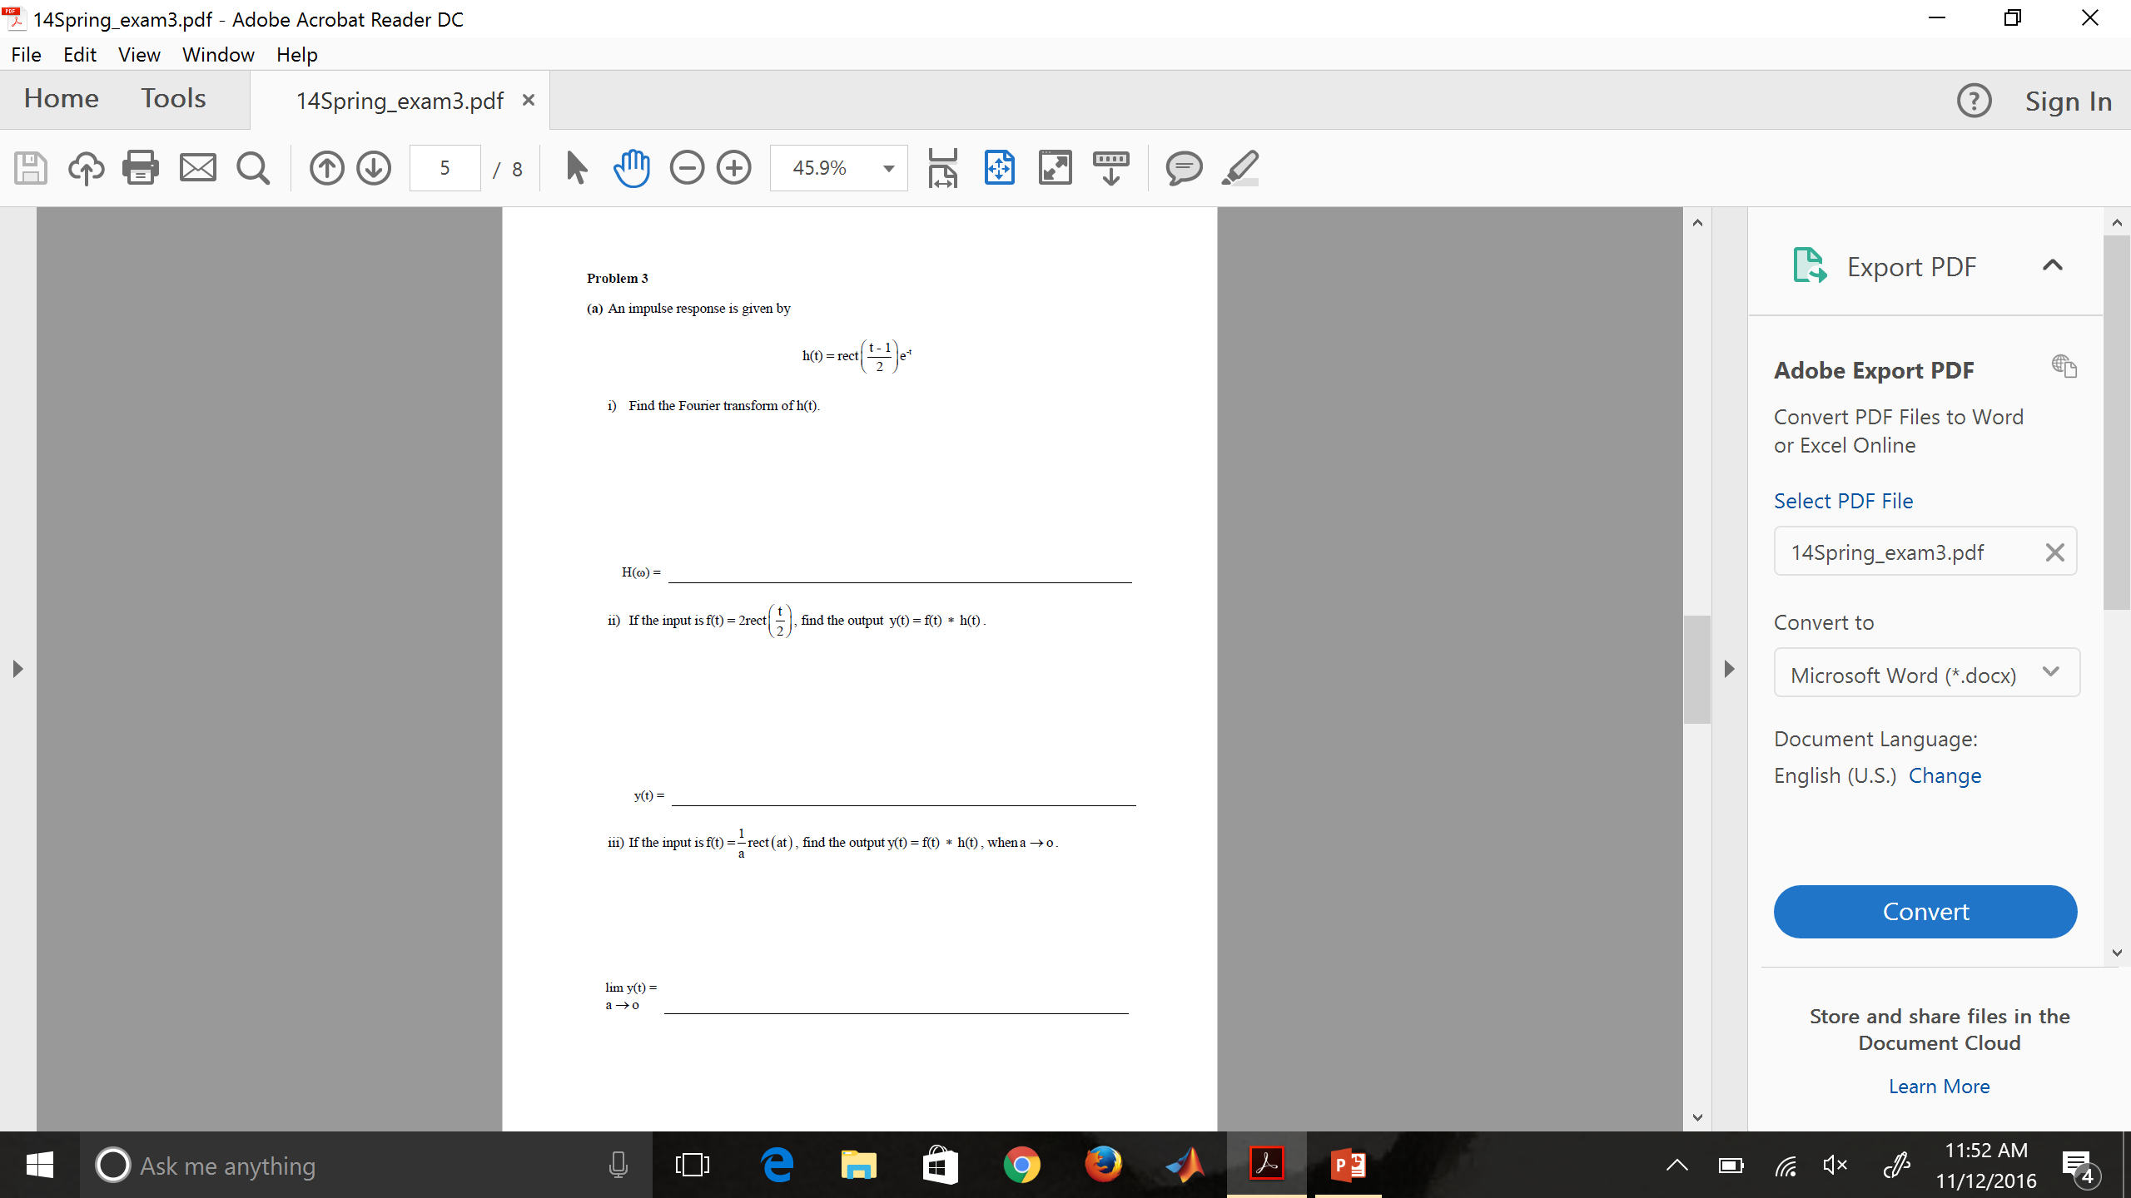
Problem 3 SP14

Slide 21

Problem 2 SP13

Slide 22
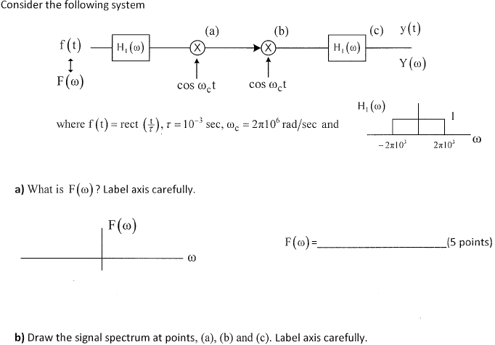
Problem 2 FA15

Slide 23
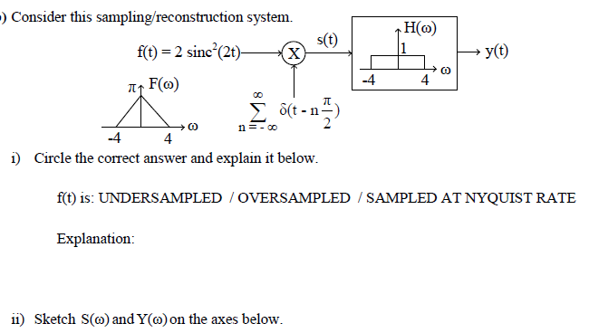
Problem 4 SP14
iii) Determine y(t)

Slide 24
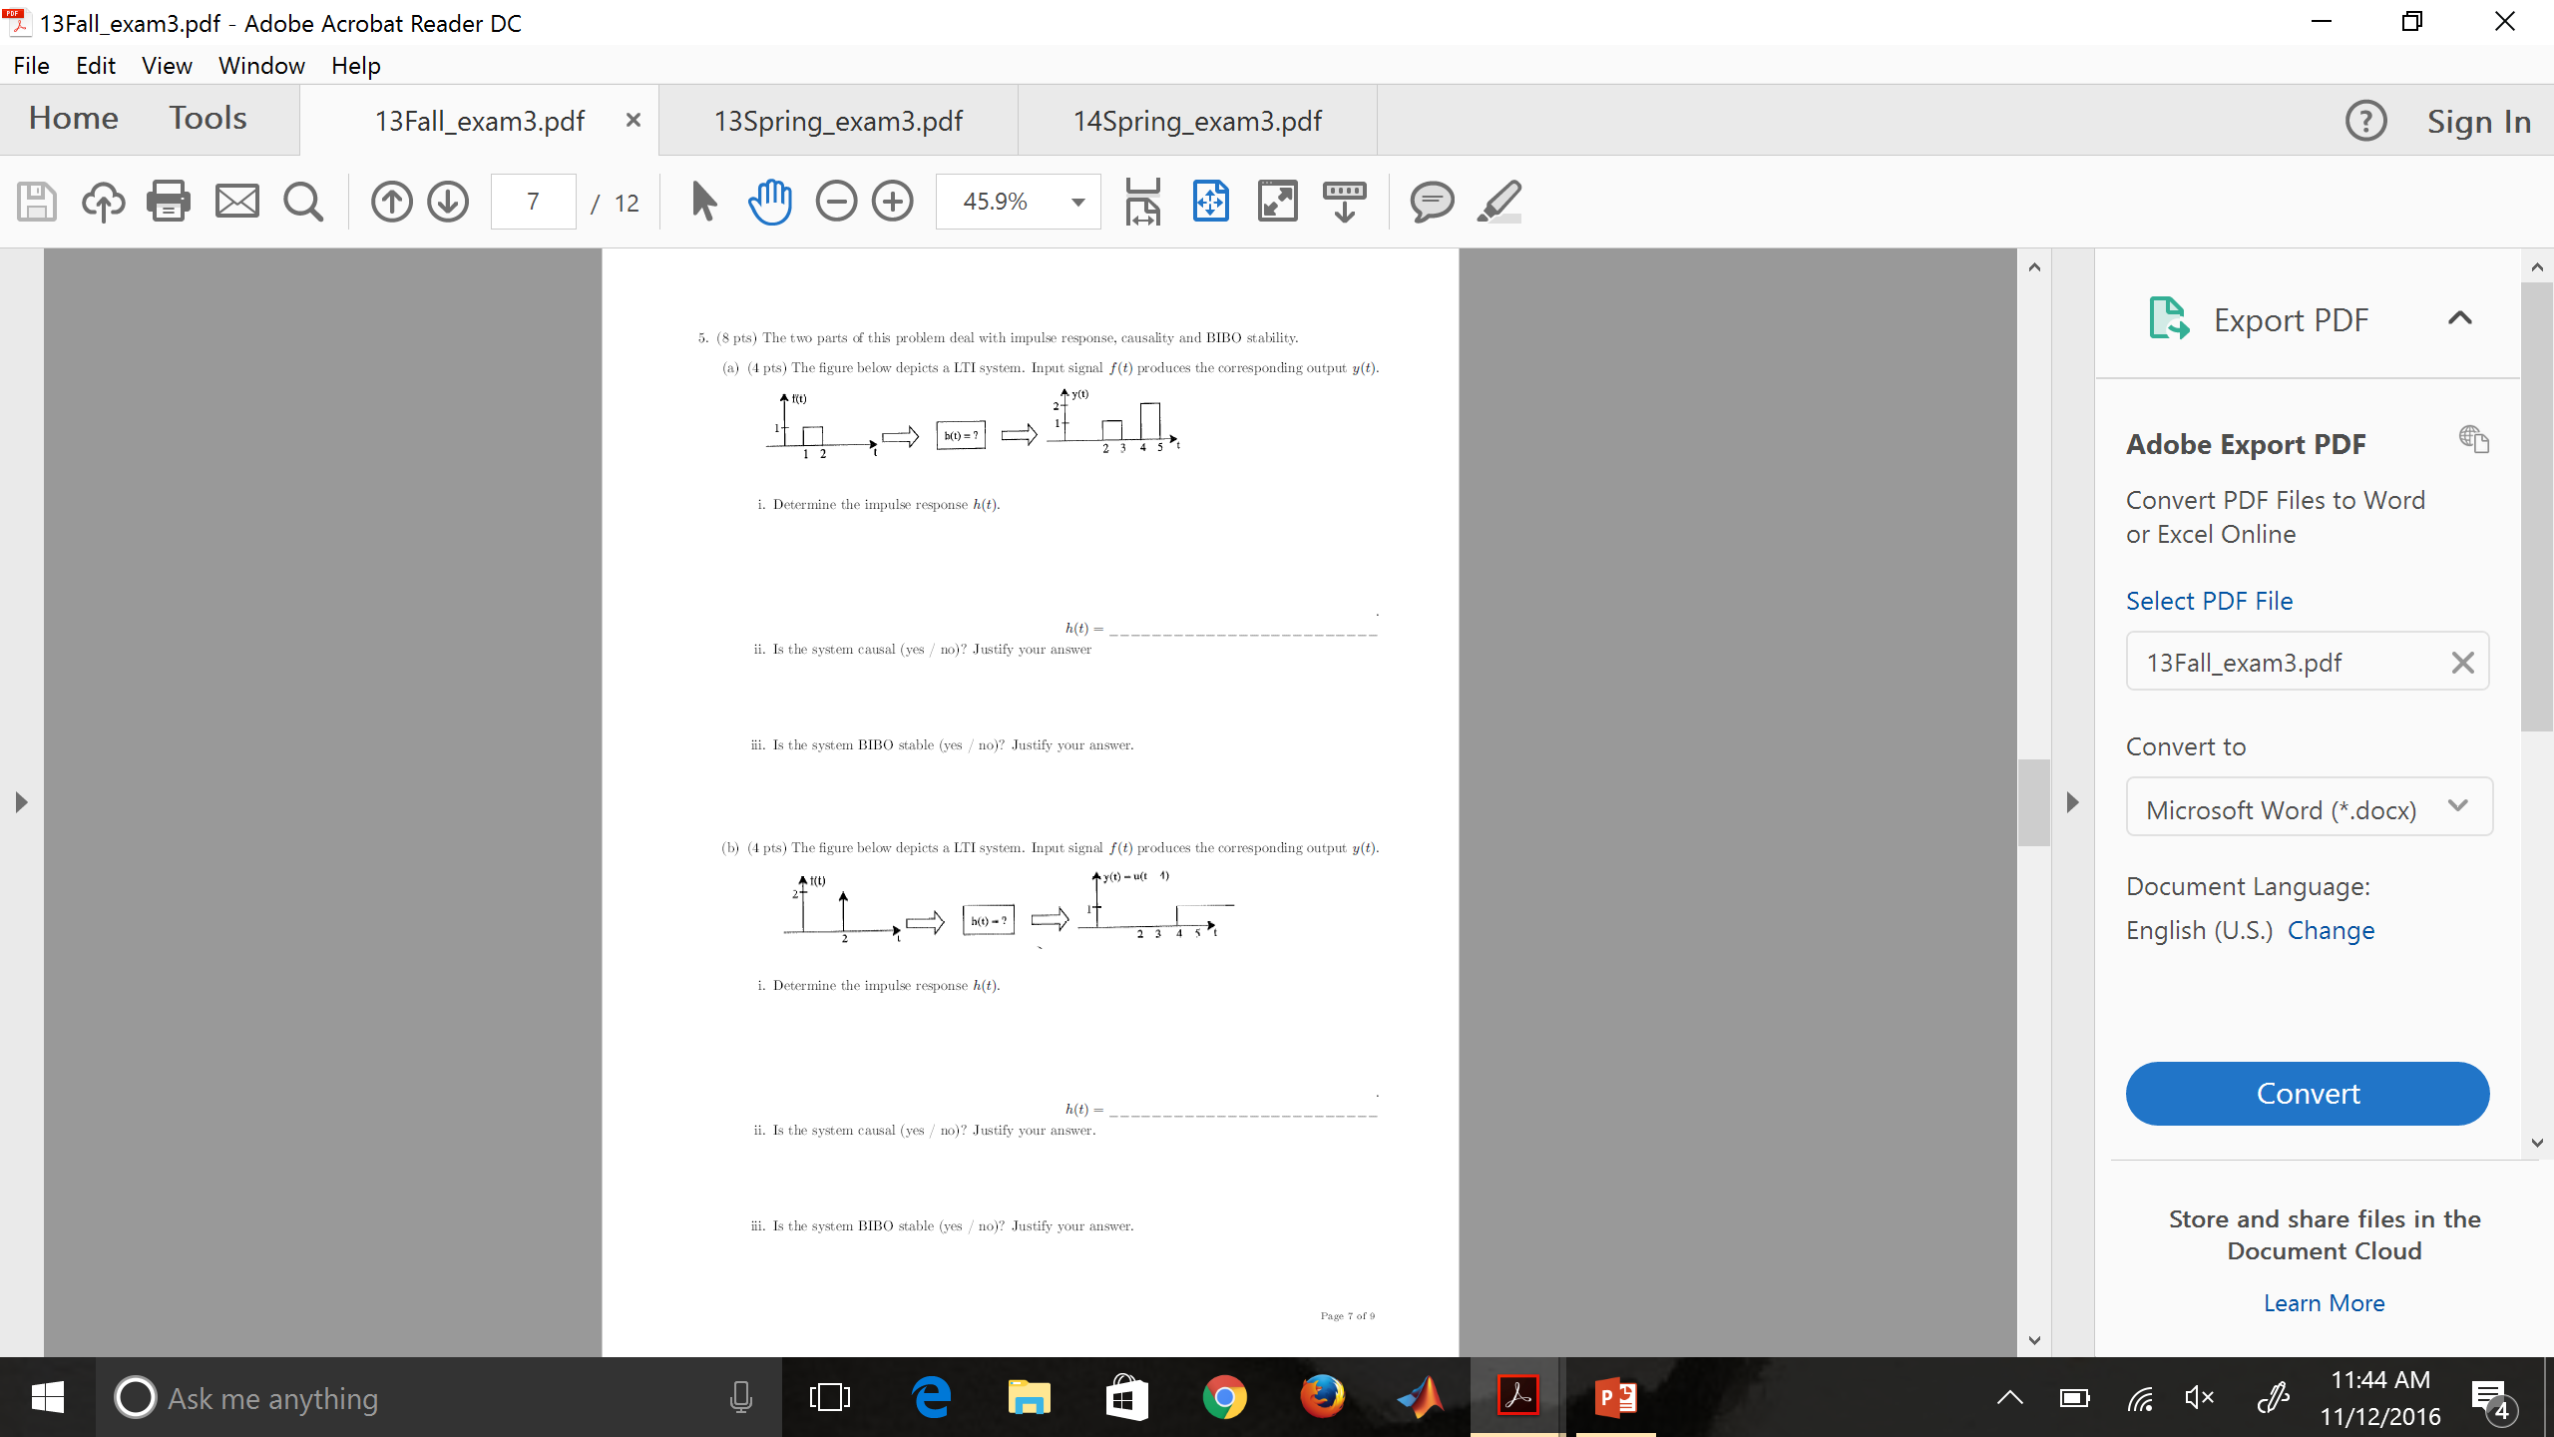
Problem 5 FA13
a)i. Determine h(t)
ii. Is the system causal?
iii. Is the system BIBO stable?
b)i. Determine h(t)
ii. Is the system causal?
iii. Is the system BIBO stable?

