Slide 1

ECE 220 Midterm 2: HKN Review
Fall 2018
Srijan, Joseph, Kanad, Siddharth

Slide 2
HKN Services
Offer review sessions for most required ECE and PHYS
HKN offers peer-to-peer tutoring for ECE 220 (As well as most required ECE, CS, MATH and PHYS courses)
https://hkn.illinois.edu/service/
Scroll to tutoring and pick anyone for one-on-one tutoring
Contact us directly! All netIDs provided!

Slide 3
Functions in C
The function prototype or declaration:
Name (identifier)
Return type or output
Arguments or inputs and their types
If not void, MUST return something
Provides abstraction
Hide low-level details
Give high-level structure to program, easier to understand overall program flow
enable separable, independent development
reuse code
Example: int isPrime(int n)

Slide 4
The C Runtime Stack
Used by the compiler to keep track of variables and memory
R5 – Frame Pointer. It points to the beginning of a region of activation record that stores local variables for the current function.
R6 – Stack Pointer. It points to the top most occupied location on the stack.
Arguments are pushed to the stack RIGHT TO LEFT
Local variables are pushed to the stack in the order declared

Slide 5
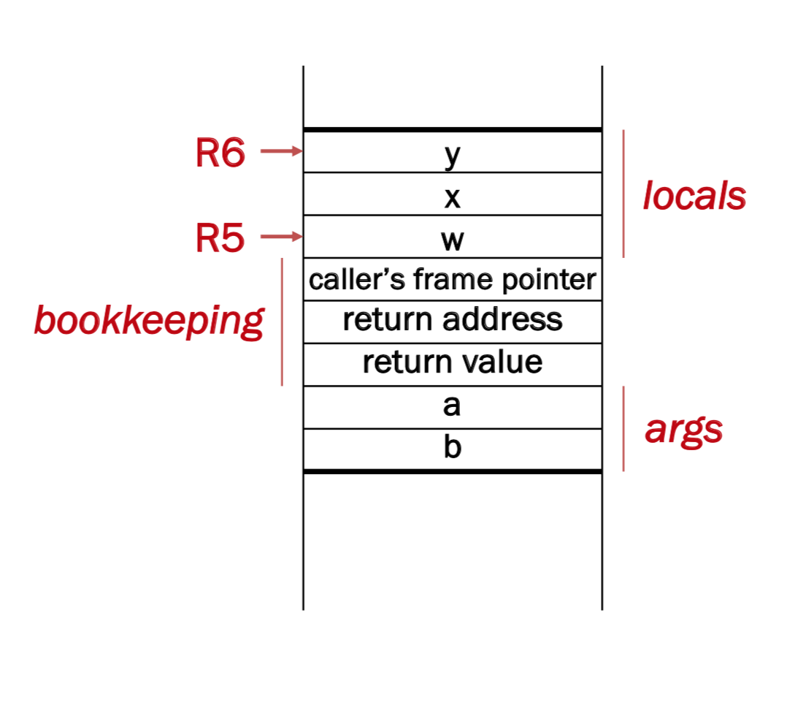
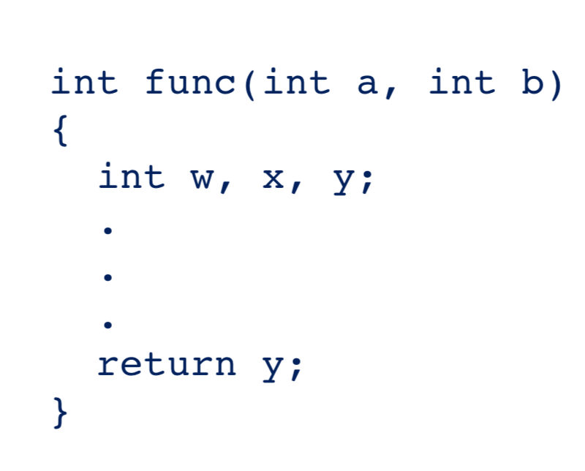

Slide 6
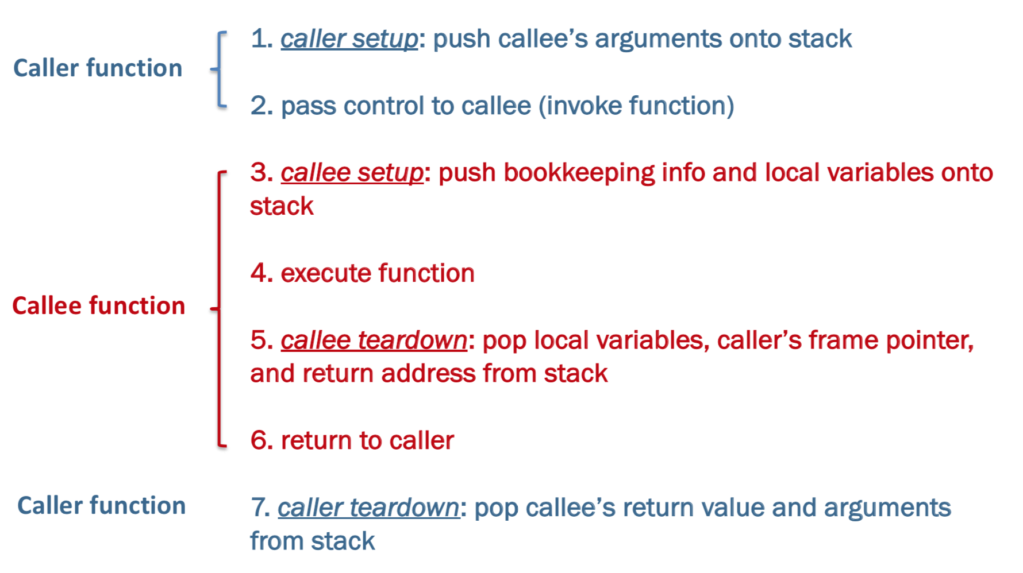
Stack Build-Up and Tear-Down

Slide 7
Register Usage
R5: Stack Frame Pointer
R6: Stack Top Pointer
R7: Return Address

Slide 8
Callee Setup in 4 steps!
ADD R6, R6, #-4 ;Allocate space for linkage and 1 local variable (to ensure R5 is valid)
STR R5, R6, #1 ;Save old value of R5
ADD R5, R6, #0 ;Set R5 to new frame base
STR R7, R5, #2 ;Save return address
What would happen if we did not add space for 1 local variable? In other words, R5 was pointing to a location above R6?

Slide 9
Callee Setup in 4 steps!
ADD R6, R6, #-4 ;Allocate space for linkage and 1 local variable (to ensure R5 is valid)
STR R5, R6, #1 ;Save old value of R5
ADD R5, R6, #0 ;Set R5 to new frame base
STR R7, R5, #2 ;Save return address
What would happen if we did not add space for 1 local variable? In other words, R5 was pointing to a location above R6?
R5 would be pointing to memory outside of the stack, and the stack data structure’s integrity would be ruined.

Slide 10
Callee Teardown in 4 steps!
ADD R6, R5, #3 ;Have R6 point to return space (3 below R5)
STR R0, R6, #0 ;Push return value into return spot (If R0 has value)
LDR R5, R6, #-2 ;Push old stack frame back into R5
LDR R7, R6, #-1 ;Load old return address back into R7
Basic trick is pop R6 4 times in one instruction, then reach at the rest of the required variable
When coding, don't forget to RET after done in JSR

Slide 11
Callee Example
; Bookkeeping creation
ADD R6, R6, #-4 ; Make space on stack
STR R5, R6, #1 ; Store R5
ADD R5, R6, #0 ; Set R5 to new frame
STR R7, R5, #2 ; Store return address
; Calculation
LDR R1, R5, #4 ; Load a into R1
LDR R2, R5, #5 ; Load b into R2
ADD R0, R1, R2 ; Store result into R0
STR R0, R5, #0 ; Store R0 in x
; Teardown frame & return
STR R0, R5, #3 ; Store R0 as ret val
LDR R7, R5, #2 ; Restore R7
LDR R5, R5, #1 ; Restore R5
ADD R6, R6, #3 ; Teardown stack, leaving return value
int foo (int a, int b) {
int x;
x = a + b;
return x;
}
...
x
Saved R5
Saved R7
R6
a
b
...
R5

Slide 12
Callee Example
; Bookkeeping creation
ADD R6, R6, #-4 ; Make space on stack
STR R5, R6, #1 ; Store R5
ADD R5, R6, #0 ; Set R5 to new frame
STR R7, R5, #2 ; Store return address
; Calculation
LDR R1, R5, #4 ; Load a into R1
LDR R2, R5, #5 ; Load b into R2
ADD R0, R1, R2 ; Store result into R0
STR R0, R5, #0 ; Store R0 in x
; Teardown frame & return
STR R0, R5, #3 ; Store R0 as ret val
LDR R7, R5, #2 ; Restore R7
LDR R5, R5, #1 ; Restore R5
ADD R6, R6, #3 ; Teardown stack, leaving return value
int foo (int a, int b) {
int x;
x = a + b;
return x;
}
...
R6
a+b
R5
Saved R5
Saved R7
Return Val
a
b
...

Slide 13
Caller Example
LDR R0, R5, #0 ; Load x from stack frame of main
ADD R6, R6, #-1
STR R0, R6, #0 ; Push R0 onto the stack
JSR foo ; Jump to foo
; Note: After the call to foo R6 has been
; decremented by 1!
LDR R0, R6, #0 ; Read the return value
ADD R6, R6, #2 ; Pop the parameters & return value from function call
STR R0, R5, #1 ; Store returned value into result
...
int main () {
int x;
int result;
result = foo(x);
}
int foo (int a) {
...
}

Slide 14
POINTERS!!!!
This slide was sponsored by POINTER GANG

Slide 15
Pointers
Dereference Operator: *
Returns the data that the pointer points to
Address Of Operator: &
Returns the address in memory of the object applied on
Shorthand Dereference & access operator: ->
pointer->member is equivalent to *(pointer).member
Good for use with struct pointers
Value is an LC3 address (x3000, xCAFE, xBABE)

Slide 16
Pointers
Pass by pointer VS pass by value
Former allows you to change actual object in memory by dereferencing the pointer, latter is just a bitwise copy
Pointer math depends on size of the pointer type
If char* a is x3000, a + 3 is x3003
If int* a is x3000, a + 3 is x300c

Slide 17
Arrays
Pointer to several blocks of memory.
If int a[#], a is a pointer to the FIRST element
arr[x] operator is same as *(arr + x)
Basically gets you to starting address of object at x
Stored sequentially in contiguous memory
When passed to function, only pointer to first element is passed
Arrays cannot be passed by value

Slide 18
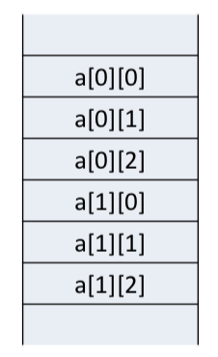
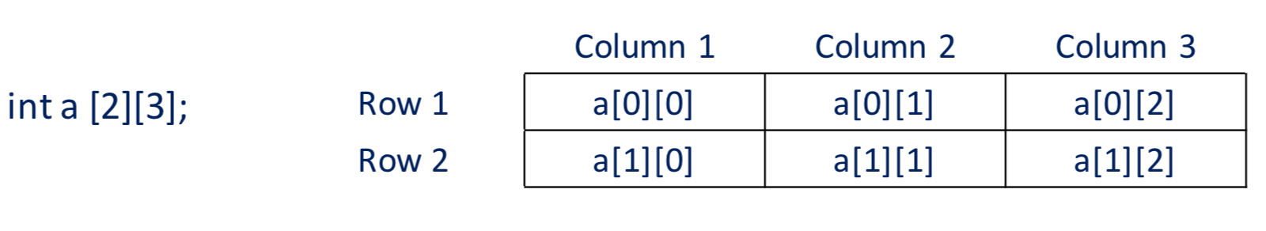
Multi Dimensional Arrays in C
Stored in memory in the Row Major Format
i*(number_of_columns) + j = element at i,j
Can be applied to higher dimensions!

Slide 19
Searches
Linear Search: iterates from the start of the array till the item is found.
Binary Search:
Find the middle and check if it is the item
Search first half if desired item is smaller than middle, else check second half
Repeat 1 and 2 until found

Slide 20
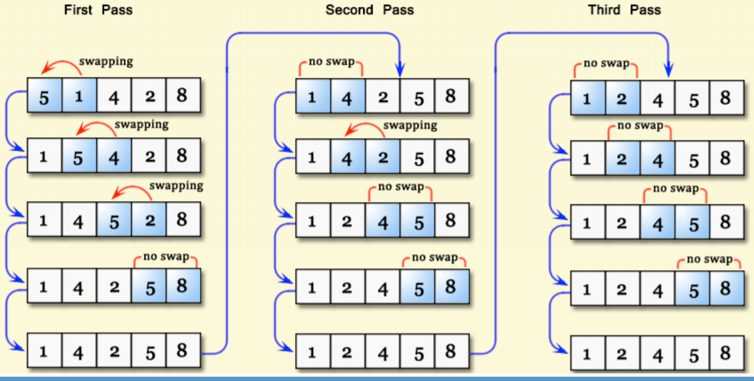
Sorting
Bubblesort: Most basic (and slow) algorithm
(Check EVERY element for EVERY spot)

Slide 21
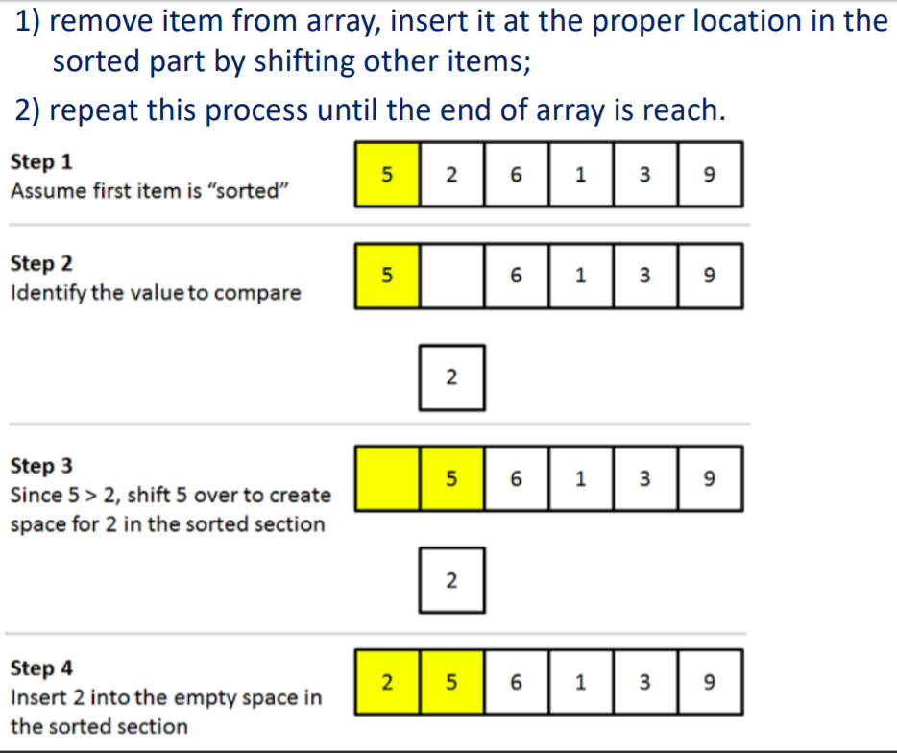
Insertion Sort

Slide 22

Recursion
Whenever a function calls itself
Builds a runtime stack frame every call
Always include a base case
Recursive case should make problem smaller
Recur_Function(2)
Recur_Function(1)
Recur_Function(0)
Main

Slide 23
Recursion and the Idea of Backtracking
Recursion: Decompose a bigger task into smaller tasks and combine them using known rule or trivial cases
Recursion + Backtracking: Guess to create smaller tasks, detect when impossible; guess again
Look at solve_sudoku in mp7 and N_queens example in lecture slides

Slide 24
Structs
Allow user to define a new type consists of a combination of fundamental data types (aggregate data type)
Example:
struct StudentStruct {
char Name[100];
int UIN; float GPA;
};
To access a member of a struct, use the “.” operator:
struct StudentStruct my_struct;
my_struct.UIN = 123456789;
To access a member of a struct pointer, use the “->” operator:
struct StudentStruct *my_struct;
my_struct->UIN = 123456789;

Slide 25
Typedef
Allows you to refer to a struct without having to specify ‘struct’ keyword each time
Example 1 (Out of line):
struct StudentStruct {
...
}
typedef struct StudentStruct Student;
// Allows you to use ‘Student’ as an alias to ‘struct StudentStruct’

Slide 26
Typedef
Allows you to refer to a struct without having to specify ‘struct’ keyword each time
Example 2 (Inline typedef):
typedef struct StudentStruct {
...
} Student;
// Allows you to use ‘Student’ as an alias to ‘struct StudentStruct’

Slide 27
Unions
Similar syntax to a struct
Only one member can be ”in use” at a time
union Data {
int i;
float f;
char str[20];
} data;

Slide 28
File I/O in C
FILE* fopen(char* filename, char* mode)
//mode: “r”, “w”, “a”, ...
success-> returns a pointer to FILE
failure-> returns NULL
int fclose(FILE* stream)
success-> returns 0 failure-> returns EOF
int fprintf(FILE* stream, const char* format, ...)
success-> returns the number of characters written failure-> returns a negative number
int fscanf(FILE* stream, consta char* format, ...)
success-> returns the number of items read; 0, if pattern doesn’t match
failure-> returns EOF
int fgetc(FILE* stream)
success-> returns the next character failure-> returns EOF and sets end-of-file indicator
int fputc(FILE* stream)
success-> write the character to file and returns the character written
failure-> returns EOF and sets end-of-file indicator
char* fgets(char* string, int, num, FILE* stream)
success-> returns a pointer to string
failure-> returns NULL
int fputs(const char* string, FILE* stream)
success-> writes string to file and returns a positive value
failure-> returns EOF and sets the end-of-file indicator

Slide 29
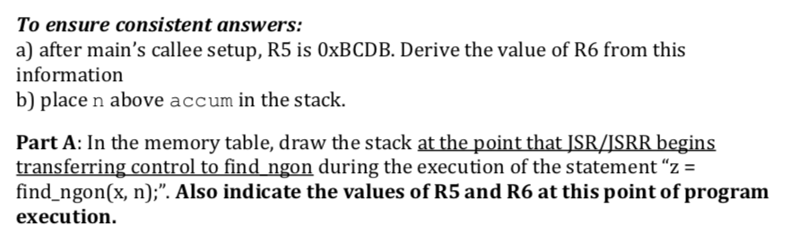
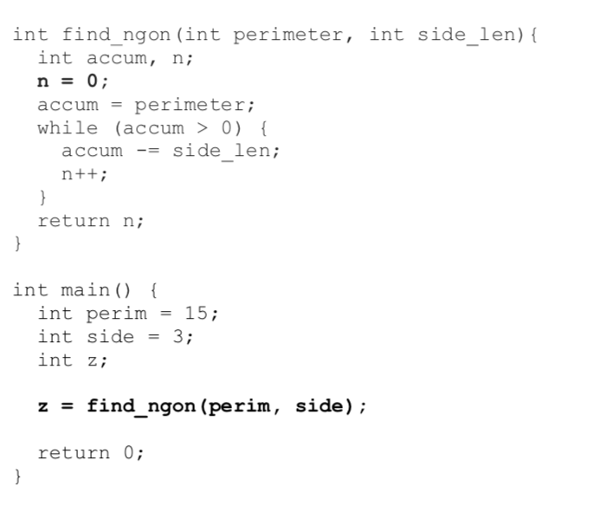
Practice Question #1
Notes:
Part A:
xBCD7 perimeter
xBCD8 side_len
xBCD9 z
xBCDA side
xBCDB perim
R5:xBCDB R6:xBCD7

Slide 30
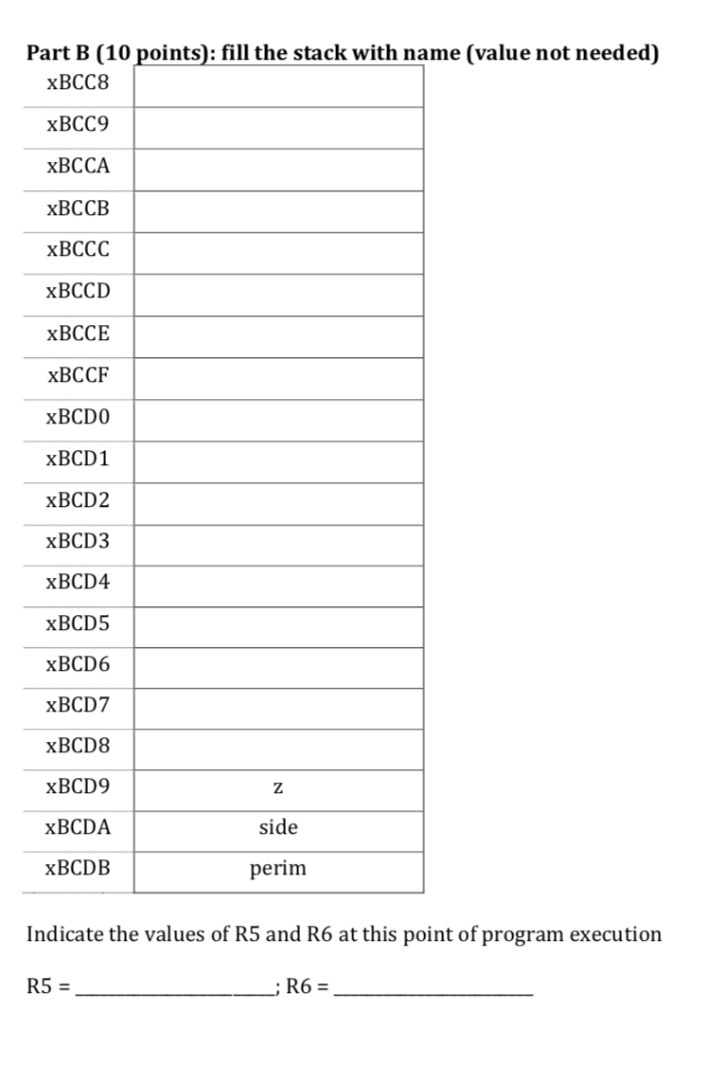
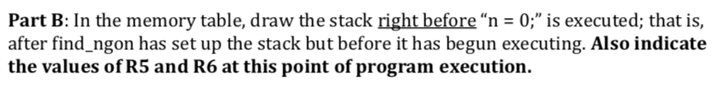
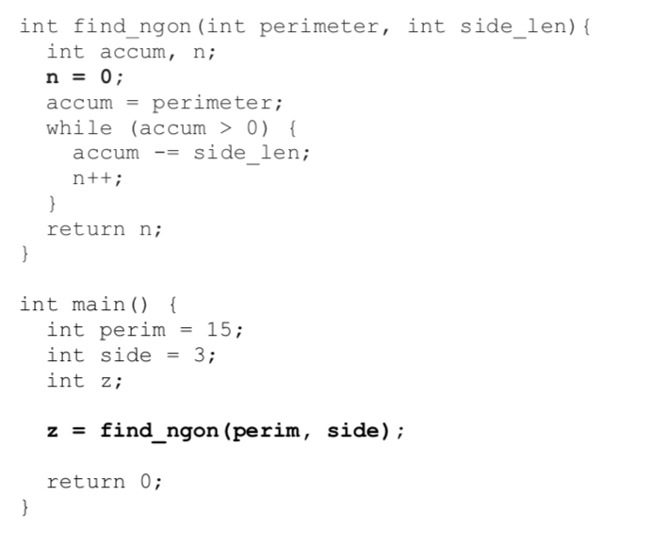
Notes:
Part B:
xBCD2 n
xBCD3 accum
xBCD4 frame ptr
xBCD5 ret_addr
xBCD6 ret_val
xBCD7 perimeter
xBCD8 side_len
xBCD9 z
xBCDA side
xBCDB perim
R5: xBCD3 R6:xBCD2

Slide 31
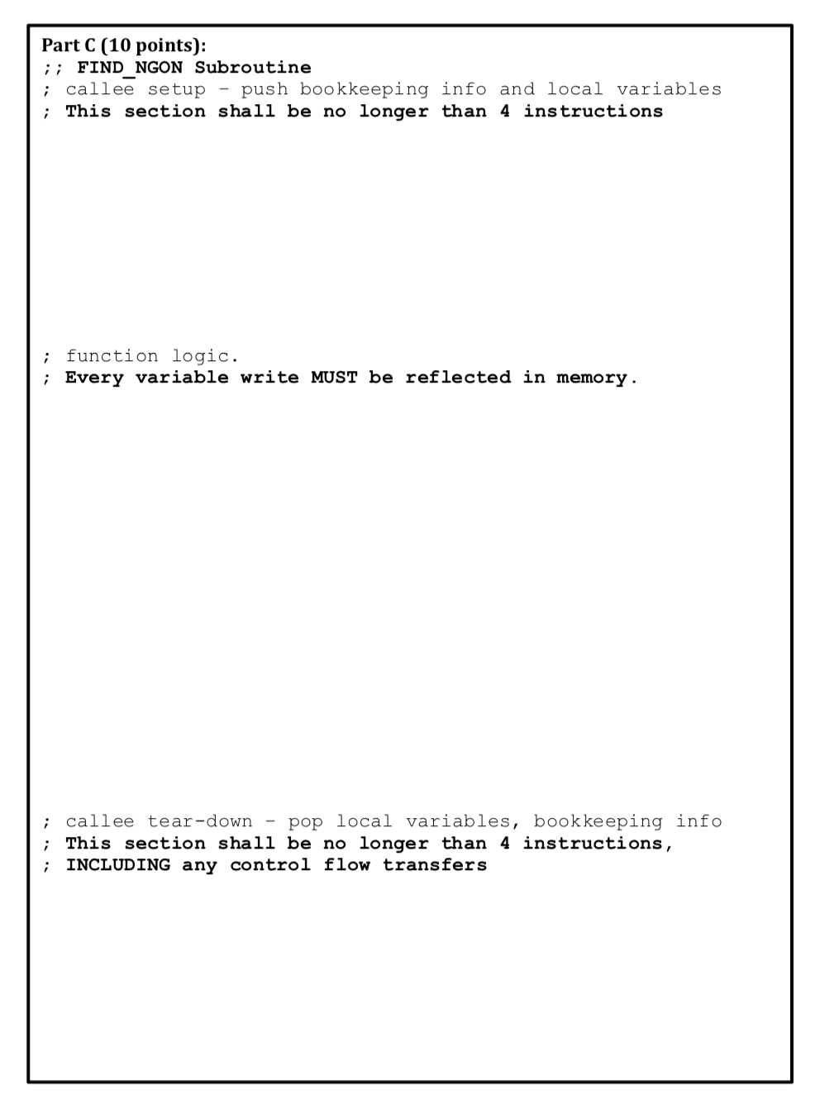
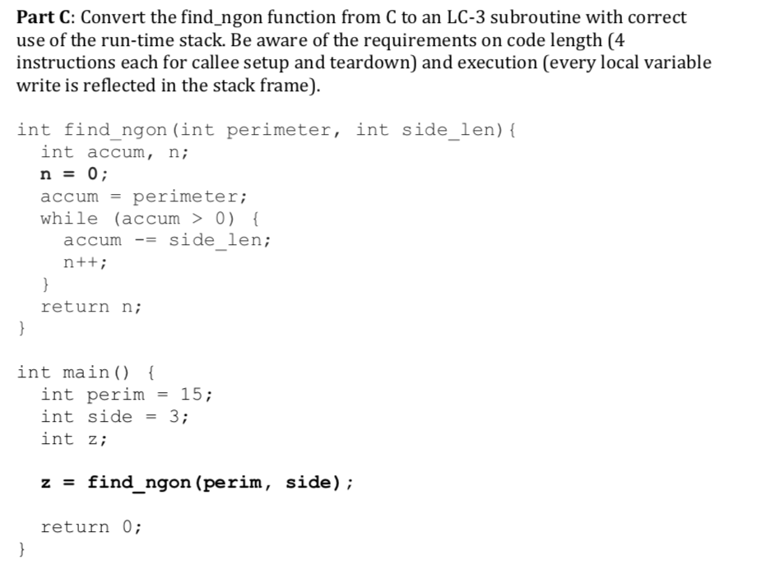
Notes:
;; FIND_NGON Subroutine
; callee setup – push bookkeeping info and local variables ; This section shall be no longer than 4 instructions
STR R7,R6,#-2;
STR R5,R6,#-3;
ADD R5,R6,#-4;
ADD R6,R6,#-5;
; function logic.
; Every variable write MUST be reflected in memory.
AND R0,R0,#0;
STR R0,R6,#0;
LDR R1,R6,#6 ;
NOT R1,R1
ADD R2,R1,#1 ;
LDR R0,R5,#4;
STR R0,R5,#0;
LOOP BRnz FINISH
LDR R0,R6,#0;
ADD R0,R0,#1;
STR R0,R6,#0
LDR R0,R5,#0;
ADD R0,R2,#0;
STR R0,R5,#0;
BR LOOP
FINISH

Slide 32
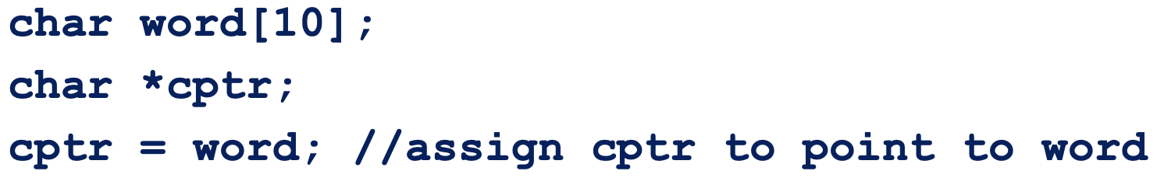
Concept Question 1
What are two other ways to set up *(cptr+n)?
How does C pass arrays?
What is the difference between Union and a Struct?
In LC-3, how many bytes of memory are needed to store an integer pointer (int *int_ptr)?

Slide 33
Concept Question 2
What is printed by this program?
#include <stdint.h>
#include <stdio.h>
static char letters[6] = {'A', 'E', 'F', 'D', 'B', 'C’};
void mystery () {
static int32_t X = 5;
static int32_t Y;
Y = 2;
printf ("%c%c", letters[--Y], letters[X--]);
}
int main () {
mystery ();
mystery ();
return 0;
}

Slide 34
Concept Question 2
What is printed by this program?
#include <stdint.h>
#include <stdio.h>
static char letters[6] = {'A', 'E', 'F', 'D', 'B', 'C’};
void mystery () {
static int32_t X = 5;
static int32_t Y;
Y = 2;
printf ("%c%c", letters[--Y], letters[X--]);
}
int main () {
mystery ();
mystery ();
return 0;
}
ECEB

Slide 35
Concept Question 3 (Challenge)
int foo () {
char buf[3];
scanf(“%s”, &buf);
return 0;
}
What happens if we pass “123456” into this program?

Slide 36
Concept Question 3 (Challenge)
int foo () {
char buf[3];
scanf(“%s”, &buf);
return 0;
}
What happens if we pass “123456” into this program?
1
R6
buf[3]
2
buf[2]
3
R5
buf[1]
Saved R5
4
5
Saved R7
6
Return Address
...

Slide 37
What is the output of the program?
What is wrong with the function ReverseArray?
Concept Question 4
#include <stdio.h>
void ReverseArray(int array[], int size) {
int start = 0, end = size - 1, temp;
if (start < end) {
temp = array[start];
array[start] = array[end];
array[end] = temp;
ReverseArray(array, size-1);
}
}
int main(){
int array[5], i;
for (i = 0; i<5; i++){
array[i] = i;
}
ReverseArray(array, 5);
printf("Reversed Array: ");
for (i = 0; i<5; i++){
printf("%d ", array[i]);
}
printf("\n");
return 0;
}

Slide 38
What is the output of the program?
What is wrong with the function ReverseArray?
Concept Question 4
#include <stdio.h>
void ReverseArray(int array[], int size) {
int start = 0, end = size - 1, temp;
if (start < end) {
temp = array[start];
array[start] = array[end];
array[end] = temp;
ReverseArray(array, size-1);
}
}
0 1 2 3 4
4 1 2 3 0
3 1 2 4 0
2 1 3 4 0
1 2 3 4 0

Slide 39
What is the output of the program?
What is wrong with the function ReverseArray?
Concept Question 4
#include <stdio.h>
void ReverseArray(int array[], int size) {
int start = 0, end = size - 1, temp;
if (start < end) {
temp = array[start];
array[start] = array[end];
array[end] = temp;
ReverseArray(array+1, size-2);
}
}

Slide 40
What is the output of the program?
What is wrong with the function ReverseArray?
Concept Question 4
#include <stdio.h>
void ReverseArray(int array[], int size) {
int start = 0, end = size - 1, temp;
if (start < end) {
temp = array[start];
array[start] = array[end];
array[end] = temp;
ReverseArray(array+1, size-2);
}
}
0 1 2 3 4 (size = 5)
4 1 2 3 0 (size = 3)
4 3 2 1 0 (size = 1)

Slide 41
Concept Question 5
What is wrong with this recursive function?
int find_midpoint(int a, int b) {
if (a == b) { return a; }
else { return find_midpoint(a+1,b-1); }
}

Slide 42
Concept Question 5
find_midpoint(0, 6)
find_midpoint(1, 5)
find_midpoint(2, 4)
find_midpoint(3, 3)
Return 3
What is wrong with this recursive function?
int find_midpoint(int a, int b) {
if (a == b) { return a; }
else { return find_midpoint(a+1,b-1); }
}

Slide 43
Concept Question 5
find_midpoint(0, 7)
find_midpoint(1, 6)
find_midpoint(2, 5)
find_midpoint(3, 4)
find_midpoint(4, 3)
find_midpoint(5, 2)
find_midpoint(6, 1)
find_midpoint(7, 0)
find_midpoint(8, -1)
find_midpoint(9, -2)
...
What is wrong with this recursive function?
int find_midpoint(int a, int b) {
if (a == b) { return a; }
else { return find_midpoint(a+1,b-1); }
}

Slide 44
Concept Question 6
Which of the following LC3 assembly sections will depend on the number of parameters passed to the function example?
In Caller:
; Section 1: Prepare for call
JSR EXAMPLE
; Section 2: Cleanup after call
In Callee:
EXAMPLE
; Section 3: Setup Stack Frame
; (Execute code)
; Section 4: Teardown stack
RET

Slide 45
Concept Question 6
Which of the following LC3 assembly sections will depend on the number of parameters passed to the function example?
In Caller:
; Section 1: Prepare for call
JSR EXAMPLE
; Section 2: Cleanup after call
In Callee:
EXAMPLE
; Section 3: Setup Stack Frame
; (Execute code)
; Section 4: Teardown stack
RET

Slide 46
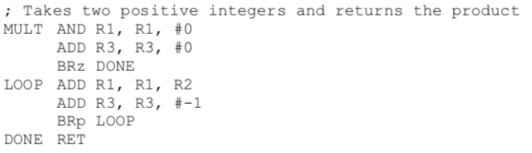
Concept Question 7
Which registers are caller saved?
Which registers are callee saved?

Slide 47
Concept Question 7
Which registers are caller saved? R1, R3, R7
Which registers are callee saved? R0, R2, R4, R5, R6

Slide 48
Concept Question 8
What is wrong with this program?
int array[4][2];
for (int i = 0; i < 2; i++) {
for (int j = 0; j < 4; j++) {
array[j][i] = i+j;
}
}

Slide 49
Concept Question 8
What is wrong with this program?
int array[4][2];
for (int i = 0; i < 2; i++) {
for (int j = 0; j < 4; j++) {
array[i][j] = i+j;
}
}

Slide 50
Concept Question 8
Fill in the blank such that array contains the same memory as it did on the previous slide
int array[8];
for (int i = 0; i < 2; i++) {
for (int j = 0; j < 4; j++) {
______________ = i+j;
}
}

Slide 51
Concept Question 8
Fill in the blank such that array contains the same memory as it did on the previous slide
int array[8];
for (int i = 0; i < 2; i++) {
for (int j = 0; j < 4; j++) {
array[(4*i)+j] = i+j;
}
}

Slide 52
Concept Question 9
Fill in the blanks, assuming fname is a file containing an integer on the first line
int read_int_from_file (const char* fname) {
int x, status;
FILE* f = _________________;
if (f == NULL) { return -1; }
status = ___________________;
_________;
if (______ != 0) { return x; }
else { return -1; }
}

Slide 53
Concept Question 9
Fill in the blanks, assuming fname is a file containing an integer on the first line
int read_int_from_file (const char* fname) {
int x, status;
FILE* f = fopen(fname, “r”);
if (f == NULL) { return -1; }
status = fscanf(f, “%d”, &x);
fclose(f);
if (status != 0) { return x; }
else { return -1; }
}

Slide 54
Concept Question 10
Fill in the blanks to find the student with the highest GPA and store a pointer to them in best_student
typedef struct StudentStruct {
int UIN;
float GPA;
} Student;
int main () {
Student all_students[5];
// Load data into all students:
load_students(all_students, 5);
// Find the student with the highest GPA:
Student* best_student = __________________;
find_best(all_students, 5, _____________);
printf(“Best GPA:%f\n”, _________________);
}
void find_best(Student* all, int num_students, Student** best) {
for (int i = 0; i < num_students; i++) {
if (all[i].GPA > ____________) {
_________________;
}
}
}

Slide 55
Concept Question 10
Fill in the blanks to find the student with the highest GPA and store a pointer to them in best_student
typedef struct StudentStruct {
int UIN;
float GPA;
} Student;
int main () {
Student all_students[5];
// Load data into all students:
load_students(all_students, 5);
// Find the student with the highest GPA:
Student* best_student = &(all_students[0]);
find_best(all_students, 5, &best_student);
printf(“Best GPA:%f\n”, best_student->GPA);
}
void find_best(Student* all, int num_students, Student** best) {
for (int i = 0; i < num_students; i++) {
if (all[i].GPA > (*best)->GPA) {
*best = &(all[i]);
}
}
}

Slide 56
Concept Question 10
Fill in the blanks to find the student with the highest GPA and store a pointer to them in best_student
typedef struct StudentStruct {
int UIN;
float GPA;
} Student;
int main () {
Student all_students[5];
// Load data into all students:
load_students(all_students, 5);
// Find the student with the highest GPA:
Student* best_student = &(all_students[0]);
find_best(all_students, 5, &best_student);
printf(“Best GPA:%f\n”, best_student->GPA);
}
void find_best(Student* all, int num_students, Student** best) {
for (int i = 0; i < num_students; i++) {
if (all[i].GPA > (*best)->GPA) {
*best = &(all[i]);
}
}
}
Critical Thinking: Why do we need this line? What if we simply said best_student = NULL?

Slide 57
Concept Question 11
How many times will the function recursive_func be called?
int main () {
recursive_func(5);
}
void recursive_func (unsigned int a) {
printf(”a is %d! \n”, a);
if (a < 0) { return; }
recursive_func(a – 1); }

Slide 58
Concept Question 11
How many times will the function recursive_func be called?
int main () {
recursive_func(5);
}
void recursive_func (unsigned int a) {
printf(”a is %d! \n”, a);
if (a < 0) { return; }
recursive_func(a – 1); }

Slide 59
Concept Question 11
How many times will the function recursive_func be called?
int main () {
recursive_func(5);
}
void recursive_func (unsigned int a) {
printf(”a is %d! \n”, a);
if (a < 0) { return; }
recursive_func(a – 1); }
a is unsigned, so it will never be less than 0!

Slide 60
Concept Question 11
How many times will the function recursive_func be called?
int main () {
recursive_func(5);
}
void recursive_func (unsigned int a) {
printf(”a is %d! \n”, a);
if (a < 0) { return; }
recursive_func(a – 1); }
a is unsigned, so it will never be less than 0!
The recursion will only end when we run out of memory!

Slide 61
Concept Question Codes
All the code has been posted online at this link:
https://pastebin.com/pyzMNmb9

Slide 62
TIPS
Make sure you understand all MPs.
Attempt the coding portion before the concept portion.
Atleast one question should be based off a lecture example or lab.
Check your pointers!

