Slide 1

ECE 210 Review Session
Midterm TWO
ashish pabba, Daksh Varshney, SANAT PANDEY, SRIJAN CHAKROBARTY

Slide 2
RL, RC, RLC Circuit
RL, RC, and RLC circuits
▪ So far, we have solved linear resistive networks. The math
involved setting up a system of equations.
▪ RL and RC circuits require setting up and solving a first-order
ODE
▪ RLC circuits require setting up and solving a second-order
ODE. You will never need to actually solve it, but you simply
need to know that the equation describing a circuit with both a
capacitor and an inductor is a second order ODE

Slide 3
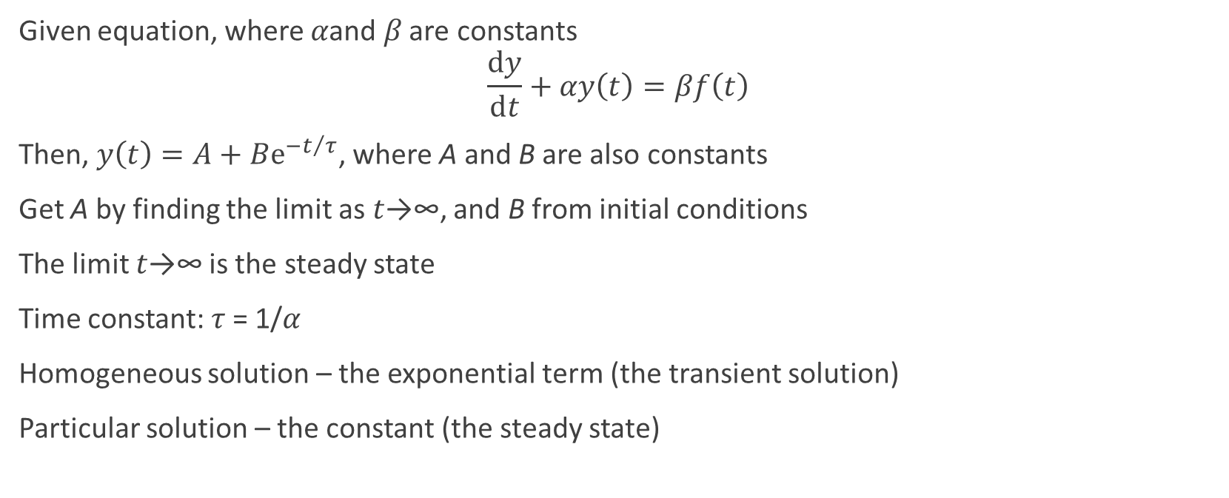
First Order Differential Equations
Given equation, where 𝛼and 𝛽 are constants
$$\frac{ⅆy}{ⅆt}+αy\left(t\right)=βf\left(t\right)$$
Then, $y\left(t\right)=A+Bⅇ^{−t/τ}$, where A and B are also constants
Get A by finding the limit as 𝑡→∞, and B from initial conditions
The limit 𝑡→∞ is the steady state
Time constant: 𝜏 = 1/𝛼
Homogeneous solution – the exponential term (the transient solution)
Particular solution – the constant (the steady state)

Slide 4
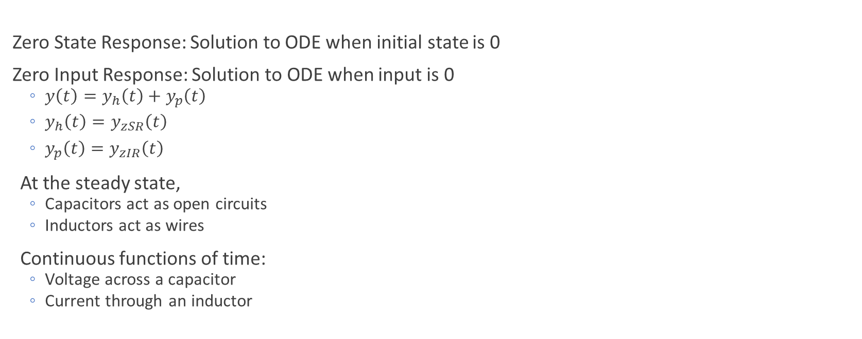
First Order Circuits
Zero State Response: Solution to ODE when initial state is 0
Zero Input Response: Solution to ODE when input is 0
$y\left(t\right)=y_{h}\left(t\right)+y_{p}\left(t\right)$
$y_{h}\left(t\right)=y_{zSR}\left(t\right)$
$y_{p}\left(t\right)=y_{zIR}\left(t\right)$
At the steady state,
Capacitors act as open circuits
Inductors act as wires
Continuous functions of time:
Voltage across a capacitor
Current through an inductor

Slide 5

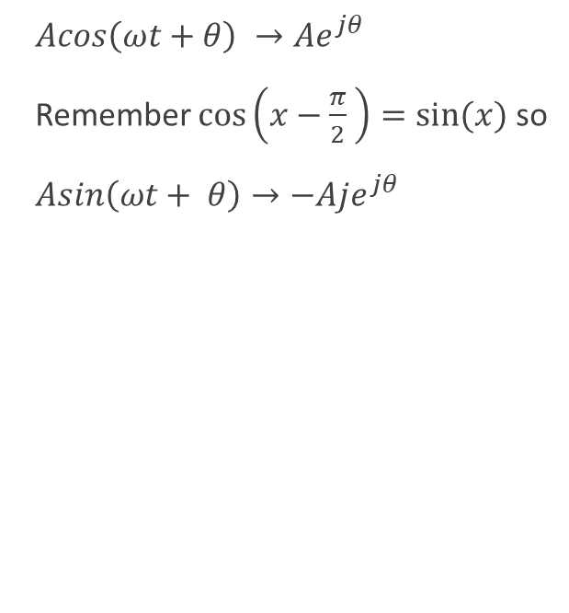
Phasors, Co-sinusoids, and Impedance
$Acos\left(ωt+θ\right) →Ae^{jθ}$
Remember $\cos\left(x−\frac{π}{2} \right)=sin⁡(x)$ so
$Asin\left(ωt+ θ\right)→−Aje^{jθ}$
Inductor: $Z=jωL$
Capacitor: $Z= \frac{1}{jωC}$
Resistor: $Z=R$
Once you’ve converted every circuit element in the phasor domain, you can analyze the circuit using all the ways covered in the first midterm!!!
Node Voltage
Superposition
Loop Current
Source Transformations
NOTE: The solution obtained after analysis with the phasor method is the STEADY STATE SOLUTION

Slide 6

Average Power
$$Average Power=\frac{1}{2}Re\left\{VI^{∗}\right\}$$
$For a Resistor=\frac{{\left|V\right|}^{2}}{2R}$ = $\frac{{R\left|I\right|}^{2}}{2}$ = $RI_{rms}^{2}$ = $\frac{V_{rms}^{2}}{R}$
NOTE 1: Capacitors and Inductors absorb no net power, they return their instantaneous absorbed power back to the circuit
NOTE 2: If the current is flowing against the direction of the voltage drop, the power is negative

Slide 7
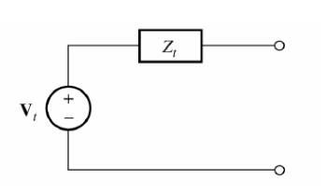
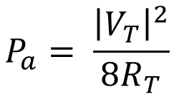
Available Power
$$Z_{L}=Z_{T}^{∗}$$
$$P_{a}= \frac{{\left|V_{T}\right|}^{2}}{8R_{T}}$$

Slide 8
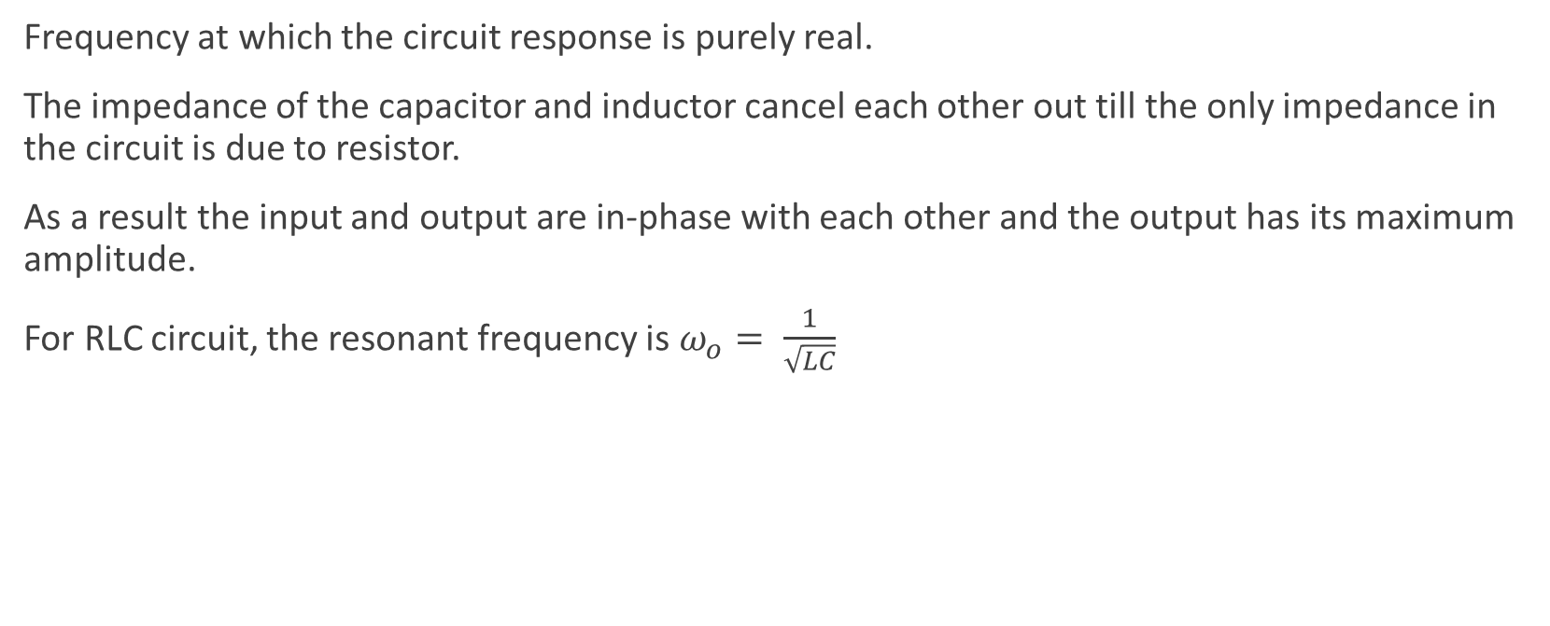
Resonance
Frequency at which the circuit response is purely real.
The impedance of the capacitor and inductor cancel each other out till the only impedance in the circuit is due to resistor.
As a result the input and output are in-phase with each other and the output has its maximum amplitude.
For RLC circuit, the resonant frequency is $ω_{o}= \frac{1}{\sqrt{LC}}$

Slide 9
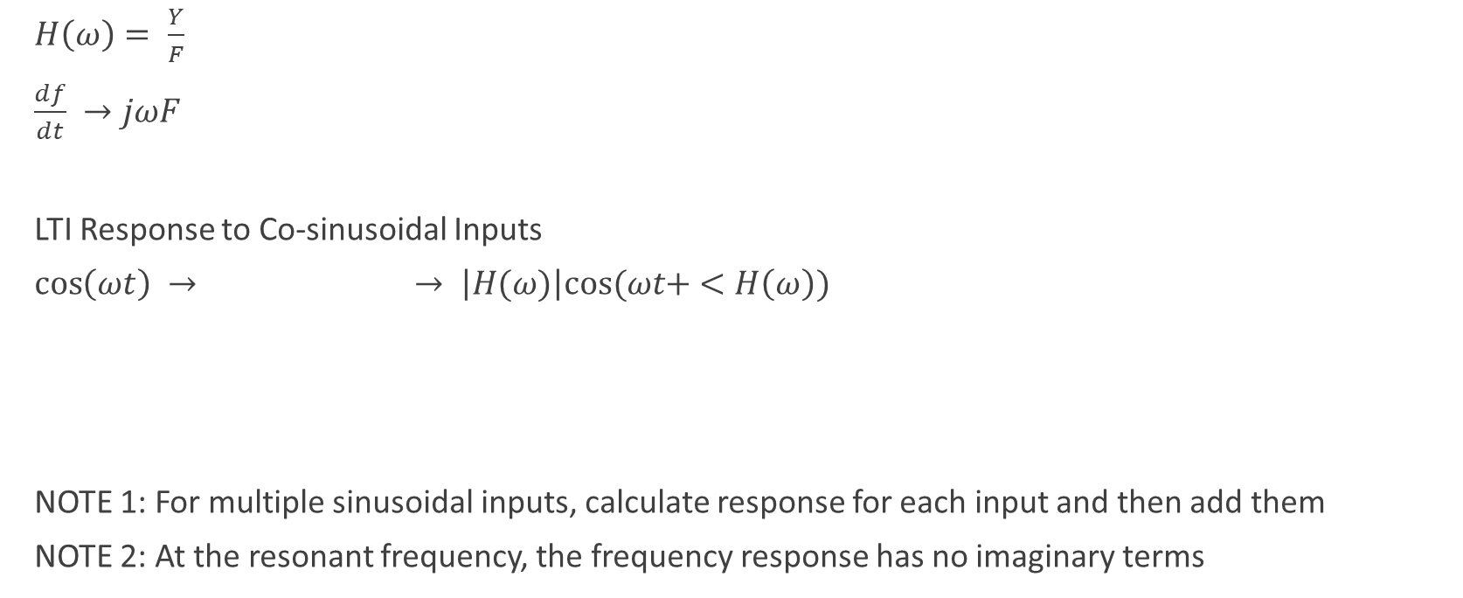
Frequency Response of LTI Systems
$H\left(ω\right)= \frac{Y}{F}$
$\frac{df}{dt} →jωF$
LTI Response to Co-sinusoidal Inputs
$\cos\left(ωt\right) →$ $→ \left|H(ω)\right|cos⁡(ωt+ <H\left(ω\right))$
NOTE 1: For multiple sinusoidal inputs, calculate response for each input and then add them
NOTE 2: At the resonant frequency, the frequency response has no imaginary terms
LTI

Slide 10

Fourier Series
Getting the recipe of a periodic signal
$\sum_{n=−∞}^{∞}{F_{n}e^{jnω_{o}t}} F_{n}=\frac{1}{T}\int_{T}{f(t)e^{−jnω_{o}t}dt}$
$\frac{c_{0}}{2}+ \sum_{n=1}^{∞}{c_{n}cos⁡(nω_{o}t+ θ)} c_{n}=2\left|F_{n}\right|$
$θ_{n}= <F_{n}$
$\frac{a_{0}}{2}+\sum_{n=1}^{∞}{a_{n}cos⁡(nω_{o}t})+b_{n}\sin\left(nω_{o}t\right) { a}_{n}= F_{n}+ F_{−n}$
` $b_{n}=j\left(F_{n}− F_{−n}\right)$

Slide 11
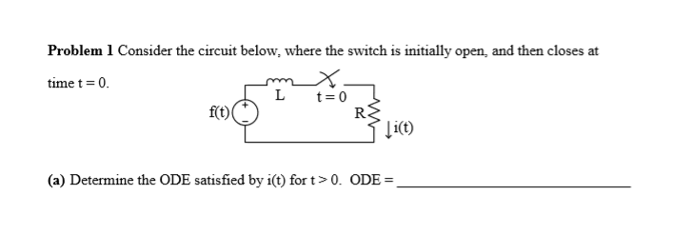
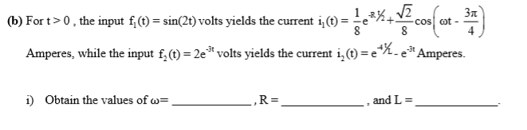
Spring 2016 Question 1

Slide 12
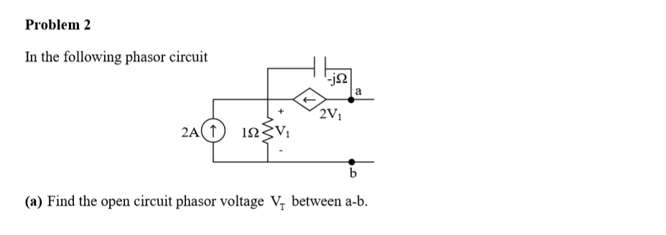

Spring 2014 Question 2

Slide 13
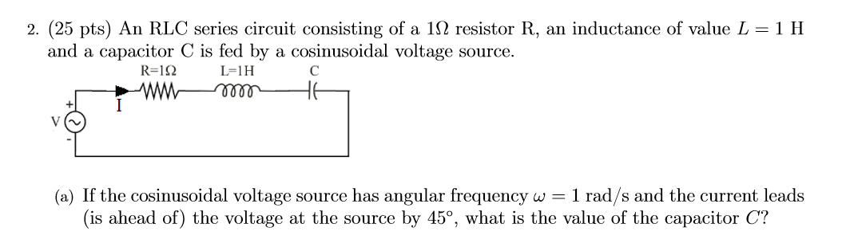

Fall 2017 Question 2

Slide 14
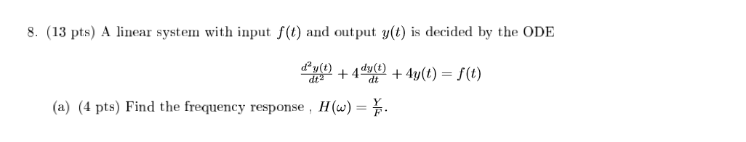
Fall 13 Question 8

Slide 15
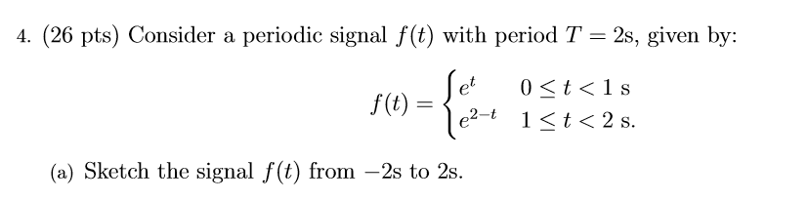
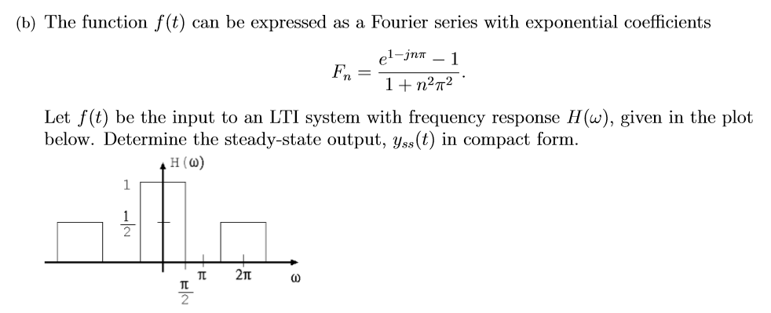
Spring 2018 Question 4

Slide 16
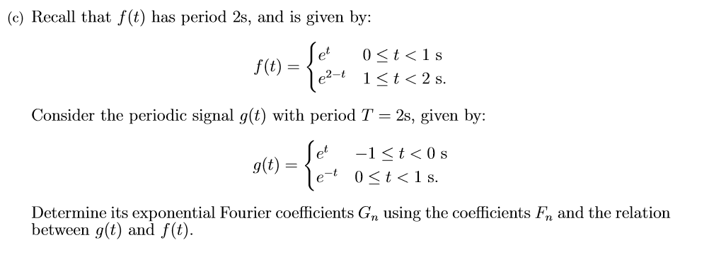
Spring 2018 Question 4 Continued

Slide 17
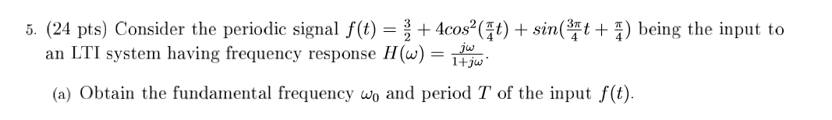
Spring 2016 Question 5

