Slide 1

ECE 210 Review Session
Midterm TWO

Slide 2

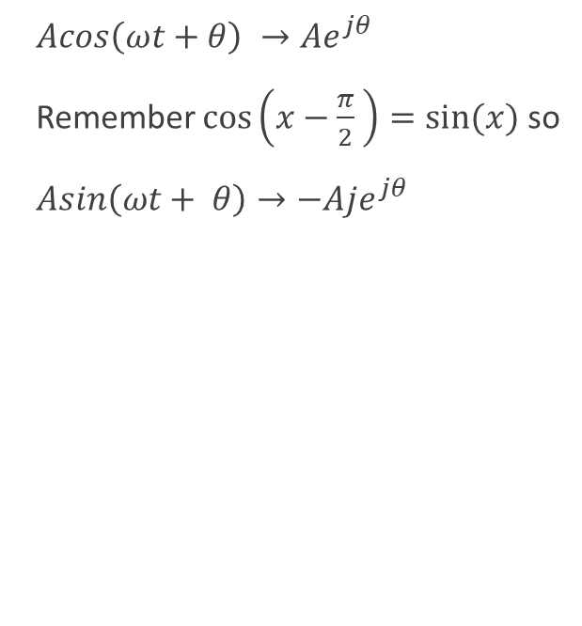
Phasors, Co-sinusoids, and Impedance
$Acos\left(ωt+θ\right) →Ae^{jθ}$
Remember $\cos\left(x−\frac{π}{2} \right)=sin⁡(x)$ so
$Asin\left(ωt+ θ\right)→−Aje^{jθ}$
Inductor: $Z=jωL$
Capacitor: $Z= \frac{1}{jωC}$
Resistor: $Z=R$
Once you’ve converted every circuit element in the phasor domain, you can analyze the circuit using all the ways covered in the first midterm!!!
Node Voltage
Superposition
Loop Current
Source Transformations
NOTE: The solution obtained after analysis with the phasor method is the STEADY STATE SOLUTION

Slide 3

Average Power
$$Average Power=\frac{1}{2}Re\left\{VI^{∗}\right\}$$
$For a Resistor=\frac{{\left|V\right|}^{2}}{2R}$ = $\frac{{R\left|I\right|}^{2}}{2}$ = $RI_{rms}^{2}$ = $\frac{V_{rms}^{2}}{R}$
NOTE 1: Capacitors and Inductors absorb no net power, they return their instantaneous absorbed power back to the circuit
NOTE 2: If the current is flowing against the direction of the voltage drop, the power is negative

Slide 4
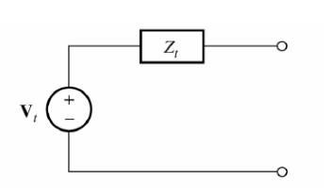
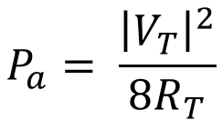
Available Power
$$Z_{L}=Z_{T}^{∗}$$
$$P_{a}= \frac{{\left|V_{T}\right|}^{2}}{8R_{T}}$$

Slide 5
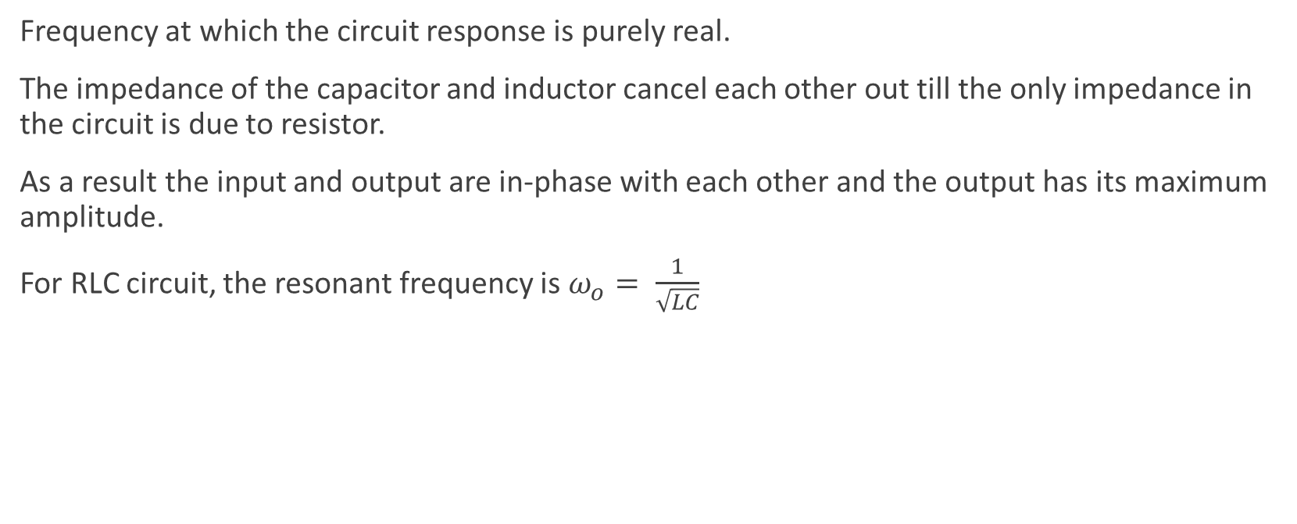
Resonance
Frequency at which the circuit response is purely real.
The impedance of the capacitor and inductor cancel each other out till the only impedance in the circuit is due to resistor.
As a result the input and output are in-phase with each other and the output has its maximum amplitude.
For RLC circuit, the resonant frequency is $ω_{o}= \frac{1}{\sqrt{LC}}$

Slide 6
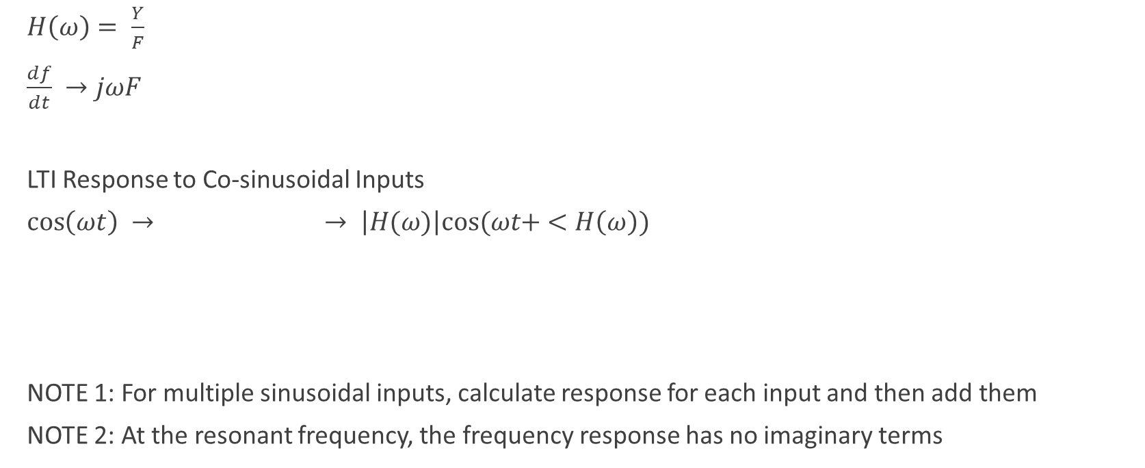
Frequency Response of LTI Systems
$H\left(ω\right)= \frac{Y}{F}$
$\frac{df}{dt} →jωF$
LTI Response to Co-sinusoidal Inputs
$\cos\left(ωt\right) →$ $→ \left|H(ω)\right|cos⁡(ωt+ <H\left(ω\right))$
NOTE 1: For multiple sinusoidal inputs, calculate response for each input and then add them
NOTE 2: At the resonant frequency, the frequency response has no imaginary terms
LTI

Slide 7

Fourier Series
Getting the recipe of a periodic signal
$\sum_{n=−∞}^{∞}{F_{n}e^{jnω_{o}t}} F_{n}=\frac{1}{T}\int_{T}{f(t)e^{−jnω_{o}t}dt}$
$\frac{c_{0}}{2}+ \sum_{n=1}^{∞}{c_{n}cos⁡(nω_{o}t+ θ)} c_{n}=2\left|F_{n}\right|$
$θ_{n}= <F_{n}$
$\frac{a_{0}}{2}+\sum_{n=1}^{∞}{a_{n}cos⁡(nω_{o}t})+b_{n}\sin\left(nω_{o}t\right) { a}_{n}= F_{n}+ F_{−n}$
` $b_{n}=j\left(F_{n}− F_{−n}\right)$

Slide 8
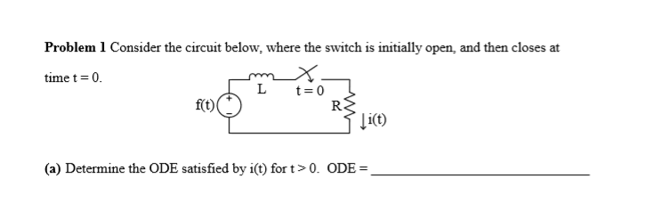
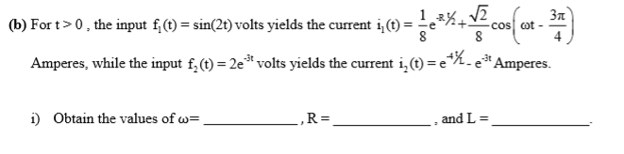
Spring 2016 Question 1

Slide 9
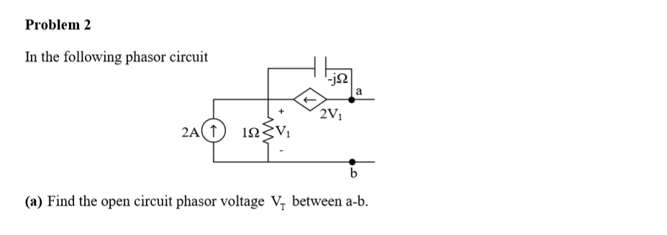

Spring 2014 Question 2

Slide 10
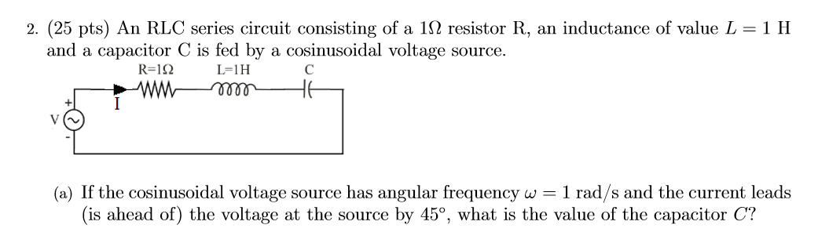

Fall 2017 Question 2

Slide 11
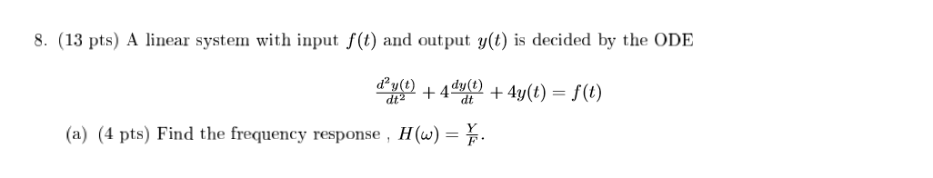
Fall 13 Question 8

Slide 12
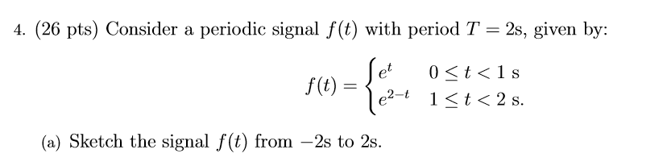
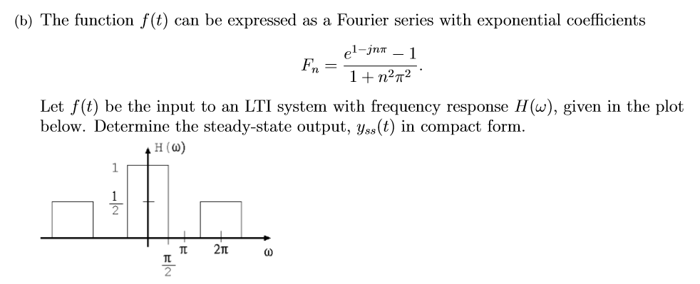
Spring 2018 Question 4

Slide 13
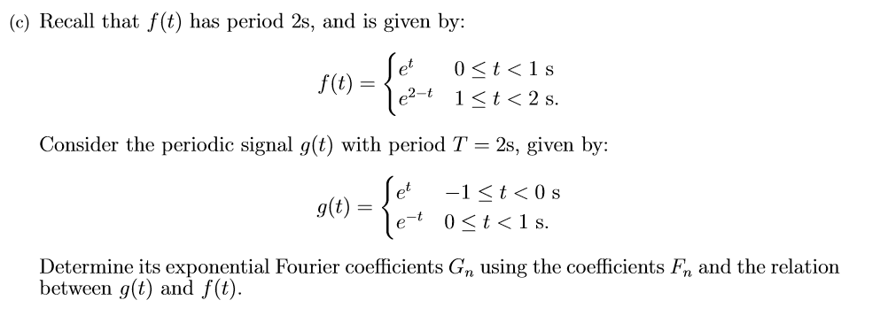
Spring 2018 Question 4 Continued

Slide 14
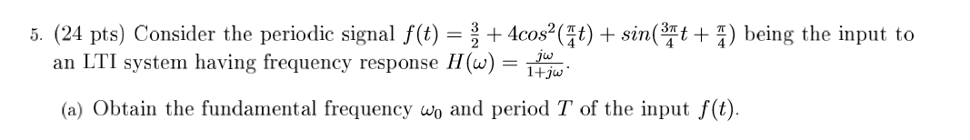
Spring 2016 Question 5

