Slide 1
HKN ECE 310 Exam Review Session
Corey Snyder
Steven Chan
Ningdong Wang

Slide 2
Topics
LSIC Systems and BIBO Stability
Impulse Response and Convolution
Z-Transform
DTFT and Frequency Response

Slide 3
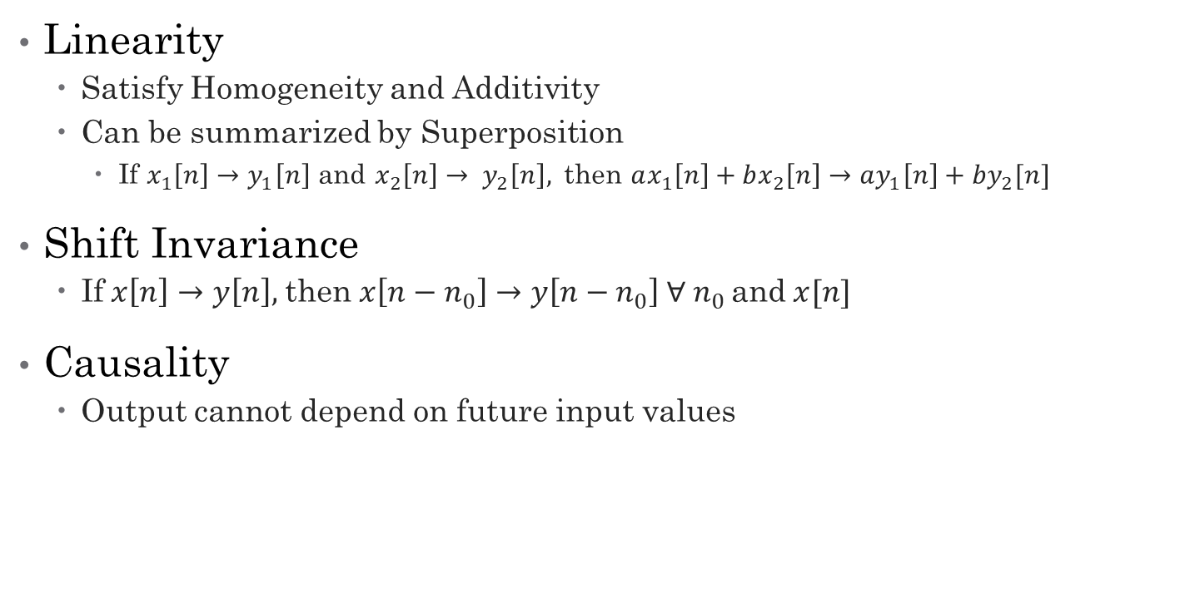
LSIC Systems
Linearity
Satisfy Homogeneity and Additivity
Can be summarized by Superposition
If $x_{1}\left[n\right]→y_{1}\left[n\right]$ and $x_{2}\left[n\right]→ y_{2}\left[n\right],$then $ax_{1}\left[n\right]+bx_{2}\left[n\right]→ay_{1}\left[n\right]+by_{2}[n]$
Shift Invariance
If$x\left[n\right]→y\left[n\right],$then $x\left[n−n_{0}\right]→y\left[n−n_{0}\right] ∀ n_{0}$and$x[n]$
Causality
Output cannot depend on future input values

Slide 4
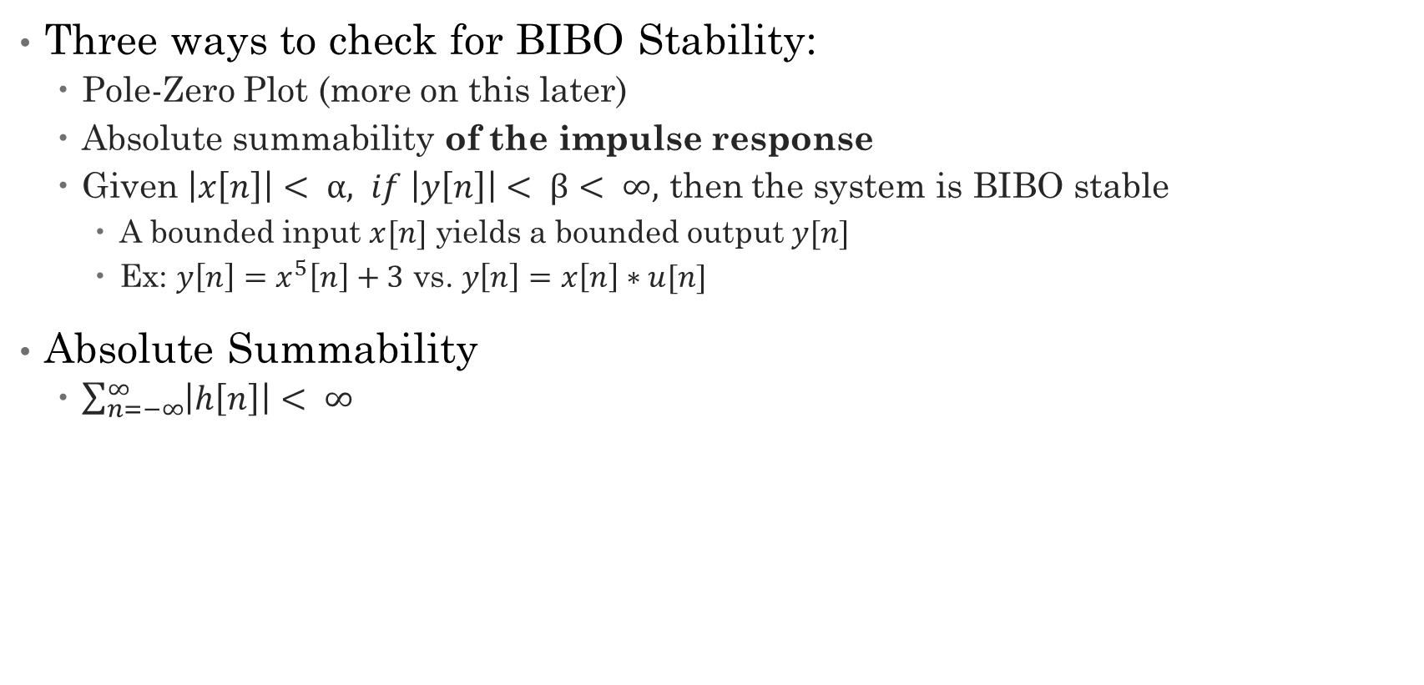
BIBO Stability
Three ways to check for BIBO Stability:
Pole-Zero Plot (more on this later)
Absolute summability of the impulse response
Given $\left|x\left[n\right]\right|< α, if \left|y\left[n\right]\right|< β< ∞,$ then the system is BIBO stable
A bounded input $x[n]$ yields a bounded output $y[n]$
Ex: $y\left[n\right]=x^{5}\left[n\right]+3$ vs. $y\left[n\right]=x\left[n\right]∗u[n]$
Absolute Summability
$\sum_{n=−∞}^{∞}{\left|h\left[n\right]\right|< ∞}$

Slide 5
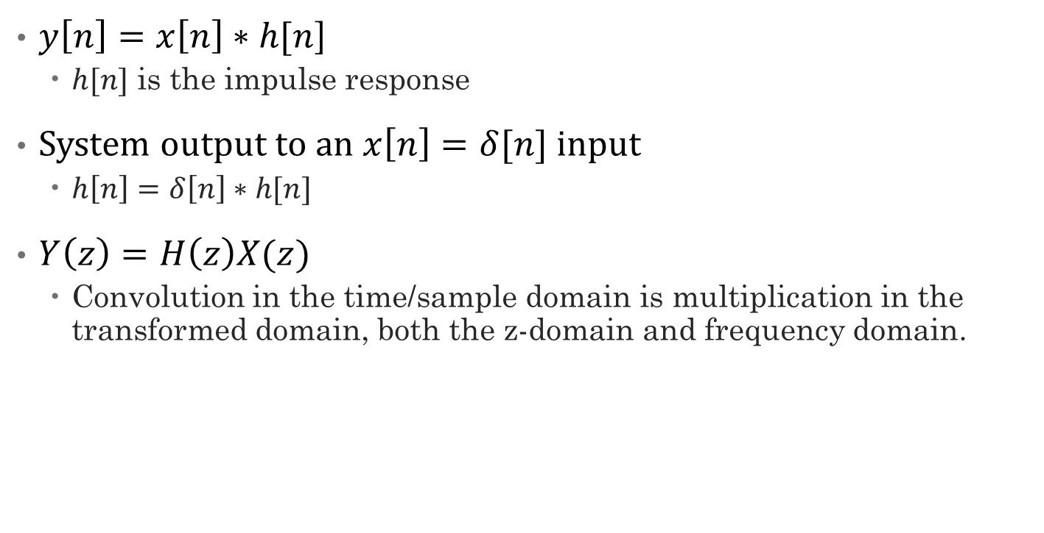
Impulse Response
$y\left[n\right]=x\left[n\right]∗h[n$]
$h[n]$ is the impulse response
System output to an $x\left[n\right]=δ[n]$ input
$h\left[n\right]=δ\left[n\right]∗h[n]$
$Y\left(z\right)=H\left(z\right)X(z)$
Convolution in the time/sample domain is multiplication in the transformed domain, both the z-domain and frequency domain.

Slide 6
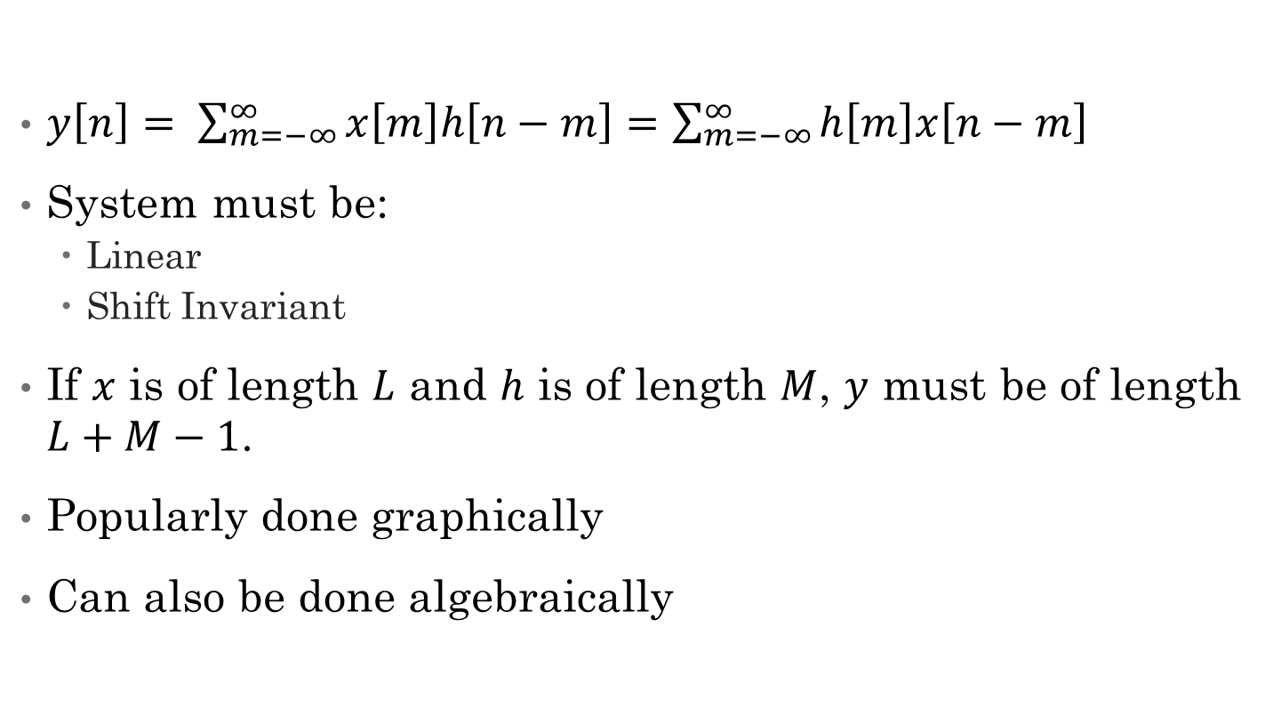
Convolution
$y\left[n\right]= \sum_{m=−∞}^{∞}{x\left[m\right]h\left[n−m\right]=\sum_{m=−∞}^{∞}{h\left[m\right]x\left[n−m\right]}}$
System must be:
Linear
Shift Invariant
If $x$ is of length $L$ and $h$ is of length $M$, $y$ must be of length $L+M−1$.
Popularly done graphically
Can also be done algebraically

Slide 7
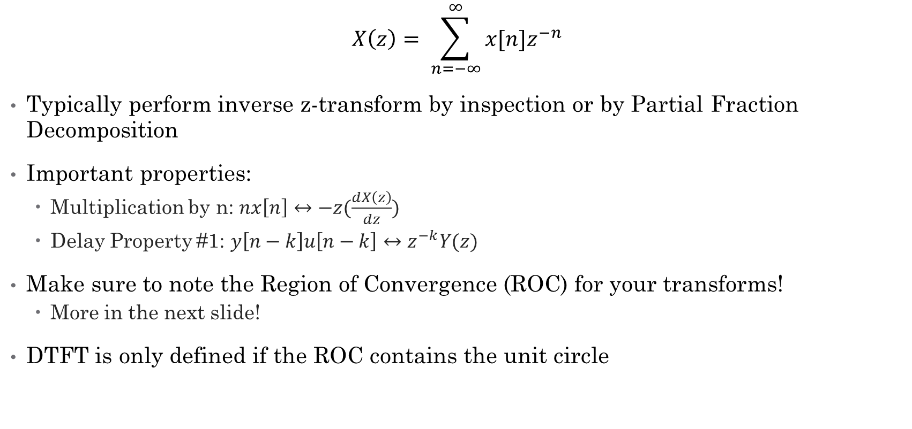
Z-Transform
$$X\left(z\right)= \sum_{n=−∞}^{∞}{x[n]z^{−n}}$$
Typically perform inverse z-transform by inspection or by Partial Fraction Decomposition
Important properties:
Multiplication by n: $nx\left[n\right]↔−z(\frac{dX\left(z\right)}{dz})$
Delay Property #1: $y\left[n−k\right]u\left[n−k\right]↔z^{−k}Y(z)$
Make sure to note the Region of Convergence (ROC) for your transforms!
More in the next slide!
DTFT is only defined if the ROC contains the unit circle

Slide 8
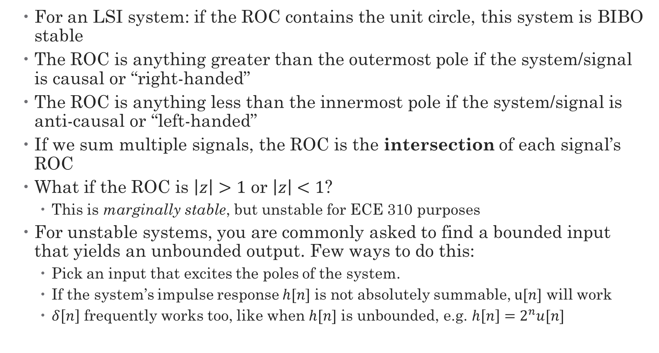
BIBO Stability Revisited: Pole-Zero Plots
For an LSI system: if the ROC contains the unit circle, this system is BIBO stable
The ROC is anything greater than the outermost pole if the system/signal is causal or “right-handed”
The ROC is anything less than the innermost pole if the system/signal is anti-causal or “left-handed”
If we sum multiple signals, the ROC is the intersection of each signal’s ROC
What if the ROC is $\left|z\right|>1$ or $\left|z\right|<1$?
This is marginally stable, but unstable for ECE 310 purposes
For unstable systems, you are commonly asked to find a bounded input that yields an unbounded output. Few ways to do this:
Pick an input that excites the poles of the system.
If the system’s impulse response $h[n]$ is not absolutely summable, $u[n]$ will work
$δ\left[n\right]$ frequently works too, like when $h[n]$ is unbounded, e.g. $h\left[n\right]=2^{n}u[n]$

Slide 9
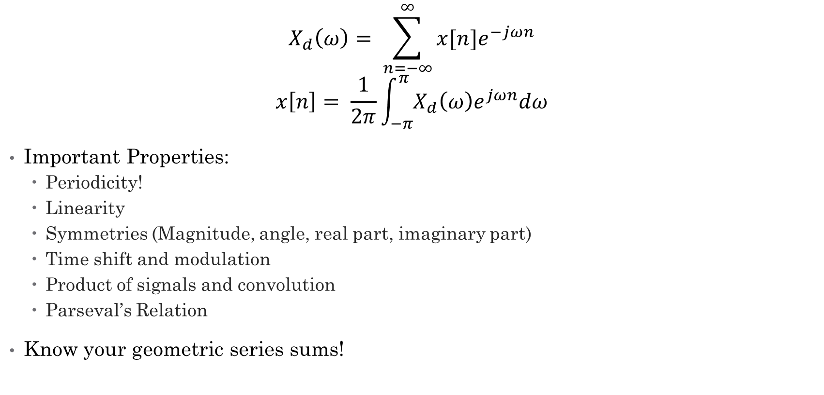
Discrete Time Fourier Transform
$$X_{d}\left(ω\right)= \sum_{n=−∞}^{∞}{x[n]e^{−jωn}}$$
$$x\left[n\right]= \frac{1}{2π}\int_{−π}^{π}{X_{d}\left(ω\right)e^{jωn}dω}$$
Important Properties:
Periodicity!
Linearity
Symmetries (Magnitude, angle, real part, imaginary part)
Time shift and modulation
Product of signals and convolution
Parseval’s Relation
Know your geometric series sums!

Slide 10
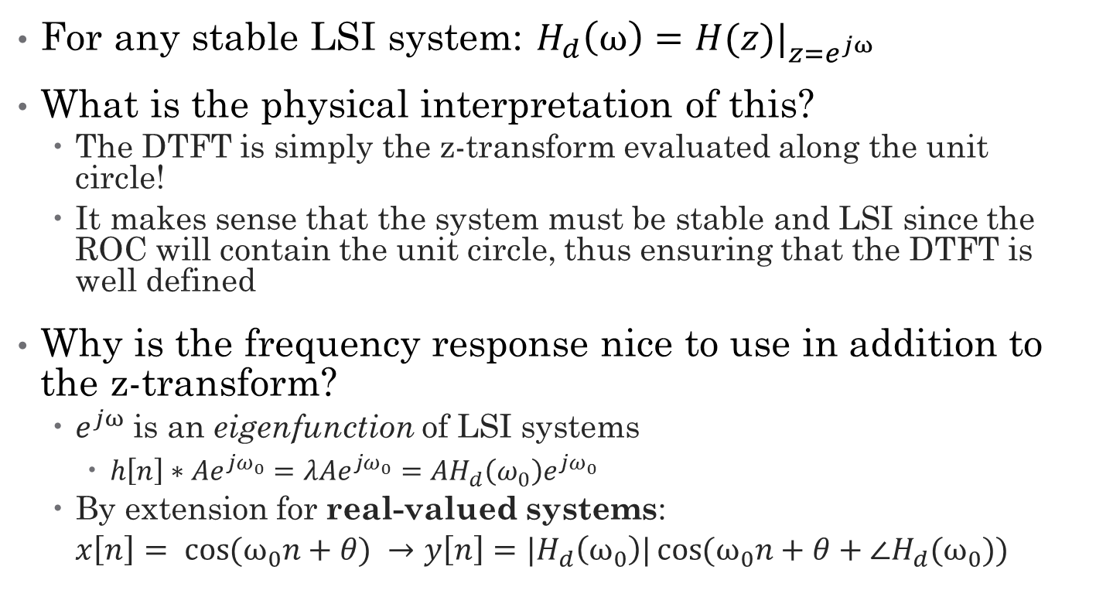
Frequency Response
For any stable LSI system: $H_{d}\left(ω\right)=H(z)|_{z=e^{jω}}$
What is the physical interpretation of this?
The DTFT is simply the z-transform evaluated along the unit circle!
It makes sense that the system must be stable and LSI since the ROC will contain the unit circle, thus ensuring that the DTFT is well defined
Why is the frequency response nice to use in addition to the z-transform?
$e^{jω}$ is an eigenfunction of LSI systems
$h\left[n\right]∗Ae^{jω_{0}}=λAe^{jω_{0}}=AH_{d}\left(ω_{0}\right)e^{jω_{0}}$
By extension for real-valued systems:
$$x\left[n\right]= \cos{{(ω}_{0}n+θ) →y\left[n\right]=|H_{d}\left(ω_{0}\right)|\cos{{(ω}_{0}n+θ+∠H_{d}(ω_{0}))}}$$

Slide 11
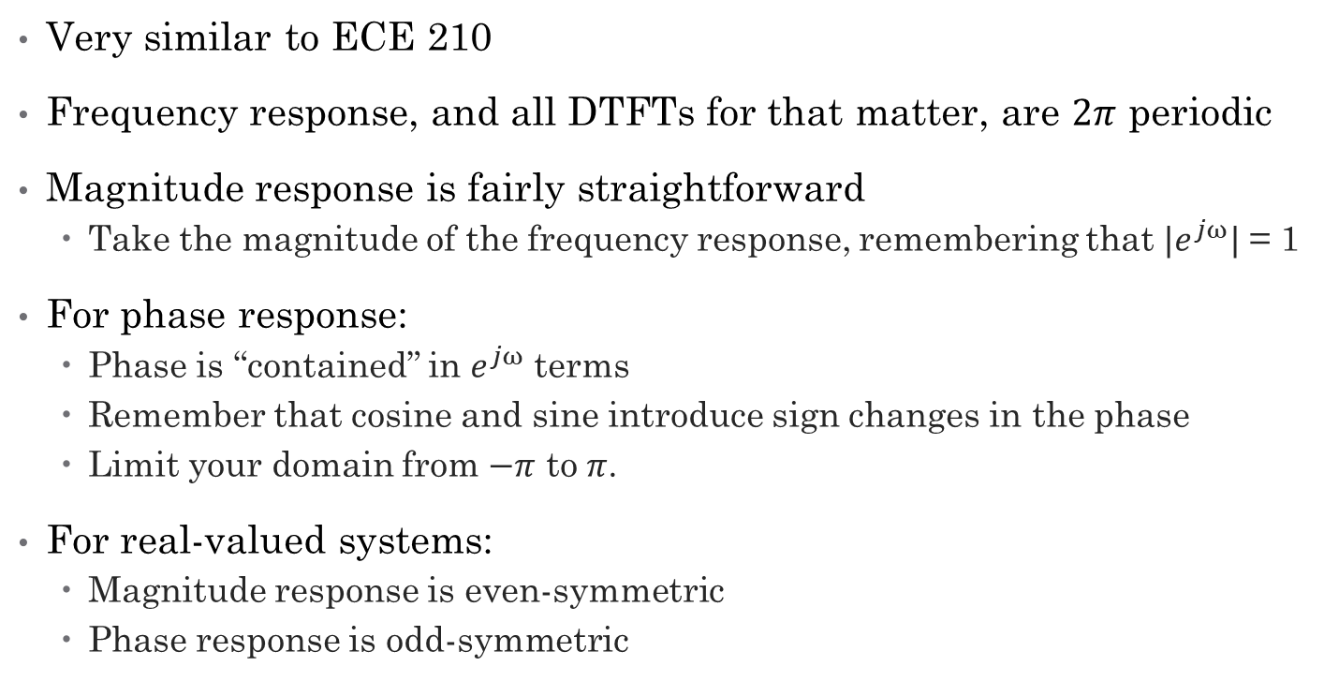
Magnitude and Phase Response
Very similar to ECE 210
Frequency response, and all DTFTs for that matter, are $2π$ periodic
Magnitude response is fairly straightforward
Take the magnitude of the frequency response, remembering that ${|e}^{jω}|$ = 1
For phase response:
Phase is “contained” in $e^{jω}$ terms
Remember that cosine and sine introduce sign changes in the phase
Limit your domain from $−π$ to $π$.
For real-valued systems:
Magnitude response is even-symmetric
Phase response is odd-symmetric

Slide 12

LSIC Examples
For the following systems, determine whether it is linear, shift-invariant, causal and stable
$y\left[n\right]=y\left[n+1\right]+x[\left|n\right|]$
$y\left[n\right]=\frac{3\sin{x\left[n\right]}}{x\left[0\right]}$
$y\left[n\right]=3^{−\left|n\right|}\log\left(\left|x\left[n\right]\right|+1\right)$

Slide 13
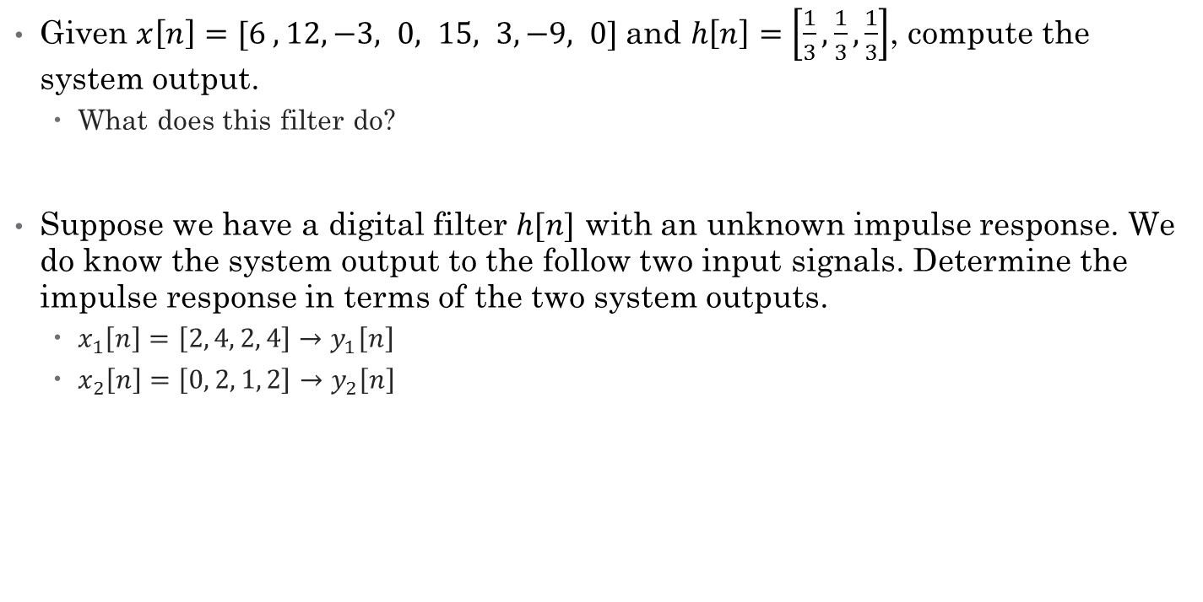
Impulse Response and Convolution Examples
Given $x\left[n\right]=[6 ,12, −3, 0, 15, 3, −9, 0]$and $h\left[n\right]=\left[\frac{1}{3},\frac{1}{3},\frac{1}{3}\right]$, compute the system output.
What does this filter do?
Suppose we have a digital filter $h[n]$ with an unknown impulse response. We do know the system output to the follow two input signals. Determine the impulse response in terms of the two system outputs.
$x_{1}\left[n\right]=\left[2, 4, 2, 4\right]→y_{1}\left[n\right]$
$x_{2}\left[n\right]=\left[0, 2, 1, 2\right]→y_{2}\left[n\right]$

Slide 14
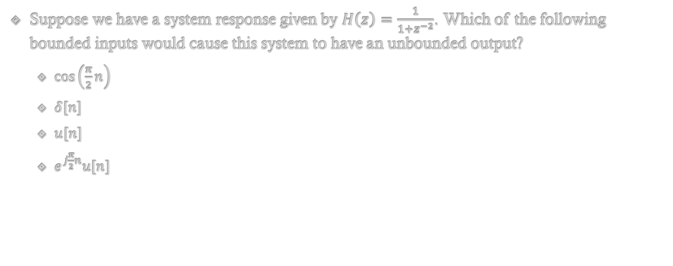
BIBO Stability Example
Suppose we have a system response given by $H\left(z\right)=\frac{1}{1+z^{−2}}$. Which of the following bounded inputs would cause this system to have an unbounded output?
$\cos\left(\frac{π}{2}n\right)$
$δ[n]$
$u[n]$
$e^{j\frac{π}{2}n}u[n]$

