Slide 1
PHYS 211 Exam 1 HKN Review Session
Keshav Harisrikanth, Arvind Subramanian,
Vincent Nguyen,David Schneck

Slide 2

1D Kinematics
Displacement [m]
The distance we travel in a certain direction
Velocity [m/s]
Average Velocity
$$v= \frac{∆x}{∆t}$$
$∆x$: distance traveled in the period $∆t$
Instantaneous Velocity
$$v= \frac{dx}{dt}$$

Slide 3

1D Kinematics
Acceleration [$m/s^{2}$]
Describe the change of velocity
$$a= \frac{dv}{dt}$$
Motion with constant acceleration
$$v= v_{0}+at$$
$$x=x_{0}+vt+\frac{1}{2}at^{2}$$
$$v^{2}−{v_{0}}^{2}=2a(x−x_{0})$$

Slide 4
Vector and 2D/3D Kinematics
Vector
A quantity that has both magnitude and direction
Examples: displacement, velocity, acceleration
Scalar
A quantity that only has magnitude
Examples: distance, speed, temperature

Slide 5

Vector and 2D/3D Kinematics
Vector Representation
$\overset{⃑}{x}=(x,y,z)$ $\overset{⃑}{v_{0}}=(v_{x},v_{y},v_{z})$ $\overset{⃑}{a_{0}}=(a_{x},a_{y},a_{z})$
Vector equations for motion with constant acceleration:
$$\overset{⃑}{v}= \overset{⃑}{v_{0}}+\overset{⃑}{a}t$$
$$\overset{⃑}{x}= \overset{⃑}{x_{0}}+\overset{⃑}{v_{0}}t+\frac{1}{2}\overset{⃑}{a}t^{2}$$
Superposition
The net motion of an object is the sum of its motion in the 2(3) independent directions.
Decompose the vector into the 2(3) directions and solve the 1D kinematics

Slide 6

Relative Motion
Relative Motion
The velocity of B relative to A is equal to the difference between the velocities of B and A with respect to C.
$$\overset{⃑}{v_{BA}}=\overset{⃑}{v_{BC}}−\overset{⃑}{v_{AC}}=\overset{⃑}{v_{BC}}+\overset{⃑}{v_{CA}}$$
We observe that “C” is “cancelled” in the subscripts
Using the same rule , we can develop a “chain rule”
$$\overset{⃑}{v_{BA}}=\overset{⃑}{v_{BC_{1}}}+\overset{⃑}{v_{C_{1}C_{2}}}+…+\overset{⃑}{v_{C_{n−1}C_{n}}}+\overset{⃑}{v_{C_{n}A}}$$

Slide 7

Circular Motion
Angular Speed
$ω [\frac{rad}{s}]$ describes how much angle the object sweeps through per unit of time
$ω=\frac{v}{R}$
Circular Motion with constant speed
Constant speed doesn’t mean constant velocity!
The velocity is changing because its direction is changing.
Centripetal Acceleration
$a_{c}=\frac{v^{2}}{R}=vω=ω^{2}R$ $R$: radius of the circle

Slide 8

Force and Newton’s Law
Newton’s First Law
An object subject to no force either moves with constant speed or stays at rest when we look from a inertial reference frame.
Newton’s Second Law
$$\overset{⃑}{F}=m\overset{⃑}{a}$$
A lot of results in the later lectures are deduced from this simple equation.
Newton’s Third Law
Every action is equal to the opposite reaction.

Slide 9

Force and Newton’s Law
Types of forces
Gravitational Force
Case I: Objects near the surface of Earth
$F=mg$
F always points towards the center of the Earth
Case II: Objects (usually celestial bodies in space)
$$F=\frac{GM_{1}M_{2}}{R^{2}} where G=6.67×{10}^{−11}m^{3}/(kg∙s^{2})$$
Spring Force
$$F=−kx$$
The minus sign means the force always retards the motion of the object connect to the spring.
“k” is called the spring constant, with unit [N/m]
“x” is the displacement from the equilibrium position.

Slide 10
Force and Newton’s Law
Types of forces
Normal Force
The force acting on an object when it’s in contact with the other one.
The magnitude is not determinant. (i.e. It’s determined by the other conditions.)
The direction of the force is perpendicular to the surface of contact.
Friction (Details covered later)
Kinetic Friction
The force that retards the motion of an object when it’s moving relative to a rough surface.
Static Friction
The force that keeps an object from moving when it’s static relative to a surface

Slide 11

Friction
Kinetic Friction
$$f=μ_{k}N$$
The direction is opposite to the motion.
$μ_{k}$ is called the kinetic friction coefficient.
N is the Normal force from the surface of contact
Static Friction
$$f≤f_{max}= μ_{s}N$$
The magnitude and direction can be obtained by other conditions (using Newton’s Laws).
Draw a free-body diagram!

Slide 12

Work and Energy
Work $\left[ N∙m \right]$
Work is a scalar describing the effect of a force over space. (Later, you will learn another quantity called impulse, which describes the effect of a force over time.)
Work with constant force
$$W=\overset{⃑}{F}∙\overset{⃑}{x}=F∙x∙\cos{θ}$$
$θ$ is the angle between the force and the displacement.
Work with variable force
$$W=\int_{\overset{⃑}{x_{1}}}^{\overset{⃑}{x_{2}}}{\overset{⃑}{F}∙\overset{⃑}{x}}$$
Work can be converted into energy.

Slide 13

Work and Energy
Energy
Kinetic Energy
$$E_{k}=\frac{1}{2}mv^{2}$$
Potential Energy (Near the Earth)
$$E_{p}=mgh+U_{0}$$
Potential Energy (General)
$$E_{p}=−\frac{GM_{1}M_{2}}{r}+U_{0}$$
Potential Energy (Spring)
$$E_{p}=\frac{1}{2}kx^{2}+U_{0}$$

Slide 14

Work and Energy
Work-energy Relation
Mechanical Energy
$$E=E_{p}+E_{k}$$
Work and Kinetic Energy
$$W_{net}=∆E_{k}$$
Conservative Force
The work done by a conservative force is path independent, meaning that as long as the start and end points are fixed, the work done by the force is a fixed value regardless of the path.
Friction is a non-conservative force.
Gravity and spring force are both conservative forces.
Work and Mechanical Energy
$$W_{nc}=∆E_{mechanical}$$
$W_{nc}$ is the net work done by all non-conservative forces

Slide 15

Center of Mass
Center of Mass
A point on the object which represents the net motion of the object
Calculation
A system of discrete objects
$$CM=\frac{\sum_{i=1}^{n}{m_{i}\overset{⃑}{r_{i}}}}{M_{total}}$$
A system with continuous mass distribution
$$CM=\frac{\int{ρ(\overset{⃑}{r})ⅆ\overset{⃑}{r}}}{M_{total}}$$

Slide 16
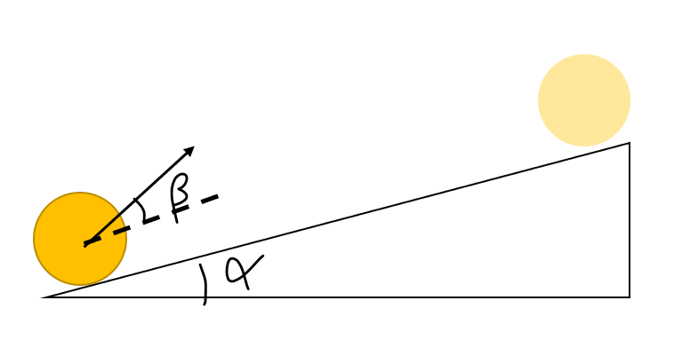

Question
A ramp makes an angle of β with respect to the horizontal ground. The ball is launched with initial velocity $v_{0}$ at the bottom of the ramp with angle α with respect to the ramp. Given β, what is the value of α that makes the ball travel the farthest along the ramp?

Slide 17
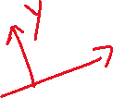

Hint
Use superposition
The acceleration can be decomposed into 2 parts, one along the ramp and the other perpendicular to the ramp.

Slide 18


Solution
X direction:
motion with initial velocity $v_{0}\cos\left(β\right)$ and constant acceleration $gsin(α)$
We need to find the time $t_{y}$ it takes for the ball to fall on the ramp so that the distance along the ramp the ball travels is:
$$x= v_{0}\cos\left(β\right)t_{y}+\frac{1}{2}gsin(α){t_{y}}^{2}$$
Y direction:
motion with initial velocity $v_{0}\sin\left(β\right)$ and constant acceleration $−gcos(α)$
Set the displacement to 0 and solve for $t_{y}$
$$v_{0}\sin\left(β\right)t_{y}−\frac{1}{2}gcos\left(α\right){t_{y}}^{2}=0$$
$$t_{y}=\frac{2v_{0}\sin\left(β\right)}{gcos\left(α\right)}$$
$$v_{0}$$

Slide 19

Solution
Therefore, we have:
$$x= \frac{2v_{0}\sin\left(β\right)v_{0}\cos\left(β\right)}{gcos\left(α\right)}+\frac{1}{2}gsin\left(α\right){\left(\frac{2v_{0}\sin\left(β\right)}{gcos\left(α\right)}\right)}^{2}$$
$$=\frac{{v_{0}}^{2}}{g{\cos\left(α\right)}^{2}}(\sin\left(2β+α\right)−\sin\left(α\right))$$
When $β=\frac{π}{4}−\frac{α}{2}$, x reaches the maximum
When that $α=0$, x has its maximum
$x=\frac{{v_{0}}^{2}sin⁡(2β)}{g}$ at $β=\frac{π}{4}$
$$v_{0}$$

Slide 20
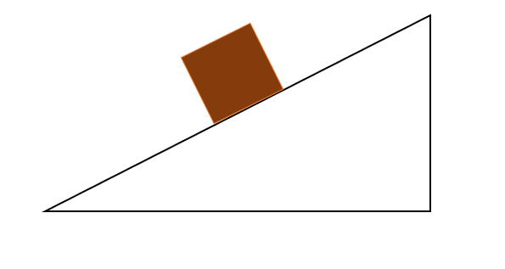
Question
A frictionless ramp with mass M and angle θ is at rest on the frictionless ground. Then, a wood with mass m is placed on the ramp so that the both blocks starts to move. What is the acceleration of the ramp?

Slide 21



Hint
All you need is to draw a free-body diagram and to use Newton’s laws!
The acceleration of the wood block and the ramp have the same magnitude in the direction perpendicular to the ramp.
$$N_{1}$$
$$N_{0}$$
mg
$$N_{2}$$
Mg

Slide 22






Solution
Wood block:
$$mgcos\left(θ\right)−N_{1}=ma_{n}$$
Ramp:
$$N_{2}\sin\left(θ\right)=Ma_{x}$$
$N_{2}$= $N_{1}$ by Newton’s 3rd Law
Both blocks have the same acceleration perpendicular to the ramp.
$$a_{n}=a_{x}sin(θ)$$
$$N_{1}$$
$$a_{τ}$$
$$N_{0}$$
$$a_{n}$$
mg
$$a_{wood}$$
$$a_{x}$$
$$a_{xn}$$
$$N_{2}$$
Mg

Slide 23

Solution
Solve for $a_{x}$
$$a_{x}=\frac{msin\left(θ\right)cos⁡(θ)}{M+m{sin⁡(θ)}^{2}}g$$
$$N_{1}$$
$$a_{τ}$$
$$N_{0}$$
$$a_{n}$$
mg
$$a_{wood}$$
$$a_{x}$$
$$a_{xn}$$
$$N_{2}$$
Mg

Slide 24
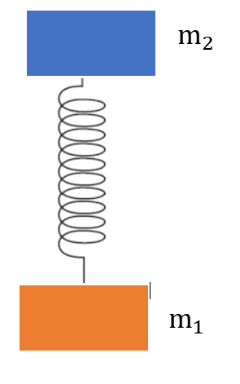

Question
An object with mass $m_{1}$ is at rest on the ground. Then, a spring with spring constant k is attached to it and another object with mass $m_{2}$ is placed on the spring. What’s the minimum force we need to press $m_{2}$ so that after we release it, $m_{1}$ will eventually jump up and leave the ground？

Slide 25
Hint
Use Newton’s law for the initial and final condition.
Mechanical energy is conserved in the process.

Slide 26


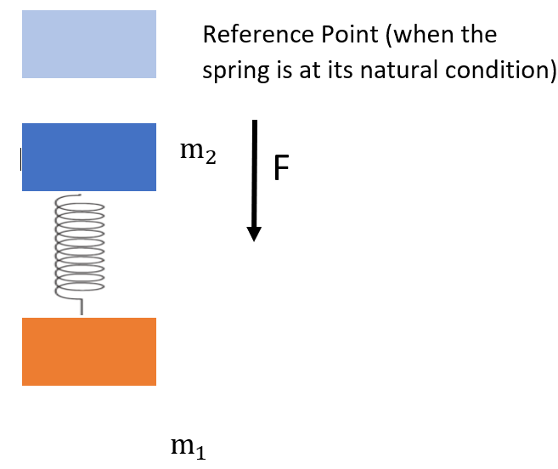
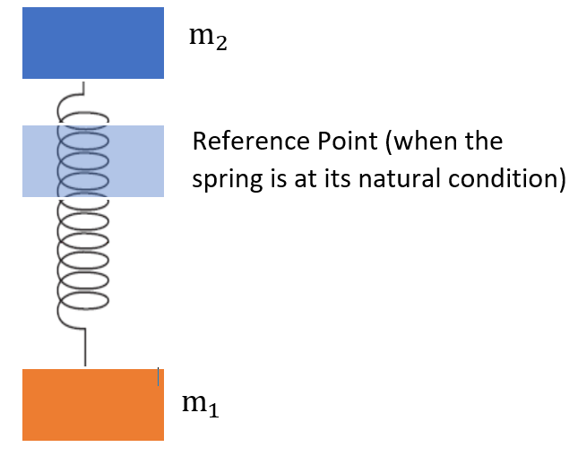




Solution
Initial condition
$$−F−m_{2}g+k∆x_{1}=0$$
Final condition
$$k∆x_{2}−m_{1}g≥0$$
We take equality for minimum F.
Energy conservation
$$\frac{1}{2}k{∆x_{1}}^{2}+U−mg∆x_{1}=\frac{1}{2}k{∆x_{2}}^{2}+U+mg∆x_{2}$$

Slide 27
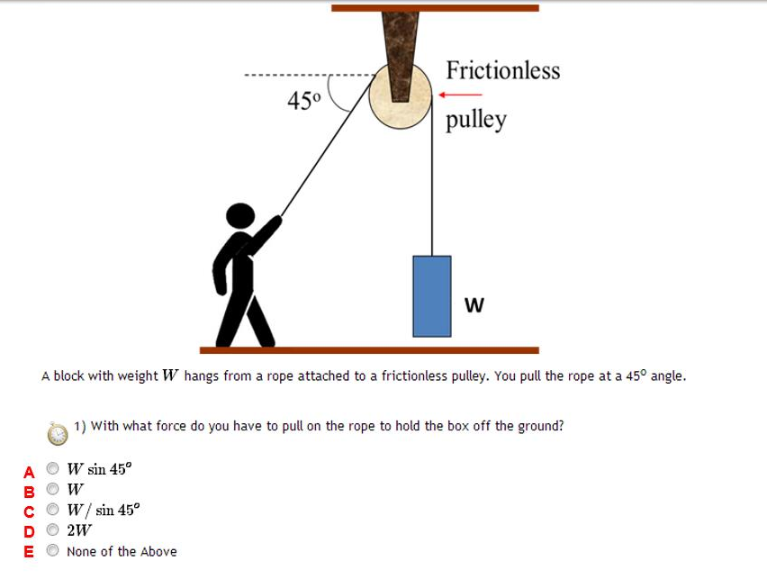
Question

Slide 28
Hint
How might this be similar to the previous ramp question? How might it be different?
Do we expect it to take more, less, or the same force as lifting the box directly?

Slide 29
Solution
The key concept at play is that the pulley is frictionless, and redirects the force you apply. It helps to draw a diagram to help you visualize the forces at play.
The answer is B, as the pulley redirects your force the same regardless of angle, making it the same as lifting the object directly.

Slide 30
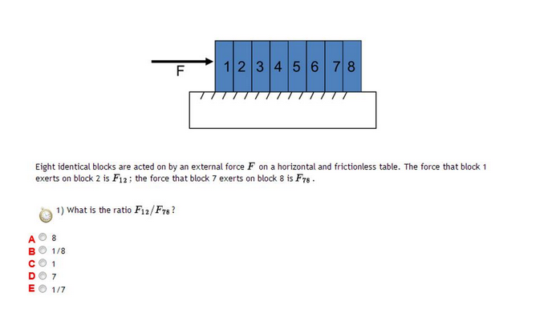
Question

Slide 31
Hint
How does the force you apply “propagate” through the blocks?
How many blocks does block 1 “move?”
Block 7?

Slide 32
Solution
Block 1 applies enough force on block 2 such that all blocks 2-7 move with the same acceleration.
Meanwhile, block 7 applies force on block 8 such that block 8 moves with the same acceleration.
You can think of it as block 1 “moving” 7 blocks while block 7 “moves” 1. As a result, the answer is 7/1=7, D.

