Slide 1
PHYS 211 Exam 2 HKN Review Session
Vincent Nguyen, Michael chen,
Keshav Harisrikanth

Slide 2

Work and Energy
Work $\left[ N∙m \right]$
Work is a scalar describing the effect of a force over space. (Later, you will learn another quantity called impulse, which describes the effect of a force over time.)
Work with constant force
$$W=\overset{⃑}{F}∙\overset{⃑}{x}=F∙x∙\cos{θ}$$
$θ$ is the angle between the force and the displacement.
Work with variable force
$$W=\int_{\overset{⃑}{x_{1}}}^{\overset{⃑}{x_{2}}}{\overset{⃑}{F}∙\overset{⃑}{x}}$$
Work can be converted into energy.

Slide 3

Work and Energy
Energy
Kinetic Energy
$$E_{k}=\frac{1}{2}mv^{2}$$
Potential Energy (Near the Earth)
$$E_{p}=mgh+U_{0}$$
Potential Energy (General)
$$E_{p}=−\frac{GM_{1}M_{2}}{r}+U_{0}$$
Potential Energy (Spring)
$$E_{p}=\frac{1}{2}kx^{2}+U_{0}$$

Slide 4

Work and Energy
Work-energy Relation
Mechanical Energy
$$E=E_{p}+E_{k}$$
Work and Kinetic Energy
$$W_{net}=∆E_{k}$$
Conservative Force
The work done by a conservative force is path independent, meaning that as long as the start and end points are fixed, the work done by the force is a fixed value regardless of the path.
Friction is a non-conservative force.
Gravity and spring force are both conservative forces.
Work and Mechanical Energy
$$W_{nc}=∆E_{mechanical}$$
$W_{nc}$ is the net work done by all non-conservative forces

Slide 5

Center of Mass
Center of Mass
A point on the object which represents the net motion of the object
Calculation
A system of discrete objects
$$CM=\frac{\sum_{i=1}^{n}{m_{i}\overset{⃑}{r_{i}}}}{M_{total}}$$
A system with continuous mass distribution
$$CM=\frac{\int{ρ(\overset{⃑}{r})ⅆ\overset{⃑}{r}}}{M_{total}}$$

Slide 6

Momentum and Impulse
Momentum
$$\overset{⃑}{P}=M\overset{⃑}{v} [kg∙\frac{m}{s}]$$
The effect of force over space:
When we exert a force on an object over a distance, the kinetic energy changes.
The effect of force over time:
When we exert a force on an object over some time period, the momentum changes.

Slide 7

Momentum and Impulse
Conservation of Momentum
$$\sum{{\overset{⃑}{F}}_{external}}=0 \underset{⇒}{} {\overset{⃑}{P}}_{total} is constant$$
Notice that the force here is the external force acting on a system we are analyzing. Therefore, ignore all the internal forces between any two objects within the system.
Conservation of momentum doesn’t imply conservation of energy. The internal force can reduce the total mechanical energy.
Conservation of Momentum in the Center of Mass Frame
$$\sum_{All objects}{\overset{⃑}{P}}=0$$

Slide 8

Momentum and Impulse
Impulse
Describes the Accumulation of Force over time
$$\overset{⃑}{I}= \int_{t_{2}}^{t_{2}}{\overset{⃑}{F}}dt \left[N∙s\right]=\left[kg∙\frac{m}{s^{2}}∙s\right]=[kg∙\frac{m}{s}]$$
Impulse has the same unit as momentum!
Impulse Theorem
The impulse produced by external force equals the change of momentum
$$\int_{t_{2}}^{t_{2}}{{\overset{⃑}{F}}_{total}}dt= ∆\overset{⃑}{P}$$

Slide 9

Collision
Two types of collision
Elastic Collision
Conserves both kinetic energy and momentum
Any inertial reference frame:
$$\left|{\overset{⃑}{v}}_{2,final}−{\overset{⃑}{v}}_{1,final}\right|=\left|{\overset{⃑}{v}}_{2,initial}−{\overset{⃑}{v}}_{1,initial}\right|$$
Special Case: Center of Mass Frame
$${v^{∗}}_{initial}={v^{∗}}_{final}$$
The speed doesn’t change
In 1D case, the direction changes to the opposite after collision

Slide 10

Collision
Two types of collision
(Completely) inelastic Collision
Conserves only momentum and causes loss of kinetic energy
The two objects have the same velocity after collision (i.e. They stick together).
$$m_{1}v_{1,i}+m_{2}v_{2,i}={(m}_{1}+m_{2})v_{f}$$
Center of Mass Frame
$${v^{∗}}_{final}=0$$

Slide 11

Kinetic Energy of a System
The total kinetic energy of a system is the sum of kinetic energy of center of mass in the lab reference frame and the kinetic energy of each object in the center of mass frame.
$$E_{k,lab}=\frac{1}{2}M_{total}{v_{CM,lab}}^{2}+\sum_{m_{i}}{\frac{1}{2}m_{i}{v_{i,CM}}^{2}}$$
$$v_{CM,lab}=\frac{\sum_{m_{i}}{m_{i}v_{i}}}{M_{total}}$$

Slide 12
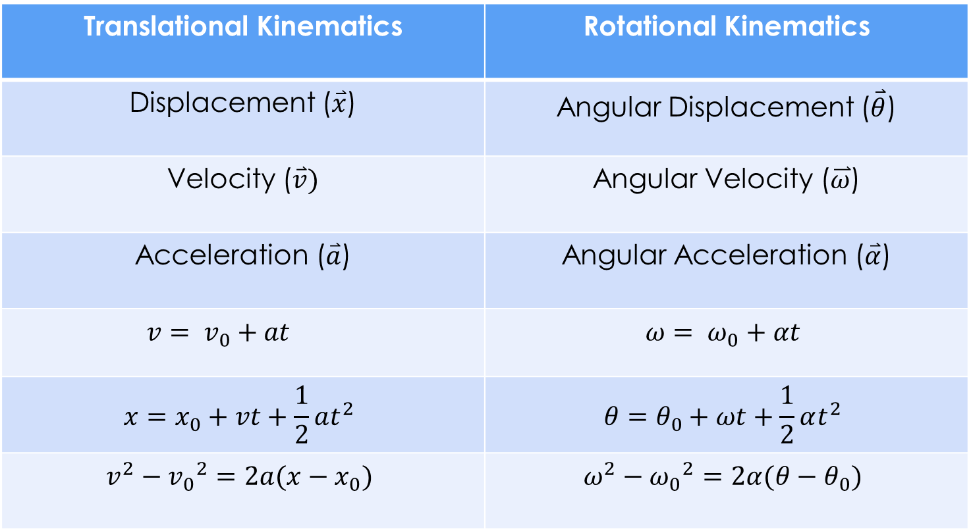
Rotational Kinematics
Translational Kinematics | Rotational Kinematics
Displacement ($\overset{⃑}{x}$) | Angular Displacement ($\overset{⃑}{θ}$)
Velocity ($\overset{⃑}{v})$ | Angular Velocity ($\overset{⃑}{ω}$)
Acceleration ($\overset{⃑}{a}$) | Angular Acceleration ($\overset{⃑}{α}$)
$$v= v_{0}+at$$ | $$ω= ω_{0}+αt$$
$$x=x_{0}+vt+\frac{1}{2}at^{2}$$ | $$θ=θ_{0}+ωt+\frac{1}{2}αt^{2}$$
$$v^{2}−{v_{0}}^{2}=2a(x−x_{0})$$ | $$ω^{2}−{ω_{0}}^{2}=2α(θ−θ_{0})$$

Slide 13

Rotational Dynamics
Moment of Inertia
“Mass” in rotation
Need a rotation axis
Discrete Mass
$$I=\sum_{i}{m_{i}{r_{i}}^{2}} [kg∙m^{2}]$$
Continuous Mass Distribution
$$I=\int{r^{2}dm}$$

Slide 14

Rotational Dynamics
Torque
“Force” in rotation
$$\overset{⃑}{τ}=\overset{⃑}{r}×\overset{⃑}{F} \left[N∙m\right]$$
Determine the magnitude
$$τ=r∙F∙\sin{θ}$$
$$where θ is the angle between \overset{⃑}{r} and \overset{⃑}{F}$$
Determine the direction
Right Hand Rule:
Point your fingers in the direction of $\overset{⃑}{r}$
Curl the fingers so that they follow the direction of $\overset{⃑}{F}$
Your thumb points to the direction of the torque

Slide 15
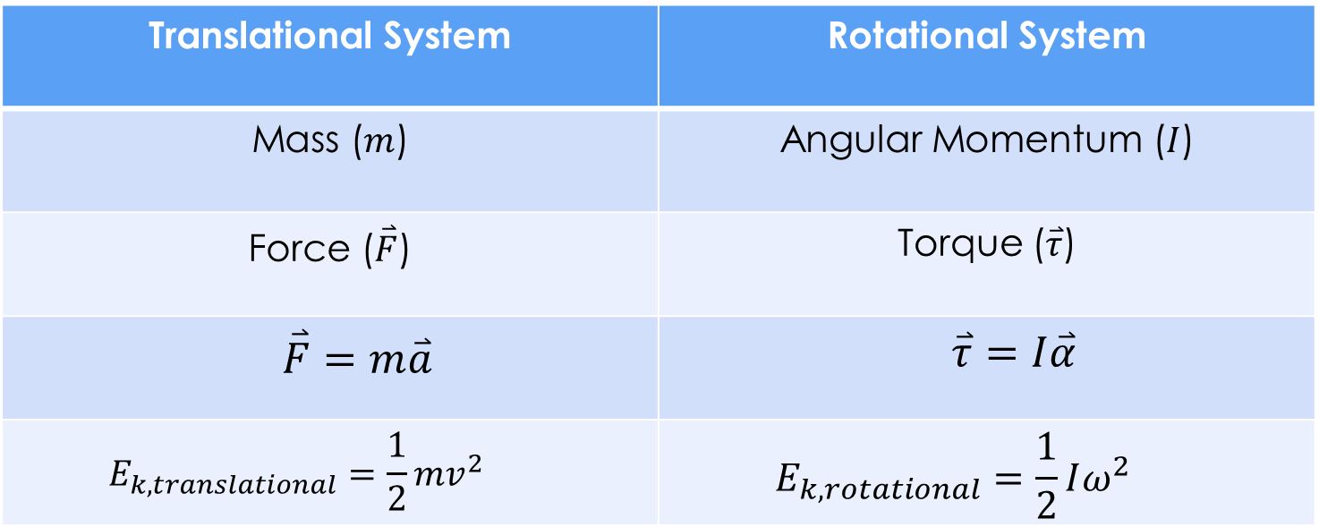
Rotational Kinematics
Translational System | Rotational System
Mass ($m$) | Angular Momentum ($I$)
Force ($\overset{⃑}{F}$) | Torque ($\overset{⃑}{τ}$)
$$\overset{⃑}{F}=m\overset{⃑}{a}$$ | $$\overset{⃑}{τ}=I\overset{⃑}{α}$$
$$E_{k,translational}=\frac{1}{2}mv^{2}$$ | $$E_{k,rotational}=\frac{1}{2}Iω^{2}$$

Slide 16
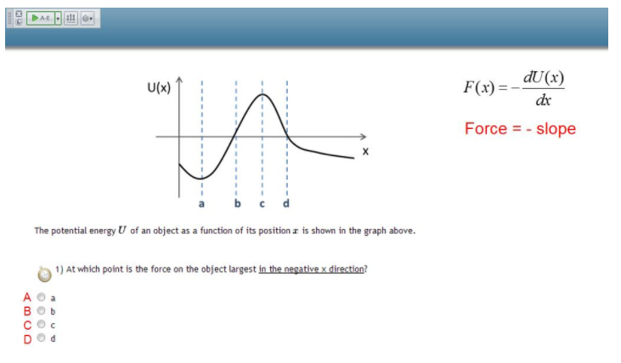
Force and Potential Energy

Slide 17
Force and Potential Energy
Hints
Take note of the equation in the top- right corner.
Consider the slopes at a,b,c,d.

Slide 18
Force and Potential Energy
Solution:
The answer is B:
The slope is most positive here.
This makes the force the most negative.

Slide 19
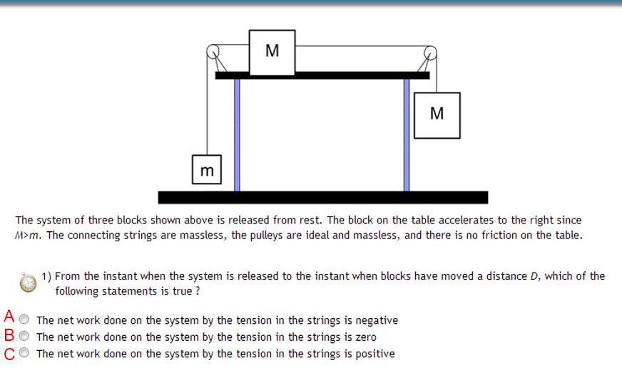
Net Work and Tension

Slide 20
Net Work and Tension
Hints:
How does the potential energy of the system change.
How does the tension contribute to it?
How does tension apply to both ends attached?

Slide 21
Net Work and Tension
Solution:
The answer is B.
The tension applies equally to both ends.
The result you would find mathematically is that the tension works against the system as much as it works for it.

Slide 22
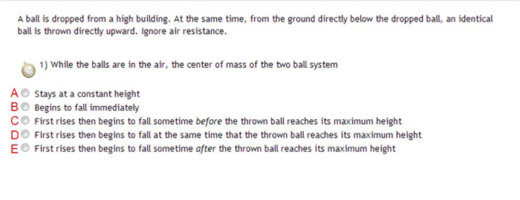
Center of Mass in Motion

Slide 23
Center of Mass in Motion
Hints
What is the systems initial momentum?
What are the ball’s individual momentums?
How do their momentums change over time?

Slide 24
Center of Mass in Motion
Solution:
The answer is C.
The center of mass initially rises because the lower ball has much more upward momentum than the above ball has downward momentum.
The above ball accelerates down while the lower decelerates.
This results in a falling center of mass before the upward moving ball reaches its peak.

Slide 25
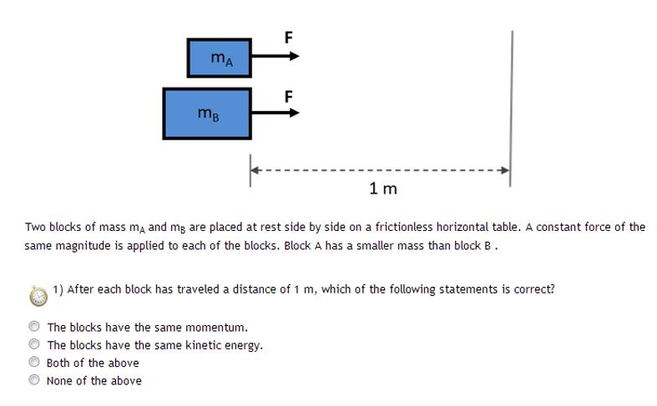
Work Over Distance

Slide 26
Work Over Distance
Hints:
How are force, distance, and work connected for this type of motion?
How does work done correspond to
Momentum
Kinetic energy

Slide 27
Work Over Distance
Solution:
The answer is B.
In this case, Fd=W=KE
Same F, same d, so same kinetic energy.
DON’T confuse force over distance with force over time.
At the same KE with different masses, momentum must differ.

Slide 28
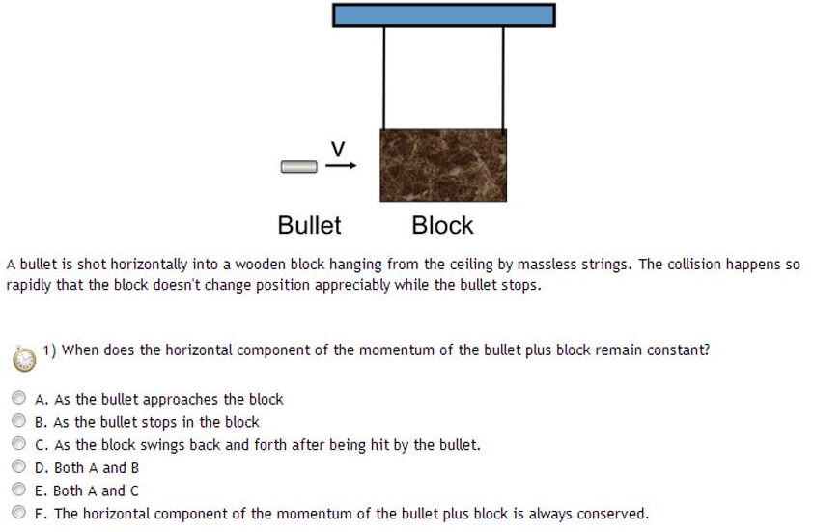
Center of Mass in Collision

Slide 29
Center of Mass in Collision
Hints:
How does momentum change with direction of motion?
How does momentum change when they aren’t in contact?

Slide 30
Center of Mass in Collision
Solution:
The answer is D (A+B).
As the bullet approaches there is no acceleration horizontally (on either).
The collision is stated to not change block position appreciably.
The back and forth motion is a clear change of momentum.

Slide 31
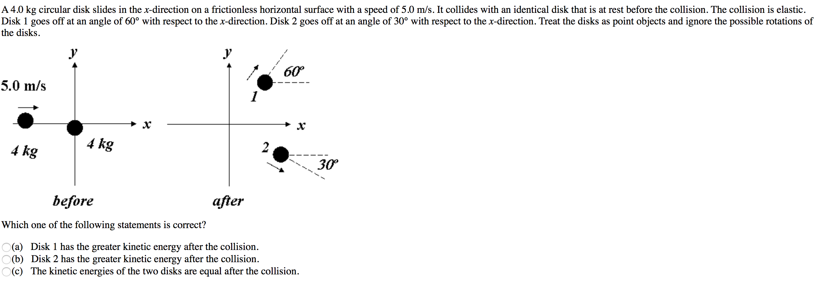
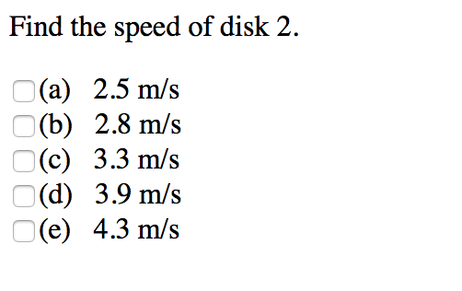
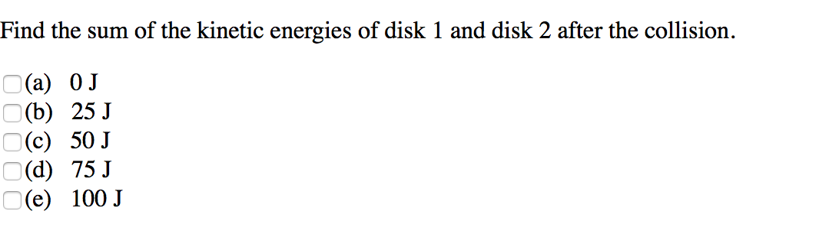
Collision (Spring 2010 #3)

Slide 32
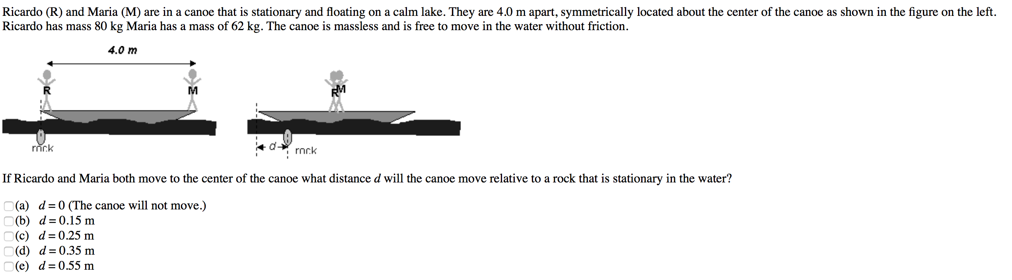
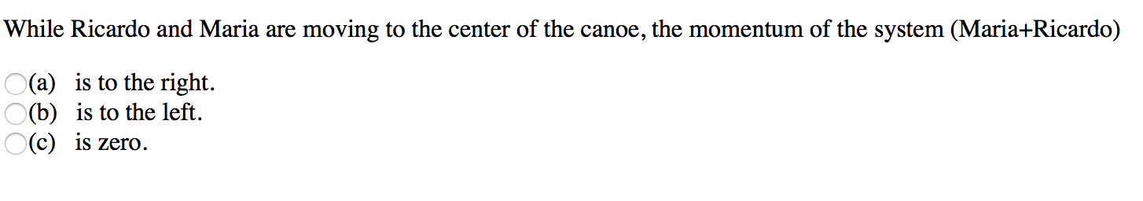
Spring 2010 #8

Slide 33
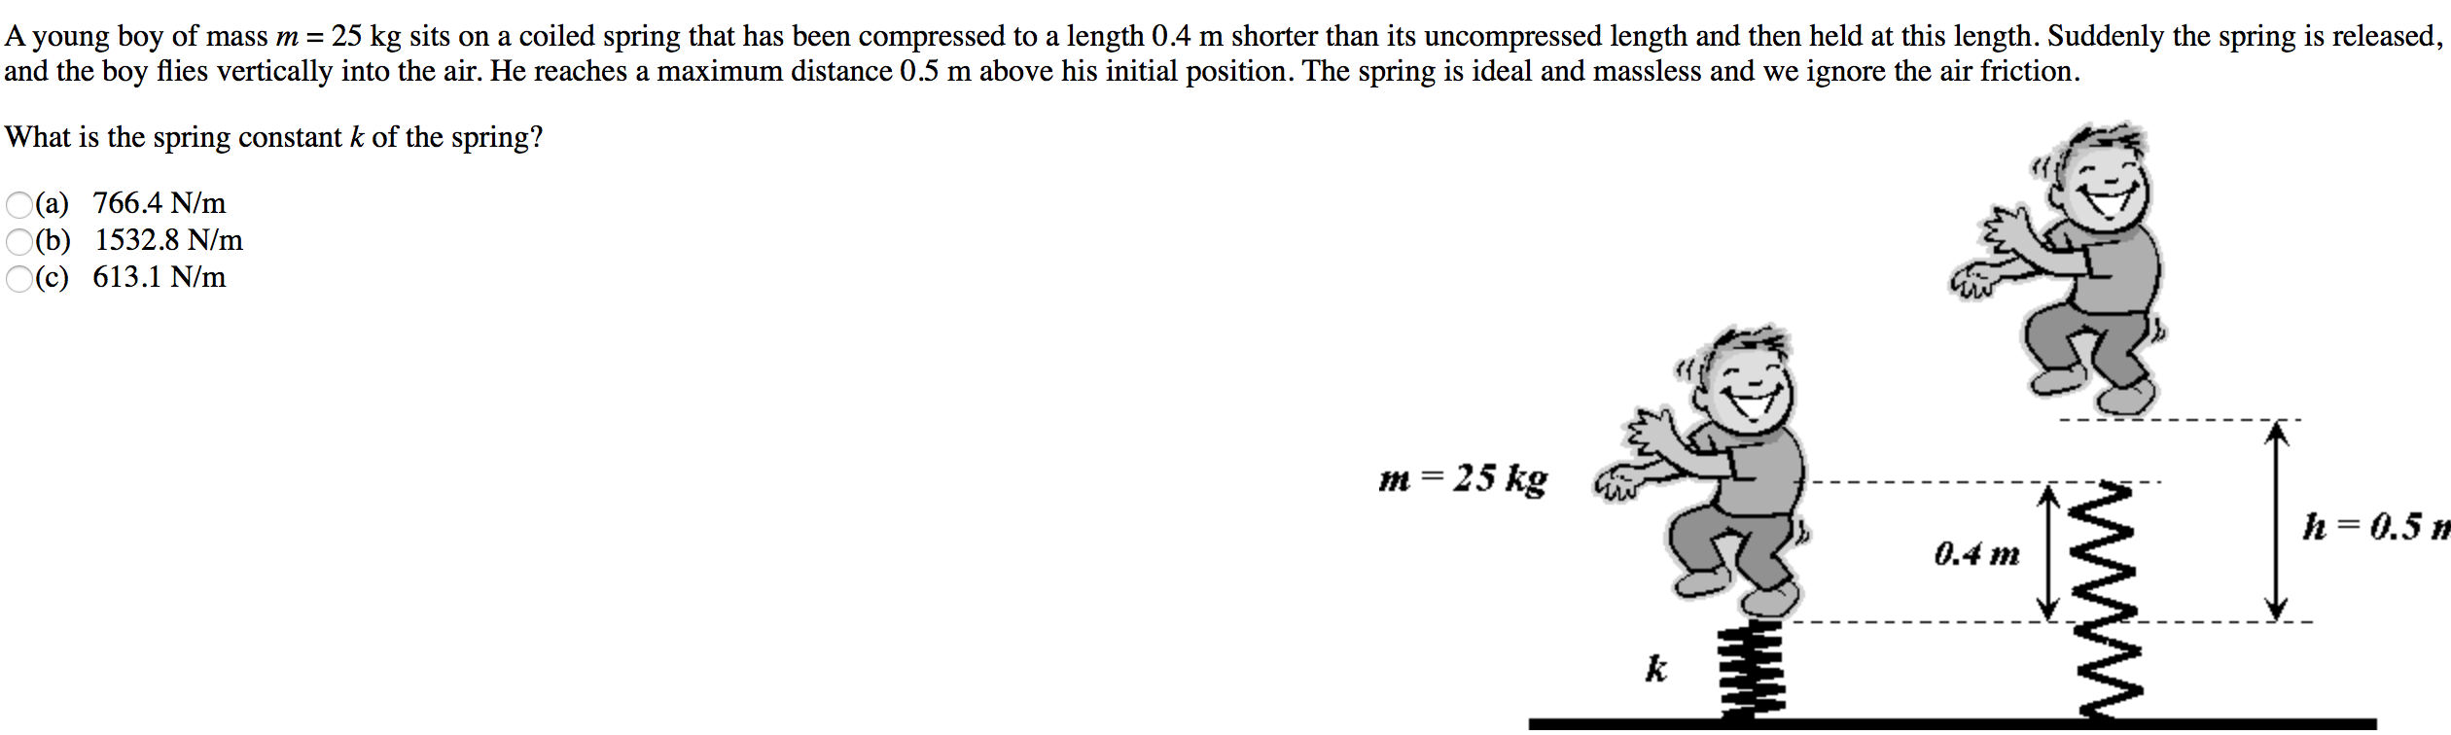
Work and Energy (Spring 2010 #13

Slide 34
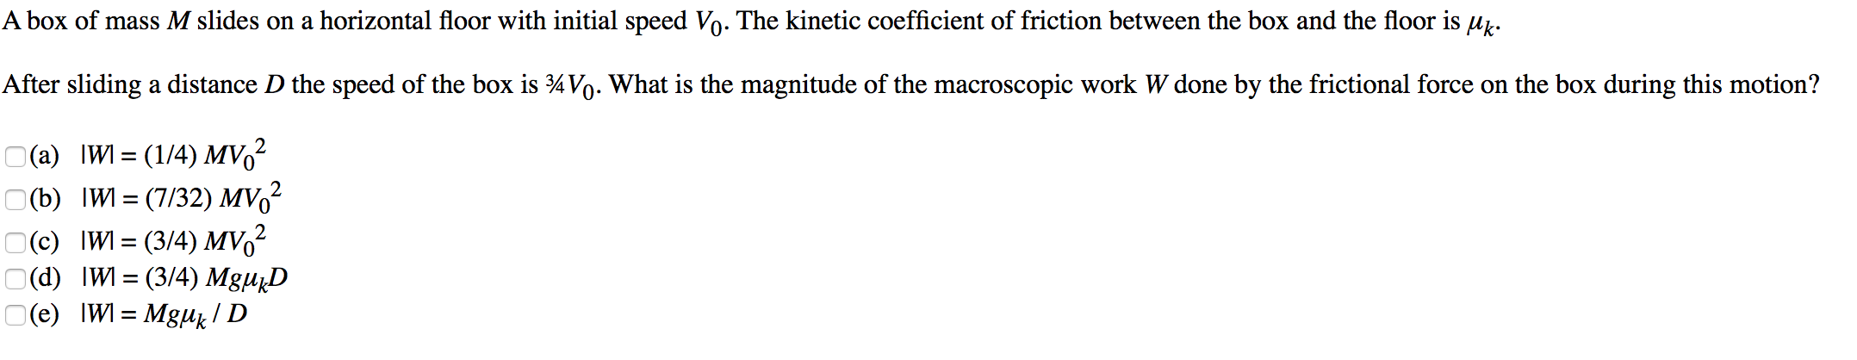
Work and Energy (Spring 2010#21,22)

