Slide 1
HKN ECE 110 Exam 2 Review Session
Eric Dong, Elisa Krause, Alex Sun, Daksh Varshney

Slide 2

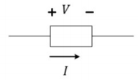
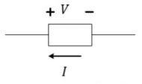
Standard VS Non-Standard Labeling
Notes:
Eric

Slide 3

Root Mean Square
Notes:
Eric

Slide 4

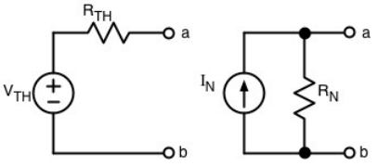
Thevenin, Norton, and IV Relationships
Notes:
Elisa

Slide 5

Node Voltage Method
Notes:
Alex

Slide 6
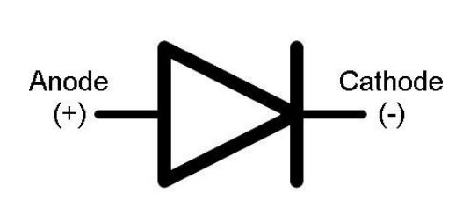
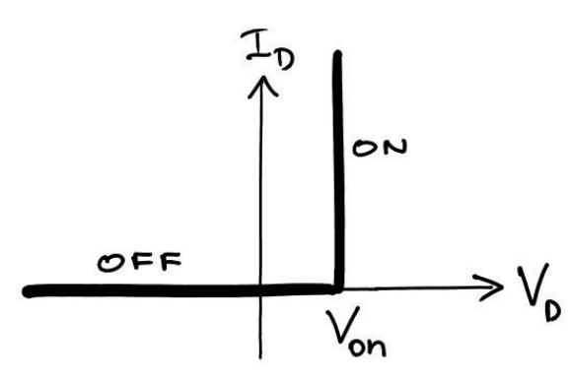
Diodes
Diodes are nonlinear devices that allow current to pass in only one direction
Offset-Ideal Model
How do we know if a diode is on? Guess and Check!
If we guess off, we say the current is zero and 𝑉D < 𝑉 on
Guess on, positive current flows and 𝑉 on volts are across diode
If our guess is wrong, one of these conditions will be violated
E.g. We guess on, but reverse current flows through the diode
Clipper circuits
Notes:
Daksh

Slide 7
Exam Advice
Do not spend too much time on questions you cannot answer
Spend your time showing what you know
Look at past exams
Take time to relax before your exam
Notes:
Daksh

Slide 8

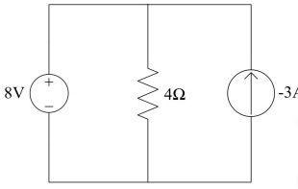
Find Power?
Notes:
Eric and question 4 on the handout

Slide 9
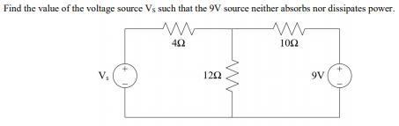
Sources and Power
Notes:
Alex Also question #2 on the handout

Slide 10

Vrms, Pavg
Notes:
Elisa- also q3 on handout

Slide 11

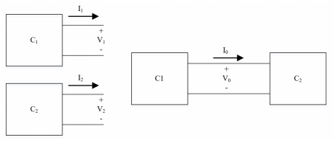
IV Characteristic Question
Notes:
Daksh - q5 on handout

