Slide 1
ECE 210 Exam 1 Review Session
Alan Liu
Tejus Kurdukar
Caleb Kong
hkn.illinois.edu

Slide 2
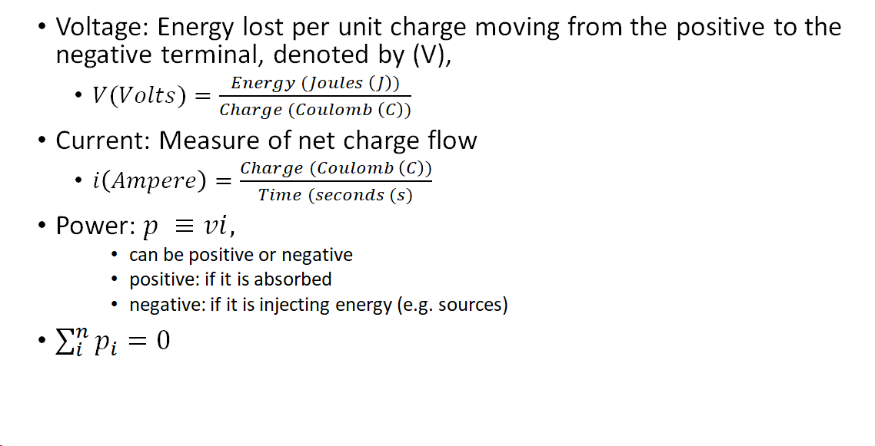
Basic Terminology

Slide 3
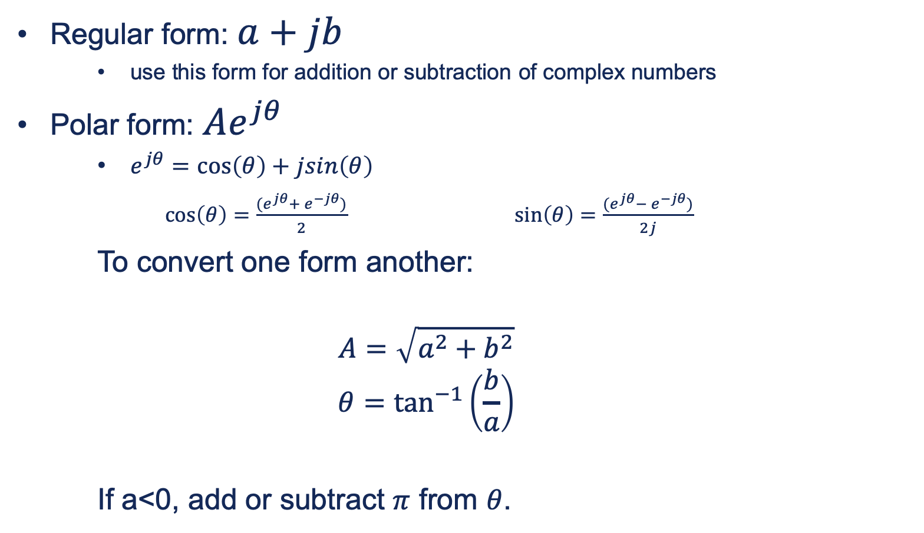
Complex Numbers
Regular form: $a+jb$
use this form for addition or subtraction of complex numbers
Polar form: $Ae^{jθ}$
$e^{jθ}=\cos\left(θ\right)+jsin\left(θ\right)$
$\cos\left(θ\right)=\frac{{{(e}^{jθ}+ e}^{−jθ})}{2}$ $\sin\left(θ\right)=\frac{{{(e}^{jθ}− e}^{−jθ})}{2j}$
To convert one form another:
$$A=\sqrt{a^{2}+b^{2}}$$
$$θ=\tan^{−1}\left(\frac{b}{a}\right)$$
If a<0, add or subtract $π$ from $θ$.

Slide 4
Complex Numbers
Simplify and express your answer in the form you prefer
$\frac{1+j}{1−j}$
Find the magnitude and phase
${(1+j)}^{4}$

Slide 5
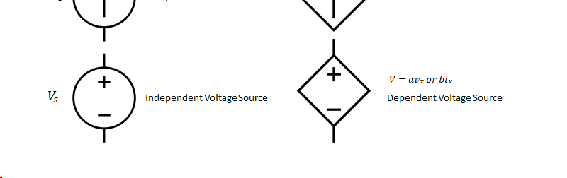
Basic Circuit Elements: Sources

Slide 6
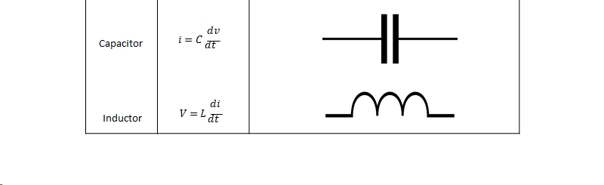
Basic Circuit Elements:

Slide 7
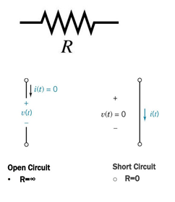

Circuit Basics
Short: zero resistance
Open: INFINITE resistance
For inductors and capacitors:
$i=C\frac{dv}{dt}$ $v=L\frac{di}{dt}$

Slide 8
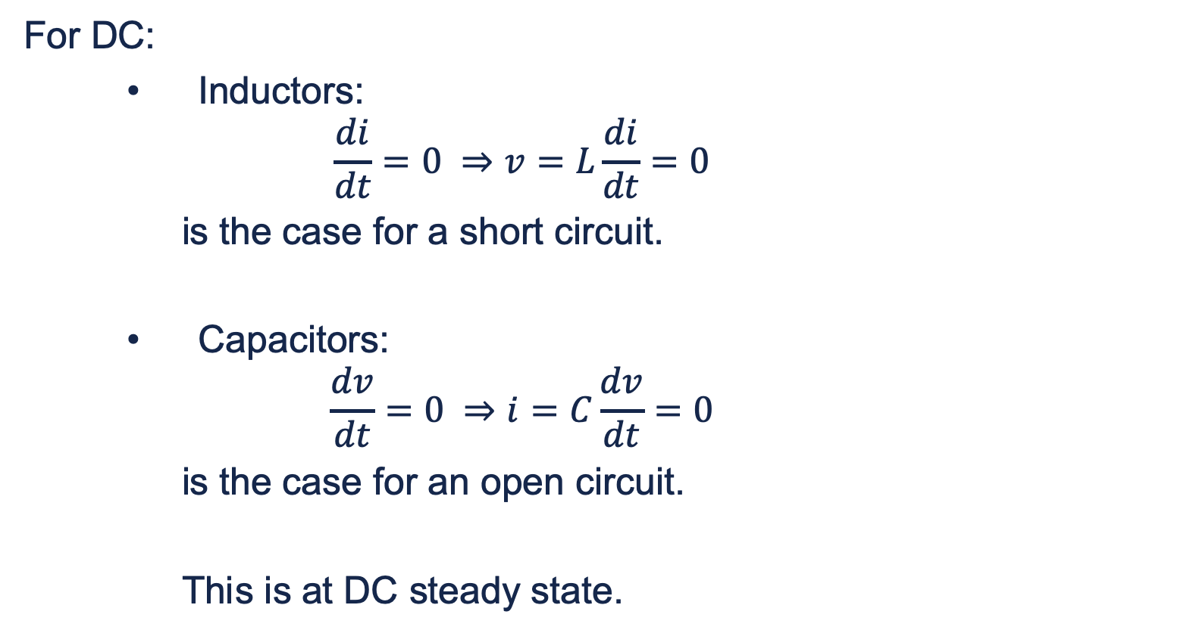
Circuit Basics
For DC:
Inductors:
$$\frac{di}{dt}=0 ⇒v=L\frac{di}{dt}=0$$
is the case for a short circuit.
Capacitors:
$$\frac{dv}{dt}=0 ⇒i=C\frac{dv}{dt}=0$$
is the case for an open circuit.
This is at DC steady state.

Slide 9
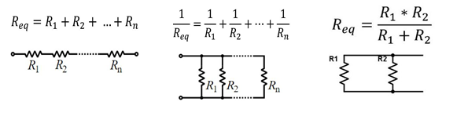
Combinations
Series: same current through element
Parallel: same voltage across element
Notes:
neo

Slide 10
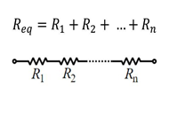
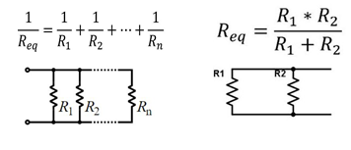

Voltage and Current Divider
$V_{k}=V_{Total}\left(\frac{R_{k}}{R_{eq}}\right)$ $I_{k}=V_{Total}\left(\frac{R_{eq}}{R_{k}}\right)$

Slide 11
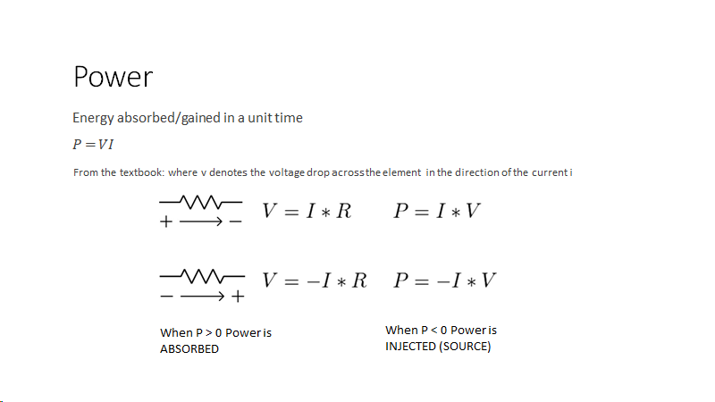

Slide 12
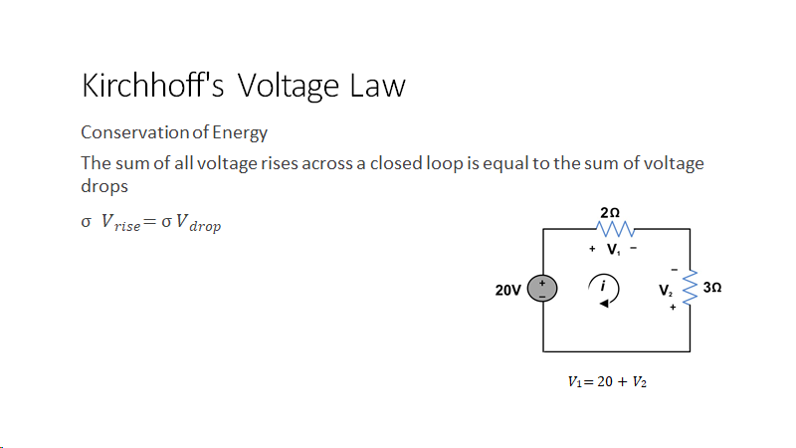
Notes:
anna

Slide 13
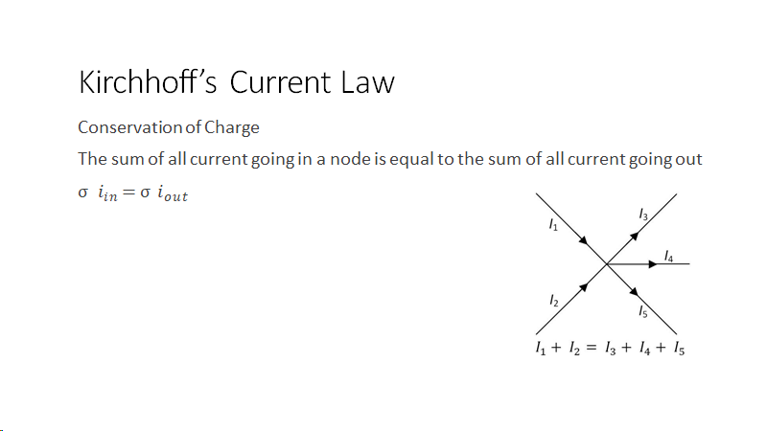

Slide 14
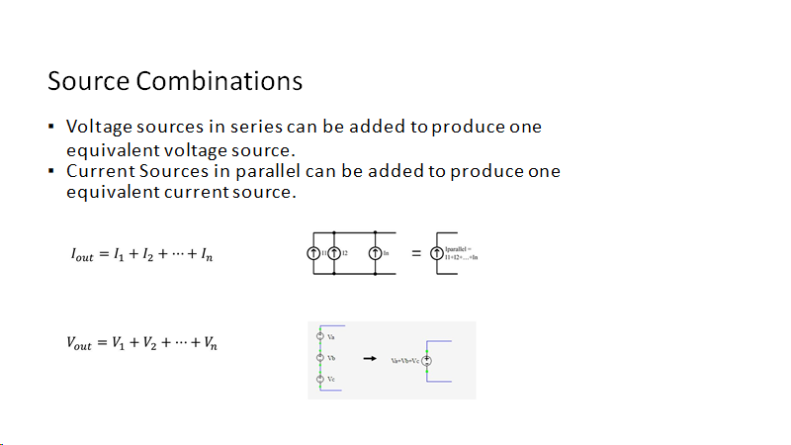

Slide 15
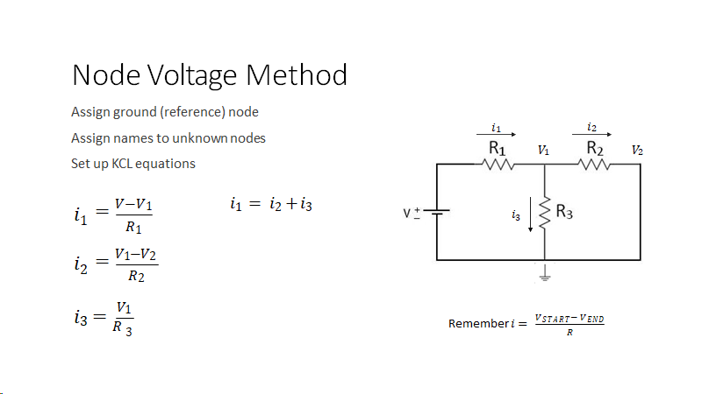
Notes:
anna

Slide 16
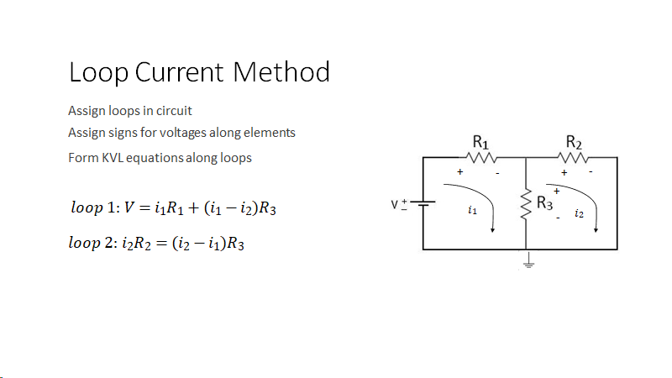
Notes:
neo

Slide 17
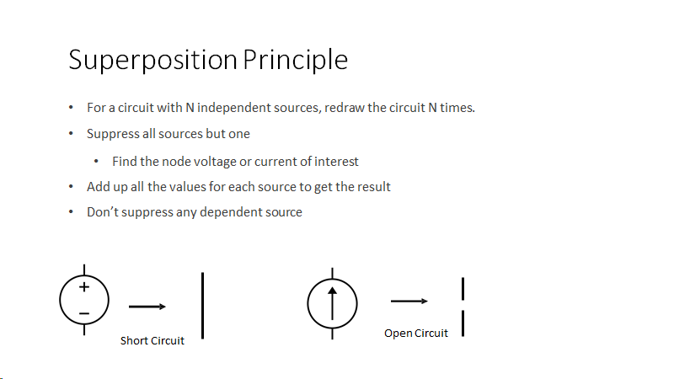

Slide 18
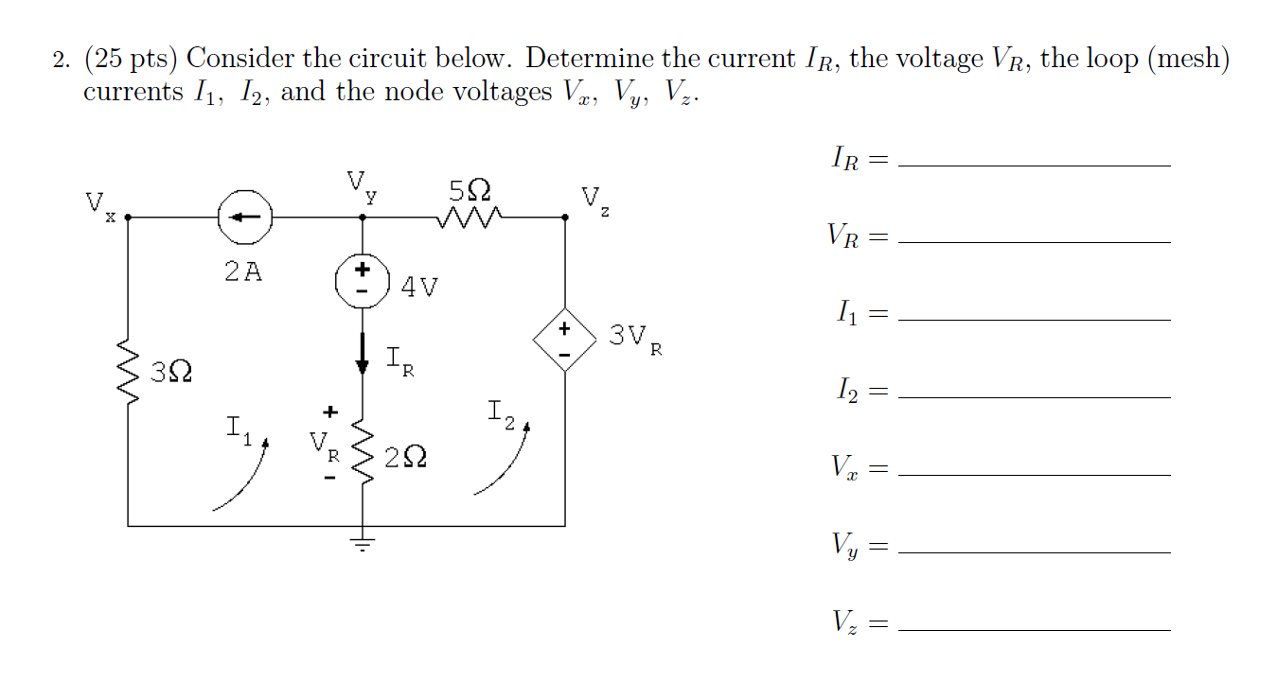
Fall 2017 Q2
Notes:
sanat

Slide 19
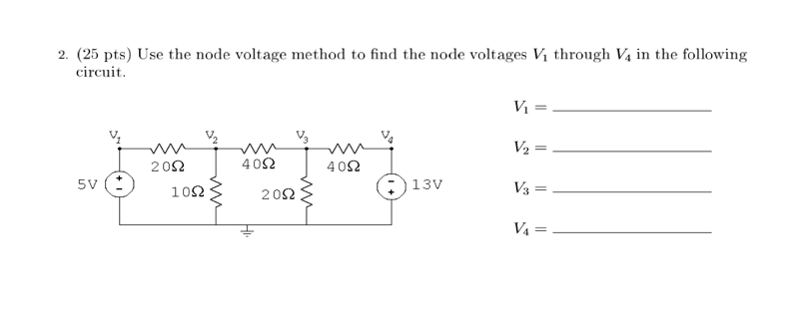
Spring 2016 Q2
Notes:
sanat

Slide 20
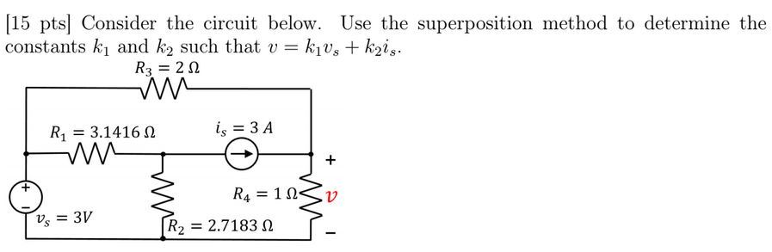
Spring 20

Slide 21
Thevenin and Norton Equivalent Circuits
Notes:
sanat

Slide 22
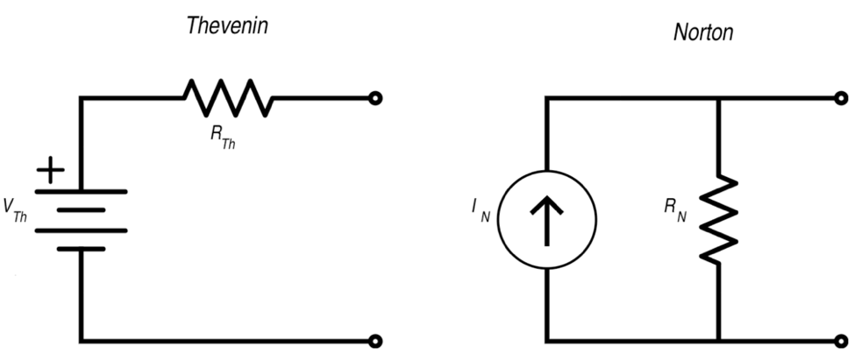

Main Idea and Important Details
Equivalent circuits
$V_{T}=I_{N}R_{T}$
$V_{T}$ $=V_{OC}=$ Open Circuit Voltage
$I_{N}=I_{SC}=$ Short Circuit Current
$R_{T} =R_{N}$

Slide 23
To get R_{T} directly
1.Source suppression of INDEPENDENT only
a. short circuit independent voltage sources
b. remove/unplug independent current sources
2. Inject 1A into the terminal (a)
3. Solve this circuit to find the V_{ab}
4. Change the units of V_{ab} from Volts (V) to Ohm(Ω)

Slide 24
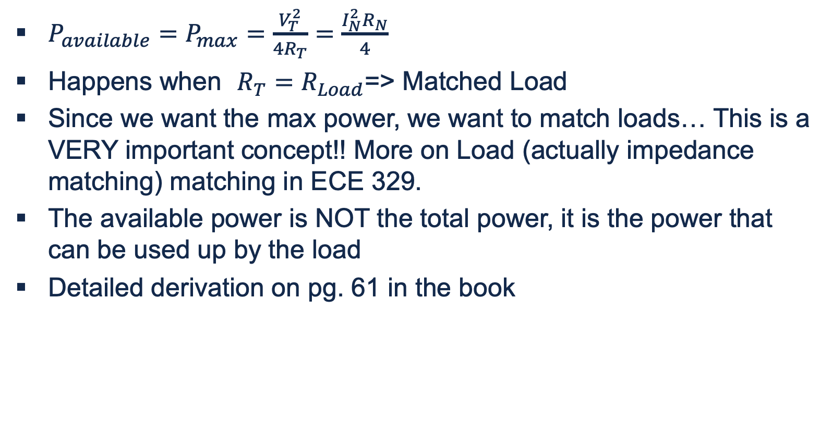
Available and Max Power
$P_{available}=P_{max}=\frac{V_{T}^{2}}{4R_{T}}=\frac{I_{N}^{2}R_{N}}{4}$
Happens when $R_{T}=R_{Load}$=> Matched Load
Since we want the max power, we want to match loads… This is a VERY important concept!! More on Load (actually impedance matching) matching in ECE 329.
The available power is NOT the total power, it is the power that can be used up by the load
Detailed derivation on pg. 61 in the book

Slide 25
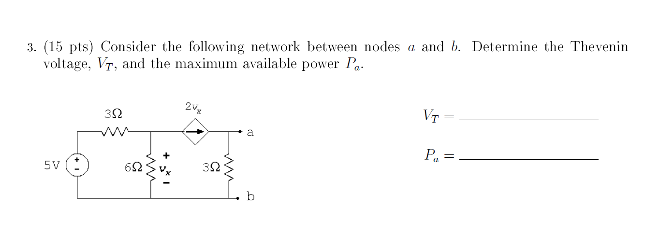
Spring 2016
Notes:
neo

Slide 26
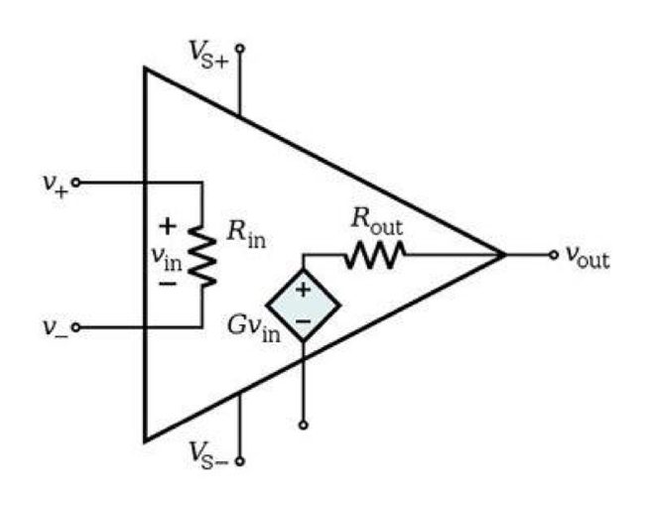
Operational Amplifier (Op-Amp)
Notes:
neo

Slide 27

Ideal Op-amp
Assume :
1.R_{in} is large => I₊ = I₋ = 0
2.R_{out}is small => V₊ = V₋
Note: NEVER do KCL on the ground node of the op amp as there other components inside the op amp as seen in the diagram

Slide 28
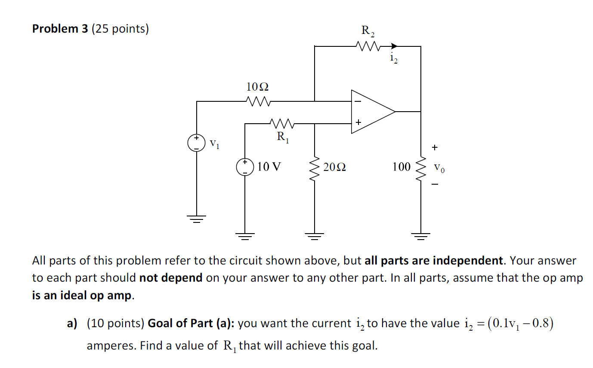
Fall 15
Notes:
sanat

Slide 29
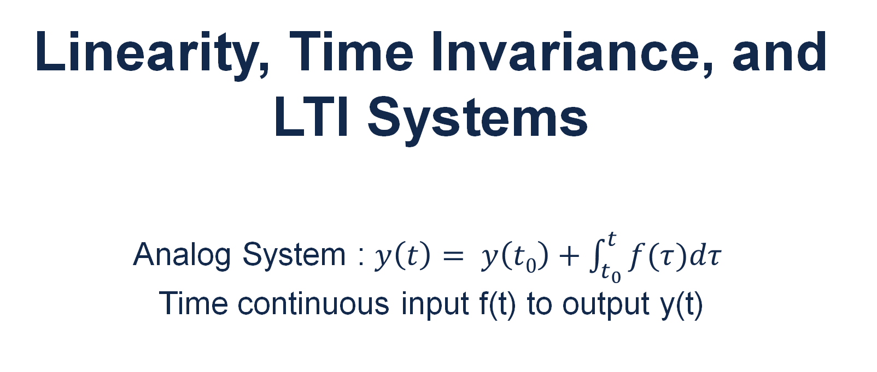
Linearity, Time Invariance, and LTI Systems
Analog System : $y\left(t\right)= y\left(t0\right)+\int_{t_{0}}^{t}{f(τ})dτ$ Time continuous input f(t) to output y(t)
Notes:
anna

Slide 30

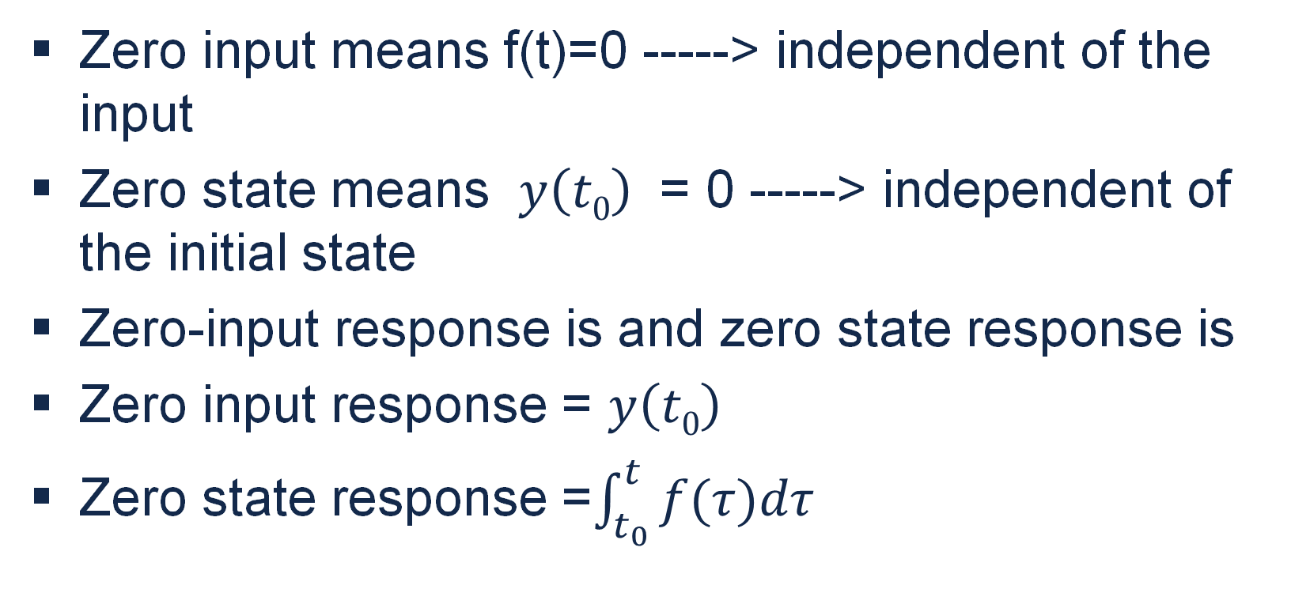
$$y\left(t\right)= y\left(t0\right)+\int_{t_{0}}^{t}{f(τ})dτ$$
Zero input means f(t)=0 -----> independent of the input
Zero state means $y\left(t0\right)$ = 0 -----> independent of the initial state
Zero-input response is and zero state response is
Zero input response = $y\left(t0\right)$
Zero state response =$\int_{t_{0}}^{t}{f(τ})dτ$

Slide 31
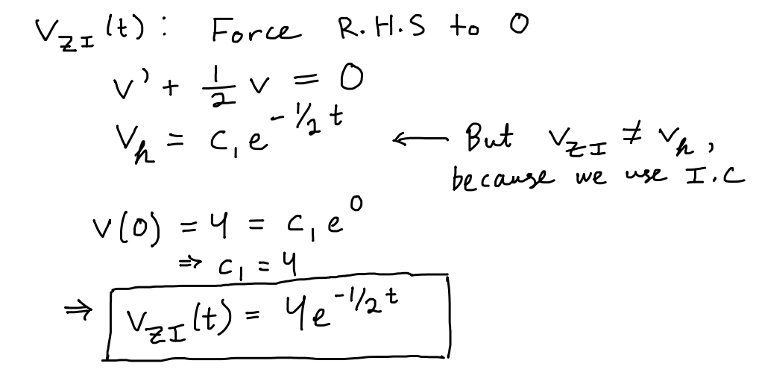
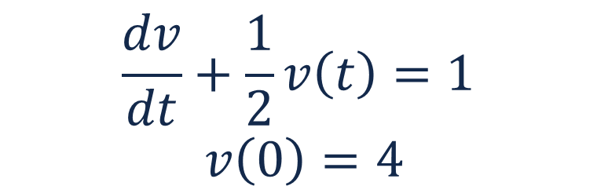
Zero State/Zero Input Example
$$\frac{dv}{dt}+\frac{1}{2}v\left(t\right)=1$$
$$v\left(0\right)=4$$

Slide 32
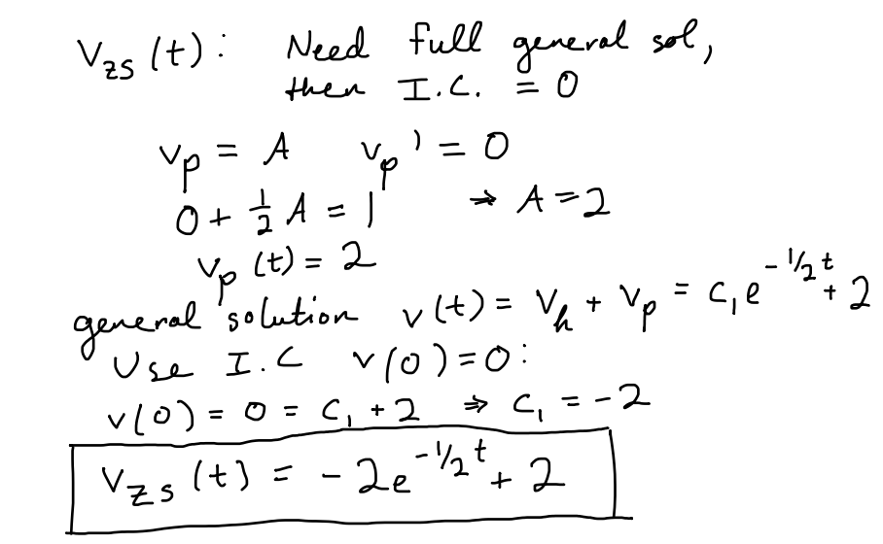
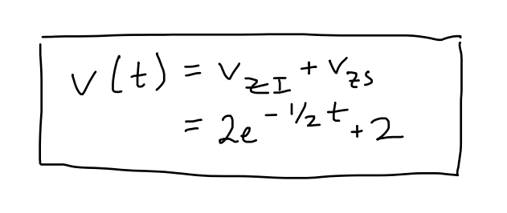
Zero State/Zero Input Example
$$\frac{dv}{dt}+\frac{1}{2}v\left(t\right)=1$$
$$v\left(0\right)=4$$

Slide 33



Linearity
“A system is said to be linear if its output is a sum of distinct zero input and zero state responses that vary linearly with the initial state of the system and linearly with the system input, respectively”
Zero State Linearity: response varies linearly with the input
Zero Input Linearity: similar concept different name
Notes:
F(t) → system → (f^2(t)) NOT linear

Slide 34
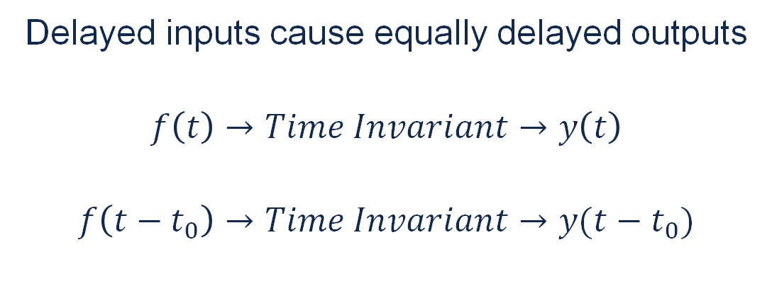
Time Invariance
Delayed inputs cause equally delayed outputs
$$f\left(t\right)→Time Invariant→y\left(t\right)$$
$$f\left(t−t_{0}\right)→Time Invariant→y(t−t_{0})$$

Slide 35
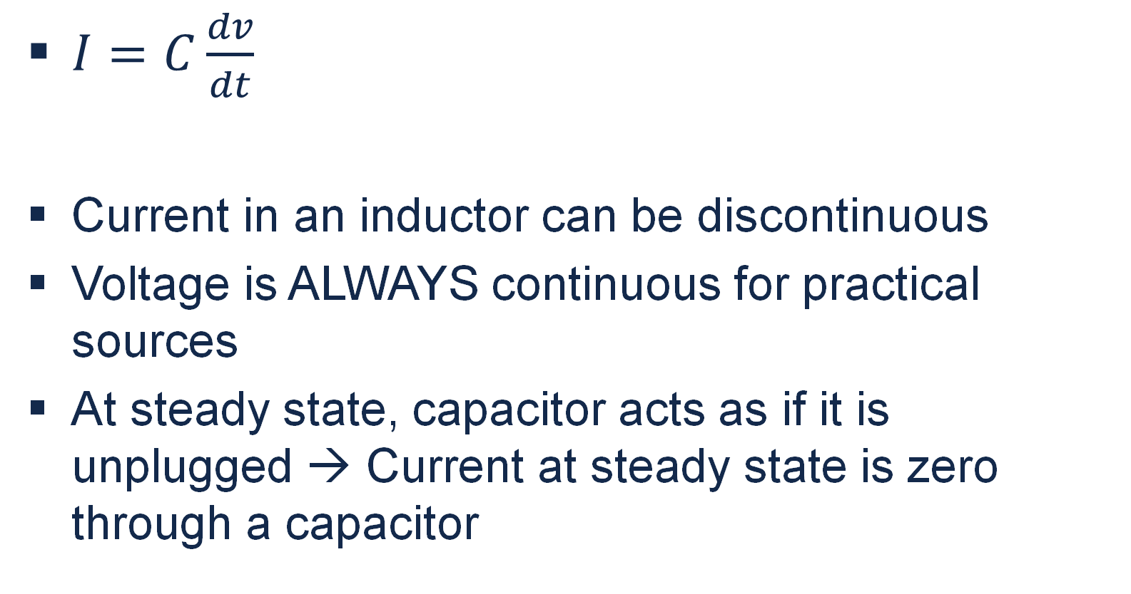
Capacitor
$I=C\frac{dv}{dt}$
Current in an inductor can be discontinuous
Voltage is ALWAYS continuous for practical sources
At steady state, capacitor acts as if it is unplugged → Current at steady state is zero through a capacitor
Notes:
Neo

Slide 36
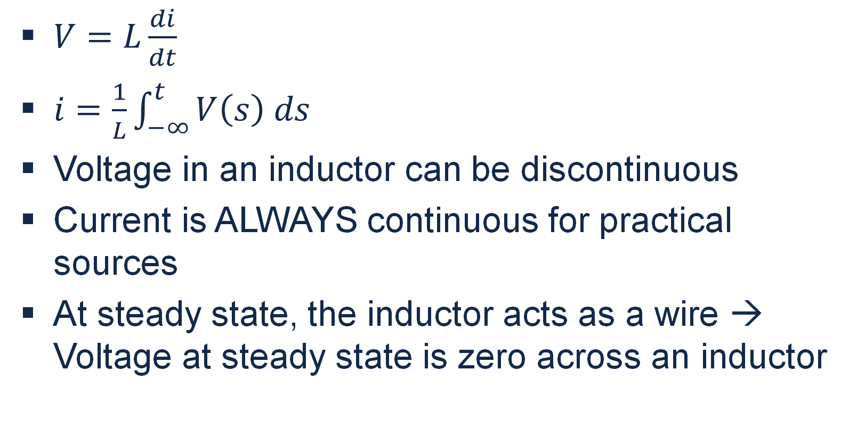
Inductor
$V=L\frac{di}{dt}$
$i=\frac{1}{L}\int_{−∞}^{t}{V\left(s\right) ds}$
Voltage in an inductor can be discontinuous
Current is ALWAYS continuous for practical sources
At steady state, the inductor acts as a wire → Voltage at steady state is zero across an inductor

Slide 37
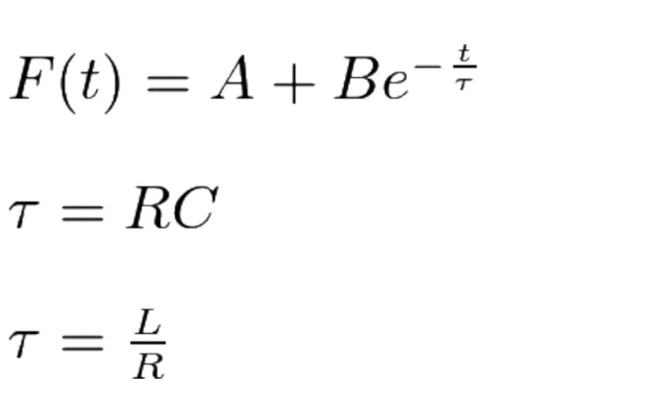
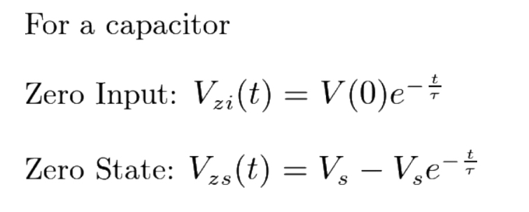
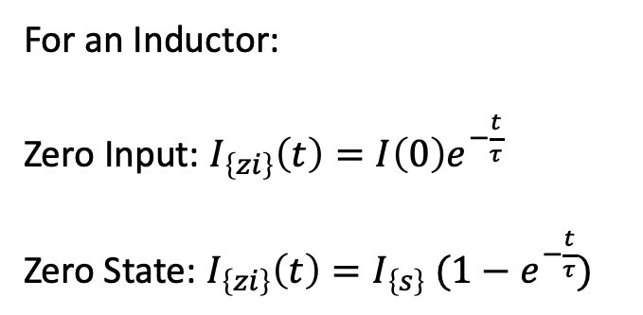
First Order RC and RL Circuits
For an Inductor:
Zero Input: $I_{\left\{zi\right\}}\left(t\right)=I\left(0\right)e^{−\frac{t}{τ}}$
Zero State: $I_{\left\{zi\right\}}\left(t\right)=I_{\left\{s\right\}} (1−e^{−\frac{t}{τ}})$

Slide 38
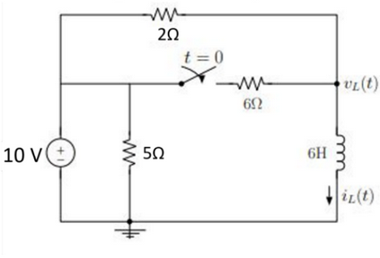
Fall 20

Slide 39
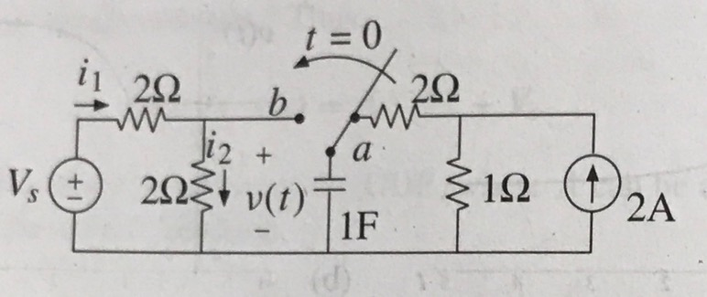
Example 3.13 and 3.14(pg. 95) from the book
Consider the circuit shown in the figure below. The switch is closed at t=0 from position a to b, bringing the capacitor into the left side of the network. Assuming that the capacitor is in the DC state when the switch is moved, calculate voltage v(t) for t>0. Also calculate i₁(t) and i₂(t).
Notes:
sanat

Slide 41
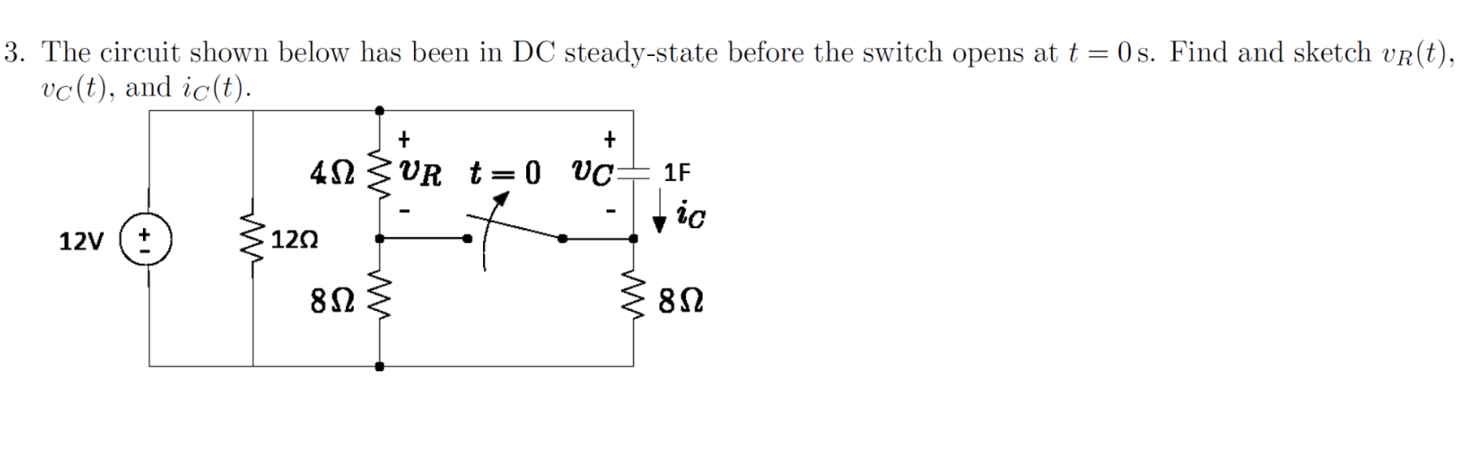
Steady-State Circuit
Notes:
anna

Slide 42
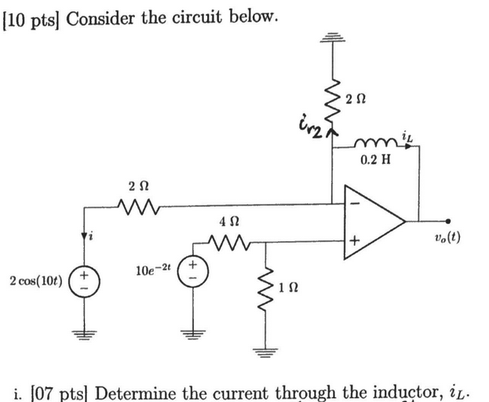
Spring 20

Slide 43
Exam Advice
Don’t panic, just keep on moving
Make sure you are in the right mindset going into the exam
Spend your time showing what you know
Check the whole test for easy points when short on time
DON’T CHEAT
Notes:
sanat

