Slide 1
HKN ECE 342 Review Session 1
Sanat pandey
Marwan eladi

Slide 2
KVL/KCL
Sum of all voltages in a loop is 0
Sum of current entering a node equals sum of current exiting a node
Notes:
Keshav

Slide 3
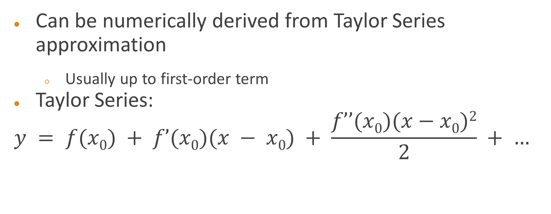
Incremental/Small Signal Model
Can be numerically derived from Taylor Series approximation
Usually up to first-order term
Taylor Series:
$$y = f(x0) + f’(x0)(x − x0) + \frac{f’’(x0)(x−x0)2}{2} + …$$
Notes:
Anthony, Diode incrementally looks like resistor with resistance Vt/Id

Slide 4
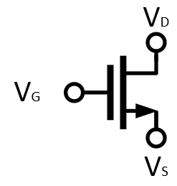
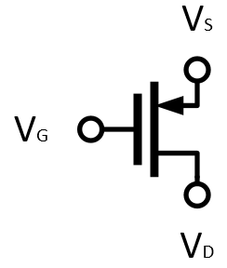
MOSFET’s
NMOS
PMOS
Notes:
Keshav

Slide 5
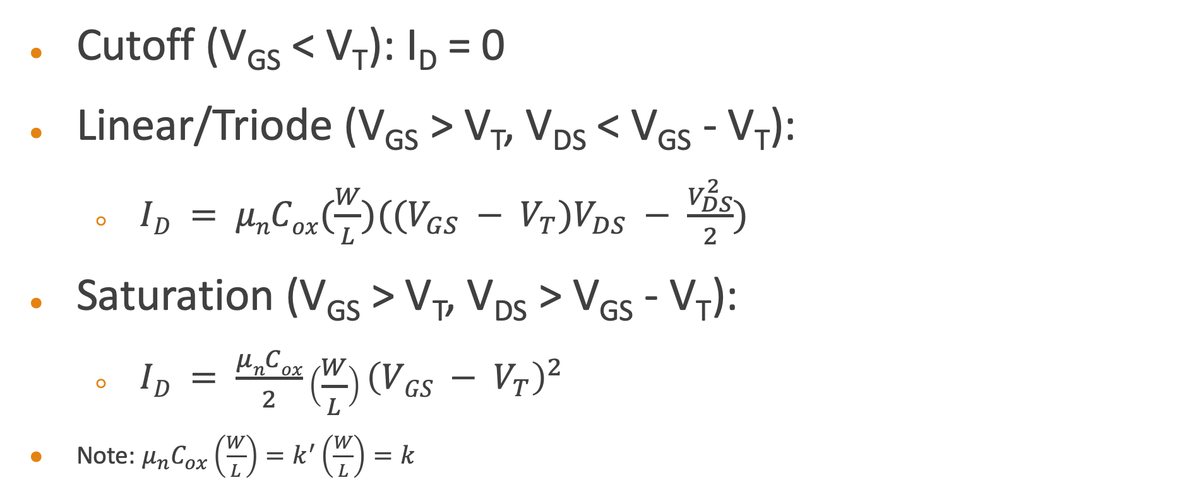
MOSFET Operating Point
Cutoff (V_{GS} < V_{T}): I_{D} = 0
Linear/Triode (V_{GS} > V_{T}, V_{DS} < V_{GS} - V_{T}):
$ID = μnCox(\frac{W}{L})((V_{GS} − V_{T})V_{DS} − \frac{V_{DS}^{2}}{2})$
Saturation (V_{GS} > V_{T}, V_{DS} > V_{GS} - V_{T}):
$ID = \frac{μnCox}{2}\left(\frac{W}{L}\right){\left(VGS − V_{T}\right)}^{2}$
Note: $μ_{n}C_{ox}\left(\frac{W}{L}\right)=k^{′}\left(\frac{W}{L}\right)=k$
Notes:
Keshav

Slide 6
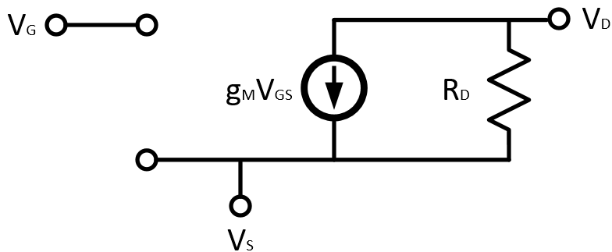

MOSFET Incremental Model
Transconductance: $g_{m}=\frac{2I_{D}}{V_{OV}}$
Notes:
Keshav

Slide 7
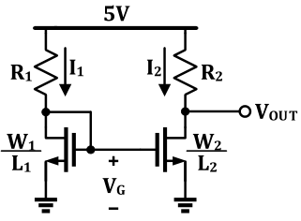

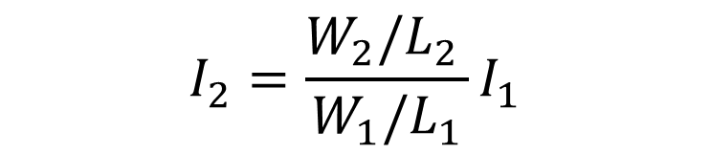
Current Mirrors
Transistors sharing the same $V_{OV}$ “mirror” current – just a ratio of transistor sizing.
$$I_{2}=\frac{W_{2}/L_{2 }}{W_{1}/L_{1}}I_{1}$$
Notes:
Anthony

Slide 8
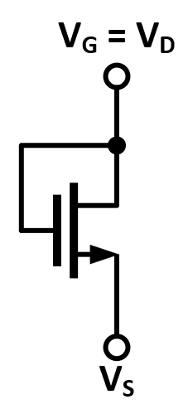
Diode-Tied Transistor
Special case when gate is shorted to drain
Behaves like a resistor
Always operating in saturation regime
Notes:
Anthony

Slide 9
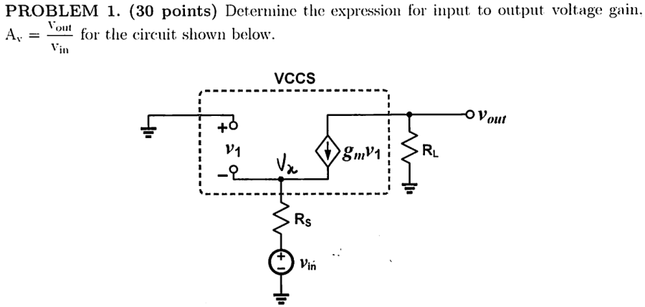
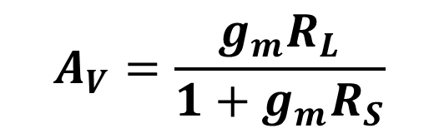
Problem 1 – Sp16 Midterm 1
$$A_{V}=\frac{g_{m}R_{L}}{1+g_{m}R_{S}}$$
Notes:
Keshav

Slide 10
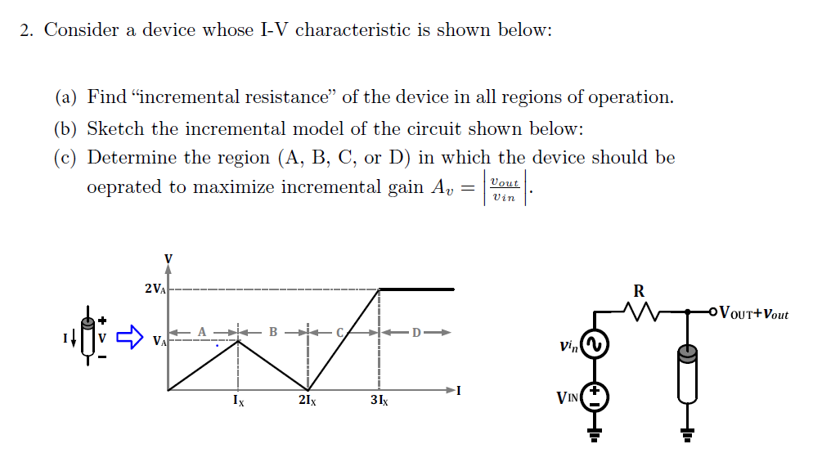
Problem 2
Notes:
Anthony

Slide 11
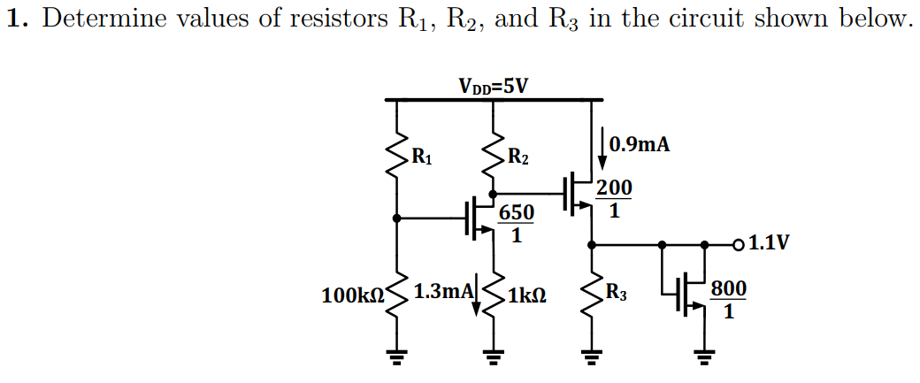
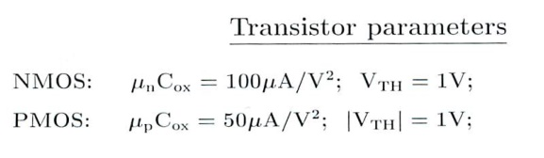

Problem 3
$$R_{1}=100 kΩ$$
$$R_{2}=2 kΩ$$
$$R_{3}=2.2 kΩ$$
Notes:
Keshav

Slide 12
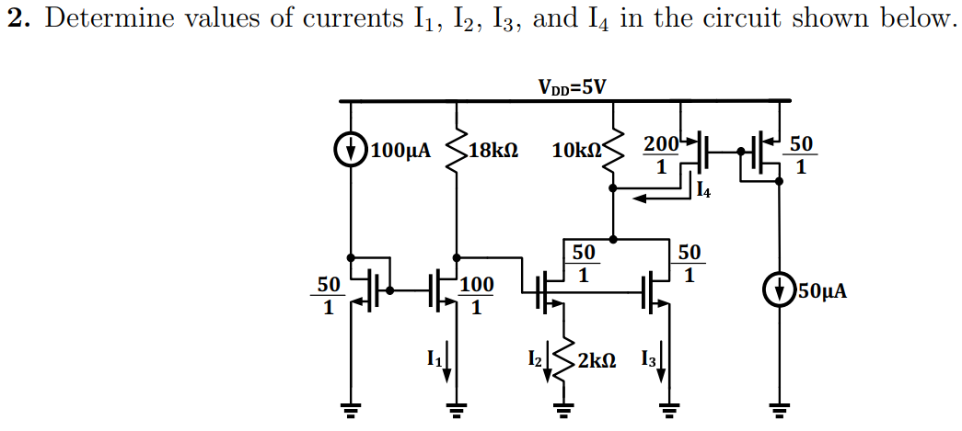

Problem 4
$$I_{1}=200 μA$$
$$I_{2}=100 μA$$
$$I_{3}=400 μA$$
$$I_{4}=200 μA$$
Notes:
Anthony

Slide 13
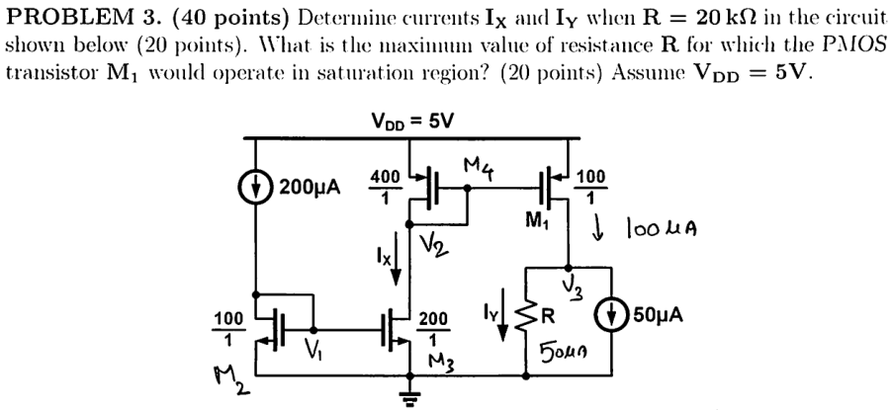

Problem 5 – Sp16 Midterm 1
$$I_{X}=400 μA$$
$$I_{Y}=50 μA$$
$$R_{max}=96 kΩ$$
Notes:
Keshav

Slide 14
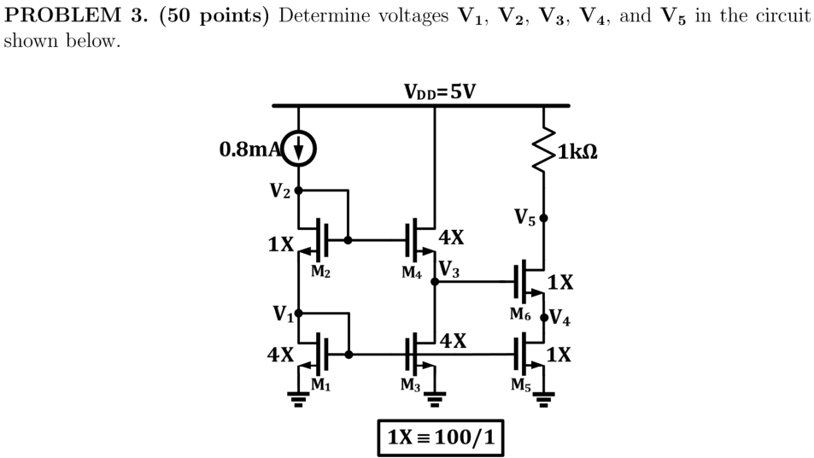
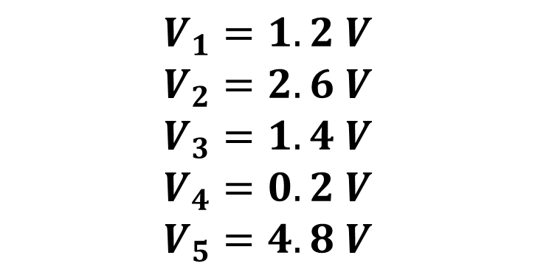
Problem 6 – Fa16 Midterm 1
$$V_{1}=1.2 V$$
$$V_{2}=2.6 V$$
$$V_{3}=1.4 V$$
$$V_{4}=0.2 V$$
$$V_{5}=4.8 V$$
Notes:
Anthony

Slide 15
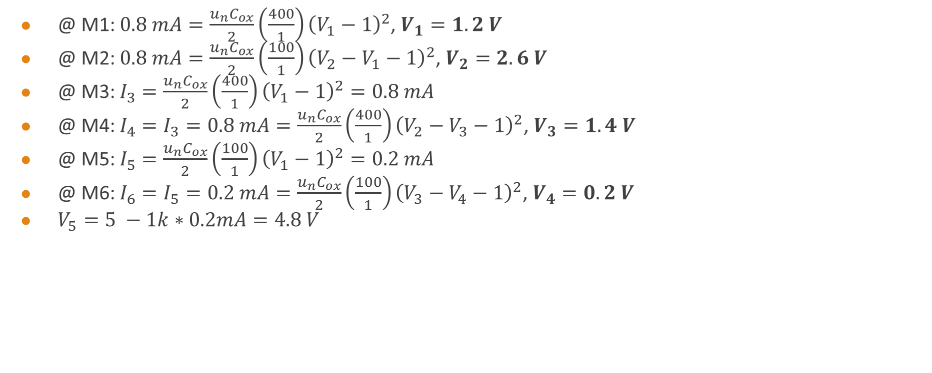
Problem 6 Solution
@ M1: $0.8 mA=\frac{u_{n}C_{ox}}{2}\left(\frac{400}{1}\right){\left(V_{1}−1\right)}^{2}$, $V_{1}=1.2 V$
@ M2: $0.8 mA=\frac{u_{n}C_{ox}}{2}\left(\frac{100}{1}\right){\left(V_{2}−V_{1}−1\right)}^{2}$, $V_{2}=2.6 V$
@ M3: $I_{3}=\frac{u_{n}C_{ox}}{2}\left(\frac{400}{1}\right){\left(V_{1}−1\right)}^{2}=0.8 mA$
@ M4: $I_{4}=I_{3}=0.8 mA=\frac{u_{n}C_{ox}}{2}\left(\frac{400}{1}\right){\left(V_{2}−V_{3}−1\right)}^{2}$, $V_{3}=1.4 V$
@ M5: $I_{5}=\frac{u_{n}C_{ox}}{2}\left(\frac{100}{1}\right){\left(V_{1}−1\right)}^{2}=0.2 mA$
@ M6: $I_{6}=I_{5}=0.2 mA=\frac{u_{n}C_{ox}}{2}\left(\frac{100}{1}\right){\left(V_{3}−V_{4}−1\right)}^{2}$, $V_{4}=0.2 V$
$V_{5}=5 −1k∗0.2mA=4.8 V$

Slide 16
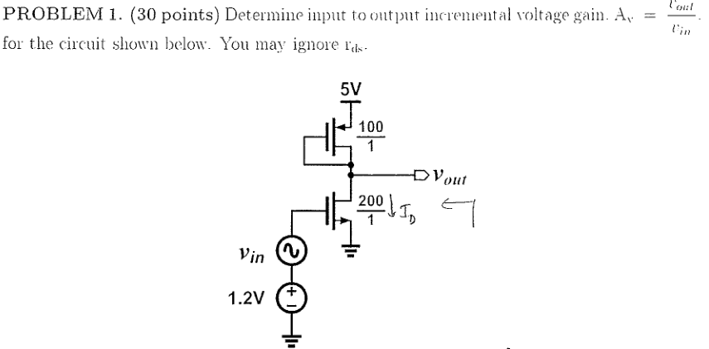

Problem 7 – Sp16 Midterm 2
$A_{V}=−2\frac{V}{V}$
Notes:
Anthony

