Slide 1

ECE 210 Review Session
Midterm TWO
SANAT PANDEY and Jason leung

Slide 2

RL, RC, RLC Circuit
▪ RL and RC circuits require setting up and solving a first-order ODE
▪ RLC circuits require setting up and solving a second-order
At the steady state,
Capacitors act as open circuits
Inductors act as wires
Continuous functions of time:
Voltage across a capacitor
Current through an inductor
$$I=C\frac{dV}{dt} for capacitors$$
$$V=L\frac{dI}{dt} for inductors$$

Slide 3
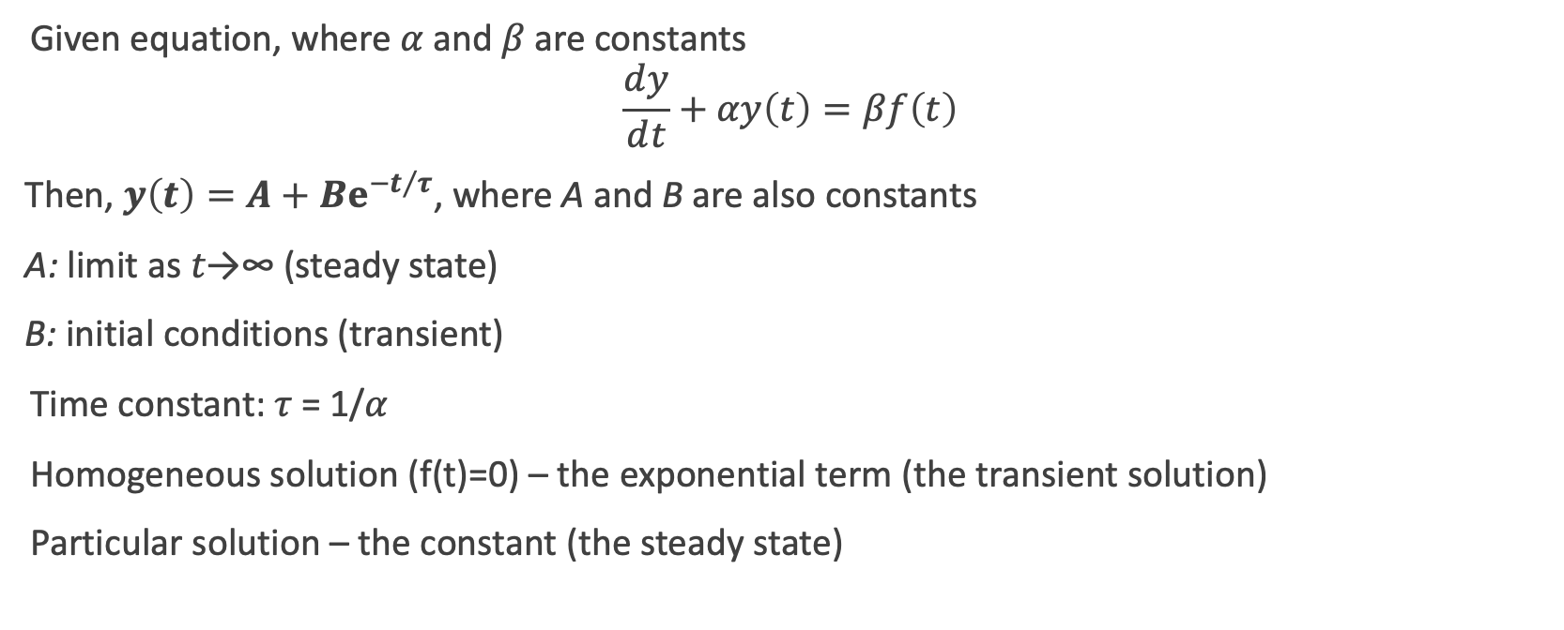
First Order Differential Equations
Given equation, where 𝛼 and 𝛽 are constants
$$\frac{ⅆy}{ⅆt}+αy\left(t\right)=βf\left(t\right)$$
Then, $y\left(t\right)=A+Bⅇ^{−t/τ}$, where A and B are also constants
A: limit as 𝑡→∞ (steady state)
B: initial conditions (transient)
Time constant: 𝜏 = 1/𝛼
Homogeneous solution (f(t)=0) – the exponential term (the transient solution)
Particular solution – the constant (the steady state)

Slide 4


First Order Circuits
Zero State Response: Solution to ODE when initial state is 0
Zero Input Response: Solution to ODE when input is 0
$y\left(t\right)=y_{h}\left(t\right)+y_{p}\left(t\right)$
$y_{p}\left(t\right)=y_{ZSR}\left(t\right)$
$y_{h}\left(t\right)=y_{ZIR}\left(t\right)$
$$y\left(t\right)=y\left(0\right)e^{−at}+y_{p}\left(t\right)−y_{p}\left(0\right)e^{−at}$$

Slide 5

y(t) expressions
$y\left(t\right)=ZI+ZS$
$y\left(t\right)=Transient+Steady State$
Both add up to y(t) but can be expressed differently
Tips:
Find ZI and ZS first → add to get y(t) → figure out Transient and Steady State

Slide 6
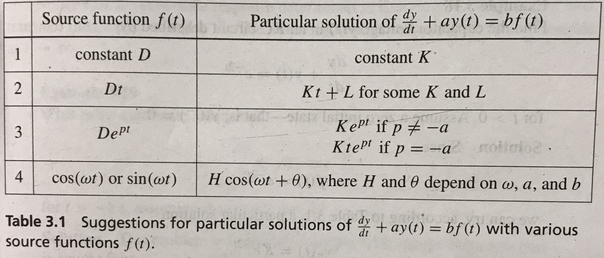

Slide 7

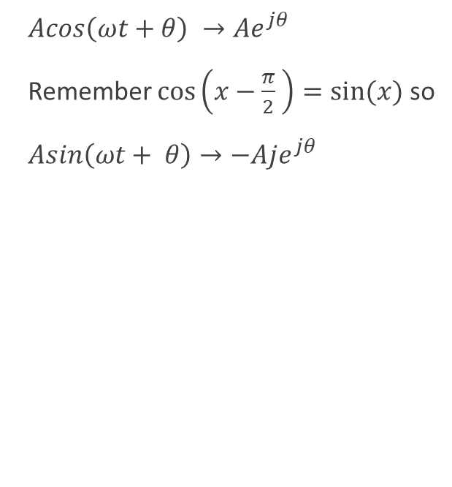
Phasors, Co-sinusoids, and Impedance
$Acos\left(ωt+θ\right) →Ae^{jθ}$
Remember $\cos\left(x−\frac{π}{2} \right)=sin⁡(x)$ so
$Asin\left(ωt+ θ\right)→−Aje^{jθ}$
Inductor: $Z=jωL$
Capacitor: $Z= \frac{1}{jωC}$
Resistor: $Z=R$
Once you’ve converted every circuit element in the phasor domain, you can analyze the circuit using all the ways covered in the first midterm!!!
Node Voltage
Superposition
Loop Current
Source Transformations
NOTE: The solution obtained after analysis with the phasor method is the STEADY STATE SOLUTION !!!

Slide 8

Average Power
$$Average Power=\frac{1}{2}Re\left\{VI^{∗}\right\}$$
$For a Resistor=\frac{{\left|V\right|}^{2}}{2R}$ = $\frac{{R\left|I\right|}^{2}}{2}$ = $RI_{rms}^{2}$ = $\frac{V_{rms}^{2}}{R}$
NOTE :
1. Capacitors and Inductors absorb no net power, they return their instantaneous absorbed power back to the circuit
2. If the current is flowing against the direction of the voltage drop, the power is negative
Absorbed Power: Positive
Dissipated Power: Negative

Slide 9
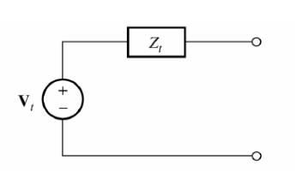

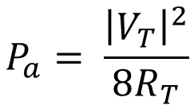
Available Power
$Z_{L}=Z_{T}^{∗}$ for max available power
$$P_{a}= \frac{{\left|V_{T}\right|}^{2}}{8R_{T}}$$

Slide 10
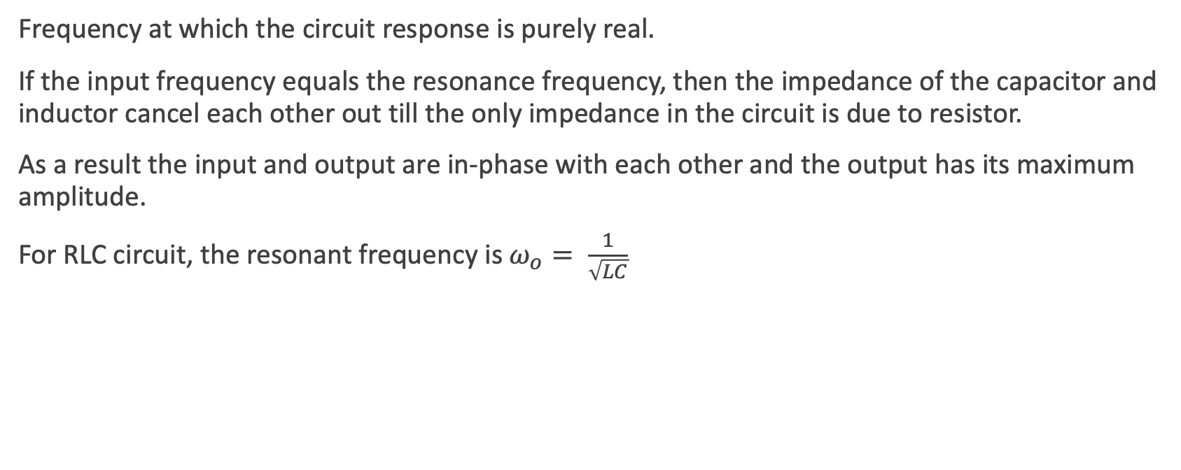
Resonance
Frequency at which the circuit response is purely real.
If the input frequency equals the resonance frequency, then the impedance of the capacitor and inductor cancel each other out till the only impedance in the circuit is due to resistor.
As a result the input and output are in-phase with each other and the output has its maximum amplitude.
For RLC circuit, the resonant frequency is $ω_{o}= \frac{1}{\sqrt{LC}}$
Notes:
Pg no. 153

Slide 11
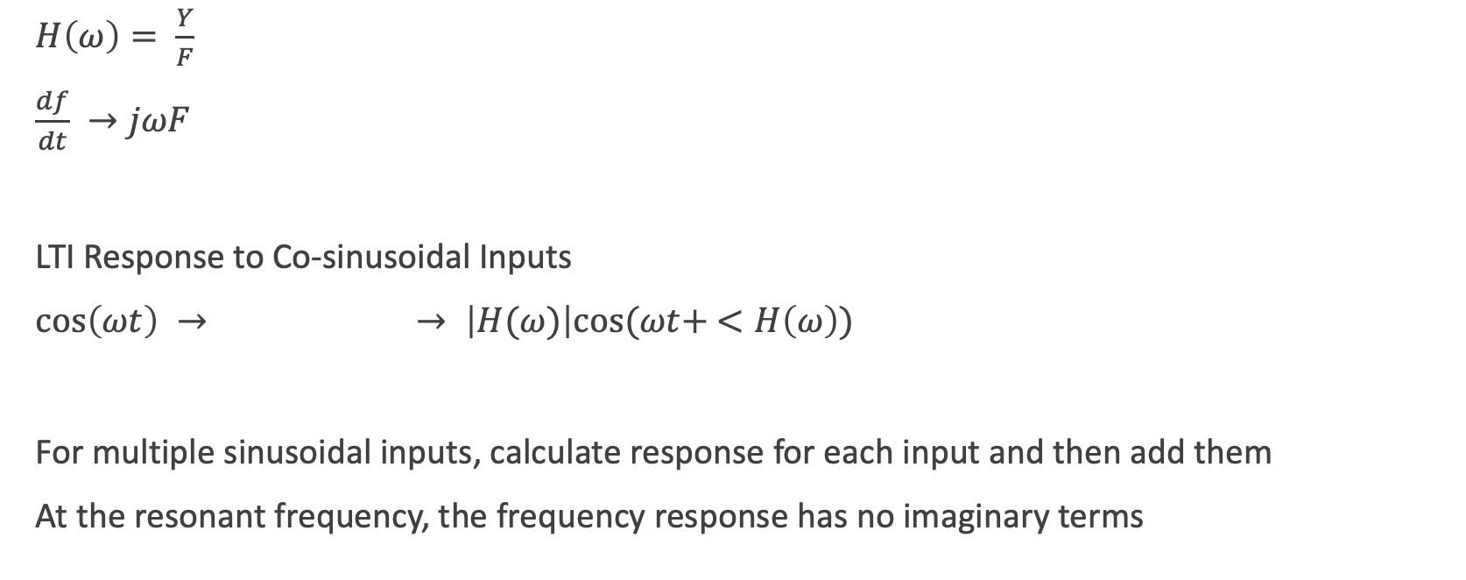
Frequency Response of LTI Systems
$H\left(ω\right)= \frac{Y}{F}$
$\frac{df}{dt} →jωF$
LTI Response to Co-sinusoidal Inputs
$\cos\left(ωt\right) →$ $→ \left|H(ω)\right|cos⁡(ωt+ <H\left(ω\right))$
For multiple sinusoidal inputs, calculate response for each input and then add them
At the resonant frequency, the frequency response has no imaginary terms
LTI
Notes:
Pg no. 159 equations relating Y,H, and F

Slide 12
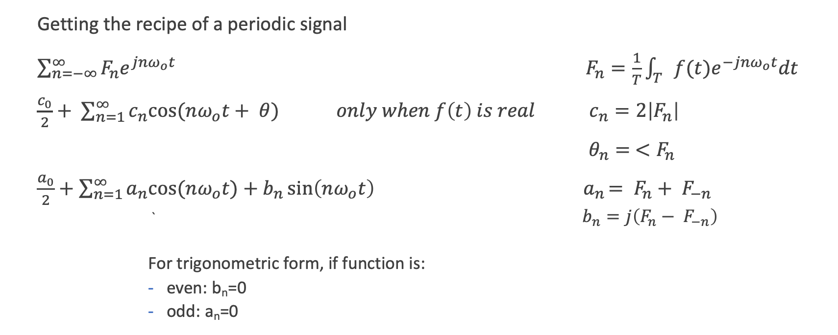
Fourier Series
Getting the recipe of a periodic signal
$\sum_{n=−∞}^{∞}{F_{n}e^{jnω_{o}t}} F_{n}=\frac{1}{T}\int_{T}{f(t)e^{−jnω_{o}t}dt}$
$\frac{c_{0}}{2}+ \sum_{n=1}^{∞}{c_{n}cos⁡(nω_{o}t+ θ)} only when f\left(t\right) is real c_{n}=2\left|F_{n}\right|$
$θ_{n}= <F_{n}$
$\frac{a_{0}}{2}+\sum_{n=1}^{∞}{a_{n}cos⁡(nω_{o}t})+b_{n}\sin\left(nω_{o}t\right) { a}_{n}= F_{n}+ F_{−n}$
` $b_{n}=j\left(F_{n}− F_{−n}\right)$
For trigonometric form, if function is:
even: b_{n}=0
odd: a_{n}=0

Slide 13
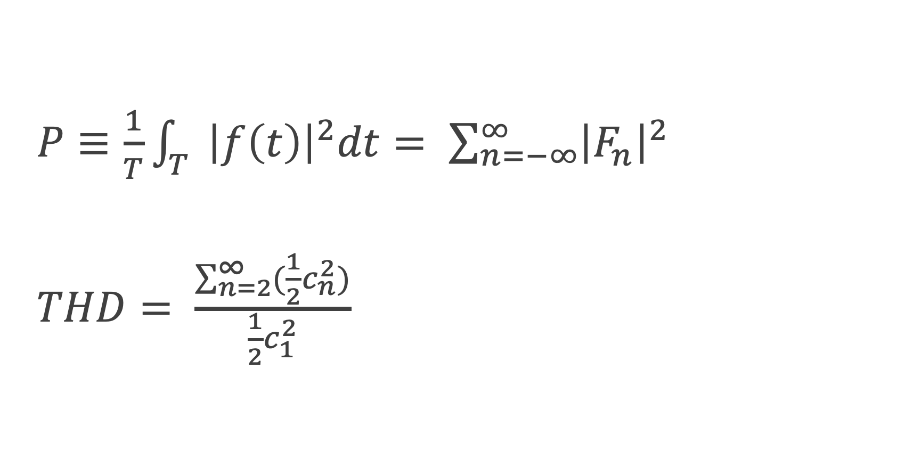
Parseval’s Theorem and THD
$P≡\frac{1}{T}\int_{T}{{\left|f\left(t\right)\right|}^{2}dt= \sum_{n=−∞}^{∞}{{\left|F_{n}\right|}^{2}}}$
$THD= \frac{\sum_{n=2}^{∞}{(\frac{1}{2}c_{n}^{2}})}{\frac{1}{2}c_{1}^{2}}$

Slide 14
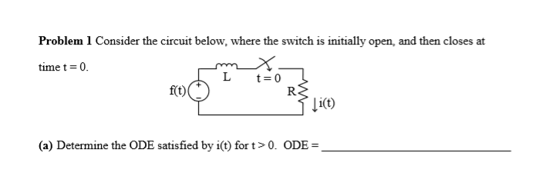
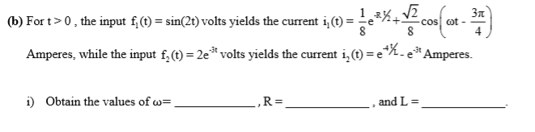
Spring 2016 Question 1

Slide 15
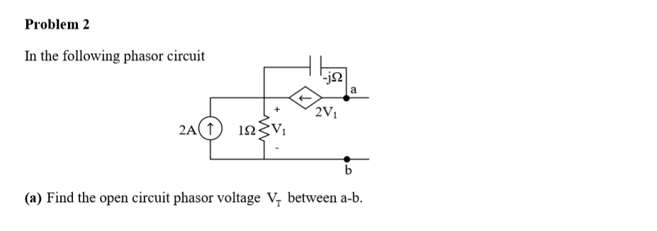

Spring 2014 Question 2

Slide 16
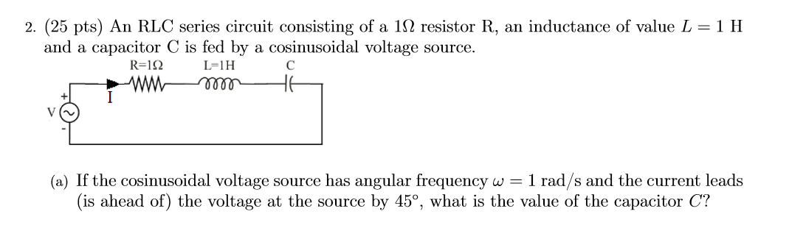

Fall 2017 Question 2

Slide 17
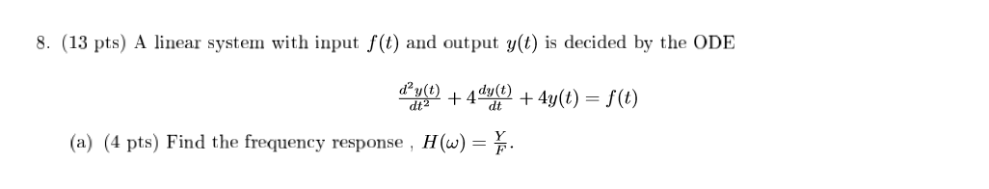
Fall 13 Question 8

Slide 18
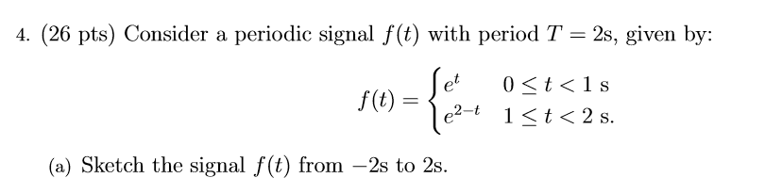
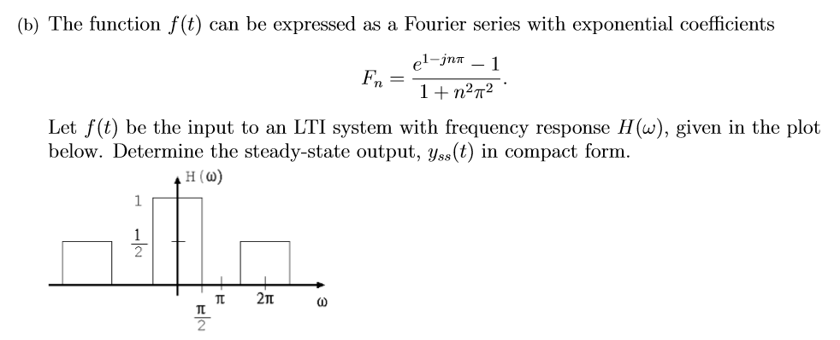
Spring 2018 Question 4

Slide 19
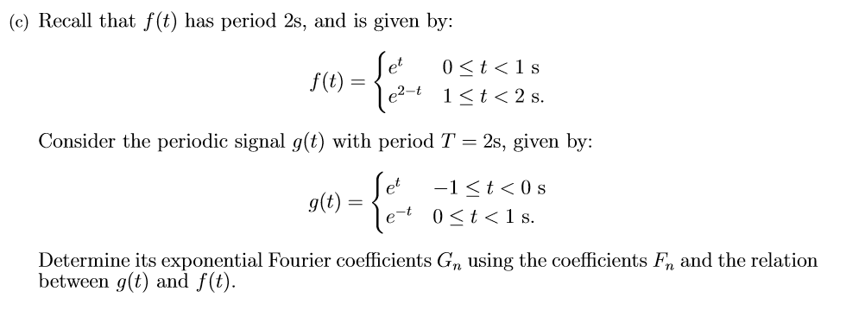
Spring 2018 Question 4 Continued

Slide 20
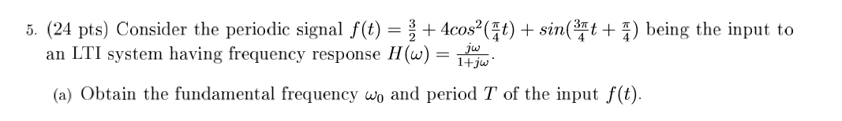
Spring 2016 Question 5

