Slide 1
ECE 329 Exam 3
HKN Review Session
Alex Littlefield

Slide 2
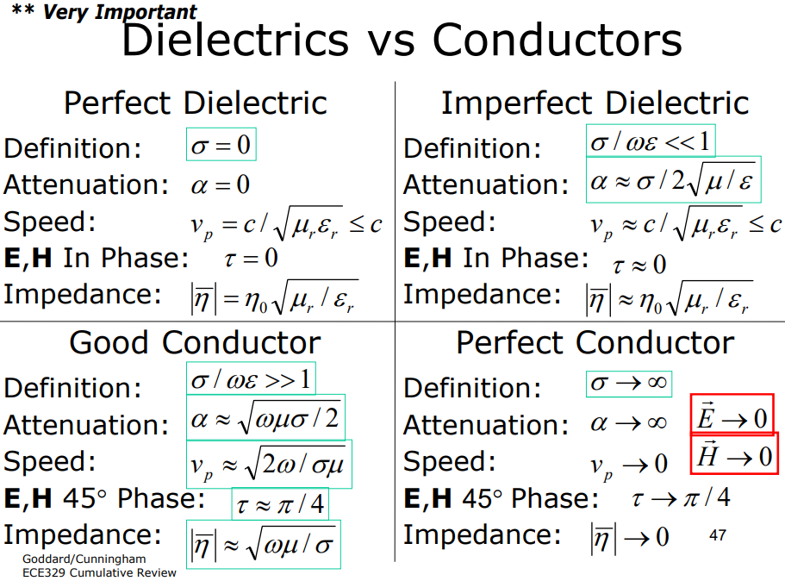

Slide 3
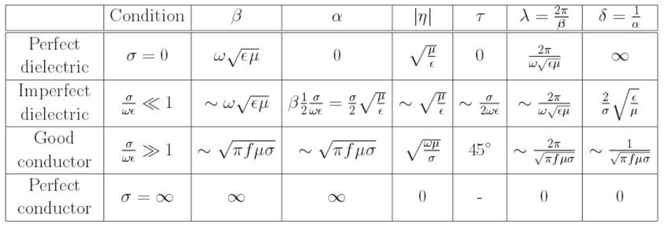

Slide 4
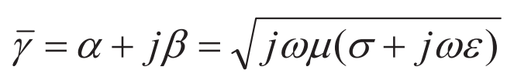
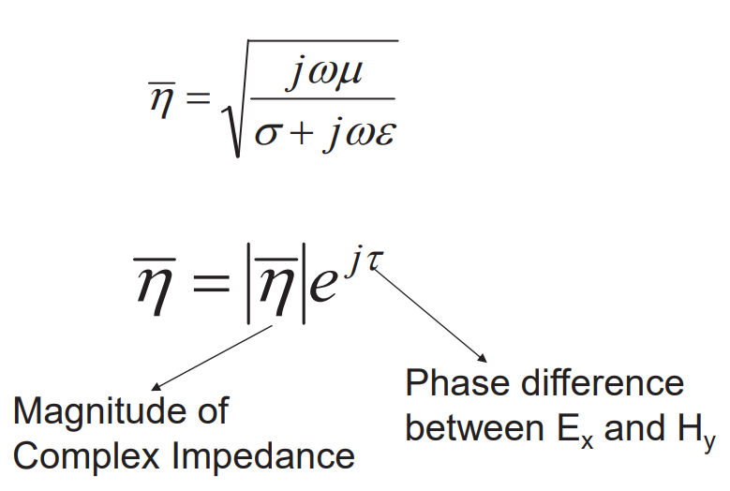
Wave Properties in Material Media
Propagation constant
Impedance
Notes:
\bar{\gamma}=\alpha+j \beta=\sqrt{j \omega \mu(\sigma+j \omega \varepsilon)}

Slide 5

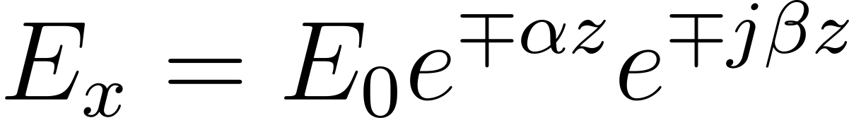


Wave Equations in Material Media
Propagation velocity in some media is frequency dependent
From the wave equation, we can get a general solution for a x-polarized wave
Penetration depth, or skin depth
Wavelength
Notes:
v_{p}=\frac{\omega}{\beta}
E_{x}=E_{0} e^{\mp \alpha z} e^{\mp j \beta z}
\delta=\frac{1}{\alpha}
\lambda=\frac{2 \pi}{\beta}

Slide 6
Wave Polarization
Linear: In phase
Circular: 90 degrees out-of-phase with equal magnitude
Right-Handed
Left-Handed
Elliptical: Anything else

Slide 7
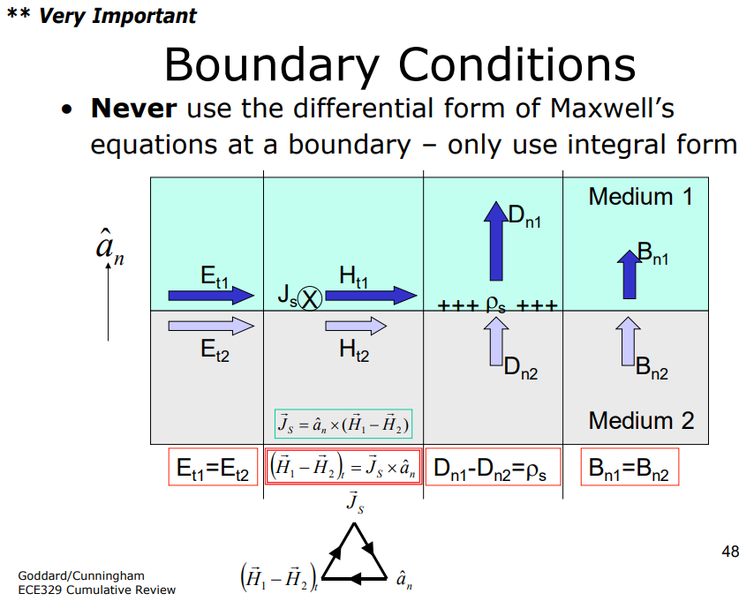

Slide 8
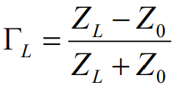
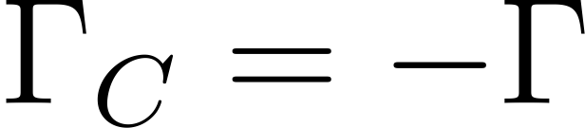
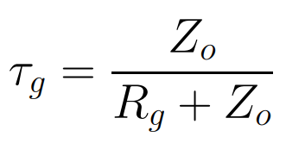
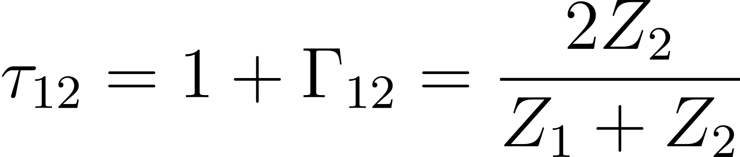
Reflection and Transmission
Perfect reflection at perfect dielectric or perfect conductor interface
Perfect transmission at impedance matched interface (Z₁=Z₂)
Reflection coefficient
Injection coefficient
Transmission coefficient
Notes:
\Gamma_{L}=\frac{Z_{L}-Z_{0}}{Z_{L}+Z_{0}}
\Gamma_{C}=-\Gamma
\tau_{g}=\frac{Z_{o}}{R_{g}+Z_{o}}
\tau_{12}=1+\Gamma_{12}=\frac{2Z_{2}}{Z_{1}+Z_{2}}

Slide 9
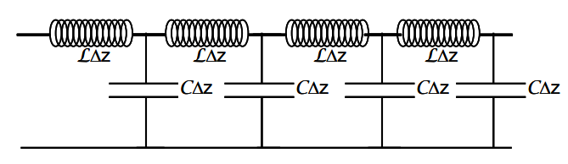
Transmission Lines (TL)
At steady state DC, TL acts like a wire
However, at microwave frequencies, lumped element model cannot be used
Creates propagating (or standing) TEM wave
To derive TL formulas, apply boundary conditions

Slide 10
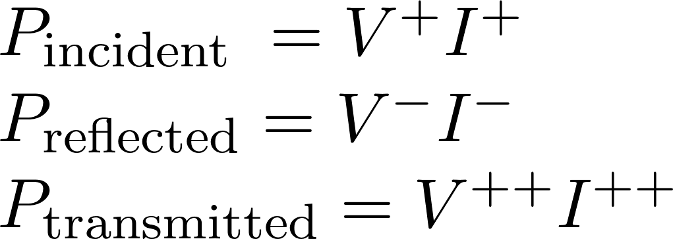
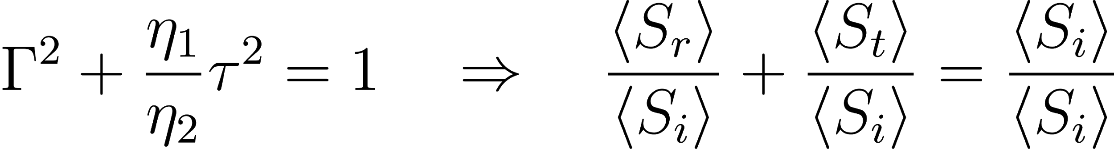
Transmission Lines
Lossless transmission lines absorb no power
All power is dissipated in resistive loads
Notes:
$\begin{array}{l}{P_{\text {incident }}=V^{+} I^{+}} \\ {P_{\text {reflected}}=V^{-} I^{-}} \\ {P_{\text {transmitted}}=V^{++} I^{++}}\end{array}$

Slide 11
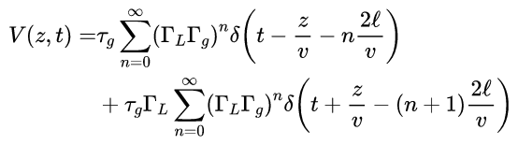
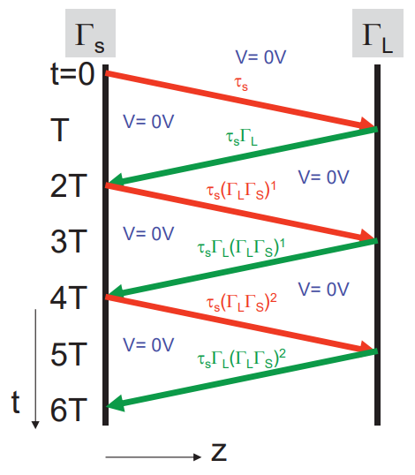
Bounce Diagram
Don’t memorize these formulas
Instead, understand bounce diagrams conceptually
Note the speed of propagation (material dependent!)
Determine the distance per time in convenient units
Multiply by the correct coefficient at any interface
Remember to negative reflection coefficient for current!
Output function will be the same as input function
Notes:
\begin{aligned} V(z, t)=& \tau_{g} \sum_{n=0}^{\infty}\left(\Gamma_{L} \Gamma_{g}\right)^{n} \delta\left(t-\frac{z}{v}-n \frac{2 \ell}{v}\right) \\ &+\tau_{g} \Gamma_{L} \sum_{n=0}^{\infty}\left(\Gamma_{L} \Gamma_{g}\right)^{n} \delta\left(t+\frac{z}{v}-(n+1) \frac{2 \ell}{v}\right) \end{aligned}

Slide 12
Open and Shorted Stubs
Open Stub:
R_{L} = ∞
I_{L} = 0
Shorted Stub:
R_{L} = 0
V_{L} = 0
Both produce a standing wave for both voltage and current

Slide 13
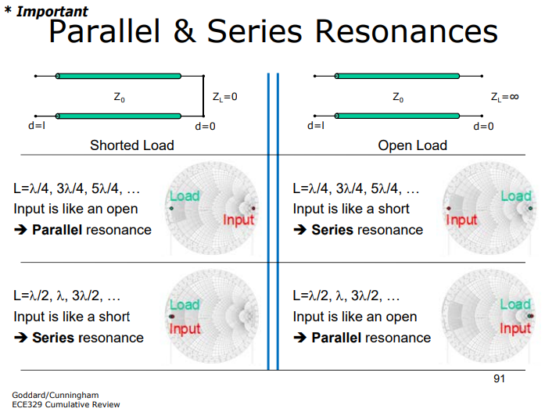
Microwave Resonators

Slide 14
Previous Exam Questions

Slide 15
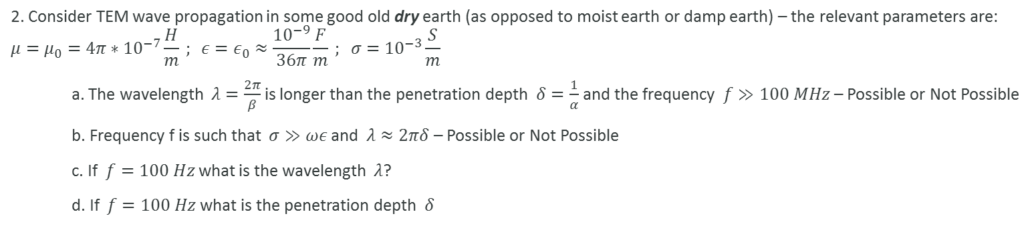
Summer 2016 #2

Slide 16
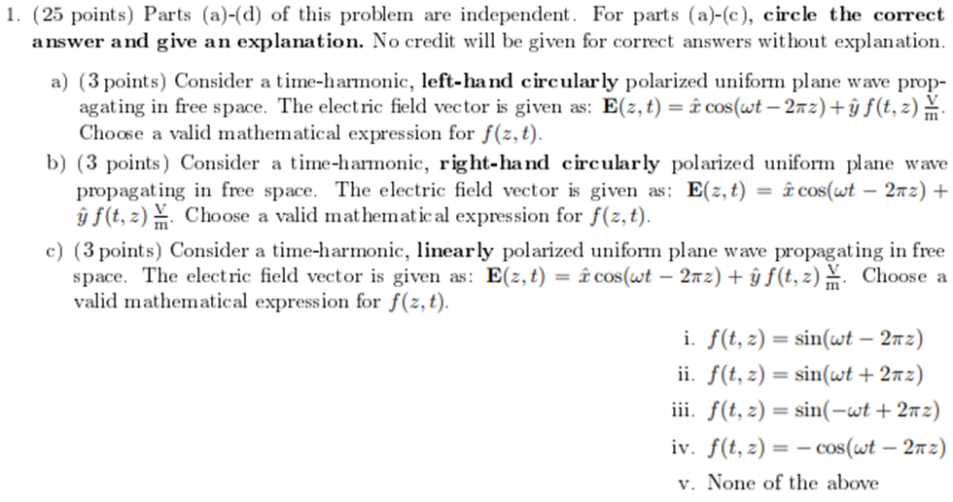
Spring 2016 #1

Slide 17
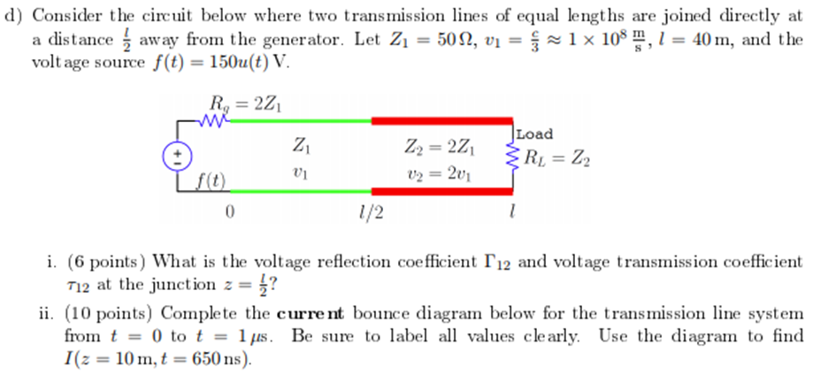
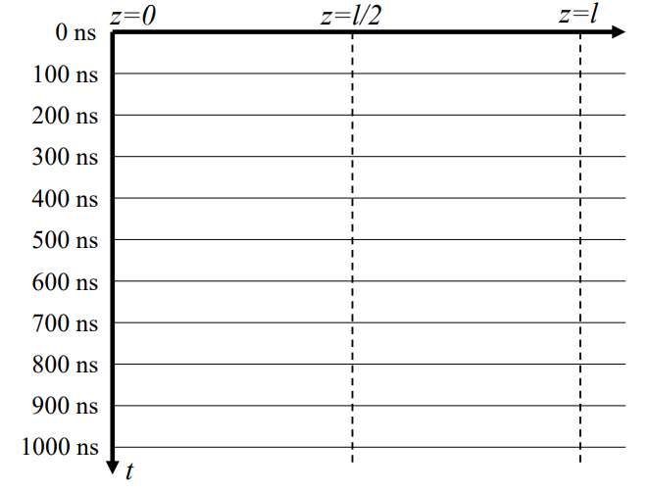
Spring 2016 #1

Slide 18
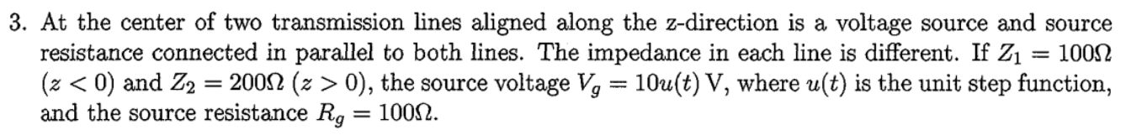
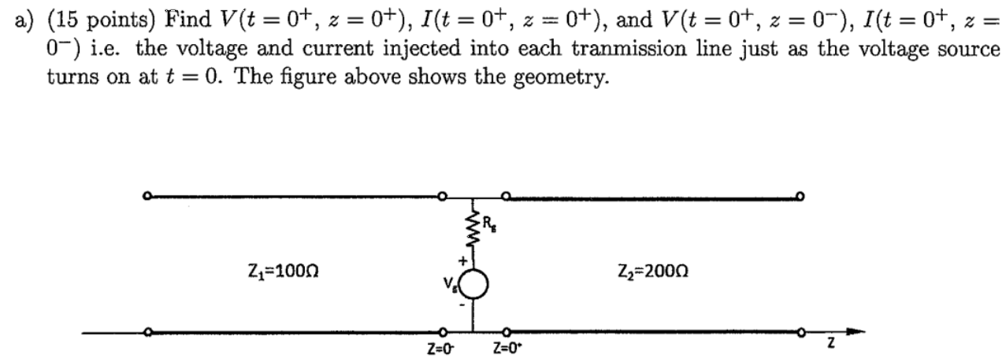
Summer 2016 #2

