Slide 1

ECE 385 Final Review Yikuan Chen, 2018
Modified by Yanpei Tian 11/10/2018
Modified by Keshav Harisrikanth FA 2019
Modified by Derek Wood, Keshav Harisrikanth FA 2019

Slide 2
Exam Breakdown
~70% will be materials after Midterm;
~30% will be materials before Midterm;
Know the high-level description (with a reasonable level of detail, of course) of each Lab is the most important thing.
Know the things discussed in lecture about Final Project will be helpful.
Know the properties of all the storages on the board (on chip memory, SRAM, SDRAM, Flash)

Slide 3
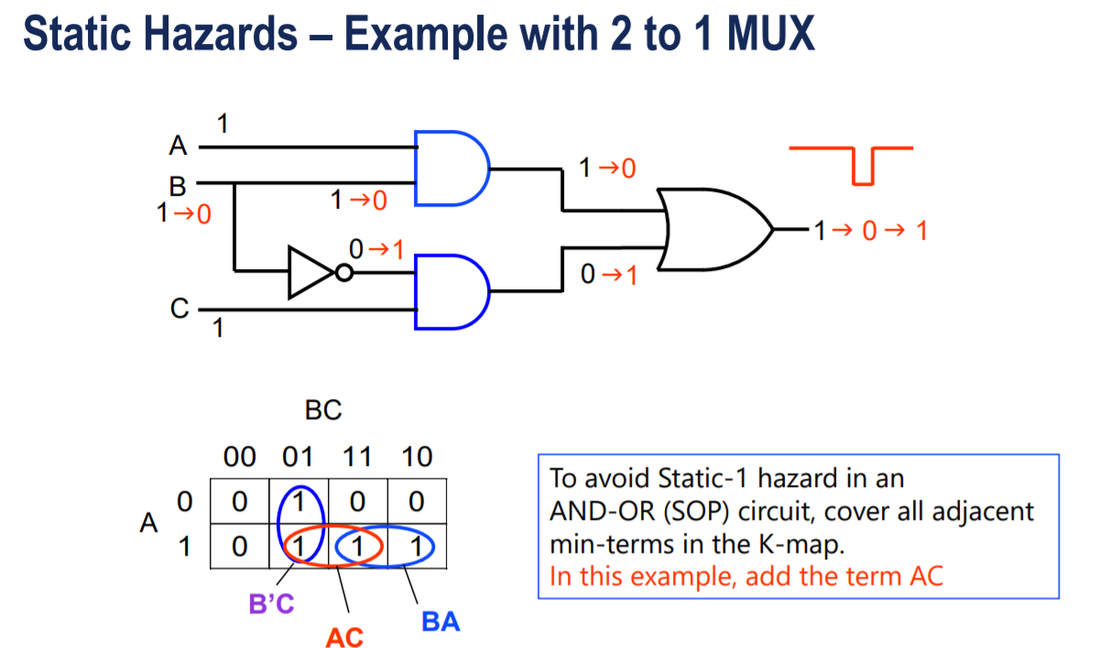
Lab 1

Slide 4
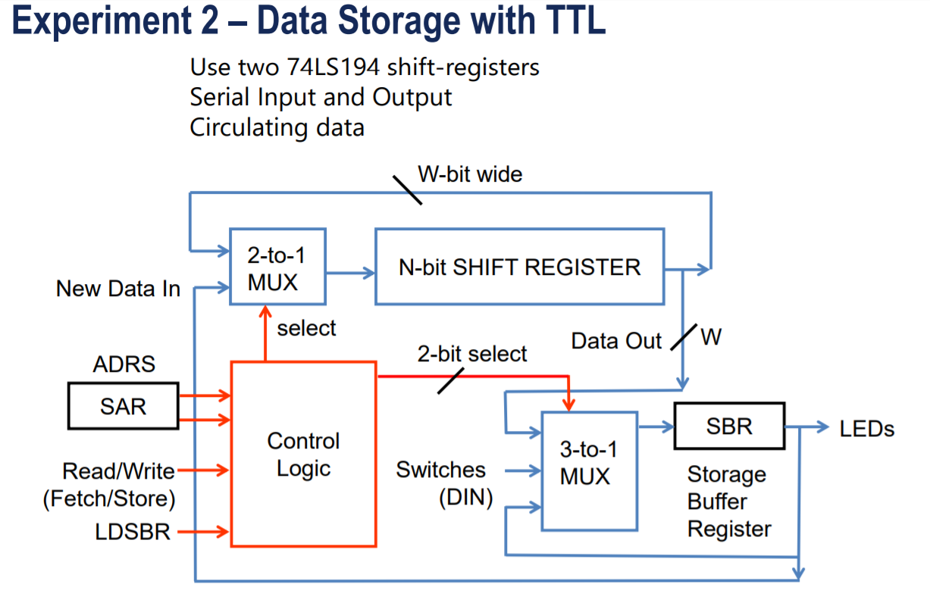
Lab 2

Slide 5
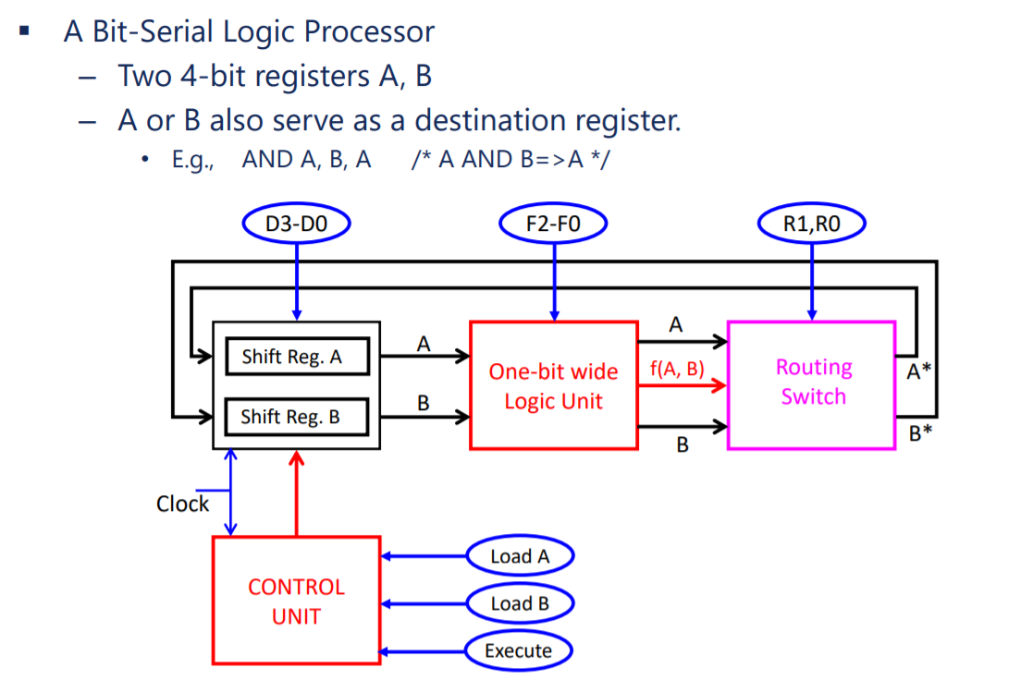
Lab 3

Slide 6
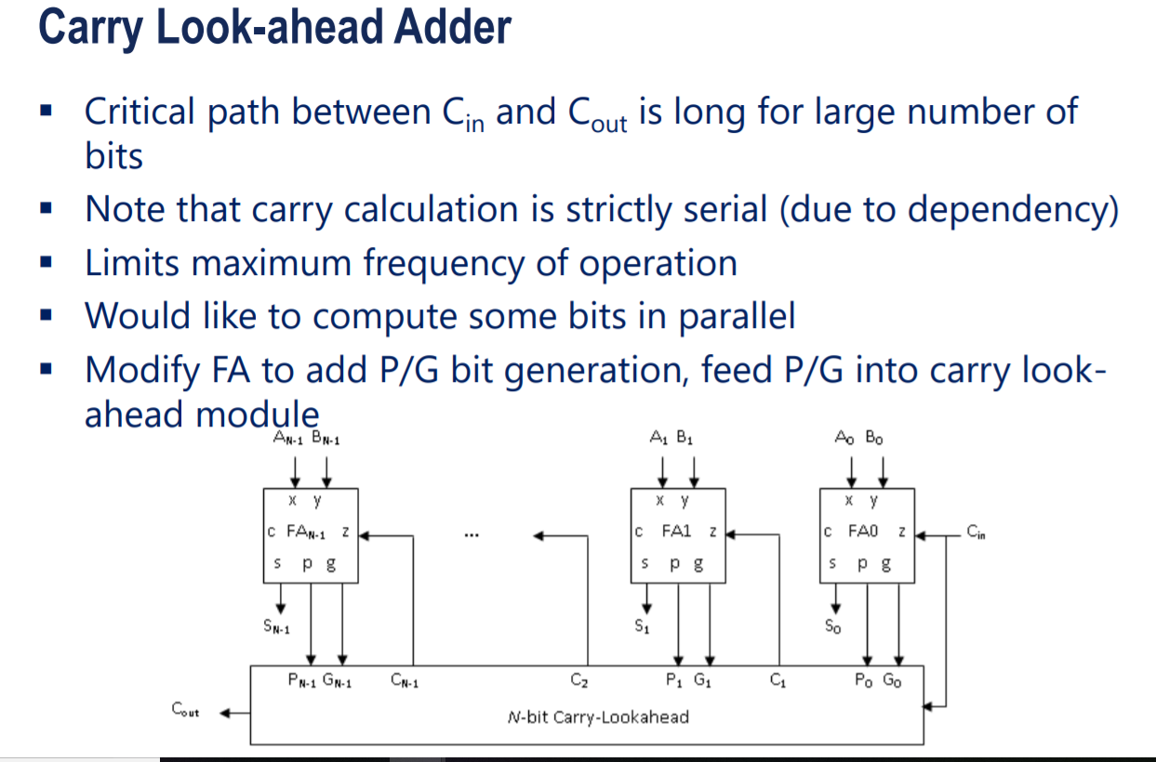
Lab 4

Slide 7
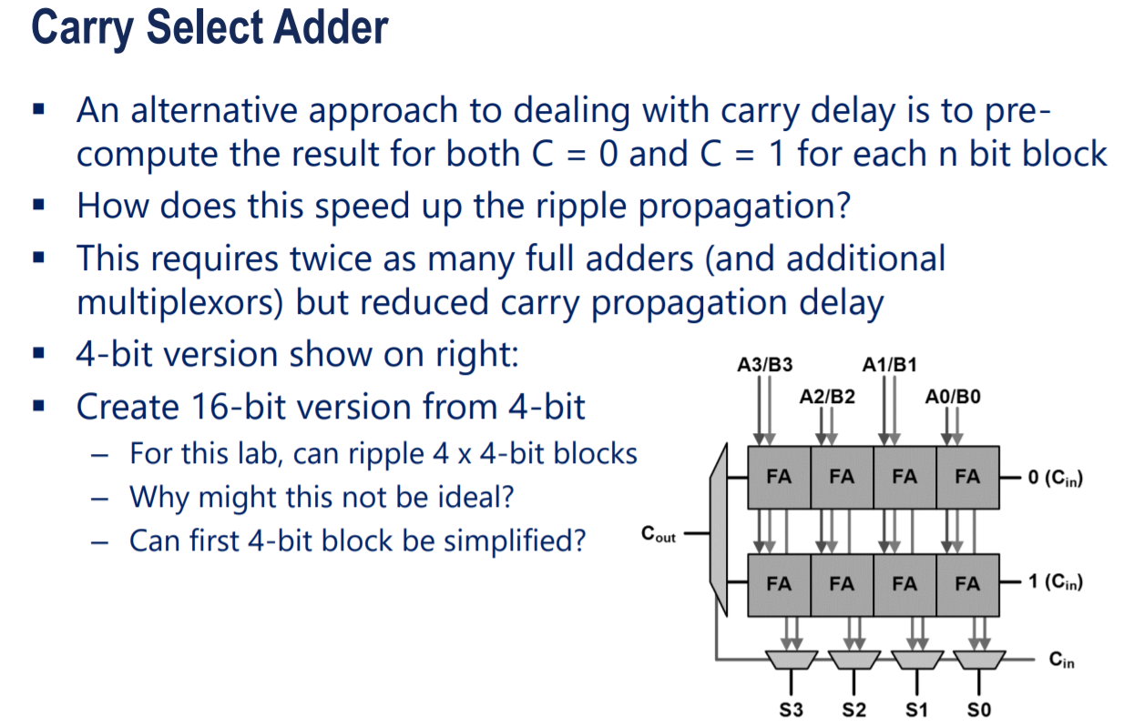
Lab 4 (Cont.)

Slide 8
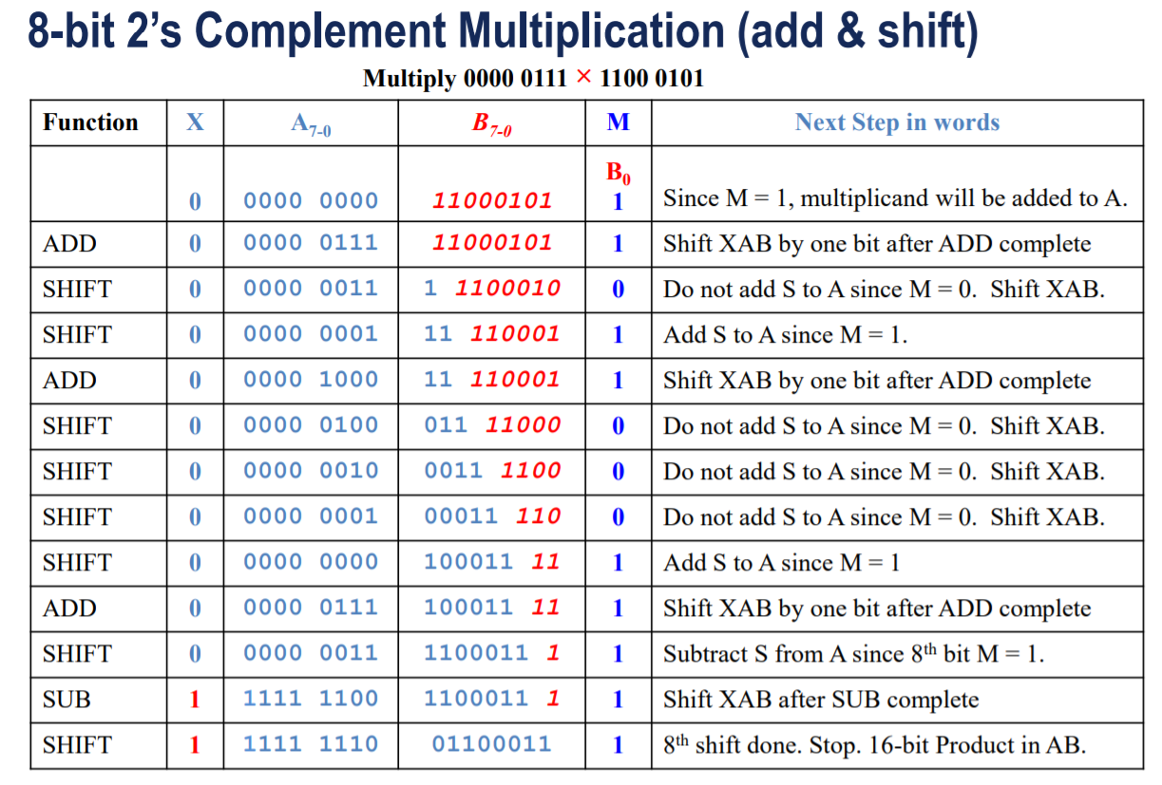
Lab 5

Slide 9
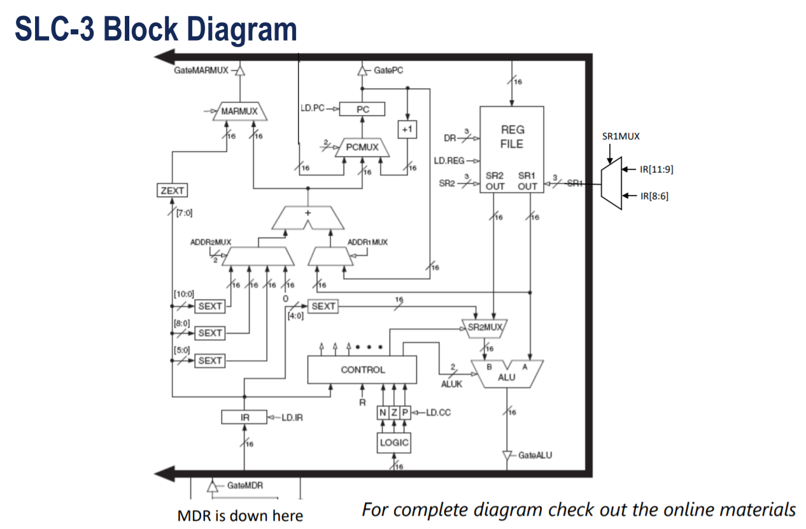
Lab 6
Won’t be on this exam.
Not even week 1.
Expect a more on the final.
When it does show up, expect questions on how memory was handled.

Slide 10
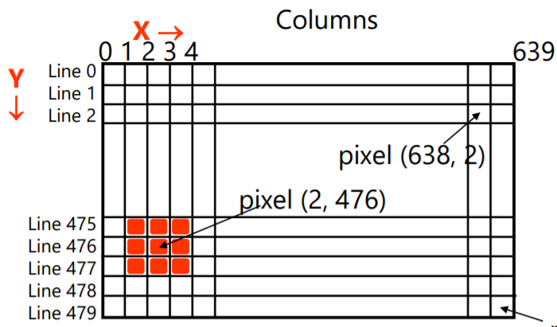
Labs 7 and 8
Lab 7: Just NIOS
Know how you controlled LEDs.
MMIO
Lab 7 questions
Lab 8: VGA and NIOS I/O
VGA Clocks, Controls and Operation
USB driver

Slide 11
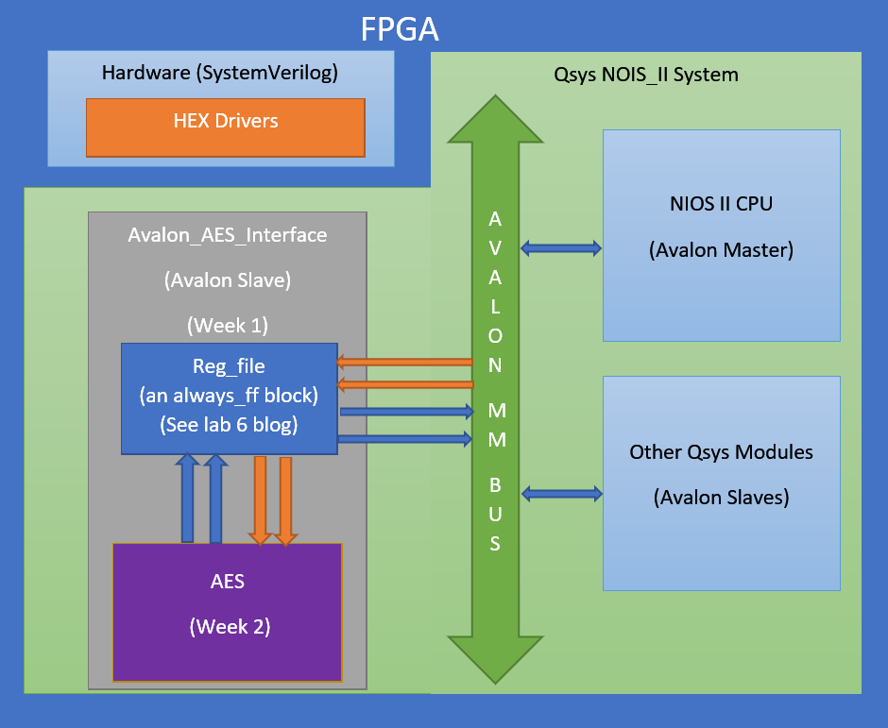
Lab 9
Avalon Bus
General interface
AES
Know modules and processes.
©2017 Yikuan Chen – AES data/signal path diagram

Slide 12
1. In Lab 8, in order to complete a USB_Read Operation, in what sequence do you need to call IO_read and IO_write? (warm-up)
a) IO_read → IO_write → IO_read → IO_write
b) IO_write →IO_read
c) IO_write → IO_write → IO_read
d) IO_read
e) IO_read → IO_read

Slide 13
1. In Lab 8, in order to complete a USB_Read Operation, in what sequence do you need to call IO_read and IO_write? (warm-up)
a) IO_read → IO_write→ IO_read→ IO_write
b) IO_write→ IO_read ★
c) IO_write → IO_write → IO_read
d) IO_read
e) IO_read → IO_read

Slide 14
3. In SystemVerilog, if we want to monitor a signal inside a sub-module without putting it in the output list, what could we do? Say we have:
module testbench()
//code neglected
adder a0(.*);
endmodule
//and we want to look at signal “a” in a0 (which is not an output)
(in testbench module): logic a_monitor;
always_comb begin a_monitor = a0.a; end
II. (in testbench module): logic a_monitor = a0.a;
III. (in testbench module):
logic a_monitor;
always_ff @ (posedge Clk) a_monitor <= adder(a0).a;
IV. (in testbench module):
logic a_monitor;
always_ff @ (posedge Clk) a_monitor <= a0.a;
module adder(…)
logic a;
//code neglected
endmodule
a) all will do
b) only III will do
c) only IV will do
d) both III and IV
e) both I and IV
Notes:
We should refer the name of the instance (i.e. a0) and use always_ff to constantly refresh the value. By the way, you may only assign a constant value to a logic if you combine declaration and assignment in one line (e.g. logic a = 0;)

Slide 15
3. In SystemVerilog, if we want to monitor a signal inside a sub-module without putting it in the output list, what could we do? Say we have:
module testbench()
//code neglected
adder a0(.*);
endmodule
//and we want to look at signal “a” in a0 (which is not an output)
(in testbench module): logic a_monitor;
always_comb begin a_monitor = a0.a; end
II. (in testbench module): logic a_monitor = a0.a;
III. (in testbench module):
logic a_monitor;
always_ff @ (posedge Clk) a_monitor <= adder(a0).a;
IV. (in testbench module):
logic a_monitor;
always_ff @ (posedge Clk) a_monitor <= a0.a;
module adder(…)
logic a;
//code neglected
endmodule
a) all will do
b) only III will do
c) only IV will do
d) both III and IV
e) both I and IV ★★
We should refer the name of the instance (i.e. a0) and use always_ff to constantly refresh the value. By the way, you may only assign a constant value to a logic if you combine declaration and assignment in one line (e.g. logic a = 0;)
Notes:
We should refer the name of the instance (i.e. a0) and use always_ff to constantly refresh the value. By the way, you may only assign a constant value to a logic if you combine declaration and assignment in one line (e.g. logic a = 0;)

Slide 16
Problem 3 – Additional Notes
A.(in testbench module):
logic a_monitor;
always_ff @ (posedge Clk) a_monitor <= a0.a;
B.(in testbench module):
logic a_monitor;
always begin
#2 a_monitor = a0.a;
end
Equivalent in Testbench.

Slide 17
A question on Time Token “#”
What is the value of b, d and f at t=21?
logic a,b,c,d,e,f=0;
initial begin: TEST_A #10 a = 1’b1; #20 b = 1’b1; end initial begin: TEST_B #10 c <= 1’b1; #20 d <= 1’b1; end
initial begin: TEST_C e <= #10 1’b1; f <= #20 1’b1; end
1,0,0
0,0,1
0,1,0
0,0,0
1,1,1
This one is interesting:)
Notes:
Non-blocking assignment evaluate right hand side, put it on the queue, assign it to left side when time ON LEFTSIDE arrives

Slide 18
A question on Time Token “#”
What is the value of b, d and f at t=21?
logic a,b,c,d,e,f=0;
initial begin: TEST_A #10 a = 1’b1; //at time=10+0=10 #20 b = 1’b1; //at time=10+20+0=30 end initial begin: TEST_B #10 c <= 1’b1; //at time=10+0=10 #20 d <= 1’b1; // at time=10+20+0=30 end
initial begin: TEST_C e <= #10 1’b1; //at time = 0+10=10 f <= #20 1’b1; //at time = 0+20=20 end
1,0,0
0,0,1
0,1,0
0,0,0
1,1,1
Non-blocking assignment evaluate right hand side, put it on the queue, assign it to left side when time ON LEFTSIDE arrives. Time token # binds to what’s on its right side (In A,B, it binds to the whole line, and in C it binds to 1’1b).
Notes:
Non-blocking assignment evaluate right hand side, put it on the queue, assign it to left side when time ON LEFTSIDE arrives

Slide 19
4. A pure combinational circuit with feedback is a latch circuit. Which one(s) of the following code will result in “latch inferred” warning in Quartus? (assume all starts with some valid value)
1. always_comb begin state = next_state; if(state == A) next_state = C; else next_state = B; end | 2. always_ff @ (posedge Clk) begin if(state == A) next_state <= C; else next_state <= B; state <= next_state; end
3. assign a = (a == 1)? 0 : 1; | 4. always_comb if(a == 1) a = 0; else a = 1; end
a)only 1 b)only 1,2 c)only 3 d)only 1,3,4 e)only 3,4
Notes:
3 and 4 are completely equivalent, and there is a latch since a depend on it self (think about how SR latch work). Although 2 is incorrect in terms of acting as a FSM, it is syntactically correct (no latch). 1 is a little bit more subtle, but state actually depend on its own value, which results in a latch.

Slide 20
4. A pure combinational circuit with feedback is a latch circuit. Which one(s) of the following code will result in “latch inferred” warning in Quartus? (assume all starts with some valid value)
1. always_comb begin state = next_state; if(state == A) next_state = C; else next_state = B; end | 2. always_ff @ (posedge Clk) begin if(state == A) next_state <= C; else next_state <= B; state <= next_state; end
3. assign a = (a == 1)? 0 : 1; | 4. always_comb if(a == 1) a = 0; else a = 1; end
a)only 1 b)only 1,2 c)only 3 d)only 1,3,4 ★ ★ e)only 3,4
3 and 4 are completely equivalent, and there is a latch since a depend on it self (think about how SR latch work). Although 2 is incorrect in terms of acting as a FSM, it is syntactically correct (no latch). 1 is a little bit more subtle, but state actually depend on its own value, which results in a latch.
Notes:
3 and 4 are completely equivalent, and there is a latch since a depend on it self (think about how SR latch work). Although 2 is incorrect in terms of acting as a FSM, it is syntactically correct (no latch). 1 is a little bit more subtle, but state actually depend on its own value, which results in a latch.

Slide 21
5. Which way of using parameter in SystemVerilog is wrong?
module regfile (input clk, input [ADDR_WIDTH-1:0]addr, inout wire [DATA_WIDTH-1:0]data);
parameter ADDR_WIDTH=8;
parameter DATA_WIDTH=32;
… (implementation code)
Endmodule
regfile #(8,16) myreg(.*);
regfile #(.ADDR_WIDTH(8),.DATA_WIDTH(16)) myreg(.*);
regfile (#ADDR_WITH =8, #DATA_WITH =16) myreg(.*);
All of them are wrong
None of them are wrong

Slide 22
5. Which way of using parameter in SystemVerilog is wrong?
module regfile (input clk, input [ADDR_WIDTH-1:0]addr, inout wire [DATA_WIDTH-1:0]data);
parameter ADDR_WIDTH=8;
parameter DATA_WIDTH=32;
… (implementation code)
Endmodule
regfile #(8,16) myreg(.*);
regfile #(.ADDR_WIDTH(8),.DATA_WIDTH(16)) myreg(.*);
regfile (#ADDR_WIDTH =8, #DATA_WIDTH =16) myreg(.*);
All of them are wrong
None of them are wrong
Note: # comes first.

Slide 23
6. What type of architecture does NIOS IIe belong to?
A Moore Machine
A Mealy Machine
A Von-Neumann Machine
A Harvard Machine
A Modified Harvard Machine
Notes:
The original Harvard Machine uses entirely separate memory system to store instructions and data.

Slide 24
6. What type of architecture does NIOS IIe belong to?
A Moore Machine
A Mealy Machine
A Von-Neumann Machine
A Harvard Machine
A Modified Harvard Machine ★
The original Harvard Machine uses entirely separate memory system to store instructions and data.
Notes:
The original Harvard Machine uses entirely separate memory system to store instructions and data.

Slide 25
7. In Lab 6, we implemented SEXT modules. What is (are) correct implementations of this module?
logic [31:0] a_sext;
//a_orig is 16 bit
b is zero-extended, c creates a register that would delay a cycle (but we only want combinational logic), d is wrong because 16’b1 is actually 16’b0000000000000001.
a)assign a_sext = {{16{a_orig[15]}},a_orig[15:0]};
b) assign a_sext = {16’b0,a_orig[15:0]};
c) always_ff @ (posedge Clk) begin
if(a_orig[15]) a_sext <= {16’b1,a_orig};
else a_sext <= {16’b0,a_orig};
end
d) always_comb @ begin
if(a_orig[15]) a_sext <= {16’b1,a_orig};
else a_sext <= {16’b0,a_orig};
end
e) More than 1 correct answer above
Notes:
b is zero-extended, c creates a register that would delay a cycle (but we only want combinational logic), d is wrong because 16’b1 is actually 16’b0000000000000001.

Slide 26
7. In Lab 6, we implemented SEXT modules. What is (are) correct implementations of this module?
logic [31:0] a_sext;
//a_orig is 16 bit
b is zero-extended, c creates a register that would delay a cycle (but we only want combinational logic), d is wrong because 16’b1 is actually 16’b0000000000000001.
a)assign a_sext = {{16{a_orig[15]}},a_orig[15:0]}; ★
b) assign a_sext = {16’b0,a_orig[15:0]};
c) always_ff @ (posedge Clk) begin
if(a_orig[15]) a_sext <= {16’b1,a_orig};
else a_sext <= {16’b0,a_orig};
end
d) always_comb @ begin
if(a_orig[15]) a_sext <= {16’b1,a_orig}; //should be 16’hFFFF
else a_sext <= {16’b0,a_orig};
end
e) More than 1 correct answer above
Notes:
b is zero-extended, c creates a register that would delay a cycle (but we only want combinational logic), d is wrong because 16’b1 is actually 16’b0000000000000001.

Slide 27
8. In Lab 8, if we don’t have the tristate buffer in hpi_io_intf, what would happen?
a) We may write to and read from OTG_DATA at the same time, which is more efficient
b) OTG_DATA may be driven with two drivers, which will cause I/O failure
c) Nothing would change
d) OTG_DATA will be grounded
e) OTG_DATA will be connected to Vcc directly
This is not even a SystemVerilog syntax problem, but a design problem. An inout logic must be connected to a tristate buffer, otherwise the behavior is undefined. By the way, FPGA only supports inout logic to be mapped to i/o pins and does not internally support inout.
Notes:
This is not even a SystemVerilog syntax problem, but a design problem. An inout logic must be connected to a tristate buffer, otherwise the behavior is undefined. By the way, FPGA only supports inout logic to be mapped to i/o pins and does not internally support inout.

Slide 28
8. In Lab 8, if we don’t have the tristate buffer in hpi_io_intf, what would happen?
a) We may write to and read from OTG_DATA at the same time, which is more efficient
b) OTG_DATA may be driven with two drivers, which will cause I/O failure ★
c) Nothing would change
d) OTG_DATA will be grounded
e) OTG_DATA will be connected to Vcc directly
This is not even a SystemVerilog syntax problem, but a design problem. An inout logic must be connected to a tristate buffer, otherwise the behavior is undefined. By the way, FPGA only supports inout logic to be mapped to i/o pins and does not internally support inout.
Notes:
This is not even a SystemVerilog syntax problem, but a design problem. An inout logic must be connected to a tristate buffer, otherwise the behavior is undefined. By the way, FPGA only supports inout logic to be mapped to i/o pins and does not internally support inout.

Slide 29
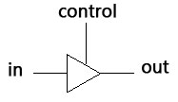
Problem 8 – Additional Notes
An inout logic must be connected to a tristate buffer, otherwise the behavior is undefined. By the way, FPGA only supports inout logic to be mapped to i/o pins and does not internally support inout.
assign out = (control)? in : 16'bZZZZZZZZZZZZZZZZ;

Slide 30
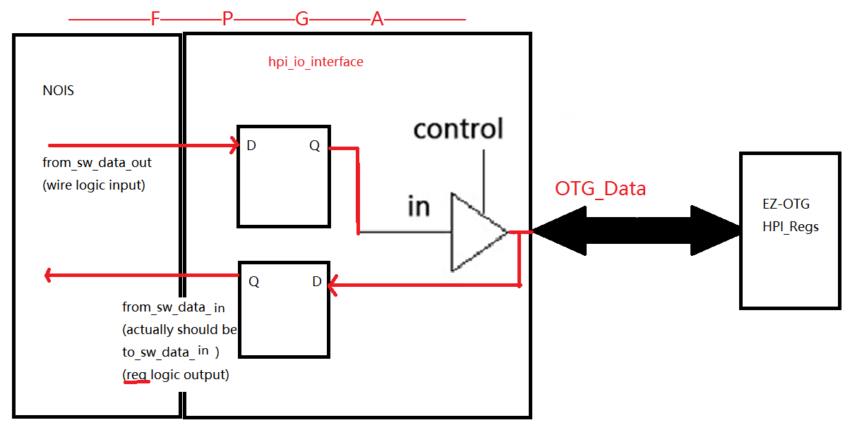
Problem 8 – Additional Notes
A more complete picture

Slide 31
9. Start from the circuit in Lab 7, if we want bit zero to be constantly blinking (with 50% duty cycle) and bit 7:1 keep displaying the accumulation value, what should we add to the code AFTER the accumulation part? Assuming all code are inside a while(1) loop, and other code (accumulation, not shown) are correctly written.
a. for(i = 0; i < 1000000; i ++); //delay *LED = *accumulator & (0x01); | b. for(i = 0; i < 1000000; i ++); //delay *accumulator = *accumulator ^ (0x01); *LED =*accumulator; for(i = 0; i < 1000000; i ++); //delay accumulator = *accumulator ^ (0x01); *LED = *accumulator;
c. for(i = 0; i < 1000000; i ++); //delay *accumulator = *accumulator & (0xFE); *LED = *accumulator; for(i = 0; i < 1000000; i ++); //delay *accumulator = *accumulator | (0x01); *LED = *accumulator; | d. for(i = 0; i < 1000000; i ++); //delay *LED = *accumulator & (0xFE); for(i = 0; i < 1000000; i ++); //delay *LED = *accumulator | (0x01);
e) more than one solution above
Notes:
A will clear bit 7:1; b does not guarantee the last bit to be always toggling (if accumulator value changes from even to odd, you will see the last bit of LED to be 1,0,0,1); c would corrupt the value of the accumulator; only d is correct.

Slide 32
9. Start from the circuit in Lab 7, if we want bit zero to be constantly blinking (with 50% duty cycle) and bit 7:1 keep displaying the accumulation value, what should we add to the code AFTER the accumulation part? Assuming all code are inside a while(1) loop, and other code (accumulation, not shown) are correctly written.
a. for(i = 0; i < 1000000; i ++); //delay *LED = *accumulator & (0x01); | b. for(i = 0; i < 1000000; i ++); //delay *accumulator = *accumulator ^ (0x01); *LED =*accumulator; for(i = 0; i < 1000000; i ++); //delay accumulator = *accumulator ^ (0x01); *LED = *accumulator;
c. for(i = 0; i < 1000000; i ++); //delay *accumulator = *accumulator & (0xFE); *LED = *accumulator; for(i = 0; i < 1000000; i ++); //delay *accumulator = *accumulator | (0x01); *LED = *accumulator; | d. ★★ for(i = 0; i < 1000000; i ++); //delay *LED = *accumulator & (0xFE); for(i = 0; i < 1000000; i ++); //delay *LED = *accumulator | (0x01);
A will clear bit 7:1; b does not guarantee the last bit to be always toggling (if accumulator value changes from even to odd, you will see the last bit of LED to be 1,0,0,1); c would corrupt the value of the accumulator; only d is correct.
e) more than one solution above
Notes:
A will clear bit 7:1; b does not guarantee the last bit to be always toggling (if accumulator value changes from even to odd, you will see the last bit of LED to be 1,0,0,1); c would corrupt the value of the accumulator; only d is correct.

Slide 33
10. In Lab 9, what would happen if the JTAG-UART module is missing?
a) NIOS II cannot transmit message to the hardware
b) Hardware cannot transmit message back to NIOS II
c) both a and b
d) nothing would change
e) none of the above
Notes:
If this module is missing, then we cannot use our PC as host device. i.e. we would not be able to type in message and key on the keyboard on our PC and let NIOS ii use it via scanf(), etc.

Slide 34
10. In Lab 9, what would happen if the JTAG-UART module is missing?
a) NIOS II cannot transmit message to the hardware
b) Hardware cannot transmit message back to NIOS II
c) both a and b
d) nothing would change
e) none of the above★
If this module is missing, then we cannot use our PC as host device. i.e. we would not be able to type in message and key on the keyboard on our PC and let NIOS ii use it via scanf(), etc.
Notes:
If this module is missing, then we cannot use our PC as host device. i.e. we would not be able to type in message and key on the keyboard on our PC and let NIOS ii use it via scanf(), etc.

Slide 35
11. In Lab 9, which module in SystemVerilog is not purely combinational?
a) AddRoundKey
b) InvMixColumn
c) InvSubByte
d) InvShiftRows
e) none of the above
Notes:
InvSubByte module is implemented as a ROM that uses the input byte as index. Note that there will be one cycle delay for the output to be valid.

Slide 36
11. In Lab 9, which module in SystemVerilog is not purely combinational?
a) AddRoundKey
b) InvMixColumn
c) InvSubByte ★
d) InvShiftRows
e) none of the above
InvSubByte module is implemented as a RAM that uses the input byte as index.
Notes:
InvSubByte module is implemented as a ROM that uses the input byte as index. Note that there will be one cycle delay for the output to be valid.

Slide 37
Lab 9 – one more question
True or false: The following code works properly with the provided lab9.sv and Qsys setup according to the tutorial
… (this is Avalon_aes_interface )
logic [31:0] reg_file[15];
always_ff @ (posedge Clk) begin
if(Reset == 0)
for(int i=0;i < 16; i++)
reg_file[i] <= 0;
else begin:
... Other code

Slide 38
Lab 9 – one more question
True or false: The following code works properly with the provided lab9.sv and Qsys setup according to the tutorial
… (this is Avalon_aes_interface ) Wrong…
logic [31:0] reg_file[15];
always_ff @ (posedge Clk) begin
if(Reset == 0)
for(int i=0;i < 16; i++)
reg_file[i] <= 0;
else begin:
... Other code

Slide 39
12. In Lab 8, which signal could be used as the clock for ball module if we want the data refreshing rate to be the same as the frame rate?
CLOCK_50
VGA_Clk
VGA_HS
VGA_VS
Draw_X or Draw_Y
Notes:
The vertical sync signal becomes low for a short period at the end of each frame, and stays high for the rest of the time, which is a good choice as the clock of ball module

Slide 40
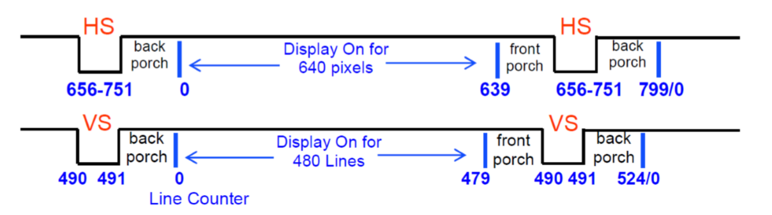
12. In Lab 8, which signal could be used as the clock for ball module if we want the data refreshing rate to be the same as the frame rate?
CLOCK_50
VGA_Clk
VGA_HS
VGA_VS ★
Draw_X or Draw_Y
The vertical sync signal becomes low for a short period at the end of each frame, and stays high for the rest of the time, which is a good choice as the clock of ball module
Picture from course lecture slides
Notes:
The vertical sync signal becomes low for a short period at the end of each frame, and stays high for the rest of the time, which is a good choice as the clock of ball module

Slide 41
13. In Lab 8, which signal(s) is(are) not an output of the VGA_controller module?
a) VGA_Clk
b) DrawX
c) Red
d) VGA_VS
e) VGA_HS
(NOTE that there will be only 1 correct answer on a real exam)
Notes:
The VGA_controller module does not handle the color being sent to the VGA monitor. It only controls which pixel is being drawn during each (VGA) clock period. Color mapper module is the one which handles the color based on DrawX/Y and other signals.

Slide 42
13. In Lab 8, which signal(s) is(are) not an output of the VGA_controller module?
a) VGA_Clk★
b) DrawX
c) Red ★
d) VGA_VS
e) VGA_HS
The VGA_controller module does not handle the color being sent to the VGA monitor. It only controls which pixel is being drawn during each (VGA) clock period. Color mapper module is the one which handles the color based on DrawX/Y and other signals.
(NOTE that there will be only 1 correct answer on a real exam)
Notes:
The VGA_controller module does not handle the color being sent to the VGA monitor. It only controls which pixel is being drawn during each (VGA) clock period. Color mapper module is the one which handles the color based on DrawX/Y and other signals.

Slide 43
14. True or False: SDRAM is faster than SRAM (since SDRAM is Dynamic RAM)
True
False
Notes:
This refresh operation is where dynamic RAM gets its name. Dynamic RAM has to be dynamically refreshed all of the time or it forgets what it is holding. The downside of all of this refreshing is that it takes time and slows down the memory. A flip-flop for a memory cell takes 4 or 6 transistors along with some wiring, but never has to be refreshed. This makes static RAM significantly faster than dynamic RAM. Take more space though

Slide 44
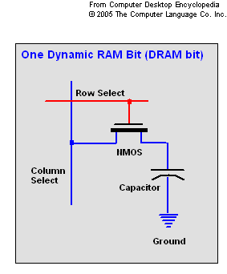
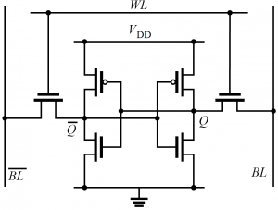
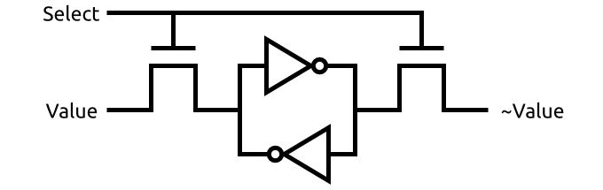
14. True or False: SDRAM is faster than SRAM (since SDRAM is Dynamic RAM)
True
False ★
This refresh operation is where dynamic RAM gets its name. Dynamic RAM has to be dynamically refreshed all of the time or it forgets what it is holding. The downside of all of this refreshing is that it takes time and slows down the memory. A flip-flop for a memory cell takes 4 or 6 transistors along with some wiring, but never has to be refreshed. This makes static RAM significantly faster than dynamic RAM. Take more space though
Notes:
This refresh operation is where dynamic RAM gets its name. Dynamic RAM has to be dynamically refreshed all of the time or it forgets what it is holding. The downside of all of this refreshing is that it takes time and slows down the memory. A flip-flop for a memory cell takes 4 or 6 transistors along with some wiring, but never has to be refreshed. This makes static RAM significantly faster than dynamic RAM. Take more space though

Slide 45
15. In Lab 6, what does the following code intend to do?
0 AND R0, R0, 0
1 ADD R0, R0, 1
2 ADD R1, R0, 1
3 STR R1, R0, -2
a) store value “1” to SRAM at address “0xFFFE”
b) store value “2” to SRAM at address “0xFFFF”
c) store value “1” to HEX Display
d) store value “2” to HEX Display
e) store value “2” to SRAM at address “0xFFFE”
Notes:
Line 0 clears R0, Line 1 add 1 to R0 (R0 holds 0), Line 2 add 1 with R0 and store to R1 (R1 holds 2), Line 3 use memory mapped IO to store 2 to “0-2 = 0xFFFF”, which is Hex Display.

Slide 46
15. In Lab 6, what does the following code intend to do?
0 AND R0, R0, 0
1 ADD R0, R0, 1
2 ADD R1, R0, 1
3 STR R1, R0, -2
Line 3 use memory mapped IO to store 2 to “1-2 = 0xFFFF”, which is Hex Display.
a) store value “1” to SRAM at address “0xFFFE”
b) store value “2” to SRAM at address “0xFFFF” (yes it does depending on implementation, but regardless you cannot read it back)
c) store value “1” to HEX Display
d) store value “2” to HEX Display ★ ★
e) store value “2” to SRAM at address “0xFFFE”
Notes:
Line 0 clears R0, Line 1 add 1 to R0 (R0 holds 0), Line 2 add 1 with R0 and store to R1 (R1 holds 2), Line 3 use memory mapped IO to store 2 to “0-2 = 0xFFFF”, which is Hex Display.

Slide 47
16. Which one of memories on DE2 board has the largest storage capacity?
SRAM
Flash Memory
c) On Chip Memory
d) SDRAM
e) Hard Disk

Slide 48
16. Which one of memories on DE2 board has the largest storage capacity?
a) SRAM (2MB)
b) Flash Memory (8MB)
c) On Chip Memory (<500 KB)
d) SDRAM (128MB) ★
e) Hard Disk

Slide 49
17. Which one of the following statements about SDRAM is correct?
SDRAM can write to successive rows (with column address fixed) faster than write to successive columns (within the same row)
SDRAM can write to successive columns (with row address fixed) faster than write to successive rows (within the same column)
Both types of operations above have the same latency
Notes:
In order to read into another closed row, currently open row must be pre-charged to close

Slide 50
17. Which one of the following statements about SDRAM is correct?
SDRAM can write to successive rows (with column address fixed) faster than write to successive columns (within the same row)
SDRAM can write to successive columns (with row address fixed) faster than write to successive rows (within the same column)
Both types of operations above have the same latency
In order to read into another closed row, currently open row must be pre-charged to close, which slows down the whole operation
Notes:
In order to read into another closed row, currently open row must be pre-charged to close

Slide 51
18. What is the correct way to initialize the On-chip Memory?
a) Use an always_ff block to assign values (like regfile in Lab 6)
b) Use $readmemh/readmemb (not synthesizable) and initial block
c) Both a and b achieves the same functionality
d) Instantiate many register modules and reset them to wanted values (like testmemory.sv in Lab 4)
e) There is no way to initialize On-Chip Memory
Notes:
Although initial block can’t be synthesized, it actually doesn’t need to synthesize it at all. The synthesis tool will read from the specified file and initialize the OCM.

Slide 52
18. What is the correct way to initialize the On-chip Memory?
a) Use an always_ff block to assign values (like regfile in Lab 6)
b) Use $readmemh/readmemb (not synthesizable) and initial block ★★
c) Both a and b achieves the same functionality
d) Instantiate many register modules and reset them to wanted values (like testmemory.sv in Lab 4)
e) There is no way to initialize On-Chip Memory
Although initial block can’t be synthesized, it actually doesn’t need to synthesize it at all. The synthesis tool will read from the specified file and initialize the On-Chip Mem.
The method in (a) and (c) will produce a huge matrix of combinational logic, using a lot of resource and make compilation time forever.
Notes:
Although initial block can’t be synthesized, it actually doesn’t need to synthesize it at all. The synthesis tool will read from the specified file and initialize the OCM.

Slide 53
Again…
~70% will be materials after Midterm;
~30% will be materials before Midterm;
Know the high-level description (with a reasonable level of detail, of course) of each Lab is the most important thing.
Know the things discussed in lecture about Final Project will be helpful.
Know the properties of all the storages on the board (on chip memory, SRAM, SDRAM, Flash)

Slide 54
Study Resource
Course Wiki: Lecture Slides, Q/A session recording
Go to Monday Lecture and Ask Questions
Spend the same time on Final Exam would probably earn you more points than Final Project
Notes:
Although initial block can’t be synthesized, it actually doesn’t need to synthesize it at all. The synthesis tool will read from the specified file and initialize the OCM.

Slide 55
Study Resources
KTTECH → ECE 385 → Labs & Other Resources
Midterm Practice Problems would be helpful for pre-midterm material
Notes:
Although initial block can’t be synthesized, it actually doesn’t need to synthesize it at all. The synthesis tool will read from the specified file and initialize the OCM.

