Slide 1
HKN ECE 329 Exam 2 Review session
Alex Littlefield
(Slides by Steven Kolaczkowski, Molly Fane, and Soo Min Kimm)

Slide 2


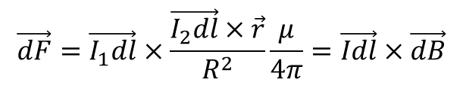

Magnetostatics ( )
$$\frac{∂I}{∂t}=0$$
Lorentz Force:
Biot-Savart Law:
Useful for finding differential B at a point and the force on one wire due to another
$$\overset{⇀}{F}=(q\vec{v}×\overset{⇀}{B})+q\vec{E}$$
$$\vec{dF}=\vec{I_{1}dl}×\frac{\vec{I_{2}dl}×\vec{r}}{R^{2}}\frac{μ}{4π}=\vec{Idl}×\vec{dB}$$

Slide 3
Ampere’s Law
Current Density (J): Amount of current flowing over a given area
Magnetic Field Intensity (H):
Ampere’s Law: Used to find the magnetic field around current carrying devices.
Use RHR to find direction on field
Wire:
Sheet of current:
Solenoid: (N is the coil density)

Slide 4
Continuity Equation and Maxwell’s Correction
The amount of charge in the universe is a constant and must be conserved in isolated systems
This leads to the continuity correction for charge carrying systems:
In order to satisfy continuity, we must add a displacement current to Ampere’s Law:
So, our 4 final Maxwell equations are:

Slide 5
Non-Conservative Fields
Integral of E·dl around a closed path is no longer zero!
Magnetic Flux: Amount of magnetic field lines penetrating a surface
Electromotive Force (emf): Change in voltage between a point and itself which gives rise to a current in the wire.

Slide 6
How do we get non-zero flux?
Area or B·dS changes
Example: Wire entering a uniform magnetic field, wire rotating in a constant magnetic field
Time varying B
Position dependent B and v≠0
Example: Wire loop moving away from a current carrying wire
Current through the wire:
Negative sign is used to indicate
that the current opposes changes in flux

Slide 7
Inductance (L)
The tendency of a device to resist changes in current. Measured in Henry's

Slide 8
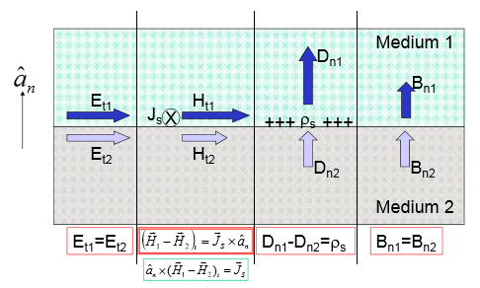
Boundary Conditions

Slide 9
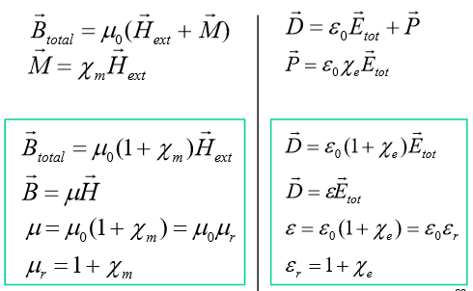
Materials
Diamagnetic (Xm < 0): magnetic dipole opposes external field.
Ex: Water, Copper
Paramagnetic (Xm > 0): magnetic dipole points in same direction as external field.
Ex: Aluminum
Ferromagnetic (Xm >> 0): Incredibly strong atomic dipole.
Ex: Iron

Slide 10
Wave Equation
In a charge free region with 0 conductivity:
Found by combining Faraday’s Law and Ampere’s
Law (assuming ρ=0, σ=0, ε and μ are constants)
Solved by the sine and cosine function
therefore it can be solved by any Fourier Series
Follow D’Alembert solutions
Useful relationships:

Slide 11

Poynting’s Theorem
Poynting Vector:
S has units of W/m²
Poynting’s Theorem:
If E·J is positive, the area is absorbing power
If E·J is negative, the area is supplying power
Power relation:
Average Poynting:

Slide 12
Plane Wave Sources
Direction of H is given by the RHR, magnitude given by:
Direction is different on the other side of the source!!!
E points opposite of Js
Direction is the same on the other side of the source!!!
Wave propagates away from source
Relate magnitudes of E and H:
Solve for Poynting Vector:
S points in the direction of propagation (perpendicular to source)

Slide 13
Previous Exam Questions

Slide 14
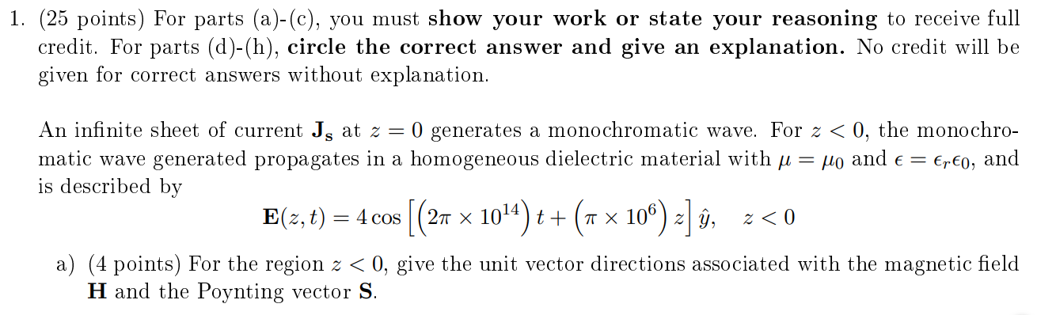
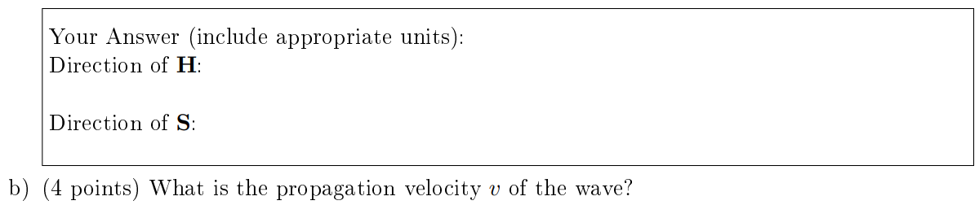
Spring 2016 #1
Notes:
1a. S=-z, H=x
1b. 2e8 m/s

Slide 15
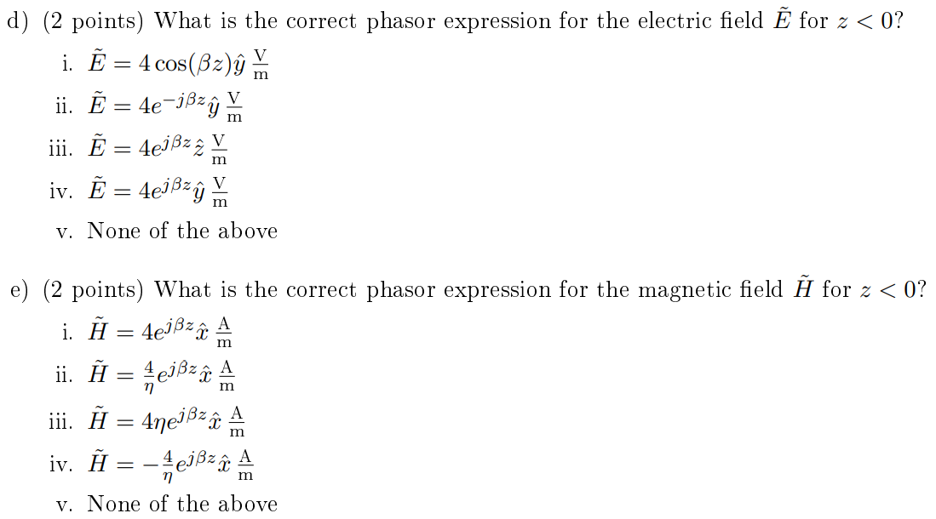
Spring 2016 #1
Notes:
1c. Er=2.25, eta=80 pi ohms
1d. IV
1e. II

Slide 16
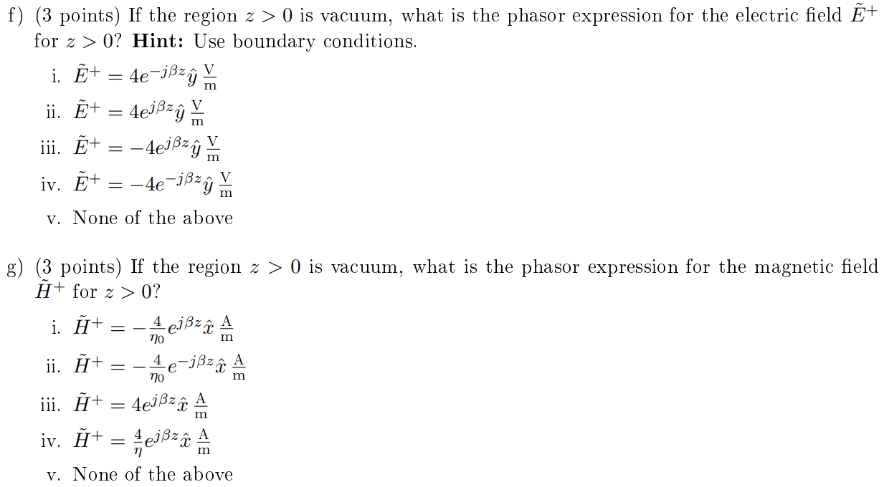
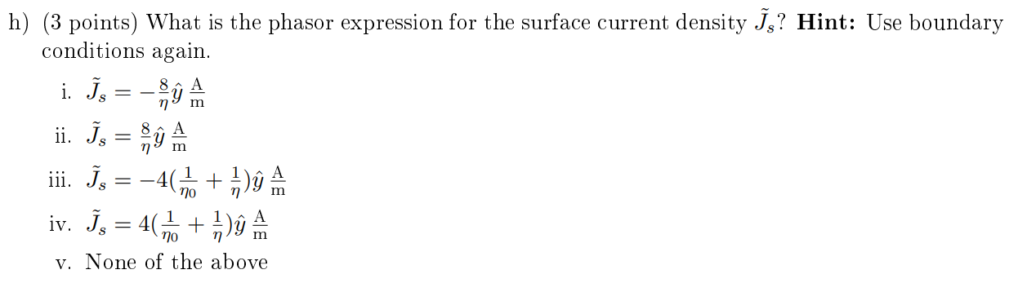
Spring 2016 #1
Notes:
1f. I
1g. II
1h. III

Slide 17
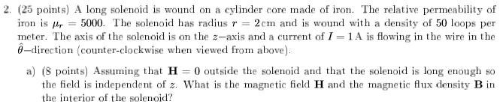
Spring 2016 #2
Notes:
2a. H=50z A/m, B=250000u0z T
2b. L=5000u0 pi H/m
2c. L=3750.25u0 pi H/m

Slide 18
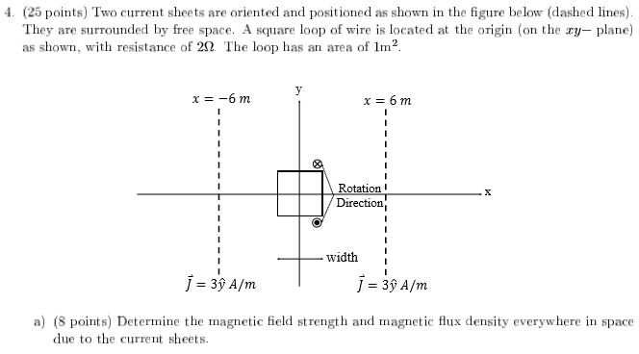

Spring 2016 #4
Notes:
4a. H: [3 z A/m for (-inf,-6)] [0 for (-6,6)] [-3 z A/m for (6,inf)]
B: [3u0 z A/m for (-inf,-6)] [0 for (-6,6)] [-3u0 z A/m for (6,inf)]
4b. 0 V / 0 A
4c. -6u0 pi sin(2 pi t) V / -3u0 pi sin(2 pi t) A

Slide 19
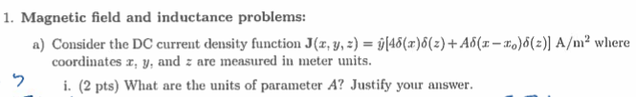
Summer 2015 #1
Notes:
1ai. Amperes
1aii. 12 A

Slide 20
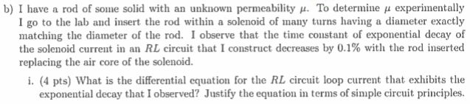
Summer 2015 #1
Notes:
1bi. dI/dt=-(R/L)I
1bii. u=0.999u0
1biii. Diamagnetic

Slide 21
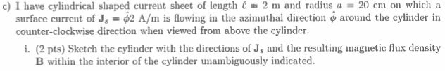
Summer 2015 #1
Notes:
1ci. H in +z, J counterclockwise (as viewed from above)
1cii. 2u0 T

Slide 22
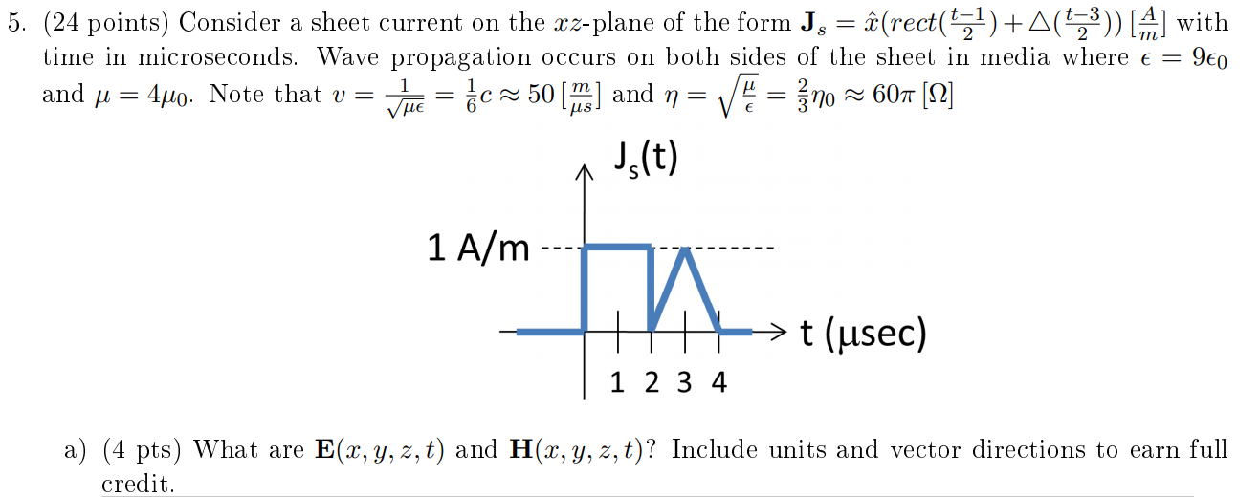
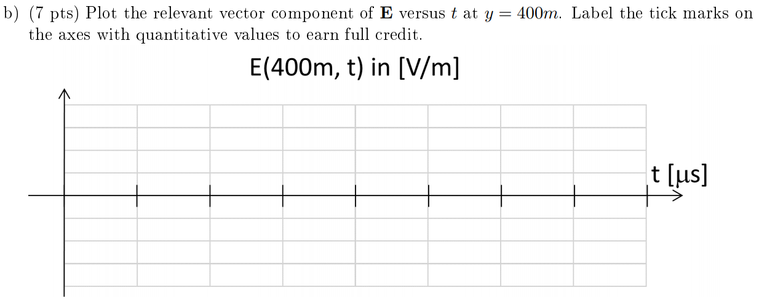
Spring 2017 #5
Notes:
Corrections to problem: eta=80pi. 1a should ask for y>0 solutions.
1a. E(x,y,z,t)=-x40pi(rect((t-y/v-1)/2)+triangle((t-y/v-3)/2)) V/m
H(x,y,z,t)=z(1/2)pi(rect((t-y/v-1)/2)+triangle((t-y/v-3)/2)) A/m
1b. E(400m,t)=-x40pi(rect((t-9)/2)+triangle((t-11)/2)) V/m

Slide 23
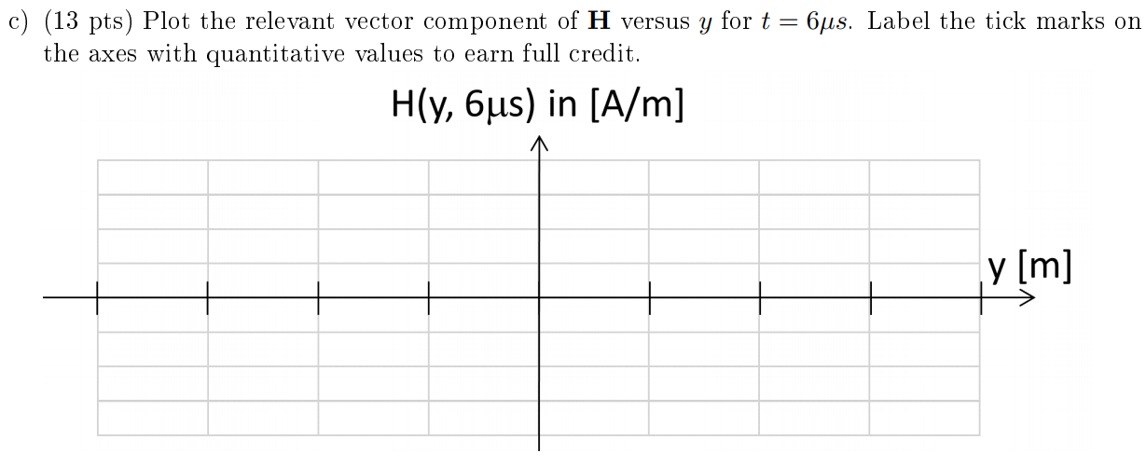
Spring 2017 #5
Notes:
1c. H(y,6us)=(1/2)z(rect((y-250)/100)+triangle((y-150)/100)-1/2)z(rect((y+250)/100)-triangle((y+150)/100)) A/m

