Slide 1
HKN ECE 313 Exam 2 Review Session
Corey Snyder
Ahnaf Masroor
Kanad Sarkar

Slide 2
Exam 2 topics
Continuous-type Random Variables (mean and variance of CRVs)
Uniform Distribution
Exponential Distribution
Poisson Process
Linear Scaling of PDFs
Gaussian Distribution
ML Parameter Estimation for Continuous Random Variables
Functions of a random variable
Failure Rate Functions
Binary Hypothesis Testing
Joint CDFs, PMFs, and PDFs
Independence of Random Variables
Distributions of sums of random variables*

Slide 3
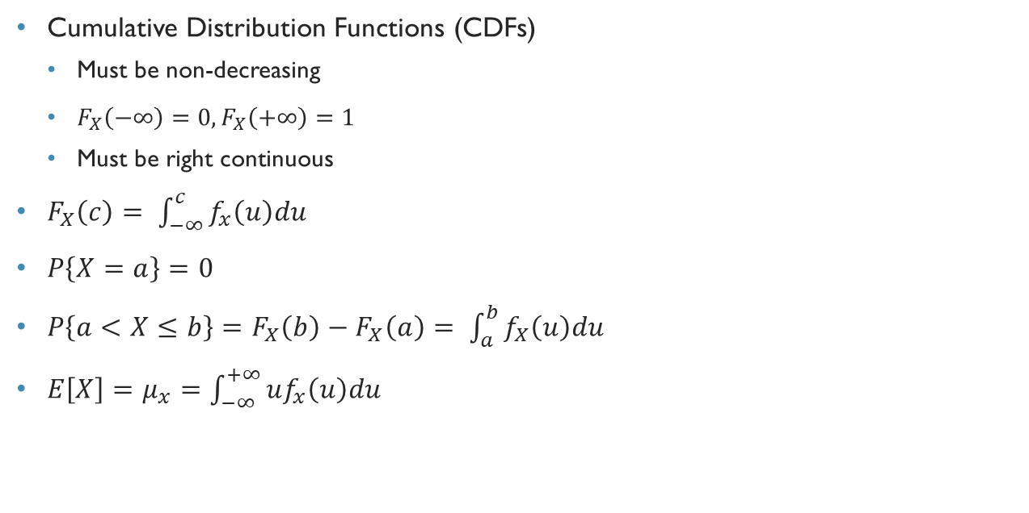
Continuous-type Random variables
Cumulative Distribution Functions (CDFs)
Must be non-decreasing
$F_{X}\left(−∞\right)=0, F_{X}\left(+∞\right)=1$
Must be right continuous
$F_{X}\left(c\right)= \int_{−∞}^{c}{f_{x}\left(u\right)du}$
$P\left\{X=a\right\}=0$
$P\left\{a<X≤b\right\}=F_{X}\left(b\right)−F_{X}\left(a\right)= \int_{a}^{b}{f_{X}\left(u\right)du}$
$E\left[X\right]=μ_{x}=\int_{−∞}^{+∞}{uf_{x}\left(u\right)du}$

Slide 4

Uniform Distribution
$Unif(a,b):$ All values between $a$ and $b$ are equally likely
pdf$:f\left(u\right)= \left\{\begin{aligned}\frac{1}{b−a} a≤u≤b \\ 0 else\end{aligned}\right\}$
mean$: \frac{a+b}{2}$
variance$: \frac{(b−a)^{2}}{12}$

Slide 5
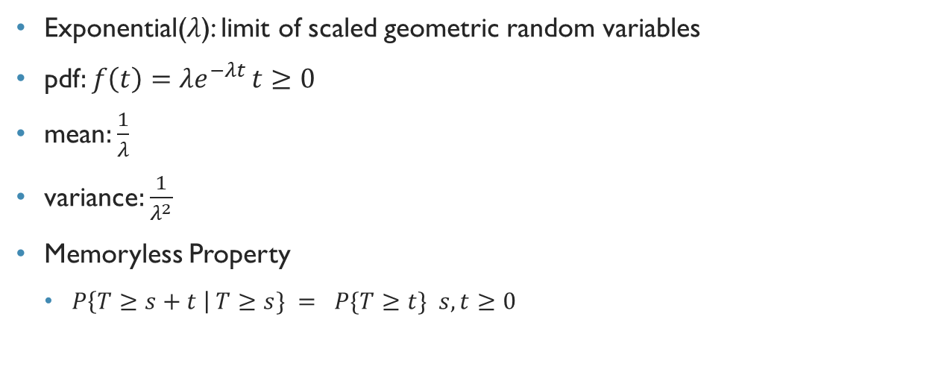
Exponential Distribution
Exponential($λ$): limit of scaled geometric random variables
pdf$:f\left(t\right)=λe^{−λt }t≥0$
mean$:\frac{1}{λ}$
variance$:\frac{1}{λ^{2}}$
Memoryless Property
$P\left\{T≥s+t \right| T≥s\} = P\{T≥t\} s,t≥0$

Slide 6
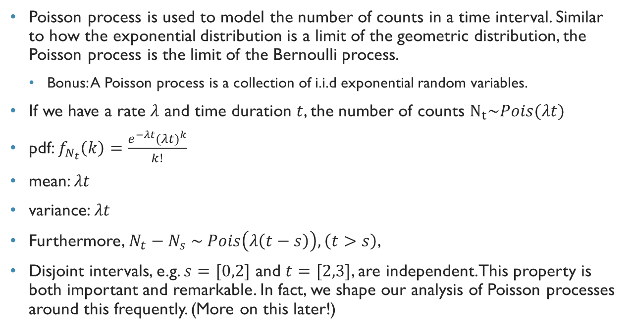
Poisson process
Poisson process is used to model the number of counts in a time interval. Similar to how the exponential distribution is a limit of the geometric distribution, the Poisson process is the limit of the Bernoulli process.
Bonus: A Poisson process is a collection of i.i.d exponential random variables.
If we have a rate $λ$ and time duration $t$, the number of counts $N_{t}\sim Pois(λt)$
pdf: $f_{N_{t}}\left(k\right)=\frac{e^{−λt}({λt)}^{k}}{k!}$
mean: $λt$
variance: $λt$
Furthermore, $N_{t}−N_{s} \sim Pois\left(λ\left(t−s\right)\right), \left(t>s\right)$,
Disjoint intervals, e.g. $s=[0,2]$ and $t=[2,3]$, are independent. This property is both important and remarkable. In fact, we shape our analysis of Poisson processes around this frequently. (More on this later!)

Slide 7

Linear scaling of pdfs
$If Y=aX+b:$
$E\left[Y\right]=aE\left[X\right]+b$
$Var\left(Y\right)= a^{2}Var\left(X\right)$
$f_{y}\left(v\right)= f_{x}(\frac{v−b}{a})\frac{1}{a}$

Slide 8
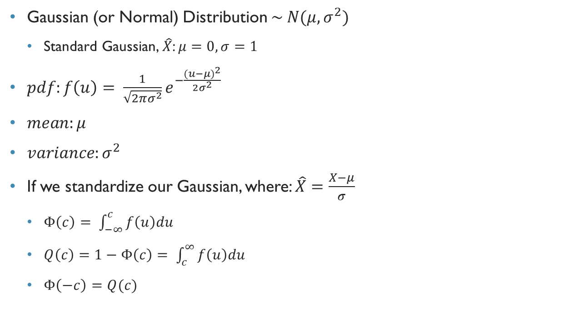
Gaussian distribution
Gaussian (or Normal) Distribution $\sim N(μ, σ^{2})$
Standard Gaussian, $\hat{X}$: $μ=0, σ=1$
$pdf:f\left(u\right)= \frac{1}{\sqrt{2πσ^{2}}}e^{−\frac{(u−μ)^{2}}{2σ^{2}}}$
$mean:μ$
$variance:σ^{2}$
If we standardize our Gaussian, where: $\hat{X}=\frac{X−μ}{σ}$
$Φ\left(c\right)= \int_{−∞}^{c}{f\left(u\right)du}$
$Q\left(c\right)=1−Φ\left(c\right)= \int_{c}^{∞}{f\left(u\right)du}$
$Φ\left(−c\right)=Q(c)$

Slide 9
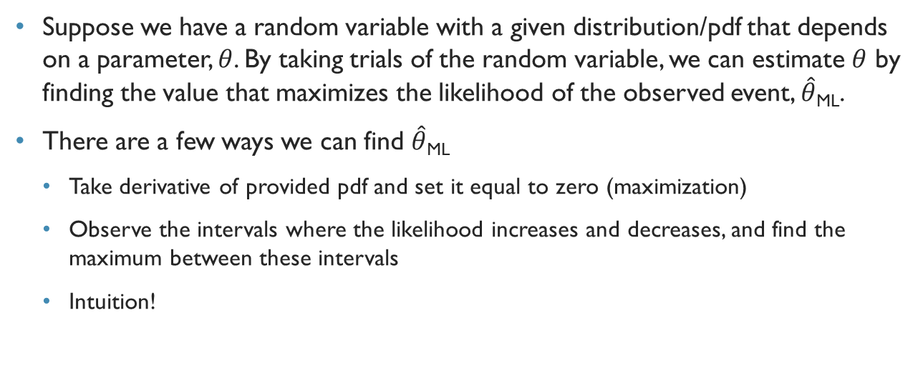
Ml parameter estimation
Suppose we have a random variable with a given distribution/pdf that depends on a parameter, $θ$. By taking trials of the random variable, we can estimate $θ$ by finding the value that maximizes the likelihood of the observed event, $\hat{θ}$_{ML}.
There are a few ways we can find $\hat{θ}$_{ML}
Take derivative of provided pdf and set it equal to zero (maximization)
Observe the intervals where the likelihood increases and decreases, and find the maximum between these intervals
Intuition!

Slide 10
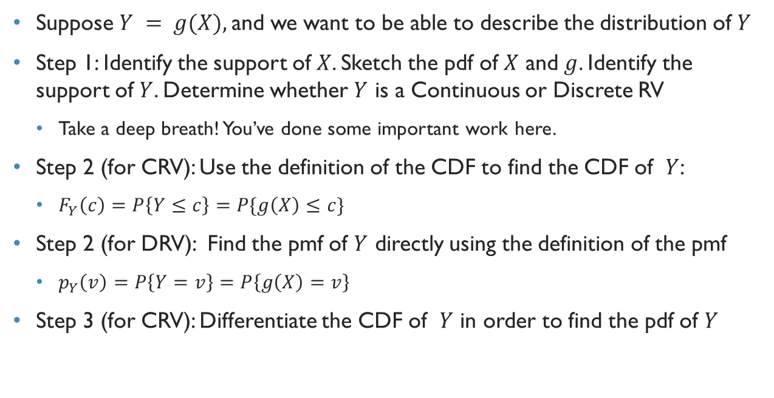
Functions of random variables
Suppose $Y = g(X),$and we want to be able to describe the distribution of $Y$
Step 1: Identify the support of $X$. Sketch the pdf of $X$ and $g$. Identify the support of $Y$. Determine whether $Y$ is a Continuous or Discrete RV
Take a deep breath! You’ve done some important work here.
Step 2 (for CRV): Use the definition of the CDF to find the CDF of $Y$:
$F_{Y}\left(c\right)=P\left\{Y≤c\right\}=P\{g\left(X\right)≤c\}$
Step 2 (for DRV): Find the pmf of $Y$ directly using the definition of the pmf
$p_{Y}\left(v\right)=P\left\{Y=v\right\}=P\left\{g\left(X\right)=v\right\}$
Step 3 (for CRV): Differentiate the CDF of $Y$ in order to find the pdf of $Y$

Slide 11
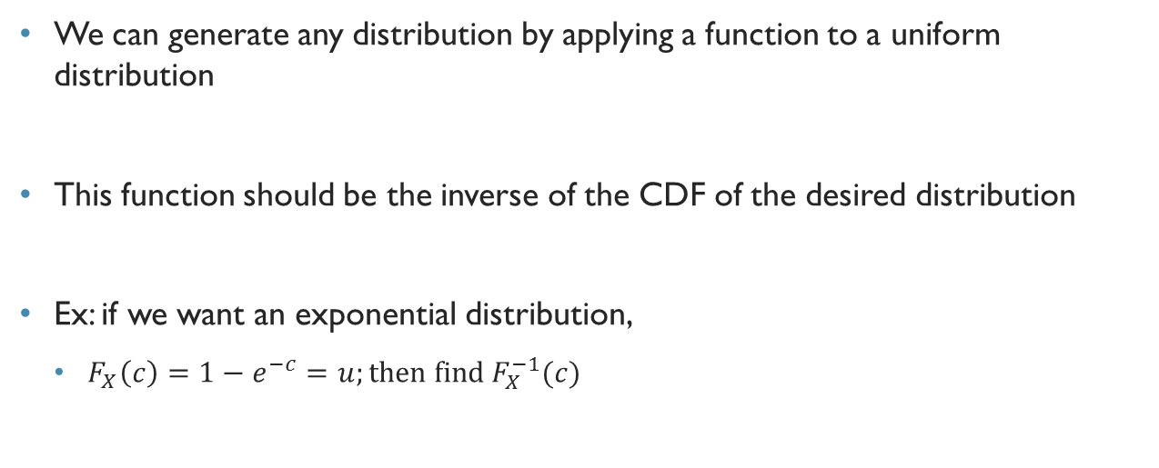
Generating a RV with a Specified distribution
We can generate any distribution by applying a function to a uniform distribution
This function should be the inverse of the CDF of the desired distribution
Ex: if we want an exponential distribution,
$F_{X}\left(c\right)=1−e^{−c}=u;then find{ F}_{X}^{−1}(c)$

Slide 12
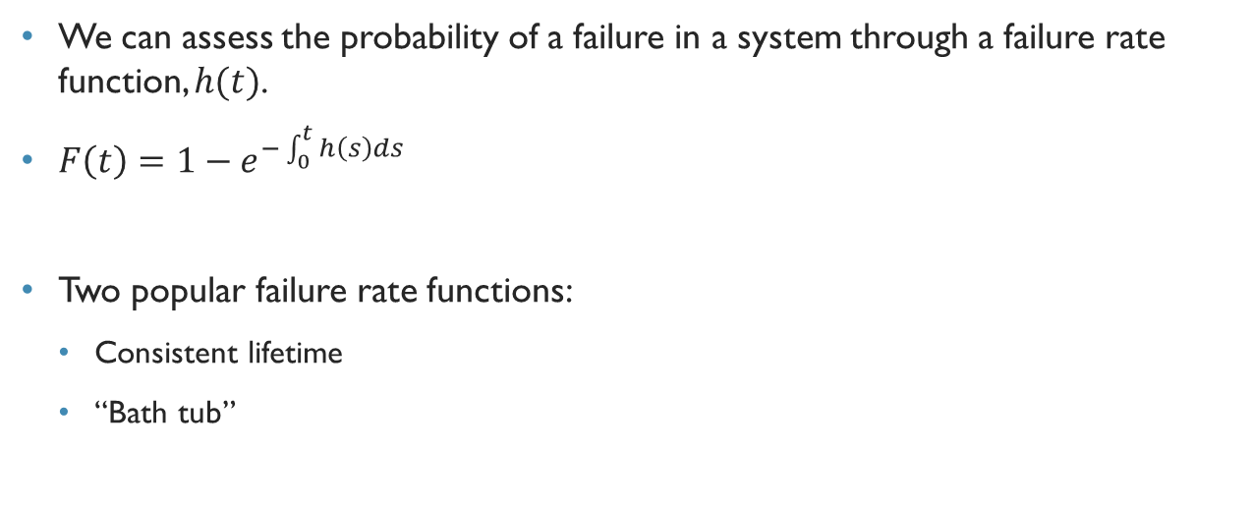
Failure rate functions
We can assess the probability of a failure in a system through a failure rate function, $h(t)$.
$F\left(t\right)=1−e^{−\int_{0}^{t}{h\left(s\right)ds}}$
Two popular failure rate functions:
Consistent lifetime
“Bath tub”

Slide 13
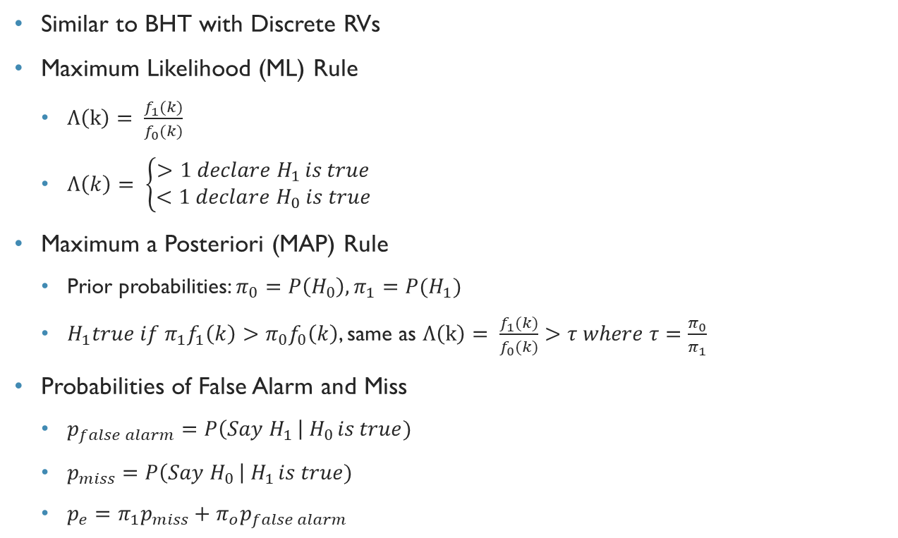
Binary hypothesis testing
Similar to BHT with Discrete RVs
Maximum Likelihood (ML) Rule
$Λ\left(k\right)= \frac{f_{1}(k)}{f_{0}(k)}$
$Λ\left(k\right)= \left\{\begin{aligned}>1 declare H_{1 }is true \\ <1 declare H_{0} is true\end{aligned}\right.$
Maximum a Posteriori (MAP) Rule
Prior probabilities: $π_{0}=P\left(H_{0}\right), π_{1}=P{(H}_{1})$
$H_{1}true if π_{1}f_{1}\left(k\right)>π_{0}f_{0}\left(k\right)$, same as $Λ\left(k\right)= \frac{f_{1}(k)}{f_{0}(k)}>τ where τ=\frac{π_{0}}{π_{1}}$
Probabilities of False Alarm and Miss
$p_{false alarm}=P\left(Say H_{1 }\right| H_{0 }is true)$
$p_{miss}=P\left(Say H_{0 }\right| H_{1 }is true)$
$p_{e}=π_{1}p_{miss}+π_{o}p_{false alarm}$

Slide 14
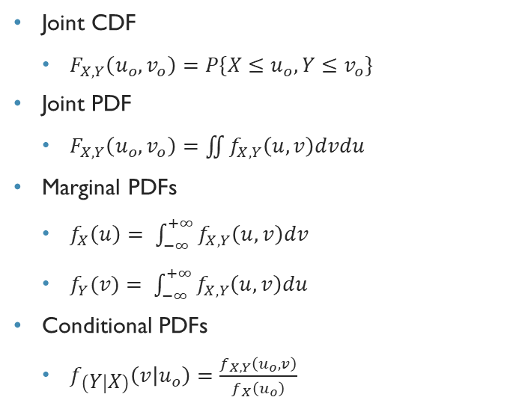
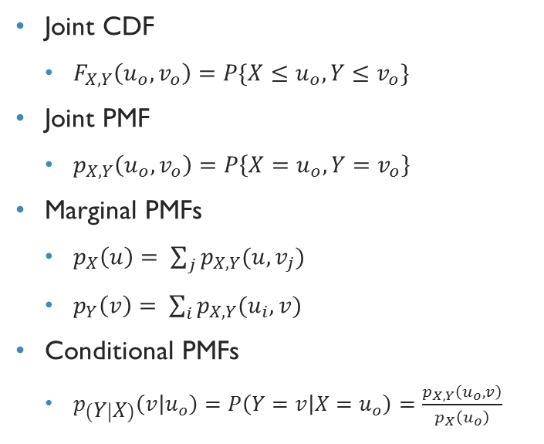
Joint cdf, pmf, and pdf
Discrete Random Variables
Continuous Random Variables
Joint CDF
$F_{X,Y}\left(u_{o},v_{o}\right)=P\{X≤u_{o}, Y≤v_{o}\}$
Joint PMF
$p_{X,Y}\left(u_{o},v_{o}\right)=P\left\{X=u_{o}, Y=v_{o}\right\}$
Marginal PMFs
$p_{X}\left(u\right)= \sum_{j}{p_{X,Y}(u,v_{j})}$
$p_{Y}\left(v\right)= \sum_{i}{p_{X,Y}(u_{i},v)}$
Conditional PMFs
$p_{\left(Y | X\right)}\left(v | u_{o}\right)=P\left(Y=v | X=u_{o}\right)=\frac{p_{X,Y}\left(u_{o},v\right)}{p_{X}\left(u_{o}\right)}$
Joint CDF
$F_{X,Y}\left(u_{o},v_{o}\right)=P\{X≤u_{o}, Y≤v_{o}\}$
Joint PDF
$F_{X,Y}\left(u_{o},v_{o}\right)=\iint{f_{X,Y}\left(u,v\right)dvdu}$
Marginal PDFs
$f_{X}\left(u\right)= \int_{−∞}^{+∞}{f_{X,Y}\left(u,v\right)dv}$
$f_{Y}(v)= \int_{−∞}^{+∞}{f_{X,Y}\left(u,v\right)du}$
Conditional PDFs
$f_{\left(Y | X\right)}\left(v | u_{o}\right)=\frac{f_{X,Y}\left(u_{o},v\right)}{f_{X}\left(u_{o}\right)}$

Slide 15
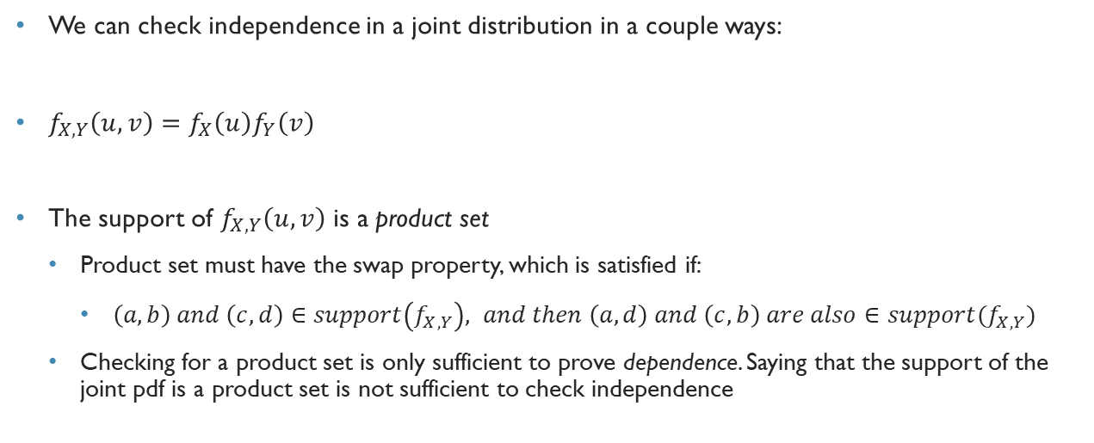
Independence of joint distributions
We can check independence in a joint distribution in a couple ways:
$f_{X,Y}\left(u,v\right)=f_{X}\left(u\right)f_{Y}\left(v\right)$
The support of $f_{X,Y}\left(u,v\right)$ is a product set
Product set must have the swap property, which is satisfied if:
$\left(a,b\right) and \left(c,d\right)∈support\left(f_{X,Y}\right), and then \left(a,d\right) and \left(c,b\right) are also∈support(f_{X,Y})$
Checking for a product set is only sufficient to prove dependence. Saying that the support of the joint pdf is a product set is not sufficient to check independence

Slide 16
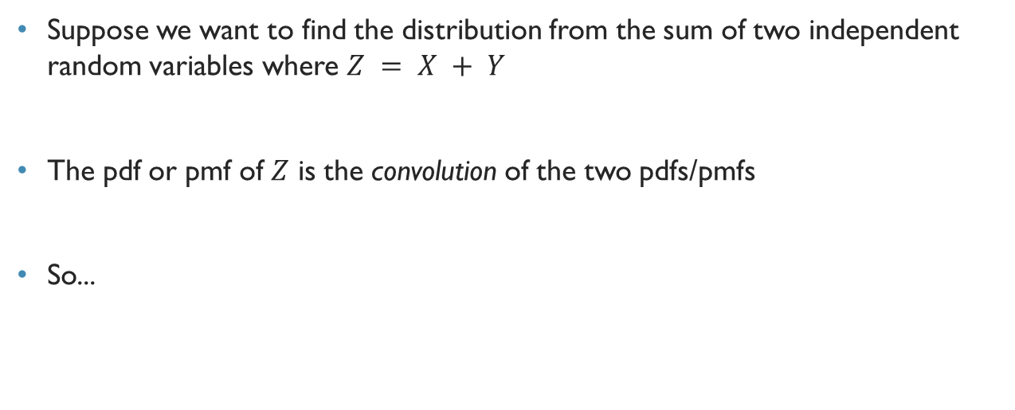
Distribution of sums of random variables
Suppose we want to find the distribution from the sum of two independent random variables where $Z = X + Y$
The pdf or pmf of $Z$ is the convolution of the two pdfs/pmfs
So...

Slide 17
What Is Convolution?
A beautiful, extraordinary linear operator that describes natural phenomena in a fundamental and concise manner.

Slide 18
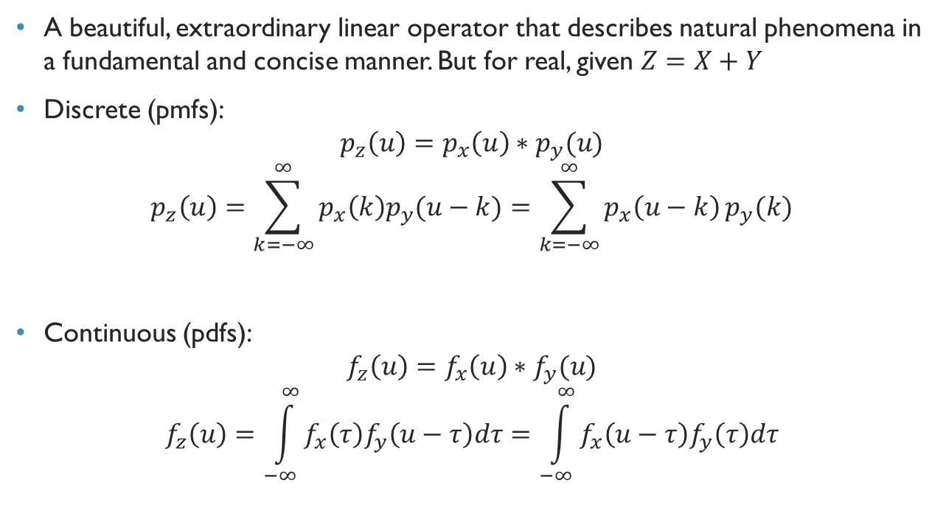
What Is Convolution?
A beautiful, extraordinary linear operator that describes natural phenomena in a fundamental and concise manner. But for real, given $Z=X+Y$
Discrete (pmfs):
$$p_{z}\left(u\right)=p_{x}\left(u\right)∗p_{y}(u)$$
$$p_{z}\left(u\right)=\sum_{k=−∞}^{∞}{p_{x}\left(k\right)p_{y}(u−k)}=\sum_{k=−∞}^{∞}{p_{x}\left(u−k\right)}p_{y}(k)$$
Continuous (pdfs):
$$f_{z}\left(u\right)=f_{x}\left(u\right)∗f_{y}(u)$$
$$f_{z}\left(u\right)=\int_{−∞}^{∞}{f_{x}\left(τ\right)f_{y}\left(u−τ\right)dτ}=\int_{−∞}^{∞}{f_{x}\left(u−τ\right)f_{y}\left(τ\right)dτ}$$

Slide 19
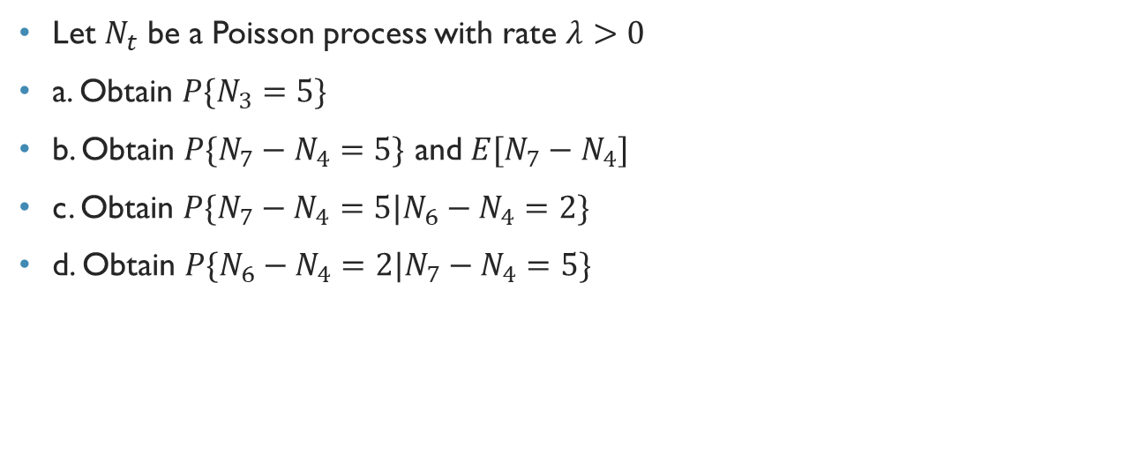
Fa15 Problem 2
Let $N_{t}$ be a Poisson process with rate $λ>0$
a. Obtain $P\{N_{3}=5\}$
b. Obtain $P\{N_{7}−N_{4}=5\}$ and $E[N_{7}−N_{4}]$
c. Obtain $P\{N_{7}−N_{4}=5|N_{6}−N_{4}=2\}$
d. Obtain $P\{N_{6}−N_{4}=2|N_{7}−N_{4}=5\}$

Slide 20
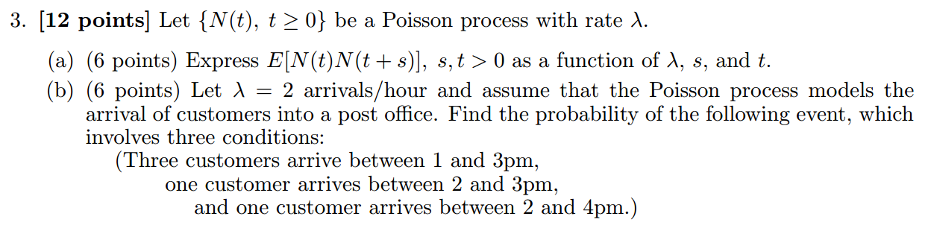
FA14 Problem 3

Slide 21
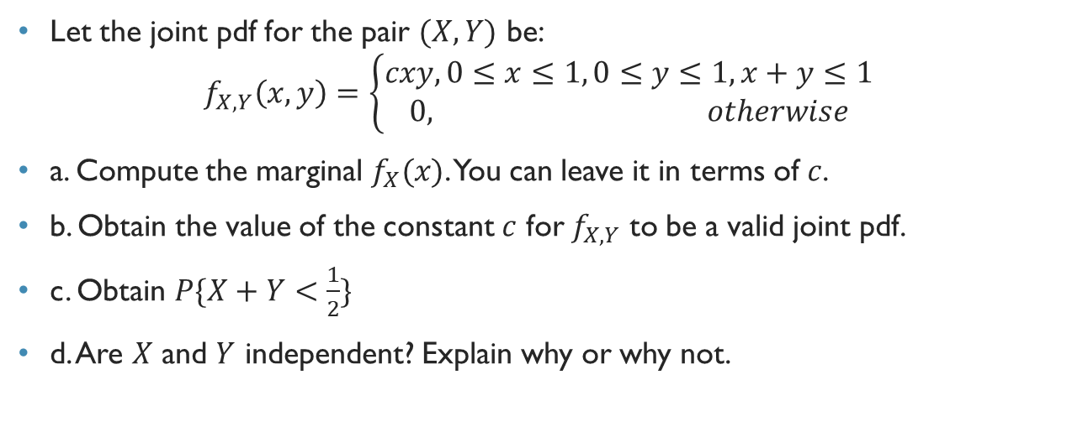
Fa15 problem 4
Let the joint pdf for the pair $(X,Y)$ be:
$$f_{X,Y}\left(x,y\right)=\left\{\begin{aligned}cxy, 0≤x≤1, 0≤y≤1, x+y≤1 \\ 0, otherwise\end{aligned}\right.$$
a. Compute the marginal $f_{X}(x)$. You can leave it in terms of $c$.
b. Obtain the value of the constant $c$ for $f_{X,Y}$ to be a valid joint pdf.
c. Obtain $P\{X+Y<\frac{1}{2}\}$
d. Are $X$ and $Y$ independent? Explain why or why not.

Slide 22
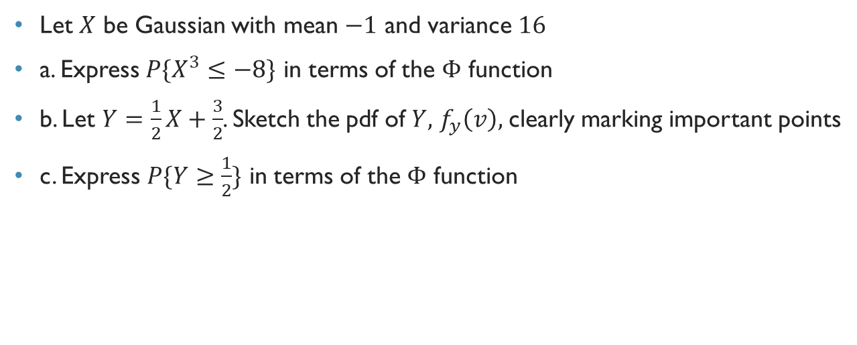
Su16 Problem 3
Let $X$ be Gaussian with mean $−1$ and variance $16$
a. Express $P\{X^{3}≤−8\}$ in terms of the $Φ$ function
b. Let $Y=\frac{1}{2}X+\frac{3}{2}$. Sketch the pdf of $Y,$ $f_{y}\left(v\right),$ clearly marking important points
c. Express $P\{Y≥\frac{1}{2}\}$ in terms of the $Φ$ function

Slide 23
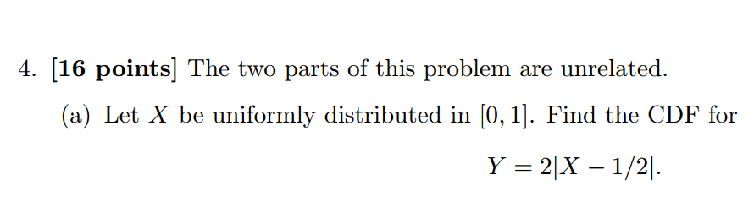
SP15 Problem 4

Slide 24
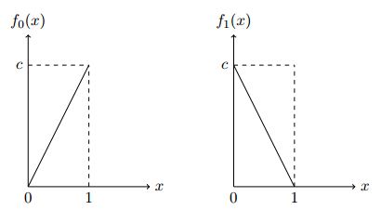
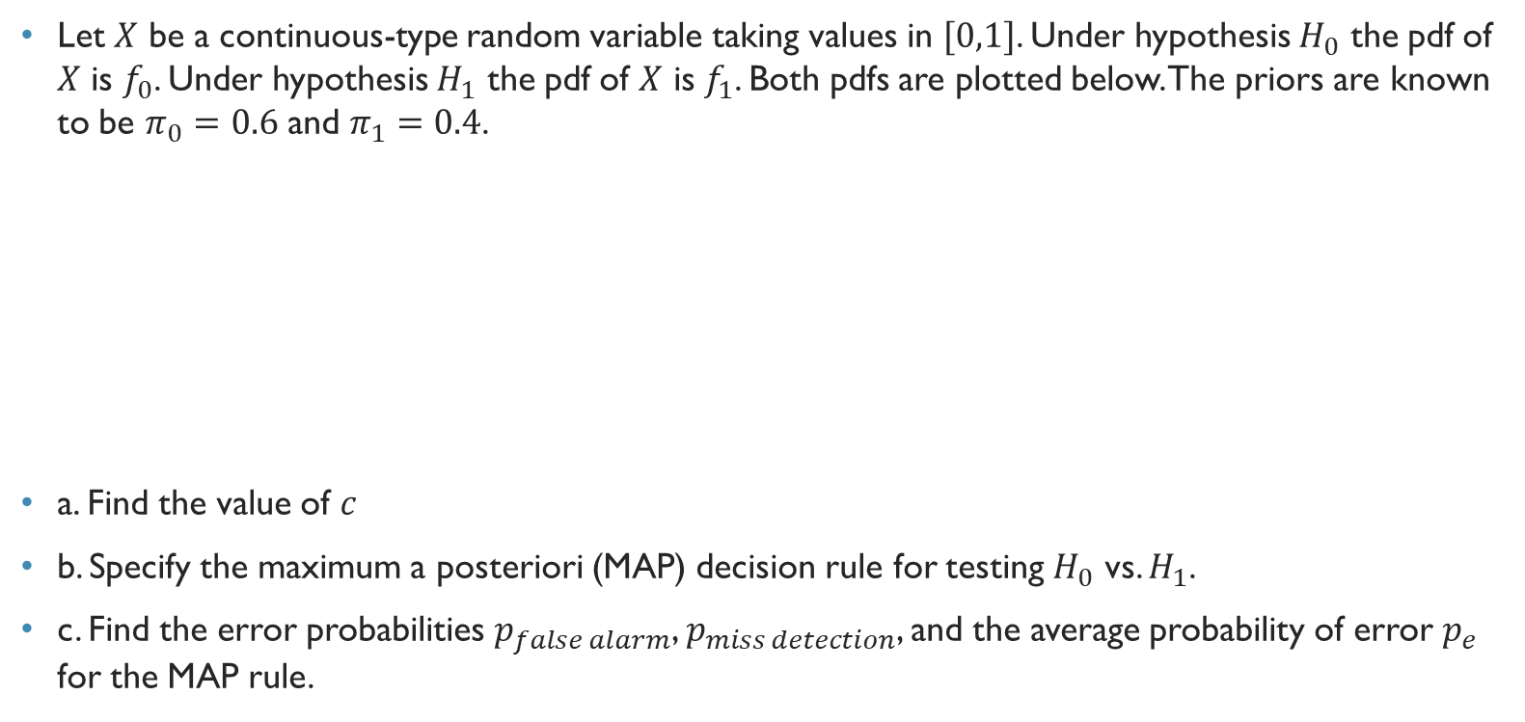
Fa15 problem 3
Let $X$ be a continuous-type random variable taking values in $[0,1]$. Under hypothesis $H_{0}$ the pdf of $X$ is $f_{0}$. Under hypothesis $H_{1}$ the pdf of $X$ is $f_{1}$. Both pdfs are plotted below. The priors are known to be $π_{0}=0.6$ and $π_{1}=0.4$.
a. Find the value of $c$
b. Specify the maximum a posteriori (MAP) decision rule for testing $H_{0}$ vs. $H_{1}$.
c. Find the error probabilities $p_{false alarm}$, $p_{miss detection}$, and the average probability of error $p_{e}$ for the MAP rule.

Slide 25
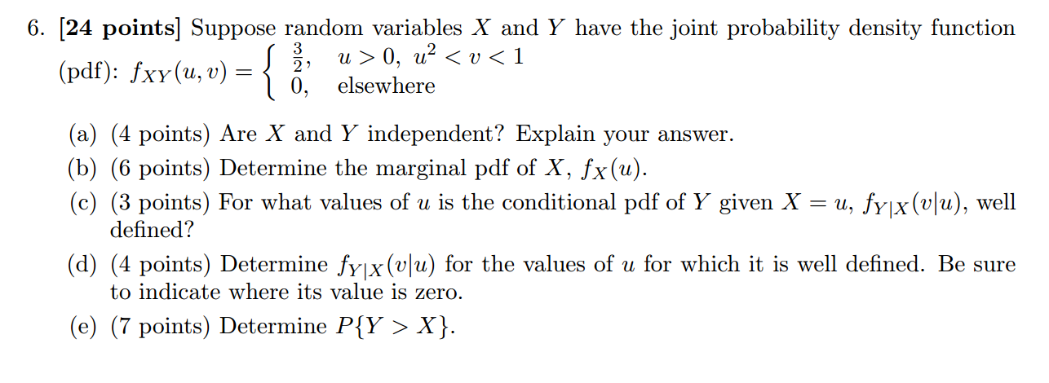
FA12 problem 6

