Slide 1

ECE 210 Review Session
Midterm TWO
Kanad Sarkar, First Yingford, Alan Liu

Slide 2
RL, RC, RLC Circuit
▪ RL and RC circuits require setting up and solving a first-order ODE
▪ RLC circuits require setting up and solving a second-order
At the steady state,
Capacitors act as open circuits
Inductors act as wires
Continuous functions of time:
Voltage across a capacitor
Current through an inductor
$$I=C\frac{dV}{dt} for capacitors$$
$$V=L\frac{dI}{dt} for inductors$$

Slide 3
Second Order Differential Equations
Given equation, where 𝛼 and 𝛽 are constants
$$\frac{d^{2}y}{dt^{2}}+α\frac{ⅆy}{ⅆt}+βy\left(t\right)=f\left(t\right)$$
Then, $y\left(t\right)=Ae^{−r_{1}t}+Bⅇ^{−r_{2}t}+h(t)$, where A and B are constants, and h(t) is the particular solution.
$r_{1}$and $r_{2}$are solutions to the equation $r^{2}+αr+β=0$.
Homogeneous solution (f(t)=0) – the “exponential” terms (the transient solution)
Particular solution – $h(t)$
Special case: If $r_{1}=r_{2}$, then the homogenous solution is instead $y\left(t\right)=Ae^{−rt}+Btⅇ^{−rt}$

Slide 4
First and Second Order Circuits
Zero State Response: Solution to ODE when initial state is 0
Zero Input Response: Solution to ODE when input is 0
$y\left(t\right)=y_{h}\left(t\right)+y_{p}\left(t\right)$
$y_{p}\left(t\right)=y_{ZSR}\left(t\right)$
$y_{h}\left(t\right)=y_{ZIR}\left(t\right)$
$$y\left(t\right)=y\left(0\right)e^{−at}+y_{p}\left(t\right)−y_{p}\left(0\right)e^{−at}$$

Slide 5
y(t) expressions
$y\left(t\right)=ZI+ZS$
$y\left(t\right)=Transient+Steady State$
Both add up to y(t) but can be expressed differently
Tips:
Find ZI and ZS first → add to get y(t) → figure out Transient and Steady State

Slide 6
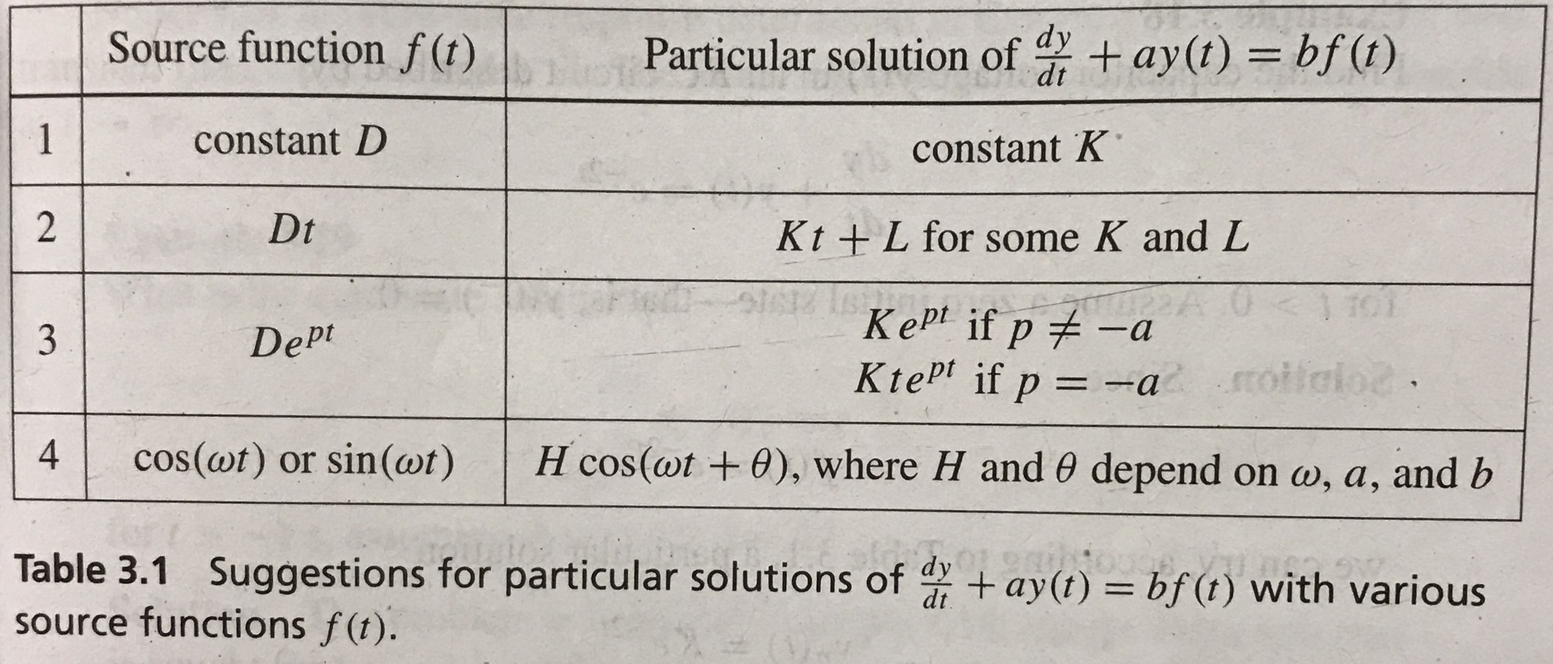

Slide 7

Average Power
$$Average Power=\frac{1}{2}Re\left\{VI^{∗}\right\}$$
$For a Resistor=\frac{{\left|V\right|}^{2}}{2R}$ = $\frac{{R\left|I\right|}^{2}}{2}$ = $RI_{rms}^{2}$ = $\frac{V_{rms}^{2}}{R}$
NOTE :
1. Capacitors and Inductors absorb no net power, they return their instantaneous absorbed power back to the circuit
2. If the current is flowing against the direction of the voltage drop, the power is negative
Absorbed Power: Positive
Dissipated Power: Negative

Slide 8
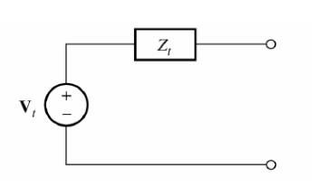

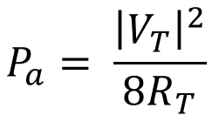
Available Power
$Z_{L}=Z_{T}^{∗}$ for max available power
$$P_{a}= \frac{{\left|V_{T}\right|}^{2}}{8R_{T}}$$

Slide 9

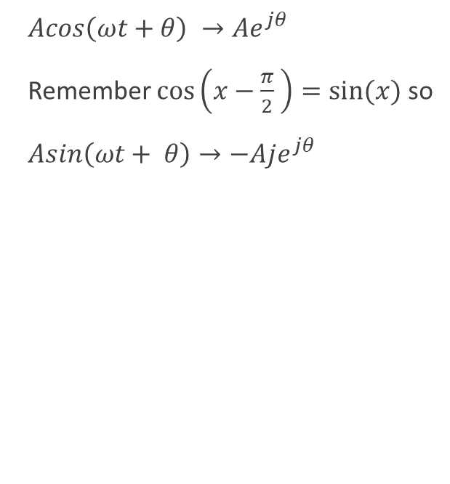
Phasors, Co-sinusoids, and Impedance
$Acos\left(ωt+θ\right) →Ae^{jθ}$
Remember $\cos\left(x−\frac{π}{2} \right)=sin⁡(x)$ so
$Asin\left(ωt+ θ\right)→−Aje^{jθ}$
Inductor: $Z=jωL$
Capacitor: $Z= \frac{1}{jωC}$
Resistor: $Z=R$
Once you’ve converted every circuit element in the phasor domain, you can analyze the circuit using all the ways covered in the first midterm!!!
Node Voltage
Superposition
Loop Current
Source Transformations
NOTE: The solution obtained after analysis with the phasor method is the STEADY STATE SOLUTION !!!

Slide 10
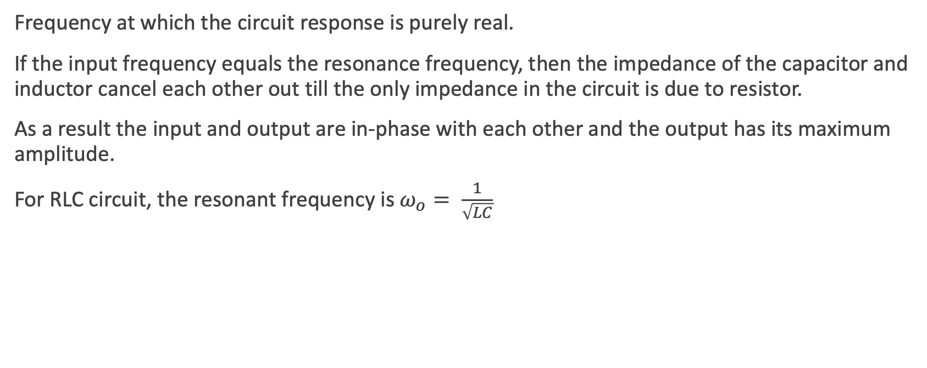
Resonance
Frequency at which the circuit response is purely real.
If the input frequency equals the resonance frequency, then the impedance of the capacitor and inductor cancel each other out till the only impedance in the circuit is due to resistor.
As a result the input and output are in-phase with each other and the output has its maximum amplitude.
For RLC circuit, the resonant frequency is $ω_{o}= \frac{1}{\sqrt{LC}}$
Notes:
Pg no. 153

Slide 11
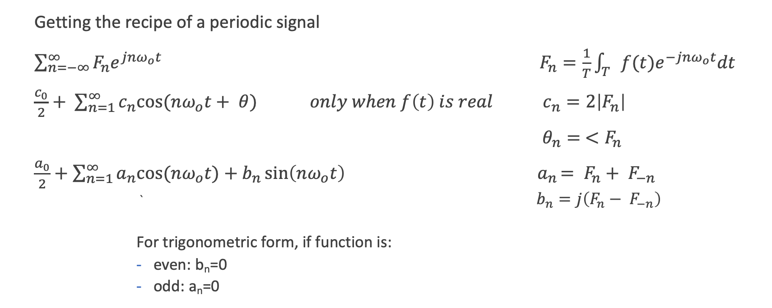
Fourier Series
Getting the recipe of a periodic signal
$\sum_{n=−∞}^{∞}{F_{n}e^{jnω_{o}t}} F_{n}=\frac{1}{T}\int_{T}{f(t)e^{−jnω_{o}t}dt}$
$\frac{c_{0}}{2}+ \sum_{n=1}^{∞}{c_{n}cos⁡(nω_{o}t+ θ)} only when f\left(t\right) is real c_{n}=2\left|F_{n}\right|$
$θ_{n}= <F_{n}$
$\frac{a_{0}}{2}+\sum_{n=1}^{∞}{a_{n}cos⁡(nω_{o}t})+b_{n}\sin\left(nω_{o}t\right) { a}_{n}= F_{n}+ F_{−n}$
` $b_{n}=j\left(F_{n}− F_{−n}\right)$
For trigonometric form, if function is:
even: b_{n}=0
odd: a_{n}=0

Slide 12
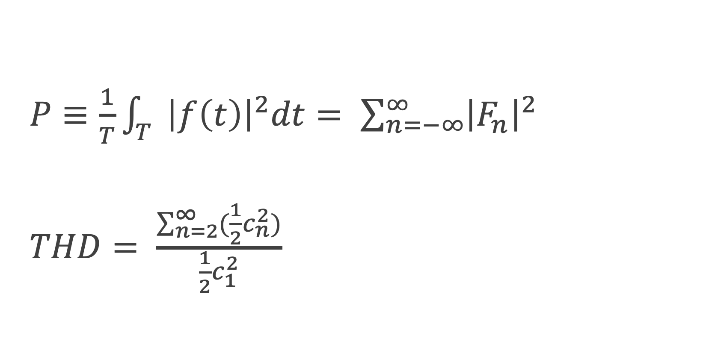
Parseval’s Theorem and THD
$P≡\frac{1}{T}\int_{T}{{\left|f\left(t\right)\right|}^{2}dt= \sum_{n=−∞}^{∞}{{\left|F_{n}\right|}^{2}}}$
$THD= \frac{\sum_{n=2}^{∞}{(\frac{1}{2}c_{n}^{2}})}{\frac{1}{2}c_{1}^{2}}$

Slide 13
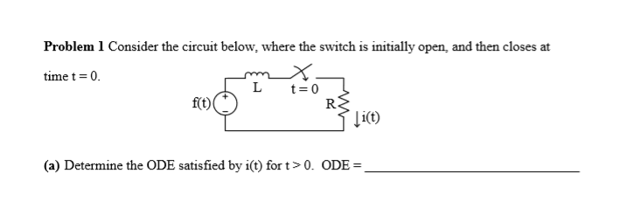
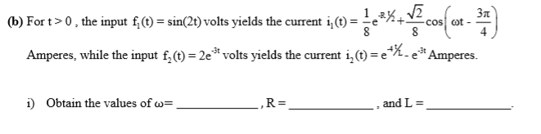
Spring 2016 Question 1

Slide 15
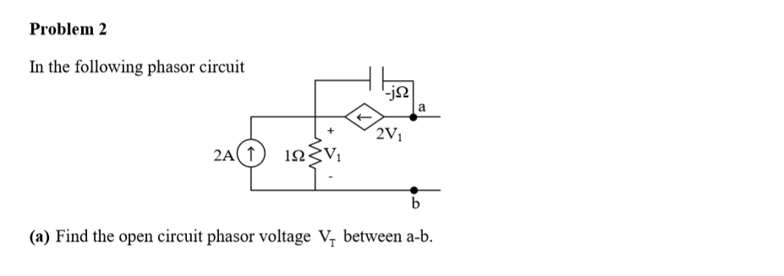

Spring 2014 Question 2

Slide 17
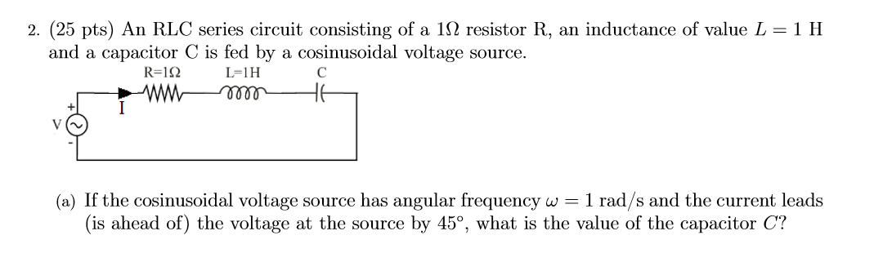

Fall 2017 Question 2

Slide 19
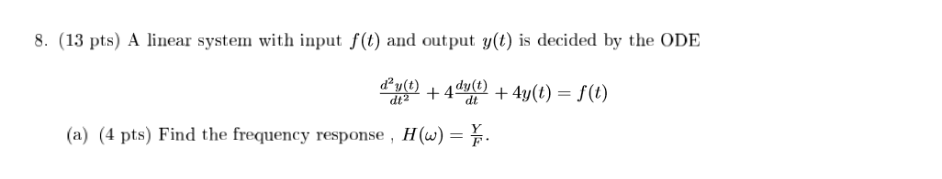
Fall 13 Question 8

Slide 21
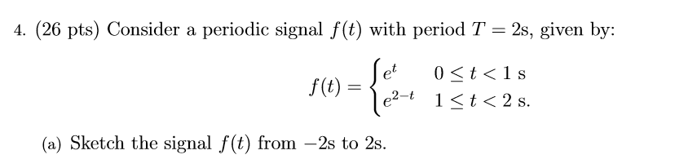
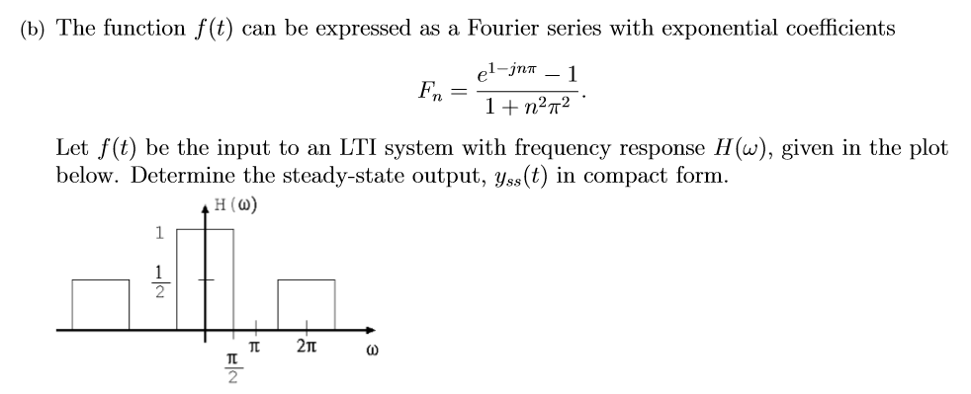
Spring 2018 Question 4

Slide 23
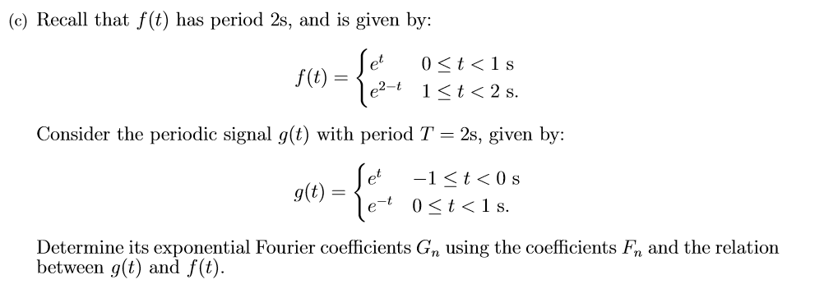
Spring 2018 Question 4 Continued

Slide 25
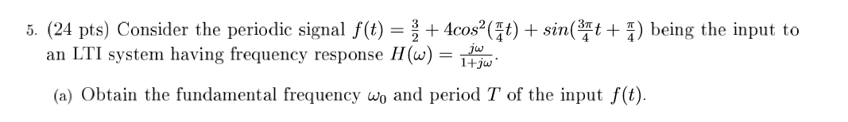
Spring 2016 Question 5

