Slide 1
HKN ECE 110 Exam 1 Review Session
Advaith Ravikumar
Aditya singla
elisa Krause
JUSTIN zhong

Slide 2

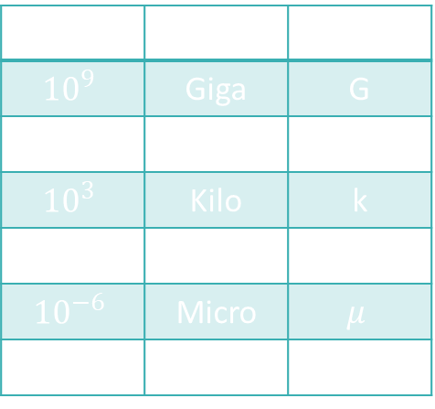
Important Quantities and Their Units
Charge (Q): Intrinsic property of matter, the driving property behind electrical energy and forces
Units: Coulombs [C]
Current (I): The amount of charge that flows in a given time
Units: $\frac{Coulmbs}{second}=Amps [A]$
Voltage $\left(V\right)$: Think of this as the pressure pushing electrons
Units: $\frac{Joules}{Coulomb}=Volts [V]$
Resistance: A materials opposition to charge flow
Units: Ohms $[Ω]$
Power | Prefix | Symbol
$${10}^{9}$$ | Giga | G
$${10}^{6}$$ | Mega | M
$${10}^{3}$$ | Kilo | k
$${10}^{−3}$$ | Milli | m
$${10}^{−6}$$ | Micro | $$μ$$
$${10}^{−9}$$ | Nano | n

Slide 3

Energy, Power, and Their Many Forms
Energy: The ability of a substance to do work
Units: Joules [J]
Total Energy is always conserved
Power: The Rate at which Energy is absorbed or supplied
Units: $\frac{Joules}{second}=Watts \left[W\right]$
$$P=\frac{ΔE}{Δt}=IV$$
$$E=Pt=QV=IVt$$

Slide 4

Capacitors
Capacitance (C): The ability of a device to store charge
Units: $\frac{Coulombs}{Volt}=Farads [F]$
$C≡\frac{Q}{V}$
$E_{Capacitor}=\frac{1}{2}CV^{2}$
The factor of one half comes from the charging efficiency of the capacitor

Slide 5

Ohm’s Law and Resistive Elements
Ohm’s Law is a way of relating the voltage across and the current through a resistive element.
Ohm’s law does NOT work for voltage sources or current sources
Ohm’s law does work for resistors.
If you want to learn about other linear components, take ECE 210
$V=IR$
Resistance of an element can by found by: $R=\frac{ρL}{A}$
Power Dissipated by an element can be found by: $P=IV=I^{2}R=\frac{V^{2}}{R}$

Slide 6



Series and Parallel Combinations
Series: It is impossible for current to flow through one element and not the other
Components in series always have the same Current
$R_{eq}=R_{1}+R_{2}+…$
Parallel: Two components share BOTH of their nodes
Components in parallel have the same Voltage
$R_{eq}=\frac{1}{\left(\frac{1}{R_{1}}+\frac{1}{R_{2}}+ …\right)}$
If we have two resistors: $R_{eq}=\frac{R_{1}R_{2}}{R_{1}+R_{2}}$
Notes:
Parallel – draw a loop with only those two elements and nothing else in between
Series – draw a loop and if one element is in the loop then the other must necessarily be in the loop

Slide 7
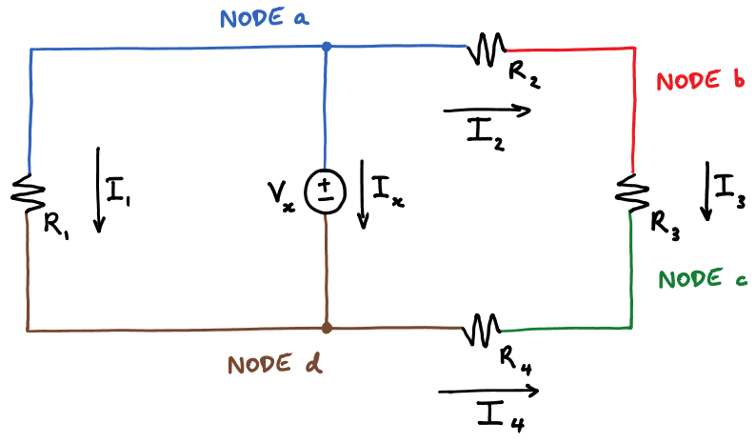

Nodes and Kirchhoff's Circuit Laws
Node: Any part of a circuit that is an equipotential
Any connected wires with no element
in between
Kirchhoff’s Voltage Law
Conservation of Energy
Performed in a loop
$Σ V_{rises}=Σ V_{drops}$
Kirchhoff’s Current Law
Conservation of Charged
Performed on a node
Bubble Method
$Σ I_{in}=Σ I_{out}$

Slide 8
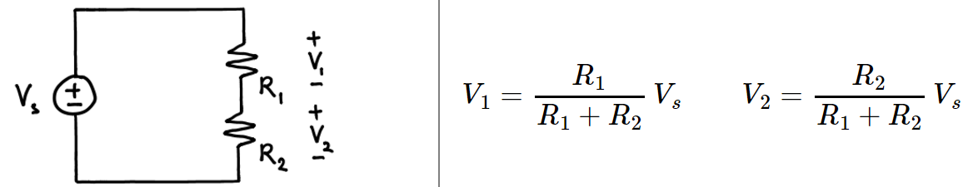
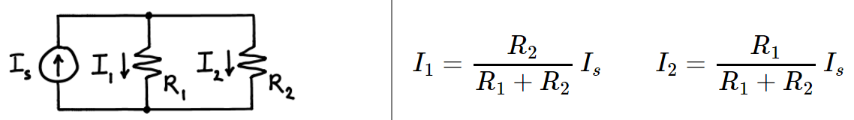
Voltage Divider and Current Divider
We use Voltage Divider Rule (VDR) in order to find the voltage across series resistors
We use Current Divider Rule (CDR) in order to find the current through parallel resistors

Slide 9



Power and Labeling
Standard Power can be expressed three ways: $P=IV=I^{2}R=\frac{V^{2}}{R}$
If $P>0$, the element is absorbing power.
Resistors will ALWAYS have $P>0$
If $P<0$, the element is supplying power.
Standard vs. Non-Standard Labeling:
Standard: Current goes $+ →−$
$P=IV$
$V=IR$
Non-Standard: Current goes $− →+$
$P=−IV$
$V=−IR$

Slide 10


Root-mean-square Voltage ($V_{rms}$)
Exact formula and what it means:
$$V_{rms}=\sqrt{\frac{\left(\int_{0}^{T}{v^{2}\left(t\right)dt}\right)}{T}}$$
Square your entire voltage signal
Find the average value of this signal over 1 period
Square root this average
Useful formulas:
$V_{rms}\left(sinusoid\right)=\frac{Amplitude}{\sqrt{2}}$ $V_{rms}\left(square wave\right)=V_{p−p}\sqrt{\%DC}=V_{p−p}\sqrt{\frac{t_{high}}{T}}$
$P_{avg}=\frac{V_{rms}^{2}}{R}$

Slide 11
Exam Advice
Check your units
Use the practice exams on PrairieLearn
Don’t spend too much time on questions you can’t answer
Spend time showing what you know
Study past exam

Slide 12
Example Problems

Slide 13

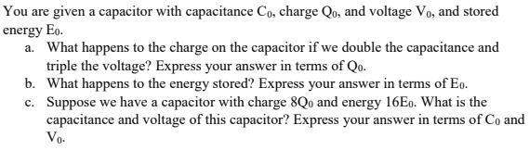

Slide 14


Slide 15
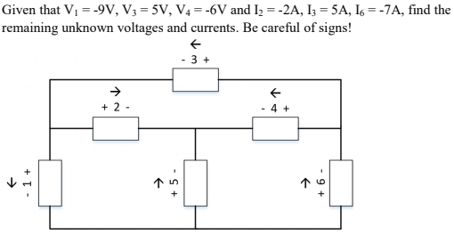

Also, find the power’s of the components. (Check that $Σ_{i}P_{i}=0)$

Slide 16
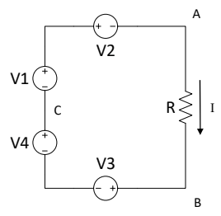

Slide 17
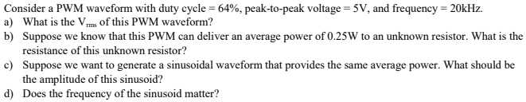

Slide 18
